Slide 1
CDTO Training
March 2020 Meeting

Slide 2
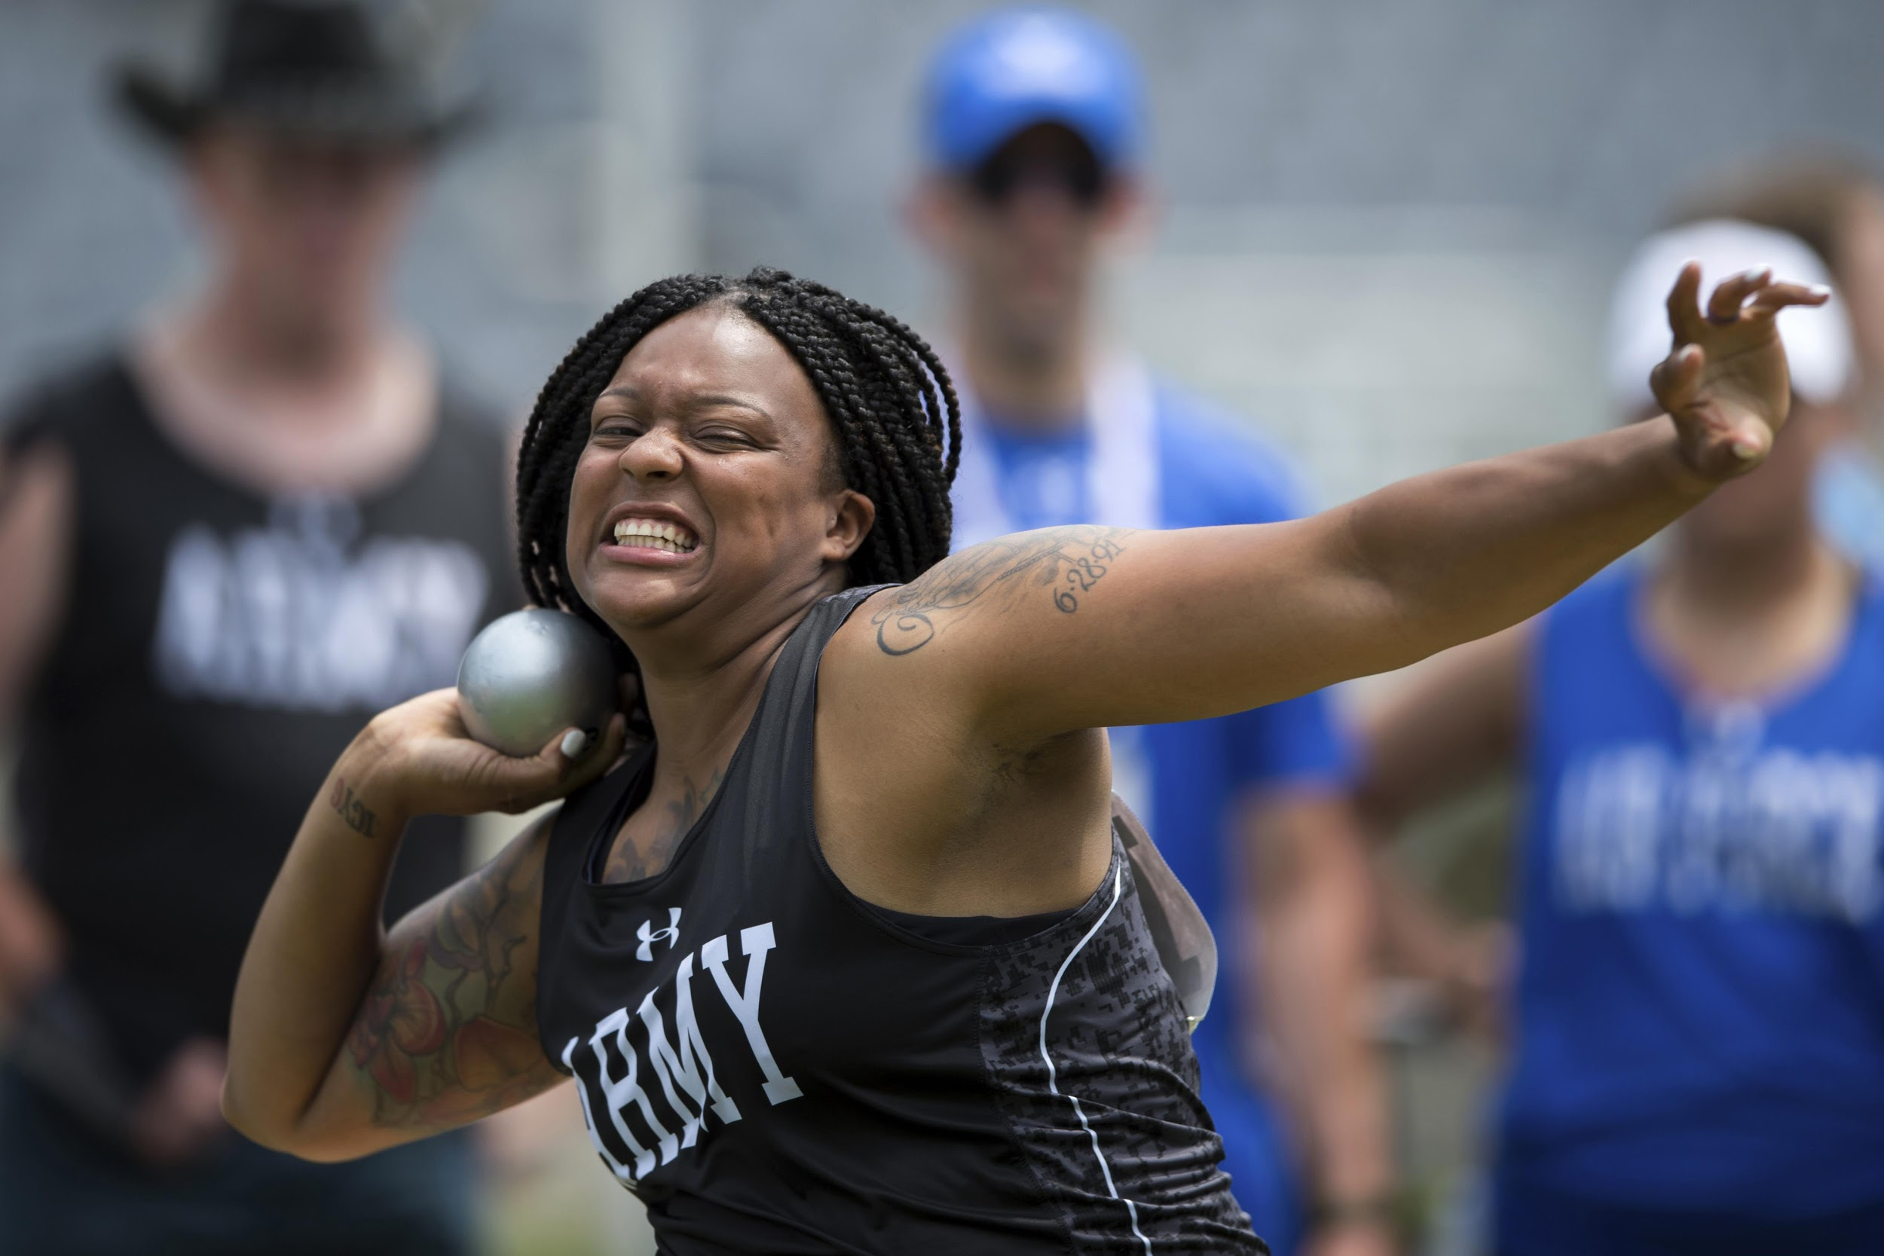
Click on Video Link Below that is underlined in Blue
Measuring the Shot & Discus
Click on Above Link!

Slide 3
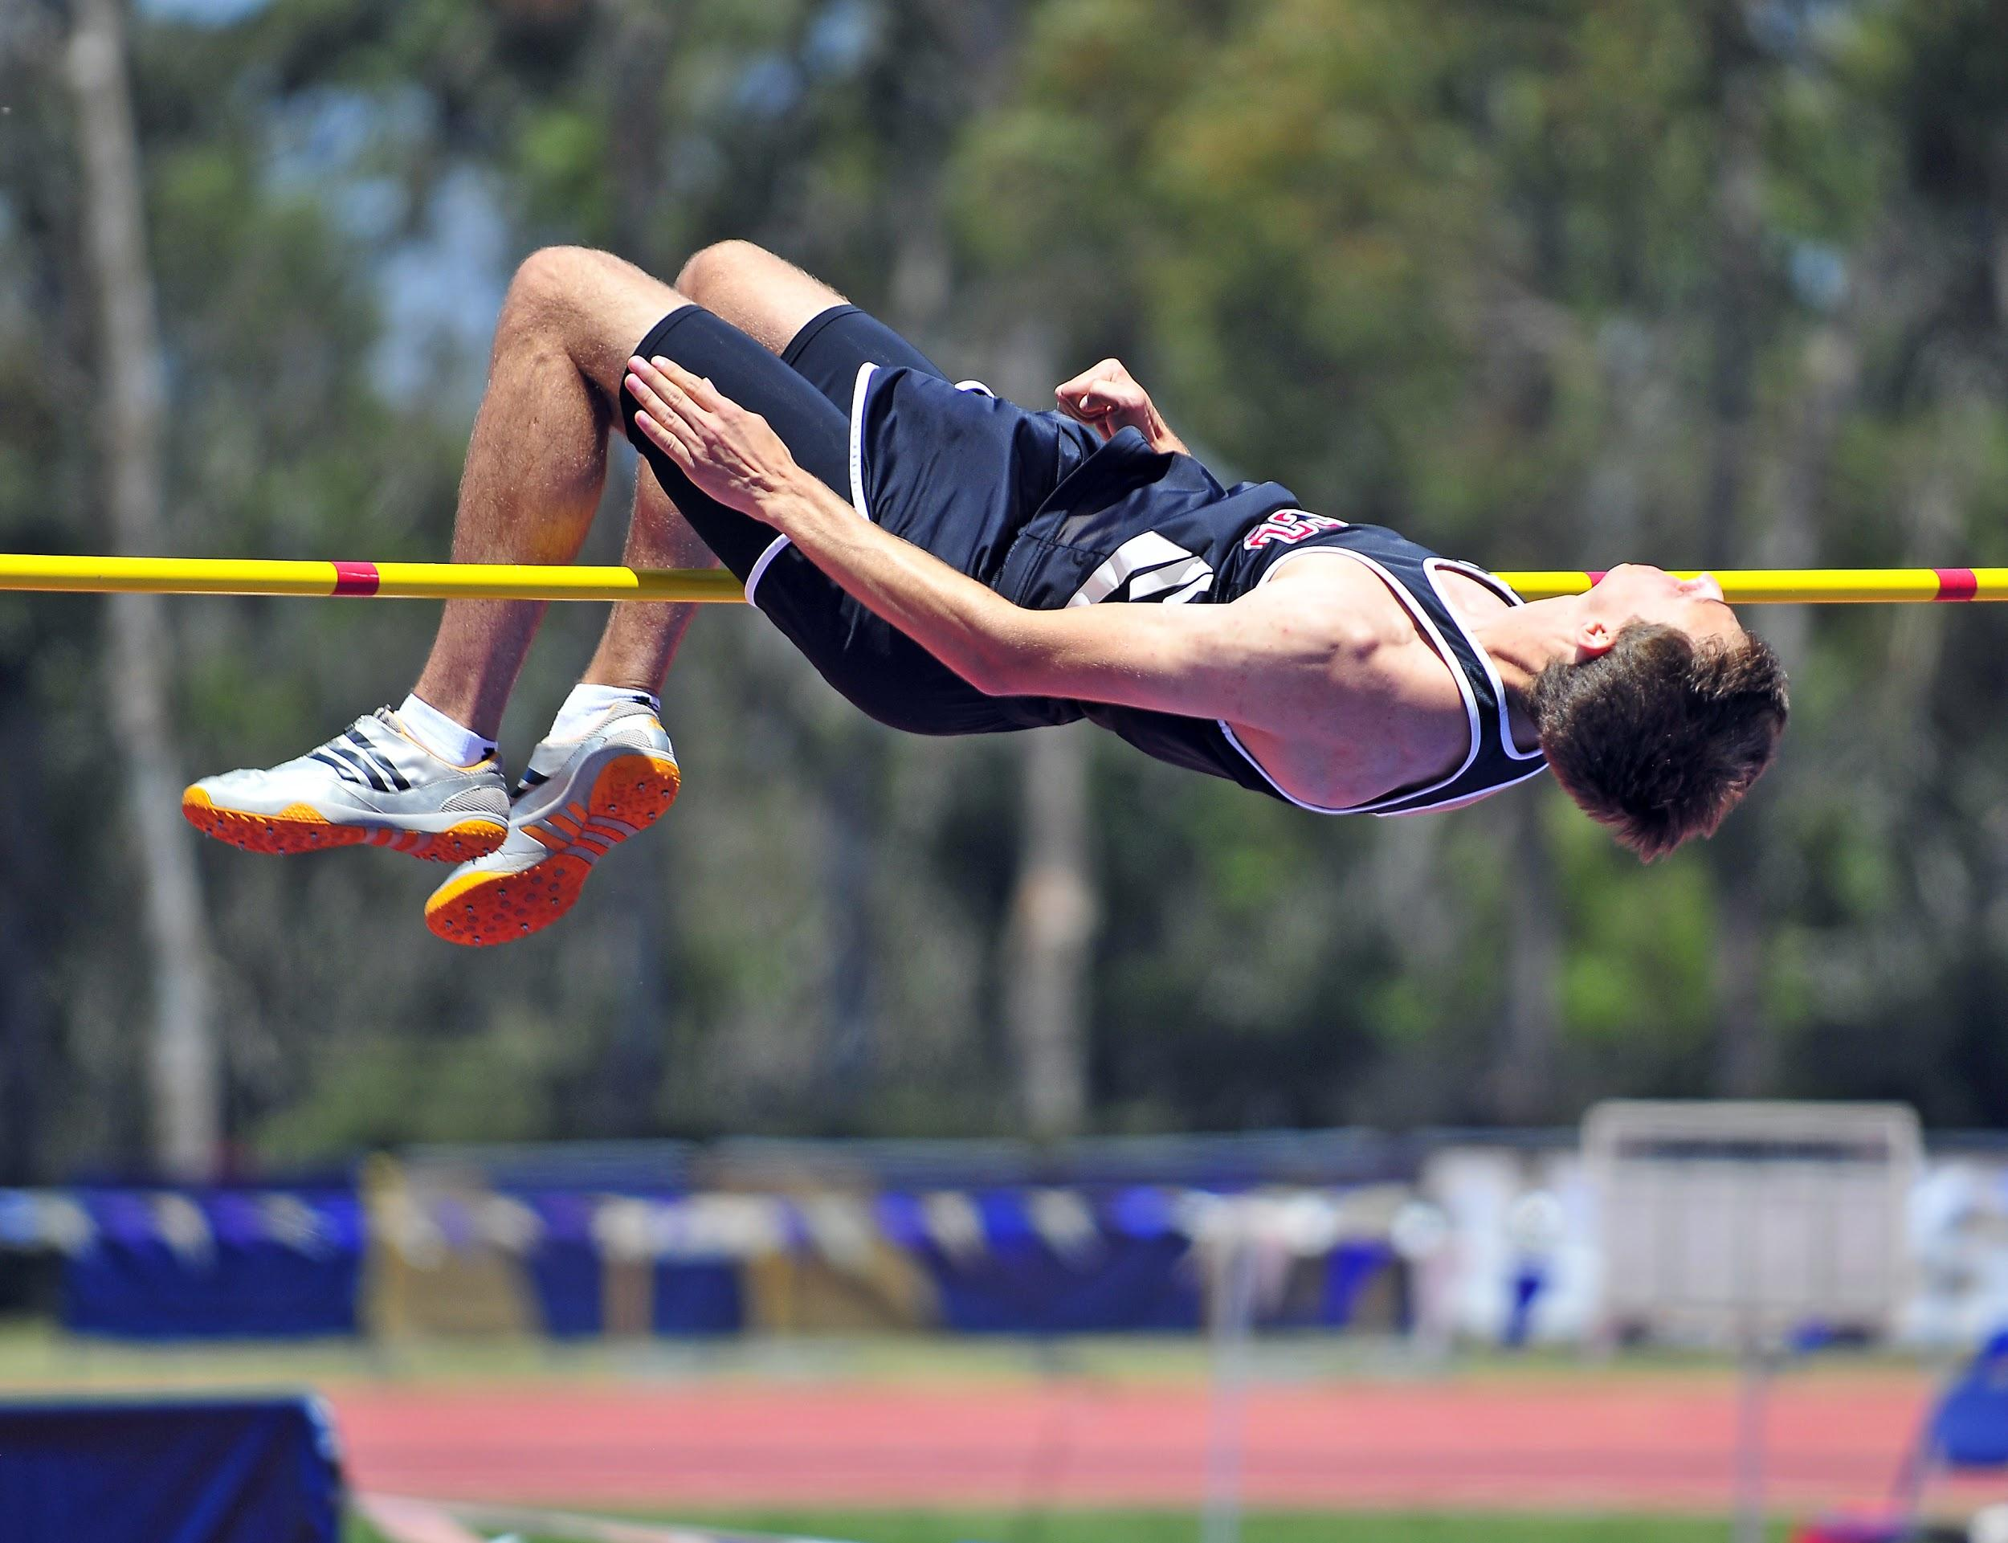
Click on Video Link Below that is underlined in Blue
Determining places in the vertical jumps
Click on Above Link!

Slide 4
Reflection-Exit Ticket: When you are done viewing the videos, send to me an email (pdsweenz@gmail.com) and in the subject line write March 2020 Training: send to me two items. 1-Name one of the two best practices listed in the measuring shot/discus video and 2-in determining Vertical Jump places what are the criteria in order
After I get your email, I will give your name as credited with the Training

Slide 5
Thank you! Questions→ pdsweenz@gmail.com

