Slide 1
Mobile Phones & Language Change in Papua New Guinea
August 2012 EPSP Monthly Series Seminar Presentation by Olga Temple Linguistics, SHSS, UPNG

Slide 2
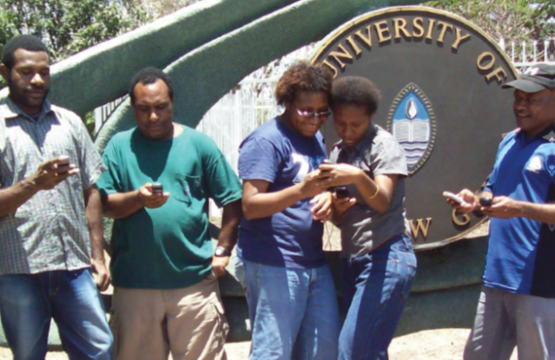
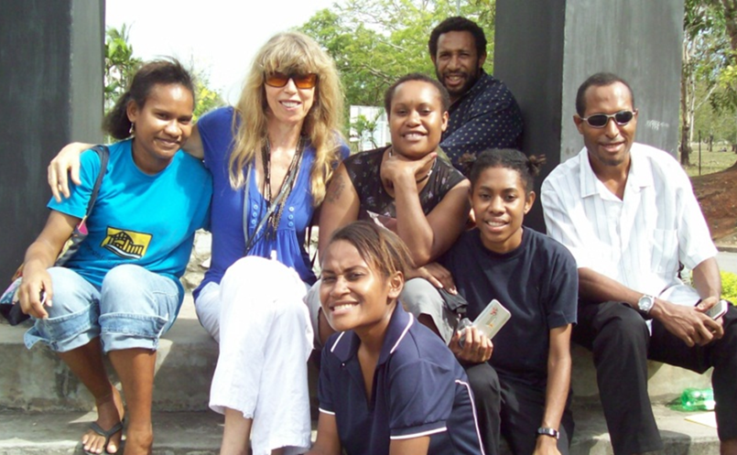
We conducted 2 studies of technology-driven language change in PNG:
2009: texting@upng.ac.pg
Olga Temple, Alopi Apakali, Dorothy Bai, David Dekemba, Lilly John, Gabriel
Matiwat & Malinda Ginmauli
[N.B. Both projects partly funded by SHSS, UPNG]
2010: Mobiles & Tok Ples
Olga Temple, Lin Berry, Jack Bobby, Charlotte Laudiwana, Nadia Lawes,
Emmanuel Maipe, Deborah Salle, Filomina Sion & Xavier Winnia

Slide 3
New Technologies & Social Networking: PNG 2007-2010
Issue
Significant changes in language use observed after 2007, when mobile phones became widespread in PNG .
Hypothesis Summary
Language, the social means of thought, embodies conceptualization of reality by a society (with all variables being in constant flux).
Every word, every meaning, is a generalization; therefore, universal principles of generalization shape all verbal thought.

Slide 4
What did we do?
We attempted to capture language change in PNG through the WA lens of dialectics & explain it in terms of universal principles of human understanding.
Why?
Be
Because only dialectical analysis can capture the interconnectedness of constantly changing complex wholes, such as Language:
Every word is already a generalisation and, therefore, an act of thought.
(Vygotsky: 1934)
How?
Through examining lists of neologisms & SMS acronyms that we as society have conceptualized after the 2007 ‘mobile revolution’
To obtain the data, we used interviews & questionnaires on two UPNG campuses and in researchers’ wantok communities

Slide 5
Dialectical Analysis is best suited to the study of complex wholes (i.e., Language):
Word-meaning is the smallest unit of Language, because every word is a generalization, an act of social mind:
psycho-physical & socio-historical properties of language
Being the creations of living, generalizing, constantly changing minds, word-meanings develop and change in time:
In the historical evolution of language, the very structure of meaning and its psychological nature also change. From primitive generalisations, verbal thought rises to the most abstract concepts. It is not merely the content of a word that changes, but the way in which reality is generalised and reflected in a word.
(Vygotsky: 1934).

Slide 6
We recorded:
Over two thousand Tok Pisin & English texting acronyms on Waigani & Taurama campuses of UPNG
&
Hundreds of new words in 14 Tok Ples languages of Papua New Guinea: Foe, Hiri Motu, Iduna, Loniu (a.k.a. Ndrokou), Yil, Iatmul, Boiken, Weri, Dobu, Keapara, Kuanua, Mussau, Solos, & Taulil

Slide 7
Our Findings: Summary
The impact of mobile phones /SMS technology on English, Tok Pisin, and Tok Ples languages was found to vary, depending on:
Speakers’ communication needs
Status of each language development & levels of literacy in each language community
Language phonology, writing system, etc.

Slide 8
Summary of Our Findings (contd.)
Our findings validated our theoretical conjectures with regard to language & language change:
Indeed,
universal principles of human understanding
(associations by resemblance, contiguity, & cause/effect) constitute the Rational Language Mechanism -
Generalization -
which shapes the structures of all human languages.

Slide 9
Generalization: Synthesis & Analysis2 In order to individuate objects by their kind, the mind must be able not only to connect things by resemblance & categorize them because of their resemblance, but also to abstract, distinguish them from other, dissimilar things – this is the essence of all abstract verbal thought, a.k.a. generalization:

Slide 10
Hume (1711-1776): What do we do when we think?
‘Though it be too obvious to escape observation, that different ideas are connected together; I do not find that any philosopher has attempted to enumerate or class all the principles of association; ... To me, there appear to be only three principles of connexion among ideas; namely, Resemblance, Contiguity in time or place, and Cause or Effect.’
(David Hume: An Enquiry Concerning Human Understanding, 1748)

Slide 11
David Hume: on Human Understanding
That these principles serve to connect ideas will not, I believe, be much doubted:
A picture naturally leads our thoughts to the original:[1]
The mention of one apartment in a building naturally introduces an enquiry or discourse concerning the others:[2] and
If we think of a wound, we can scarcely forbear reflecting on the pain which follows it.[3]
The more instances we examine, …the more assurance shall we acquire, that the enumeration … is complete and entire.
[1] Resemblance.
[2] Contiguity.
[3] Cause and effect.
David Hume: An Enquiry Concerning Human Understanding

Slide 12
We ‘make sense’ of the meaningless world: [both images below taken from FB postings by friends]

Slide 14
Our data show how the collective minds of societies create new words through associations by resemblance, contiguity, & cause/effect:

Slide 15
sms@upng.ac.pg – shaped by practical concerns & generalizing students’ minds
Can you figure out the meanings of these acronyms?
[Temple, O. et al 2009]
10q / 10Q 1ce 1t 1m
2CU 99 6y 4rnr
4rum 8U hangs LU
M8 msol NY

Slide 16
What associations resulted in these acronyms?
10q /10Q tenk yu (thank you)
1ce once
1m wanem
1t want
2CU to see you
99 nighty-night
6y sexy
4rnr foreigner
4rum Forum (UPNG Forum area)
8U hate you
hangs hangere (hunger)
LU love you
M8 mate
msol em tasol (that’s all)
NY nau yet (right now)

Slide 17
Our Major Conclusions:
Collective social minds continually ‘make sense’ of the world they live in, creating the words & structures of their languages through generalization (associations by resemblance, contiguity, & cause/effect).
The speakers’ communication needs determine the viability of every language, which explains the current trends:
Expansion of Tok Pisin (TP) use, particularly in texting
Increased influence of English on TP
Increased vulnerability of Tok Ples languages in Papua New Guinea → urgent need for language development.

Slide 18
Our findings, analysis & conclusions have been published, and are available in the UPNG Bookshop:
Temple, O. et al. (2011). Tok Ples in Texting and Social Networking. University Bookshop. ISBN: 978-9980-945-29-7
Temple, O. et al. (2009). PNG SMS Serendipity or sms@upng.ac.pg UPNG. University Press ISBN 978-9980-84-885-7
N.B. More info available on my website www.templeok.com

Slide 19
References
Temple et al. (2009). PNG SMS Serendipity or sms@upng.ac.pg. UPNG University Press. ISBN 978-9980-84-885-7
Temple et al. (2011) Tok Ples in Texting and Social Networking. University Bookshop. ISBN: 978-9980-945-29-7
Vygotsky, L. Thinking and Speaking. The M.I.T. Press, 1962; http://www.marxists.org/archive/vygotsky/works/words/index.htm (27/06/2008)
Hume, D. An Enquiry Concerning Human Understanding, Section III – Of the Association of Ideas.
http://18th.eserver.org/hume-enquiry.html#3 (27/06/2008)

