Slide 1
S17.
Pituitary hormones
Thyroid hormones and antithyroid drugs
Agents that affect bone mineral homoestasis

Slide 2
Pituitary hormones: growth hormone, antagonist octreotide, oxytocin, antagonists of prolactine, vasopressin
Chapter 37
Physiology of hypothalamic and pituitary hormones is not test material but is recommended for reading in order to better understand the pharmacology of drugs described in this chapter. Data in tables 37-1 and 37-3 are not necessary, data in table 37-2 only informative. The frame text “Treatment of obesity” and table 37-5 can be test material;
- growth hormone and antagonist octreotide (mechanism of action, effects and indications)
- oxytocin (indications and ADRs)
- vasopressin antagonist: conivaptan

Slide 3
Thyroid hormones and antithyroid drugs
Chapter 38
Thyroid physiology at the beginning of the chapter is not test material but is recommended for reading in order to better understand the pharmacology of the described drugs. Subtitle “Clinical pharmacology of thyroid & antithyroid drugs” is not test material. Data in tables 38-1, 38-2, 38-4 and 38-5 need not to be memorized.
Basic pharmacology of thyroid & antithyroid drugs (mechanism of action, indications and ADRs);
- thyroid hormones: levothyroxine
- antithyroid agents: thioamides: methimazole, propylthiouracil
Anion inhibitors
iodides
radioactive iodine
beta blockers (see also chapter 10)

Slide 4
Drugs used in treatment of osteoporosis
Chapter 42.
The subtitle “Clinical pharmacology” is not test material but is recommended for reading in
order to better understand the indications for drugs described in this.
Data in table 42-2, and the frame text ”Newer therapies for osteoporosis” can be test material
- calcitonin, parathyroid hormone (PTH)
- estrogens
- vitamin D and calcium
- bisphosphonates: alendronate
- raloxifen
- strontium ranelate
(mechanism of action and ADRs)

Slide 5
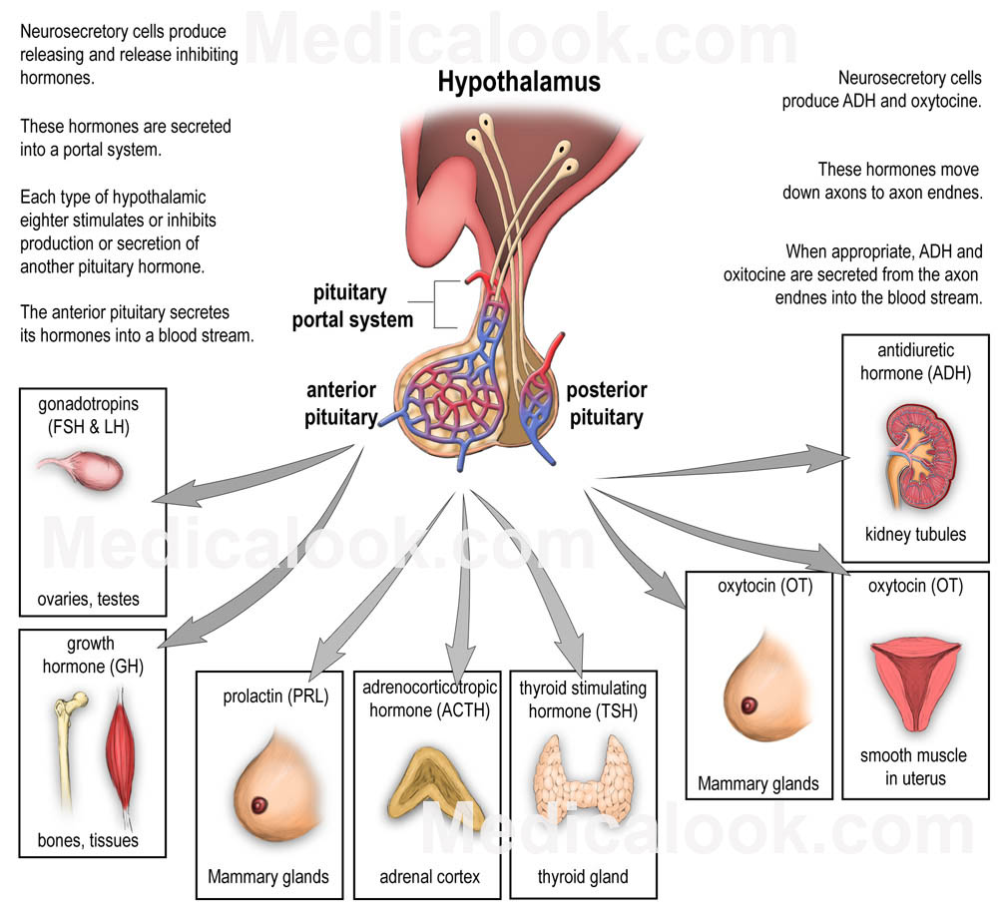
Notes:
Hipotalamus: RH
Hipotalamus: TRH, CRH, GnRH, GHRH, SST (inh. GH) i DA (inh.prolaktin)

Slide 6
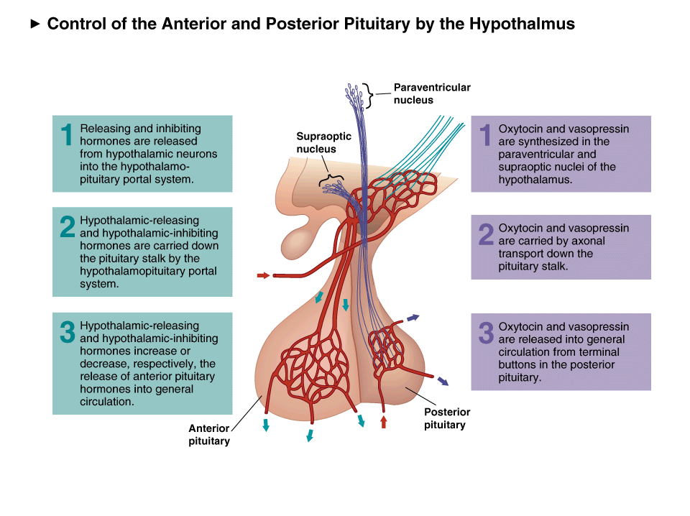

Slide 7
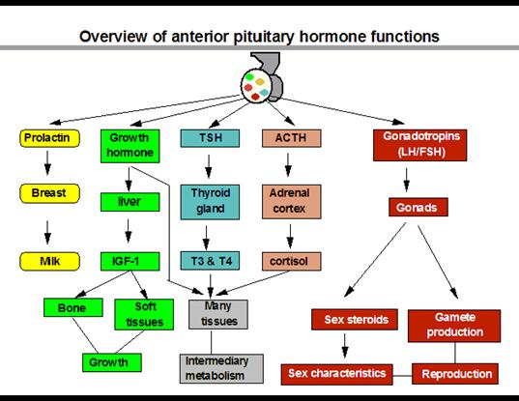
Hipofiza
Topljivi u vodi: B i C
Topljivi u mastima: A, D, E i K

Slide 8
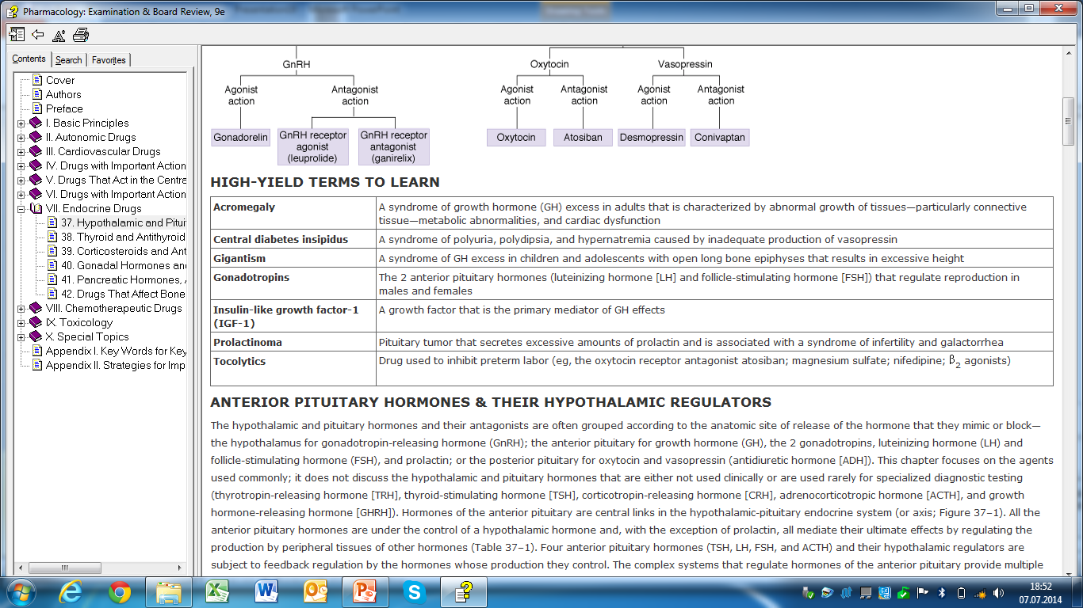
The hormones produced by the hypothalamus and pituitary gland are key regulators of metabolism, growth, and reproduction. Preparations of these hormones, including products made by recombinant DNA technology and drugs that mimic or block their effects, are used in the treatment of a variety of endocrine disorders

Slide 9
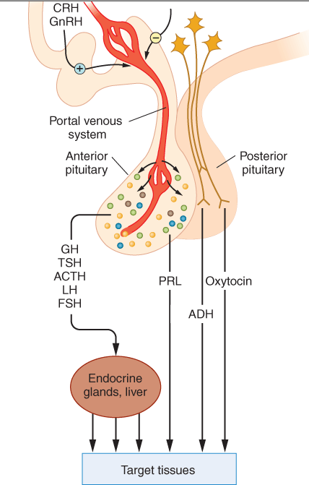
Hormones of the anterior pituitary are central links in the hypothalamic-pituitary endocrine system . All the anterior pituitary hormones are under the control of a hypothalamic hormone and, with the exception of prolactin, all mediate their ultimate effects by regulating the production by peripheral tissues of other hormones. Four anterior pituitary hormones (TSH, LH, FSH, and ACTH) and their hypothalamic regulators are subject to feedback regulation by the hormones whose production they control. The complex systems that regulate hormones of the anterior pituitary provide multiple avenues of pharmacologic intervention.

Slide 10
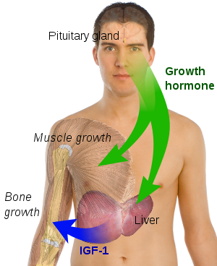

Slide 11
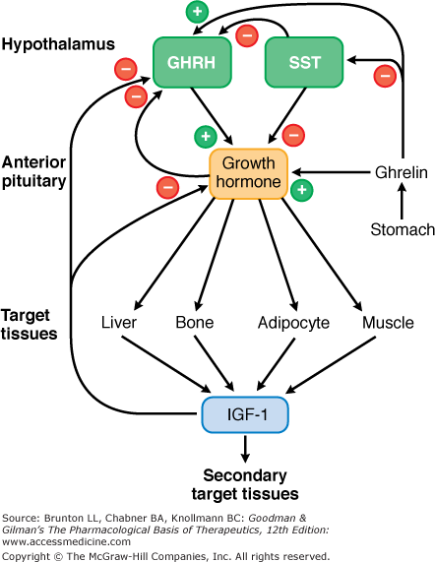

Slide 12

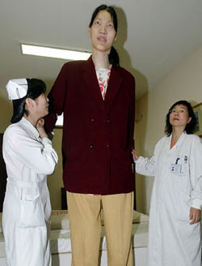

Slide 13
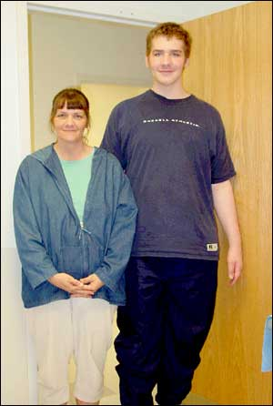
1) GIGANTISM- children and adolescents who have not completed their growth phase
12-years old boy with his mother

Slide 14
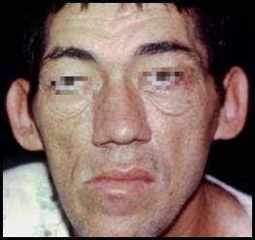
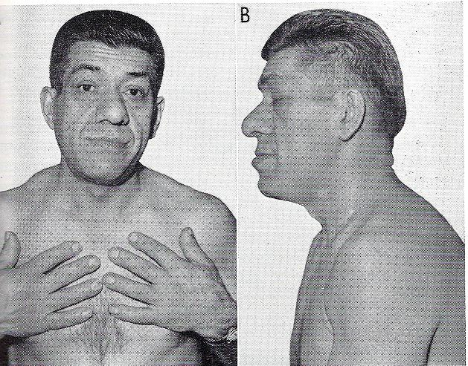
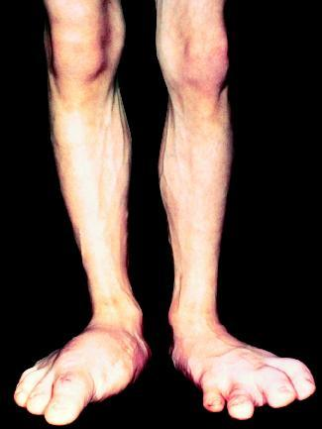
2) Acromegaly- in adults

Slide 15
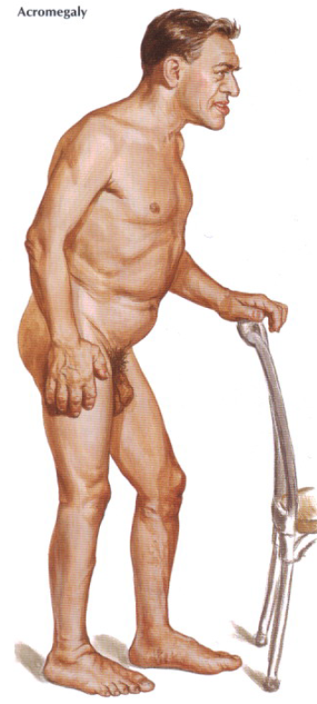

Slide 16
Growth Hormone (GH)
Growth hormone -required for normal growth during childhood and adolescence
- an important regulator throughout life of lipid and carbohydrate metabolism, lean body mass
- effects primarily mediated by regulating the production in peripheral tissues of insulin-like growth factor 1 (IGF-1) and 2 (IGF-2)
Somatropin is a recombinant form of human GH
treatment of GH deficiency in children and adults and in the treatment of children with genetic diseases associated with short stature (eg, Turner's syndrome, Noonan syndrome, Prader-Willi syndrome)
GH treatment also improves growth in children with failure to thrive because of chronic renal failure or the small-for-gestational-age condition
In adults, GH has efficacy in treatment of AIDS-associated wasting and GH deficiency,
it may improve gastrointestinal function in patients who have undergone intestinal resection and have subsequently developed a malabsorption syndrome
GH is a popular component of antiaging programs even though studies in model animal systems have consistently found that analogs of GH and IGF-1 shorten lifespan
GH is also used by athletes for a purported increase in muscle mass and athletic performance and is one of the drugs banned by the Olympic Committee and professional sports associations.
Adults generally tolerate GH less well than children. Adverse effects include peripheral edema, myalgia, and arthralgia. Rarely, GH causes intracranial hypertension.

Slide 17
Growth Hormone Antagonists
Growth hormone-secreting pituitary adenomas cause acromegaly in adults and, rarely, gigantism in children and adolescents who have not completed their growth phase.
Somatostatin Analogs
Somatostatin, a 14-amino-acid peptide, inhibits the release of GH, glucagon, insulin, and gastrin.
Octreotide - long-acting synthetic analog of somatostatin
acromegaly, carcinoid, gastrinoma, glucagonoma, other endocrine tumors
regular octreotide must be administered subcutaneously 2–4 times daily whereas a slow-release intramuscular formulation of octreotide is administered every 4 wk for long-term therapy
Octreotide causes significant gastrointestinal disturbances, gallstones, and cardiac conduction abnormalities

Slide 18
Posterior Pituitary Hormones
Oxytocin
Oxytocin - a nonapeptide synthesized in cell bodies in the paraventricular nuclei of the hypothalamus and transported through the axons of these cells to the posterior pituitary
an effective stimulant of uterine contraction
used intravenously to induce or reinforce labor
Atosiban - an antagonist of the oxytocin receptor, used in some countries as a tocolytic , a drug used to treat preterm labor

Slide 19
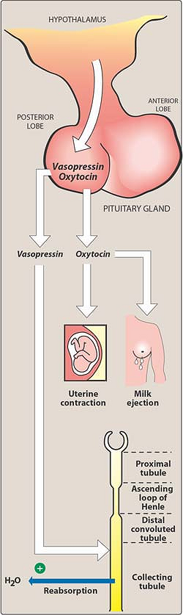
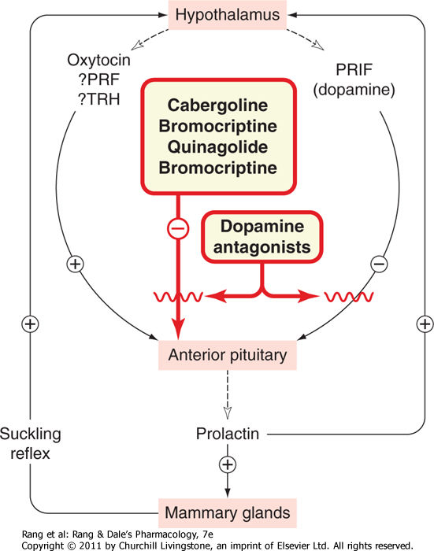

Slide 20
Vasopressin (Antidiuretic Hormone [ADH])
Vasopressin- synthesized in neuronal cell bodies in the hypothalamus and released from nerve terminals in the posterior pituitary
vasopressin acts through V₂ receptors to increase the insertion of water channels in the apical membranes of collecting duct cells in the kidney and to thereby provide an antidiuretic effect
extrarenal V₂-like receptors regulate the release of coagulation factor VIII and von Willebrand factor
Desmopressin, a selective agonist of V₂ receptors, is administered orally, nasally, or parenterally in patients with pituitary diabetes insipidus and in patients with mild hemophilia A or von Willebrand disease.
contracts vascular smooth muscle by activating V₁ receptors. Because of this vasoconstrictor effect, vasopressin is sometimes used to treat patients with bleeding from esophageal varices or colon diverticula.

Slide 21
Several antagonists of vasopressin receptors (eg, conivaptan, tolvaptan) have been developed to offset the fluid retention that results from the excessive production of vasopressin associated with hyponatremia or acute heart failure

Slide 22
Thyroid & Antithyroid Drugs
2 types of hormones: iodine-containing amino acids (thyroxine and triiodothyronine) and a peptide (calcitonin).
Thyroxine and triiodothyronine have broad effects on growth, development, and metabolism
Calcitonin is important in calcium metabolism
hypothyroidism
hyperthyroidism.

Slide 23
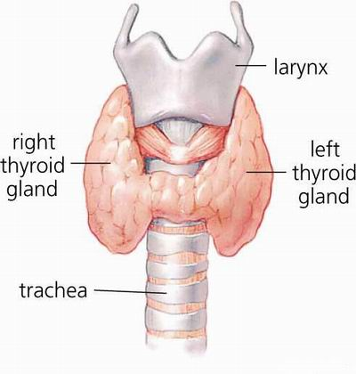

Slide 24
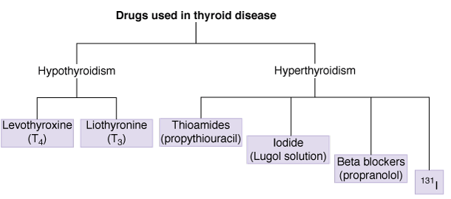

Slide 25
Synthesis & Transport of Thyroid Hormones
The thyroid secretes 2 iodine-containing hormones:
thyroxine (T4 ) and
triiodothyronine (T₃)
The iodine necessary for the synthesis of these molecules comes from food or iodide supplements.
Iodide ion is actively taken up by and highly concentrated in the thyroid gland, where it is converted to elemental iodine by thyroidal peroxidase
The protein thyroglobulin serves as a scaffold for thyroid hormone synthesis.
Tyrosine residues in thyroglobulin are iodinated to form monoiodotyrosine (MIT) or diiodotyrosine (DIT) in a process known as iodineorganification.
Within thyroglobulin, 2 molecules of DIT combine to form T_{4,} while 1 molecule each of MIT and DIT combine to form T₃.
Proteolysis of thyroglobulin liberates the T₄ and T₃, which are then released from the thyroid.
After release from the gland, T₄ and T₃ are transported in the blood by thyroxine-binding globulin, a protein synthesized in the liver.

Slide 26
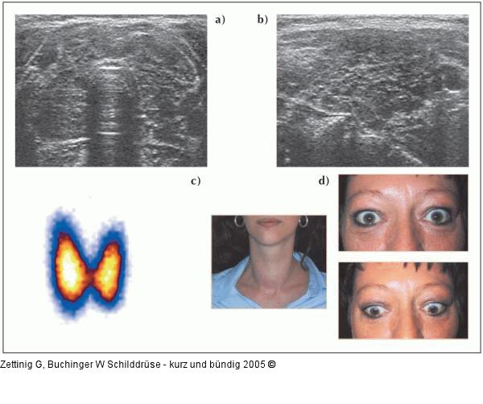
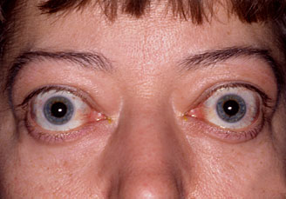

Slide 27
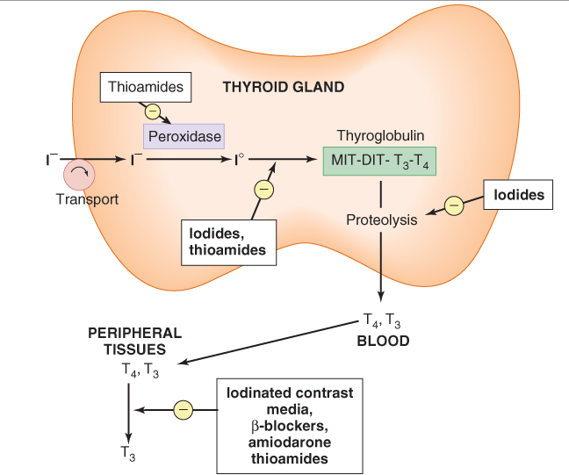

Slide 28
Thyroid function is controlled by the pituitary through the release of thyrotropin (thyroid-stimulating hormone [TSH]) and by the availability of iodide.
Thyrotropin stimulates the uptake of iodide as well as synthesis and release of thyroid hormone. It also has a growth-promoting effect that causes thyroid cell hyperplasia and an enlarged gland (goiter). High levels of thyroid hormones inhibit the release of TSH, providing an effective negative feedback control mechanism. In Graves' disease, an autoimmune disorder, B lymphocytes produce an antibody that activates the TSH receptor and can cause a syndrome of hyperthyroidism called thyrotoxicosis. Because these lymphocytes are not susceptible to negative feedback, patients with Graves' disease can have very high blood concentrations of thyroid hormone at the same time that their blood concentrations of TSH are very low.

Slide 29
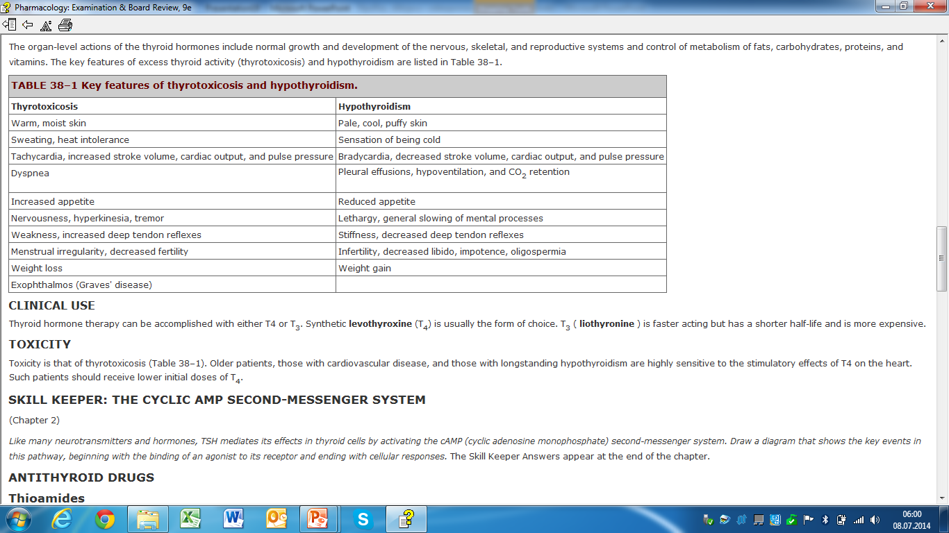
Effects of Thyroid Hormone
The organ-level actions of the thyroid hormones include normal growth and development of the nervous, skeletal, and reproductive systems and control of metabolism of fats, carbohydrates, proteins, and vitamins.

Slide 31
Clinical Use
Thyroid hormone therapy can be accomplished with either T4 or T₃.
Synthetic levothyroxine (T₄) is usually the form of choice.
T₃ ( liothyronine ) is faster acting but has a shorter half-life and is more expensive.
Toxicity
- thyrotoxicosis
-Older patients, those with cardiovascular disease, and those with longstanding hypothyroidism are highly sensitive to the stimulatory effects of T4 on the heart
-Such patients should receive lower initial doses of T₄.

Slide 33
Antithyroid Drugs
Thioamides
Methimazole and propylthiouracil (PTU) are small sulfur-containing thioamides that inhibit thyroid hormone synthesis by blocking peroxidase-catalyzed reactions, iodination of the tyrosine residues of thyroglobulin, and coupling of DIT and MIT
Propylthiouracil and, to a much lesser extent, methimazole inhibit peripheral conversion of T4 to T_{3.}
Because the thioamides do not inhibit the release of preformed thyroid hormone, their onset of activity is usually slow, often requiring 3–4 wk for full effect.
The thioamides can be used by the oral route and are effective in young patients with small glands and mild disease.
Methimazole is generally preferred because it can be administered once per day. However, PTU is preferred in pregnancy because it is less likely than methimazole to cross the placenta and enter breast milk.
Toxic effects include skin rash (common) and severe reactions (rare) such as vasculitis, agranulocytosis, hypoprothrombinemia, and liver dysfunction. These effects are usually reversible.

Slide 35
Iodide Salts and Iodine
Iodide salts inhibit iodination of tyrosine and thyroid hormone release
these salts also decrease the size and vascularity of the hyperplastic thyroid gland
Because iodide salts inhibit release as well as synthesis of the hormones, their onset of action occurs rapidly, within 2–7 d. However, the effects are transient; the thyroid gland "escapes" from the iodide block after several weeks of treatment.
Iodide salts are used in the management of thyroid storm and to prepare patients for surgical resection of a hyperactive thyroid.
The usual forms of this drug are Lugol's solution (iodine and potassium iodide) and saturated solution of potassium iodide.
Adverse effects include rash, drug fever, metallic taste, bleeding disorders, and, rarely, anaphylactic reactions.

Slide 36
Radioactive Iodine
Radioactive iodine (¹³¹I) is taken up and concentrated in the thyroid gland so avidly that a dose large enough to severely damage the gland can be given without endangering other tissues. Unlike the thioamides and iodide salts, an effective dose of ¹³¹I can produce a permanent cure of thyrotoxicosis without surgery. ¹³¹I should not be used in pregnant or nursing women.
Anion Inhibitors
Anions such as thiocyanate (SCN–) and perchlorate (ClO₄–) block the uptake of iodide by the thyroid gland through competitive inhibition of the iodide transporter. Their effectiveness is unpredictable and ClO₄– can cause aplastic anemia, so these drugs are rarely used clinically.
Other Drugs
An important class of drugs for the treatment of thyrotoxicosis is the beta blockers. These agents are particularly useful in controlling the tachycardia and other cardiac abnormalities of severe thyrotoxicosis. Propranolol also inhibits the peripheral conversion of T4 to T₃.

Slide 37
The iodine-containing antiarrhythmic drug amiodarone can cause hypothyroidism through its ability to block the peripheral conversion of T4 to T₃.
It also can cause hyperthyroidism either through an iodine-induced mechanism in persons with an underlying thyroid disease such as multinodular goiter or through an inflammatory mechanism that causes leakage of thyroid hormone into the circulation.
Amiodarone-associated hypothyroidism is treated with thyroid hormone.
Iodine-associated hyperthyroidism caused by amiodarone is treated with thioamides, whereas the inflammatory version is best treated with corticosteroids.
Iodinated radiocontrast media (eg, oral diatrizoate and intravenous iohexol) rapidly suppress the conversion of T4 to T₃ in the liver, kidney, and other peripheral tissues.

Slide 40
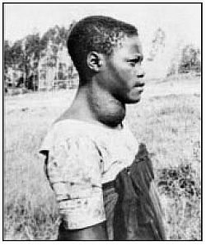
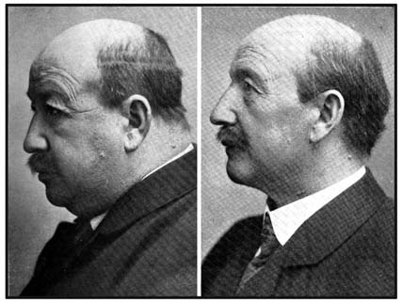

Slide 41
DRUGS THAT AFFECT BONE MINERAL HOMEOSTASIS
Calcium and phosphorus, the 2 major elements of bone, are crucial not only for the mechanical strength of the skeleton but also for the normal function of many other cells in the body.
Accordingly, a complex regulatory mechanism has evolved to tightly regulate calcium and phosphate homeostasis.
Parathyroid hormone (PTH) and vitamin D are primary regulators
calcitonin, glucocorticoids, and estrogens play secondary roles.
These hormones or drugs that mimic or suppress their actions are used in the treatment of bone mineral disorders (eg, osteoporosis, rickets, osteomalacia, Paget's disease), as are several nonhormonal agents.

Slide 42
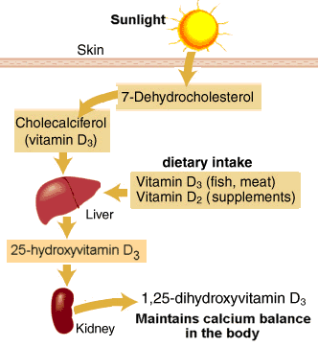
Notes:
Vit D2 ergokalciferol

Slide 43
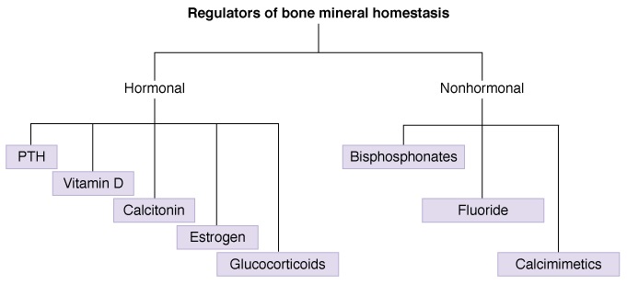

Slide 44
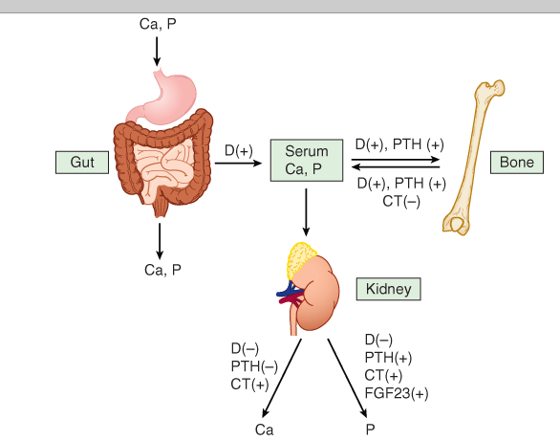
Effects of active metabolites of vitamin D (D), parathyroid hormone (PTH), calcitonin (CT), calcium and phosphorus homeostasis.
Active metabolites of vitamin D increase absorption of calcium from both gut and bone, whereas PTH increases reabsorption from bone. Vitamin D metabolites and PTH both reduce urinary excretion of calcium.

Slide 45
Parathyroid Hormone
Parathyroid hormone (PTH), acts on bone and renal tubular cells.
In the kidney, PTH inhibits calcium excretion, promotes phosphate excretion, and stimulates the production of active vitamin D metabolites In bone, PTH promotes bone turnover by increasing the activity of both osteoblasts and osteoclasts
Osteoclast activation is not a direct effect and instead results from PTH stimulation of osteoblast formation of RANK ligand (RANKL), a member of the tumor necrosis factor (TNF) cytokine family that stimulates the activity of mature osteoclasts and the differentiation of osteoclast precursors.
At the continuous high concentrations seen in hyperparathyroidism, the net effect of elevated PTH is increased bone resorption, hypercalcemia, and hyperphosphatemia. However, low intermittent doses of PTH produce a net increase in bone formation; this is the basis of the use of teriparatide , a recombinant form of PTH, for parenteral treatment of osteoporosis.
The synthesis and secretion of PTH is primarily regulated by the serum concentration of free ionized calcium; a drop in free ionized calcium stimulates PTH release. Active metabolites of vitamin D play a secondary role in regulating PTH secretion by inhibiting PTH synthesis.

Slide 46
Vitamin D
Vitamin D, a fat-soluble vitamin
-can be synthesized in the skin from 7-dehydrocholesterol under the influence of ultraviolet light
-or absorbed from the diet in the natural form (vitamin D3 , cholecalciferol ) or the plant form (vitamin D2 , ergocalciferol ).
-active metabolites are formed in the liver (25-hydroxyvitamin D or calcifediol) and kidney (1,25-dihydroxyvitamin D or calcitriol plus other metabolites).
Renal synthesis of active vitamin D metabolites is stimulated by PTH and by fibroblast growth factor 23 (FGF23), a factor produced by osteoblasts and osteoclasts. Renal synthesis of 1,25-dihydroxyvitamin D₂ is inhibited by phosphate and vitamin D metabolites.
The action of vitamin D metabolites is mediated by activation of 1 or possibly a family of nuclear receptors that regulate gene expression.

Slide 47
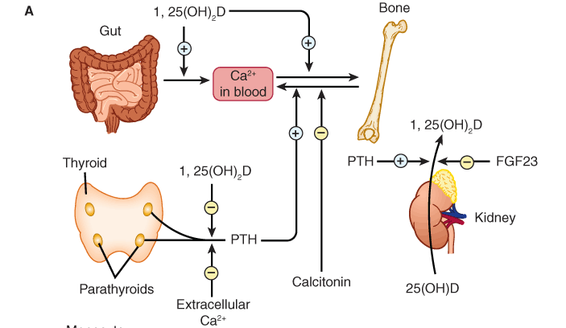

Slide 48
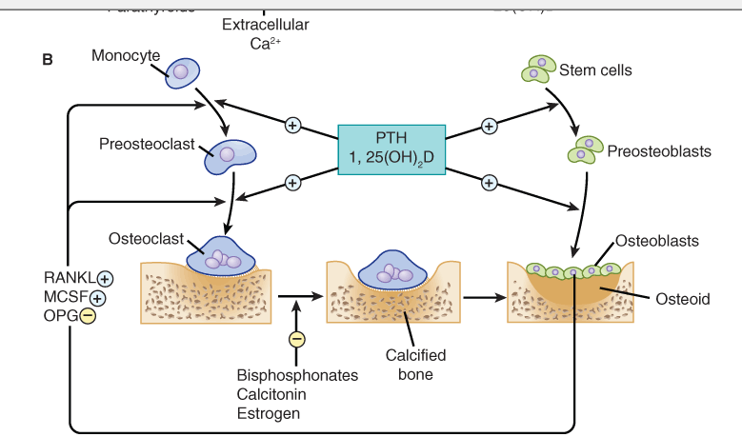

Slide 49
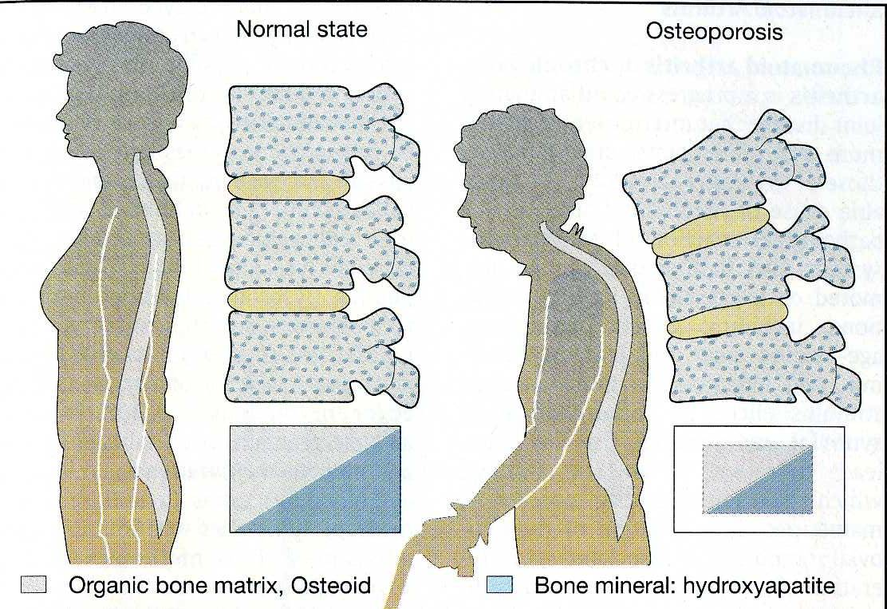

Slide 50
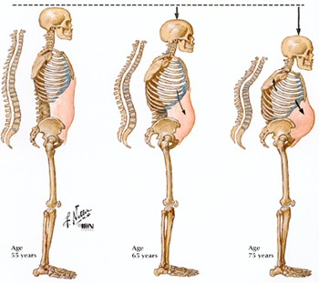

Slide 51
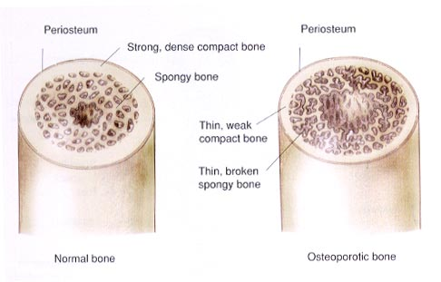

Slide 52
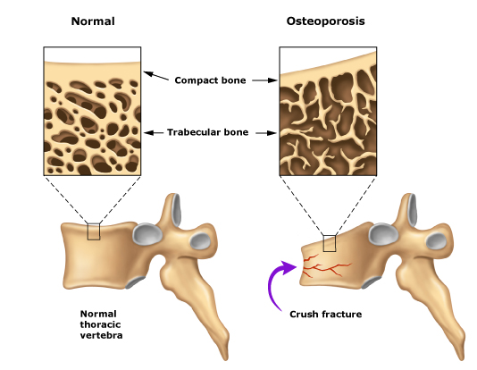

Slide 53
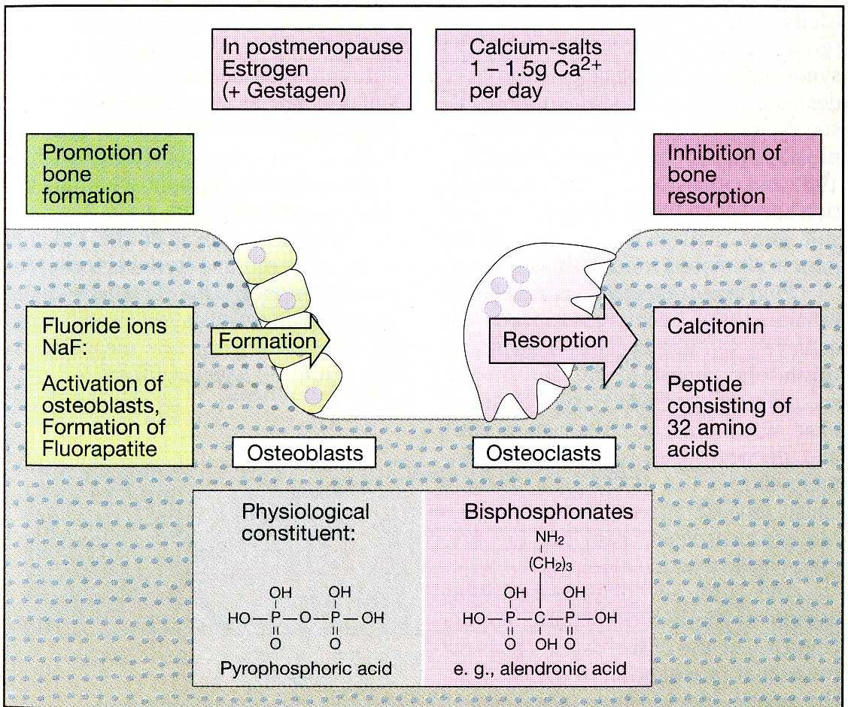

Slide 54
Active vitamin D metabolites cause a net increase in serum concentrations of calcium and phosphate:
- by increasing intestinal absorption and bone resorption
- decreasing renal excretion
- Because their effect in the gastrointestinal (GI) tract and bone is greater than their effect in the kidney, they also increase urinary calcium.
-Active vitamin D metabolites are required for normal mineralization of bone; deficiencies cause rickets in growing children and adolescents and osteomalacia in adults.
-Vitamin D metabolites inhibit PTH secretion directly and indirectly, by increasing serum calcium.
Vitamin D, vitamin D metabolites, and synthetic derivatives are used to treat deficiency states, including nutritional deficiency, intestinal osteodystrophy, chronic kidney or liver disease, hypoparathyroidism, and nephrotic syndrome. They are also used, in combination with calcium supplementation, to prevent and treat osteoporosis in older women and men.
Topical formulations are used in psoriasis, a hyperproliferative skin disorder.
The 2 forms of vitamin D—cholecalciferol and ergocalciferol—are available as oral supplements and are commonly added to dairy products and other foods. In patients with conditions that impair vitamin D activation (chronic kidney disease, liver disease, hypoparathyroidism), an active form of vitamin D such as calcitriol is required

Slide 55
- 1-Hydroxyvitamin D₂ ( doxercalciferol ) is a prodrug that is converted in the liver to 1,25-dihyroxyvitamin D
-19-nor-1,25-dihydroxyvitamin D₂ ( paricalcitol ) and calcipotriene (calcipotriol) are analogs of calcitriol.
The primary toxicity caused by chronic overdose with vitamin D or its active metabolites is hypercalcemia, hyperphosphatemia, and hypercalciuria.

Slide 56
Calcitonin
Calcitonin, a peptide hormone secreted by the thyroid gland, decreases serum calcium and phosphate by inhibiting bone resorption and inhibiting renal excretion of these minerals.
Bone formation is not impaired initially, but ultimately it is reduced. The hormone has been used in conditions in which an acute reduction of serum calcium is needed (eg, Paget's disease and hypercalcemia). Calcitonin is approved for treatment of osteoporosis and has been shown to increase bone mass and to reduce spine fractures. However, it is not as effective as teriparatide or bisphosphonates. Although human calcitonin is available, salmon calcitonin is most often selected for clinical use because of its longer half-life and greater potency. Calcitonin is administered by injection or as a nasal spray.

Slide 57
Estrogens
Estrogens and selective estrogen receptor modulators (SERMs; eg, raloxifene ) can prevent or delay bone loss in postmenopausal women. Their action involves the inhibition of PTH-stimulated bone resorption
Glucocorticoids
The glucocorticoids inhibit bone mineral maintenance. As a result, chronic systemic use of these drugs is a common cause of osteoporosis in adults. However, these hormones are useful in the intermediate-term treatment of hypercalcemia.

Slide 58
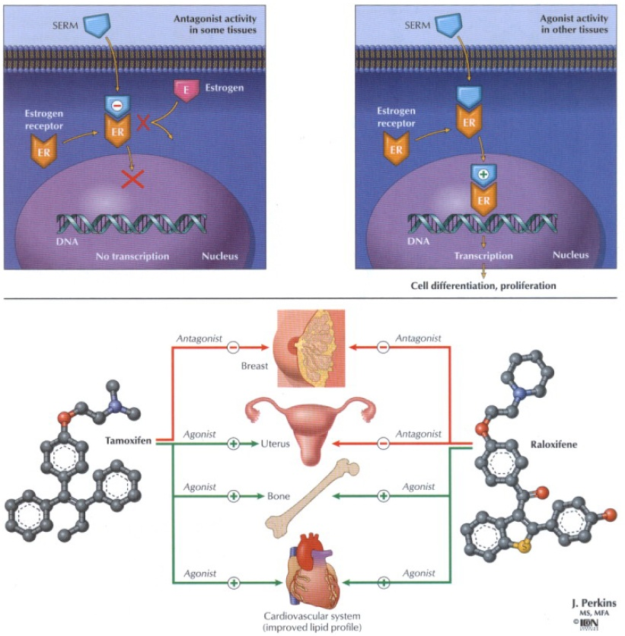
SERM
Notes:
SERM – selektivni estrogen receptor modulatori (na neke agonistički, na neke antagonistički djeluju)

Slide 59
Nonhormonal Agents
Bisphosphonates
The bisphosphonates (alendronate, etidronate, ibandronate, pamidronate, risedronate, tiludronate, and zoledronic acid) are short-chain organic polyphosphate compounds that reduce both the resorption and the formation of bone by an action on the basic hydroxyapatite crystal structure. The bisphosphonates have other complex cellular effects, including effects on vitamin D production and calcium absorption from the GI tract, and direct effects on osteoclasts, including inhibition of farnesyl pyrophosphate synthase, an enzyme that appears to play a critical role in osteoclast survival. Bisphosphonates are used to manage the hypercalcemia associated with some malignancies and to treat Paget's disease. Chronic bisphosphonate therapy is used commonly to prevent and treat all forms of osteoporosis. It has been shown to increase bone density and reduce fractures.

Slide 60
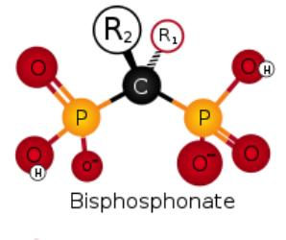
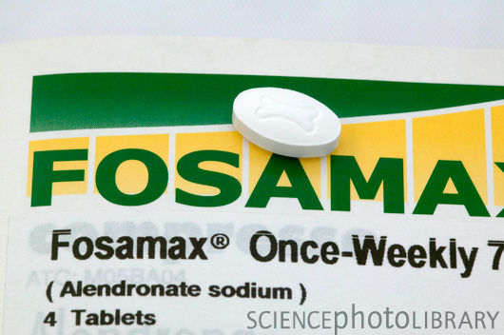

Slide 61
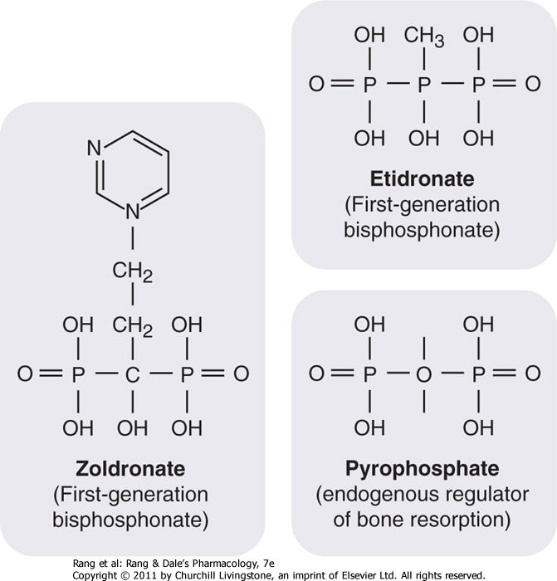

Slide 62
Fluoride
Appropriate concentrations of fluoride ion in drinking water or as an additive in toothpaste have a well-documented ability to reduce dental caries. Chronic exposure to the ion, especially in high concentrations, may increase new bone synthesis. It is not clear, however, whether this new bone is normal in strength. Clinical trials of fluoride in patients with osteoporosis have not demonstrated a reduction in fractures. Acute toxicity of fluoride (usually caused by ingestion of rat poison) is manifested by gastrointestinal and neurologic symptoms.

Slide 63
Other Drugs with Effects on Serum Calcium and Phosphate
Strontium ranelate, an organic ion bound to 2 atoms of strontium, promotes osteoclast apoptosis and increases concentrations of bone formation markers; it is used in Europe for treatment of osteoporosis.

