Slide 1
2020
POPE Cross Country
Kickoff Meeting
WELCOME!

Slide 2
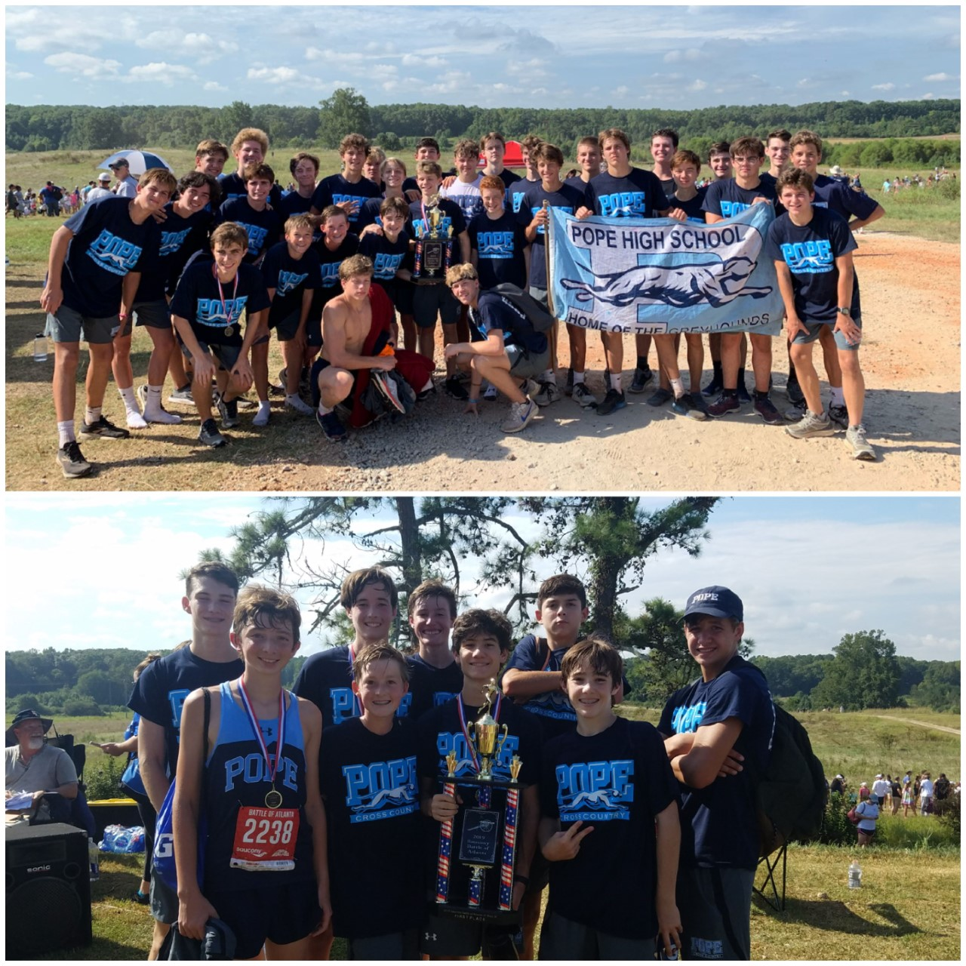
WE enjoyed last year but are challenged to do even more this year!!!!

Slide 3
2020 Pope XC Booster Club
Mindy Sullivan
Latricia Golden
David Laushey
Tera-Lee Dodsworth
Meredith Hay
Christy Wright
Amy Crowell

Slide 4
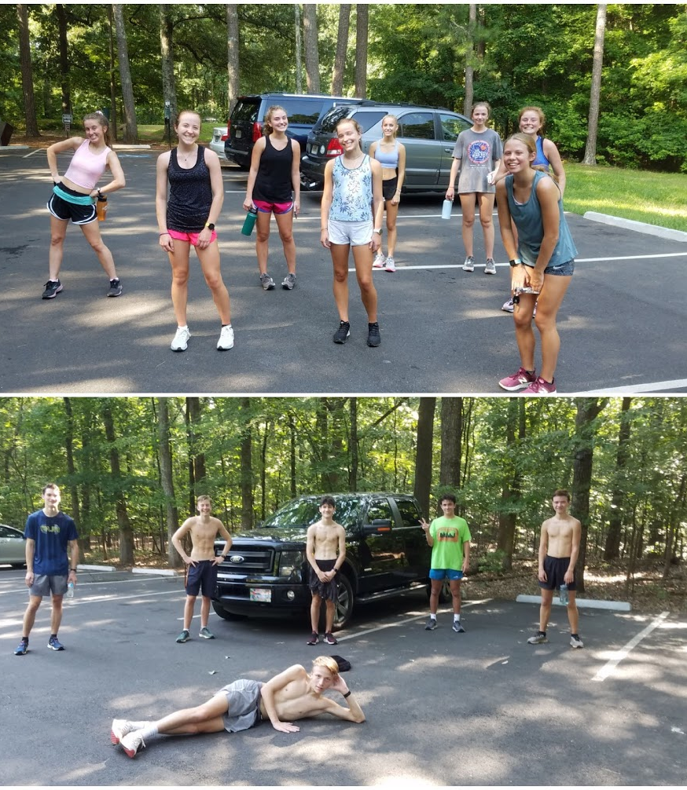
SOCIAL DISTANCING!!!!
#Whatever it takes

Slide 5
Strength training makes us faster
FANSTASTIC effort this summer in the weightroom!!!!

Slide 6
Social distancing in the weight room

Slide 7
BILATERAL STRENGTH and upper body

Slide 8
Where Do I Need to Do?
Pay Dues
- Cash, CC’s, Checks payable to Pope TFXC
2.Volunteer
3. Pay/Order/Pick Up Uniforms
TEAM SPIRIT PACK TEAM short
TEAM Tshirt water bottle
Mask
Will be given out at practice on FRIDAY.

Slide 9
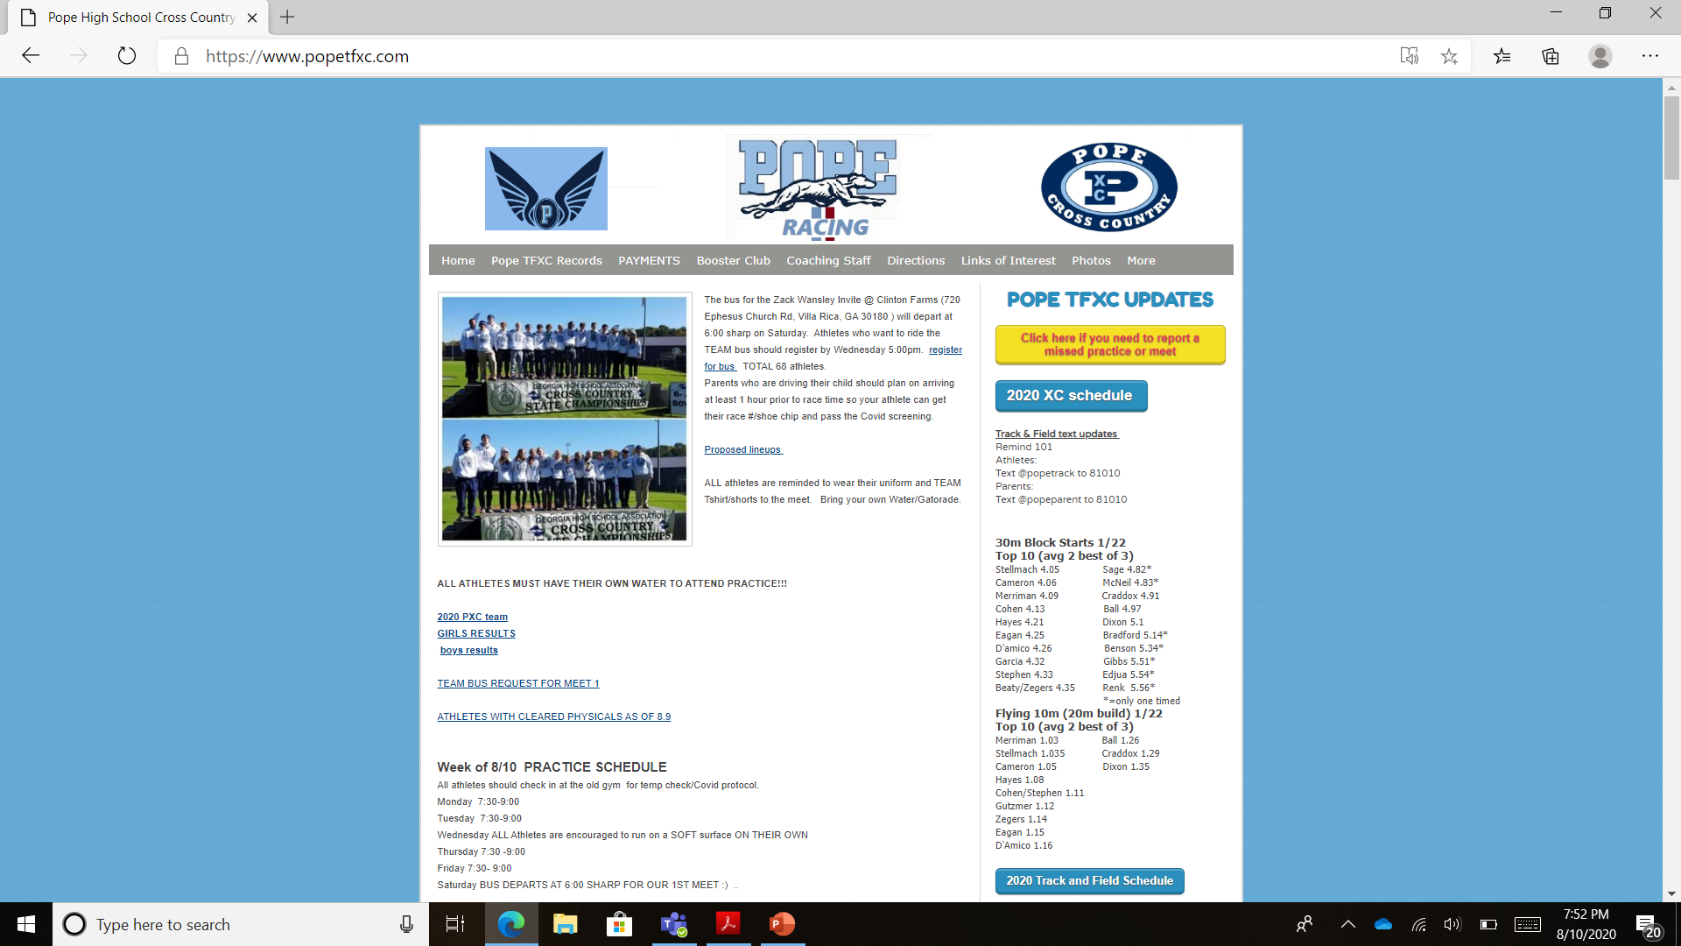
Website has everything you need to know
www.popetfxc.com

Slide 10
Pope TFXC Booster Club
----Board Objectives----
Support Development of Strong Winning Program
Continue Strong Booster Club Communication
Increase Family Participation
Repair / Maintain of Pope Trail

Slide 11
Pope TFXC Booster Club
Volunteer Opportunities
Team Photographers
Trail Cleanup Day?
Senior Week
Team Banquet
Meet Set Up / Breakdown

Slide 12
Registration Fees Toward…
Coaches Stipends & Supplements
Athletic Trainer Supplement
Weight Room Fees
Team Events
Meet Supplies & Snacks
Meet Transportation
Trail Maintenance
Substitute Fees
Senior Gifts
Team Shirt/shorts
Team Awards
MASK

Slide 13
Uniforms
Required for all athletes: GHSA standard
All athletes must have Pope Singlet & Shorts
Booster Club carries minimal inventory (cost)
XC uniforms are for sale through the Booster club for new athletes and those athletes who need a new piece.
UNIFORMS WILL BE HERE GIVEN OUT AT PRACTICE ON FRIDAY.

Slide 14
Save on Shoes and Apparel
$$$
POPE XC - Discount at BIG PEACH-Marietta
POPE Athletes get 10% off training shoes/15% off spikes, 20% off Apparel, 10% off everything else in store.
HOURS: M-F 10a-8p, Sat 9a-6p, Sun 12p-5p
POPE Family members get 10% off any purchase
www.bigpeachrunningco.com
* 1062 Johnson Ferry Road Marietta, GA 30068

Slide 15
LINKS to the future!!
When your legs tire run with your heart

Slide 16
2020 Coaching staff
Head Coach
Cathi Monk
Assistant Coaches
Steve Krause
Morgan Fleming

Slide 17
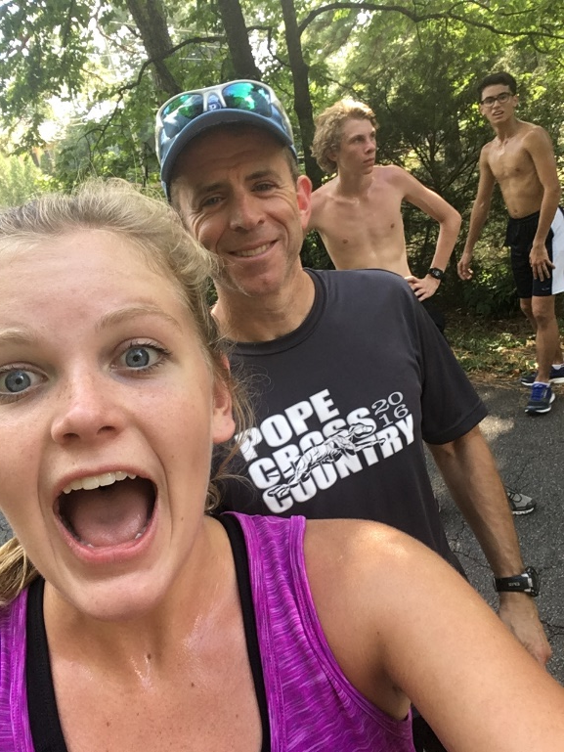
Coach Steve Krause
3 time State Champion in 300 AND 400.
PR of 48.3 in 400
Certified personal Trainer

Slide 18
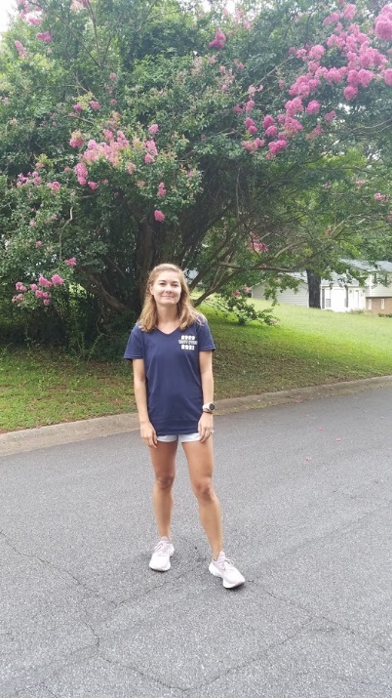
Morgan LAUSHEY
Ran at POPE HS with Pr’s of
1600 5:20
3200 11:40
5K 19:26
Ran at Georgia State
1500 4:54
3000 10:36
5K 18:37

Slide 19
Cathi monk
Walton HS alumni
Auburn University athlete
26 years of Coaching Experience
Coached multiple region and State individual Champions.
Numerous time County/Region Coach of the year.
TEAM GEORGIA Coordinator
Elected as Vice President of the GATFXCCA
(Coaches Assn).
Post 40 PR’s
19:21 5K
41:40 10K
1:35 ½ marathon
3:22 marathon

Slide 20
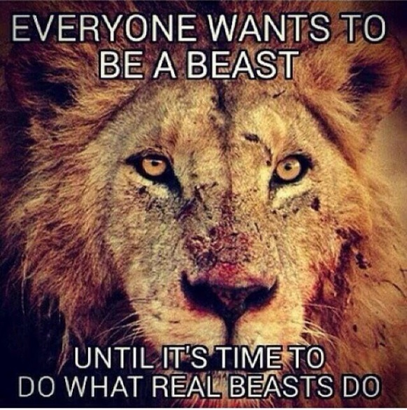
BUILD THE BASE!!!
Long runs!!!! Vary the terrain and pace!!
Weights
WE encourage STRONG athletes!!
Consistency in training is KEY!!

Slide 21
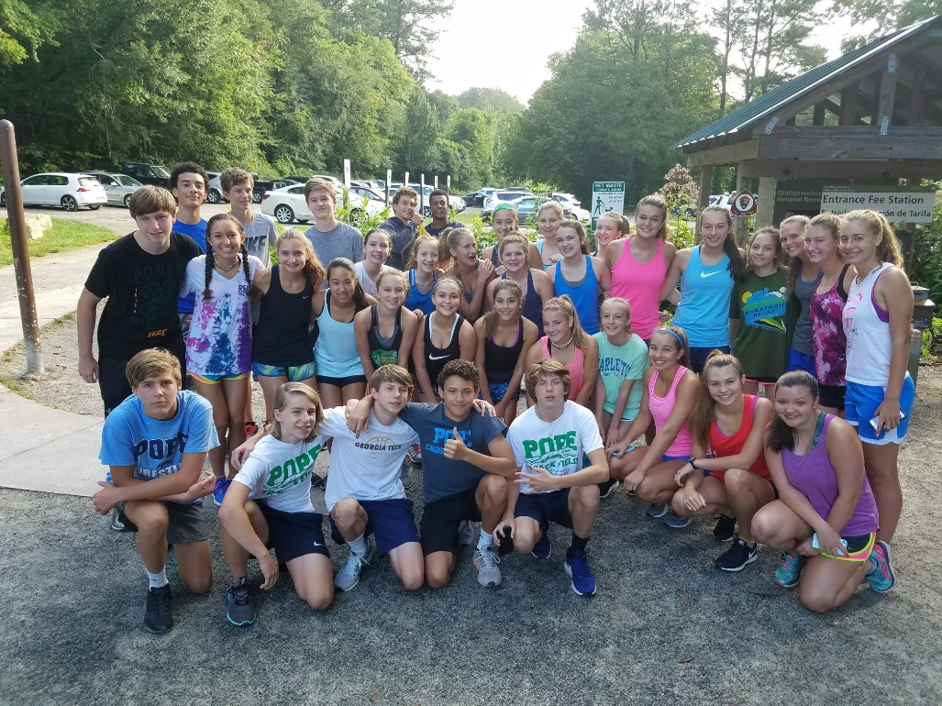
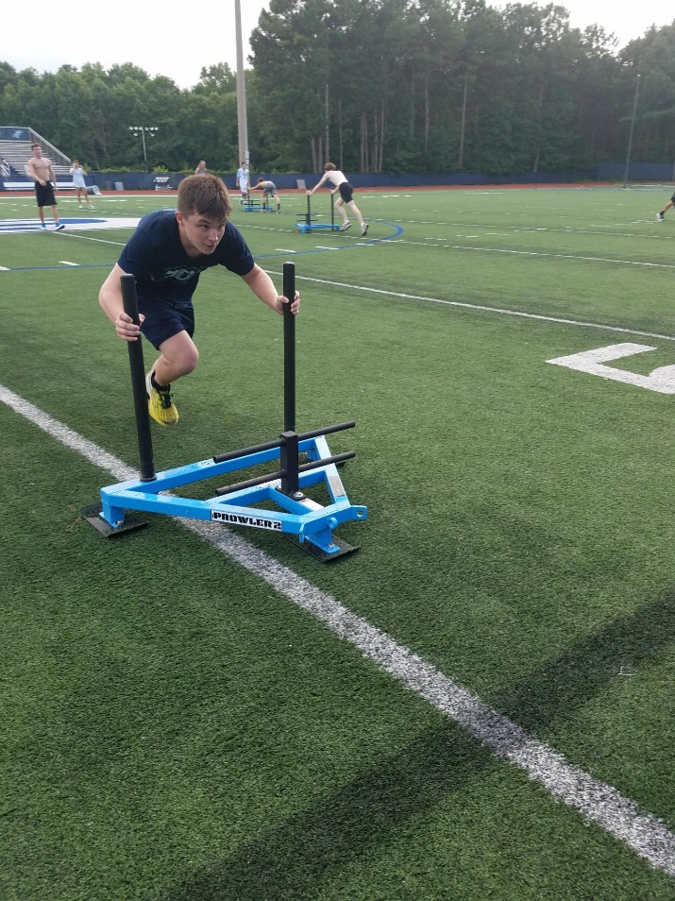
Summer training

Slide 22
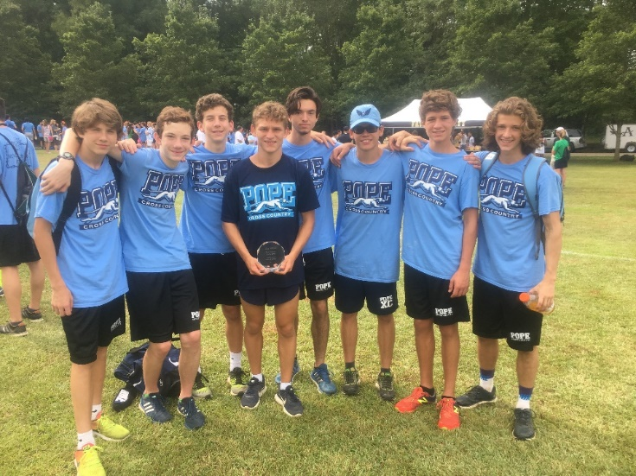
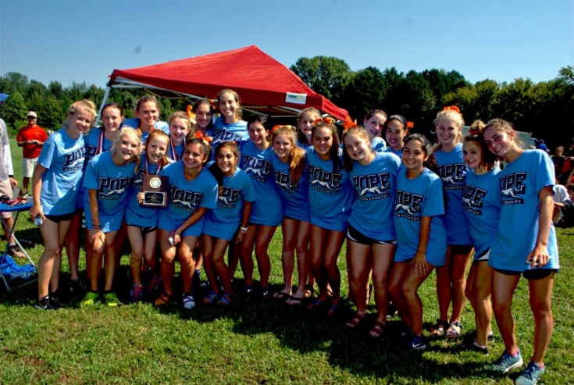
Practice Schedule
Monday Thursday 3:45-6:00pm
Wednesday Varsity will meet off site.
Tuesday Friday 6:20-7:30am Check out with a COACH!!
Alert Coaches prior to practice if you are going to miss via the website. Go to the front page of the website….click on ABSENCE NOTIFICATION
No Practice = No RACE

Slide 23
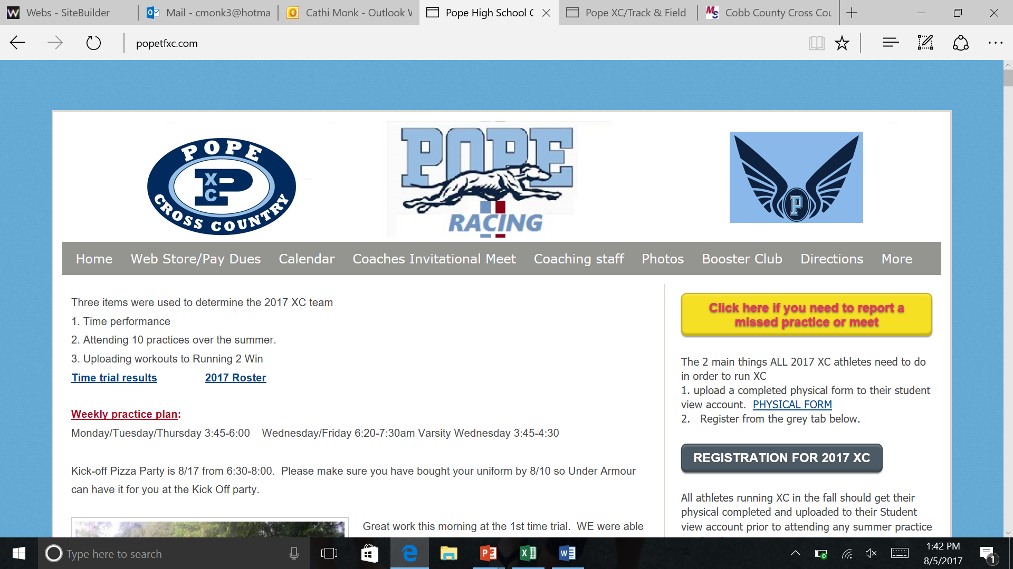
Attendance policy
Please submit your absence notification BEFORE you miss practice.
If you have an UNEXCUSED absence it is at the Coaches discretion to allow the athlete to compete. It is a privilege to compete and something you earn!!!!

Slide 24
Training
BE TRUE TO THE GREYHOUND!!
All our Coaches share the same training philosophy and have numerous years of experience.
During XC season we expect that all athletes are PRIMARILY XC athletes. IF you are a 2 sport athlete you need to bring a schedule in to the coaches ASAP.

Slide 25
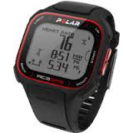
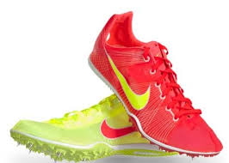
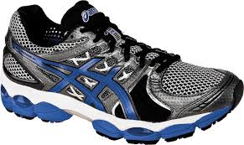
What do I need for xc?
SHOES!!!!!!!!! New within the last 3 months!!!
Most athletes need a basic cushioning running shoe –
Spikes for meets (optional but highly recommended)
Timing EVERYDAY!!!!
Sports watch –Walmart/Target
Map my Run or Strava
Team uniform – required
TEAM shorts/Tshirt

Slide 26
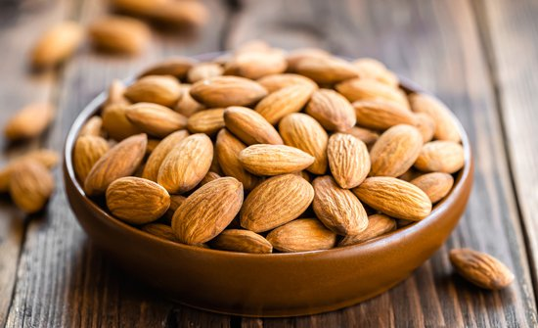
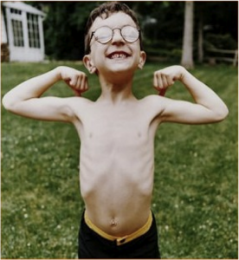
Take care of your body!!!!
Take your vitamins….specifically iron and D!!!!
Hydrate! 4-5 waters bottles a day.
Feed your children!!!!!
SLEEP!!
2-3 snacks a day and 3 FULL meals!!

Slide 27
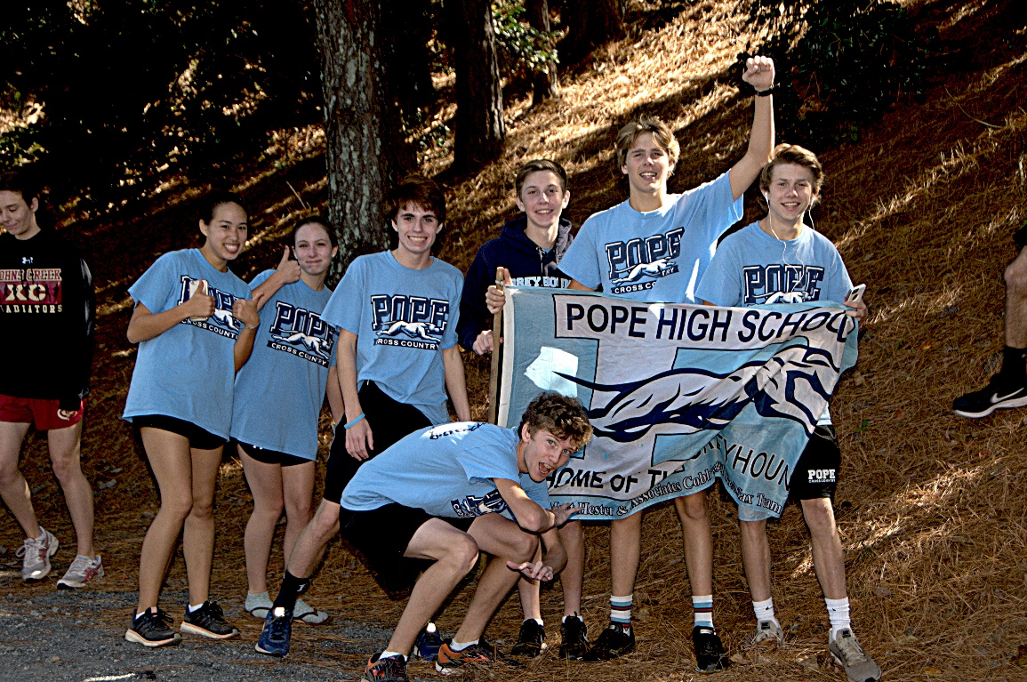
Now for the fun stuff : meets
In some meets/divisions we have entry limits!!!
If you need to miss a meet Go to the website….
Click on ABSENCE NOTIFICATION
Our warmup prior to Covid 19!!
BAHAAAAAA!!!!!!!

Slide 28
Now for the fun stuff : meets
Athletes will need for meets: 1. Uniform 2. training shoes 3. Team Tshirt/shorts 4. Sweats when cold 5. spikes
6. WATER/Gatorade 7. TEAM SPIRIT!!!

Slide 29
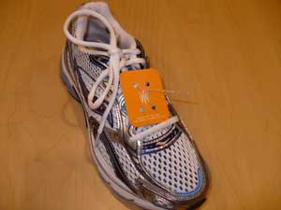
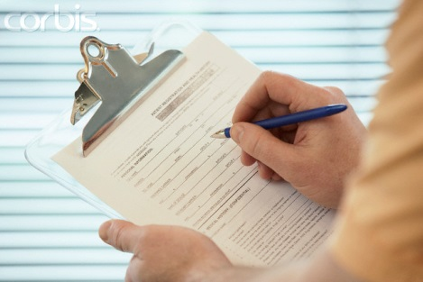
NOW THE FUN STUFF…MEETS!
Buses will leave EARLY in the morning so PLEASE be on time.
ATTACH your chip!!!!
Warm-up and Cool-down are important! All
athletes will need to cool down BEFORE parents sign them out at a meet!!!☺
If you are taking your kids home please sign them out at the meet. NO ATHLETES will be allowed to drive another athlete home!! THIS IS ONLY FOR THOSE WHO RIDE THE BUS DOWN BUT RIDE HOME WITH THEIR PARENTS.
After the race athletes will need to turn in their timing chip at the team tent. Failure to do so will cause a $25 fee

Slide 30
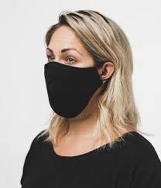
1st meet reminders
Bus lists will be posted on Friday afternoon. ALL athletes will be screened for temperature and Covid question prior to boarding bus. ALL athletes will assigned a bus/seat that will be utilized to and from the meet. WE are leaving at 6:00 so arrive earlier so you can be screened.
Those athletes who ride with their parents to the meet should plan on being at the team tent 1 hour prior to their scheduled race time. FORTY FIVE before each race those who rode with their parents will be given their race number/shoe chip AND have their temperature check/Covid questions.
In order to attend the meet athletes/coaches/spectators MUST have a face covering. THIS IS MANDATORY!!!!!
All other information will be updated on a daily basis to www.popetfxc.com
Even is this crazy time out kids have worked SOOOOO hard to prepare for this meet. Proud of their efforts and overly excited to get to watch them race on Saturday!!!!

Slide 31
UPDATES
Take pictures/videos and submit them to the website ☺
We need someone to assist with pictures and videos.
Follow us on Twitter: @PopeXC Instagram pope-xc coach.monk
Pope Athletics: @PopeAthletics
Most questions can usually be answered on the PHS XC website.

Slide 32
How do I earn a VARSITY LETTER?
VARSITY LETTER CRITERIA
AUTOMATIC TIME QUALIFIERS: 5K COURSES ONLY
GRADE MALE FEMALE
9 20:45 24:30
10 20:15 23:45
11 19:45 23:00
12 19:00 22:15
CHAMPIONSHIP MEETS:
Any athlete who places in the top 20 overall in the County or Region Championships.
Any athlete who places in the top 30 overall in the State Championships
SENIORS:
Any senior who has completed 2 Cross Country seasons in good standing with the team.
COACHES DISCRETION:
The coaching staff reserves the right to award a varsity letter to any athlete in a situation where they have not met any of the above criteria.
GUIDELINES:
The athlete must show progress throughout the season and compete maintain 80% attendance.
The athlete must finish the season in good standing with the team based on attendance and conduct.

Slide 33
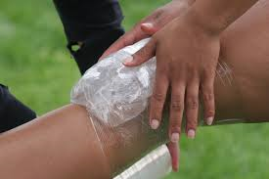
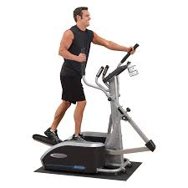
What if I am injured?
All athletes who have an injury should still come to practice. Prior to coming up to the track they should go to the trainer.
CHOA
Alexis Mariner, MS ATC
Alexis.Mariner@sourceatlanta.com
Dani Hall, MS ATC
dani.hall@sourceatlanta.com

Slide 34
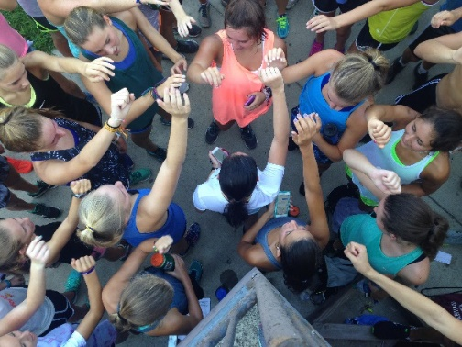
Not sure about XC Cross Country 101
Races typically 5K or 3.1 miles
Varsity, Junior Varsity and Open Races
Boys & girls and varsity & junior varsity run separate races (typically same day & place)
Varsity events maximum of seven (or 10) athletes per team
Some JV events allow more runners
Lowest team score wins
Athletes must wear proper running shoes and watch
Athletes may choose to wear racing spikes or flats
No earrings (male and female)/jewelry

Slide 35
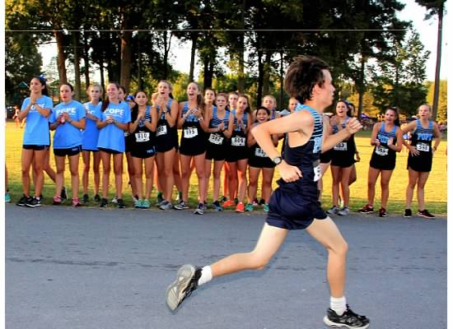
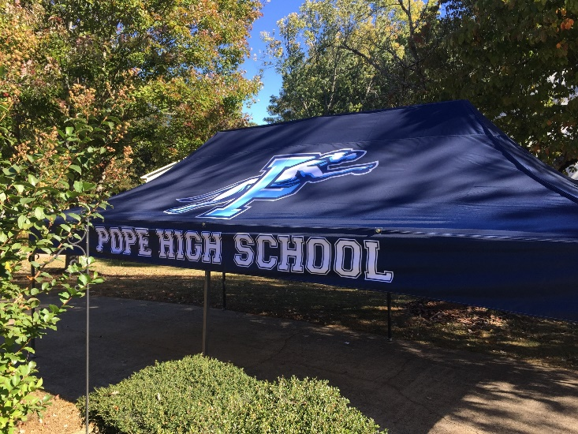
Cross Country 101
CHEER ON THOSE POPE ATHLETES!!!!!
Not the typical spectator sport
Select spot for best viewing
Spectators encouraged to cheer on all Pope athletes.
If you can’t put a name with an athlete’s face, fear not, “Go Pope!” or “Go Hounds!” works great!
Wear Pope spirit wear
Introduce yourself to other parents. It’s part of the sport!
Bring a comfortable chair and look for the Pope tent
Food!! Booster club funds provide snacks for the athletes. Parents are need to assist with set up and break down

Slide 36
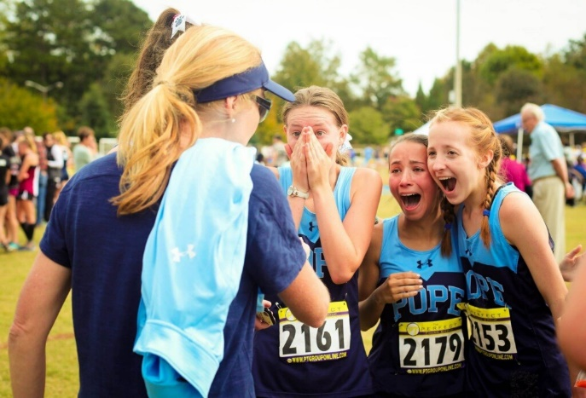
TEAM Champions Prove team depth!!!!
2019 JV County runner up
4 YEARS in a ROW Region TEAM CHAMPS!!!!
Girls REGION CHAMPS..EVERY athlete counts

Slide 37
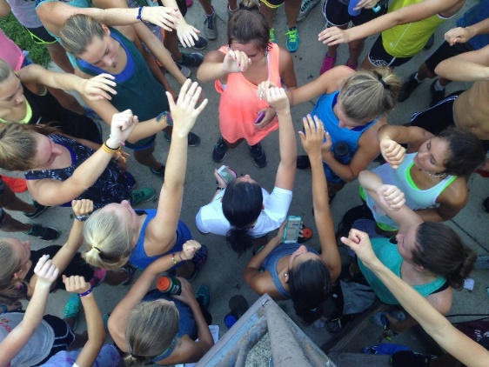
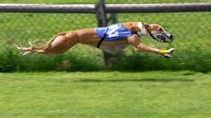
Be a part of something bigger than yourself!!

Slide 38
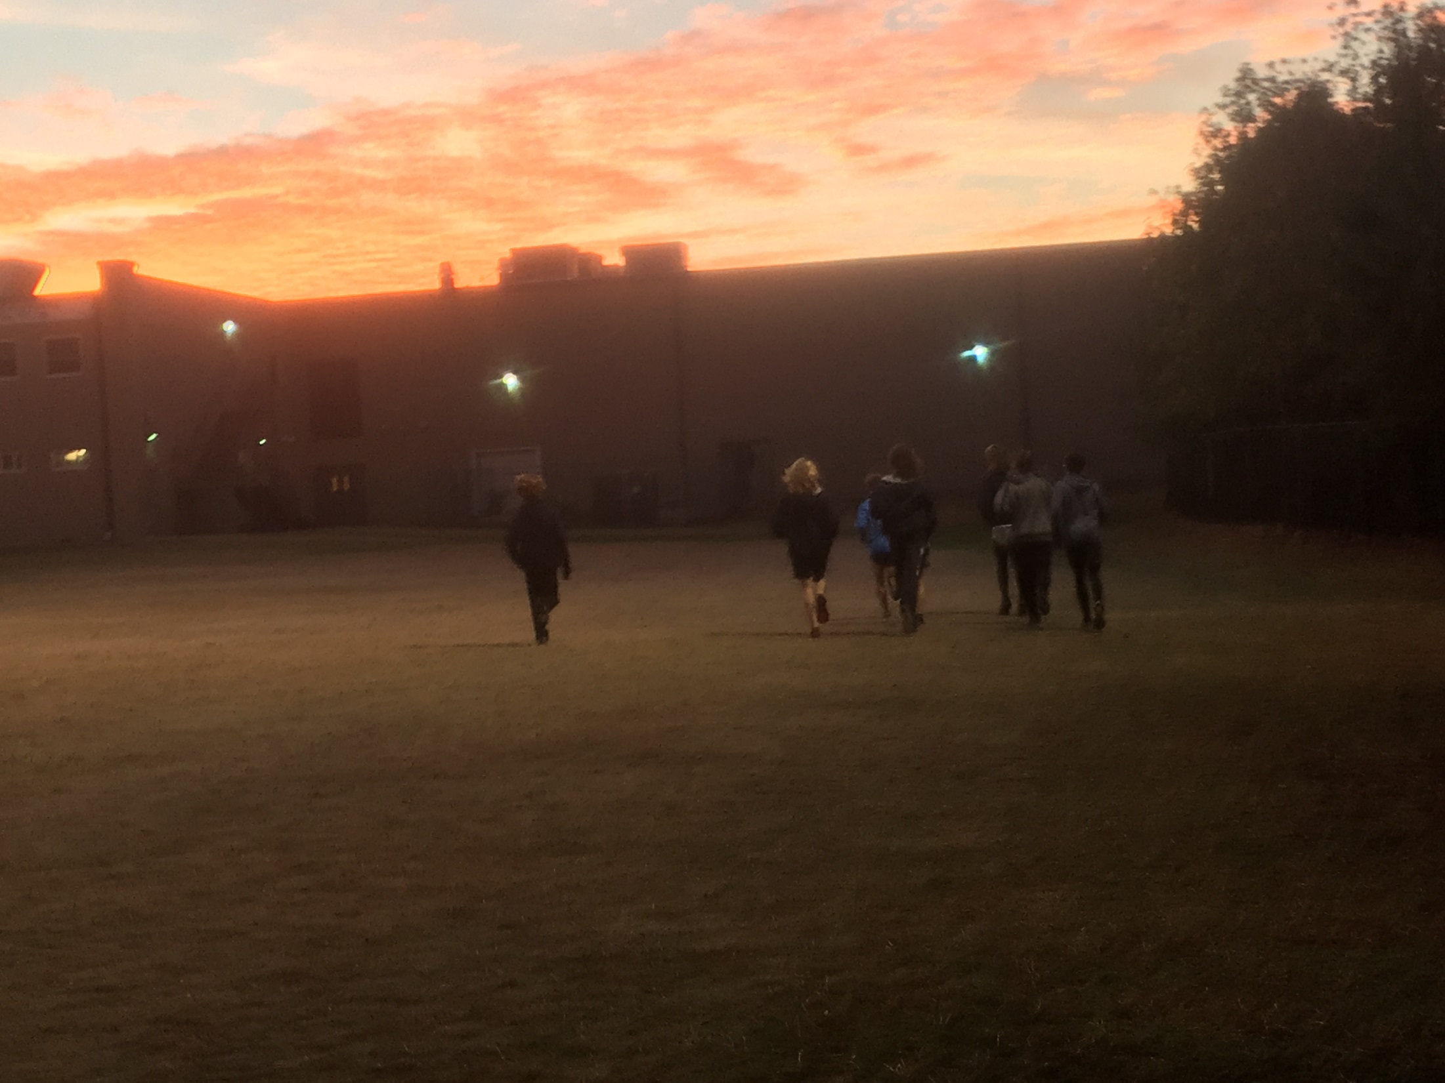
Will you be pleased with the result?????????

Slide 39
Questions:
WE have made a concerted effort at practice all week to remind the athletes of procedures for practice and meets. Please email me should you have questions cathi.monk@cobbk12.org

