Slide 1

Networking for Technical Pros
Grow your career.
Expand opportunities.
Have more fun!
Notes:
I used to really hate the idea of networking. Even though I’m a very successful salesperson, I’m also very introverted. That may seem funny, but it’s true! So, my perspective on networking was going to horrible

Slide 2
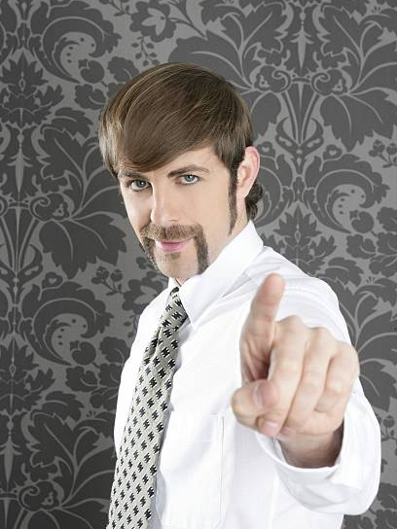

Slide 3

Reasons Why to Network
What We’ll Cover
The 2 Cardinal Rules
How to Be Great At It
What to Do With It

Slide 4
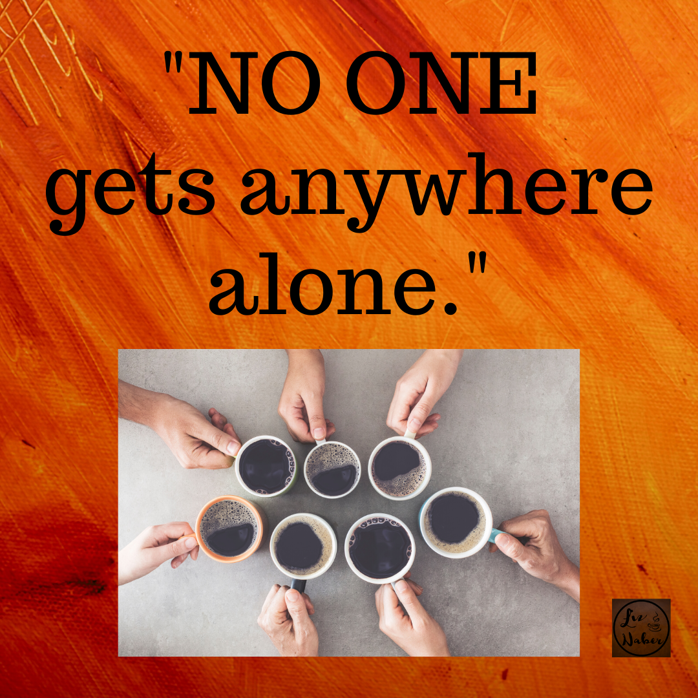
Reasons Why to Network

Slide 5

2 Cardinal Rules

Slide 6

2 Cardinal Rules
NURTURE IT
~ before ~
YOU NEED IT

Slide 7
Being your best “YOU”
How to be Great at Networking
Where to do it
Tips & Techniques

Slide 8
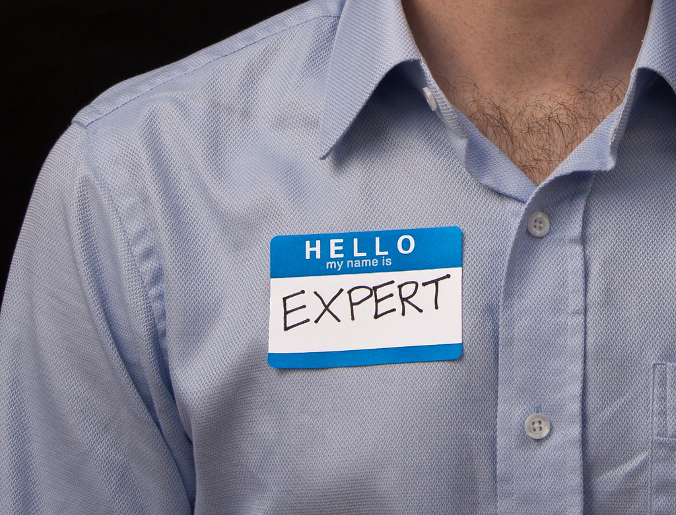
How to Be Great At Networking: Being your best “YOU”
Curate articles on LinkedIn
Videos on YouTube
Get Interviewed
Start a blog
Start an Instagram account
Speak at an event
Tweet it out, YO!

Slide 9

How to be Great at Networking: Being your best “YOU”
What Do You Like To Do?

Slide 10

How to be Great at Networking: Being your best “YOU”
What Do You Want To Develop?

Slide 11

In Person
How to be Great at Networking: Where to do it.
Where to Network
Church
Volunteering
Business Events
Lunch
Coffee
Clubs

Slide 12
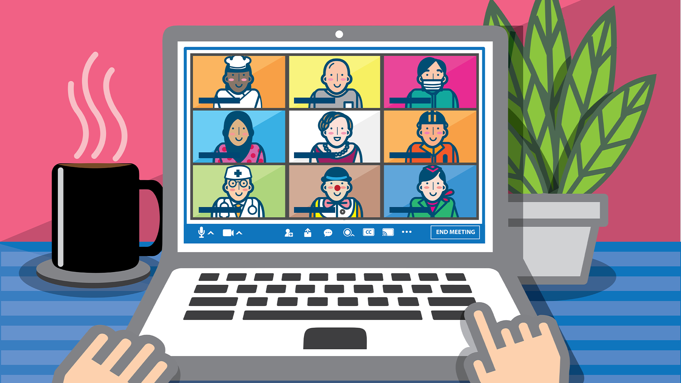
Online
How to be Great at Networking: Where to do it.
Where to Network
Online conferences
Book Club
Virtual Happy Hour
Virtual Lunch
Virtual Coffee
Webinars

Slide 13

Social Media
How to be Great at Networking: Where to do it.
Where to Network
LinkedIn
Facebook
Instagram
Twitter
Pinterest
Blogs

Slide 14

Don’t wait for opportunity
How to be Great at Networking: Where to do it
CREATE IT

Slide 15
In Person
How to be Great at Networking: Tips & Techniques
Ask about THEM first
Ask what they came to the event to get or accomplish
Find out who they’re trying to meet
Be prepared, be concise: “I do X for Y and deliver Z results”
Be a connector whenever possible
Keep moving
Sit away from colleagues
Set a goal
Use the “listening in” technique to insert yourself in a conversation
Ask what you can do for them
Research people ahead of time
Ask them to connect in some way after the event
Online
Social Media

Slide 16
How to be Great at Networking: Tips & Techniques
Online
Listen first to understand
Research people ahead of time
Be intentional about your background
Have light on your face – watch backlighting
Put the camera up in height
Look the part
Find people you want to connect with in some way after the event

Slide 17
How to be Great at Networking: Tips & Techniques
Social Media
Never pitch anything to anyone on social media
Share interesting content and tag people
Comment on and share their posts
Make introductions
Write an endorsement on their page
Endorse them for specific skills
Take it offline as soon as people

Slide 18

How to be Great at Networking: Tips & Techniques
FIND YOUR SECRET WEAPON

Slide 19
Nurture It
What to Do With It
Make Requests

Slide 20
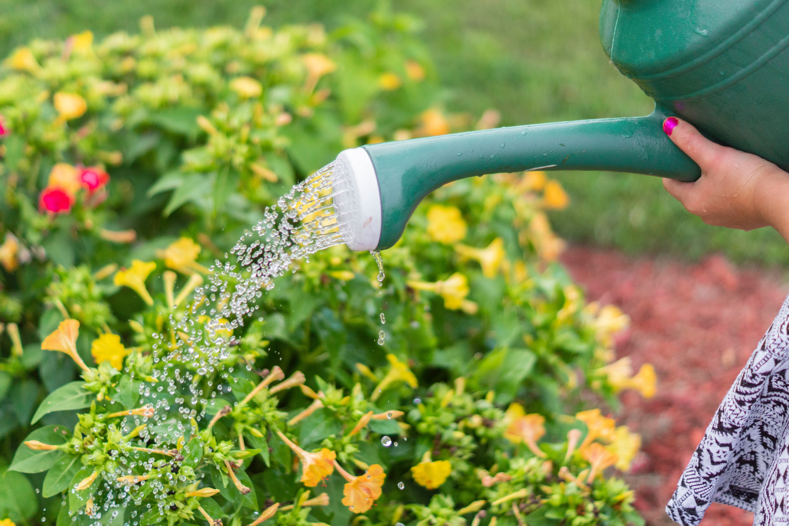
3 Ways to Nurture Your Network
What to do with it
Notes:
Make Introductions
Share Content
Send notes and small gifts
Request virtual catch-up calls

Slide 21

How to Ask for Help!
What to do with it

Slide 22
Reasons Why to Network
What We Covered
The 2 Cardinal Rules
How to Be Great At It
What to Do With It

Slide 23


