Slide 1

Trinity Evangelical Lutheran Church
Announcements
February 13, 2022
The Bread of Life
This week’s scripture focus:
John 6:35-59
Notes:
Image: Preparing yeast dough. Copyright © tomasworks/iStock/Thinkstock. Used by permission.

Slide 2

Body, Mind, Spirit
BODY: Wear something red
MIND: Watch a Valentine movie
SPIRIT: Pass out Valentine cards

Slide 3


Our Office Secretary Is Sharon Fourman
Church Office Schedule
  Tuesday-Thursday
  8:00 am – 12:00 pm
Church Office: 937 692-5670
Email: secretary@pitsburgtlc.org

Slide 4


The Trinity Trumpet
A Monthly Newsletter
Published by Trinity Lutheran Church,
Pitsburg, OH
We’re looking for stories and pictures of Trinity people in action!
Submit to Secretary, Sharon Fourman at secretary@pitsburgtlc.org
Articles and Info due on or about the 15th of each month

Slide 5

We’re Online!
www.pitsburgtlc.org
Sermons and announcements are posted weekly
Trinity Trumpet is Posted here too!
The ‘Official’ Trinity Calendar is available for you to see!
Pictures, Videos and more!
Also, like us on FaceBook at
facebook.com/pitsburgtrinitylutheran.church

Slide 6
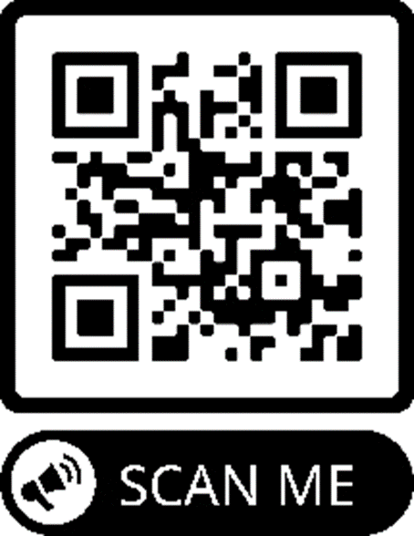
We’re Online!
www.pitsburgtlc.org
We now have our own QR Code!
Scan this code with your Smartphone and you will connect to all our Online media (Facebook, YouTube, and our own Church Website)

Slide 7
Online Giving
www.pitsburgtlc.org
Click the “Give to Trinity” Button
Stay current in your giving even when you can’t make it to Worship!
Separate Giving Categories for:
    General Treasury
    Building Fund
    Annual Christmas Auction
    Donald K. Lucas Memorial Fund

Slide 8


Church
Council
Trinity Church Council
Next Meeting:
Wednesday, February 16, 2022
@ 7:00 pm

Slide 9


Trinity’s Team Meetings
Next Meeting
Wed, Sept 15th
@ 6:00 pm
On the Agenda – Preparing the proposed 2022 budget

Slide 10
Please Pass the Pew Pads
(We now track Communion on the Pads)

Slide 11

Worship Team
Next Meeting:
  TBD

Slide 12

Mutual Ministry Team
  Julie Kossler
  Joe Netzley
  Peggy Didier
  Please see one of them with your comments and suggestions
  Next Meeting - TBD

Slide 13


Christian Education
Sunday School Teachers and Helpers Needed!!!
New, easy to use curriculum
Can you give one Sunday per month for our Children?

Slide 14
Trinity’s Team Meetings
Christian Education Team
Next Meeting
  Tuesday, September 14, 2021
  @ 3:30 pm

Slide 15

Trinity Trumpet
    Your Trinity Trumpet Newsletter for January is available!
    Please take your copy before you leave today!

Slide 16


Choice FISH Pantry
Please join us every Friday @ 3:30 pm
400 Markwith Dr, Greenville OH
Most Needed Items
Kidney Beans
Canned Peas
Hamburger Helper
Pork & Beans
Canned Mixed Veggies
Large Cans of Soups
Applesauce
Boxed Meals
(i.e. Rice a Roni)

Slide 17

Next Meeting:
Thursday, March 3, 2022
@ 6:30 pm
Note the date change due to Ash Wednesday…

Slide 18
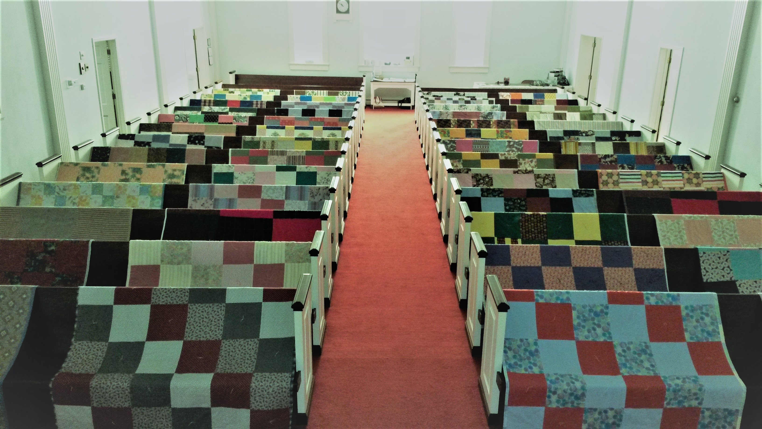
Prayers and Squares
Quilting Ministry
February 22 @ 10:00 am
March 10 @ 10:00 am

Slide 19


Ladies and Gents Luncheon
Thursday, February 17, 2022
Where: Jack’s Cabin, Greenville
For Reservations:
        See Linda Baker or call her at (937) 547-0975

Slide 20

Confirmation Classes
    All 7th and 8th Grade Students
    Meets on 2nd and 4th Wednesdays
    Time – 6:30 – 8:30 pm

Slide 21
Confirmation Program
    Weekly Worship attendance is required (In person or via FaceBook)
    Worship Notes may be emailed to pastor@pitsburgtlc.org or placed in Pr Mel’s mailbox outside the Church Office
    Confirmands are encouraged to take turns as Acolyte

Slide 22

    Please sign up for Acolyte Duty on the chart by the Church Office!
    Confirmation Students are Highly Encouraged to perform Acolyte duty…
    Please sign up today!

Slide 23
WELCA PROJECT
JANUARY thru MARCH
Personal Care Kits
1 Adult Tooth Brush
2 Bath Size Bars of Soap
1 Wide Tooth Comb
1 Bath Towel
(Dark in color & no larger than 52X27)
1 Nail Clippers (w/ optional nail file)

Slide 24

    Commemorate special days like Anniversaries, Birthdays, Baptisms and more…
    Please sign up for Altar Flowers on the chart by the Church Office or see Shirley Rhoades

Slide 25

Holy Communion – Today!
Communion Elements are prepackaged by TruVine, a division of Concordia Church Supply Co.
Safe for all humans (Especially sinners)
Holy Communion Schedule will resume our Pre-Covid Schedule
    First and Third Sundays each month
    All White and Red Sundays of the Church Year

Slide 26


Slide 27
Lenten Season Begins With Ash Wednesday
March 2, 2022
At 7:00 pm

Slide 28

Lenten Mid-Week Reflections
The Things of God
Reflections based on items mentioned during the Passion of Christ
  The Thorns
  The Sponge
  The Coins
  The Sign on the Cross
  The Cup
These Reflections will be pre-recorded and released on our Facebook page on Wednesday each week during Lent

