Slide 1
Advancing the Science: The Latest in Alzheimer’s and Dementia Research
Rebecca Edelmayer, Ph.D.
Sr. Director, Scientific Engagement
Medical & Scientific Relations

Slide 2
DEMENTIA IS A SYNDROME
Dementia
An ‘umbrella’ term used to describe a range of symptoms associated with cognitive impairment
Dementia is a collection of symptoms related to cognitive decline
Can include cognitive, behavioral and psychological symptoms
Due to biological changes in the brain
Alzheimer’s is most common cause
Mixed dementia is very prevalent
Some causes of cognitive decline are reversible and not truly dementia
Alzheimer’s
60%-80%
Vascular
10%-40%
Lewy Bodies
10%-25%
Frontotemporal
~10%
Mixed Dementia = > 1 Neuropathology Prevalence ~50%

Slide 3
Cognitively Unimpaired
Mild Cognitive Impairment
Mild Dementia
Moderate Dementia
Severe Dementia
CONTINUUM OF COGNITIVE IMPAIRMENT
Impairment does not interfere with activities of daily living
Impairment in two or more cognitive functions that interfere with activities of daily living
MCI is a known risk factor for dementia
Everyone who experiences dementia passes through MCI
When you prevent new cases of MCI, you are preventing new cases of dementia

Slide 4
GENDER, RACIAL & ETHNIC DISPARITIES in Alzheimer’s prevalence & Clinical TRIALS
Ethnoracial groups have been historically underrepresented in clinical studies, underscoring the need for more diversity in dementia research.
Older Black and Hispanic Americans are disproportionately more likely than older Whites to have Alzheimer’s or other dementias.
Almost two-thirds of Americans with Alzheimer’s are women.
Facts and Figures 2021

Slide 5
HEALTHY AND PATHOLOGICAL AGING?
Importance of Chronic Exposure to Multiple Factors
Across the Lifespan
Unhealthy diet
Smoking
Alcohol misuse
Depression
Diabetes
Risk Factors
APOE,
other genes
Obesity
Neuronal damage
Hypertension
First Degree Family History
Vascular insults
Dyslipidemia
0
20
Adult-life
60
Mid-life
75
Late-life
Dementia
Education
Brain Reserve
AD Risk
impact on neuron viability, inflammation, oxidative stress, glucose metabolism, endothelial cell damage, clearance of tau and b-amyloid from brain
Protective
Factors
Cognitive Reserve
Across the Lifespan
Physical Activity
Cognitive & Social Activity
Notes:
Composite representation of various exposures that confer not only risk but also protection for brain health with advancing age
Modifiable risks associated with medical comorbidities represent downstream consequences of day-after-day exposure to an unhealthy lifestyle that ultimately leads to neuronal and vascular damage
In contrast, the results of epidemiological research suggests that risks for cognitive decline and dementia are lower for those who regularly exercise, consume a healthy diet, and engage in intellectual & social stimulation
The balance of these factors for any one individual predicts brain health trajectory

Slide 6
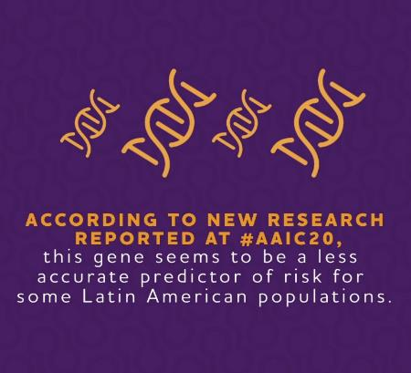
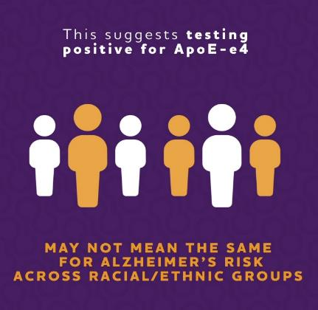
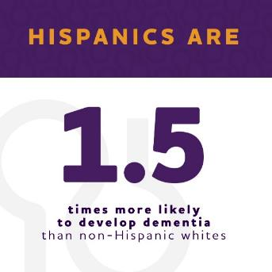
GENETICS AND ALZHEIMER’S

Slide 7
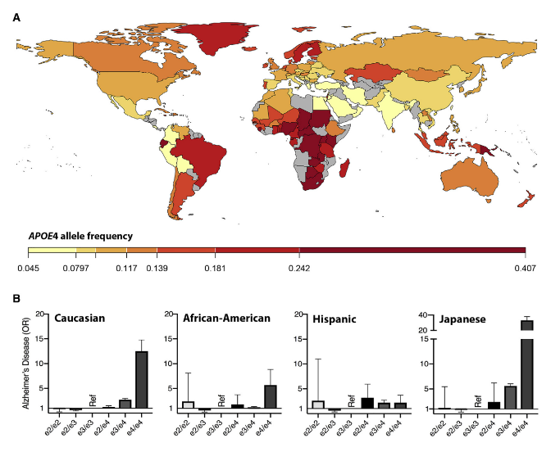
GENETICS AND ALZHEIMER’S
Effect sizes of disease-associated gene variants can differ between populations
APOE
AA: 1.93 (1.72-2.17)
EUR: 3.32 (3.20-3.45)
JAP: 5.5 (4.4-6.9)*
ABCA7
AA: 1.41 (1.21-1.65)
EUR: 1.13 (1.09-1.18)
JAP: NS
SORL1
AA: NS
EUR: 0.81 (0.76–0.88)
JAP: 0.75 (0.66–0.85)*
*Miyashita et al. 2013. PLoS One; Beloy et al. 2019. Neuron
Adapted from Shea Andrews and Alison Goate, Ichan School of Medicine, Mt Sinai

Slide 8
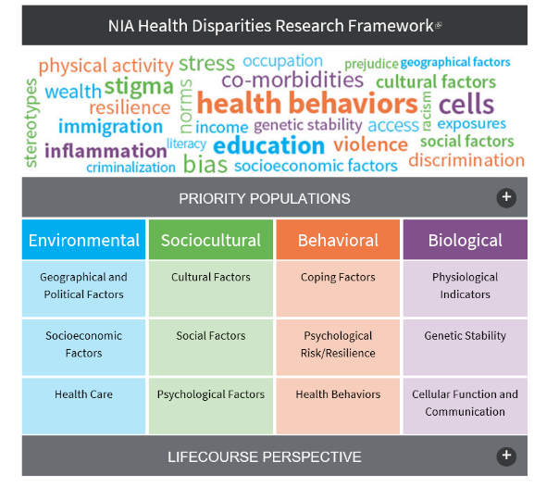
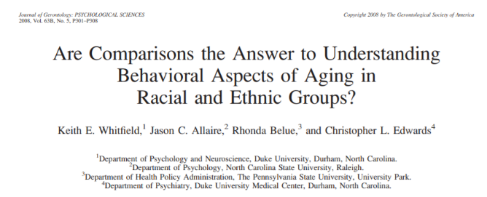
TIME FOR A PARADIGM SHIFT
While traditional risk factors studied in predominantly White samples provide useful information for understanding disparities, we must incorporate “lived experiences” of diverse participants
Hill, Perez-Stable, Anderson, Bernard, Ethn Dis 2015
Adapted from Barnes, L., AAIC 2020
Notes:
I don’t know if you had the chance to participate, but during the very successful 2020 AAIC, Dr. Lisa Barnes articulated a broad vision for health equity research during a plenary session presentation…
…and she articulated a need to move beyond comparisons, to a focus on the many factors that might be relevant for understanding risk in diverse populations.
This is especially relevant today, as we grapple with a pandemic that has disproportionately affected Black, Native and Hispanic Americans. With this pandemic, our pursuit of health equity has been increased with yet another phenomena to consider… (PAUSE) While research has moved quickly to make effective vaccines available…there is still much to understand how risk is patterned by race/ethnicity…by the availability of RESOURCES like information and quality health care…and…(very important to our work_…how COVID risk and infection relates to Alzheimer’s and other dementia.

Slide 9
IMPACT OF COVID-19
IN PEOPLE LIVING WITH DEMENTIA
Most people with dementia are 65 or older, which puts them at increased risk of COVID-19. Many also may be living in congregate settings.
42,000 more deaths attributed to Alzheimer’s and dementia during COVID-19 in 2020 —– 16% increase.
Many people with dementia are likely to have underlying health problems. This can increase their risk for COVID-19 complications
Notes:
As you can see, we are learning more and more everyday about the impact of Covid-19 on our communities and what may be driving risk.
We know that most people with dementia are 65 or older, which puts them at increased risk of COVID-19 infection. Many also may be living in congregate settings. And the symptoms of dementia may decrease their ability to regularly follow public health guidelines like, remembering to mask-up or wash their hands, things which know may reduce their risk for infection.
As I mentioned, many people with dementia are likely to have underlying health problems. This can increase their risk for COVID-19 complications
In the Case Western study, people with dementia who contracted COVID-19 had significantly more hospitalizations and deaths than those who had COVID-19 but not dementia.
Meaning their course of Covid-19 was more complicated in terms of treatment and care.
The percentage of hospitalizations was even higher (73.08%) among African Americans in the study, compared to 53.85% of Whites with both conditions.
And you saw in March published in our Facts and Figures report, 42,000 more deaths were attributed to Alzheimer’s and dementia during COVID-19 in 2020 which is a 16% increase from what we would have predicted.
It is not entirely clear what is driving this increase in deaths attributed to Alzheimer’s...Inaccurate reporting, comorbidities, LTC communal living, reduced access to healthcare, social isolation —– may all be potential reasons. We have so much to still learn about what goes into this figure.
More research is needed to understand exactly what is happening in the brains of individuals with dementia that may be making them more susceptible to COVID-19 and also what the long term impact of Covid infection might be on our brains.
Outcomes from all of this research will continue to drive strategies to gain health equity for Covid-19 but also Alzheimer’s and other dementia.

Slide 10
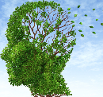
IMPACT OF DEMENTIA ON COVID-19 INFECTION RISK
Dementia
African-Americans close to 3x risk of COVID-19 infection as Whites
COVID-19
Healthcare
Disparities
Racial
disparities
Researchers analyzed health record data from almost 62 million American adults
Potential Factors contributing to increased vulnerability include comorbidities such as hypertension and diabetes, forgetting to wash hands/social distance & living in long-term care facilities.
Risk of contracting COVID-19 was 2x as high for people in the study with dementia than for those without it
Wang et al., Alzheimer’s & Dementia, 2021
Notes:
I would like to give you more details on a new research study that was published in our Journal Alzheimer’s & Dementia on Feb. 9.
Let’s first talk about the size and scope
Researchers at Case Western University examined electronic health records from 360 hospitals and 317,000 providers nationally, representing 20% of the U.S. population.
Of the nearly 62 million adults in the study population, more than 1 million had dementia, over 15 thousand had COVID-19 and 810 had both.
So what did they learn from this large scale study?
They found that the risk of contracting COVID-19 was twice as high for people with dementia in the study than for those without it.
Individuals in the study that had vascular dementia had the highest risk of getting COVID-19 — more than three times higher risk than people without dementia.
Among those with dementia, African Americans had close to three times the risk of getting COVID-19 as Whites.
These findings, though preliminary, suggest a frightening reality of the vulnerabilities associated with living with dementia.
It has been speculated since the beginning of the pandemic that – because of the vulnerabilities associated with dementia – individuals with dementia are at an increased risk of contracting COVID-19.
But this is the first time we are seeing strong, credible data showing a clear connection.
The study findings illustrate well-known health disparities that must be addressed and I want to draw some parallels for you.
We know Blacks are disproportionately impacted by Alzheimer’s. As reported in the Alzheimer’s Association Facts and Figures Report, Blacks are nearly two times more likely to develop Alzheimer’s than Whites.
We have also learned through the course of the Covid-19 pandemic that racial and ethnic disparities exist, but that we still have much more to understand about what is driving these differences in risk, infections, hospitalizations, and deaths.
But this is the first time we are also seeing the intersection in a large scale study that shows that health disparities impact risk across both dementia and covid-19 and the disparity may be compounded for individuals who have both conditions.
There are a few theories on why we see these results, but it is still a complex issue that will take time to tease out.
One theory: The factors causing or contributing to dementia, including hypertension and diabetes, may be what make all individuals with dementia more vulnerable to contracting COVID-19.
However, we also know that there is a well-established high risk for cardiovascular health issues in African Americans, which may be reflected in the findings of this study and may make them more vulnerable to dementia but also Covid-19.
There are also many other factors that may explain these disparities, including some of the factors that contribute to risk across a lifecourse…including SDOH and access to quality healthcare.
An additional key takeaway here is (while the largest of its kind) this study only examined data from health records of those who visited a doctor or otherwise interacted with the health care system, and does not include those who may not have access to care.
Knowing dementia is a grossly underdiagnosed disease, it's possible these data are even an underestimate of the risk factors between dementia and COVID-19.

Slide 11
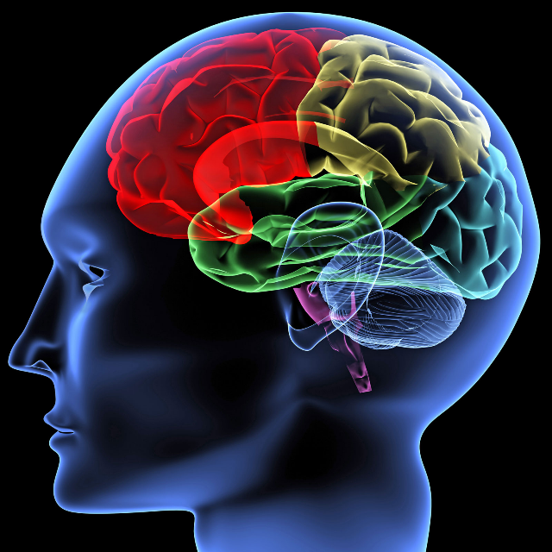
COVID-19 AND THE BRAIN
Studies have suggested COVID-19 is able to get into the brain
Impact may be direct or indirect
Blood brain barrier
Inflammation/ Immune response
Vascular connections
Other mechanisms?
de Erausquin GA et al., A&D 2021: https://alz-journals.onlinelibrary.wiley.com/doi/full/10.1002/alz.12255
Notes:
We are continuing to learn and understand the links of COVID-19 and the brain.
And while there is a clear connection, there is a lot that is still unknown.
Many people have reported loss of smell and taste. This is a sign that there are changes in the brain.
Reports have highlighted that although still rare, individuals who have experienced COVID-19 have had increased numbers of seizures and stroke. The biology of this is still not well understood but suggests our brain’s vascular system - so blood vessels and blood flow - may be involved.
In addition, we have all seen the reports - referred to as “COVID long hauler symptoms” or “brain fog” - describing the changes in memory or function or behavior that a person may experience.
The research is emerging - although still unclear if the effects of COVID are direct or indirect on the brain’s function.
Meaning does the virus get into the brain and take action or its effect outside of the brain?
In some individuals, COVID-19 triggers a massive release of inflammation signals leading to breakdown of the blood brain barrier.
The blood brain barrier is not a physical barrier but a really cool biochemical one - it controls what can go in and out of the brain and helps to protect our brains - the control center of everything we do and are!
The impact of inflammation, and BBB breakdown may promote even more inflammation and contribute to brain cell death.
These biologies - inflammation and breakdown of BBB - are also known to play important roles in the underlying biology of Alzheimer’s.
At this point we do not know if there is a connection, we do not know who is vulnerable to these changes or why, if this is reversible or if the body is able to repair itself or whether this may make the brain more vulnerable to other brain changes, such as those in Alzheimer’s.

Slide 12
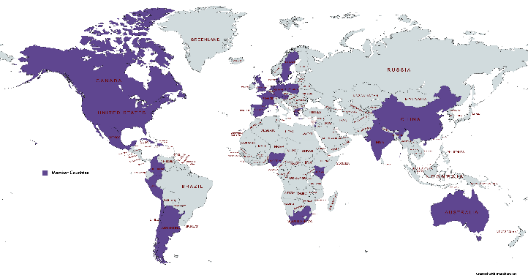
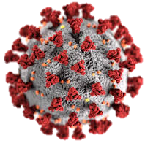
ALZHEIMER’S ASSOCIATION SARS-CoV-2 INTERNATIONAL RESEARCH STUDY TO UNDERSTAND IMPACT ON THE BRAIN
Investigating the long-term impact of exposure to the novel coronavirus (SARS-CoV-2) on the brain, including cognition, behavior and function.
More Information: http://alz.org/SARS-CoV2-study
Photo courtesy Alissa Eckert, Dan Higgins, CDC
Notes:
Lay Audience
And this is why the Alzheimer’s Association has partnered with researchers at the University of Texas San Antonio - Dr. Gabriel De Erasquin and Dr. Sudha Seshadri - as well as physicians and researchers from over 40 countries - to form and lead an international consortium to better understand the short and long term impact of COVID-19 on the brain. We have also provided some initial funding to support the coordination of these large scale global efforts.
The consortium is also recognized by the World Health Organization and receives technical guidance from the WHO. Dr. De Erasquin sits on one of the WHO taskforce aimed to coordinate global efforts around COVID19.
The goal of the study is to engage and follow individuals who experienced COVID-19 - with a range of symptoms from mild to severe - from different ages, and from different genetic backgrounds - to understand the impact on memory, function and overall behaviors. Participants will be evaluated on a host of measures at their initial appointment and again at six, nine and 18 months. These measures include cognition, behavior and, when possible, brain volumes measured by magnetic resonance imaging.
This is where the international aspect is so important - Who are the most vulnerable to these changes and symptoms? Do we see differences in outcomes - short and long term outcomes?
All of this would be valuable to understand and share with the field - and ensure that we are developing or have the appropriate systems to ensure health equity around the world.
Perhaps we will observe that individuals that receive certain types of treatment - such as vaccines - may have better outcomes -- not only COVID-related outcomes but also neurological outcomes. We have seen this before in other studies.

Slide 13
Early detection and diagnosis

Slide 14
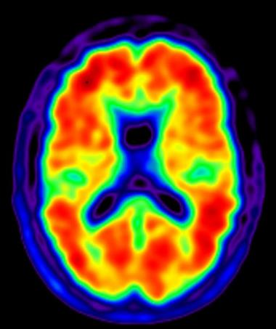
BIOMARKERS ARE CHANGING THE GAME
Brain Imaging
Biofluid Analysis
Emerging Markers

Slide 15
PROGRESS TOWARDS A BLOOD TEST
Global race to uncover and develop blood based biomarkers for Alzheimer’s and other dementia
More research validating amyloid beta and tau in blood by comparing to imaging and cognitive testing
New research on blood tests for alpha synuclein and neurofilament light and other markers

Slide 16
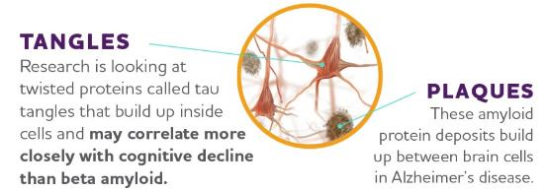
TAU: ANOTHER BLOOD BIOMARKER EMERGES
Research suggests that a form of tau called p-Tau217 is very specific to Alzheimer’s and, when measured in the blood, is highly accurate in distinguishing Alzheimer’s from other neurodegenerative disorders.
While still in research stages, blood tests are easier to administer and more accessible than current methods of evaluating Alzheimer’s
https://alz.org/aaic/pressroom.asp
Barthelemy et al 2020 JEM
Haanson et al 2020 JAMA
Notes:
I know so many of you joining us for AAIC – and heard the most progress being made to develop a blood test.
Two different research teams – using different study populations and different methods of how they measured – found that a specific form of tau called p-217 tau is consistently specific to Alzheimer’s, and is an accurate indicator of both amyloid and tau related brain changes. This is really exciting – to have one measure in blood to accurately tell us what is happening in the brain!
While this is not yet available in a doctors office, we are seeing already rapid uptake of this measure into ongoing clinical trials. This is an essential step to further validate this finding in larger and more diverse populations.
[For Cindy – here is press release link: https://alz.org/aaic/releases_2020/blood-biomarkers-tau.asp]

Slide 17
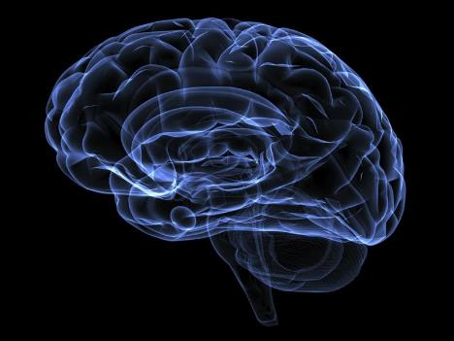
Progress toward
more effective DRUG treatments

Slide 18
LANDSCAPE OF CLINICAL TRIALS FOR
ALZHEIMER’S & DEMENTIA: DRUGS AND DEVICES *
Phase I
Phase II
Phase III
129
191
62
Always a Need for Diverse Participants
* As of Apr. 2021

Slide 20
TREATMENTS BEING TESTED MAY BENEFIT…
Clinical Symptoms of Dementia or Change Disease Progression
Cognitive
Behavioral & Psychological
Memory
Learning
Thinking
Planning
Depression
Anxiety
Delusions
Hallucinations
Apathy
Agitation
Sleep disturbances

Slide 21
Medicines Focused on Cognitive & Functional Symptoms of Dementia
Lilly's Donanemab Slows Clinical Decline of Alzheimer's Disease in Positive Phase 2 Trial
INDIANAPOLIS, Jan. 11, 2021 /PRNewswire/ -- Donanemab, an investigational antibody that targets a modified form of beta amyloid called N3pG, showed significant slowing of decline in a composite measure of cognition and daily function in patients with early symptomatic Alzheimer's disease compared to placebo in results from Eli Lilly and Company's (NYSE: LLY) Phase 2 TRAILBLAZER-ALZ study. Donanemab met the primary endpoint of change from baseline to 76 weeks in the Integrated Alzheimer's Disease Rating Scale (iADRS), slowing decline by 32 percent relative to placebo, which was statistically significant. The iADRS is a clinical composite tool combining the cognitive measure ADAS-Cog13 and functional measure ADCS-iADL, two commonly used measures in Alzheimer's disease. Donanemab also showed consistent improvements in all prespecified secondary endpoints measuring cognition and function compared to placebo but did not reach nominal statistical significance on every secondary endpoint.
Donanemab (anti-amyloid therapy)
Cognition
Early symptomatic Alzheimer’s
Phase 2 trial show significant slowing of cognitive decline & daily function
Novel aspects of trial design
Must test positive on amyloid and tau PET
Volunteers switched to placebo once amyloid plaque level was lowered to normal levels
A second, larger Phase 2 trial is still ongoing
Notes:
These initial, topline results are encouraging, but there is more work to be done on this experimental drug therapy.
This is the first Phase 2 Alzheimer’s trial to show positive results on a primary outcome related to cognition.
The initial Phase 2 results showed significant slowing of decline in a composite measure of cognition and daily function in people with early symptomatic Alzheimer's, compared to placebo.
This was a moderately-sized Phase 2 trial, and the results are encouraging. We look forward to the results of a second Phase 2 trial, which is currently recruiting 500 participants.
TRAILBLAZER-ALZ initially recruited 266 participants age 60-85. About 90 people in each study arm finished the 18-month trial.
People interested in participating in Alzheimer’s and dementia research can find trials that are recruiting near them by using Alzheimer's Association TrialMatch — a free, easy-to-use, online service.
There are many novel and innovative aspects of this trial, which is a demonstration of the evolution and maturity of the field.
For example, in order to volunteer for the TRAILBLAZER-ALZ trial, volunteers had to test positive on both amyloid and tau PET scans.
In this study, patients stopped receiving donanemab and switched to placebo once their plaque level was lowered to what is considered a normal level.

Slide 22
BIOGEN SEEKS APPROVAL FOR ADUCANUMAB
Aducanumab (Anti-amyloid therapy)
Ph 3 Trial Population: MCI due to Alzheimer’s & mild Alzheimer’s dementia
Futility Analysis Halted Trial: Mar 2019
Expanded Data Analysis Reported CTAD: Dec 2019
Reduction in clinical decline
Effects on cognition and function
Reduction in amyloid/tau biomarkers
Open Label Extension Studies Launced: Mar 2020
FDA grants ‘Priority Review’: Aug 2020
FDA decision anticipated: June 7, 2021

Slide 23
CHANGING THE TRAJECTORY OF ALZHEIMER’S DISEASE:
Delayed Onset
If we develop a treatment by 2025 that delays the onset of Alzheimer’s by just 5 years…
2050
2025
5.7
million people
expected to develop Alzheimer’s in 2050 would not.
2015

Slide 24
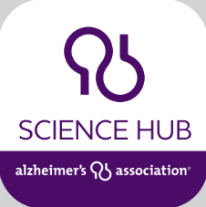
Notes:
I know I have only scratched the surface. If you want to learn more about what is happening in dementia research around the world, consider downloading the Science Hub App.
And “at any given moment” you can have research news at your fingertips. Available where you get your apps.

Slide 25
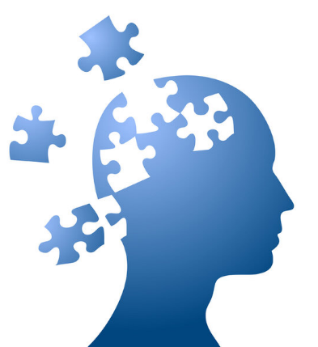
IN SUMMARY…
Alzheimer’s Association is the global leader for Alzheimer’s and dementia science
Exciting time in research
New tools for detection and diagnosis
Growing diversity of therapies under investigation
There is HOPE in research

Slide 26
1-800-272-3900
ALZ.ORG

