Slide 1
Grote Woerdlaan 36B
2671 CL Naaldwijk
mail@lohuislighting.nl
+31 (0)10 76 00 377
LED Horticulture Lighting

Slide 2
Vertical Farm System
Greenhouse Light
Cannabis Light
Seaweeds Growth Light
Grape Growth Light
Full Spectrum Light/ Residential Growth Light

Slide 3
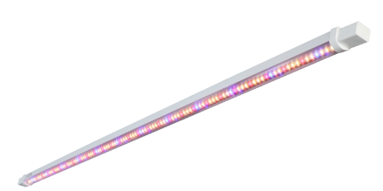
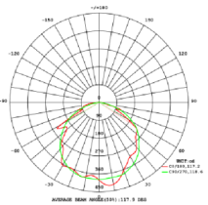
Low-Power Top light—10/15/18W
LED low power Top light
Lifetime: 25000H
IP65
Beam angle: 120
Customizable spectrum;
Applications：
Vertical farming;
Tissues culture, herbs, medical plants
and vegetables.
Power, W | Voltage, V | PF | Photon, umol/s | Beam angle | Spectrum | Size | IP | Installation | Certification
10 | 100-277 | 0.95 | 20 | 120 | customizable | 1200 | 65 | Ceiling | CE/UL
15 | 100-277 | 0.95 | 30 | 120 | customizable | 1200 | 65 | Ceiling | CE/UL
18 | 100-277 | 0.95 | 36 | 120 | customizable | 1200 | 65 | Ceiling | CE/UL

Slide 4
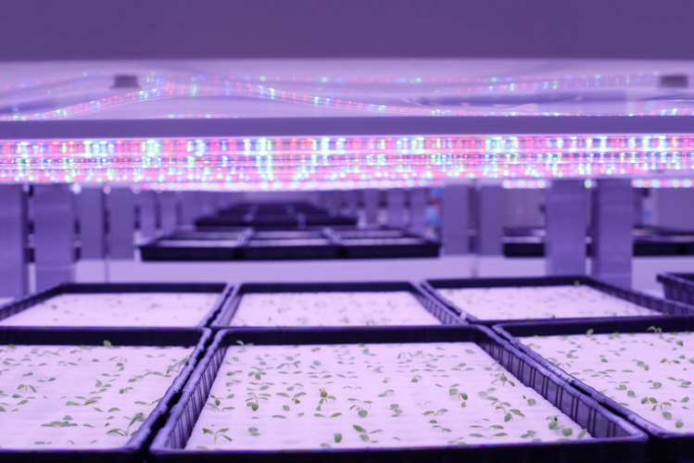
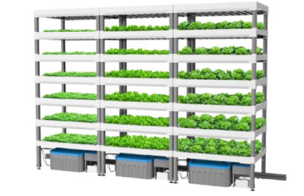
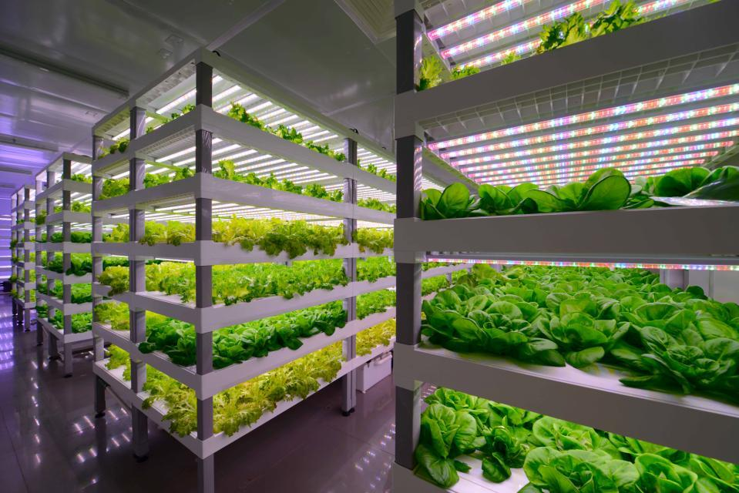
Applications-Vertical Farm
Growth shelf( Unit): including
Water/ nutrition cycle system;
Growth raft;
Growth lighting
Seedling period
Growing period

Slide 5
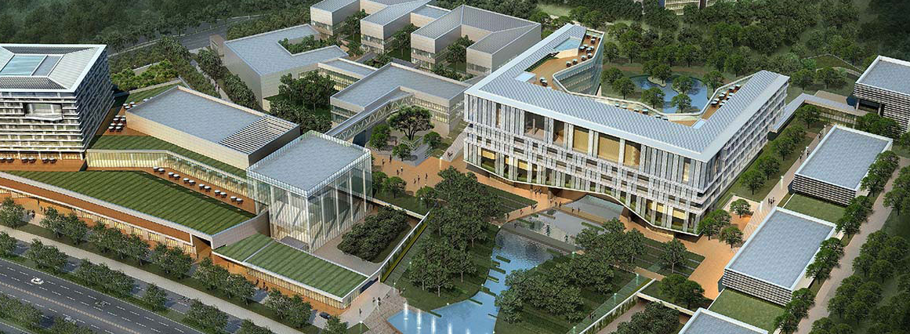
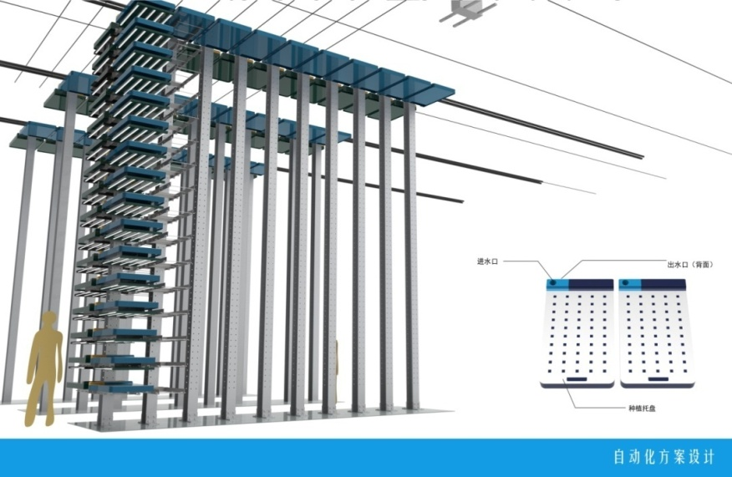
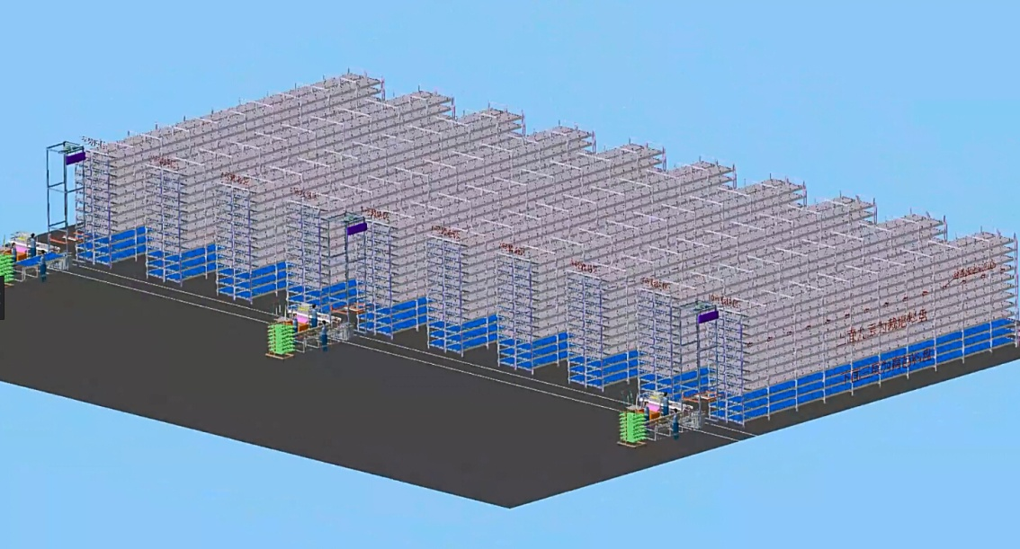
Vegetable fty of Sanan

Slide 6
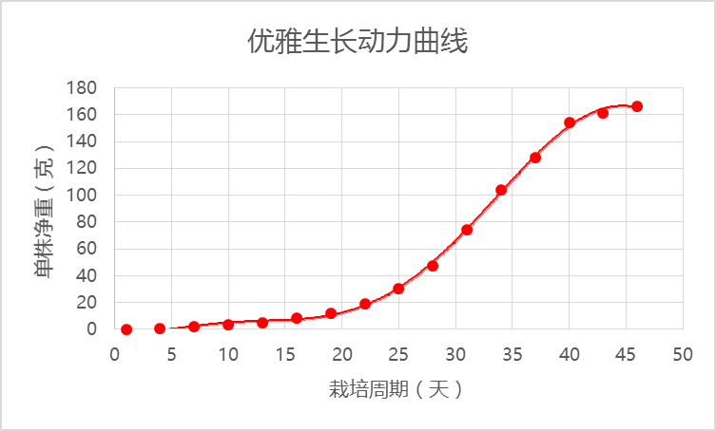
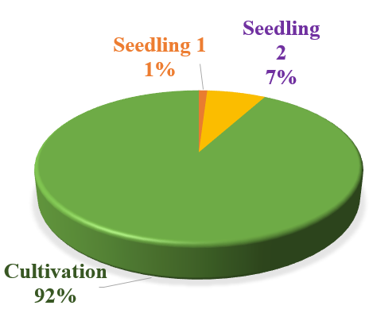
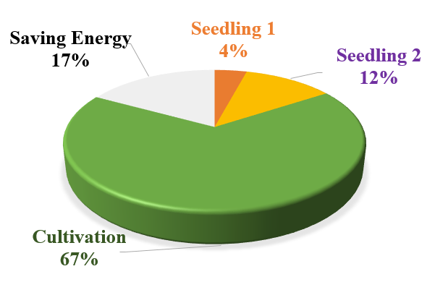
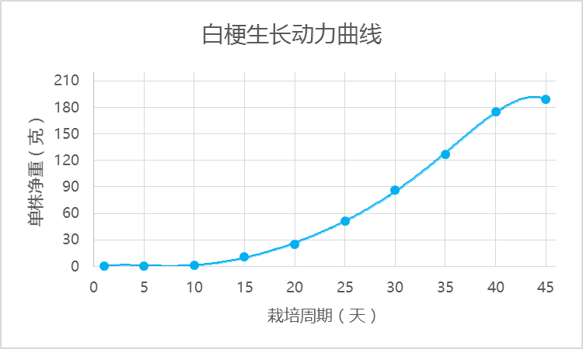
Planting results compare
Lettuce
Traditional cultivation mode
Pakchoi
Vertical farmEffect: output increased by 25% and energy consumption reduced by 17%.
From seed germination to harvest:
Lettuce:35 days 110g, 40 days 160g
Pakchoi:35 days 120g, 40 days 180g
Notes:
栽培技术体系在植物工厂高效生产中占有重要的地位，例如，我们仅仅育苗期的栽培技术模式，降低幼苗期栽培密度和延长光照时间，效果:产量增加25%，能耗降低17% 。目前我们植物工厂已构建了几类植物生产的栽培技术体系，包括生菜（4个品种）、小白菜（2个品种），冰菜、罗勒、金线莲等。按照栽培技术体系进行生产，生产的水平处于国际领先地位。如日本生产生产水平最高的Spread公司从萌芽到采收35天80g，我们35天平均110g，40天采收160g;小白菜白梗35天平均120g,40天180g

Slide 7
Contents
Vertical Farm System
Greenhouse Light
Cannabis Light
Seaweeds Growth Light
Grape Growth Light
Full Spectrum Light/ Residential Growth Light

Slide 8
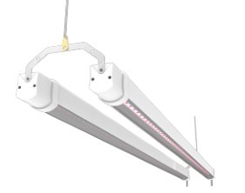
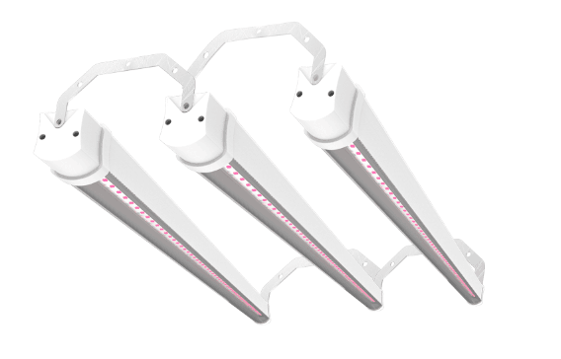
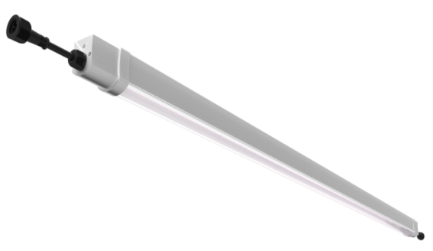
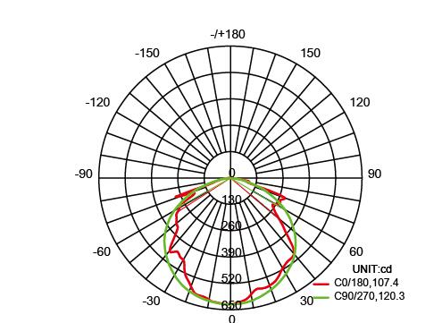
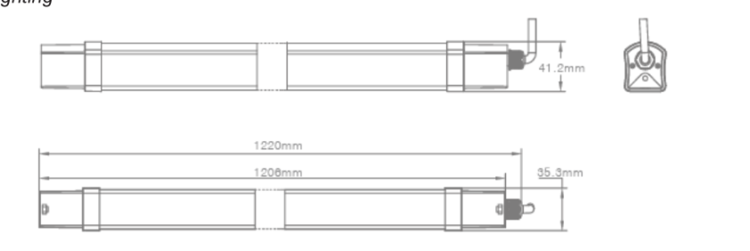
Middle power Top light—30/60/90W
LED middle power Top light
Lifetime: 25000H
IP65
Beam angle: 110
Customizable spectrum
Head to end connection
Applications：
Power, W | Voltage, V | PF | Photon, umol/s | Beam angle | Spectrum | Size | IP
30 | 220-240 | 0.9 | 66 | 110 | Full spectrum | 1200 | 65
60 | 220-240 | 0.9 | 132 | 110 | Full spectrum | 1200 | 65
90 | 220-240 | 0.9 | 198 | 110 | Full spectrum | 1200 | 65

Slide 9
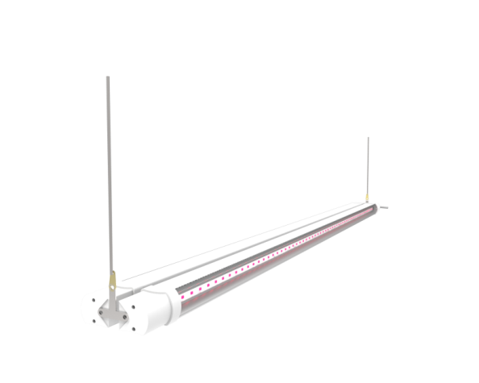
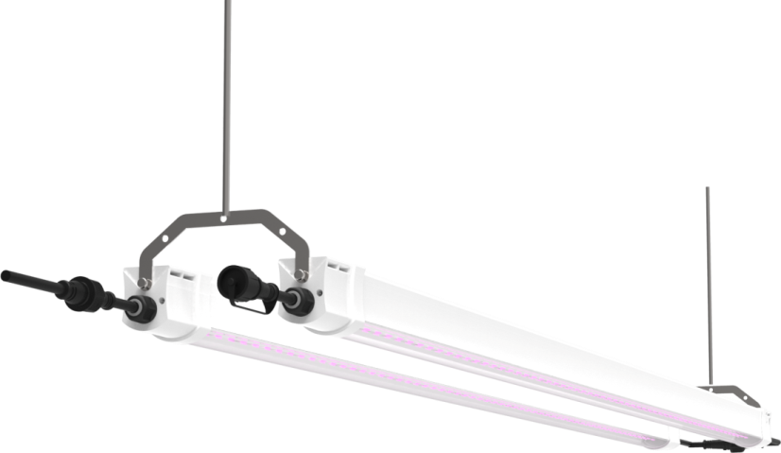
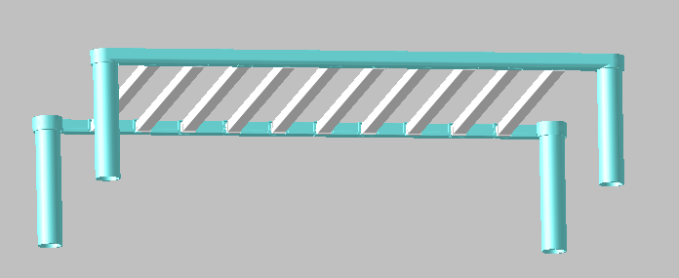
Installation
Option1: Ceiling Mounting
Option2: Hanging Mounting
Option3: Bracket Mounting

Slide 10
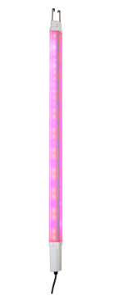
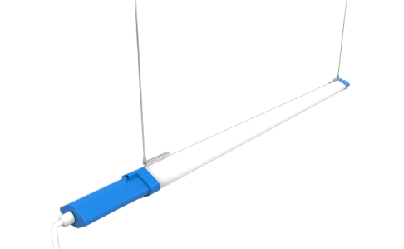
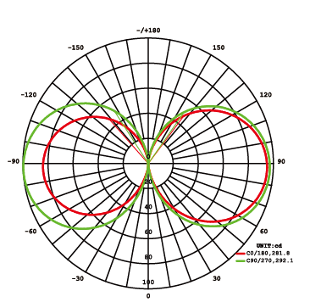
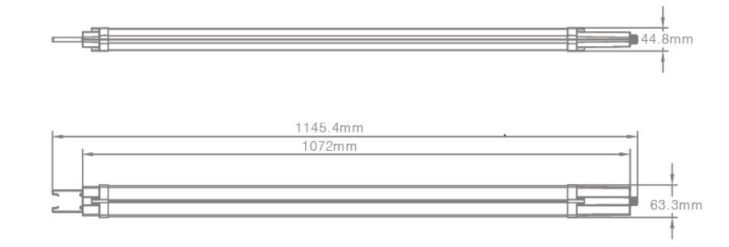
Inter light—40W
LED Top light
Lifetime: 25000H
IP65
Beam angle: 360
Customizable spectrum
Applications：
Power, W | Voltage, V | PF | Photon, umol/s | Beam angle | Spectrum | Size | IP
40 | 220-240 | 0.9 | 85 | 360 | red+ blue | 1200 | 65
40 | 220-240 | 0.9 | 85 | 360 | Full spectrum | 1200 | 65

Slide 11
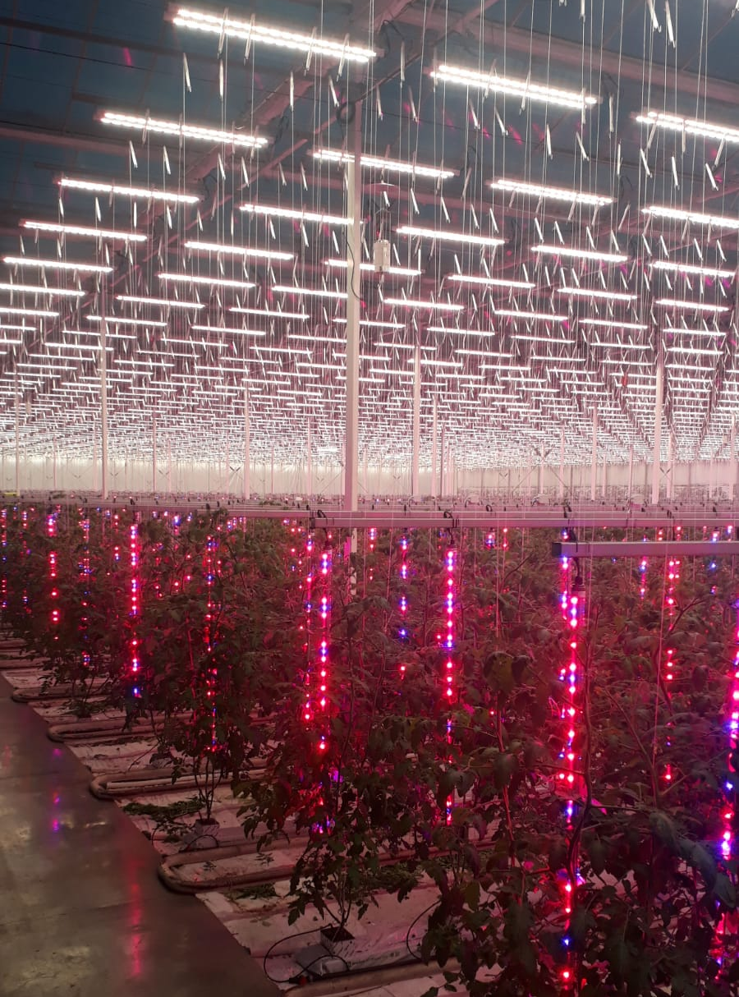
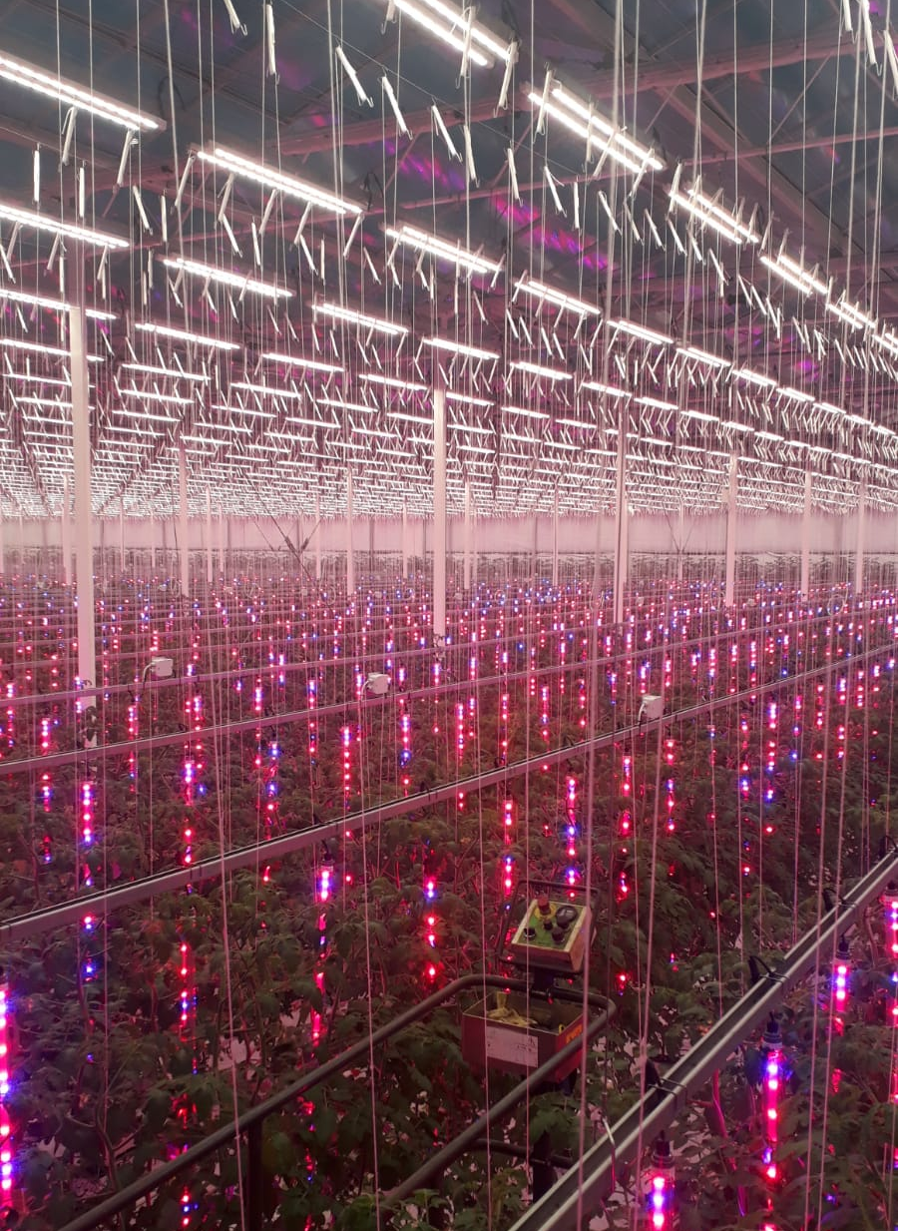
Multiple lighting system—Top light+ inter light
Top light: 2pcs/ set, 60W/set;
Inter light: 40W/ pcs;.

Slide 12
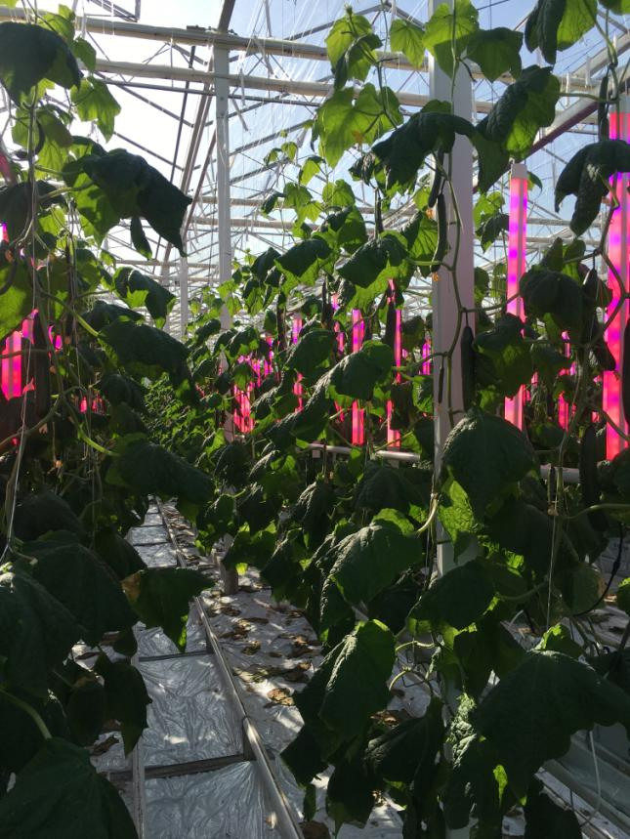
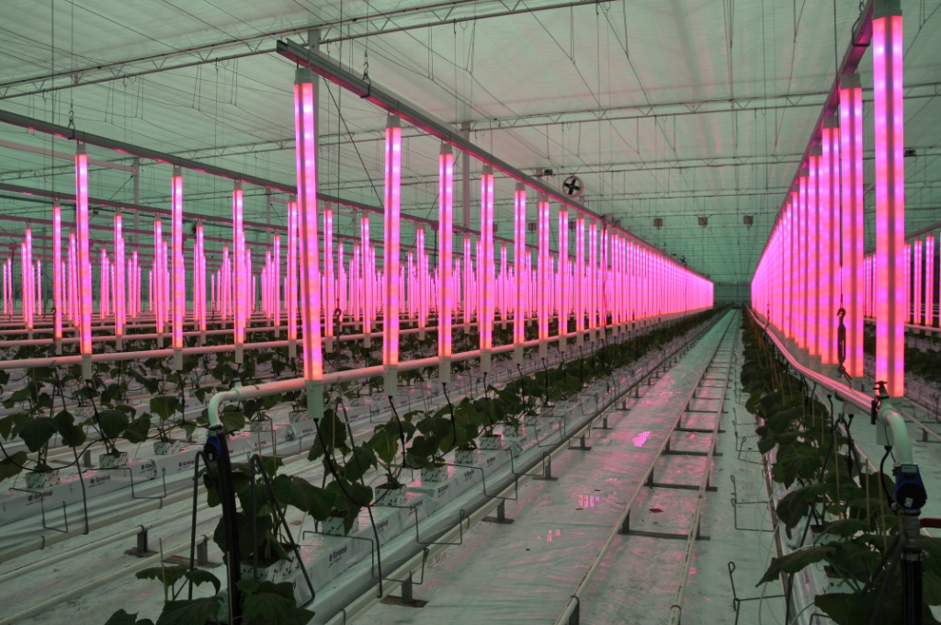
Simply lighting system—Inter light
Inter light: 40W/ pcs, vertical installation

Slide 13
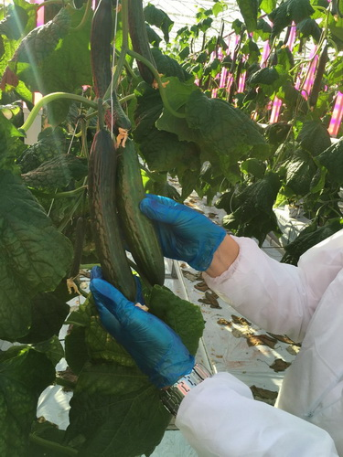
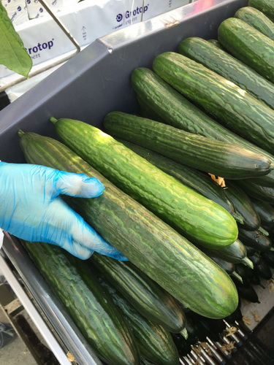
Cucumber growth compare
VS
With inter lighting | Without inter lighting
Leaf is more green, fruit is more green and bigger. | Natural growth, leaf and fruit is normal size.
Fruit size is uniformity, light irradiation is more equal. | Fruit size is different due to different sunlight irradiation.
Taste is more fresh and juicy. | Taste is normal.
Fm bloom to fruit need 13days. | Fm bloom to fruit need 21days.
Output: 128kg/m²/year | Output: 96kg/m²/year
Without interlight
With interlight
Without interlight
With interlight

Slide 14
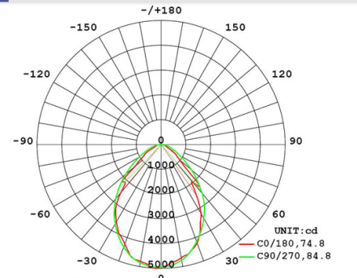
Hi-Power Top light—200W
LED Top light
Lifetime: 25000H
IP65
Beam angle: 120
Customizable spectrum
Head to end connection
Applications：
Power, W | Voltage, V | PF | Photon, umol/s | Beam angle | Spectrum | Size | IP
200 | 220-240 | 0.9 | 400 | 120 | red+ blue | 1200 | 65
200 | 220-240 | 0.9 | 400 | 120 | Full spectrum | 1200 | 65

Slide 15
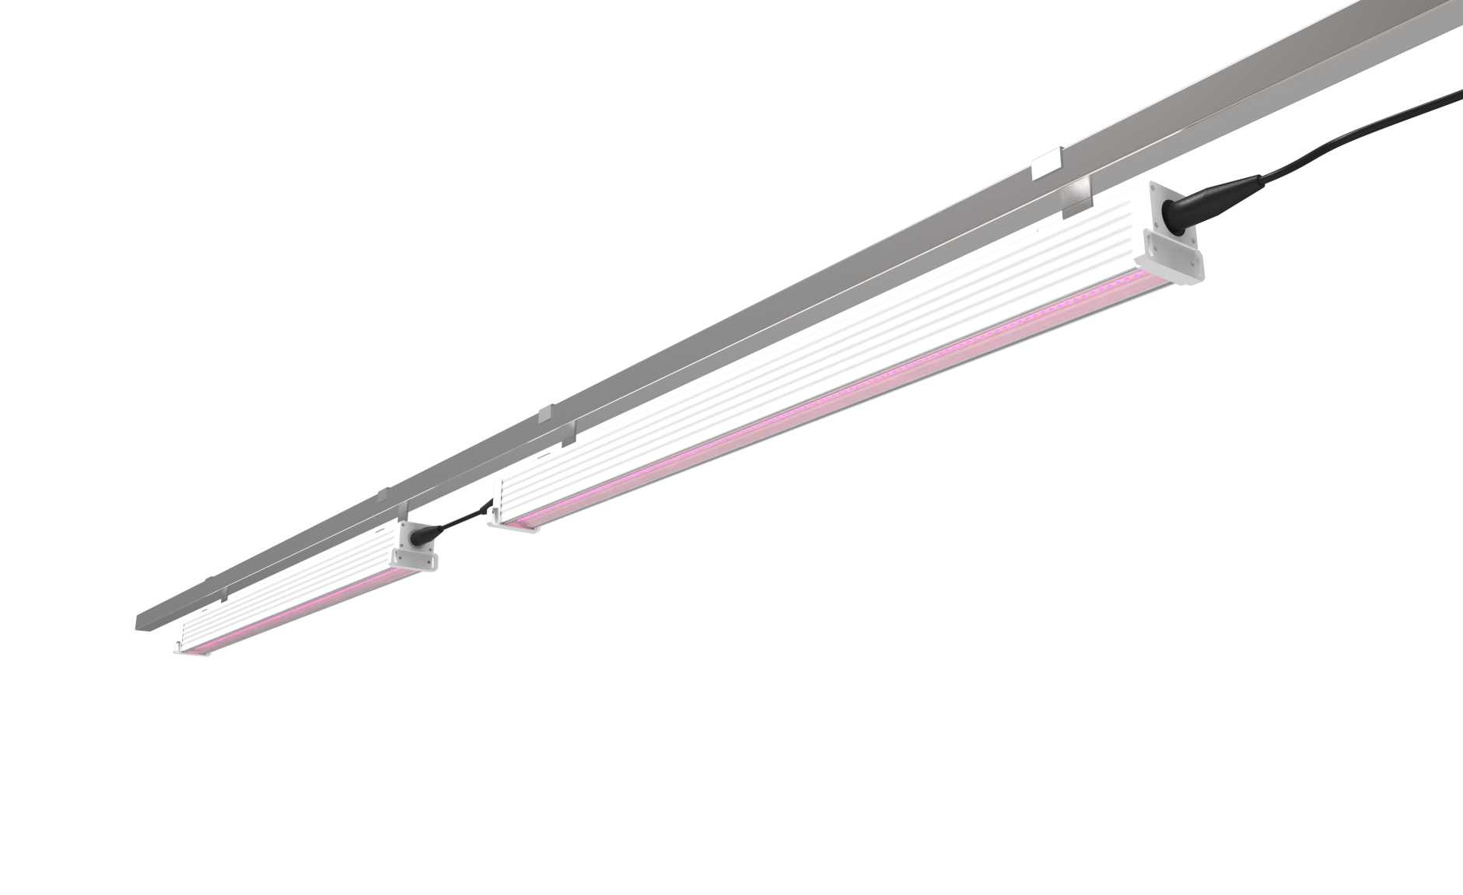
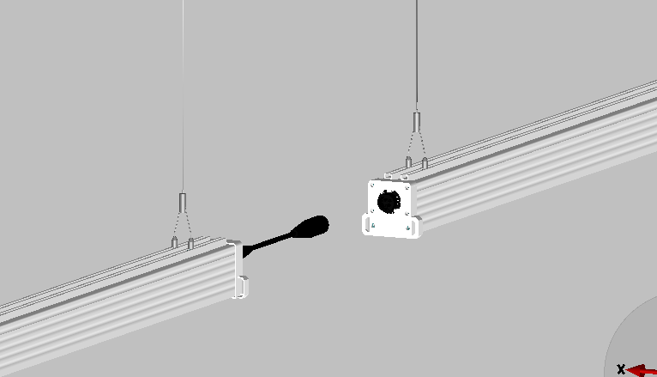
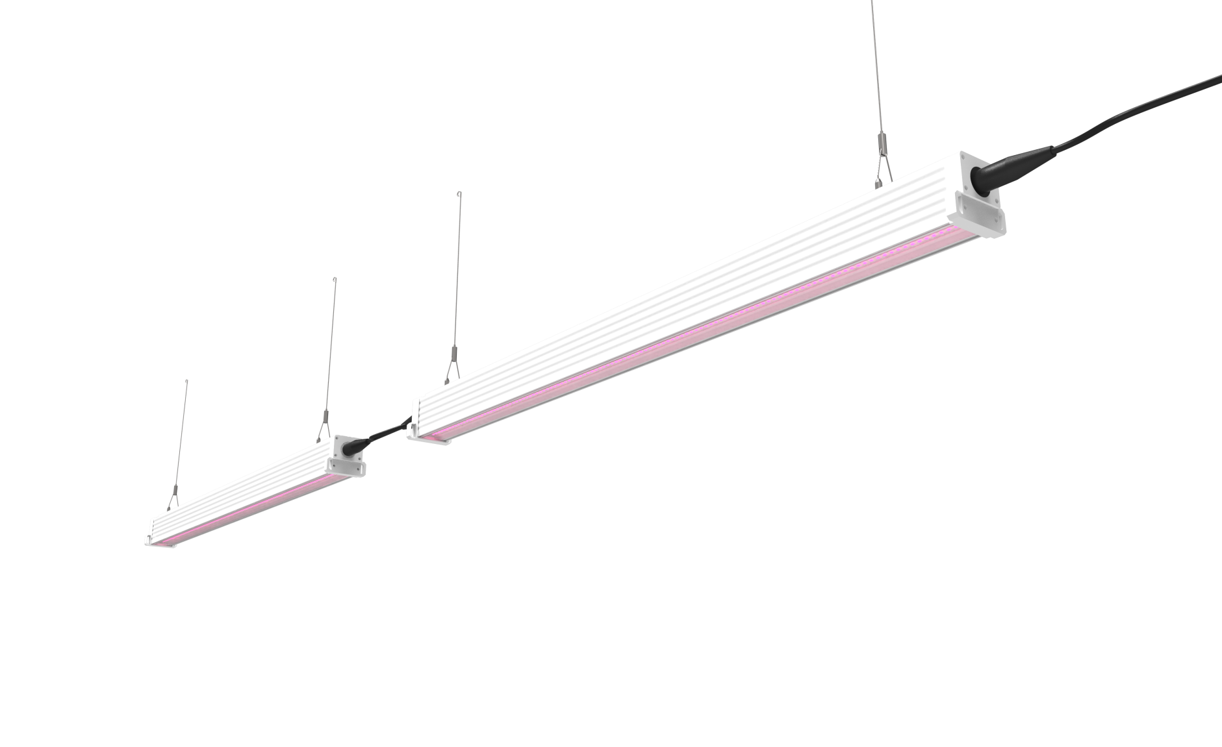
Installation
Option1: Hang by pole
Head to end connection
Option2: Hang by rope

Slide 16
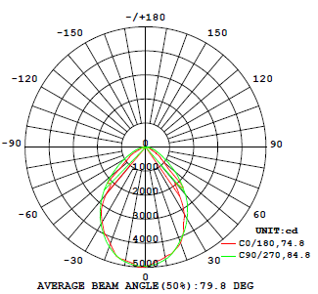
Hi-Power Top light--600W
LED Top light
Lifetime: 25000H
IP65
Beam angle: 360
Customizable spectrum
Applications：
Power, W | Voltage, V | PF | Photon, umol/s | Beam angle | Spectrum | Size | IP | Installation | Certification
600 | 100-240 | 0.95 | 900 | 90 | customized | 1200 | 65 | Mounting Hook mounting | ETL/ CE

Slide 17
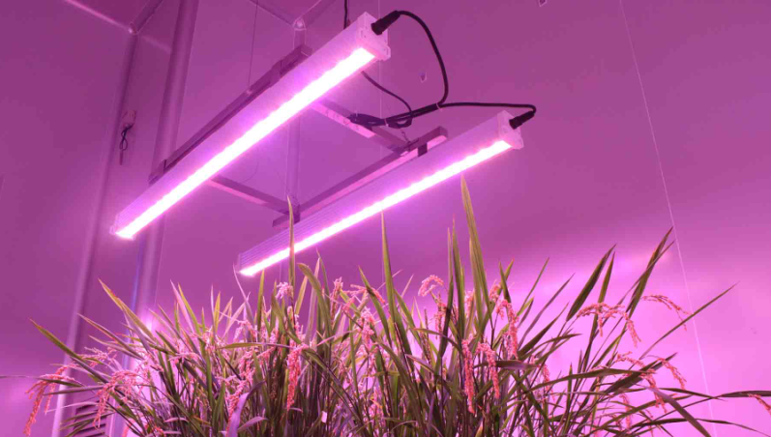
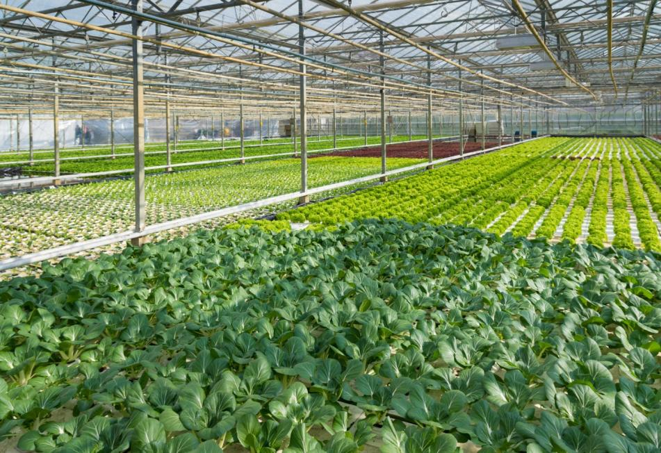
Application
Top light: 200W/900W per pcs, hang on the top of greenhouse.

Slide 18
Contents
Vertical Farm System
Greenhouse Light
Cannabis Light
Seaweeds Growth Light
Grape Growth Light
Full Spectrum Light/ Residential Growth Light

Slide 19
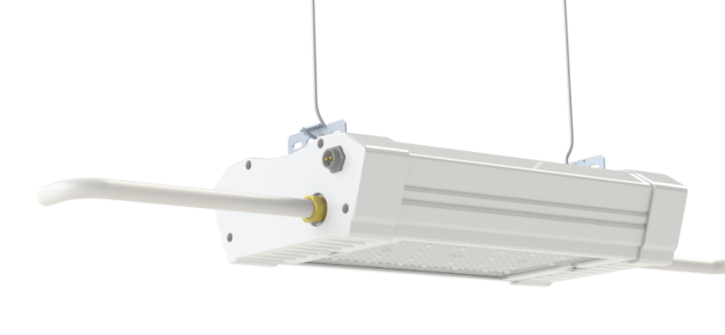
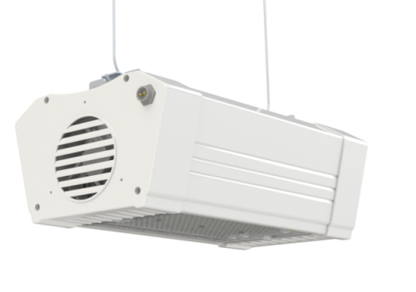
Hi-Power Growth Light （Smart Growth Light）
LED Top light
Water cooling
Wind cooling
Lifetime: 25000H
IP65
Beam angle: 60
Adjustable spectrum
Applications：
Power, W | Voltage, V | PF | Photon, umol/s | Beam angle | Spectrum | Size | IP | Installation | Certification
550 | 100-277 | 0.95 | 660 | 60 | Adjustable | 185/112 | 65 | Hang mounting | UL/ CE

Slide 20
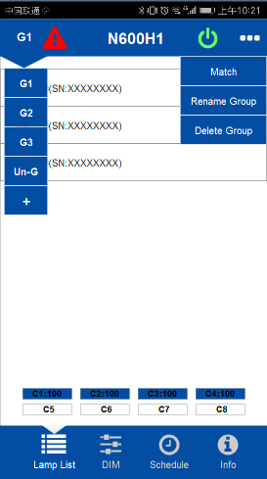
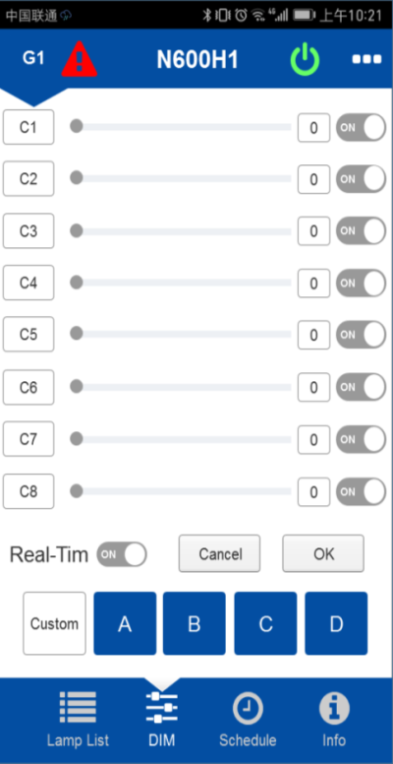
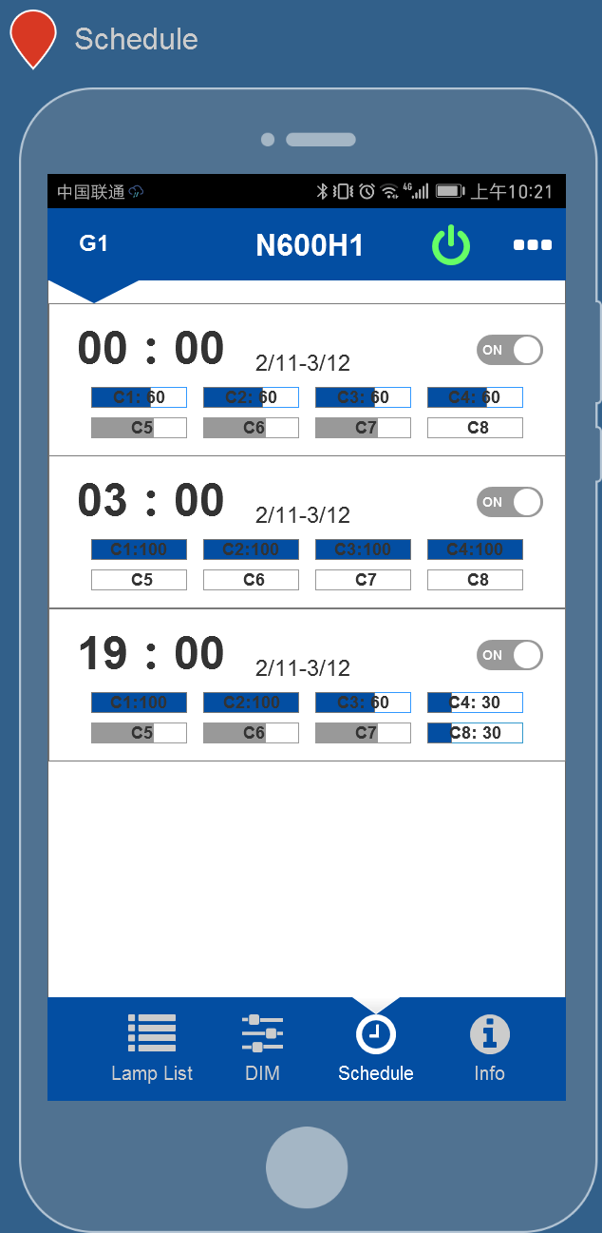
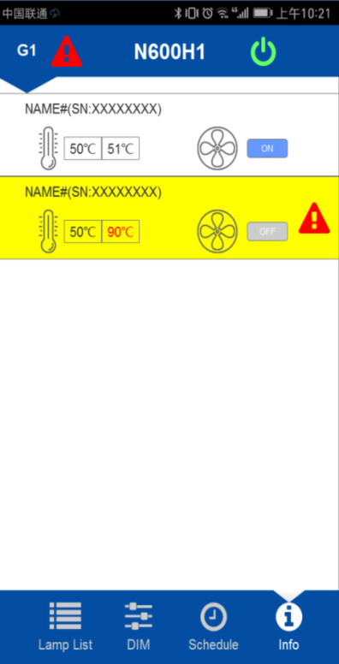
Flexible Spectrum
N600H1
N600H1
APP
Gateway
N600H1
APP Wireless control
Group Control
15pcs max in one group
50pcs max in one geteway
Spectrum dimmable 8Channels max
Schedule
Lamp Info
Warning

Slide 21
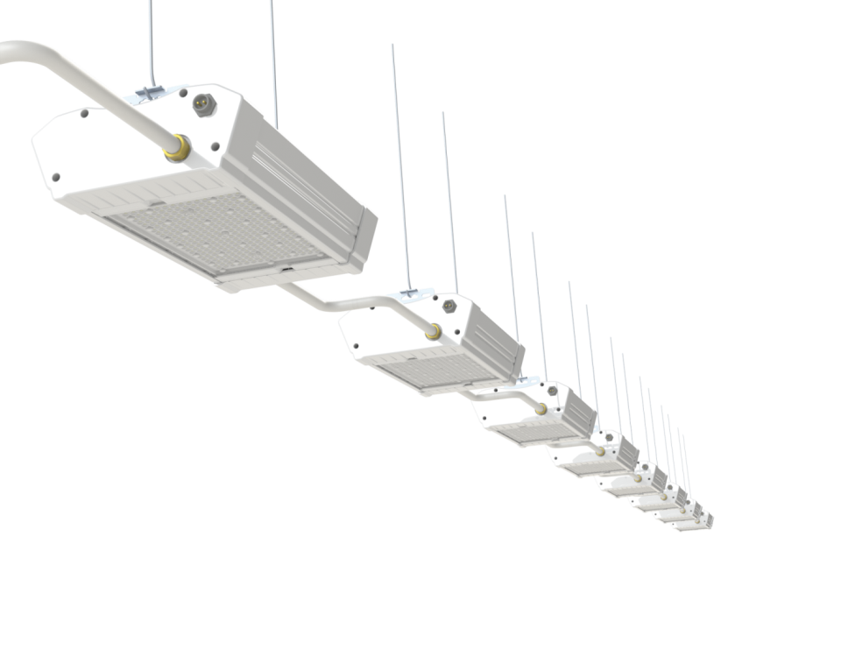
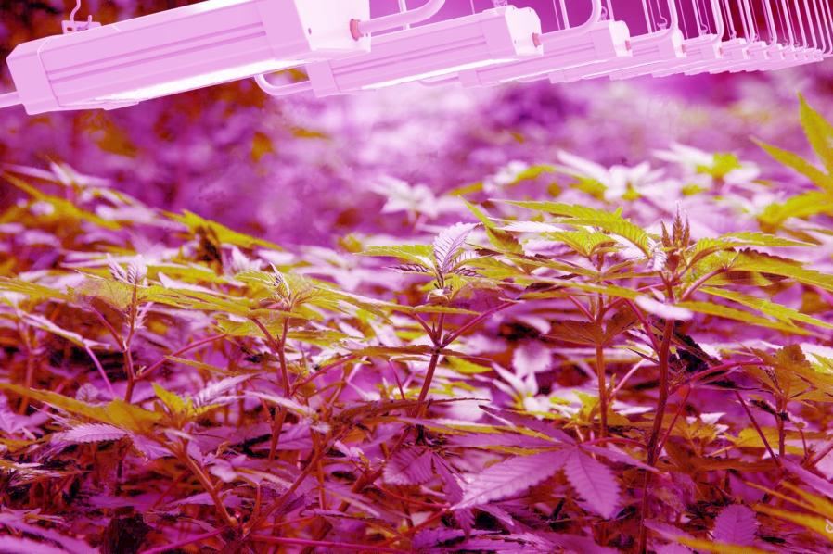
Cannabis
High profit industry;
Legal in more and more countries;
Medical value

Slide 22
Contents
Vertical Farm System
Greenhouse Light
Cannabis Light
Seaweeds Growth Light
Grape Growth Light
Full Spectrum Light/ Residential Growth Light

Slide 23
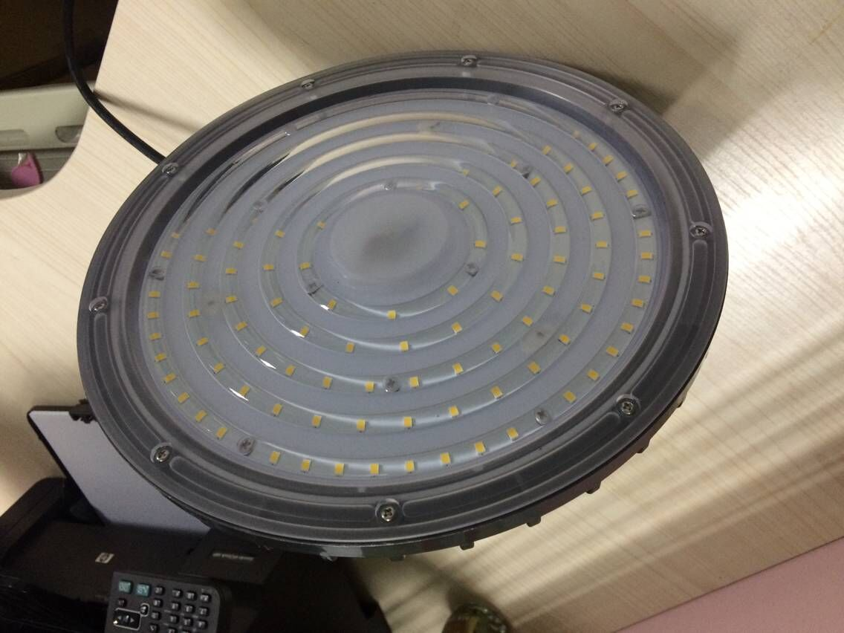
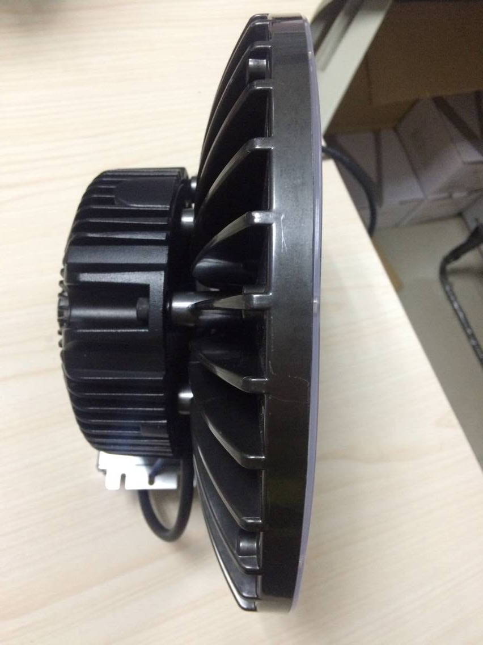
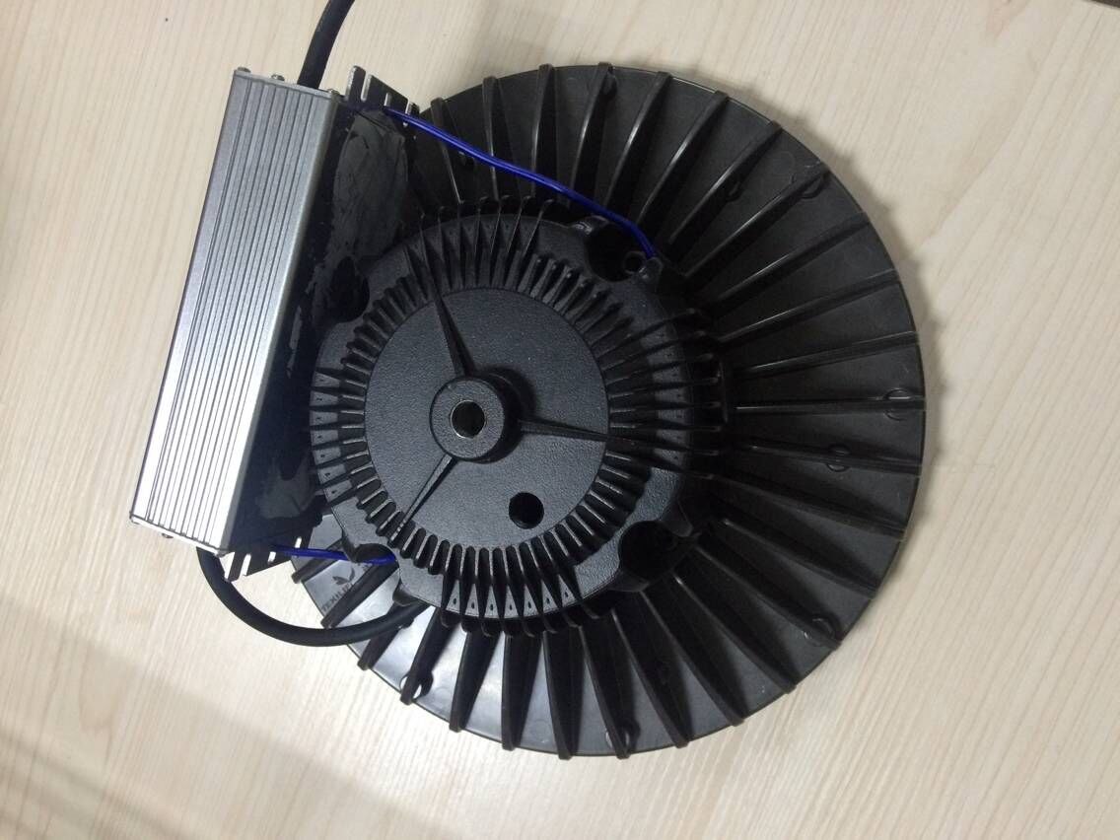
High Bay—seaweeds growth
Power, W | Voltage, V | PF | Photon, umol/s | Spectrum | IP
120 | 220-240 | 0.95 | 190 | Full spectrum | 65

Slide 24
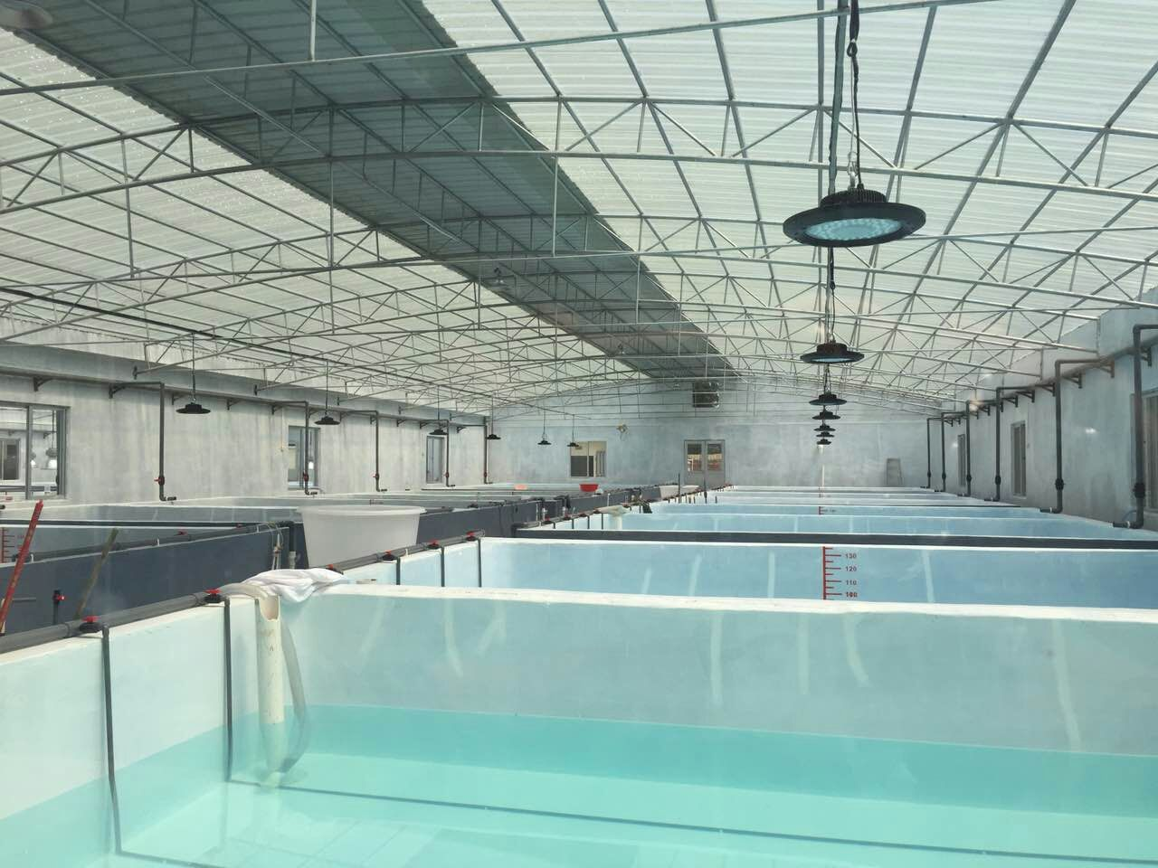
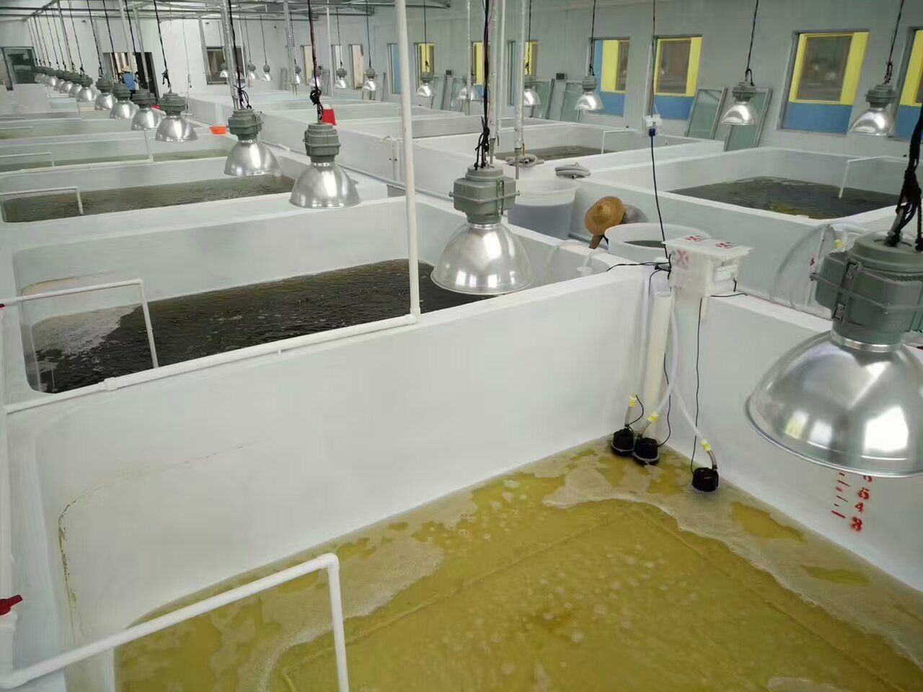
Growth Period
Container: Grow seaweeds.
Container: Grow seaweeds.

Slide 25
Contents
Vertical Farm System
Greenhouse Light
Cannabis Light
Seaweeds Growth Light
Grape Growth Light
Full Spectrum Light/ Residential Growth Light

Slide 26
Top light—Grape growth
Power, W | Voltage, V | PF | Photon, umol/s | Specturm | Length, mm | IP
40W | 220-240 | 0.9 | 54 | Blue / Red | ------ | 65

Slide 27
Contents
Vertical Farm System
Greenhouse Light
Cannabis Light
Seaweeds Growth Light
Grape Growth Light
Full Spectrum Light/ Residential Growth Light

Slide 28
Residential growth light
A60
PAR
Tube—T8
Strip
Shape | Power, W | Voltage, V | PF | Photon, umol/s | Beam angle | Spectrum | Size | IP
A60 | 10 | 120 | 0.5 | 20 | 270 | full spectrum | 110 | 20
Strip | 24 | DC12 | 0.9 | 28 | -- | full specturm | 1200 | 20

Slide 29
LED Tube for meat
Shape | Power, W | Voltage, V | PF | Luminous flux | Beam angle | Color temperature | CRI | IP
Tube-0.6M | 9 | 220-240 | 0.9 | 920lm | 120° | 3500K | 85 | 20
Tube-0.9M | 14 | 220-240 | 0.9 | 1350lm | 120° | 3500K | 85 | 20
Tube-1.2M | 17 | 220-240 | 0.9 | 1700lm | 120° | 3500K | 85 | 20
Tube-1.5M | 20 | 220-240 | 0.9 | 1950lm | 120° | 3500K | 85 | 20

Slide 30
Kantoor:
Grote Woerdlaan 36B
2671 CL Naaldwijk
mail@lohuislighting.nl
+31 (0)10 76 00 377

