Slide 1
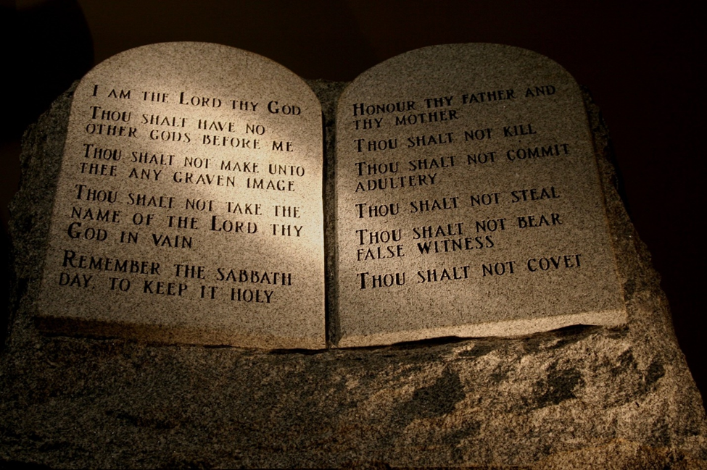
Welcome in the Name of
The Triune God
October 9, 2022
Covenant and Commandments
Prelude by Roxanne Groff
Office of the Acolyte
Ringing of the Bell
Scripture Focus:
Exodus 19:3-7; 20:1-17
Notes:
Image: Preparing yeast dough. Copyright © tomasworks/iStock/Thinkstock. Used by permission.

Slide 2
CONFESSION AND FORGIVENESS
All may make the sign of the cross, the sign marked at baptism…
P: We confess our sins before God and one another.
Pause for silence and reflection.
P: God of promise,
Notes:
Image: Five Loaves by Caroline Coolidge Brown. Copyright © Caroline Coolidge Brown. All rights reserved. Used by permission of the artist.

Slide 3
CONFESSION AND FORGIVENESS
C: You have given us all we are and all we have, and still we have not trusted you fully. We have tried to be god in our own lives, hurting ourselves and those around us in our attempts to control. Wash us clean in the waters of your salvation, and bring us back into right relationship with you.
Notes:
Image: Five Loaves by Caroline Coolidge Brown. Copyright © Caroline Coolidge Brown. All rights reserved. Used by permission of the artist.

Slide 4
CONFESSION AND FORGIVENESS
L: God welcomes you home with open arms, and forgives you all your sin, for the sake of Jesus Christ. By the power of the Holy Spirit, live in the promise of God’s love, freely given.
C: Amen.
☩
Notes:
Image: Five Loaves by Caroline Coolidge Brown. Copyright © Caroline Coolidge Brown. All rights reserved. Used by permission of the artist.

Slide 5
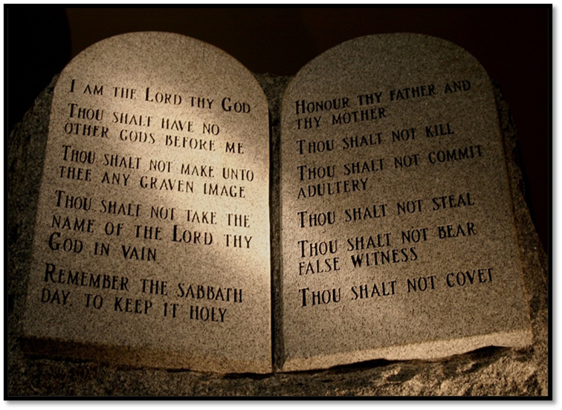
Hymn of Praise
Spirit of Gentleness ELW 396
Notes:
Image: Five Loaves by Caroline Coolidge Brown. Copyright © Caroline Coolidge Brown. All rights reserved. Used by permission of the artist.

Slide 6
Spirit of Gentleness ELW 396
Refrain
Spirit, Spirit of gentleness,
blow through the wilderness calling and free;
Spirit, Spirit of restlessness,
stir me from placidness, wind, wind on the sea.
Notes:
Image: Five Loaves by Caroline Coolidge Brown. Copyright © Caroline Coolidge Brown. All rights reserved. Used by permission of the artist.

Slide 7
Spirit of Gentleness ELW 396
1 You moved on the waters, you called to the deep,
then you coaxed up the mountains from the valleys of sleep;
and over the eons you called to each thing:
"Awake from your slumbers and rise on your wings."
Notes:
Image: Five Loaves by Caroline Coolidge Brown. Copyright © Caroline Coolidge Brown. All rights reserved. Used by permission of the artist.

Slide 8
Spirit of Gentleness ELW 396
Refrain
Spirit, Spirit of gentleness,
blow through the wilderness calling and free;
Spirit, Spirit of restlessness,
stir me from placidness, wind, wind on the sea.
Notes:
Image: Five Loaves by Caroline Coolidge Brown. Copyright © Caroline Coolidge Brown. All rights reserved. Used by permission of the artist.

Slide 9
Spirit of Gentleness ELW 396
2 You swept through the desert, you stung with the sand,
and you goaded your people with a law and a land;
and when they were blinded with idols and lies,
then you spoke through your prophets to open their eyes.
Notes:
Image: Five Loaves by Caroline Coolidge Brown. Copyright © Caroline Coolidge Brown. All rights reserved. Used by permission of the artist.

Slide 10
Spirit of Gentleness ELW 396
Refrain
Spirit, Spirit of gentleness,
blow through the wilderness calling and free;
Spirit, Spirit of restlessness,
stir me from placidness, wind, wind on the sea.
Notes:
Image: Five Loaves by Caroline Coolidge Brown. Copyright © Caroline Coolidge Brown. All rights reserved. Used by permission of the artist.

Slide 11
Spirit of Gentleness ELW 396
3 You sang in a stable, you cried from a hill,
then you whispered in silence when the whole world was still;
and down in the city you called once again,
when you blew through your people on the rush of the wind.
Notes:
Image: Five Loaves by Caroline Coolidge Brown. Copyright © Caroline Coolidge Brown. All rights reserved. Used by permission of the artist.

Slide 12
Spirit of Gentleness ELW 396
Refrain
Spirit, Spirit of gentleness,
blow through the wilderness calling and free;
Spirit, Spirit of restlessness,
stir me from placidness, wind, wind on the sea.
Notes:
Image: Five Loaves by Caroline Coolidge Brown. Copyright © Caroline Coolidge Brown. All rights reserved. Used by permission of the artist.

Slide 13
Spirit of Gentleness ELW 396
4 You call from tomorrow, you break ancient schemes.
From the bondage of sorrow all the captives dream dreams;
our women see visions, our men clear their eyes.
With bold new decisions your people arise.
Notes:
Image: Five Loaves by Caroline Coolidge Brown. Copyright © Caroline Coolidge Brown. All rights reserved. Used by permission of the artist.

Slide 14
Spirit of Gentleness ELW 396
Refrain
Spirit, Spirit of gentleness,
blow through the wilderness calling and free;
Spirit, Spirit of restlessness,
stir me from placidness, wind, wind on the sea.
Notes:
Image: Five Loaves by Caroline Coolidge Brown. Copyright © Caroline Coolidge Brown. All rights reserved. Used by permission of the artist.

Slide 15
APOSTOLIC GREETING
P: The grace of our Lord Jesus Christ, the love of God, and the communion of the Holy Spirit be with you all.
C: And also with you.
Notes:
Image: Five Loaves by Caroline Coolidge Brown. Copyright © Caroline Coolidge Brown. All rights reserved. Used by permission of the artist.

Slide 16
PRAYER OF THE DAY
P: Let us pray… Holy God, you made a covenant with the people of Israel that you would be their God, and they would be your people. Teach us to obey your commands, that we might live in love and peace with you and our neighbors.
C: Amen.
Notes:
Image: Five Loaves by Caroline Coolidge Brown. Copyright © Caroline Coolidge Brown. All rights reserved. Used by permission of the artist.

Slide 17
Notes:
Image: Preparing yeast dough. Copyright © tomasworks/iStock/Thinkstock. Used by permission.

Slide 18
Scripture Reading
R: The Scripture includes readings from the book of Exodus, Chapters 19 & 20.
C: Glory to you O’ Lord! (Spoken)
Notes:
Image: Five Loaves by Caroline Coolidge Brown. Copyright © Caroline Coolidge Brown. All rights reserved. Used by permission of the artist.

Slide 19
Exodus 19:3-7; 20:1-17
³Then Moses went up to God; the Lord called to him from the mountain, saying, “Thus you shall say to the house of Jacob, and tell the Israelites: ⁴You have seen what I did to the Egyptians, and how I bore you on eagles’ wings and brought you to myself. ⁵Now therefore, if you obey my voice and keep my covenant, you shall be my treasured possession out of all
Notes:
Image: Five Loaves by Caroline Coolidge Brown. Copyright © Caroline Coolidge Brown. All rights reserved. Used by permission of the artist.

Slide 20
Exodus 19:3-7; 20:1-17
the peoples. Indeed, the whole earth is mine, ⁶but you shall be for me a priestly kingdom and a holy nation. These are the words that you shall speak to the Israelites.” ⁷So Moses came, summoned the elders of the people, and set before them all these words that the Lord had commanded him. Then God spoke all these words:
Notes:
Image: Five Loaves by Caroline Coolidge Brown. Copyright © Caroline Coolidge Brown. All rights reserved. Used by permission of the artist.

Slide 21
Exodus 19:3-7; 20:1-17
²I am the Lord your God, who brought you out of the land of Egypt, out of the house of slavery; ³you shall have no other gods before me. ⁴You shall not make for yourself an idol, whether in the form of anything that is in heaven above, or that is on the earth beneath, or that is in the water under the earth. ⁵You shall not bow down to them or worship them; for I the Lord your God
Notes:
Image: Five Loaves by Caroline Coolidge Brown. Copyright © Caroline Coolidge Brown. All rights reserved. Used by permission of the artist.

Slide 22
Exodus 19:3-7; 20:1-17
am a jealous God, punishing children for the iniquity of parents, to the third and the fourth generation of those who reject me, ⁶but showing steadfast love to the thousandth generation of those who love me and keep my commandments. ⁷You shall not make wrongful use of the name of the Lord your God, for the Lord will not acquit anyone who misuses his name.
Notes:
Image: Five Loaves by Caroline Coolidge Brown. Copyright © Caroline Coolidge Brown. All rights reserved. Used by permission of the artist.

Slide 23
Exodus 19:3-7; 20:1-17
⁸Remember the sabbath day, and keep it holy. ⁹Six days you shall labor and do all your work. ¹⁰But the seventh day is a sabbath to the Lord your God; you shall not do any work—you, your son or your daughter, your male or female slave, your livestock, or the alien resident in your towns. ¹¹For in six days the Lord made heaven and earth, the sea, and all that is in them, but
Notes:
Image: Five Loaves by Caroline Coolidge Brown. Copyright © Caroline Coolidge Brown. All rights reserved. Used by permission of the artist.

Slide 24
Exodus 19:3-7; 20:1-17
rested the seventh day; therefore the Lord blessed the sabbath day and consecrated it.
¹²Honor your father and your mother, so that your days may be long in the land that the Lord your God is giving you. ¹³You shall not murder. ¹⁴You shall not commit adultery. ¹⁵You shall not steal. ¹⁶You shall not bear false witness against your neighbor.
Notes:
Image: Five Loaves by Caroline Coolidge Brown. Copyright © Caroline Coolidge Brown. All rights reserved. Used by permission of the artist.

Slide 25
Exodus 19:3-7; 20:1-17
¹⁷You shall not covet your neighbor’s house; you shall not covet your neighbor’s wife, or male or female slave, or ox, or donkey, or anything that belongs to your neighbor.
Notes:
Image: Five Loaves by Caroline Coolidge Brown. Copyright © Caroline Coolidge Brown. All rights reserved. Used by permission of the artist.

Slide 26
Exodus 19:3-7; 20:1-17
P: This is the Word of the Lord.
C: Praise to You, O Christ (Spoken)
Notes:
Image: Five Loaves by Caroline Coolidge Brown. Copyright © Caroline Coolidge Brown. All rights reserved. Used by permission of the artist.

Slide 27
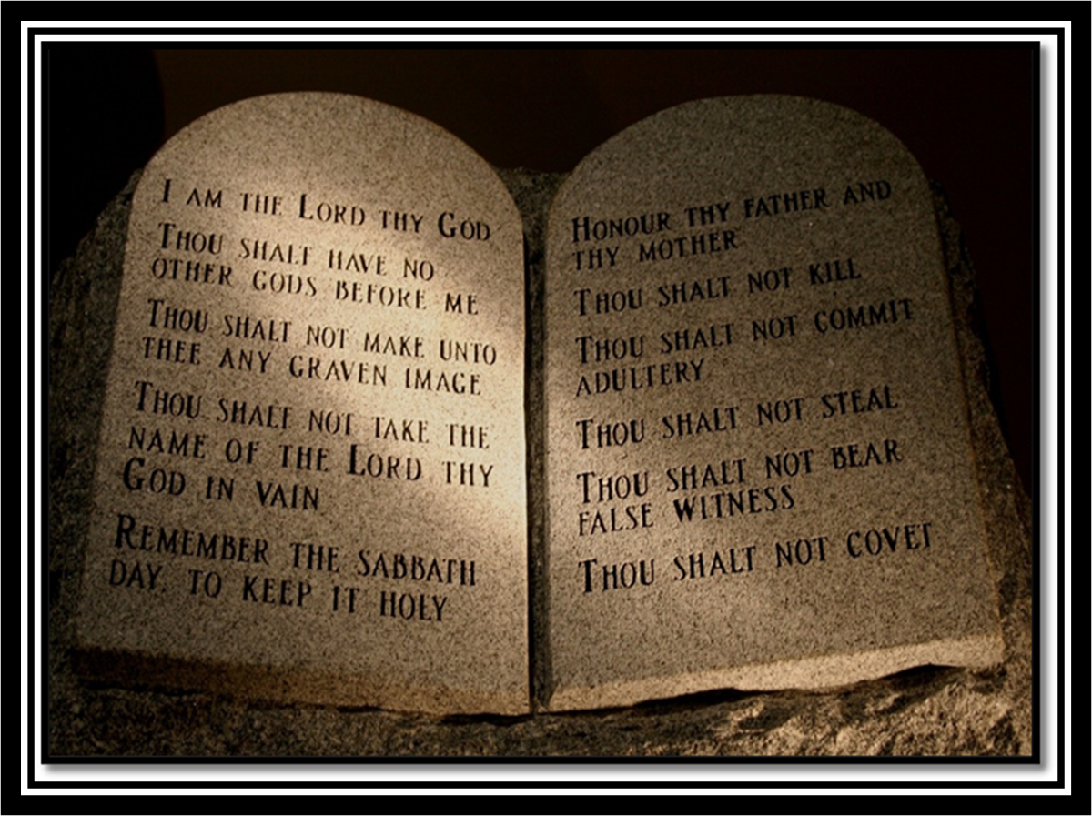
Sermon
Notes:
Image: Five Loaves by Caroline Coolidge Brown. Copyright © Caroline Coolidge Brown. All rights reserved. Used by permission of the artist.

Slide 28
APOSTLE’S CREED
C: I believe in God, the Father almighty, creator of heaven and earth.

Slide 29
APOSTLE’S CREED
C: I believe in Jesus Christ, his only Son, our Lord. He was conceived by the power of the Holy Spirit and born of the virgin Mary. He suffered under Pontius Pilate, was crucified, died, and was buried.

Slide 30
APOSTLE’S CREED
C: He descended into hell. On the third day he rose again. He ascended into heaven, and is seated at the right hand of the Father. He will come again to judge the living and the dead.

Slide 31
APOSTLE’S CREED
C: I believe in the Holy Spirit, the holy catholic Church, the communion of saints, the forgiveness of sins, the resurrection of the body, and the life everlasting. Amen.

Slide 32
NICENE CREED
C: We believe in one God, the Father, the Almighty, maker of heaven and earth, of all that is, seen and unseen.

Slide 33
NICENE CREED
C: We believe in one Lord, Jesus Christ, the only Son of God, eternally begotten of the Father, God from God, Light from Light, true God from true God, begotten, not made, of one Being with the Father.

Slide 34
NICENE CREED
C: Through him all things were made. For us and for our salvation he came down from heaven; by the power of the Holy Spirit he became incarnate from the virgin Mary, and was made man. For our sake he was crucified under Pontius Pilate;

Slide 35
NICENE CREED
C: he suffered death and was buried. On the third day he rose again in accordance with the Scriptures; he ascended into heaven and is seated at the right hand of the Father. He will come again in glory to judge the living and the dead, and his kingdom will have no end.

Slide 36
NICENE CREED
C: We believe in the Holy Spirit, the Lord, the giver of life, who proceeds from the Father and the Son. With the Father and the Son he is worshiped and glorified. He has spoken through the prophets. We believe in one holy catholic and apostolic Church.

Slide 37
NICENE CREED
C: We acknowledge one Baptism for the forgiveness of sins. We look for the resurrection of the dead, and the life of the world to come. Amen.

Slide 38
PRAYERS OF INTERCESSION
Each petition will end with the words,
A: God of promise,
The congregation will respond with:
C: You hear our prayer.

Slide 39
PRAYERS OF INTERCESSION
The prayer concludes…
P: Trusting in your grace and mercy, we lift these prayers to you, in the name of Jesus Christ.
C: Amen.

Slide 40
SHARING OF THE Peace
The Sharing of the Peace that began when the congregation arrived is now shared with the Pastor at this time...
P: The peace of the Lord be with you always.
C: And also with you.

Slide 41
Offering Prayer
Notes:
Image: Five Loaves by Caroline Coolidge Brown. Copyright © Caroline Coolidge Brown. All rights reserved. Used by permission of the artist.

Slide 42
THE LORD’S PRAYER
P: Jesus is the “tie that Binds us together”, let us pray as Jesus taught…
C: Our Father, who art in heaven, hallowed be thy name, thy kingdom come, thy will be done, on earth as it is in heaven. Give us this day our daily bread; and forgive us our trespasses,

Slide 43
THE LORD’S PRAYER
C: as we forgive those who trespass against us; and lead us not into temptation, but deliver us from evil. For thine is the kingdom, and the power, and the glory, forever and ever. Amen.

Slide 44
Announcements
Notes:
Image: Five Loaves by Caroline Coolidge Brown. Copyright © Caroline Coolidge Brown. All rights reserved. Used by permission of the artist.

Slide 45
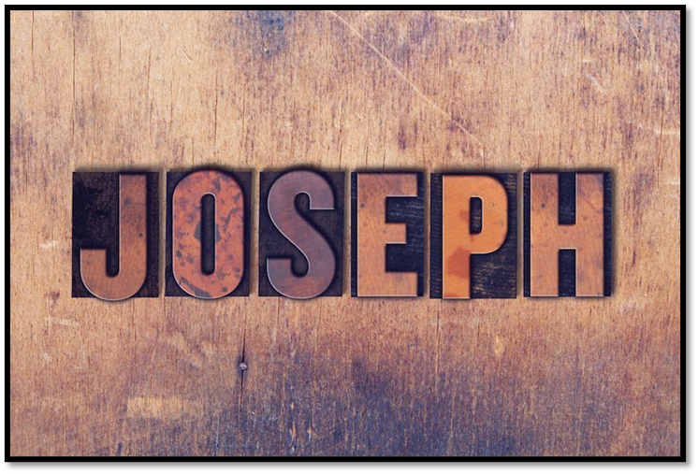
Announcements
Notes:
Image: Five Loaves by Caroline Coolidge Brown. Copyright © Caroline Coolidge Brown. All rights reserved. Used by permission of the artist.

Slide 46
SENDING BLESSING
P: God, who gives life to all things and frees us from despair, bless you with truth and peace. And may the holy Trinity, ☩ one God, guide you always in faith, hope, and love.
C: Amen.
☩

Slide 47
Sending Song
“This Little Light of Mine” ELW 677
Notes:
Image: Five Loaves by Caroline Coolidge Brown. Copyright © Caroline Coolidge Brown. All rights reserved. Used by permission of the artist.

Slide 48
“This Little Light of Mine” ELW 677
1 This little light of mine, I'm goin'-a let it shine;
this little light of mine, I'm goin'-a let it shine;
this little light of mine, I'm goin'-a let it shine,
let it shine, let it shine, let it shine.
Notes:
Image: Five Loaves by Caroline Coolidge Brown. Copyright © Caroline Coolidge Brown. All rights reserved. Used by permission of the artist.

Slide 49
“This Little Light of Mine” ELW 677
2 Ev'rywhere I go, I'm goin'-a let it shine;
ev'rywhere I go, I'm goin'-a let it shine;
ev'rywhere I go, I'm goin'-a let it shine,
let it shine, let it shine, let it shine.
Notes:
Image: Five Loaves by Caroline Coolidge Brown. Copyright © Caroline Coolidge Brown. All rights reserved. Used by permission of the artist.

Slide 50
“This Little Light of Mine” ELW 677
3 Jesus gave it to me, I'm goin'-a let it shine;
Jesus gave it to me, I'm goin'-a let it shine;
Jesus gave it to me, I'm goin'-a let it shine,
let it shine, let it shine, let it shine.
Notes:
Image: Five Loaves by Caroline Coolidge Brown. Copyright © Caroline Coolidge Brown. All rights reserved. Used by permission of the artist.

Slide 51
DISMISSAL
P: Until we gather again as God’s people to offer our worship and praise, depart in Christ’s Love,
C: Seeking, welcoming, and serving all. Amen!
Postlude by Roxanne Groff
Copyright © 2022 Augsburg Fortress. All rights reserved. Reprinted by permission under Augsburg Fortress Liturgies Annual License #SAS023830. New Revised Standard Version Bible, Copyright © 1989, Division of Christian Education of the National Council of the Churches of Christ in the United States of America. Used by permission. All rights reserved. Revised Common Lectionary, Copyright © 1992 Consultation on Common Texts, admin Augsburg Fortress. Used by permission.

