Slide 1
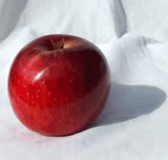
The Elements of Art
The Elements Of Art are the building blocks used by artists to create a work of art.
Line
Shape
Value
Form
Texture
Space
Color

Slide 2
Line
The distance between two points (or the path of a moving point) Line may be two-or three-dimensional, descriptive, or implied.
Notes:
https://www.youtube.com/watch?v=BDePyEFT1gQ

Slide 3
Contour Line
An outline used to define the outside edge of a shape.

Slide 4
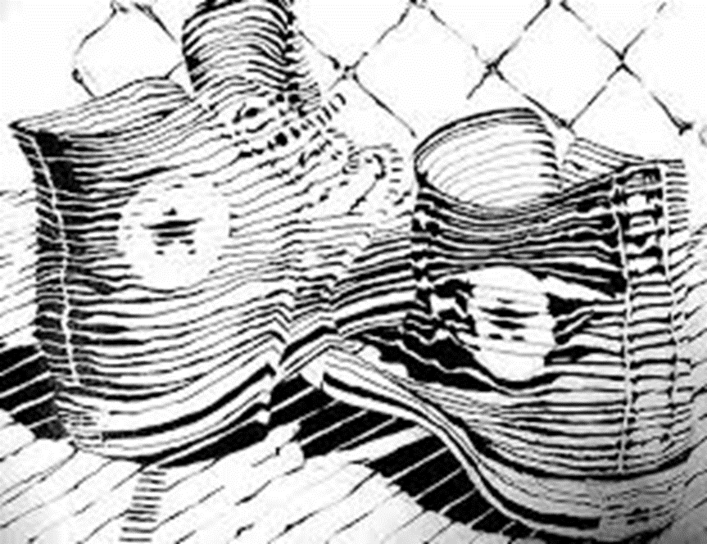
Cross Contour Line
Lines that describe form and Volume. Lines within and around an outline.

Slide 5
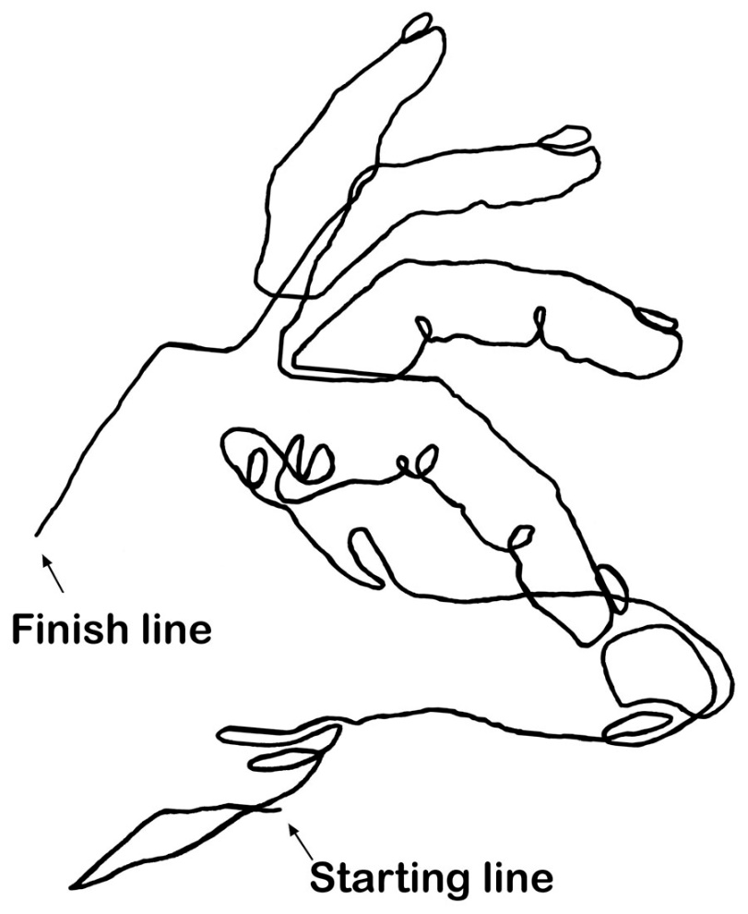
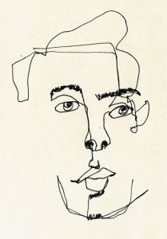
Blind Contour Line
When contour drawing is done without looking at the paper.

Slide 6
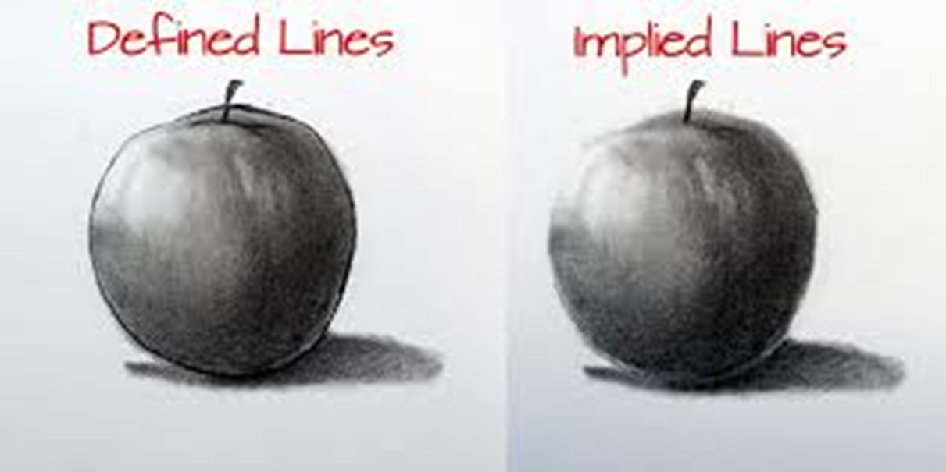
Implied Line
Lines that suggest an edge instead of clearly showing one. It can also be a line created by positioning a series of points so that the eye connects them.

Slide 8
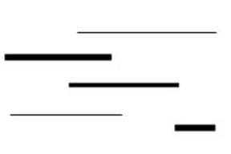
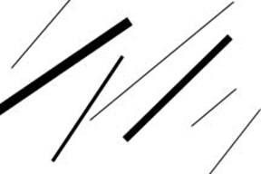
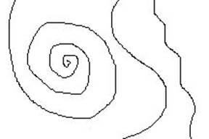
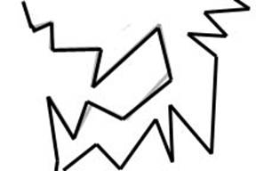
Line Types
Vertical Lines
Horizontal Lines
Diagonal Lines
Curved Lines
Zigzag Lines
Dot or Dashed Lines
,,,,,,,,,,,,,,,,,,,,,,,,,,,,
------------------------

Slide 9
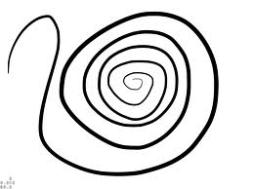
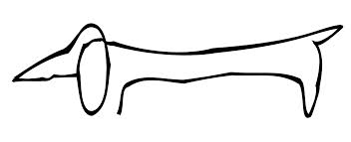
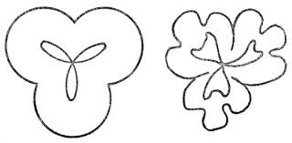
Line Quality/Variation
Length
Width
Value
Direction
Degree of curve

Slide 10
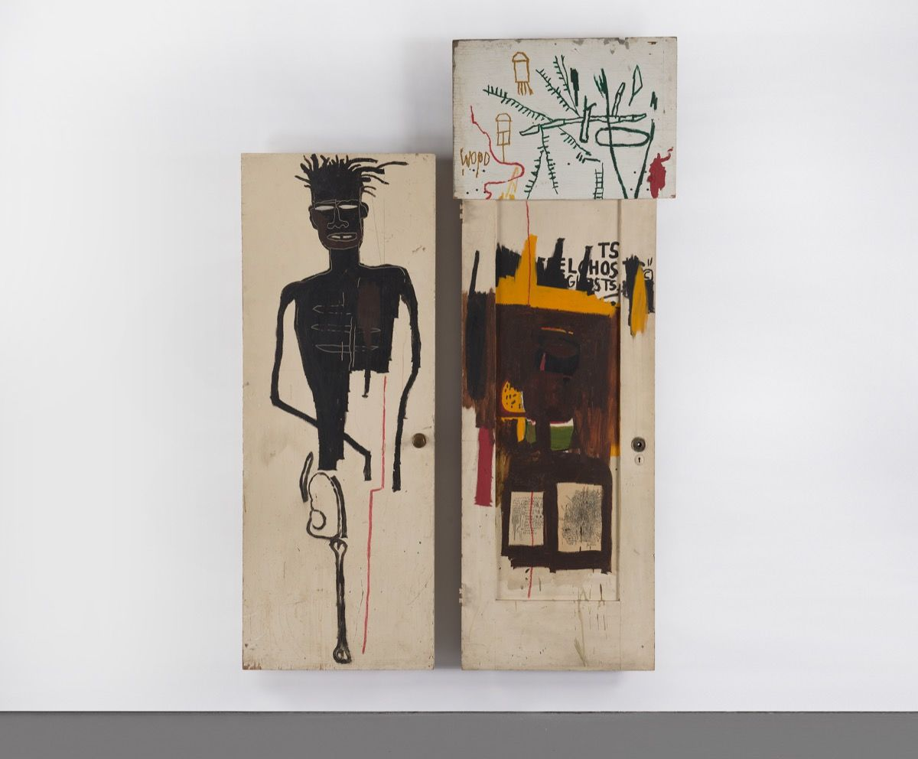
Jean-Michel Basquiat, Self Portrait, 1983.

Slide 11
Shape
The defined enclosed space contained within lines. Shapes are 2 dimensional (They are flat). They can be used to simplify complex objects for effective communication.
Notes:
https://www.youtube.com/watch?v=bJzGkZwkHt4

Slide 12
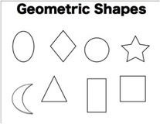
Geometric
Shapes that are precise and consistent, they often look like they were man-made. circle, square, rectangle, diamond, oval, crescent, heart, triangle, octagon.
Notes:
https://www.youtube.com/watch?v=bJzGkZwkHt4

Slide 13
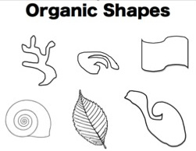
Organic Shapes
Have a natural and flowing look, they often look like they would appear in nature. Biomorphic, natural, irregular

Slide 14
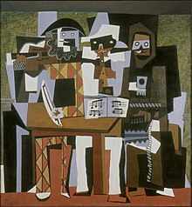
Pablo PicassoThree Musicians

Slide 15
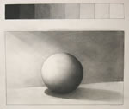
Value
The degree of lightness or darkness of an object. The effect of light and shade in a picture.
Notes:
https://www.youtube.com/watch?v=AAwYHNo31ZQ

Slide 16
Value Scale A sequence of tones from light to dark that can be made between black and white

Slide 17
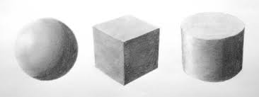
Shading with Pencil

Slide 18
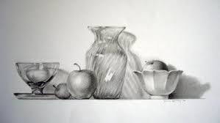

Slide 19
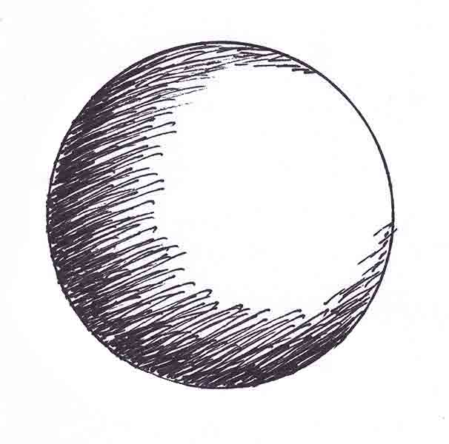
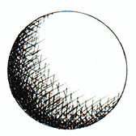
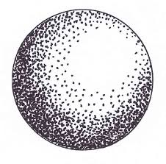
Creating Value with Pen and Ink
Hatching
Cross Hatching
Stippling

Slide 20
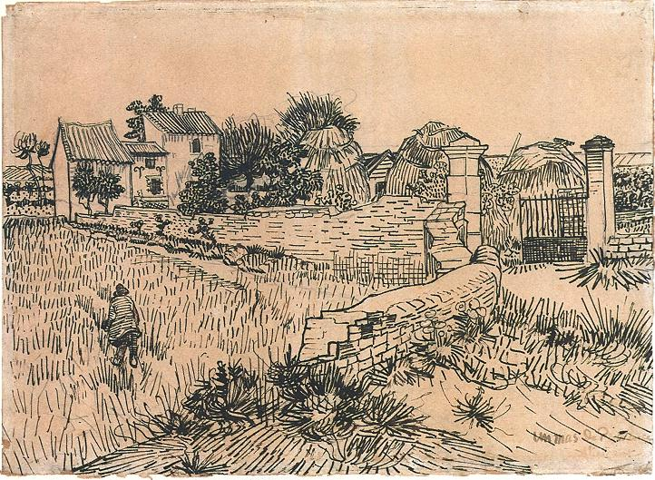

Slide 21
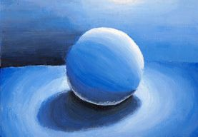
Adding Value with Color
Hard and Soft Pressure
Tints, Tones and Shades

Slide 22
Form
Objects having three dimensions (3D), or height, width, and depth. You can walk around a form. Forms can be Geometric or Organic. Examples of form can include cubes, cylinders, spheres and the human figure.
Notes:
https://www.youtube.com/watch?v=9DIPs3T2dQk

Slide 23
The Thinker (Le Penseur)Auguste Rodin

Slide 24
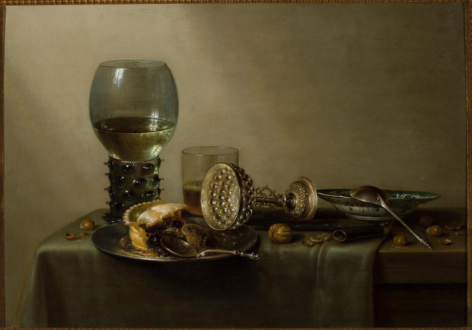
Willem Claesz, 1637, “Dessert”
Notes:
Dutch

Slide 25
Texture
How something feels or looks like it would feel if you could touch it.
Real/actual: how something actually feels, such as a sculpture.
Implied/visual: when an artist paints or draws a texture but it is artificial.
Notes:
https://www.youtube.com/watch?v=YoOb3JSDAUo

Slide 26
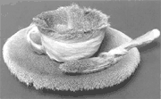
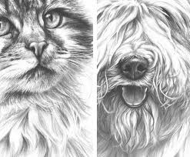
Real Implied

Slide 27
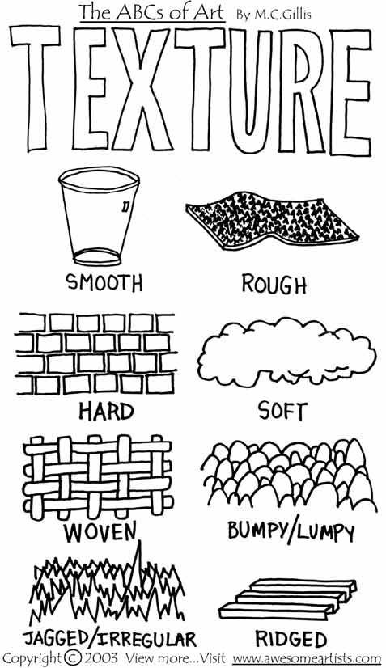

Slide 28
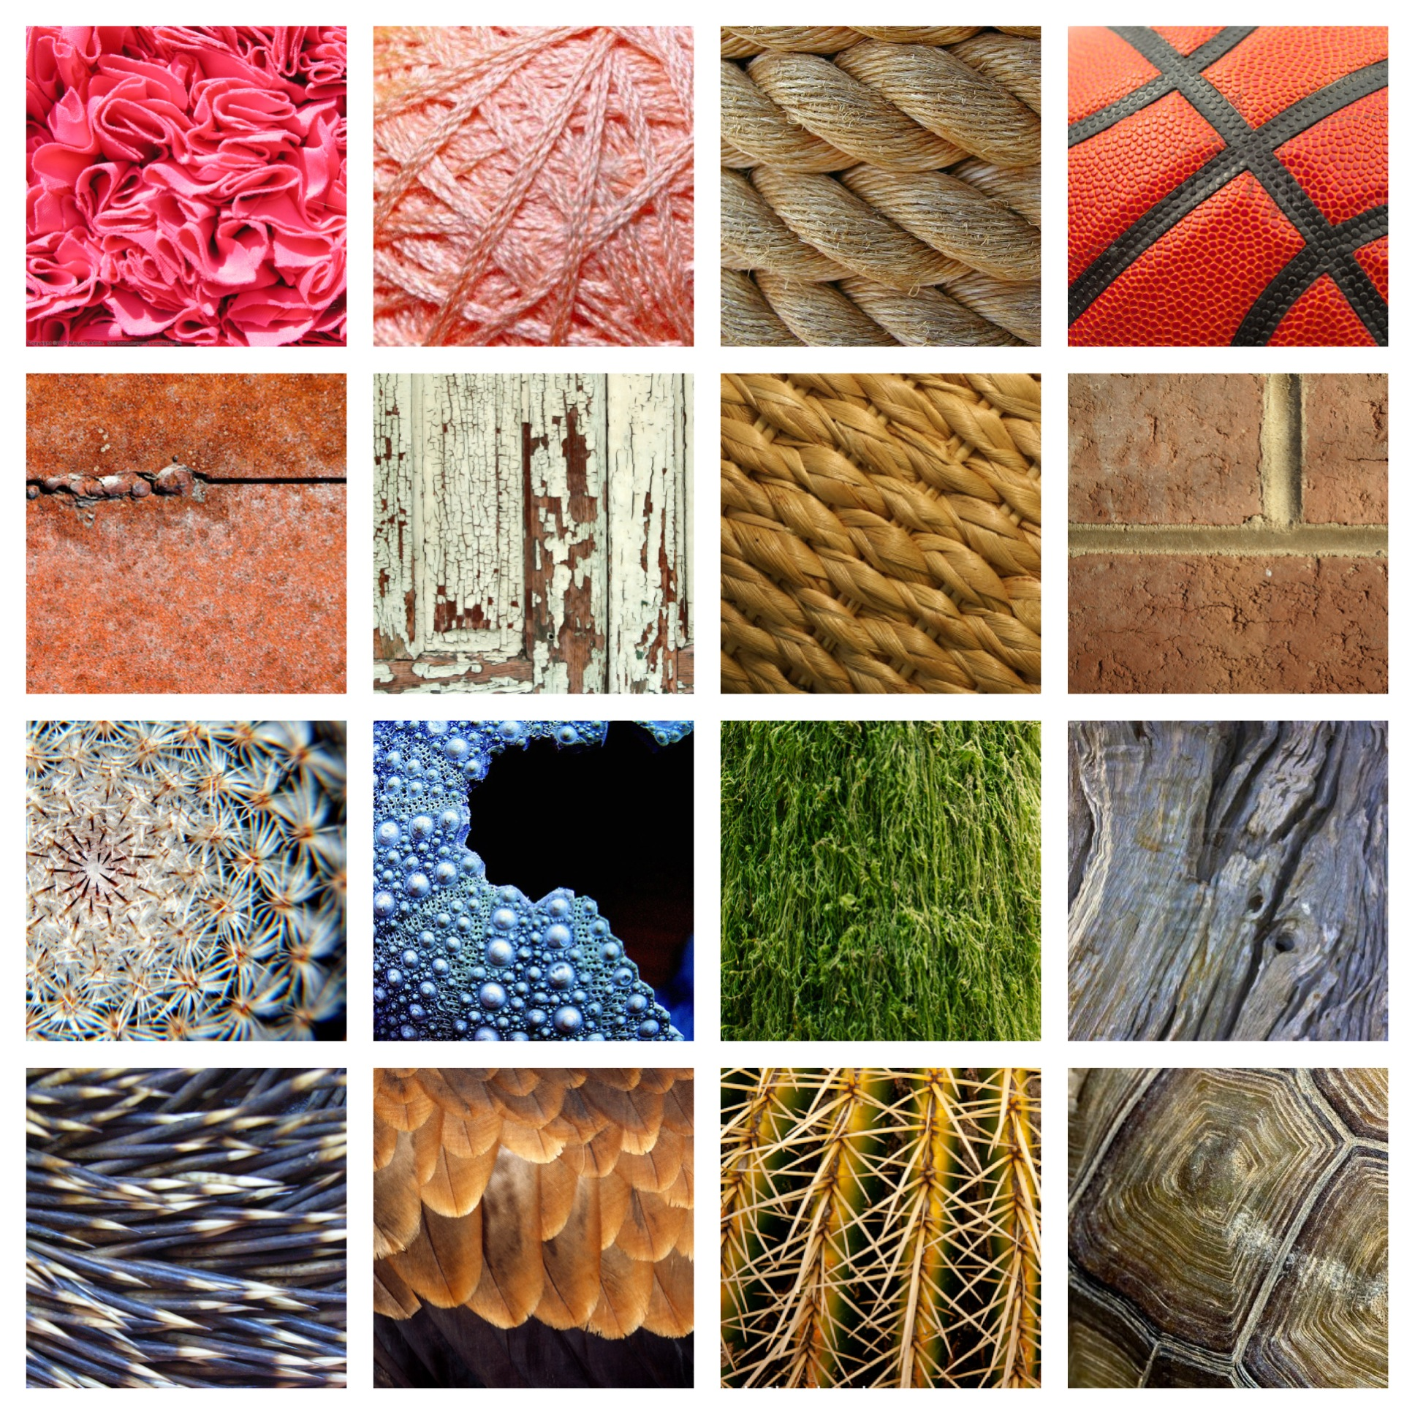
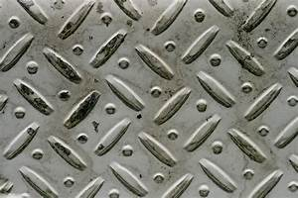
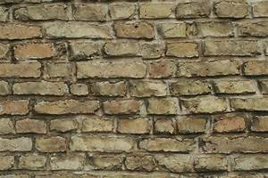
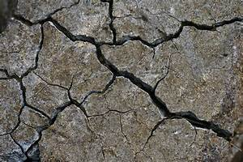

Slide 29
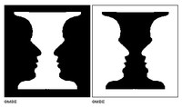
Space
The element of art that refers to the emptiness or area around or within objects.
Positive space refers to the subject or part of the artwork that takes up space.
Negative space is the area around that object.
Notes:
https://www.youtube.com/watch?v=rAyfXdPo9n8

Slide 30
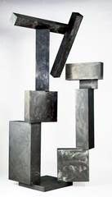
The negative shape inside this sculpture repeats the overall structure of the sculptor's positive shapes. The geometry of the boxes piled high emphasizes the negative shape in the middle of the sculpture.
David Smith Cubi IX 1961 stainless steel Walker Art Center Gift of the T. B. Walker Foundation

Slide 31
Using Space in your Compositions to Create Interest
Draw Big
Fill the Space
Extend Lines Off The Paper to give the illusion that the space extends beyond the picture frame

Slide 32
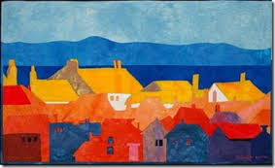
Fill The Space

Slide 33
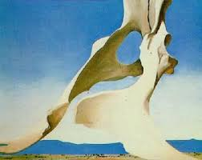
Extend Lines Off The Paper to give the illusion that the space extends beyond the picture frame

Slide 34
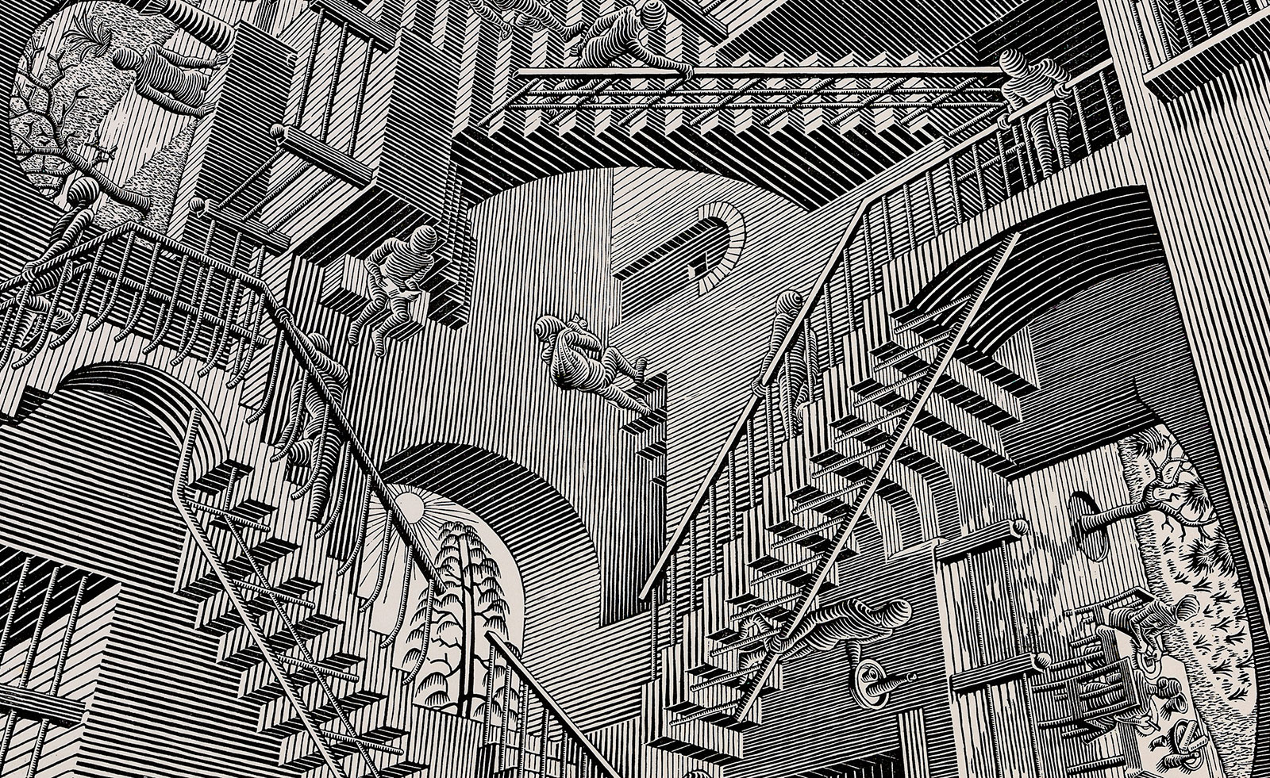
MC Escher
Creating Optical illusions with the element of SPACE
Notes:
https://www.youtube.com/watch?v=D32XQLIUcgI&feature=player_embedded

Slide 35
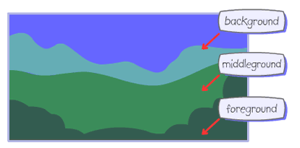
This element of art also refers to the "parts" of the picture... Foreground, Middleground and Background

Slide 36
Foreground: the part of a picture that is nearest to the viewer.
Middle ground: The middle distance in a picture.
Background: The part of a picture that is farthest from the viewer.

Slide 37
Six Ways to Create Space
Perspective
Size
Placement
Detail
Value/Color
Overlapping

Slide 38
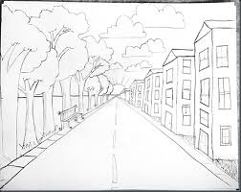
PERSPECTIVE
Perspective is a mathematical system for creating the illusion of space and distance on a flat surface.

Slide 39
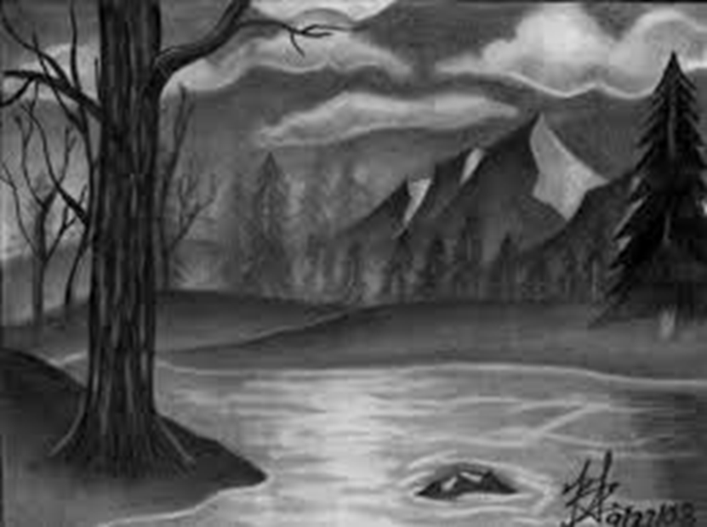
Size
Objects are smaller in the distance.
Objects are larger closer up.

Slide 40
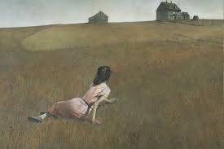
Placement Objects placed higher on the picture plane will appear further away. Objects placed lower on the picture plane will appear closer to the viewer.
Andrew Wyeth. Christina's World. 1948

Slide 41
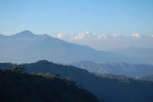
Value/Color
Also called Atmospheric Perspective
Objects are darker/brighter closer up.
Objects are lighter/duller farther away.

Slide 42
Detail
Objects that are closer have more detail.
Objects farther away have less detail.

Slide 43
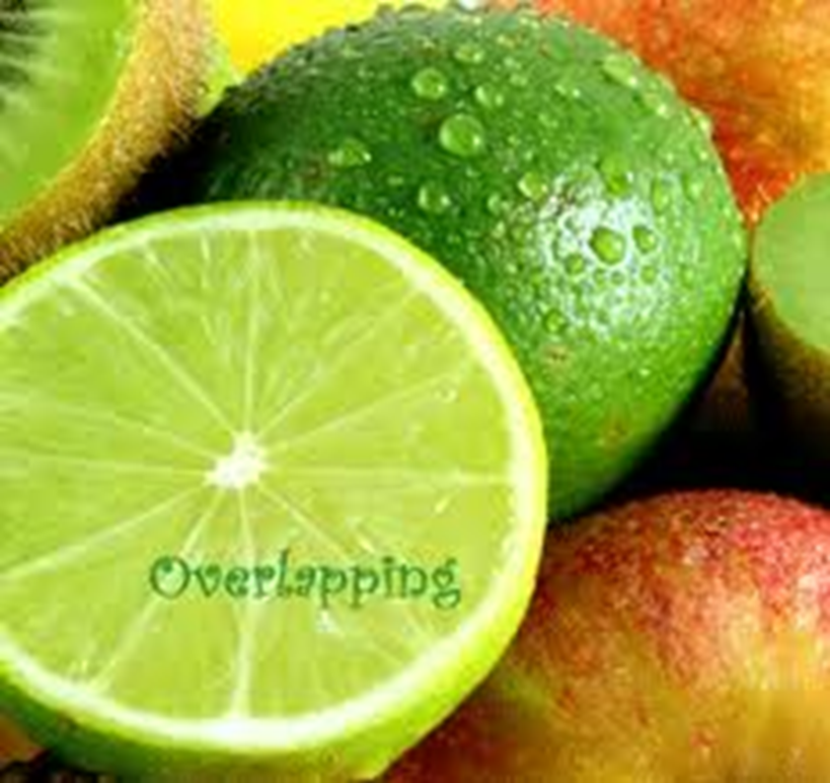
Overlapping
Objects that are closer to the viewer overlap the objects behind them.

Slide 44
Color
The element of art derived from reflected absorbed light. Color adds interest and mood to a work of art. It is also referred to as "Hue".
Notes:
https://www.youtube.com/watch?v=wWW_UbrkBEw

Slide 45
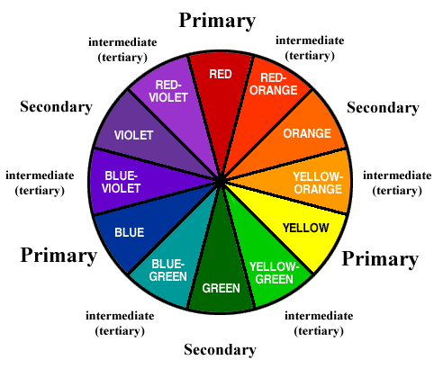

Slide 46
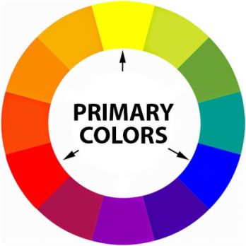
Primary Colors
Red Yellow Blue

Slide 47
Primary colors cannot be mixed from other colors. They are the source of all other colors.
ROY LICHTENSTEIN Maybe, 1969 color silkscreen

Slide 48
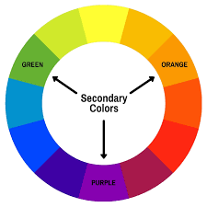
Secondary Colors
Violet Orange Green

Slide 49
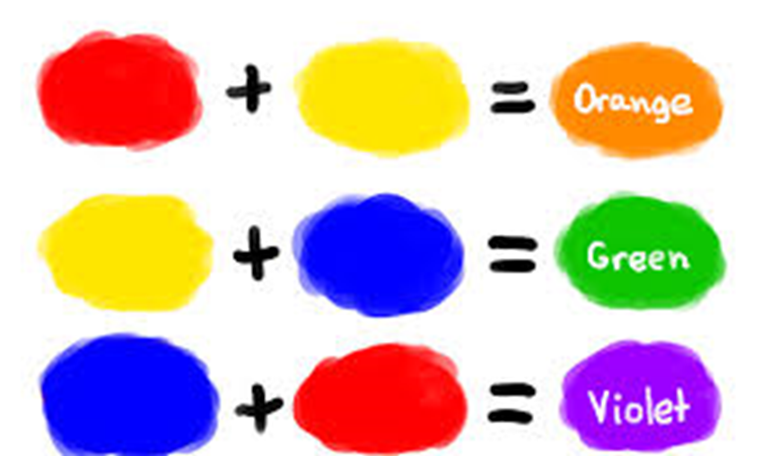
A secondary color is a color made by mixing of two primary colors

Slide 50
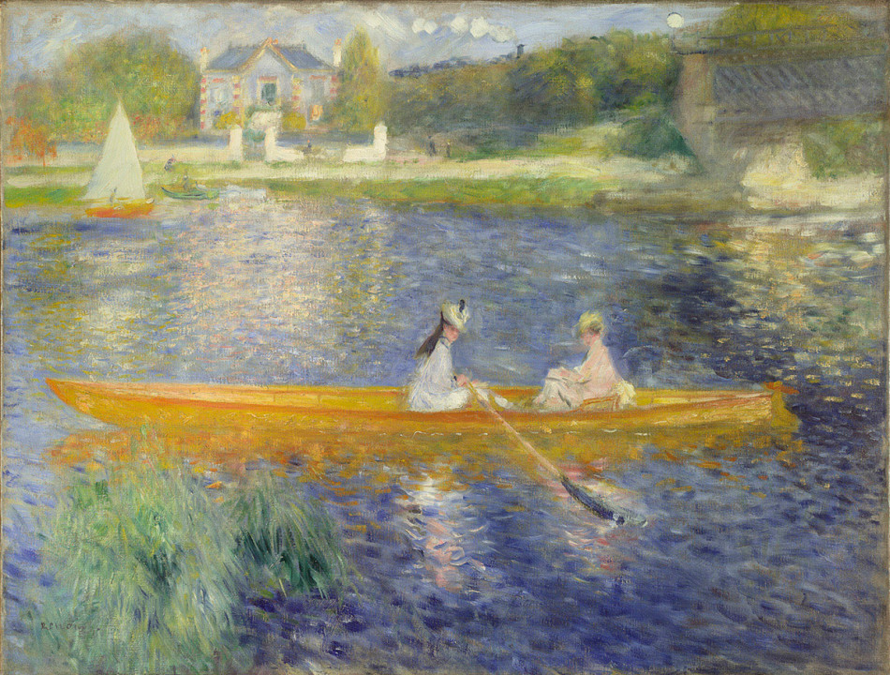
Pierre-Auguste Renoir, The Skiff (La Yole), 1875.

Slide 51
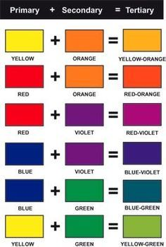
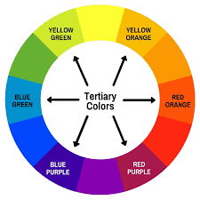
Tertiary (Intermediate) Colors
Tertiary colors are combinations of primary and secondary colors. There are six tertiary colors; red-orange, yellow-orange, yellow-green, blue-green, blue-violet, and red-violet

Slide 52
Henri Matisse. Portrait of Madame Matisse. (The green line). 1905. 40.5 x 32.5 cm. Oil and tempera on canvas

Slide 53
Warm and Cool Colors
Warm and cool colors impact our visual perception of the objects that we see.

Slide 54
Cool Colors
Cool colors — such as blue, green, and purple (violet); evoke a cool feeling because they remind us of things like water or grass.
Cool colors have nearly the opposite effects of warm colors. Receding from the eye, cool colors can make a space feel larger and more open.
Cool colors provide a sense of calm and relaxation.
''Starry Night'' by Vincent van Gogh painted 1889

Slide 55
Warm Colors
Warm colors — such as red, yellow, and orange; evoke warmth because they remind us of things like the sun or fire.
Warm colors feel inviting and comforting, and provide the illusion of heat and warmth.
These colors advance toward the eye, and work well in large spaces in order to make them feel cozy and secure.
Sunflowers (Van Gogh series)

Slide 56
Color Values

Slide 57
.
Hue: Pure color on the color wheel.
Tint: Adding white to a pure hue to make something lighter.
Shade: Adding black to a pure hue to make something darker.
Tone: Adding gray to make color less vibrant

Slide 58
Monochromatic
Mono=one
Chroma=color
Monochromatic=
One Color

Slide 59
Color Intensity
Also referred to as Saturation or Chroma.
Intensity refers to the brightness or dullness of a color.
It is adjusted by adding grey to a pure hue or by mixing complementary colors.

Slide 60
Color Harmonies
Complementary: Colors that are opposite each other on the color wheel
Analogous: colors that are next to each other on the color wheel.
Triad: A triadic color scheme uses colors that are evenly spaced around the color wheel.

Slide 61
The high contrast of complementary colors creates a vibrant look especially when used at full saturation

Slide 62
Monet, Claude: Impression, Sunrise

Slide 63
Analogous color schemes are often found in nature and are harmonious and pleasing to the eye.

Slide 64
Paul Cézanne | Houses in Provence 1883

Slide 65
Triadic color harmonies tend to be quite vibrant, even if you use pale or unsaturated versions of your hues.

Slide 66
Composition IV Wassily Kandinsky

Slide 67
Color Fun!!!!! Did you know you can get different effects when pairing colors??

Slide 69
What color scheme is it?

