Slide 1
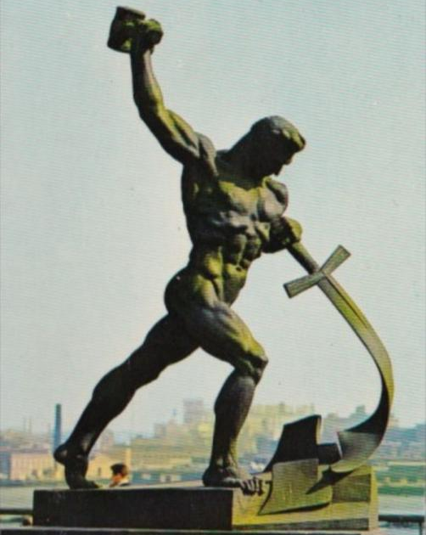
Trinity Evangelical Lutheran Church November 20, 2022
WELCOME!
Isaiah 36:1-3, 13-20; 37:1-7; 2:1-4
Notes:
Image: Five Loaves by Caroline Coolidge Brown. Copyright © Caroline Coolidge Brown. All rights reserved. Used by permission of the artist.

Slide 2
= Please stand if able
= Please be seated
Prelude – Roxanne Groff
Office of the Acolyte
Ringing of the Bell
Welcome
Notes:
Image: Five Loaves by Caroline Coolidge Brown. Copyright © Caroline Coolidge Brown. All rights reserved. Used by permission of the artist.

Slide 3
CONFESSION AND FORGIVENESS
All may make the sign of the cross, the sign marked at baptism…
L: We confess our sins before God and one another.
Pause for silence and reflection.
L: Gracious God…
Notes:
Image: Five Loaves by Caroline Coolidge Brown. Copyright © Caroline Coolidge Brown. All rights reserved. Used by permission of the artist.

Slide 4
CONFESSION AND FORGIVENESS
C: We have sinned against you and our neighbors. We have taken what is not ours, and justified our actions. We have turned away from your wisdom. We have not done justice, loved kindness, nor walked humbly with you. Forgive us for the harms we have caused through word and action, and restore us to the joy of following your will for us.
Notes:
Image: Five Loaves by Caroline Coolidge Brown. Copyright © Caroline Coolidge Brown. All rights reserved. Used by permission of the artist.

Slide 5
CONFESSION AND FORGIVENESS
L: God knows our every weakness and yet loves us without ceasing. Rejoice and be glad, for the God of grace and mercy forgives you all your sins, for the sake of our savior Jesus Christ.
C: Amen.
Notes:
Image: Five Loaves by Caroline Coolidge Brown. Copyright © Caroline Coolidge Brown. All rights reserved. Used by permission of the artist.

Slide 6
Hymn of Praise
“Arise, Your Light Has Come!”
ELW 314
Notes:
Image: Five Loaves by Caroline Coolidge Brown. Copyright © Caroline Coolidge Brown. All rights reserved. Used by permission of the artist.

Slide 7
“Arise, Your Light Has Come!” ELW 314
1 Arise, your light has come!
The Spirit's call obey;
show forth the glory of your God
which shines on you today.
2 Arise, your light has come!
Fling wide the prison door;
proclaim the captive's liberty,
good tidings to the poor.
Notes:
Image: Preparing yeast dough. Copyright © tomasworks/iStock/Thinkstock. Used by permission.

Slide 8
“Arise, Your Light Has Come!” ELW 314
3 Arise, your light has come!
All you in sorrow born,
bind up the brokenhearted ones
and comfort those who mourn.
4 Arise, your light has come!
The mountains burst in song!
Rise up like eagles on the wing,
God's pow'r will make us strong.
Notes:
Image: Preparing yeast dough. Copyright © tomasworks/iStock/Thinkstock. Used by permission.

Slide 9
APOSTOLIC GREETING
P: The grace of our Lord Jesus Christ, the love of God, and the communion of the Holy Spirit be with you all.
C: And also with you.
Notes:
Image: Five Loaves by Caroline Coolidge Brown. Copyright © Caroline Coolidge Brown. All rights reserved. Used by permission of the artist.

Slide 10
KYRIE
A: In peace let us pray to the Lord.
C: Lord have mercy.
A: For the peace from above, and for our salvation, let us pray to the Lord.
C: Lord have mercy.
A: For the peace of the whole world, for the well being of the Church of God, and for the unity of all, let us pray to the Lord.
C: Lord have mercy.
Notes:
Image: Five Loaves by Caroline Coolidge Brown. Copyright © Caroline Coolidge Brown. All rights reserved. Used by permission of the artist.

Slide 11
KYRIE
A: For this Holy House, and for all who offer here their worship and praise, let us pray to the Lord.
C: Lord have mercy.
A: Help, save, and defend us, gracious Lord.
C: Amen.
Notes:
Image: Five Loaves by Caroline Coolidge Brown. Copyright © Caroline Coolidge Brown. All rights reserved. Used by permission of the artist.

Slide 12
PRAYER OF THE DAY
P: Let us pray… God of wisdom, the prophet Isaiah foretold the time of peace, when weapons would be turned into tools for farming. Give us hope that peace is possible in our war-torn world, and the courage to work for it.
C: Amen.
Notes:
Image: Five Loaves by Caroline Coolidge Brown. Copyright © Caroline Coolidge Brown. All rights reserved. Used by permission of the artist.

Slide 13
Notes:
Image: Preparing yeast dough. Copyright © tomasworks/iStock/Thinkstock. Used by permission.

Slide 14
Scripture Reading
R: The Scripture reading is from the Book of Isaiah, Chapters 36, 37, and 2.
C: Glory to you O’ Lord! (Spoken)
Notes:
Image: Five Loaves by Caroline Coolidge Brown. Copyright © Caroline Coolidge Brown. All rights reserved. Used by permission of the artist.

Slide 15
Isaiah 36:1-3, 13-20; 37:1-7; 2:1-4
Chapter 36
In the fourteenth year of King Hezekiah, King Sennacherib of Assyria came up against all the fortified cities of ¹Judah and captured them. ²The king of Assyria sent the Rabshakeh from Lachish to King Hezekiah at Jerusalem, with a great army. He stood by the conduit of the upper pool on the highway to the Fuller’s Field. ³And there
Notes:
Image: Five Loaves by Caroline Coolidge Brown. Copyright © Caroline Coolidge Brown. All rights reserved. Used by permission of the artist.

Slide 16
Isaiah 36:1-3, 13-20; 37:1-7; 2:1-4
came out to him Eliakim son of Hilkiah, who was in charge of the palace, and Shebna the secretary, and Joah son of Asaph, the recorder.
¹³Then the Rabshakeh stood and called out in a loud voice in the language of Judah, “Hear the words of the great king, the king of Assyria! ¹⁴Thus says the king: ‘Do not let Hezekiah deceive you, for he will not be able to deliver
Notes:
Image: Five Loaves by Caroline Coolidge Brown. Copyright © Caroline Coolidge Brown. All rights reserved. Used by permission of the artist.

Slide 17
Isaiah 36:1-3, 13-20; 37:1-7; 2:1-4
you. ¹⁵Do not let Hezekiah make you rely on the Lord by saying, The Lord will surely deliver us; this city will not be given into the hand of the king of Assyria.’ ¹⁶Do not listen to Hezekiah; for thus says the king of Assyria: ‘Make your peace with me and come out to me; then everyone of you will eat from your own vine and your own fig tree and drink water from your own cistern,
Notes:
Image: Five Loaves by Caroline Coolidge Brown. Copyright © Caroline Coolidge Brown. All rights reserved. Used by permission of the artist.

Slide 18
Isaiah 36:1-3, 13-20; 37:1-7; 2:1-4
¹⁷until I come and take you away to a land like your own land, a land of grain and wine, a land of bread and vineyards. ¹⁸Do not let Hezekiah mislead you by saying, The Lord will save us. Has any of the gods of the nations saved their land out of the hand of the king of Assyria? ¹⁹Where are the gods of Hamath and Arpad? Where are the gods of Sepharvaim? Have they
Notes:
Image: Five Loaves by Caroline Coolidge Brown. Copyright © Caroline Coolidge Brown. All rights reserved. Used by permission of the artist.

Slide 19
Isaiah 36:1-3, 13-20; 37:1-7; 2:1-4
delivered Samaria out of my hand? ²⁰Who among all the gods of these countries have saved their countries out of my hand, that the Lord should save Jerusalem out of my hand?’”
Chapter 37
When King Hezekiah heard it, he tore his clothes, covered himself with sackcloth, and went into the house of the Lord. ²And he sent Eliakim, who
Notes:
Image: Five Loaves by Caroline Coolidge Brown. Copyright © Caroline Coolidge Brown. All rights reserved. Used by permission of the artist.

Slide 20
Isaiah 36:1-3, 13-20; 37:1-7; 2:1-4
was in charge of the palace, and Shebna the secretary, and the senior priests, covered with sackcloth, to the prophet Isaiah son of Amoz. ³They said to him, “Thus says Hezekiah, This day is a day of distress, of rebuke, and of disgrace; children have come to the birth, and there is no strength to bring them forth. ⁴It may be that the Lord your God heard the words of the
Notes:
Image: Five Loaves by Caroline Coolidge Brown. Copyright © Caroline Coolidge Brown. All rights reserved. Used by permission of the artist.

Slide 21
Isaiah 36:1-3, 13-20; 37:1-7; 2:1-4
Rabshakeh, whom his master the king of Assyria has sent to mock the living God, and will rebuke the words that the Lord your God has heard; therefore lift up your prayer for the remnant that is left.” ⁵When the servants of King Hezekiah came to Isaiah, ⁶Isaiah said to them, “Say to your master, ‘Thus says the Lord: Do not be afraid because of the words that you have heard, with
Notes:
Image: Five Loaves by Caroline Coolidge Brown. Copyright © Caroline Coolidge Brown. All rights reserved. Used by permission of the artist.

Slide 22
Isaiah 36:1-3, 13-20; 37:1-7; 2:1-4
which the servants of the king of Assyria have reviled me. ⁷I myself will put a spirit in him, so that he shall hear a rumor, and return to his own land; I will cause him to fall by the sword in his own land.’”
Chapter 2
The word that Isaiah son of Amoz saw concerning Judah and Jerusalem. ²In days to come the mountain of the
Notes:
Image: Five Loaves by Caroline Coolidge Brown. Copyright © Caroline Coolidge Brown. All rights reserved. Used by permission of the artist.

Slide 23
Isaiah 36:1-3, 13-20; 37:1-7; 2:1-4
Lord’s house shall be established as the highest of the mountains, and shall be raised above the hills; all the nations shall stream to it. ³Many peoples shall come and say, “Come, let us go up to the mountain of the Lord, to the house of the God of Jacob; that he may teach us his ways and that we may walk in his paths.”
Notes:
Image: Five Loaves by Caroline Coolidge Brown. Copyright © Caroline Coolidge Brown. All rights reserved. Used by permission of the artist.

Slide 24
Isaiah 36:1-3, 13-20; 37:1-7; 2:1-4
For out of Zion shall go forth instruction, and the word of the Lord from Jerusalem. ⁴He shall judge between the nations, and shall arbitrate for many peoples; they shall beat their swords into plowshares, and their spears into pruning hooks; nation shall not lift up sword against nation, neither shall they learn war any more.
Notes:
Image: Five Loaves by Caroline Coolidge Brown. Copyright © Caroline Coolidge Brown. All rights reserved. Used by permission of the artist.

Slide 25
Isaiah 36:1-3, 13-20; 37:1-7; 2:1-4
P: This is the Word of the Lord.
C: Praise to You, O Christ (Spoken)
Notes:
Image: Five Loaves by Caroline Coolidge Brown. Copyright © Caroline Coolidge Brown. All rights reserved. Used by permission of the artist.

Slide 26
Sermon
Notes:
Image: Five Loaves by Caroline Coolidge Brown. Copyright © Caroline Coolidge Brown. All rights reserved. Used by permission of the artist.

Slide 27
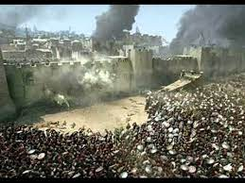
Sermon
Notes:
Image: Five Loaves by Caroline Coolidge Brown. Copyright © Caroline Coolidge Brown. All rights reserved. Used by permission of the artist.

Slide 28
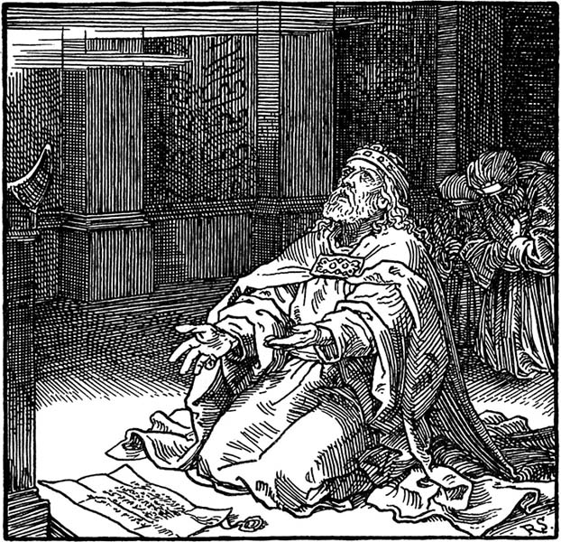
Sermon
Notes:
Image: Five Loaves by Caroline Coolidge Brown. Copyright © Caroline Coolidge Brown. All rights reserved. Used by permission of the artist.

Slide 29
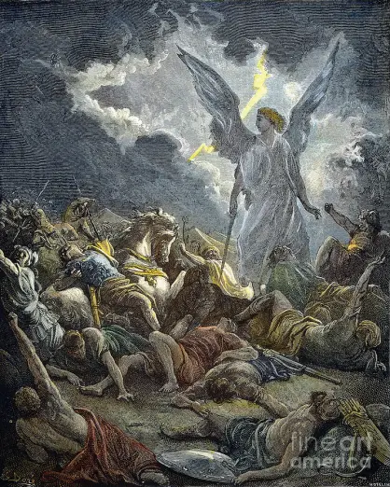
Sermon
Notes:
Image: Five Loaves by Caroline Coolidge Brown. Copyright © Caroline Coolidge Brown. All rights reserved. Used by permission of the artist.

Slide 30
Sermon
Notes:
Image: Five Loaves by Caroline Coolidge Brown. Copyright © Caroline Coolidge Brown. All rights reserved. Used by permission of the artist.

Slide 31
SPECIAL MUSIC
Larry Harter
Notes:
Image: Five Loaves by Caroline Coolidge Brown. Copyright © Caroline Coolidge Brown. All rights reserved. Used by permission of the artist.

Slide 32
APOSTLE’S CREED
C: I believe in God, the Father almighty, creator of heaven and earth.

Slide 33
APOSTLE’S CREED
C: I believe in Jesus Christ, his only Son, our Lord. He was conceived by the power of the Holy Spirit and born of the virgin Mary. He suffered under Pontius Pilate, was crucified, died, and was buried.

Slide 34
APOSTLE’S CREED
C: He descended into hell. On the third day he rose again. He ascended into heaven, and is seated at the right hand of the Father. He will come again to judge the living and the dead.

Slide 35
APOSTLE’S CREED
C: I believe in the Holy Spirit, the holy catholic Church, the communion of saints, the forgiveness of sins, the resurrection of the body, and the life everlasting. Amen.

Slide 36
NICENE CREED
C: We believe in one God, the Father, the Almighty, maker of heaven and earth, of all that is, seen and unseen.

Slide 37
NICENE CREED
C: We believe in one Lord, Jesus Christ, the only Son of God, eternally begotten of the Father, God from God, Light from Light, true God from true God, begotten, not made, of one Being with the Father.

Slide 38
NICENE CREED
C: Through him all things were made. For us and for our salvation he came down from heaven; by the power of the Holy Spirit he became incarnate from the virgin Mary, and was made man. For our sake he was crucified under Pontius Pilate;

Slide 39
NICENE CREED
C: he suffered death and was buried. On the third day he rose again in accordance with the Scriptures; he ascended into heaven and is seated at the right hand of the Father. He will come again in glory to judge the living and the dead, and his kingdom will have no end.

Slide 40
NICENE CREED
C: We believe in the Holy Spirit, the Lord, the giver of life, who proceeds from the Father and the Son. With the Father and the Son he is worshiped and glorified. He has spoken through the prophets. We believe in one holy catholic and apostolic Church.

Slide 41
NICENE CREED
C: We acknowledge one Baptism for the forgiveness of sins. We look for the resurrection of the dead, and the life of the world to come. Amen.

Slide 42
PRAYERS OF INTERCESSION
Each petition will end with the words,
A: Merciful God,
The congregation will respond with:
C: You hear our prayer.

Slide 43
PRAYERS OF INTERCESSION
The prayer concludes…
P: We lift all for whom we pray into your loving arms, O God, in the name of Jesus, our savior.
C: Amen.

Slide 44
OFFERING PRAYER
Notes:
Image: Five Loaves by Caroline Coolidge Brown. Copyright © Caroline Coolidge Brown. All rights reserved. Used by permission of the artist.

Slide 45
THE GREAT THANKSGIVING
Communion by pre-packaged Communion Cups. All the Baptized are welcome to celebrate this Holy Meal.

Slide 46
DIALOGUE
P: The Lord be with you.
C: And also with you.
P: Lift up your hearts.
C: We lift them to the Lord.
P: Let us give thanks to the Lord our God.
C: It is right to give him thanks and praise.

Slide 47
Preface
P: It is indeed right…
…join their unending hymn

Slide 48
Sanctus
C: Holy, holy, holy Lord, God of power and might: Heaven and earth are full of your glory. Hosanna. Hosanna. Hosanna in the highest. Blessed is he who comes in the name of the Lord. Hosanna in the highest.

Slide 49
Eucharistic Prayer
P: Holy God, our Maker, Redeemer, and Healer…
…in your holy Church, both now and forever.
C: Amen

Slide 50
THE LORD’S PRAYER
C: Our Father, who art in heaven, hallowed be thy name, thy kingdom come, thy will be done, on earth as it is in heaven.

Slide 51
THE LORD’S PRAYER
C: Give us this day our daily bread; and forgive us our trespasses, as we forgive those who trespass against us; and lead us not into temptation, but deliver us from evil.

Slide 52
THE LORD’S PRAYER
C: For thine is the kingdom, and the power, and the glory, forever and ever. Amen.

Slide 53
INVITATION TO COMMUNION
P: All the nations stream to the house of the Lord to turn away from war and strife. We, too, have a place at this holy table. Come, join with the whole human family in the feast of God’s peace and justice.

Slide 54
POST COMMUNION BLESSING
P: May this Body and Blood of our Lord and Savior, Jesus Christ, strengthen, keep, and unite us, now and forever.
C: Amen.

Slide 55
POST COMMUNION PRAYER
P: Let us pray… We give you thanks, most gracious God, that you have fed us with the bread of heaven and given us a foretaste of Paradise. Enliven us to be your body in the world and to serve those who are in need; through Jesus Christ our Lord.
C: Amen

Slide 56
ANNOUNCEMENYS
Notes:
Image: Five Loaves by Caroline Coolidge Brown. Copyright © Caroline Coolidge Brown. All rights reserved. Used by permission of the artist.

Slide 57
SENDING BLESSING
P: The God of peace, who creates all things and calls them good, who makes us alive in Jesus, and who breathes on us the Spirit of hope, bless you now and forever.
C: Amen.
☩

Slide 58
SENDING SONG
“Beautiful Savior”
LBW 518
Notes:
Image: Five Loaves by Caroline Coolidge Brown. Copyright © Caroline Coolidge Brown. All rights reserved. Used by permission of the artist.

Slide 59
Beautiful Savior LBW 518
1 Beautiful Savior,
King of creation,
Son of God and Son of Man!
Truly I'd love thee,
truly I'd serve thee,
light of my soul, my joy, my crown.
Notes:
Image: Five Loaves by Caroline Coolidge Brown. Copyright © Caroline Coolidge Brown. All rights reserved. Used by permission of the artist.

Slide 60
Beautiful Savior LBW 518
2 Fair are the meadows,
fair are the woodlands,
robed in flow'rs of blooming spring;
Jesus is fairer,
Jesus is purer,
he makes our sorrowing spirit sing.
Notes:
Image: Five Loaves by Caroline Coolidge Brown. Copyright © Caroline Coolidge Brown. All rights reserved. Used by permission of the artist.

Slide 61
Beautiful Savior LBW 518
3 Fair is the sunshine,
fair is the moonlight,
bright the sparkling stars on high;
Jesus shines brighter,
Jesus shines purer
than all the angels in the sky.
Notes:
Image: Five Loaves by Caroline Coolidge Brown. Copyright © Caroline Coolidge Brown. All rights reserved. Used by permission of the artist.

Slide 62
Beautiful Savior LBW 518
4 Beautiful Savior,
Lord of the nations,
Son of God and Son of Man!
Glory and honor,
praise, adoration,
now and forevermore be thine!
Notes:
Image: Five Loaves by Caroline Coolidge Brown. Copyright © Caroline Coolidge Brown. All rights reserved. Used by permission of the artist.

Slide 63
DISMISSAL
P: … depart in Christ’s Love.
C: Seeking, welcoming, and serving all. Amen!
POSTLUDE
By
Roxanne Groff
From sundaysandseasons.com. Copyright © 2022 Augsburg Fortress. All rights reserved. Reprinted by permission under Augsburg Fortress Liturgies Annual License #SAS023830. New Revised Standard Version Bible, Copyright © 1989, Division of Christian Education of the National Council of the Churches of Christ in the United States of America. Used by permission. All rights reserved. Revised Common Lectionary, Copyright © 1992 Consultation on Common Texts, admin Augsburg Fortress. Used by permission.

