Slide 1
HIV infection

Slide 2
Epidemiology

Slide 3
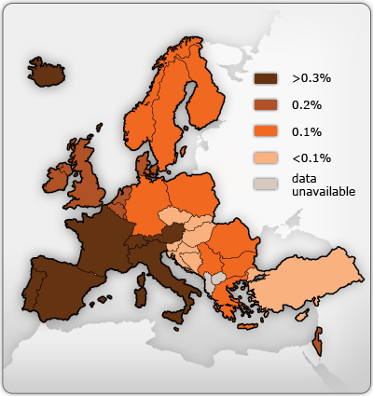
Croatia
-1100 persons with HIV(2013)
-60 new cases/year
-15 new cas./1 mil/year
Other EU countries:
57 new cas./mil/year

Slide 4
Route and risk of infection
Blood transfusinon = 100 %
Child born from untreated mother = 30%
Nidle-stic injury from HIV + = 1:300
Sexual (rectal =vaginal):
High viremia: 1% per intercourse
Low viremia: < 0,01% per intercourse
Repeated exposure : 1% per month
Gental ulcers increase risk by10 times
Kissing ?! = 0% HIV in not present in saliva

Slide 5
What decreases risk of infection?
Condoms (almost 100% reduction)
Blood supply control
1infection/0,5 mil transfusions = 0,000005%
Therapy of mother: risk for child <1%
Sterile nidles (nidle stick exchange) in IVU: 90% reduction

Slide 6
Pathogenesis
Viral gp120 binds to DC-SIGN of
dendritic cells (DC)
Attachment to CD4 (lymphocytotophic virus)
and CCR5 receptors (monocytotrophic virus)

Slide 8
Pathogenesis-continued
HIV crosses mucosa,
Transport by dendritic cells (Trojan horse) into the lymph nodes
Infection of T lymphocyte in the lymphnodes
Replication and release of HIV,
Infection of new lyphocytes- rise of viremia (millions/ml)
After 2-3 weeks of “incubation”
Acute retroviral syndrome

Slide 9
Pathogenesis-continued

Slide 10
Pathogenesis-continued
2-4-weeks after acute retroviral sy.
Immune response awakes
Antibodies + Specific cytotoxic T cells appear
Tansient control of HIV replication is established
Drop of viremia to plato level
av. ≅ 30.0000 copies/mL
the higher plato level = the shorter duration of control
Clinical latency

Slide 11
Pathogenesis-continued

Slide 12
Pathogenesis-continued
After latent period
CD4 cell count drop progressively
HIV replication inceases exponentially
CD4 cel count < 200/ml - opportunistic infections appear

Slide 14
Type of progression | Years to symptomatic infections (CD4 <200/mL)
Typical | 8-10 y
Rapid | 1-2 y
Slow | >10 y
Long-term non-progressors | virtually never

Slide 15
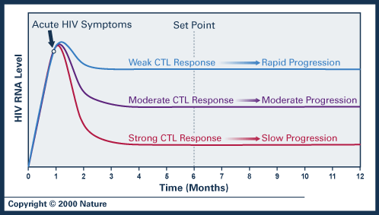
Progression inversely correlates with viral load plateau:
the lower is viral load = the better is cytotoxic T-ly response

Slide 16
Factors influencing progression of HIV infection
Generaly not well understood
Age:
Fetal infection ………. more rapid progression
Younger adult age …… slower progression
Older adult age ……… more rapid progression

Slide 17
Acute HIV infection
Clinical feature

Slide 18
Asymptomatic early infection
PGL- peristent genelised lymphadenopathy
Afebrile
Enlargment of lymphnodes in ≥2 areas
Lymphnode diamenter ≥ 1cm
No other etiology confirmed

Slide 19
Acute HIV syndrome (tansient symptomatic disease)
Fever
Flu like disesase,
Rash, oral and genital ulcers
Pharyngitis
Lymphadenopathy
Aseptic meningitis (headake)

Slide 20
Pink-to-red macules or maculopapules: trunk, neck, face
Painful oral and genital ulcers
Symptoms resolve within 2 weeks
Lethargy and fatigue may perisit for months

Slide 21
LABORATORY
Leucocyte count: normal or slightly below normal
Liver transminases: moderately elevated
CSF (if positive): viral meningitis profile

Slide 22
Symptomatic HIV infection
Acquired Immune Deficiency Syndrome
(AIDS)

Slide 23
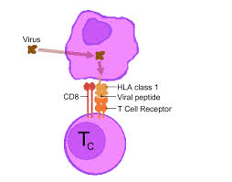
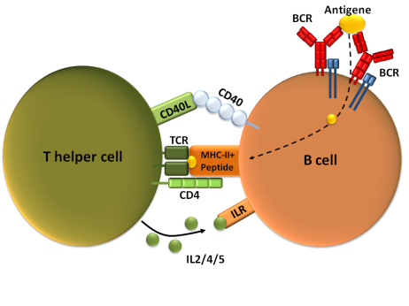
Cytotoxicity
(CD8)
Antibody production
(B cells)
CD4
-T helper-

Slide 24
Decreased CD4 cell count
Critical = 200 /mL
Exogenous infections: repeated and prologed
S.penumoniae, non-typhiod Samonella
Reactivation of latent infections
Infections caused by opportunistic pathognes
Developement of malignancies

Slide 25
Reactivation of latent infections Infections caused by opportunistic pathognes
Bacterial: Mycobacterium tbc, atypical mycobacteria (MAC)
Fungal: Candida, Pneumocystis j., Crypotococcus, Histoplasma
Viral: CMV, HSV, VZV, EBV,HHV, poliomaJCV*
Protozal : Toxoplasma g., Cryptosporidium, Isospora belli
Roundworm: Strongiloides stercoralis
* JCV (John Cunningham virus)
Notes:
JCV (John Cunningham virus)

Slide 26
Indicator diseas of AIDS in adults
Bacterial infections
Recurrent bacterial pnemonia ( ≥ 2 episodes/1 month)
Recurrent Salmonella septicema or prolonged diarrhoea
Pulmonary/extrapulmonary tuberculois
Disseminated Mycobacterium avium
Nocardiosis

Slide 27
Indicator conditions of AIDS in adults- continued
Fungal infections
Candidiasis: oesophagus, trachea, lungs
Pneumocystis jiroveci pneumonia
Cryptococcosis: extrapulmonary (CNS)
Extrapulmonary histoplasmosis

Slide 28
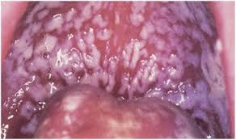
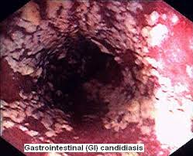
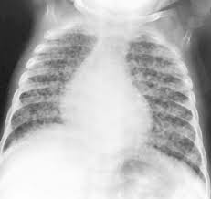
Candidiasis
Oral
Esophageal
Respiratory
Notes:
Oral, esofađial, rispiratry

Slide 29
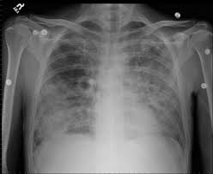
Pneumocystis jiroveci
SatO₂ ⬇
LHD ⬆
Notes:
Pniumositis điroveći

Slide 30
Indicator conditions of AIDS in adults- continued
Viral infections
HSV: mucocutaneous ulcerations for more than 1 month
CMV: colitis, penumonia, etc. (ly.nodes, spleen, liver and eye- excluded)
JC V (John Cunninhamvirus) :
progressive multifocal leucoencephalopathy
Notes:
Mjukukitejnijus alcerejšns

Slide 31
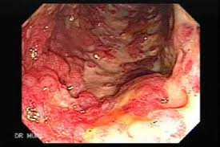
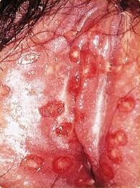
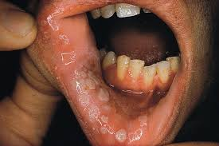
Genital HSV ulcerations
CMV ulcerative colitis
Oral HSV ulcerations

Slide 32
Indicator conditions of AIDS in adults- continued
Protozal infectios
Cryptosporidosis: diarrhoea for more than 1 month
Toxoplasmosis of internal organs (CNS)
Roundworm infection
Extraintestinal stongyloidiasis
Notes:
Mjukukitejnijus alcerejšns

Slide 33
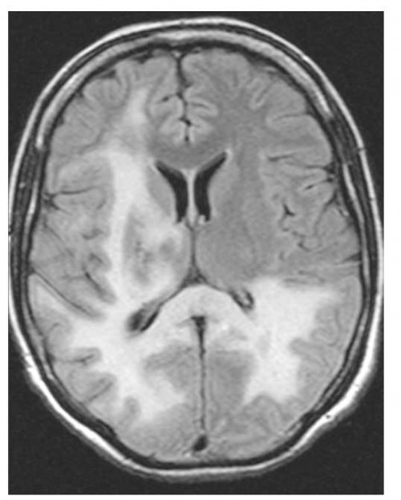
Indicator conditions of AIDS in adults- continued
Progressive multifocal
leucoencephalopathy
(PML)
JCV
 White matter inflammation
 Demyelinating disase

Slide 34
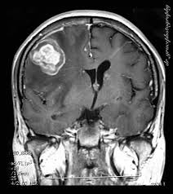
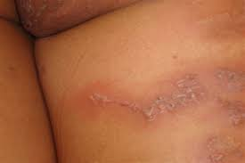
CNS toxoplasmosis
Extraintestinal stongyloidiasis
sepigonus subcutaneous infiltates
Notes:
Extraintestinal strogiloidajasis

Slide 35
Indicator conditions of AIDS in adults- continued
HIV-associated wasting :
Involuntary loss of >10% of weight
+
Chronic diarrhoea (more than 1 month) or chronica wekness
+
Prolonged enigmatic fever (more than 1 month).
HIV-associted dementia
Loos of cognitive functions
Notes:
los, kognitiv

Slide 37
Developement of malignancies
 | Virus
AIDS related
Caposi sarcoma | HHV-8
Non-Hodgkin B-cell lymphoma (systemic and CNS) | EBV ; HHV-8
Invasive cervical carcinoma | HPV
AIDS non-related
Leiomyosarcoma (pediatric) | EBV
Hepatocellular carcinoma | HCV, HBV
Hodgkin disease | EBV
Anal cancer | HPV

Slide 38
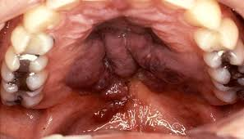
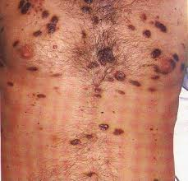
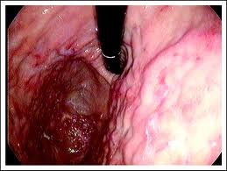
Caposi sarcoma
Oral
brownish skin infiltrates
brown to dark purple tumors
Intestinal

Slide 39
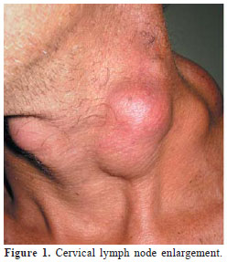
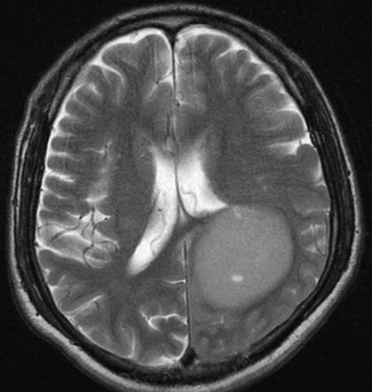
Non-hodgkin B cell lymphoma
(neck)
CNS B cell lymphoma (unilocular)

Slide 40
Diagnosis

Slide 41
Testing for HIV
anti-HIV: antibodies to envelope glycpoprotein gp120
99% sensitive and specific
window period ±18-24 days
95% become positive witnih 90 days
determined by 3rd and 4th generation ELISA
HIV Ag: protein p24
detectable in early (acute) infection
4th generation ELISA
PCR HIV-1 nucleic acids
Notes:
Antiiđen

Slide 42
4th generation ELISA- remcomended
Detection of p24Ag + anti-gp120 Ab
Confirmation with the same 4th gen.test
3rd generation ELISA
Detection of anti-gp120 Ab
Confirmation with Western blot is recquired

Slide 43
PCR HIV-1
Qualitiative (+ or -)
detection of revresely transcribed viral DNA (in CD4+cells)
useful in ELISA (anti-HIV) negative windov period
Qunatitative (number of copies/ml)
detection of viral RNA in plasma
used to determine level of viremia

Slide 44
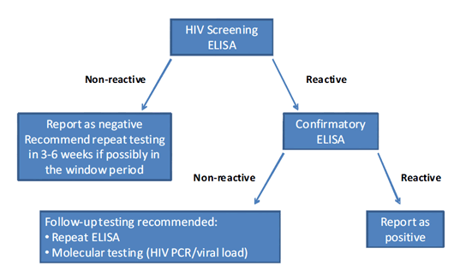
Diagnostic algorithm
Notes:
Ako je skrining učinjen s 4.generacijom ELIS, potvrdni test je isti, ako je s 3.gen. Potvrdni test je Western blot (aalgorithm)

Slide 45
THERAPY

Slide 46
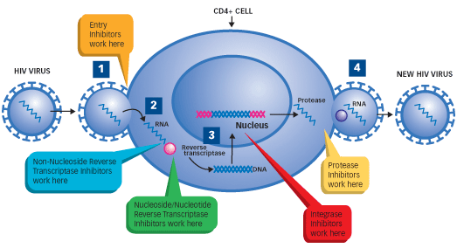
Target sites of action of antiretoviral therapy (ART)
1st line HAART

Slide 47
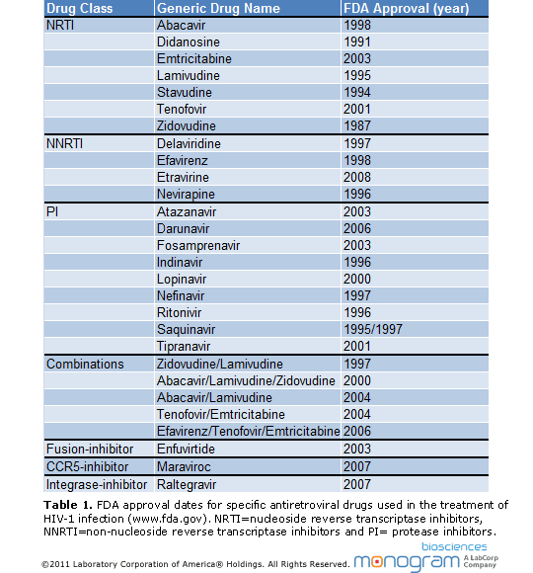
Nucleoside
Reverse Transcriptase Inhibitors
Non Nucleoside
Reverse Transcriptase Inhibitors
Protease Inhibotors
Entry inhibotor

Slide 48
HAART-Higly Active ART
Combination of at least 3 drugs:
First line: 2 NRTI + 1 PI (or 1 NNRTI)
Why HAART?
High rate of replication of HIV
Rapid development of resistence with monotherapy
Tretment goal
Maintenace of HIV RNA copies below 50/mL
(the best prevention of drug resistence )
Lifelong therapy reqiured

Slide 49
When to start therapy?
Should be guided by the number of CD4:
CD4 count below 350/mL- strongly reccomanded
CD4 count 350-500/mL- moderately reccomanded
CD4 count above 500/mL- optional
ie: high level od HIV RNA (rapid progressor)

Slide 50
Disadvantages of HAART
Lifelong therapy
Frequent drug toxicity
Dug interaction
(prophylaxis or therapy of opportunistic infections)
Resistant HIV quasipecies may occur
Monitoring of CD4 cell count recquired
Monitoring of HIV RNA level recquired
Patient’s high motivation and compliance are essential

