Slide 1
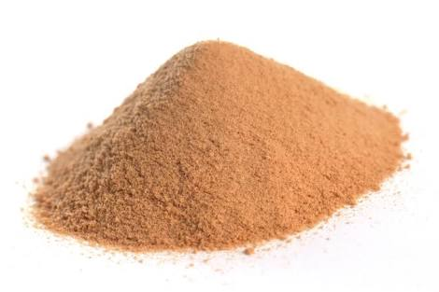
Tayammum
تَيَمُّم

Slide 2
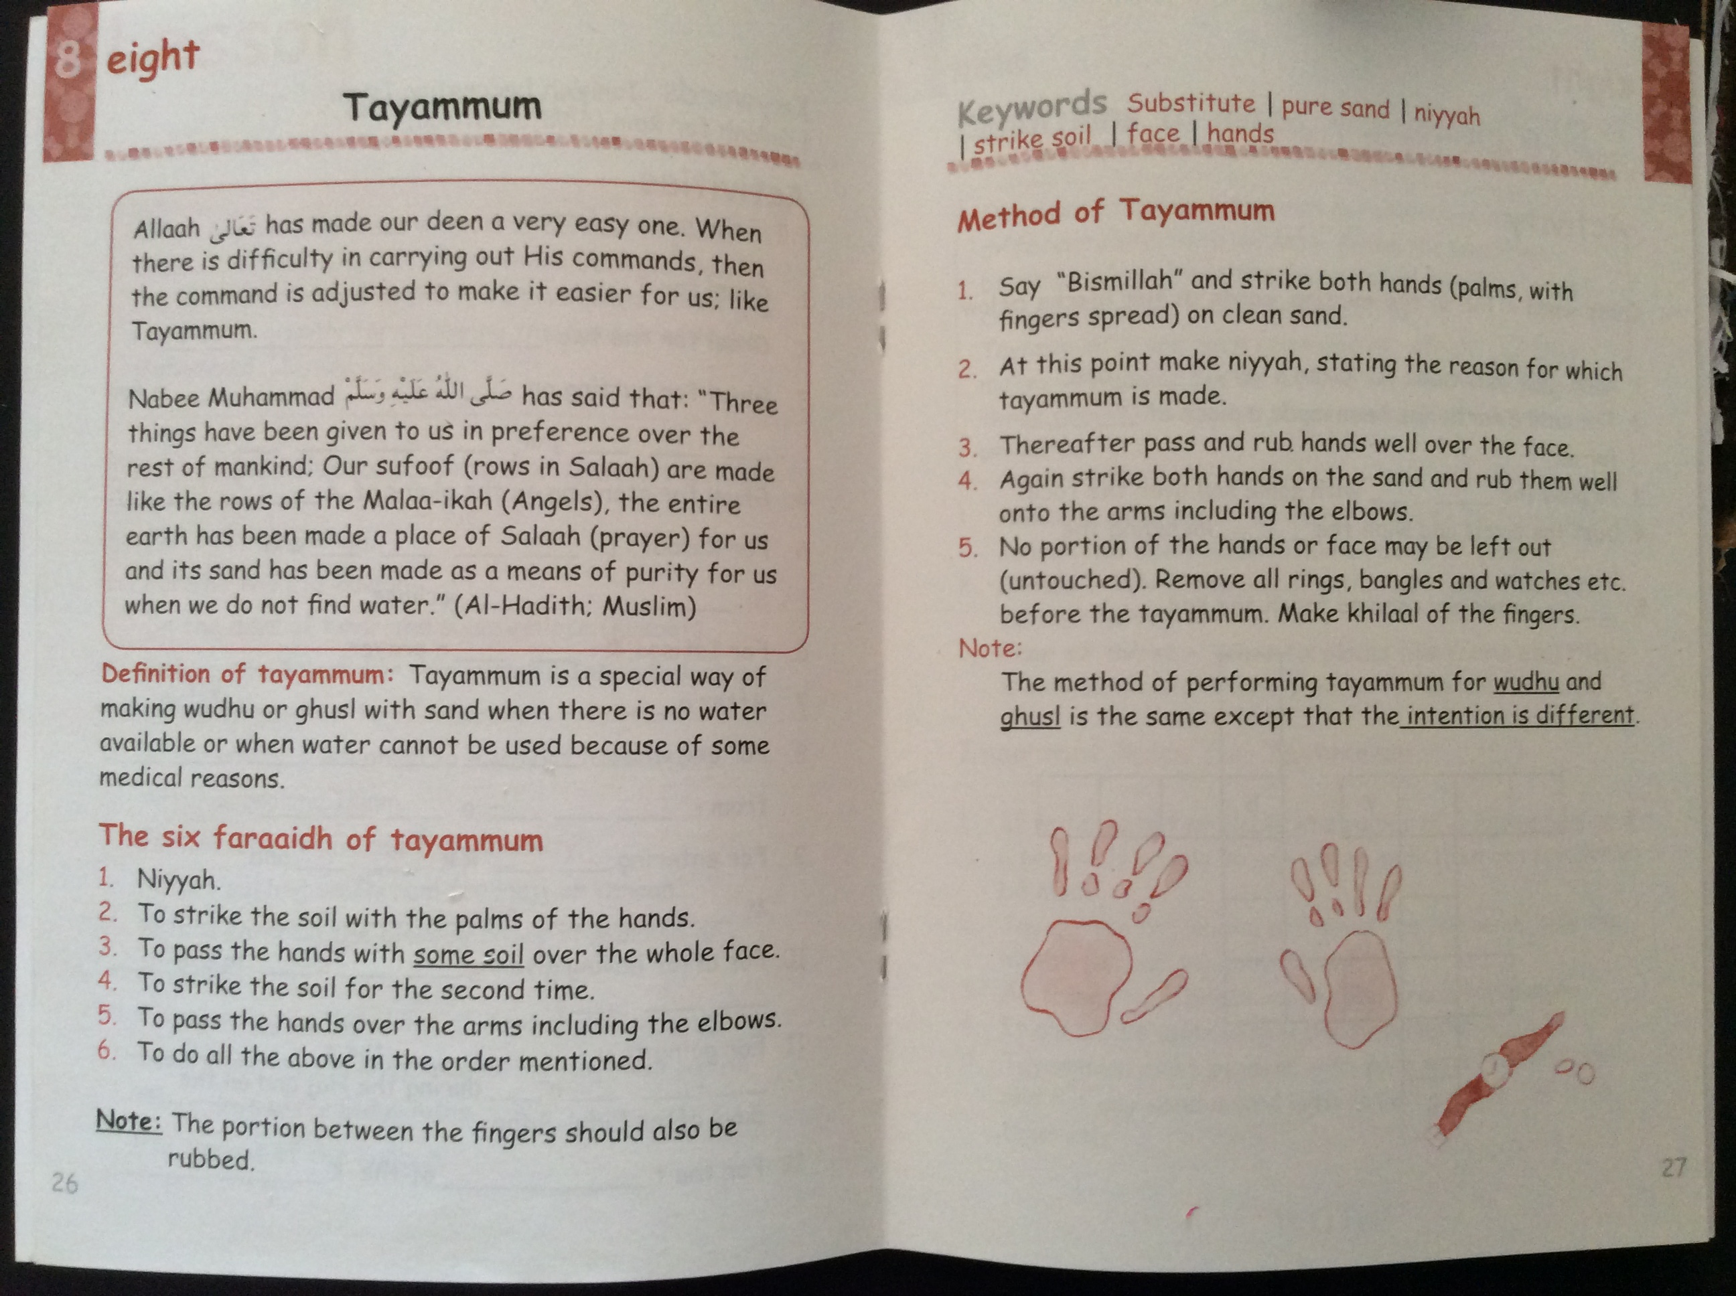

Slide 3
Outcome
Text
Learner needs to understand the concept
Learner needs to understand the Reason
Learner needs to know the Faraaidh
Learner needs to know the Method

Slide 4
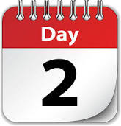
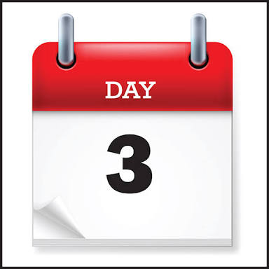
DAY
OUTCOME
RESOURCES
Explain the Concept
Write topic on the board
Question the learner.
Bring a picture of sand / drought
Explain the Definition
Revision
6 Faraaidh of
Tayammum
Question the learner on the previous lesson
Write the six Faraaidh on the board
Let the learner recap
Recap
Take the learners outside
Practical demonstration by Muallim
One demonstrate One test
Revision
Method

Slide 6
Draw up a lesson plan

