Slide 1
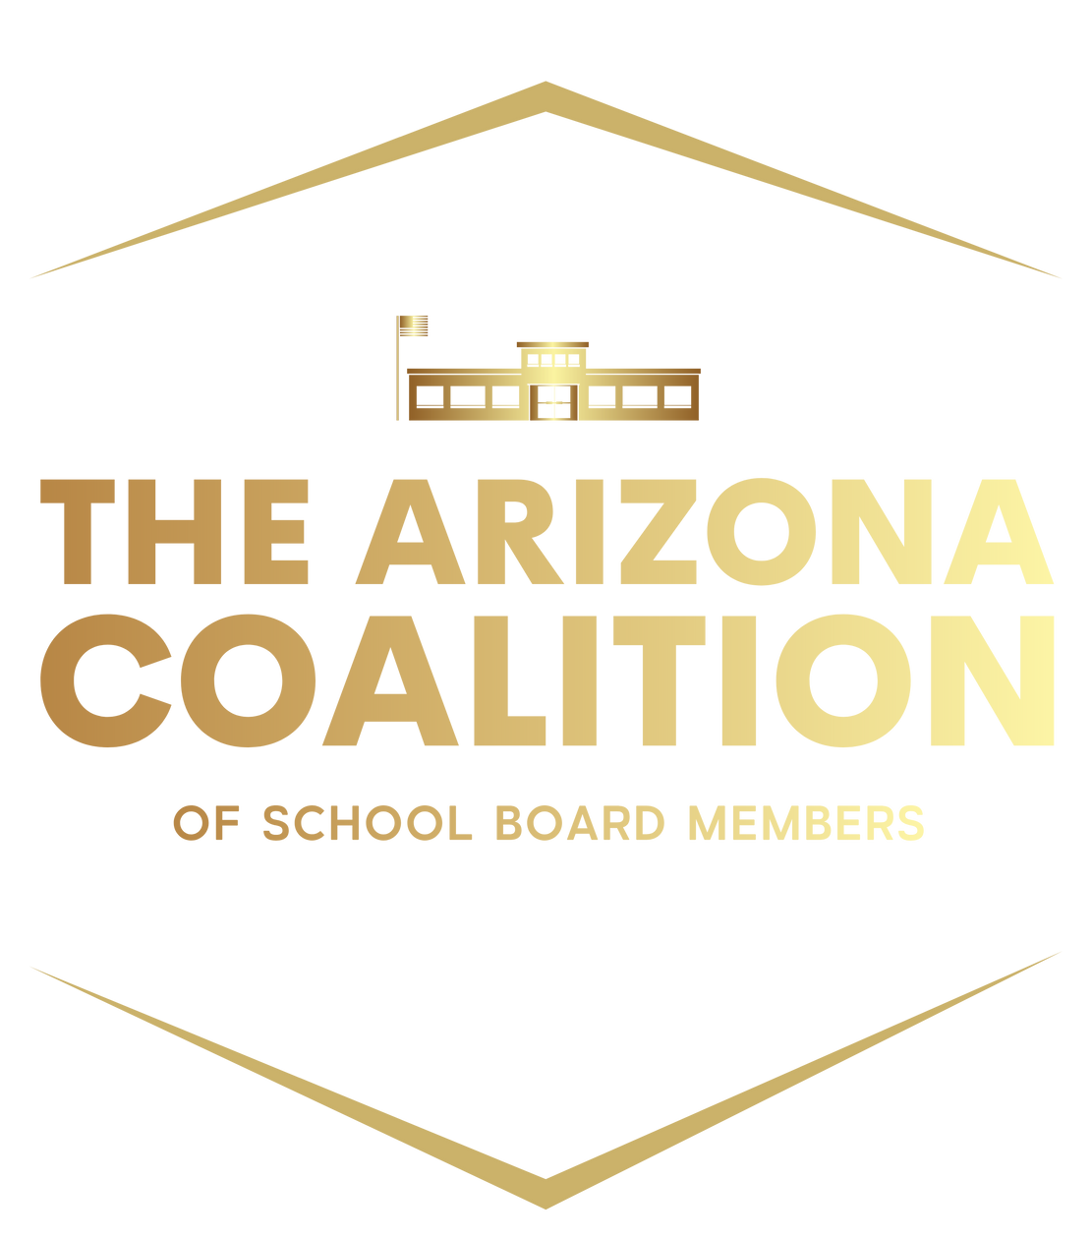

Slide 2
ARIZONA BUDGET TIMELINE
Meet & Confer Jan-March
Legislature Sine Die May-June
School Boards Approve Budget June
Adopted Budget (approved & uploaded) July 15
Annual Financial Report October 15
Preliminary School District Employee Report (SDER) October 15
Final Budget Revision (approved by Board) May 15

Slide 3
AUDITOR GENERAL RESOURCES
Uniform System of Financial Records (USFR)
Chart of Accounts
School District Financial Risk Analysis (FRISK)
School District Spending Report
COVID Spending
FAQs
Webinars

Slide 4
UNIFORM SYSTEM FINANCIAL RECORDS
FOR ARIZONA SCHOOL DISTRICTS
(USFR)
School District Governing Boards are the primary governing body of the Arizona public school system. Major district accounting and finance related duties and responsibilities of these boards include the following.
Maintain established schools as prescribed by law
Adopt the annual budget
Purchase, construct, manage, insure, rent, and sell school buildings, furniture, equipment, supplies, and other assets
Employ personnel and establish their salaries
Accept revenues and authorize expenditures
Implement the policies and procedures prescribed by the USFR, including controls that comply with the requirements of the USFR

Slide 5
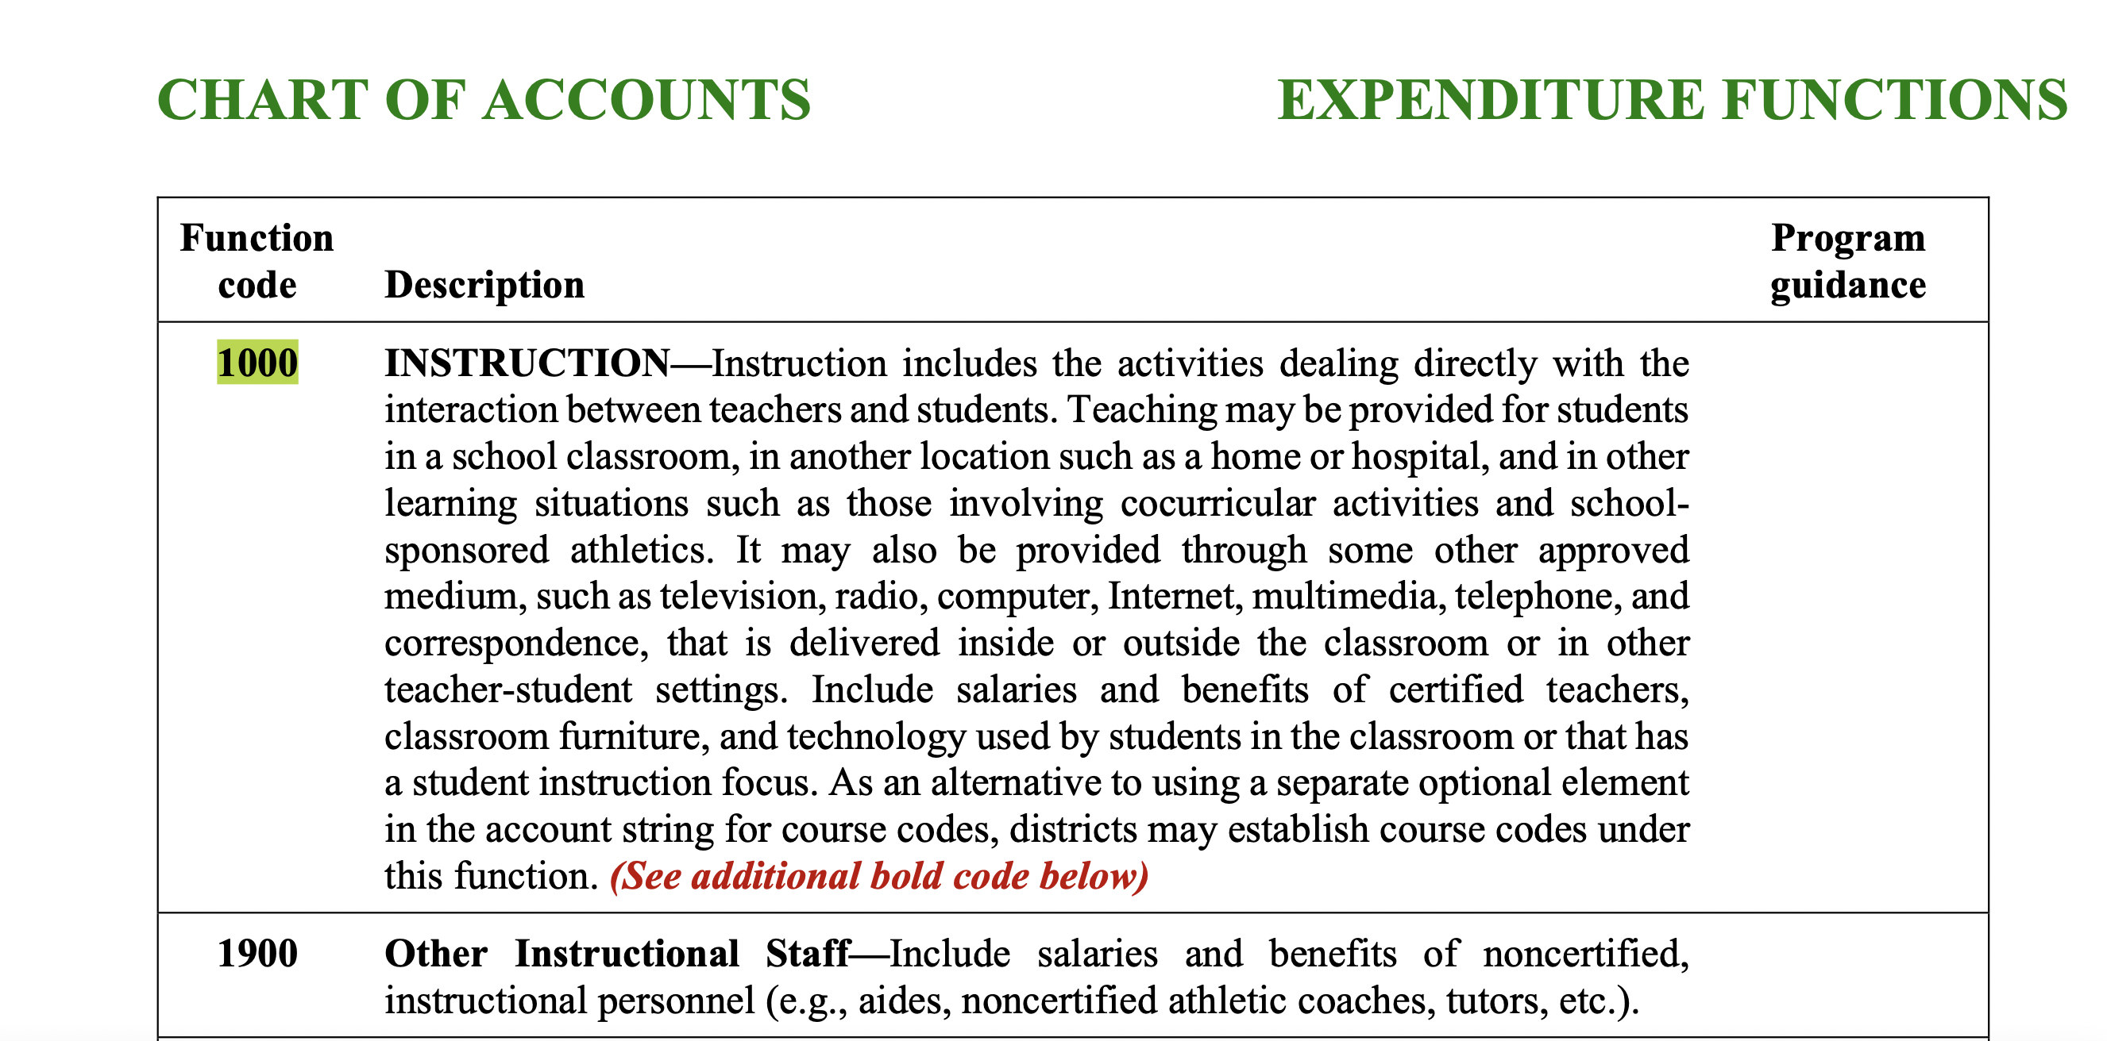
CHART OF ACCOUNTS

Slide 6
COVID REPORT

Slide 7
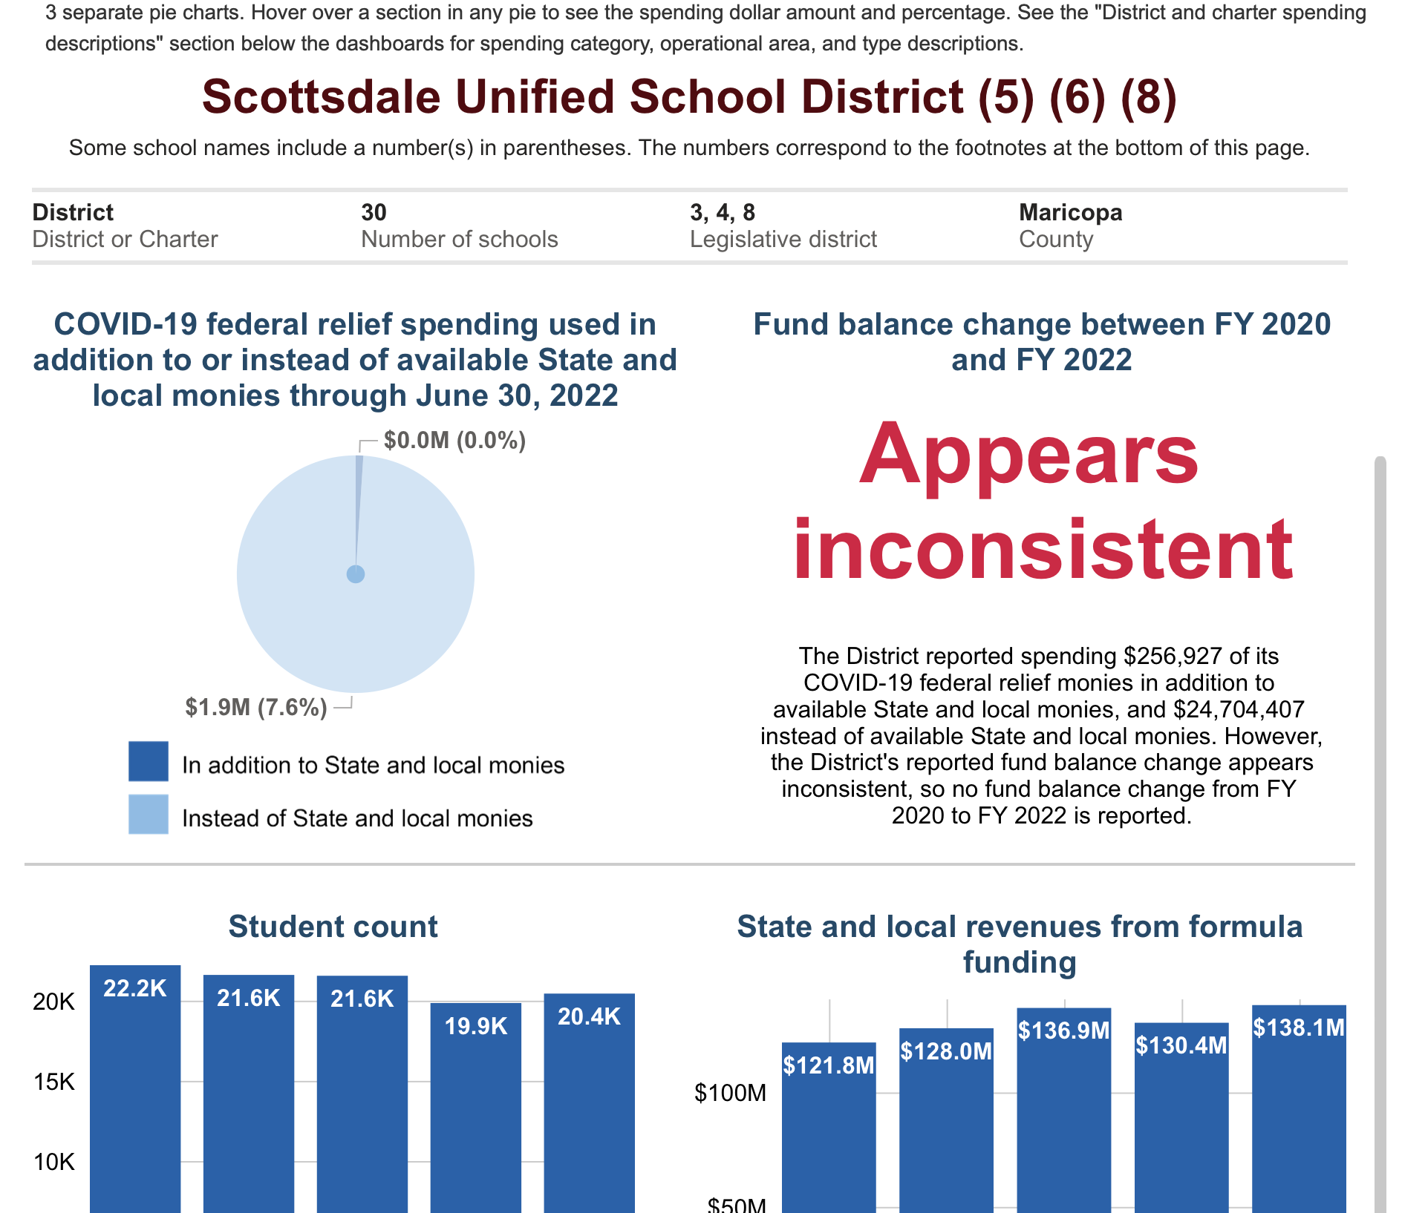
COVID REPORT (cont.)

Slide 8
SCHOOL DISTRICT FINANCIAL RISK ANALYSIS (FRISK)

Slide 9
SCHOOL DISTRICT FINANCIAL RISK ANALYSIS (cont.) (FRISK)

Slide 10
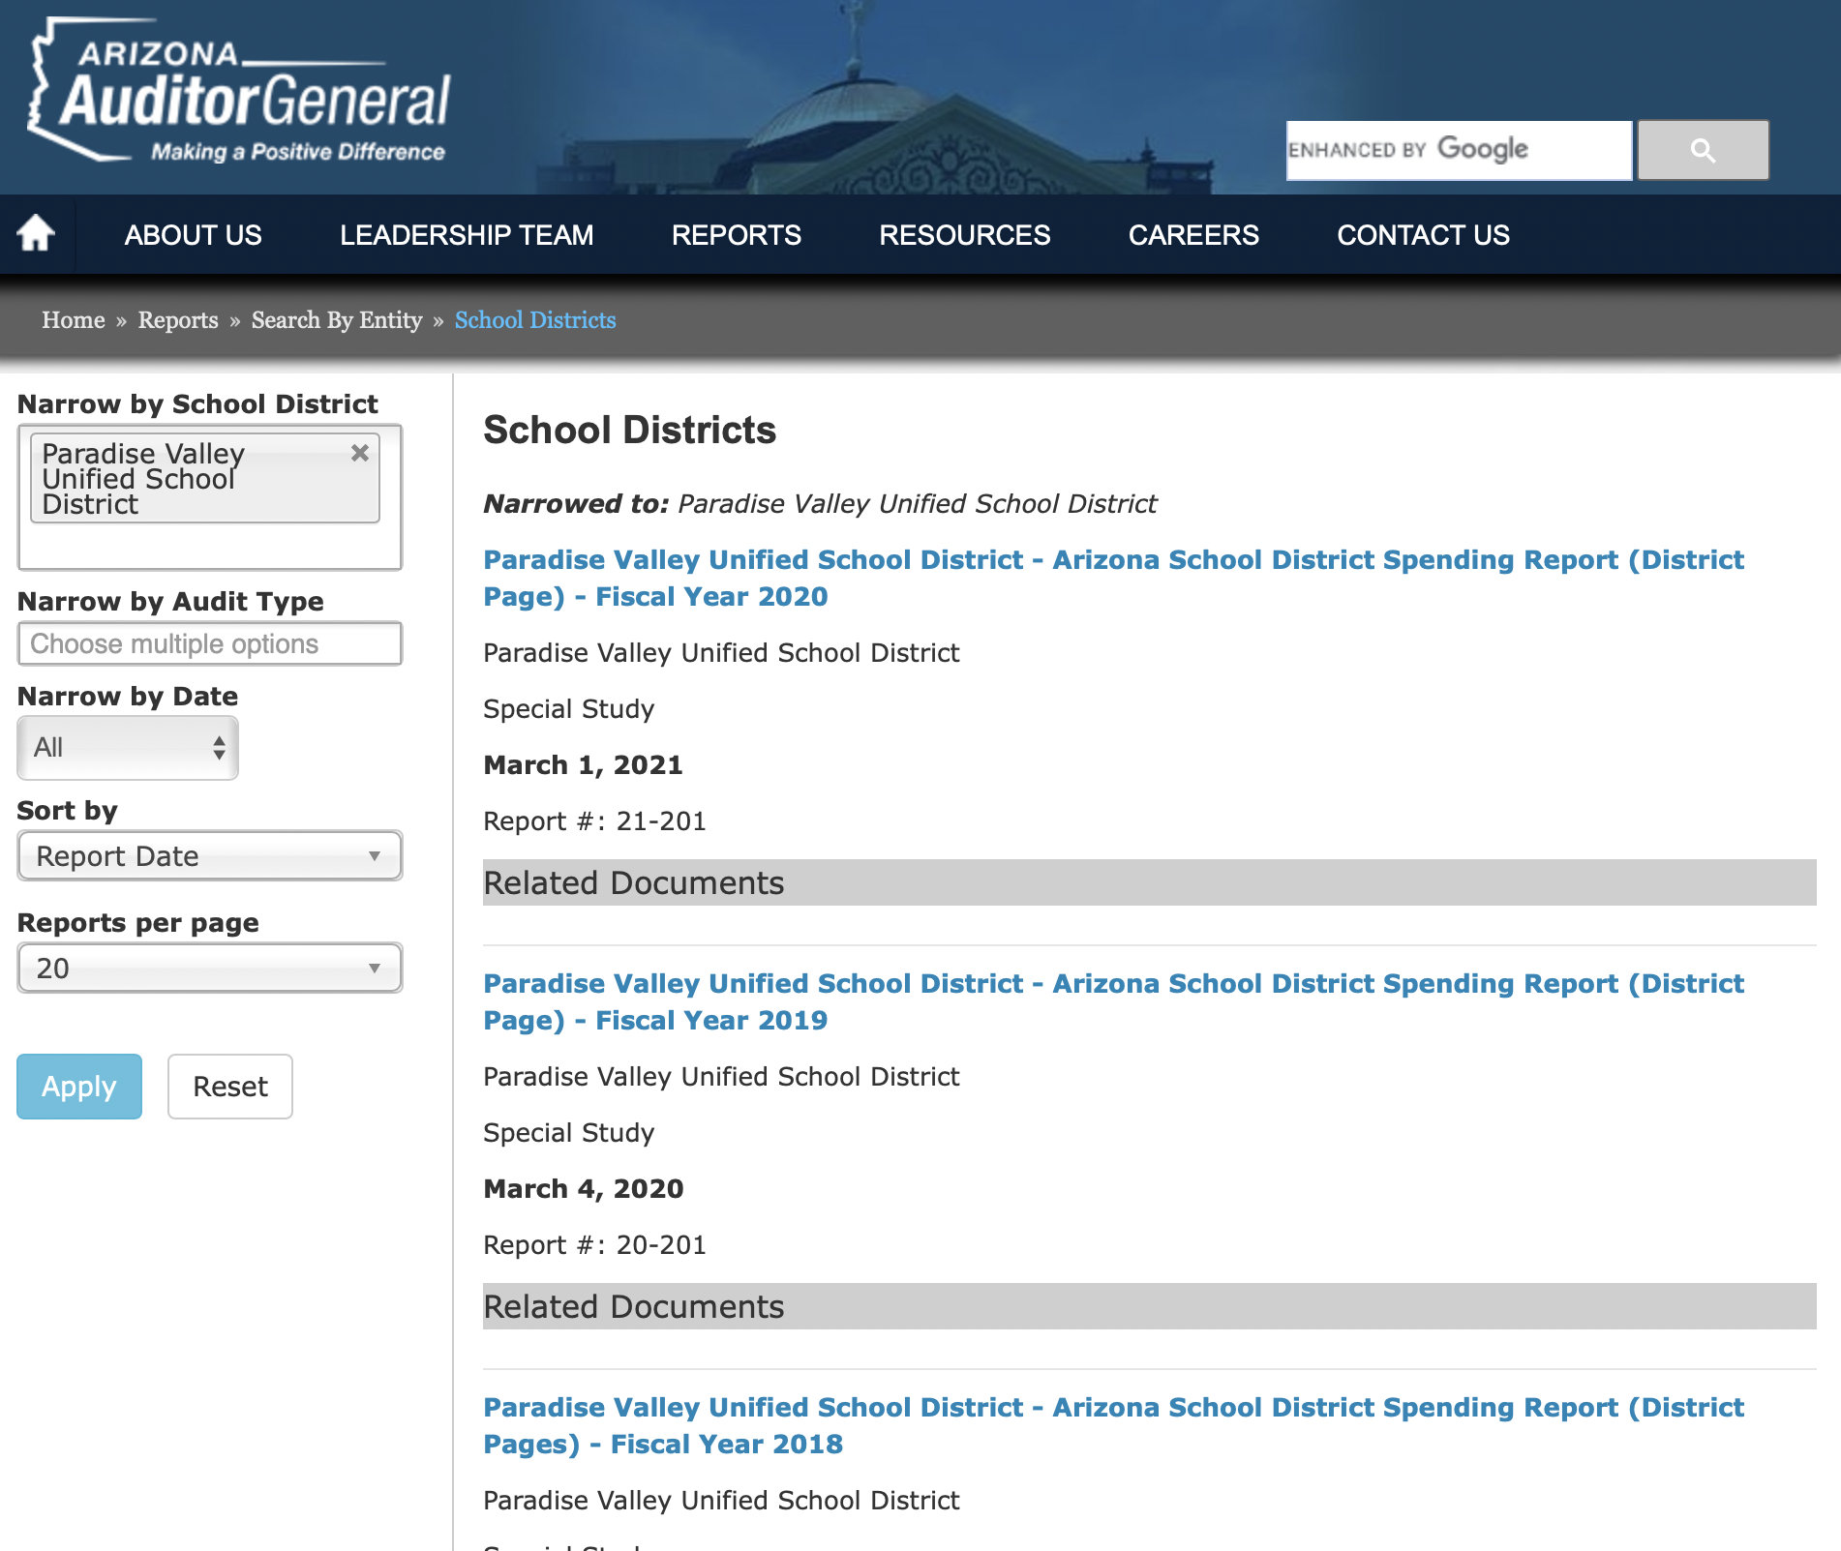
SCHOOL DISTRICT SPENDING REPORT

Slide 11
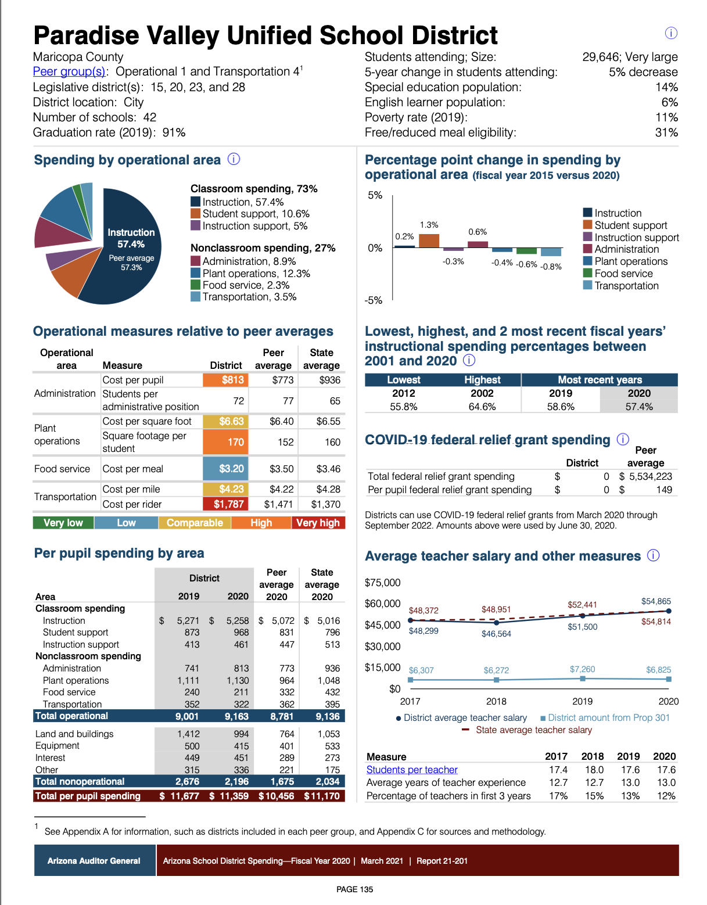
SCHOOL DISTRICT SPENDING REPORT (cont.)

Slide 12
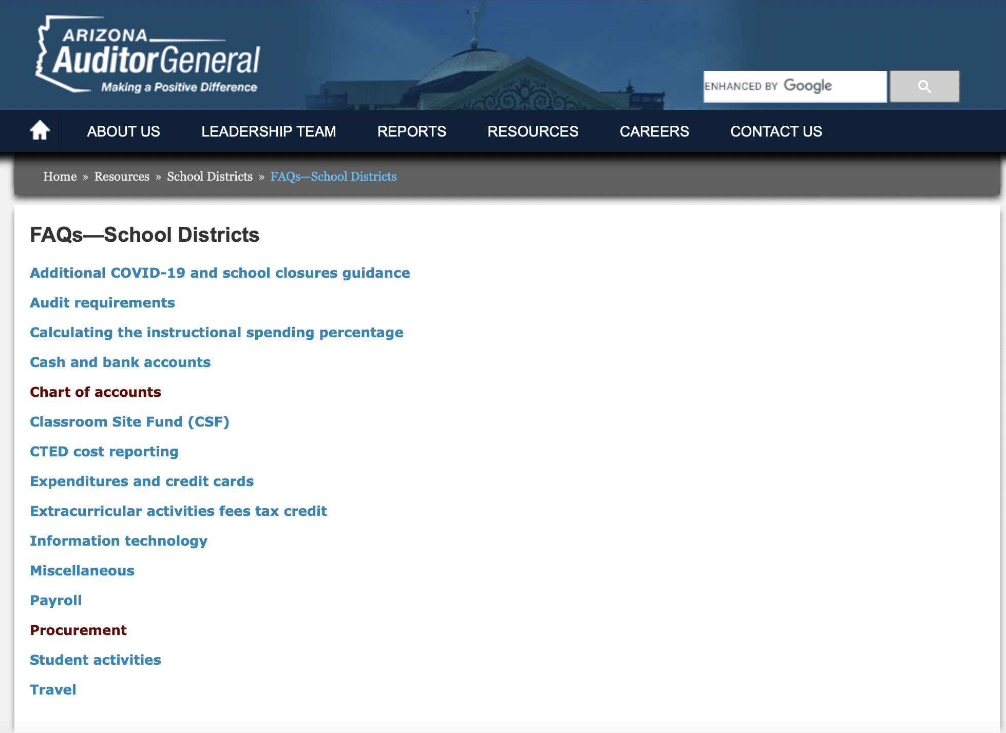
FAQs – SCHOOL DISTRICTS

Slide 13
FAQs – SCHOOL DISTRICTS (cont.)

Slide 14
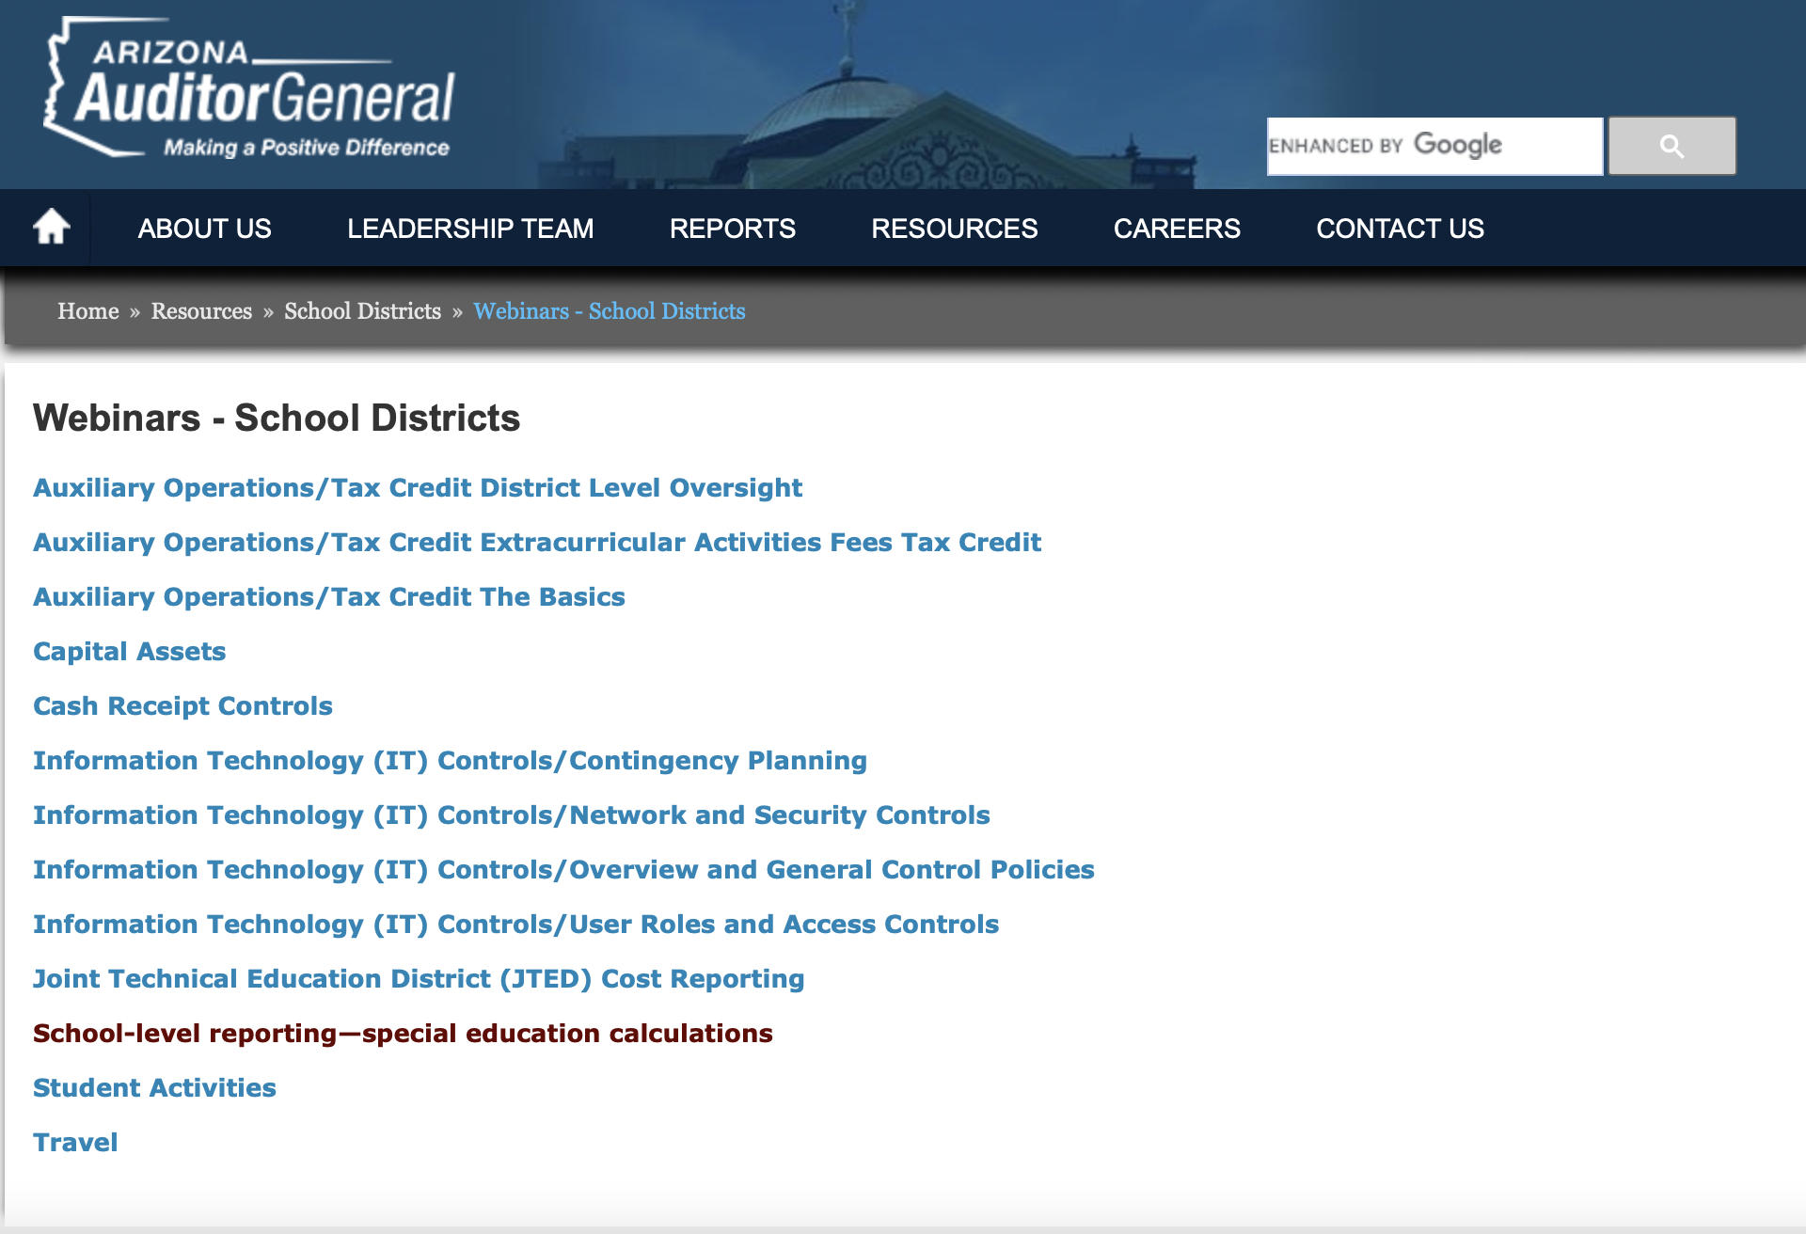
WEBINARS

Slide 15
UPCOMING AUDITOR GENERAL TRAINING for COALITION MEMBERS
Auditor General’s COVID-19 Special Spending Report and the School District Financial Risk Analysis
Presentation on Auditor General’s Fiscal Year 2022 School District Spending Report
March 2
4 PM
April 11
4 PM

Slide 16
AUDITOR GENERAL
CONTACT INFORMATION
Auditor General Boardmember Hotline
602-977-2796

Slide 17
azcoalition.org
@TheAZCoalition

