Slide 1
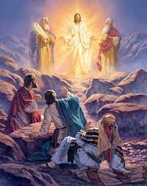
Trinity Evangelical Lutheran Church
February 19, 2023
WELCOME!
1. Gather
2. Word
3. Meal
4. Sending
Notes:
Image: Five Loaves by Caroline Coolidge Brown. Copyright © Caroline Coolidge Brown. All rights reserved. Used by permission of the artist.

Slide 2

= Please stand if able
= Please be seated
1. Gather
Prelude – Roxanne Groff
Office of the Acolyte
Ringing of the Bell
Welcome
Notes:
Image: Five Loaves by Caroline Coolidge Brown. Copyright © Caroline Coolidge Brown. All rights reserved. Used by permission of the artist.

Slide 3
1. Gather
CONFESSION
AND
FORGIVENESS
All may make the sign of the cross, the sign marked at baptism…
L: We confess our sins before God and one another.
Pause for silence and reflection.
L: Merciful God…
Notes:
Image: Five Loaves by Caroline Coolidge Brown. Copyright © Caroline Coolidge Brown. All rights reserved. Used by permission of the artist.

Slide 4

CONFESSION AND FORGIVENESS
C: Christ came into the world and showed us how to live, but we have failed to live by what he taught. We have not loved you with all our heart, soul, mind and strength, we have not done to others as we would have done to ourselves. Shine a light on our hearts, that we might turn from the shadows of our sin and walk in your ways.
Notes:
Image: Five Loaves by Caroline Coolidge Brown. Copyright © Caroline Coolidge Brown. All rights reserved. Used by permission of the artist.

Slide 5
CONFESSION AND FORGIVENESS
L: Jesus came not to condemn the world, but that the world might be saved through him. By his abundant love, all your sins are forgiven, that you might walk in the light of Christ.
C: Amen.
Notes:
Image: Five Loaves by Caroline Coolidge Brown. Copyright © Caroline Coolidge Brown. All rights reserved. Used by permission of the artist.

Slide 6
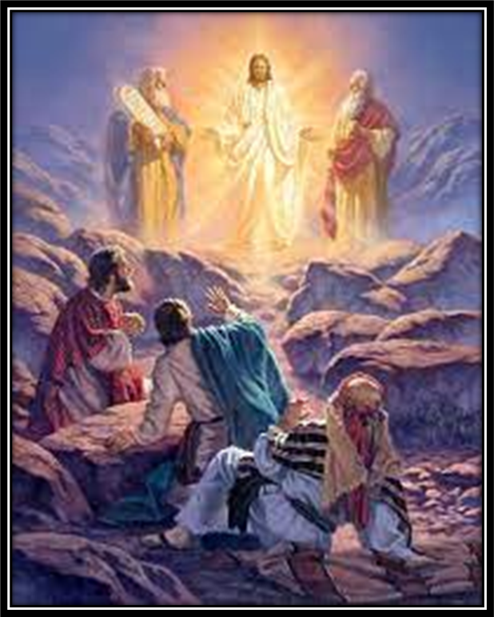
GATHERING SONG
1. Gather
“How Good Lord To Be Here”
LBW 89
Notes:
Image: Five Loaves by Caroline Coolidge Brown. Copyright © Caroline Coolidge Brown. All rights reserved. Used by permission of the artist.

Slide 7
1. Gather
How Good Lord To Be Here–LBW 89
1 How good, Lord, to be here!
Your glory fills the night;
your face and garments, like the sun,
shine with unborrowed light.
2 How good, Lord, to be here!
your beauty to behold
where Moses and Elijah stand,
your messengers of old.
Notes:
Image: Preparing yeast dough. Copyright © tomasworks/iStock/Thinkstock. Used by permission.

Slide 8
1. Gather
How Good Lord To Be Here–LBW 89
3 Fulfiller of the past
and hope of things to be,
we hail your body glorified
and our redemption see.
4 Before we taste of death,
we see your kingdom come;
we long to hold the vision bright
and make this hill our home.
Notes:
Image: Preparing yeast dough. Copyright © tomasworks/iStock/Thinkstock. Used by permission.

Slide 9
1. Gather
How Good Lord To Be Here–LBW 89
5 How good, Lord, to be here!
Yet we may not remain;
but since you bid us leave the mount,
come with us to the plain.
Notes:
Image: Preparing yeast dough. Copyright © tomasworks/iStock/Thinkstock. Used by permission.

Slide 10
1. Gather
APOSTOLIC GREETING
P: The grace of our Lord Jesus Christ, the love of God, and the communion of the Holy Spirit be with you all.
C: And also with you.
Notes:
Image: Five Loaves by Caroline Coolidge Brown. Copyright © Caroline Coolidge Brown. All rights reserved. Used by permission of the artist.

Slide 11
1. Gather
KYRIE
P: In peace let us pray to the Lord.
C: Lord have mercy.
P: For the peace from above, and for our salvation, let us pray to the Lord.
C: Lord have mercy.
P: For the peace of the whole world, for the well being of the Church of God, and for the unity of all, let us pray to the Lord.
C: Lord have mercy.
Notes:
Image: Five Loaves by Caroline Coolidge Brown. Copyright © Caroline Coolidge Brown. All rights reserved. Used by permission of the artist.

Slide 12
1. Gather
KYRIE
P: For this Holy House, and for all who offer here their worship and praise, let us pray to the Lord.
C: Lord have mercy.
P: Help, save, and defend us, gracious Lord.
C: Amen.
Notes:
Image: Five Loaves by Caroline Coolidge Brown. Copyright © Caroline Coolidge Brown. All rights reserved. Used by permission of the artist.

Slide 13
1. Gather
PRAYER OF THE DAY
P: Let us pray… Almighty God, you call us to listen to your Son, and follow him in all things. Transform our hearts with your love that we might continue his ministry of healing and reconciliation in the world.
C: Amen.
Notes:
Image: Five Loaves by Caroline Coolidge Brown. Copyright © Caroline Coolidge Brown. All rights reserved. Used by permission of the artist.

Slide 14
Word
Gather
Sending
Meal
Notes:
Image: Preparing yeast dough. Copyright © tomasworks/iStock/Thinkstock. Used by permission.

Slide 15

Word
Notes:
Image: Preparing yeast dough. Copyright © tomasworks/iStock/Thinkstock. Used by permission.

Slide 16

Word
Notes:
Image: Preparing yeast dough. Copyright © tomasworks/iStock/Thinkstock. Used by permission.

Slide 17
Scripture Reading
Word
R: The Holy Gospel according to Saint Matthew, the 16th and 17th chapters.
C: Glory to you O’ Lord! (Spoken)
Notes:
Image: Five Loaves by Caroline Coolidge Brown. Copyright © Caroline Coolidge Brown. All rights reserved. Used by permission of the artist.

Slide 18
Word
Matthew 16:24 – 17:8
Chapter 16
²⁴Then Jesus told his disciples, “If any want to become my followers, let them deny themselves and take up their cross and follow me. ²⁵For those who want to save their life will lose it, and those who lose their life for my sake will find it. ²⁶For what will it profit them if they gain the whole world but forfeit
Notes:
Image: Five Loaves by Caroline Coolidge Brown. Copyright © Caroline Coolidge Brown. All rights reserved. Used by permission of the artist.

Slide 19
Word
Matthew 16:24 – 17:8
their life? Or what will they give in return for their life? ²⁷“For the Son of Man is to come with his angels in the glory of his Father, and then he will repay everyone for what has been done. ²⁸Truly I tell you, there are some standing here who will not taste death before they see the Son of Man coming in his kingdom.”
Notes:
Image: Five Loaves by Caroline Coolidge Brown. Copyright © Caroline Coolidge Brown. All rights reserved. Used by permission of the artist.

Slide 20
Word
Matthew 16:24 – 17:8
Chapter 17
Six days later, Jesus took with him Peter and James and his brother John and led them up a high mountain, by themselves. ²And he was transfigured before them, and his face shone like the sun, and his clothes became dazzling white. ³Suddenly there appeared to them Moses and Elijah, talking with
Notes:
Image: Five Loaves by Caroline Coolidge Brown. Copyright © Caroline Coolidge Brown. All rights reserved. Used by permission of the artist.

Slide 21
Word
Matthew 16:24 – 17:8
him. ⁴Then Peter said to Jesus, “Lord, it is good for us to be here; if you wish, I will make three dwellings here, one for you, one for Moses, and one for Elijah.” ⁵While he was still speaking, suddenly a bright cloud overshadowed them, and from the cloud a voice said, “This is my Son, the Beloved; with him I am well pleased; listen to him!”
Notes:
Image: Five Loaves by Caroline Coolidge Brown. Copyright © Caroline Coolidge Brown. All rights reserved. Used by permission of the artist.

Slide 22
Word
Matthew 16:24 – 17:8
⁶When the disciples heard this, they fell to the ground and were overcome by fear. ⁷But Jesus came and touched them, saying, “Get up and do not be afraid.” ⁸And when they looked up, they saw no one except Jesus himself alone.
Notes:
Image: Five Loaves by Caroline Coolidge Brown. Copyright © Caroline Coolidge Brown. All rights reserved. Used by permission of the artist.

Slide 23
Word
Matthew 16:24 – 17:8
R: This is the Word of the Lord.
C: Praise to You, O Christ (Spoken)
Notes:
Image: Five Loaves by Caroline Coolidge Brown. Copyright © Caroline Coolidge Brown. All rights reserved. Used by permission of the artist.

Slide 24
Sermon
Word
Notes:
Image: Five Loaves by Caroline Coolidge Brown. Copyright © Caroline Coolidge Brown. All rights reserved. Used by permission of the artist.

Slide 25
Word
APOSTLE’S CREED
C: I believe in God, the Father almighty, creator of heaven and earth.

Slide 26
APOSTLE’S CREED
Word
C: I believe in Jesus Christ, his only Son, our Lord. He was conceived by the power of the Holy Spirit and born of the virgin Mary. He suffered under Pontius Pilate, was crucified, died, and was buried.

Slide 27
APOSTLE’S CREED
Word
C: He descended into hell. On the third day he rose again. He ascended into heaven, and is seated at the right hand of the Father. He will come again to judge the living and the dead.

Slide 28
APOSTLE’S CREED
Word
C: I believe in the Holy Spirit, the holy catholic Church, the communion of saints, the forgiveness of sins, the resurrection of the body, and the life everlasting. Amen.

Slide 29
NICENE CREED
Word
C: We believe in one God, the Father, the Almighty, maker of heaven and earth, of all that is, seen and unseen.

Slide 30
NICENE CREED
Word
C: We believe in one Lord, Jesus Christ, the only Son of God, eternally begotten of the Father, God from God, Light from Light, true God from true God, begotten, not made, of one Being with the Father.

Slide 31
NICENE CREED
Word
C: Through him all things were made. For us and for our salvation he came down from heaven; by the power of the Holy Spirit he became incarnate from the virgin Mary, and was made man. For our sake he was crucified under Pontius Pilate;

Slide 32
NICENE CREED
Word
C: he suffered death and was buried. On the third day he rose again in accordance with the Scriptures; he ascended into heaven and is seated at the right hand of the Father. He will come again in glory to judge the living and the dead, and his kingdom will have no end.

Slide 33
NICENE CREED
Word
C: We believe in the Holy Spirit, the Lord, the giver of life, who proceeds from the Father and the Son. With the Father and the Son he is worshiped and glorified. He has spoken through the prophets. We believe in one holy catholic and apostolic Church.

Slide 34
NICENE CREED
Word
C: We acknowledge one Baptism for the forgiveness of sins. We look for the resurrection of the dead, and the life of the world to come. Amen.

Slide 35
PRAYERS OF INTERCESSION
Word
Each petition will end with the words,
A: Merciful God,
The congregation will respond with:
C: You hear our prayer.

Slide 36
PRAYERS OF INTERCESSION
Word
The prayer concludes…
P: Receive our prayers and hold all for whom we pray in your loving arms, in the name of your son, Jesus Christ.
C: Amen.

Slide 37
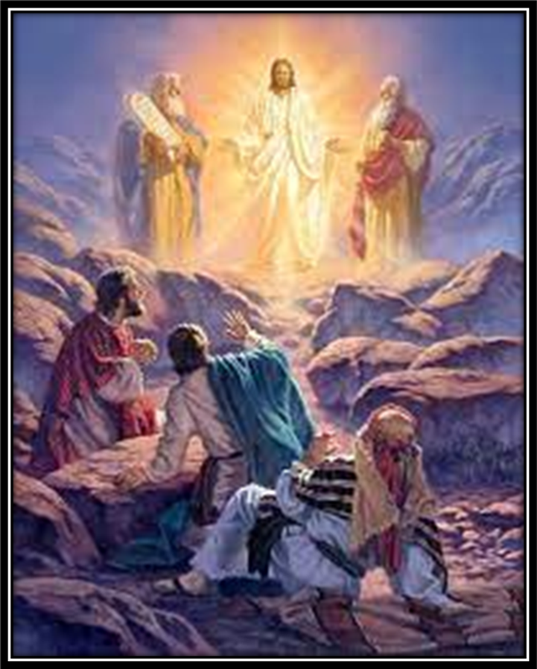
OFFERING
OFFERTORY PRAYER
Gather
Word
Sending
Meal
Notes:
Image: Five Loaves by Caroline Coolidge Brown. Copyright © Caroline Coolidge Brown. All rights reserved. Used by permission of the artist.

Slide 38
DIALOGUE
Meal

Slide 39
DIALOGUE
Meal

Slide 40
THE PREFACE
P: It is indeed right and salutary…
… we praise your name and join their unending hymn.
Meal

Slide 41
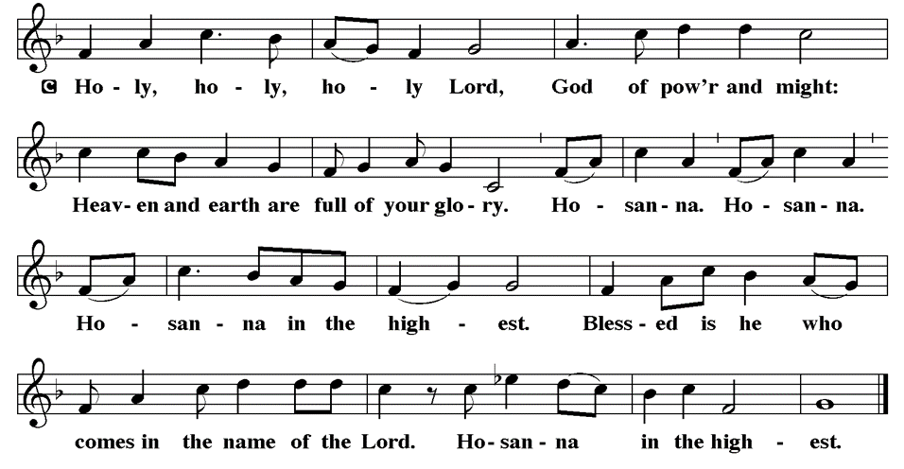
THE SANCTUS
Meal

Slide 42
THE SANCTUS
Meal

Slide 43
EUCHARISTIC PRAYER
P: Almighty Lord…
…With joy we tell our story: Alleluia!
C: Alleluia
P: We call for your Spirit…
… Amen, amen, amen, amen.
C: Amen, amen, amen, amen.
Meal

Slide 44
THE LORD’S PRAYER
C: Our Father, who art in heaven, hallowed be thy name, thy kingdom come, thy will be done, on earth as it is in heaven.
Meal

Slide 45
THE LORD’S PRAYER
C: Give us this day our daily bread; and forgive us our trespasses, as we forgive those who trespass against us; and lead us not into temptation, but deliver us from evil.
Meal

Slide 46
THE LORD’S PRAYER
C: For thine is the kingdom, and the power, and the glory, forever and ever. Amen.
Meal

Slide 47
INVITATION TO COMMUNION
P: It is good for us to be here in the presence of our savior, Jesus Christ, and all the saints, living and departed. Jesus invites you to the feast of all creation. Come and be fed.
Meal

Slide 48
COMMUNION DISTRIBUTION
Communion is by “Station”. The bread may be broken for distribution. As the ministers give the bread and wine, they say these words to each communicant:
The body of Christ, given for you.
The blood of Christ, shed for you.
The communicant may say: Amen.
Meal

Slide 49
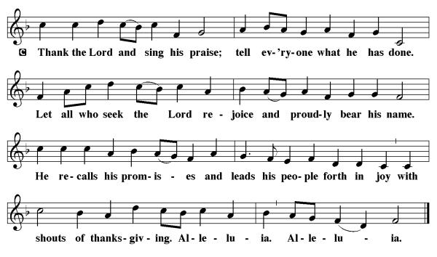
POST COMMUNION CANTACLE
Meal

Slide 50
POST COMMUNION CANTACLE
Meal

Slide 51
POST COMMUNION BLESSING
P: May this Body and Blood of our Lord and Savior, Jesus Christ, strengthen, keep, and unite us, ☩ now and forever.
C: Amen.
Meal

Slide 52
POST COMMUNION PRAYER
P: Let us pray… Holy One, we thank you for the healing that springs forth abundantly from this table. Renew our strength to do justice, love kindness, and journey humbly with you.
C: Amen
Meal

Slide 53
ANNOUNCEMENTS
Gather
Word
Meal
Sending
Notes:
Image: Five Loaves by Caroline Coolidge Brown. Copyright © Caroline Coolidge Brown. All rights reserved. Used by permission of the artist.

Slide 54
SENDING BLESSING
P: The God who faithfully brings forth justice and breaks the oppressor’s rod bless, strengthen, and uphold you, today and always.
C: Amen.
☩
Sending

Slide 55
Sending Song
“Beautiful Savior”
LBW 518
Sending
Notes:
Image: Five Loaves by Caroline Coolidge Brown. Copyright © Caroline Coolidge Brown. All rights reserved. Used by permission of the artist.

Slide 56
Beautiful Savior LBW 518
1 Beautiful Savior,
King of creation,
Son of God and Son of Man!
Truly I'd love thee,
truly I'd serve thee,
light of my soul, my joy, my crown.
Sending
Notes:
Image: Preparing yeast dough. Copyright © tomasworks/iStock/Thinkstock. Used by permission.

Slide 57
Beautiful Savior LBW 518
2 Fair are the meadows,
fair are the woodlands,
robed in flow'rs of blooming spring;
Jesus is fairer,
Jesus is purer,
he makes our sorrowing spirit sing.
Sending
Notes:
Image: Preparing yeast dough. Copyright © tomasworks/iStock/Thinkstock. Used by permission.

Slide 58
Beautiful Savior LBW 518
3 Fair is the sunshine,
fair is the moonlight,
bright the sparkling stars on high;
Jesus shines brighter,
Jesus shines purer
than all the angels in the sky.
Sending
Notes:
Image: Preparing yeast dough. Copyright © tomasworks/iStock/Thinkstock. Used by permission.

Slide 59
Beautiful Savior LBW 518
4 Beautiful Savior,
Lord of the nations,
Son of God and Son of Man!
Glory and honor,
praise, adoration,
now and forevermore be thine!
Sending
Notes:
Image: Preparing yeast dough. Copyright © tomasworks/iStock/Thinkstock. Used by permission.

Slide 60
DISMISSAL
P: … depart in Christ’s Love.
C: Seeking, welcoming, and serving all. Amen!
POSTLUDE
By
Roxanne Groff
From sundaysandseasons.com. Copyright © 2023 Augsburg Fortress. All rights reserved. Reprinted by permission under Augsburg Fortress Liturgies Annual License #SAS023830. New Revised Standard Version Bible, Copyright © 1989, Division of Christian Education of the National Council of the Churches of Christ in the United States of America. Used by permission. All rights reserved. Revised Common Lectionary, Copyright © 1992 Consultation on Common Texts, admin Augsburg Fortress. Used by permission.
Sending

