Slide 1
The Shadow Over The Manger
Born To Die
John 12:23-33

Slide 2
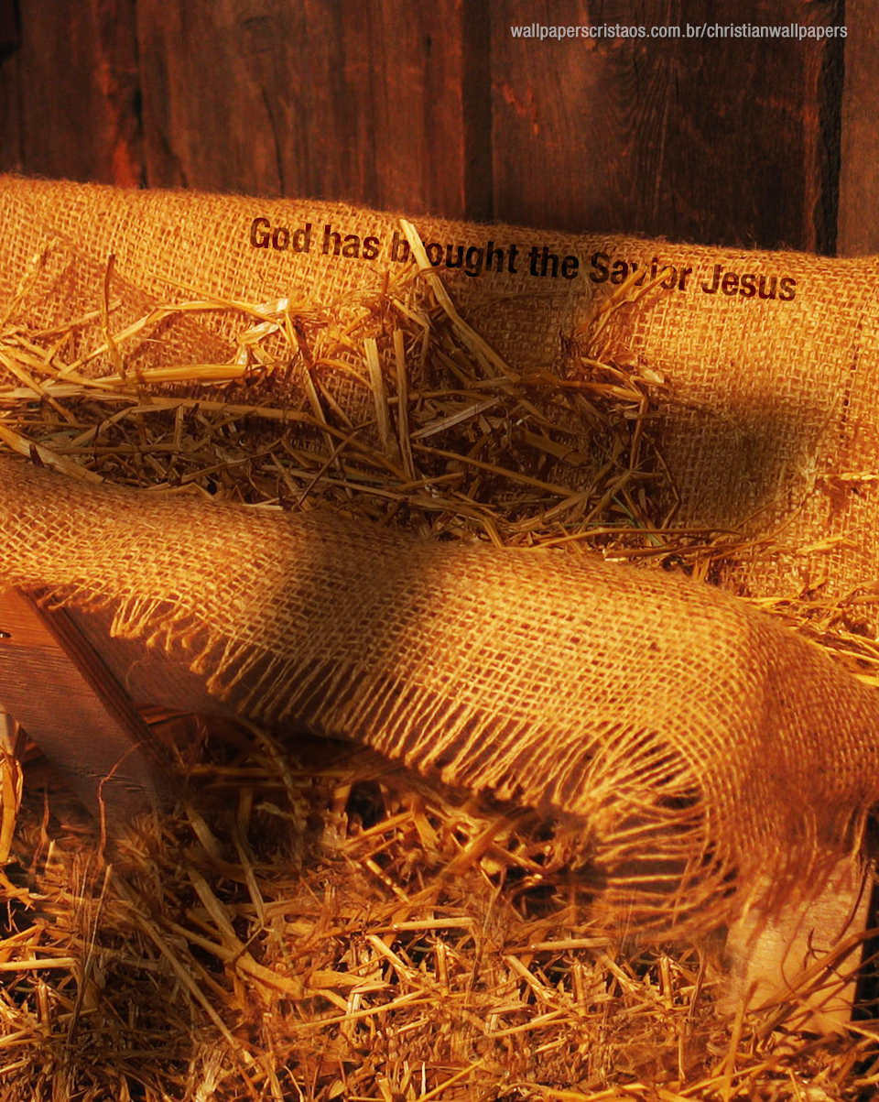

Slide 3
It Was Opposed In Eternity Past
Revelation 12:1-5

Slide 4
It Was Decreed Before Creation
Revelation 13:8
Acts 2:23
1 Peter 1:18-20

Slide 5
It Was Declared In the Garden Of Eden
Genesis 3:15

Slide 6
It Was Foretold By The Prophets
Psalm 22:16
Isaiah 53:5-6

Slide 7
It Was Announced By John The Baptist
John 1:29

Slide 8
It Was Proclaimed At His Birth
Matthew 1:21
Luke 2:10-12

Slide 9
It Was Pictured By The Gifts
Matthew 2:1, 11

Slide 10
It Was Acknowledged By Christ Himself
John 12:27

Slide 11
TEXT John 12:23-33
²³ And Jesus answered them, saying, The hour is come, that the Son of man should be glorified.
²⁴ Verily, verily, I say unto you, Except a corn of wheat fall into the ground and die, it abideth alone: but if it die, it bringeth forth much fruit.
²⁵ He that loveth his life shall lose it; and he that hateth his life in this world shall keep it unto life eternal.

Slide 12
²⁶ If any man serve me, let him follow me; and where I am, there shall also my servant be: if any man serve me, him will my Father honour.
²⁷ Now is my soul troubled; and what shall I say? Father, save me from this hour: but for this cause came I unto this hour.
²⁸ Father, glorify thy name. Then came there a voice from heaven, saying, I have both glorified it, and will glorify it again.

Slide 13
²⁹ The people therefore, that stood by, and heard it, said that it thundered: others said, An angel spake to him.
³⁰ Jesus answered and said, This voice came not because of me, but for your sakes.
³¹ Now is the judgment of this world: now shall the prince of this world be cast out.

Slide 14
³² And I, if I be lifted up from the earth, will draw all men unto me.
³³ This he said, signifying what death he should die.

Slide 15
Why Was Jesus Born to Die
He Was Born to Die Because There Was No Salvation in His Birth
He Was Born to Die Because God the Son Had to Become a Man to Pay the Price for Our Sin
He Was Born to Die That We Might Live

