Slide 1
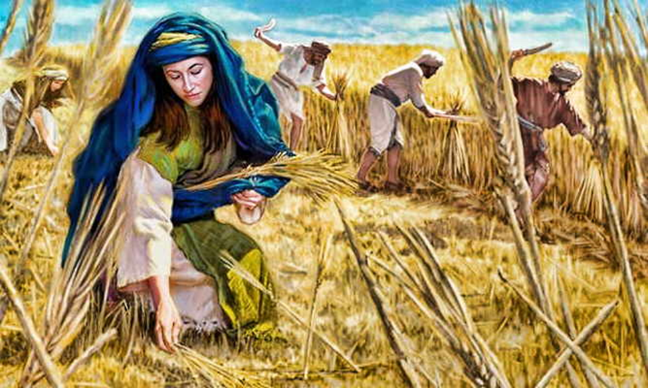
Trinity Evangelical Lutheran Church August 21, 2022
WELCOME!
Ruth, Chapter 2
Notes:
Image: Five Loaves by Caroline Coolidge Brown. Copyright © Caroline Coolidge Brown. All rights reserved. Used by permission of the artist.

Slide 2
= Please stand if able
= Please be seated
Prelude – Darrell Fryman
Office of the Acolyte
Ringing of the Bell
Welcome
Notes:
Image: Five Loaves by Caroline Coolidge Brown. Copyright © Caroline Coolidge Brown. All rights reserved. Used by permission of the artist.

Slide 3
CONFESSION AND FORGIVENESS
All may make the sign of the cross, the sign marked at baptism…
L: We confess our sins before God and one another.
Pause for silence and reflection.
L: Faithful God…
Notes:
Image: Five Loaves by Caroline Coolidge Brown. Copyright © Caroline Coolidge Brown. All rights reserved. Used by permission of the artist.

Slide 4
CONFESSION AND FORGIVENESS
C: We are not always quick to claim you as our God. We do not show care for one another. We fail to see all people as your people, and hurt one another with our actions or lack of action. Forgive us our sins, and give us the same fierce love for our neighbors that Ruth had for Naomi.
Notes:
Image: Five Loaves by Caroline Coolidge Brown. Copyright © Caroline Coolidge Brown. All rights reserved. Used by permission of the artist.

Slide 5
CONFESSION AND FORGIVENESS
L: God, who calls and sustains, forgives you all your sins. Go forth in the confidence of God’s loving care, in Jesus Christ, our savior.
C: Amen.
Notes:
Image: Five Loaves by Caroline Coolidge Brown. Copyright © Caroline Coolidge Brown. All rights reserved. Used by permission of the artist.

Slide 6
Hymn of Praise
“We Plow the Fields and Scatter” LBW 362
Notes:
Image: Five Loaves by Caroline Coolidge Brown. Copyright © Caroline Coolidge Brown. All rights reserved. Used by permission of the artist.

Slide 7
We Plow the Fields and Scatter LBW 362
1 We plow the fields and scatter
the good seed on the land,
but it is fed and watered
by God’s almighty hand.
He sends the snow in winter,
the warmth to swell the grain,
the breezes and the sunshine,
and soft refreshing rain.
Notes:
Image: Preparing yeast dough. Copyright © tomasworks/iStock/Thinkstock. Used by permission.

Slide 8
We Plow the Fields and Scatter LBW 362
Refrain
All good gifts around us
are sent from heav’n above.
Then thank the Lord, oh, thank the Lord
for all his love.
Notes:
Image: Preparing yeast dough. Copyright © tomasworks/iStock/Thinkstock. Used by permission.

Slide 9
We Plow the Fields and Scatter LBW 362
2 He only is the maker
of all things near and far;
he paints the wayside flower,
he lights the evening star.
The winds and waves obey him;
by him the birds are fed.
Much more to us, his children,
he gives our daily bread.
Notes:
Image: Preparing yeast dough. Copyright © tomasworks/iStock/Thinkstock. Used by permission.

Slide 10
We Plow the Fields and Scatter LBW 362
Refrain
All good gifts around us
are sent from heav’n above.
Then thank the Lord, oh, thank the Lord
for all his love.
Notes:
Image: Preparing yeast dough. Copyright © tomasworks/iStock/Thinkstock. Used by permission.

Slide 11
We Plow the Fields and Scatter LBW 362
3 We thank you, our creator,
for all things bright and good,
the seedtime and the harvest,
our life, our health, our food.
No gifts have we to offer
for all your love imparts,
but what you most would treasure--
our humble, thankful hearts.
Notes:
Image: Preparing yeast dough. Copyright © tomasworks/iStock/Thinkstock. Used by permission.

Slide 12
We Plow the Fields and Scatter LBW 362
Refrain
All good gifts around us
are sent from heav’n above.
Then thank the Lord, oh, thank the Lord
for all his love.
Notes:
Image: Preparing yeast dough. Copyright © tomasworks/iStock/Thinkstock. Used by permission.

Slide 13
APOSTOLIC GREETING
P: The grace of our Lord Jesus Christ, the love of God, and the communion of the Holy Spirit be with you all.
C: And also with you.
Notes:
Image: Five Loaves by Caroline Coolidge Brown. Copyright © Caroline Coolidge Brown. All rights reserved. Used by permission of the artist.

Slide 14
KYRIE
A: In peace let us pray to the Lord.
C: Lord have mercy.
A: For the peace from above, and for our salvation, let us pray to the Lord.
C: Lord have mercy.
A: For the peace of the whole world, for the well being of the Church of God, and for the unity of all, let us pray to the Lord.
C: Lord have mercy.
Notes:
Image: Five Loaves by Caroline Coolidge Brown. Copyright © Caroline Coolidge Brown. All rights reserved. Used by permission of the artist.

Slide 15
KYRIE
A: For this Holy House, and for all who offer here their worship and praise, let us pray to the Lord.
C: Lord have mercy.
A: Help, save, and defend us, gracious Lord.
C: Amen.
Notes:
Image: Five Loaves by Caroline Coolidge Brown. Copyright © Caroline Coolidge Brown. All rights reserved. Used by permission of the artist.

Slide 16
PRAYER OF THE DAY
P: Let us pray… God of all grace… You call us to provide for our neighbors with generosity. Show us how to respond to the needs of others, and to accept others’ generosity to us, for the sake of your son, Jesus Christ,
C: Amen.
Notes:
Image: Five Loaves by Caroline Coolidge Brown. Copyright © Caroline Coolidge Brown. All rights reserved. Used by permission of the artist.

Slide 17
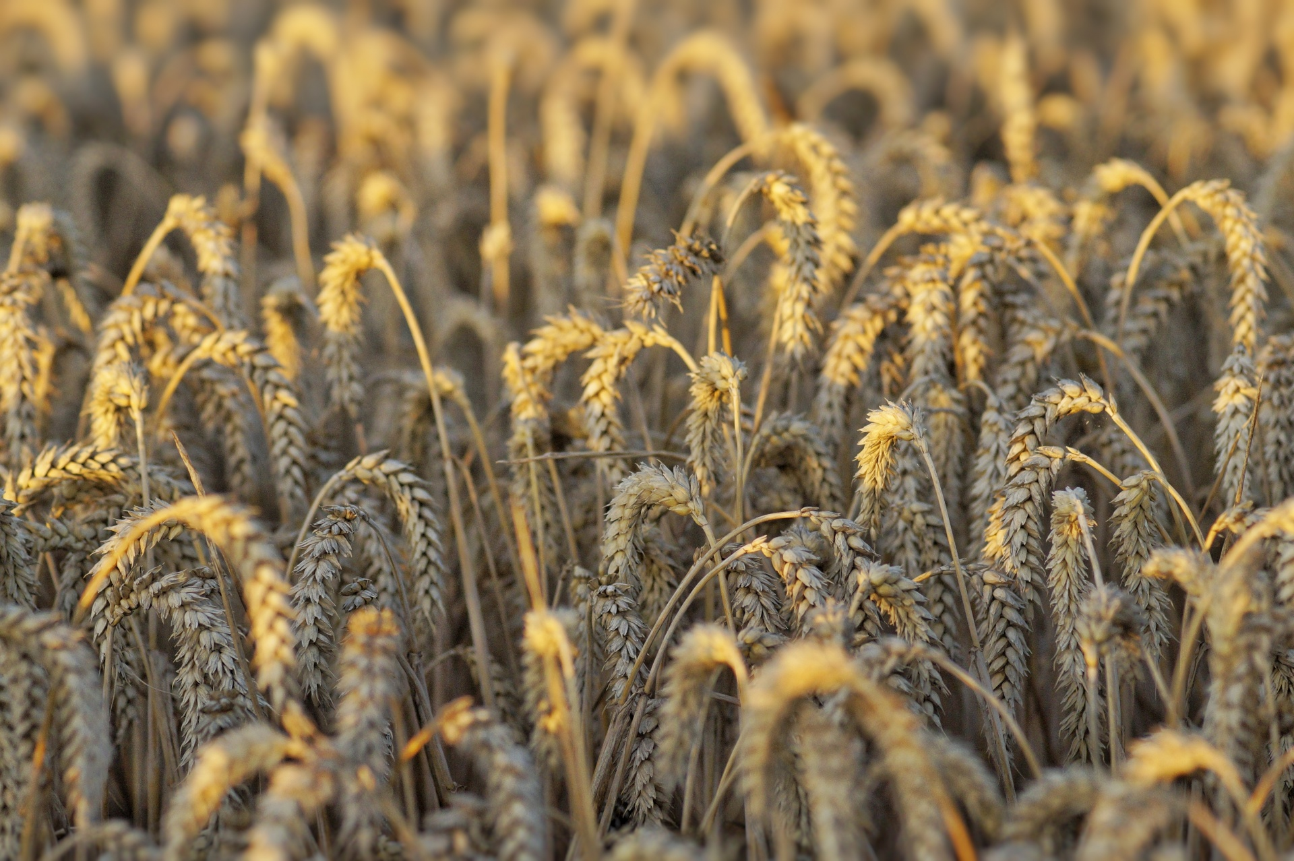
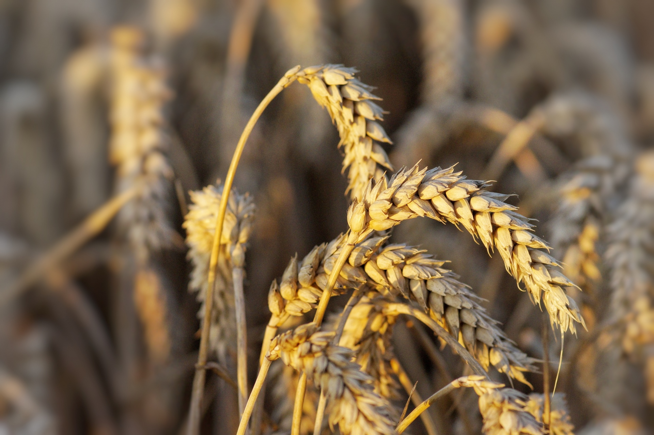
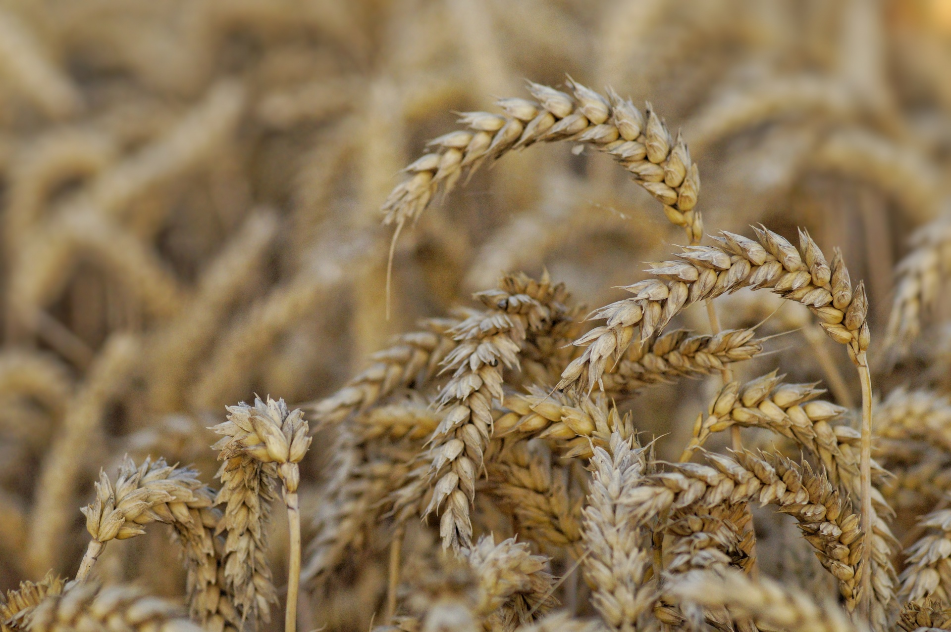
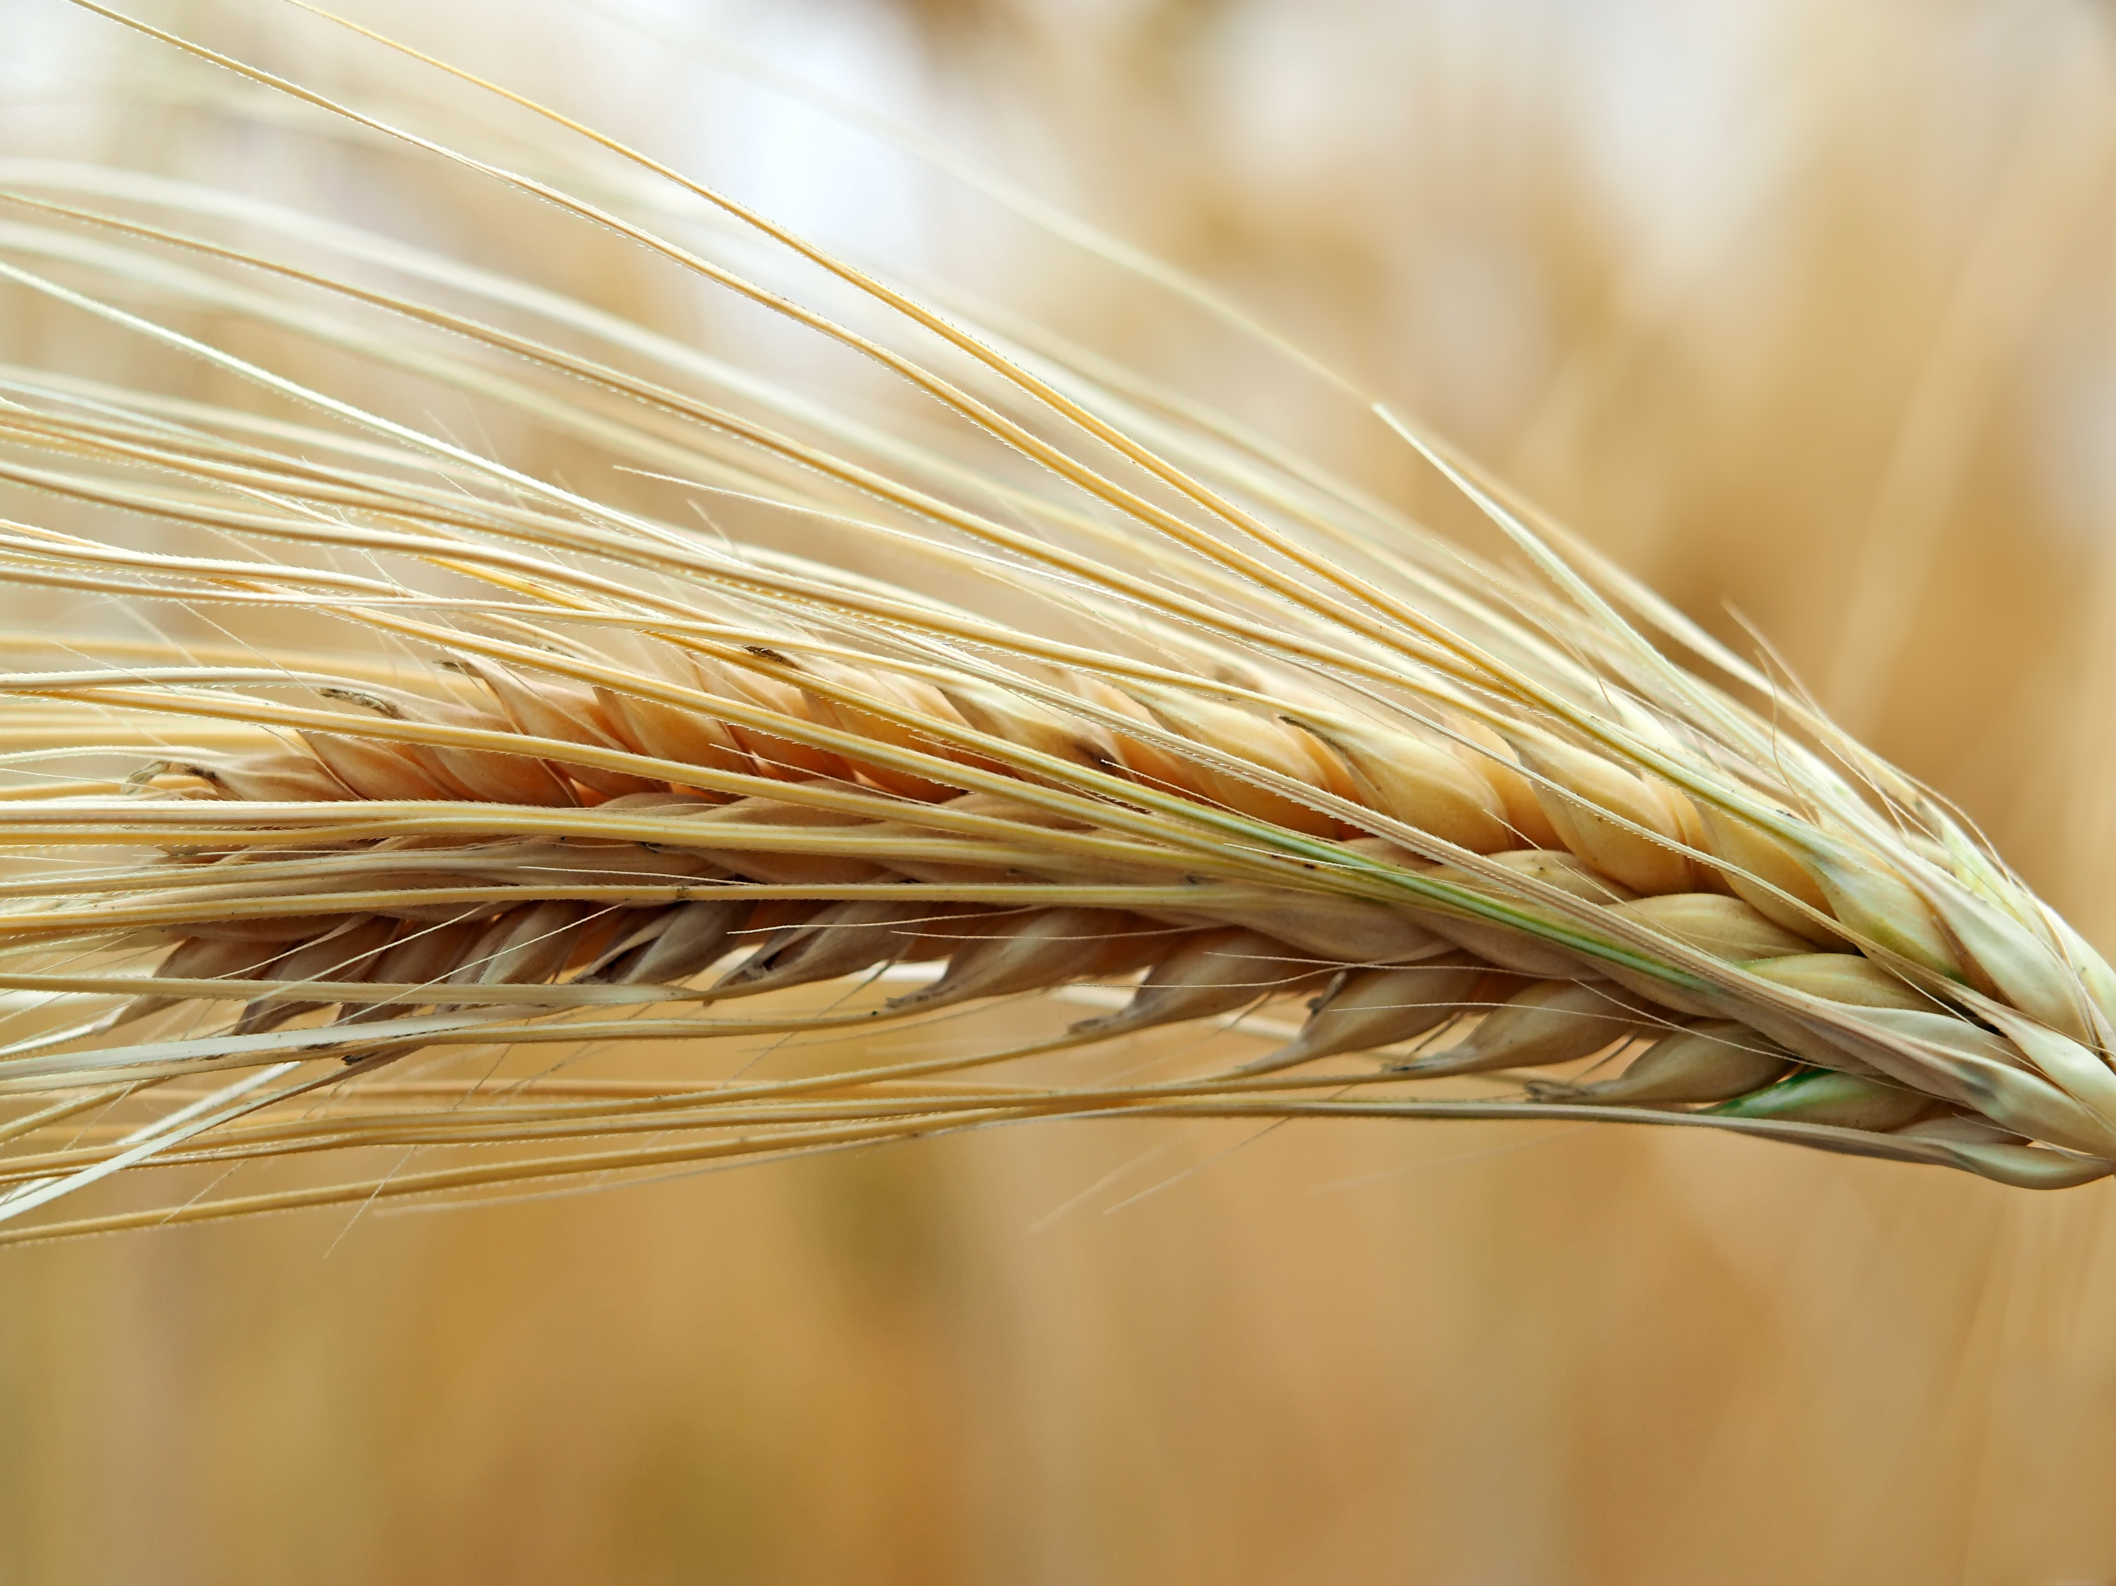
Barley
Notes:
Image: Preparing yeast dough. Copyright © tomasworks/iStock/Thinkstock. Used by permission.

Slide 18
Scripture Reading
R: The Scripture reading is from the Book of Ruth, Chapter 2.
C: Glory to you O’ Lord! (Spoken)
Notes:
Image: Five Loaves by Caroline Coolidge Brown. Copyright © Caroline Coolidge Brown. All rights reserved. Used by permission of the artist.

Slide 19
Ruth 2
Now Naomi had a kinsman on her husband’s side, a prominent rich man, of the family of Elimelech, whose name was Boaz. ²And Ruth the Moabite said to Naomi, “Let me go to the field and glean among the ears of grain, behind someone in whose sight I may find favor.” She said to her, “Go, my daughter.” ³So she went. She came and gleaned in the field behind the reapers.
Notes:
Image: Five Loaves by Caroline Coolidge Brown. Copyright © Caroline Coolidge Brown. All rights reserved. Used by permission of the artist.

Slide 20
Ruth 2
As it happened, she came to the part of the field belonging to Boaz, who was of the family of Elimelech.
⁴Just then Boaz came from Bethlehem. He said to the reapers, “The Lord be with you.” They answered, “The Lord bless you.” ⁵Then Boaz said to his servant who was in charge of the reapers, “To whom does this young woman belong?” ⁶The servant who was
Notes:
Image: Five Loaves by Caroline Coolidge Brown. Copyright © Caroline Coolidge Brown. All rights reserved. Used by permission of the artist.

Slide 21
Ruth 2
in charge of the reapers answered, “She is the Moabite who came back with Naomi from the country of Moab. ⁷She said, ‘Please, let me glean and gather among the sheaves behind the reapers.’ So she came, and she has been on her feet from early this morning until now, without resting even for a moment.” ⁸Then Boaz said to Ruth, “Now listen, my daughter, do not
Notes:
Image: Five Loaves by Caroline Coolidge Brown. Copyright © Caroline Coolidge Brown. All rights reserved. Used by permission of the artist.

Slide 22
Ruth 2
go to glean in another field or leave this one, but keep close to my young women. ⁹Keep your eyes on the field that is being reaped, and follow behind them. I have ordered the young men not to bother you. If you get thirsty, go to the vessels and drink from what the young men have drawn.” ¹⁰Then she fell prostrate, with her face to the ground, and said to him, “Why have I found
Notes:
Image: Five Loaves by Caroline Coolidge Brown. Copyright © Caroline Coolidge Brown. All rights reserved. Used by permission of the artist.

Slide 23
Ruth 2
favor in your sight, that you should take notice of me, when I am a foreigner?” ¹¹But Boaz answered her, “All that you have done for your mother-in-law since the death of your husband has been fully told me, and how you left your father and mother and your native land and came to a people that you did not know before. ¹²May the Lord reward you for your deeds, and may you have a
Notes:
Image: Five Loaves by Caroline Coolidge Brown. Copyright © Caroline Coolidge Brown. All rights reserved. Used by permission of the artist.

Slide 24
Ruth 2
full reward from the Lord, the God of Israel, under whose wings you have come for refuge!” ¹³Then she said, “May I continue to find favor in your sight, my lord, for you have comforted me and spoken kindly to your servant, even though I am not one of your servants.” ¹⁴At mealtime Boaz said to her, “Come here, and eat some of this bread, and dip your morsel in the sour
Notes:
Image: Five Loaves by Caroline Coolidge Brown. Copyright © Caroline Coolidge Brown. All rights reserved. Used by permission of the artist.

Slide 25
Ruth 2
wine.” So she sat beside the reapers, and he heaped up for her some parched grain. She ate until she was satisfied, and she had some left over. ¹⁵When she got up to glean, Boaz instructed his young men, “Let her glean even among the standing sheaves, and do not reproach her. ¹⁶You must also pull out some handfuls for her from the bundles, and leave
Notes:
Image: Five Loaves by Caroline Coolidge Brown. Copyright © Caroline Coolidge Brown. All rights reserved. Used by permission of the artist.

Slide 26
Ruth 2
them for her to glean, and do not rebuke her.”
¹⁷So she gleaned in the field until evening. Then she beat out what she had gleaned, and it was about an ephah of barley. ¹⁸She picked it up and came into the town, and her mother-in-law saw how much she had gleaned. Then she took out and gave her what was left over after she herself had
Notes:
Image: Five Loaves by Caroline Coolidge Brown. Copyright © Caroline Coolidge Brown. All rights reserved. Used by permission of the artist.

Slide 27
Ruth 2
been satisfied. ¹⁹Her mother-in-law said to her, “Where did you glean today? And where have you worked? Blessed be the man who took notice of you.” So she told her mother-in-law with whom she had worked, and said, “The name of the man with whom I worked today is Boaz.” ²⁰Then Naomi said to her daughter-in-law, “Blessed be he by the Lord, whose kindness has
Notes:
Image: Five Loaves by Caroline Coolidge Brown. Copyright © Caroline Coolidge Brown. All rights reserved. Used by permission of the artist.

Slide 28
Ruth 2
not forsaken the living or the dead!” Naomi also said to her, “The man is a relative of ours, one of our nearest kin.” ²¹Then Ruth the Moabite said, “He even said to me, ‘Stay close by my servants, until they have finished all my harvest.’”
Notes:
Image: Five Loaves by Caroline Coolidge Brown. Copyright © Caroline Coolidge Brown. All rights reserved. Used by permission of the artist.

Slide 29
Ruth 2
²²Naomi said to Ruth, her daughter-in-law, “It is better, my daughter, that you go out with his young women, otherwise you might be bothered in another field.” ²³So she stayed close to the young women of Boaz, gleaning until the end of the barley and wheat harvests; and she lived with her mother-in-law.
Notes:
Image: Five Loaves by Caroline Coolidge Brown. Copyright © Caroline Coolidge Brown. All rights reserved. Used by permission of the artist.

Slide 30
Ruth 2
P: This is the Word of the Lord.
C: Praise to You, O Christ (Spoken)
Notes:
Image: Five Loaves by Caroline Coolidge Brown. Copyright © Caroline Coolidge Brown. All rights reserved. Used by permission of the artist.

Slide 31
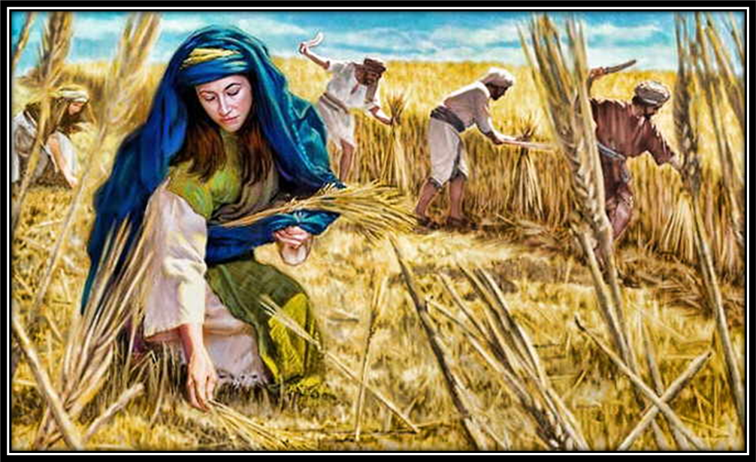
Sermon
Notes:
Image: Five Loaves by Caroline Coolidge Brown. Copyright © Caroline Coolidge Brown. All rights reserved. Used by permission of the artist.

Slide 32
APOSTLE’S CREED
C: I believe in God, the Father almighty, creator of heaven and earth.

Slide 33
APOSTLE’S CREED
C: I believe in Jesus Christ, his only Son, our Lord. He was conceived by the power of the Holy Spirit and born of the virgin Mary. He suffered under Pontius Pilate, was crucified, died, and was buried.

Slide 34
APOSTLE’S CREED
C: He descended into hell. On the third day he rose again. He ascended into heaven, and is seated at the right hand of the Father. He will come again to judge the living and the dead.

Slide 35
APOSTLE’S CREED
C: I believe in the Holy Spirit, the holy catholic Church, the communion of saints, the forgiveness of sins, the resurrection of the body, and the life everlasting. Amen.

Slide 36
NICENE CREED
C: We believe in one God, the Father, the Almighty, maker of heaven and earth, of all that is, seen and unseen.

Slide 37
NICENE CREED
C: We believe in one Lord, Jesus Christ, the only Son of God, eternally begotten of the Father, God from God, Light from Light, true God from true God, begotten, not made, of one Being with the Father.

Slide 38
NICENE CREED
C: Through him all things were made. For us and for our salvation he came down from heaven; by the power of the Holy Spirit he became incarnate from the virgin Mary, and was made man. For our sake he was crucified under Pontius Pilate;

Slide 39
NICENE CREED
C: he suffered death and was buried. On the third day he rose again in accordance with the Scriptures; he ascended into heaven and is seated at the right hand of the Father. He will come again in glory to judge the living and the dead, and his kingdom will have no end.

Slide 40
NICENE CREED
C: We believe in the Holy Spirit, the Lord, the giver of life, who proceeds from the Father and the Son. With the Father and the Son he is worshiped and glorified. He has spoken through the prophets. We believe in one holy catholic and apostolic Church.

Slide 41
NICENE CREED
C: We acknowledge one Baptism for the forgiveness of sins. We look for the resurrection of the dead, and the life of the world to come. Amen.

Slide 42
PRAYERS OF INTERCESSION
Each petition will end with the words,
A: God, in your mercy,
The congregation will respond with:
C: You hear our prayer.

Slide 43
PRAYERS OF INTERCESSION
The prayer concludes…
P: With gratitude for your faithfulness, we pray these things in the name of Jesus Christ, our savior.
C: Amen.

Slide 44
Offering Prayer
Notes:
Image: Five Loaves by Caroline Coolidge Brown. Copyright © Caroline Coolidge Brown. All rights reserved. Used by permission of the artist.

Slide 45
THE GREAT THANKSGIVING
Communion by pre-packaged Communion Cups. All the Baptized are welcome to celebrate this Holy Meal.

Slide 46
DIALOGUE
P: The Lord be with you.
C: And also with you.
P: Lift up your hearts.
C: We lift them to the Lord.
P: Let us give thanks to the Lord our God.
C: It is right to give him thanks and praise.

Slide 47
Preface
P: It is indeed right…
…join their unending hymn

Slide 48
Sanctus
C: Holy, holy, holy Lord, God of power and might: Heaven and earth are full of your glory. Hosanna. Hosanna. Hosanna in the highest. Blessed is he who comes in the name of the Lord. Hosanna in the highest.

Slide 49
Eucharistic Prayer
P: Holy God, our Maker, Redeemer, and Healer…
…in your holy Church, both now and forever.
C: Amen

Slide 50
THE LORD’S PRAYER
C: Our Father, who art in heaven, hallowed be thy name, thy kingdom come, thy will be done, on earth as it is in heaven. Give us this day our daily bread; and forgive us our trespasses, as we forgive those who trespass against us; and lead us not into temptation, but deliver us from evil.

Slide 51
THE LORD’S PRAYER
C: For thine is the kingdom, and the power, and the glory, forever and ever. Amen.

Slide 52
INVITATION TO COMMUNION
P: Just as God sustained Ruth and Naomi through the generosity of Boaz, God nourishes and sustains us through the gift of bread and wine in Jesus Christ. All are welcome at this holy table. Come and eat.

Slide 53
POST COMMUNION BLESSING
P: May this Body and Blood of our Lord and Savior, Jesus Christ, strengthen, keep, and unite us, now and forever.
C: Amen.

Slide 54
POST COMMUNION PRAYER
P: Let us pray… Life-giving God, through this meal you have bandaged our wounds and fed us with your mercy. Now send us forth to live for others, both friend and stranger, that all may come to know your love. This we pray in the name of Jesus.
C: Amen

Slide 55
Announcements
Notes:
Image: Five Loaves by Caroline Coolidge Brown. Copyright © Caroline Coolidge Brown. All rights reserved. Used by permission of the artist.

Slide 56
SENDING BLESSING
P: The God of peace, Father, ☩ Son, and Holy Spirit, bless you, comfort you, and show you the path of life this day and always.
C: Amen.

Slide 57
Sending Song
“Great Is Thy Faithfulness” ELW 733
Notes:
Image: Five Loaves by Caroline Coolidge Brown. Copyright © Caroline Coolidge Brown. All rights reserved. Used by permission of the artist.

Slide 58
“Great Is Thy Faithfulness” ELW 733
1 Great is thy faithfulness, O God my Father;
there is no shadow of turning with thee;
thou changest not, thy compassions they fail not;
as thou hast been, thou forever wilt be.
Notes:
Image: Five Loaves by Caroline Coolidge Brown. Copyright © Caroline Coolidge Brown. All rights reserved. Used by permission of the artist.

Slide 59
“Great Is Thy Faithfulness” ELW 733
Refrain
Great is thy faithfulness! Great is thy faithfulness!
Morning by morning new mercies I see;
all I have needed thy hand hath provided;
great is thy faithfulness, Lord, unto me!
Notes:
Image: Five Loaves by Caroline Coolidge Brown. Copyright © Caroline Coolidge Brown. All rights reserved. Used by permission of the artist.

Slide 60
“Great Is Thy Faithfulness” ELW 733
2 Summer and winter and springtime and harvest,
sun, moon, and stars in their courses above
join with all nature in manifold witness
to thy great faithfulness, mercy, and love.
Notes:
Image: Five Loaves by Caroline Coolidge Brown. Copyright © Caroline Coolidge Brown. All rights reserved. Used by permission of the artist.

Slide 61
“Great Is Thy Faithfulness” ELW 733
Refrain
Great is thy faithfulness! Great is thy faithfulness!
Morning by morning new mercies I see;
all I have needed thy hand hath provided;
great is thy faithfulness, Lord, unto me!
Notes:
Image: Five Loaves by Caroline Coolidge Brown. Copyright © Caroline Coolidge Brown. All rights reserved. Used by permission of the artist.

Slide 62
“Great Is Thy Faithfulness” ELW 733
3 Pardon for sin and a peace that endureth,
thine own dear presence to cheer and to guide;
strength for today and bright hope for tomorrow,
blessings all mine, with ten thousand beside!
Notes:
Image: Five Loaves by Caroline Coolidge Brown. Copyright © Caroline Coolidge Brown. All rights reserved. Used by permission of the artist.

Slide 63
“Great Is Thy Faithfulness” ELW 733
Refrain
Great is thy faithfulness! Great is thy faithfulness!
Morning by morning new mercies I see;
all I have needed thy hand hath provided;
great is thy faithfulness, Lord, unto me!
Notes:
Image: Five Loaves by Caroline Coolidge Brown. Copyright © Caroline Coolidge Brown. All rights reserved. Used by permission of the artist.

Slide 64
DISMISSAL
P: … depart in Christ’s Love.
C: Seeking, welcoming, and serving all. Amen!
POSTLUDE
By
Darrell Fryman
From sundaysandseasons.com. Copyright © 2022 Augsburg Fortress. All rights reserved. Reprinted by permission under Augsburg Fortress Liturgies Annual License #SAS023830. New Revised Standard Version Bible, Copyright © 1989, Division of Christian Education of the National Council of the Churches of Christ in the United States of America. Used by permission. All rights reserved. Revised Common Lectionary, Copyright © 1992 Consultation on Common Texts, admin Augsburg Fortress. Used by permission.

