Slide 1
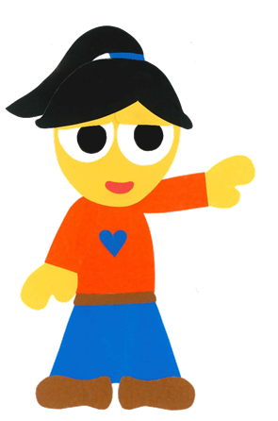
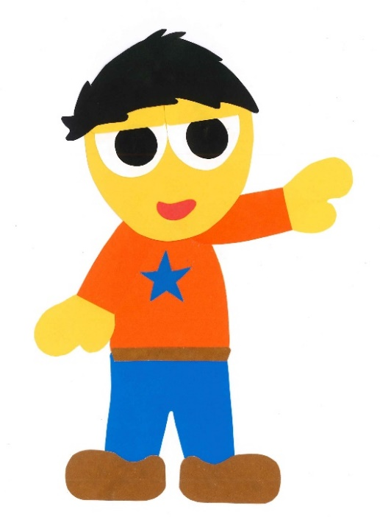
WE
CAN
READ
Donald Joyce

Slide 2
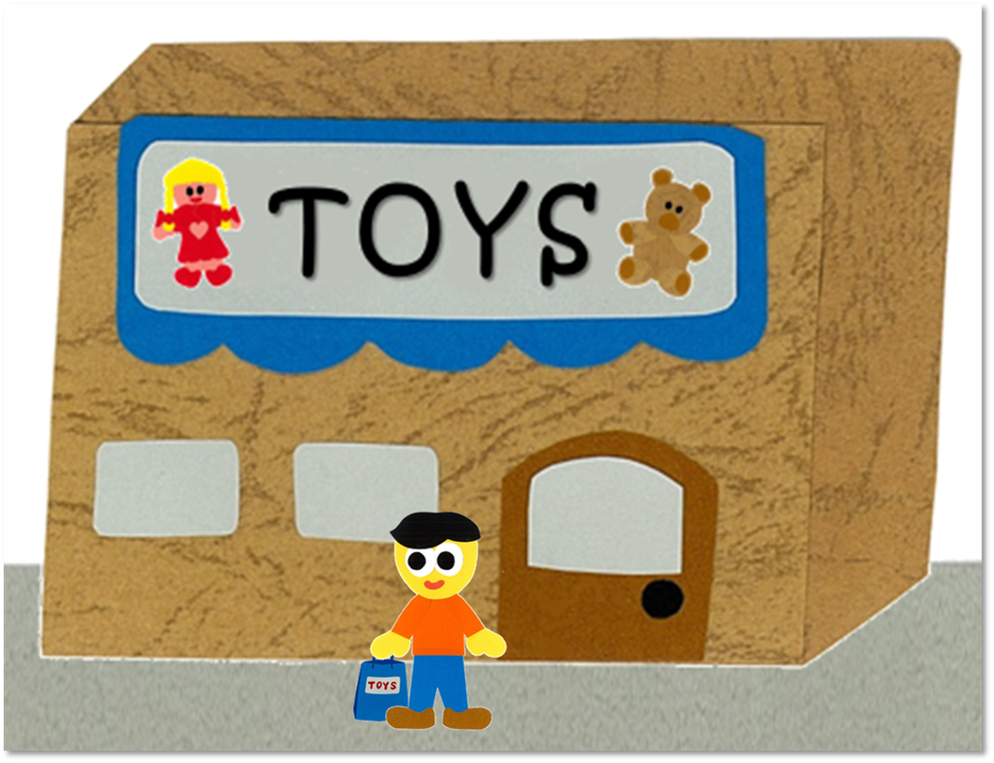
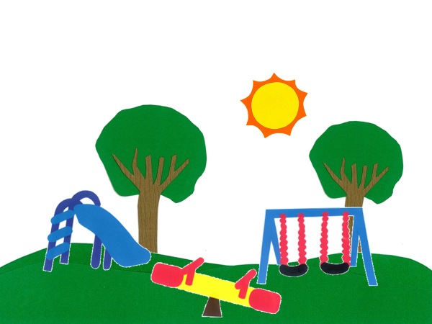
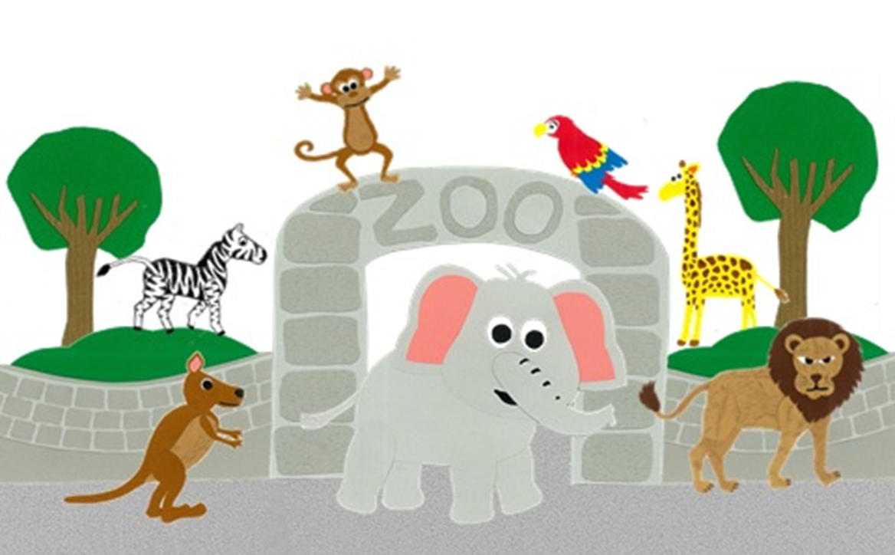
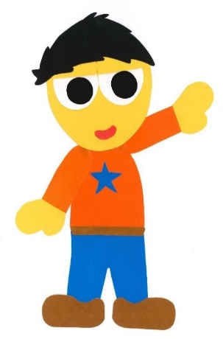
Where Do You Want To Go?
By:
Donald Joyce
WE CAN READ

Slide 3
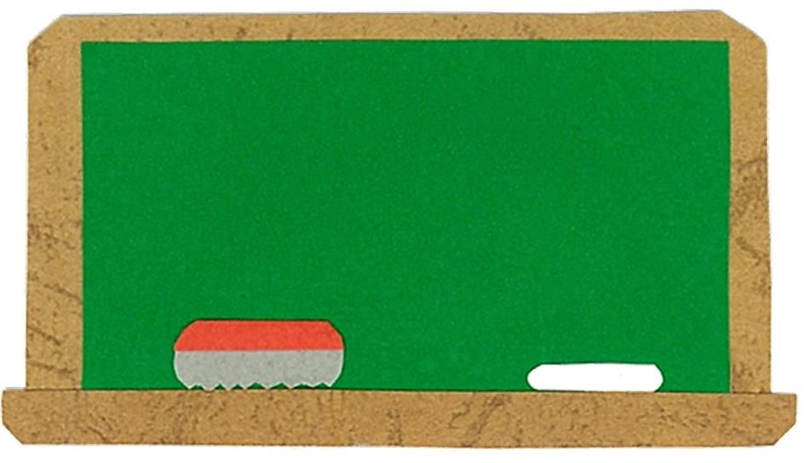
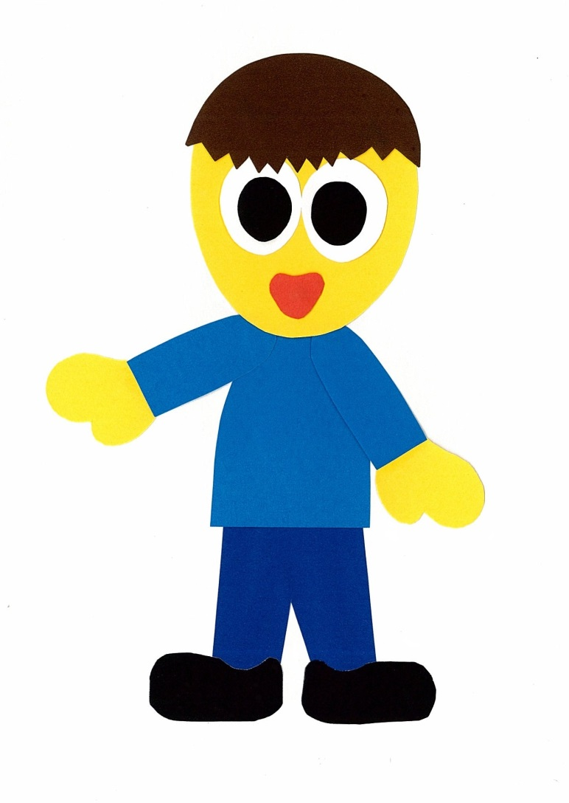
Let’s
Talk!

Slide 4
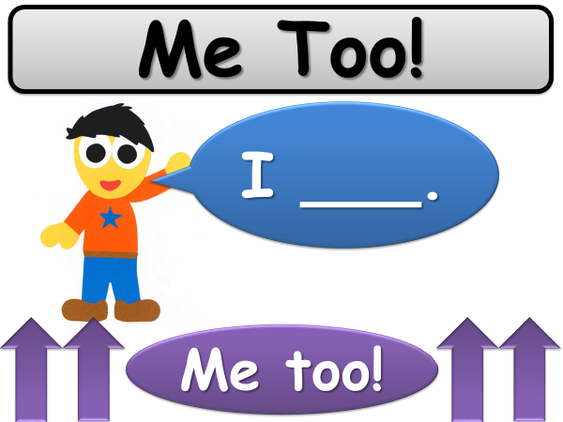

Slide 5
Where do you like to go?
I like to go
to ___.
Me too!

Slide 6
Let’s
Learn!

Slide 7
the library
the park
the zoo
the toy store

Slide 8
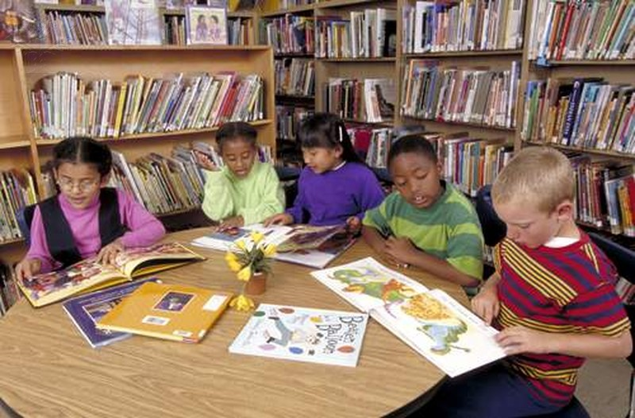
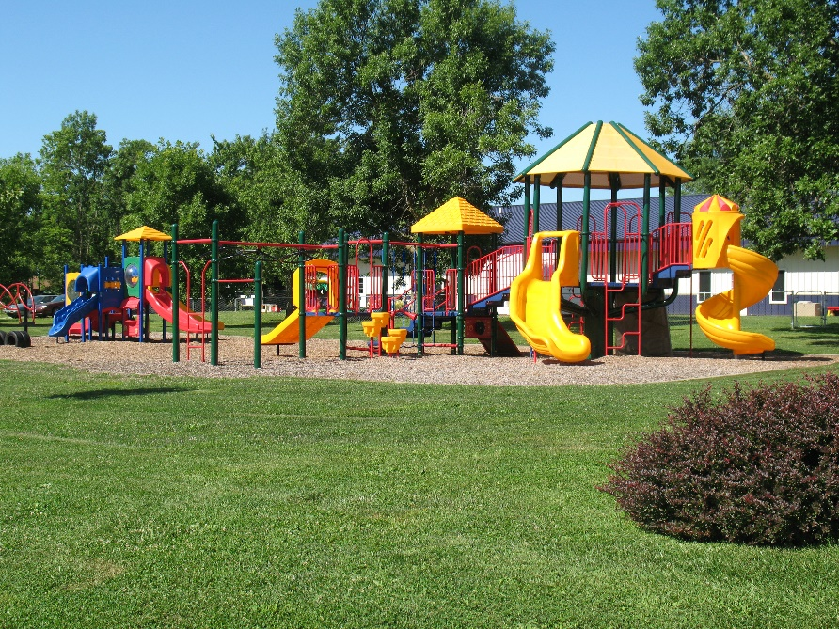
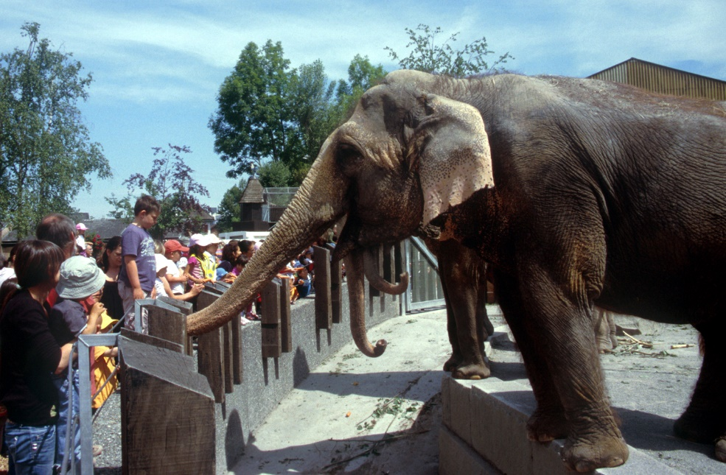
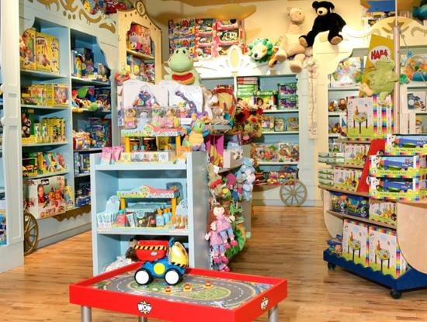
the library
the park
the zoo
the toy store

Slide 9
Let’s
Read!

Slide 10
Where Do You Want To Go?
By:
Donald Joyce
WE CAN READ

Slide 11
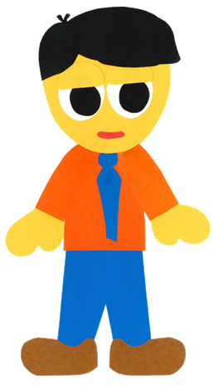
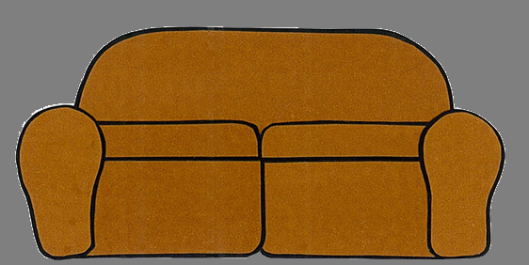
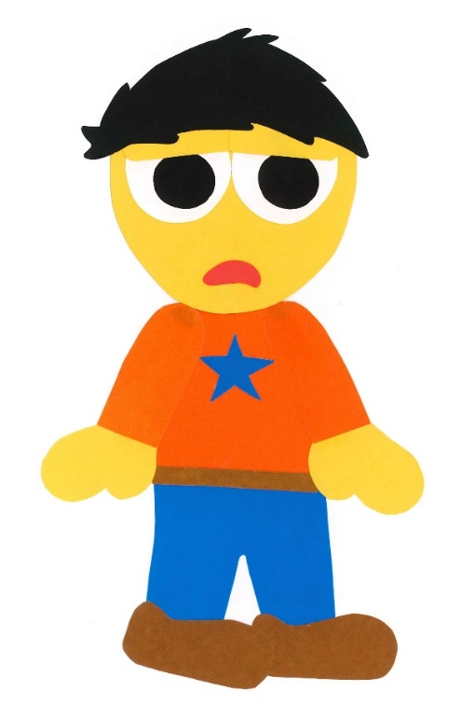
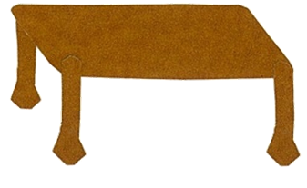
Dad, I am bored.

Slide 12
I want to go somewhere.

Slide 13
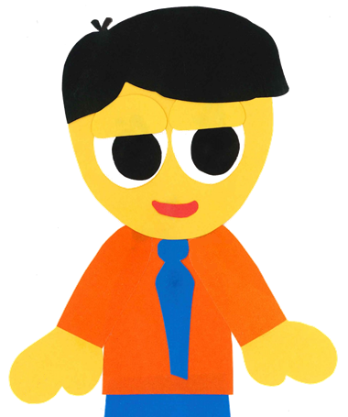
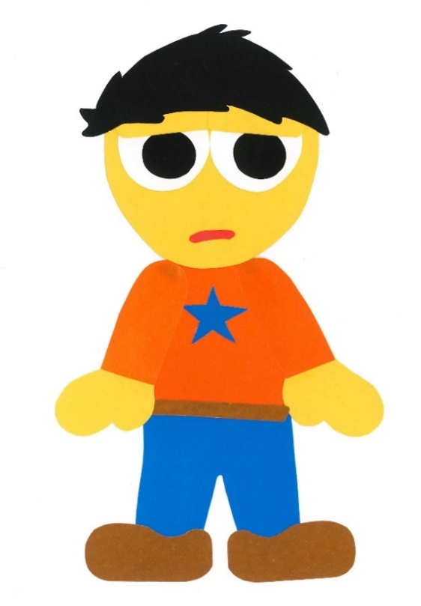
Do you want to go to the park?

Slide 14
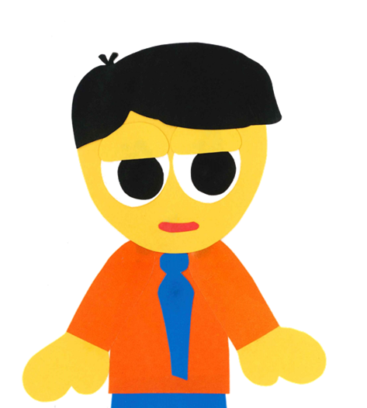
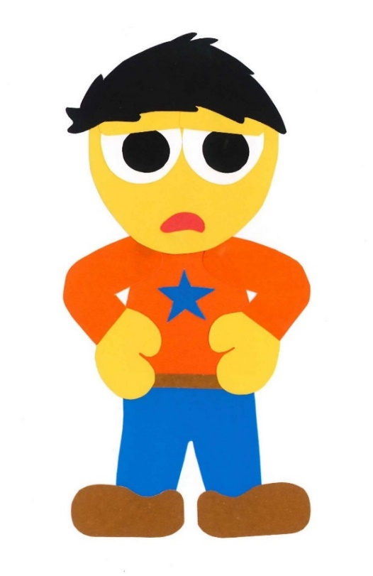
No, I do not.

Slide 15
The park is boring.

Slide 16
Let’s go to
the library.

Slide 17
I don’t want to go to the library.

Slide 18
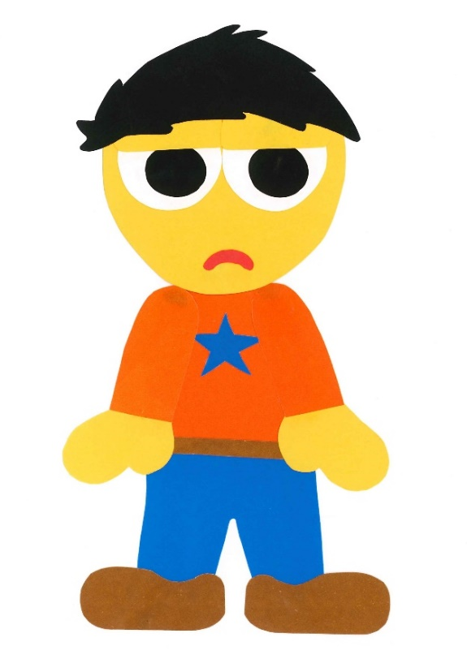
Do you want to go to the toy store?

Slide 19
No, I do not.

Slide 20
The toy store
is boring.

Slide 21
Let’s go to the zoo.

Slide 22
I don’t want to go
to the zoo.

Slide 23
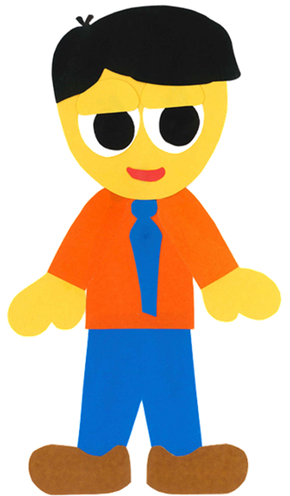
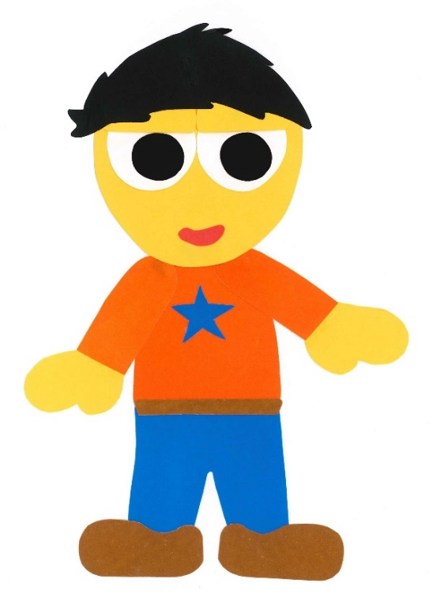
Where do you
want to go?

Slide 24
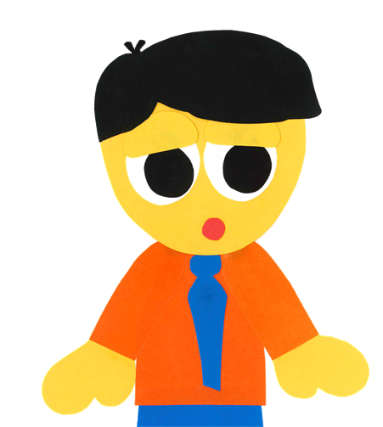
I want to go to
the moon!

Slide 25
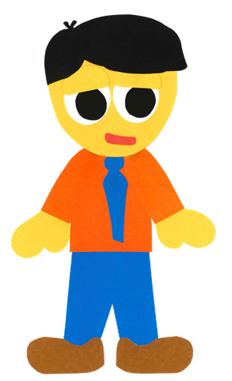
How can we go to the moon?

Slide 26
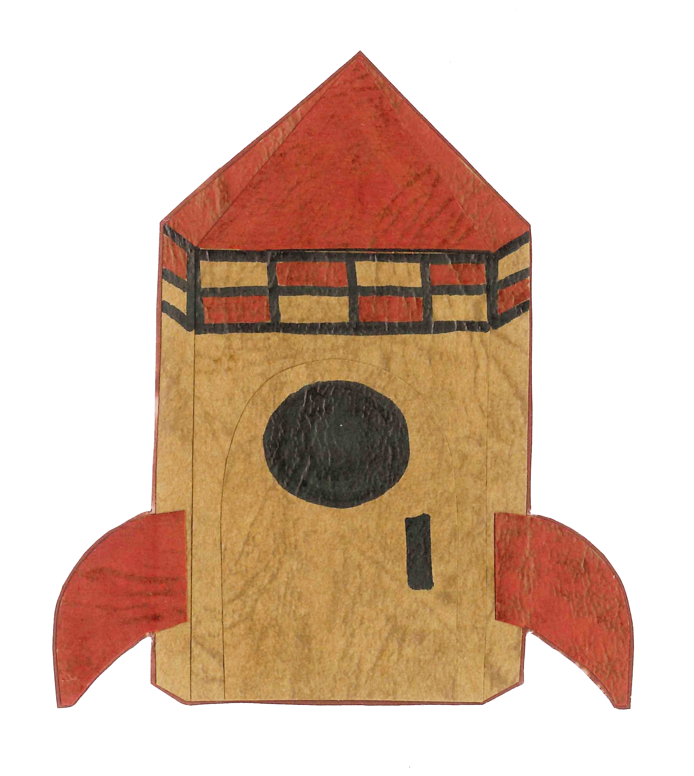
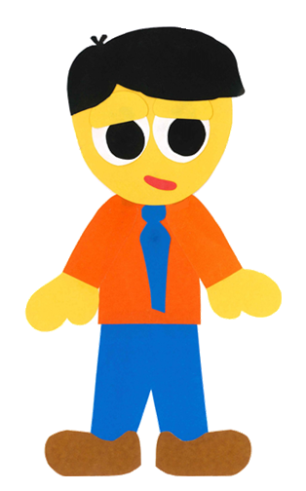
We can fly in
my rocket!

Slide 27
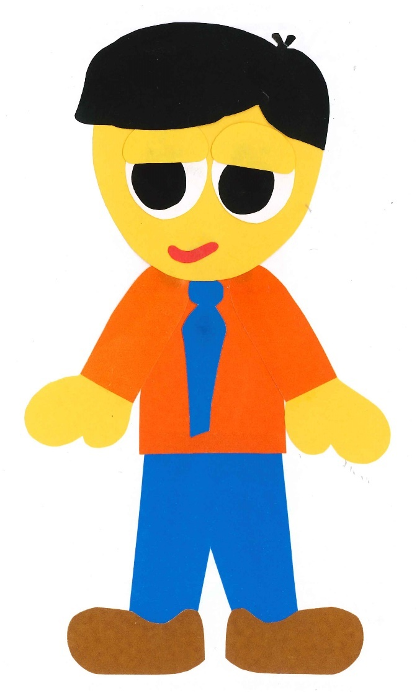
Get in!

Slide 28
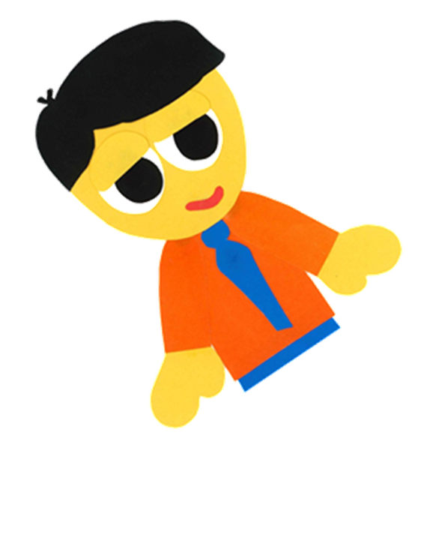
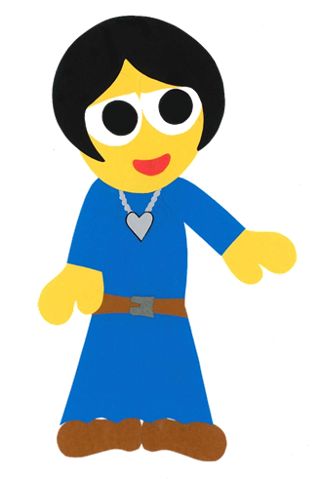
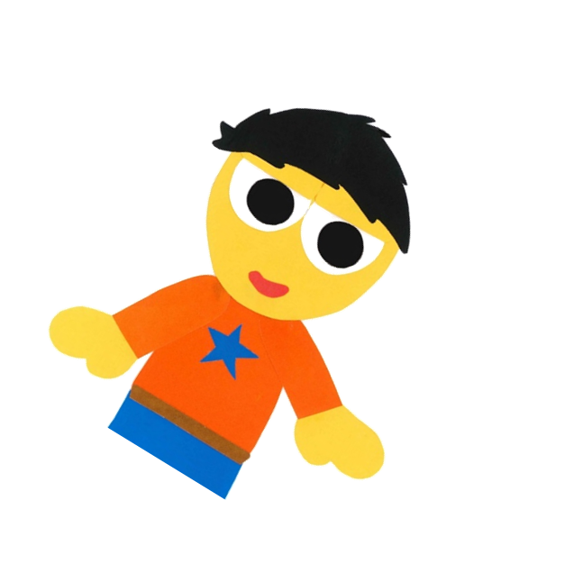
Where are you going?

Slide 29
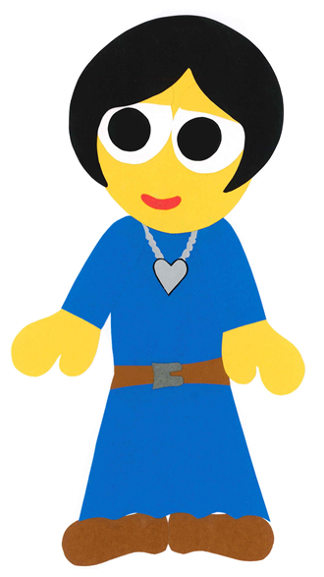
We are going to
the moon!

Slide 30
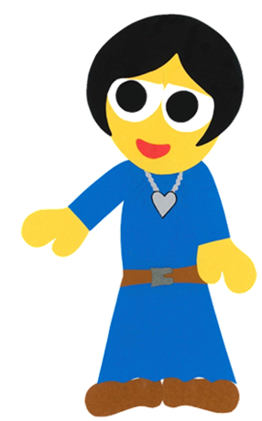
Have fun!

Slide 31
10…9…8…7…6…

Slide 32
5…4…3…2…1…

Slide 33
BLAST OFF!

Slide 37
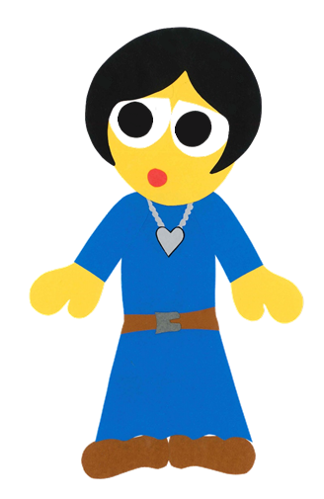
Where did they go?

Slide 38
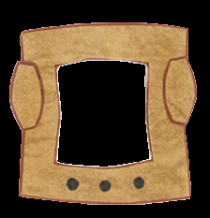

Slide 39
Where Do You Want To Go?
By:
Donald Joyce
WE CAN READ

Slide 40
Let’s
Review!

Slide 41
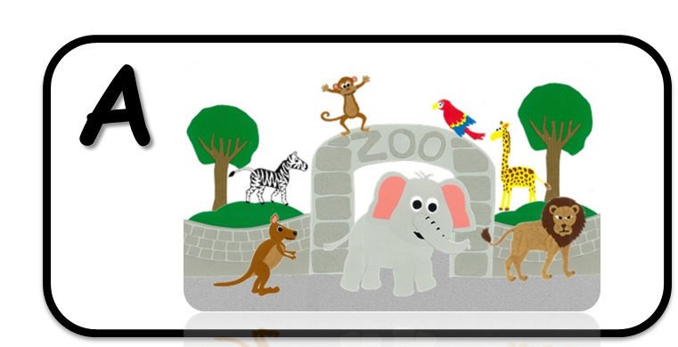
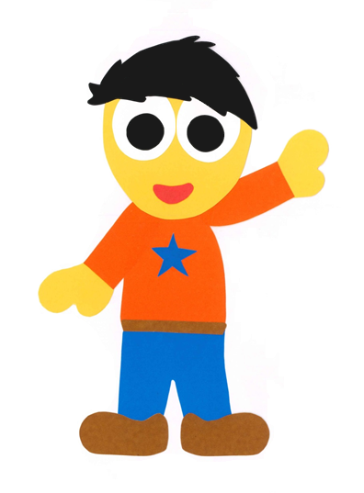
He wants to go to the library.

Slide 42
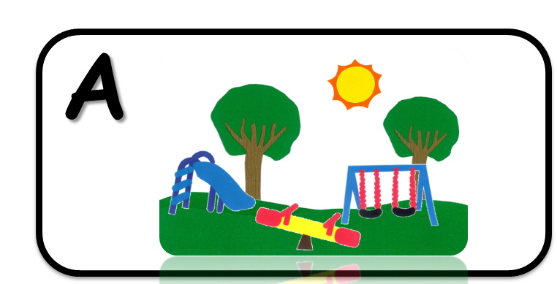
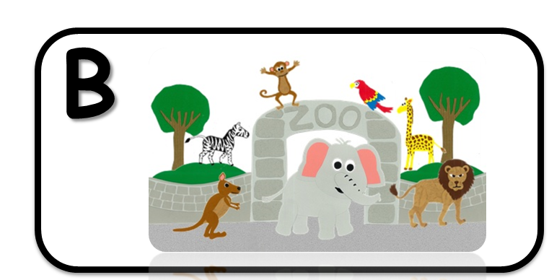
He wants to go to the park.

Slide 43
He wants to go to the toy store.

Slide 44
He wants to go to the zoo.

Slide 45
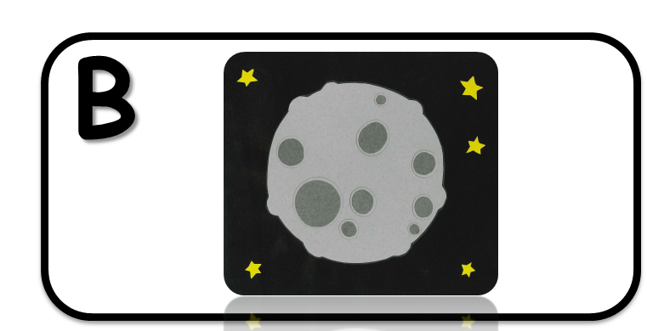
He wants to go to the moon.

Slide 46
Good Job!

Slide 47
Let’s
Connect!

Slide 48
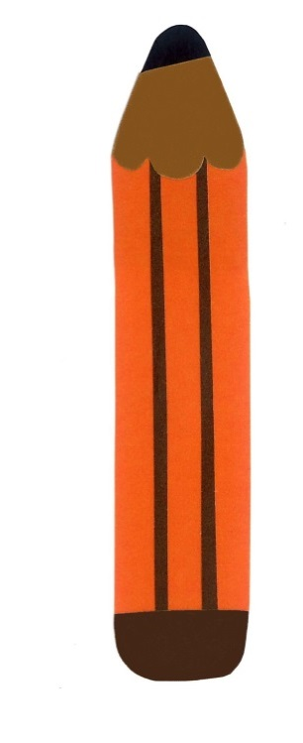
Draw and Write…

Slide 49
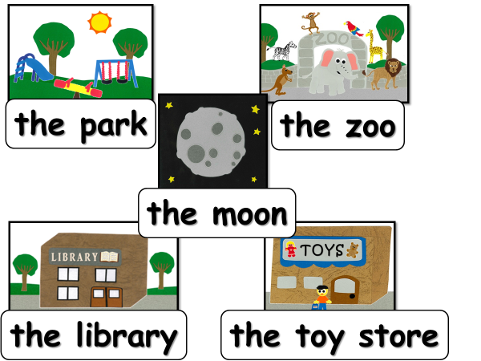
I want to go to ___.

Slide 50
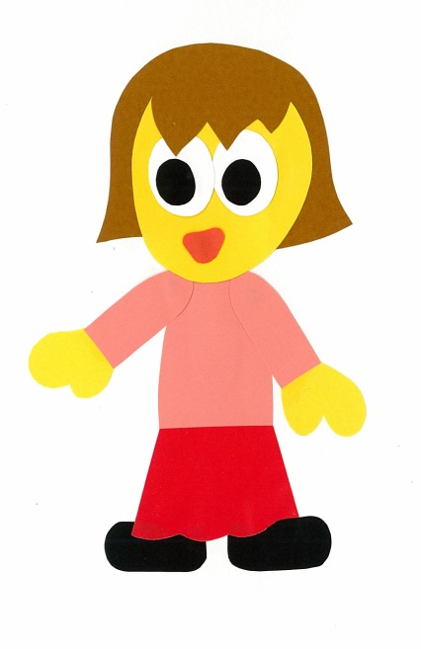
Let’s guess…
No, I don’t.
Do you want to go to the park?

Slide 51
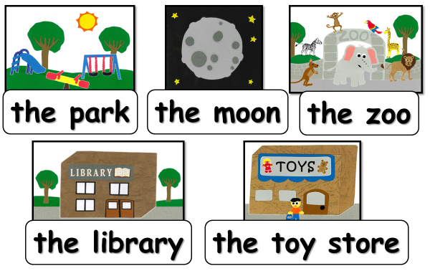
Do you want to go to ____?
Yes, I do.
No, I don’t.

Slide 52
WE
CAN
READ
Donald Joyce
www.teacherdonald.com

