Slide 1
“Extreme” RBC Alloimmunization:
Risk Factors, Blood Availability Challenges, & Transfusion Support
North Dakota state ASCLS meeting 2022
4/26/2022
Rim Abdallah, MD
Medical Director, Mountain Division
Vitalant
Notes:
Hi again! Long time, no see ☺ I gave earlier this morning a talk about blood shortage during the pandemic. We are switching gears and I will be talking about RBC alloimmunization now.

Slide 2
Conflict of Interest Disclosure &Acknowledgements
- The speaker has no relevant financial relationships with commercial or other entities that would lead to a potential conflict of interest w.r.t. this presentation
- Many thanks to Dr. Chris Gresens for providing his slides.

Slide 3

Objectives
At the end of this activity participants will be able to:
  Explain how red cell alloimmunization is triggered, focusing on the roles of donors’ and recipients’ genetics and environmental influences
  Describe the difficulties in supplying compatible RBC units for the transfusion of heavily alloimmunized patients
  Review ways to support affected patients by:
    Minimizing their likelihood of developing antibodies
    Identifying and recruiting rare blood donors
    Designing/implementing suitable anemia mitigation strategies

Slide 4
Outline
Case study: An extremely alloimmunized patient
Background: Overview of red cell alloimmunization
Solutions: What can we do to mitigate and respond to these challenging situations?
Fun quiz (non-graded ☺)
References
Q-&-A

Slide 5
Outline
Case study: An extremely alloimmunized patient
Background: Overview of red cell alloimmunization
Solutions: What can we do to mitigate and respond to these challenging situations?
Fun quiz (non-graded ☺)
References
Q-&-A

Slide 6
An Extremely Alloimmunized Patient
31-year-old pregnant (32-week gestational age), O-positive African-American woman
Possesses very rare red cell phenotype and multiple clinically significant antibodies
Scheduled to deliver by (C-section) at ~37 weeks

Slide 7
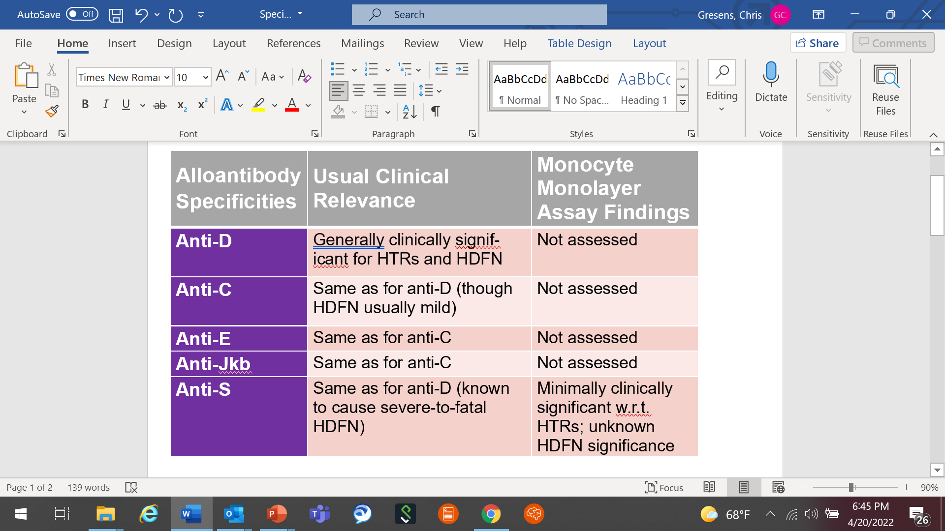
An Extremely Alloimmunized Patient
Five of her eight defined red cell alloantibodies

Slide 8
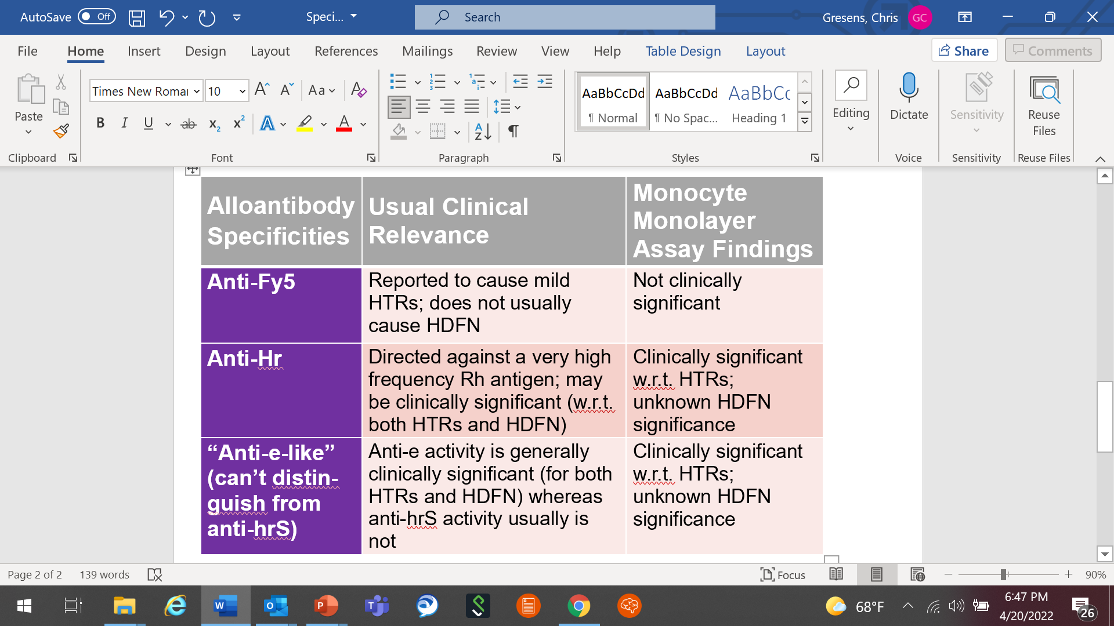
An Extremely Alloimmunized Patient
The remaining three red cell alloantibodies

Slide 9
An Extremely Alloimmunized Patient
Patient’s red cell antigen profile (based upon genotyping and serologic phenotyping)
          Her predicted phenotype is:
            D-positive (partial expression)
            C-negative
            E-negative
            c-positive (partial expression)
            e-positive (partial expression)
            V-positive (weakly expressed)
            VS-negative
            hrB-positive
            hrS-negative
            K-negative/k-positive
            Kpa-negative/Kpb-positive
            Jsa-negative/Jsb-positive
            Fya-negative/Fyb-negative (GATA Box-positive)
            M-positive/N-negative
            S-negative/s-positive/U-positive
          Her Rh genotype is:
            Homozygous for RHD*DAR
            Homozygous for RHCE*ceAR

Slide 10
An Extremely Alloimmunized Patient
Bottom-line: No perfectly matched donors/units could be identified in the U.S. within either Vitalant or the American Rare Donor Program (ARDP)

Slide 11
An Extremely Alloimmunized Patient
Additional medical background
  Height: 160 cm (5’2”); Weight: 107.5 Kg (237 lbs.)
  Hgb at 27 weeks GA was 11.7 g/dL (note: by this time she had received at least 3 injections of an erythropoiesis-stimulating agent and 2 infusions of iron totaling up to 1,000 mg
“Geo-logistical” background
  This patient was located in Fargo, ND
  This location does not have the capacity to freeze liquid-state RBC units or thaw/deglycerolize frozen units
  The nearest Vitalant site where such functions could be supported was (and remains) in Denver, CO

Slide 12
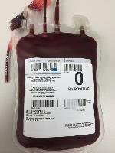
Plan = To collect two units from patient
An Extremely Alloimmunized Patient
Question: Whether to collect …
Double red blood cells (DRBCs)
VERSUS
Whole blood (WB)
Answer: WB (with rationale to follow …)

Slide 13
An Extremely Alloimmunized Patient
Case to be made for a DRBC collection …
PROS | CONS
Isovolemic Having 2 RBC units available at once | Having to wait until relatively close to delivery to collect (d/t 42-day shelf life of units) → No blood available if any complications were to arise before then Does not satisfy donor criteria of Hb >13.3 and Height > 5’5” Leads to immediate ↓in pregnant patient’s hemoglobin of around 2 g/dl

Slide 14
An Extremely Alloimmunized Patient
Case to be made for two WB collections …
PROS | CONS
Ability to start collecting sooner → earlier availability of a unit in “liquid-state” in case any pre-delivery complications Smaller ↓ hemoglobin per procedure compared to DRBC collection Qualifies for autologous (Hgb =11.7) Possibility of collecting more units (> 7 days per collection) | Only 1 unit available at a time Risk of not fulfilling minimal Hgb requirement for subsequent donation(s)

Slide 15
An Extremely Alloimmunized Patient
PLAN
Acquire two RBC units via whole blood collections
  1st collection: 10/18/2021 (~estim. expir. date = 11/29); ship from Fargo to Denver (if not used) on/by Nov 22nd
  2nd collection: 11/11/2021 (~estim. expir. date 12/23); ship from Fargo to Denver (if not used) on/by Dec 20th
Keep both units in “liquid state” (i.e., readily available to patient/baby if needed quickly)
Freeze the rare units (if not needed/used), close to their expiration dates. per SOP

Slide 16
NEXT QUESTION: Autologous vs. Allogeneic?
An Extremely Alloimmunized Patient
She was pregnant and her initial Hgb was < 12.5 mg/dL → Not eligible for allogeneic
However, considering rareness of her phenotype (i.e., no matched units available in the US), the question arose if, she might not need/use them, could another recipient with the same (or very similar) rare phenotype access them?
Our donor care, regulatory/quality and manufacturing teams worked together to make her unit “allogeneic”
Plus, her first collection Hgb was 13.3 mg/dL (luck sometimes does favor the prepared ☺)

Slide 17
Additional backup strategy: Potentially importing a unit from South Africa
An Extremely Alloimmunized Patient
Our hospital-based colleagues and we worked with ARDP to collect/ import a unit from a suitable donor identified in South Africa
Eventually, though, it was decided that such a need no longer existed (owing to all the MANY preparations that were being made domestically)
For a time, however, we wrestled with the question of whether Vitalant could accept, issue, and (if not ultimately transfused) freeze the unit from South Africa

Slide 18
Additional backup strategy: Potentially importing a unit from South Africa
An Extremely Alloimmunized Patient
Future “to-do list assignment:” We will inquire further about the regulatory aspects of this kind of request to sort out the logistics in case we need to accommodate similar requests in the future

Slide 19
What ultimately happened…
An Extremely Alloimmunized Patient
31-year-old pregnant (32 weeks), group O, Rh(D)-positive African-American woman
Very rare phenotype + multiple clinically significant antibodies
Scheduled delivery (C-Section) at 37 weeks (around December 17^{th)} with use of intraoperative cell saver and tranexamic acid
First collection on Oct 18th (expiration Nov 29th), with shipping to Denver (if not used) on Nov 22nd.
Second collection was on Nov 11th (estimated expiration date Dec 23rd), with shipping to Denver (if not used) on Dec 20th

Slide 20
What ultimately happened…
An Extremely Alloimmunized Patient
C-section went well with an estimated 600 mL blood loss
Baby was found to be mildly anemic (Hct 34) with increased reticulocytes and elevated bilirubin (6.1) shortly after birth, highly suggestive of HDN
Mom was discharged without any complications
Baby received intensive phototherapy and IVIG. However her HCT continued to decline and bilirubin continued to rise despite therapy
Provider decided to transfuse → 2 irradiated washed aliquots ordered
Notes:
If we wash the whole unit, it will be expiring in 24 hours. Aliquoting the unit will help us avoid a situation where we waste 50%+ of this rare unit. Then, we would have to thaw and send the frozen unit that is located in Denver which we won’t be able to do immediately.
Concerns from our manufacturing team: No washed/irradiated codes for a split product in eProgesa . That means they will have to do everything from that point forward manually. That includes manual labeling and manual shipping. Another concern is that it was already a small unit with only 250mls, so we were not sure how well it will wash when split in half. Our manufacturing team pulled a rejected unit and try it out first and were successful. They did not want to try it on our rare unit first.
Another question that came up: Irradiating the small aliquot vs. the unit?→Okay to irradiate the whole unit. We always try to irradiate units as close as possible to transfusion (concern of hyperkalemia especially for newborn). Since we were going to wash the aliquot before transfusion, which will take care of the excess potassium, we decided that it was okay to irradiate the whole unit.

Slide 21
What ultimately happened …
An Extremely Alloimmunized Patient
Our hospital-based colleagues asked us to wash the aliquots rather than the whole unit
Concern from Vitalant’s manufacturing team about washing a small aliquot and having to do everything manually
Our quality team did a Non-Conforming Product Evaluation (NCPE) in advance so that it is approved and ready to go when the order comes in
Another question that came up: Irradiating the small aliquot vs. the whole unit → okay to irradiate the whole unit since we will be washing the aliquots before transfusion
The unit was irradiated, the two aliquots were washed and transfused on 12/22
Notes:
If we wash the whole unit, it will be expiring in 24 hours. Aliquoting the unit will help us avoid a situation where we waste 50%+ of this rare unit. Then, we would have to thaw and send the frozen unit that is located in Denver which we won’t be able to do immediately.
Concerns from our manufacturing team: there will not be any washed/irradiated codes for a split product in eProgesa . That means they will have to do everything from that point forward manually. That includes manual labeling and manual shipping. Another concern is that it was already a small unit with only 250mls, so we were not sure how well it will wash when split in half. Our manufacturing team pulled a rejected unit and try it out first. They did not want to try it on our rare unit first.
Another question that came up about irradiating the small aliquot vs. the unit→Okay to irradiate the whole unit. We always try to irradiate units as close as possible to transfusion (concern of hyperkalemia especially for newborn). Since we were going to wash the aliquot before transfusion, which will take care of the excess potassium, we decided that it was okay

Slide 22
What ultimately happened …
An Extremely Alloimmunized Patient
On 12/28, we received an order to deglyc the rare unit located in Denver
I called the hospital blood bank and the clinicians to make sure that they would transfuse in the next 24 hours
Provider confirmed the need to transfuse (HCT:20/threshold 22)
Gave the approval to deglyc the unit
Coordination between IRL, hospital services, flight schedule and unit made it to Fargo on time
Baby was transfused on 12/29 (HCT 20→28.4). Baby discharged on 1/2/22 with HCT of 29.4

Slide 23
Debriefing/Take-Home Messages
An Extremely Alloimmunized Patient
Importance of close communication and coordination between Vitalant’s team and our hospital based colleagues
Planning was also key in this case. We got multiple meetings and exchanged multiple emails for months in preparation for this both within Vitalant as well as with our hospital based colleagues.
Communication, coordination and planning made this a success
This case also highlights the importance of blood donation, especially among minorities who have been historically underrepresented among blood donors
This was also a chance to increase awareness about the importance of donating blood while communicating with this patient/donor.

Slide 24
Outline
Case study: An extremely alloimmunized patient
Background: Overview of red cell alloimmunization
Solutions: What can we do to mitigate and respond to these challenging situations?
Fun quiz (non-graded ☺)
References
Q-&-A

Slide 25

A “35,000-foot view”
(Focus = Alloimmunization in General)

Slide 26
Background
Over 11 million red blood cells (RBCs) are transfused annually in the US, making transfusion the most common procedure completed during a given hospitalization.
Transfusion threshold studies have shown that restrictive hemoglobin thresholds are as safe as or safer than liberal hemoglobin thresholds for many patient populations and indications, leading to a decline in transfused RBC units over the past decade.
Despite decreasing transfusion burdens, alloantibody formation to transfused blood products remains a clinically significant problem

Slide 27
Background
RBC alloantibodies may be clinically significant in future transfusion or pregnancy scenarios.
These antibodies can lead to acute or delayed hemolytic transfusion reactions or hemolytic disease of the fetus and newborn
They may also lead to lengthy and costly evaluations in the blood bank and delays in locating compatible RBC units for future transfusions

Slide 28
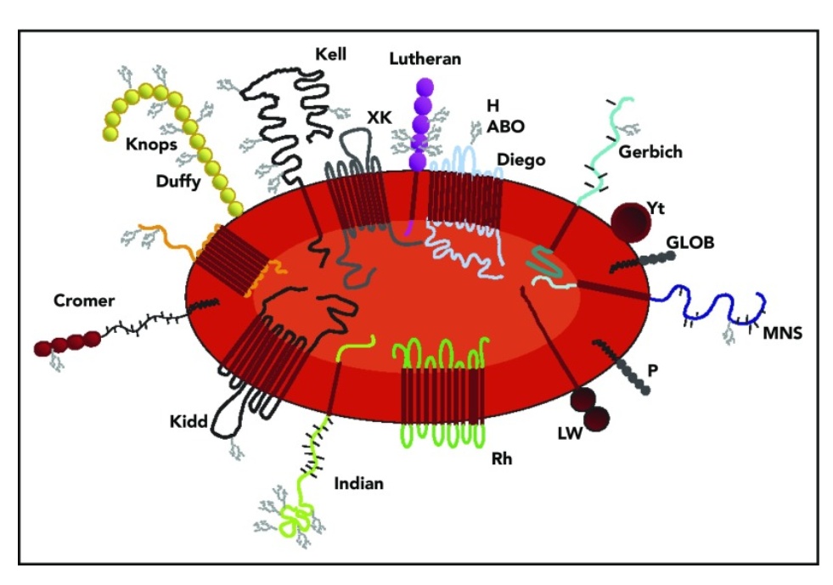
Red Cell Alloimmunization: A High-Level Review
Several hundred distinct red cell antigens exist
In general …
  Polypeptide antigens stimulate (37º C-reactive) IgG
  Carbohydrate antigens stimulate (RT-reactive) IgM
Blood. 2019. 133: 1821–30..
Notes:
RBC antigens are numerous and diverse from a structural and functional perspective. For instance, it has generally been found that polypeptide antigens give rise to alloantibodies of an immunoglobulin G (IgG) class (reactive at 37°C), while carbohydrate antigens tend to give rise to IgM-class antibodies showing strongest reactivity at 22°C (also referred to as immediate spin reactivity).

Slide 29
Red Cell Alloimmunization: A High-Level Review
Red cell alloantibodies: Who’s affected and why?
They develop in a subset of individuals exposed to “non-self” (i.e., “allo”) antigens – usually via:
  Transfusion or
  Pregnancy
Factors affecting their development include:
  Blood donor variables
  Blood product variables
  Transfusion recipient variables, such as:
    Genetics
    Innate immunity
    Adaptive immunity
Incidence and impact: Vary based upon multiple factors

Slide 30
Red Cell Alloimmunization: A High-Level Review
Red cell alloantibodies: The consequences
Direct clinical consequences include:
  Reduced post-transfusion red cell survival
  Hemolytic transfusion reactions (acute and/or delayed)
  Hemolytic disease of fetus/newborn
  None (i.e., many are clinically irrelevant “nuisances”)
Indirect clinical (and lab) consequences include:
  Substantial time on pre-transfusion compatibility testing
  Delayed transfusions
  Varied impacts of above on:
    Patient outcomes
    Overall use of (sometimes scarce) resources

Slide 31
Caveat
Autoantibodies
Drug antibodies
This is an “autoantibody/drug-antibody-free” discussion, i.e., …
All of the challenges we’re about to discuss will be accentuated/exacerbated by:
  Autoantibodies AND …
  Drug-associated antibodies
Today we will NOT focus on the above-two entities
Keep in mind, however, that the (alloantibody-related) principles we will discuss nonetheless apply in the presence of these kinds of additional immunoreactivity

Slide 32

A more detailed view
(Focus = “Complex” Alloimmunization)

Slide 33
Red Cell Alloimmunization: More Complex Situations
We face special challenges when dealing with:
  Multiple alloantibodies against non-high-frequency antigens (sometimes called “common alloantibodies”)
  AND/OR …
  One (or more) alloantibodies against high-frequency antigens (often referred to as “rare alloantibodies”)

Slide 34
Red Cell Alloimmunization: More Complex Situations
We face special challenges when dealing with:
  Multiple alloantibodies against non-high-frequency antigens (sometimes called “common alloantibodies”)
  AND/OR …
  One (or more) alloantibodies against high-frequency antigens (often referred to as “rare alloantibodies”)
We’ll start by focusing on the first of these two challenges (i.e., multiple alloantibodies)

Slide 35
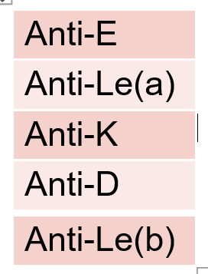
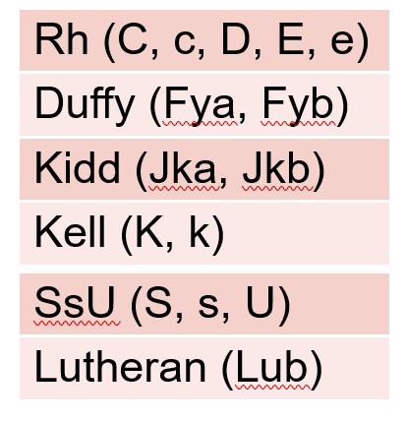
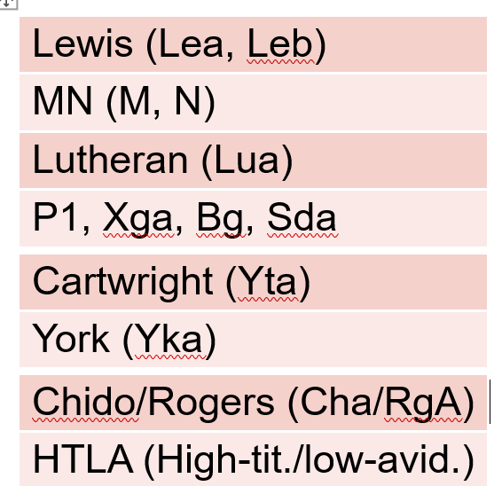
Red Cell Alloimmunization: More Complex Situations
Common alloantibodies: Their specificities, relative
incidence, and general relevance
Most often seen are …
Usually relevant …
Usually irrelevant …
Blood. 2019. 133: 1821–30..

Slide 36
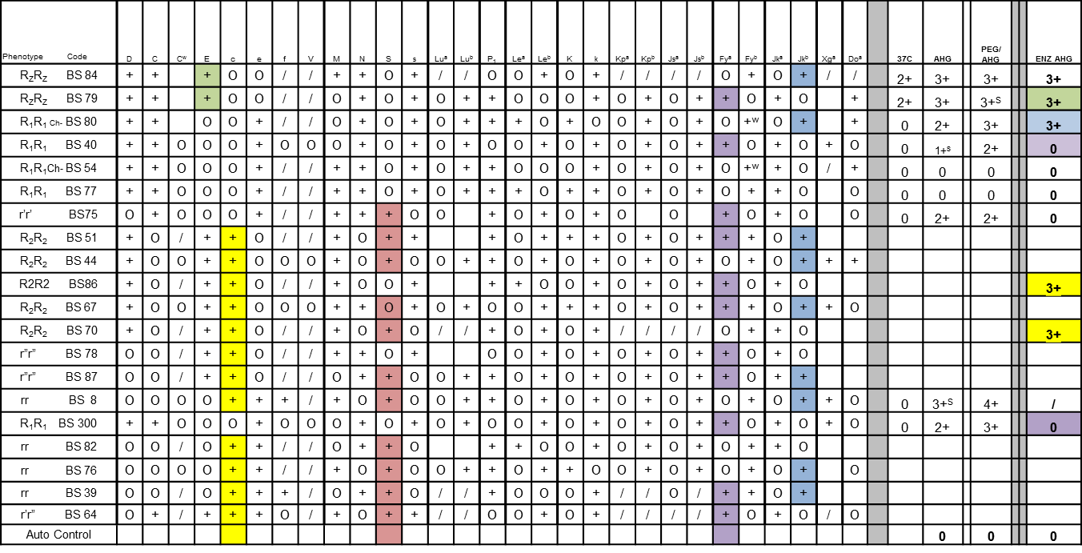
Red Cell Alloimmunization: More Complex Situations
Example of Red Cell Antibody Panel Demonstrating Multiple Alloantibodies
  Anti-c – Anti-E – Anti-S – Anti-Fyª – Anti-Jk^{b}

Slide 37
Red Cell Alloimmunization: More Complex Situations
Only some (and not most) people develop alloantibodies
Who becomes alloimmunized (and why?)?
  Almost everyone transfused with non-phenotype-matched RBCs will be exposed to > 1 clinically relevant alloantigens
  Yet only 2-5% of transfused patients make alloantibodies
  Alloimmunized individuals “must have an HLA binding motif capable of presenting a portion of the non-self antigen”
  Antigenic immunogenicity and density have importance
  Number of cumulative exposures also is important
  Certain other variables clearly play a role, too – e.g., …
    Disease states (myelodysplasia, sickle cell disease)
    Inflammatory conditions (autoimmune hemolytic anemias)
  Other factors also play a role, though we’ll stop here for now
Blood. 2019. 133: 1821–30..

Slide 38
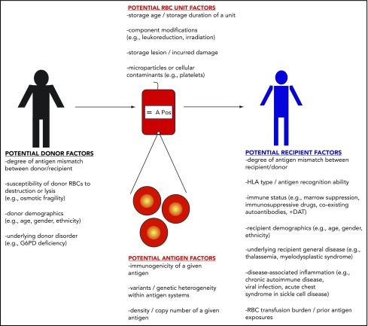
Who becomes alloim-munized (and why?)?
Blood. 2019. 133: 1821–30..

Slide 39
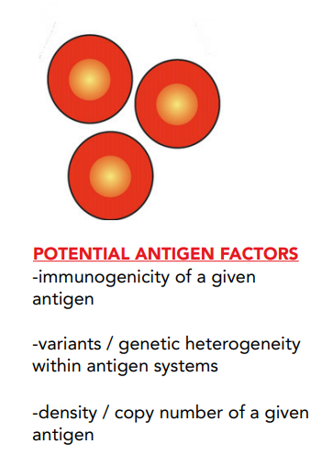
Red Cell Alloimmunization: More Complex Situations
Only some (and not most) people develop alloantibodies
Blood. 2019. 133: 1821–30..

Slide 40
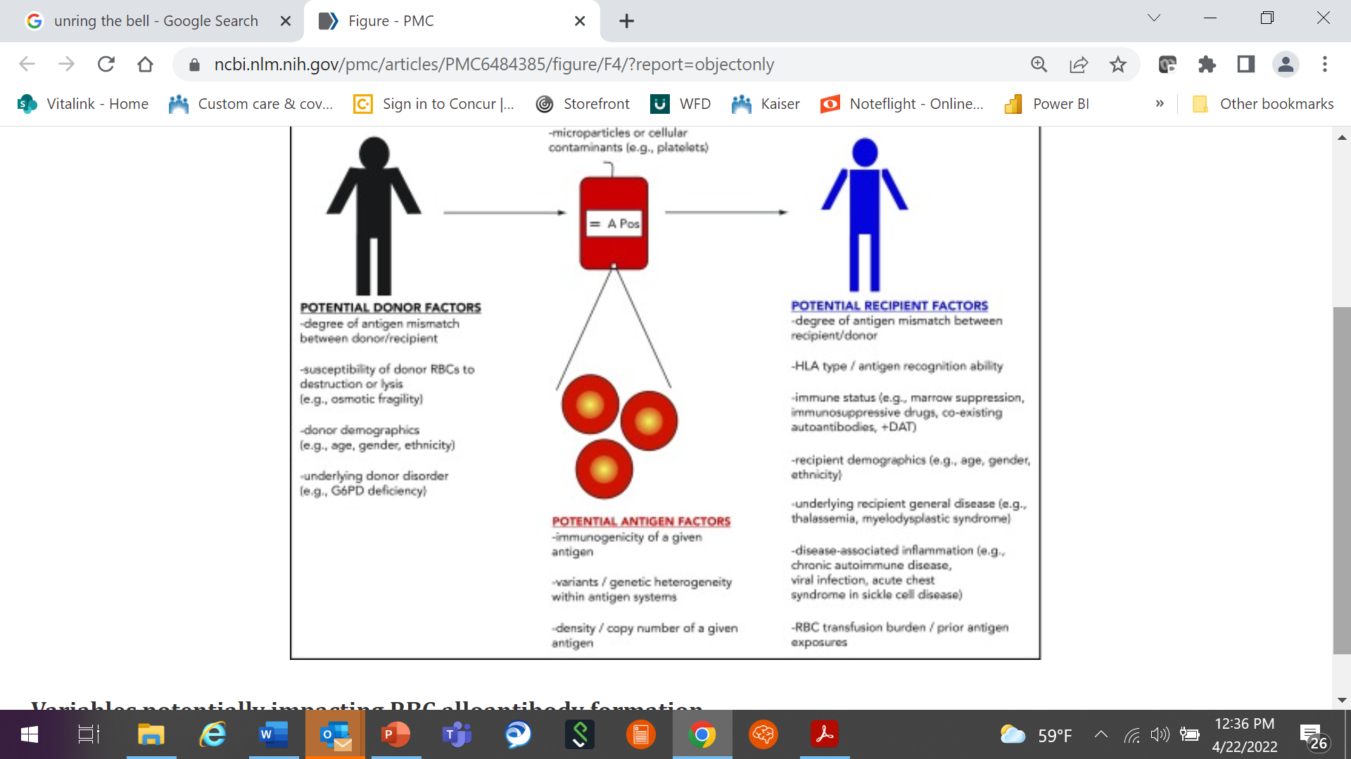
Red Cell Alloimmunization: More Complex Situations
Only some (and not most) people develop alloantibodies
  Degree of antigen mismatch between donor and patient
  Susceptibility of donor red cells to destruction and/or lysis
  Donor demographics (e.g., age, gender, ethnicity)
  Underlying donor disorders (e.g., G6PD deficiency)
Blood. 2019. 133: 1821–30..

Slide 41
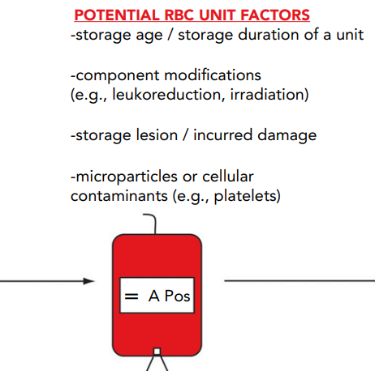
Red Cell Alloimmunization: More Complex Situations
Only some (and not most) people develop alloantibodies
Blood. 2019. 133: 1821–30..

Slide 42
Red Cell Alloimmunization: More Complex Situations
Only some (and not most) people develop alloantibodies
  HLA antigen recognition ability
  Immune status
  Recipient demographics (e.g., age, gender, ethnicity)
  Underlying recipient diseases
  Disease-associated inflammation
  RBC transfusion burden/prior antigen exposures
Blood. 2019. 133: 1821–30..

Slide 43
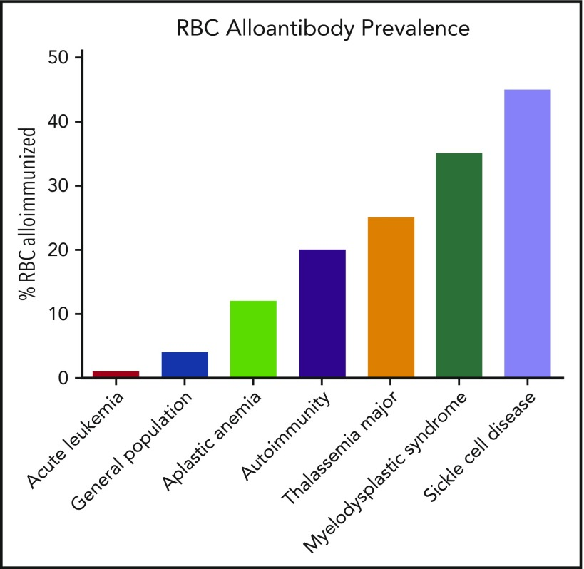
Red Cell Alloimmunization: More Complex Situations
  Red cell Alloimmunization Prevalence Seen in Various Conditions and/or Disease States
Blood. 2019. 133: 1821–30..
Notes:
Patients with SCD have among the highest rates of RBC alloimmunization of any population. This may be due in part to the relatively high transfusion burden of patients living with SCD and also to the number of Rh variants (of D, E/e, or C/c) known to occur in patients of African descent. One major difference between these populations is that SCD occurs predominantly in people of African ancestry, whereas the donor population in North America and Europe is predominantly of European ancestry. As the fundamental requirement for alloimmunization to occur is exposure to a foreign antigen, the difference in prevalence between African Americans and Caucasians of several RBC antigens, as well as a lack of certain high-prevalence antigens in populations of African descent, is likely a major contributor to the higher incidence of alloimmunization. In contrast, patient populations with lower RBC alloimmunization rates than predicted based on transfusion burden include those with leukemia undergoing chemotherapy.

Slide 44

Red Cell Alloimmunization: More Complex Situations
Only some (and not most) people develop alloantibodies
  Why do some people make multiple alloantibodies?
  All of the aforementioned causes for alloimmunization play a role here, too
  Further understanding of the “why’s” of this is, however, is beyond today’s discussion
  Our focus (on “multiple alloantibody-makers” will instead take a more practical turn …
How do we support multiple alloantibody-makers?

Slide 45
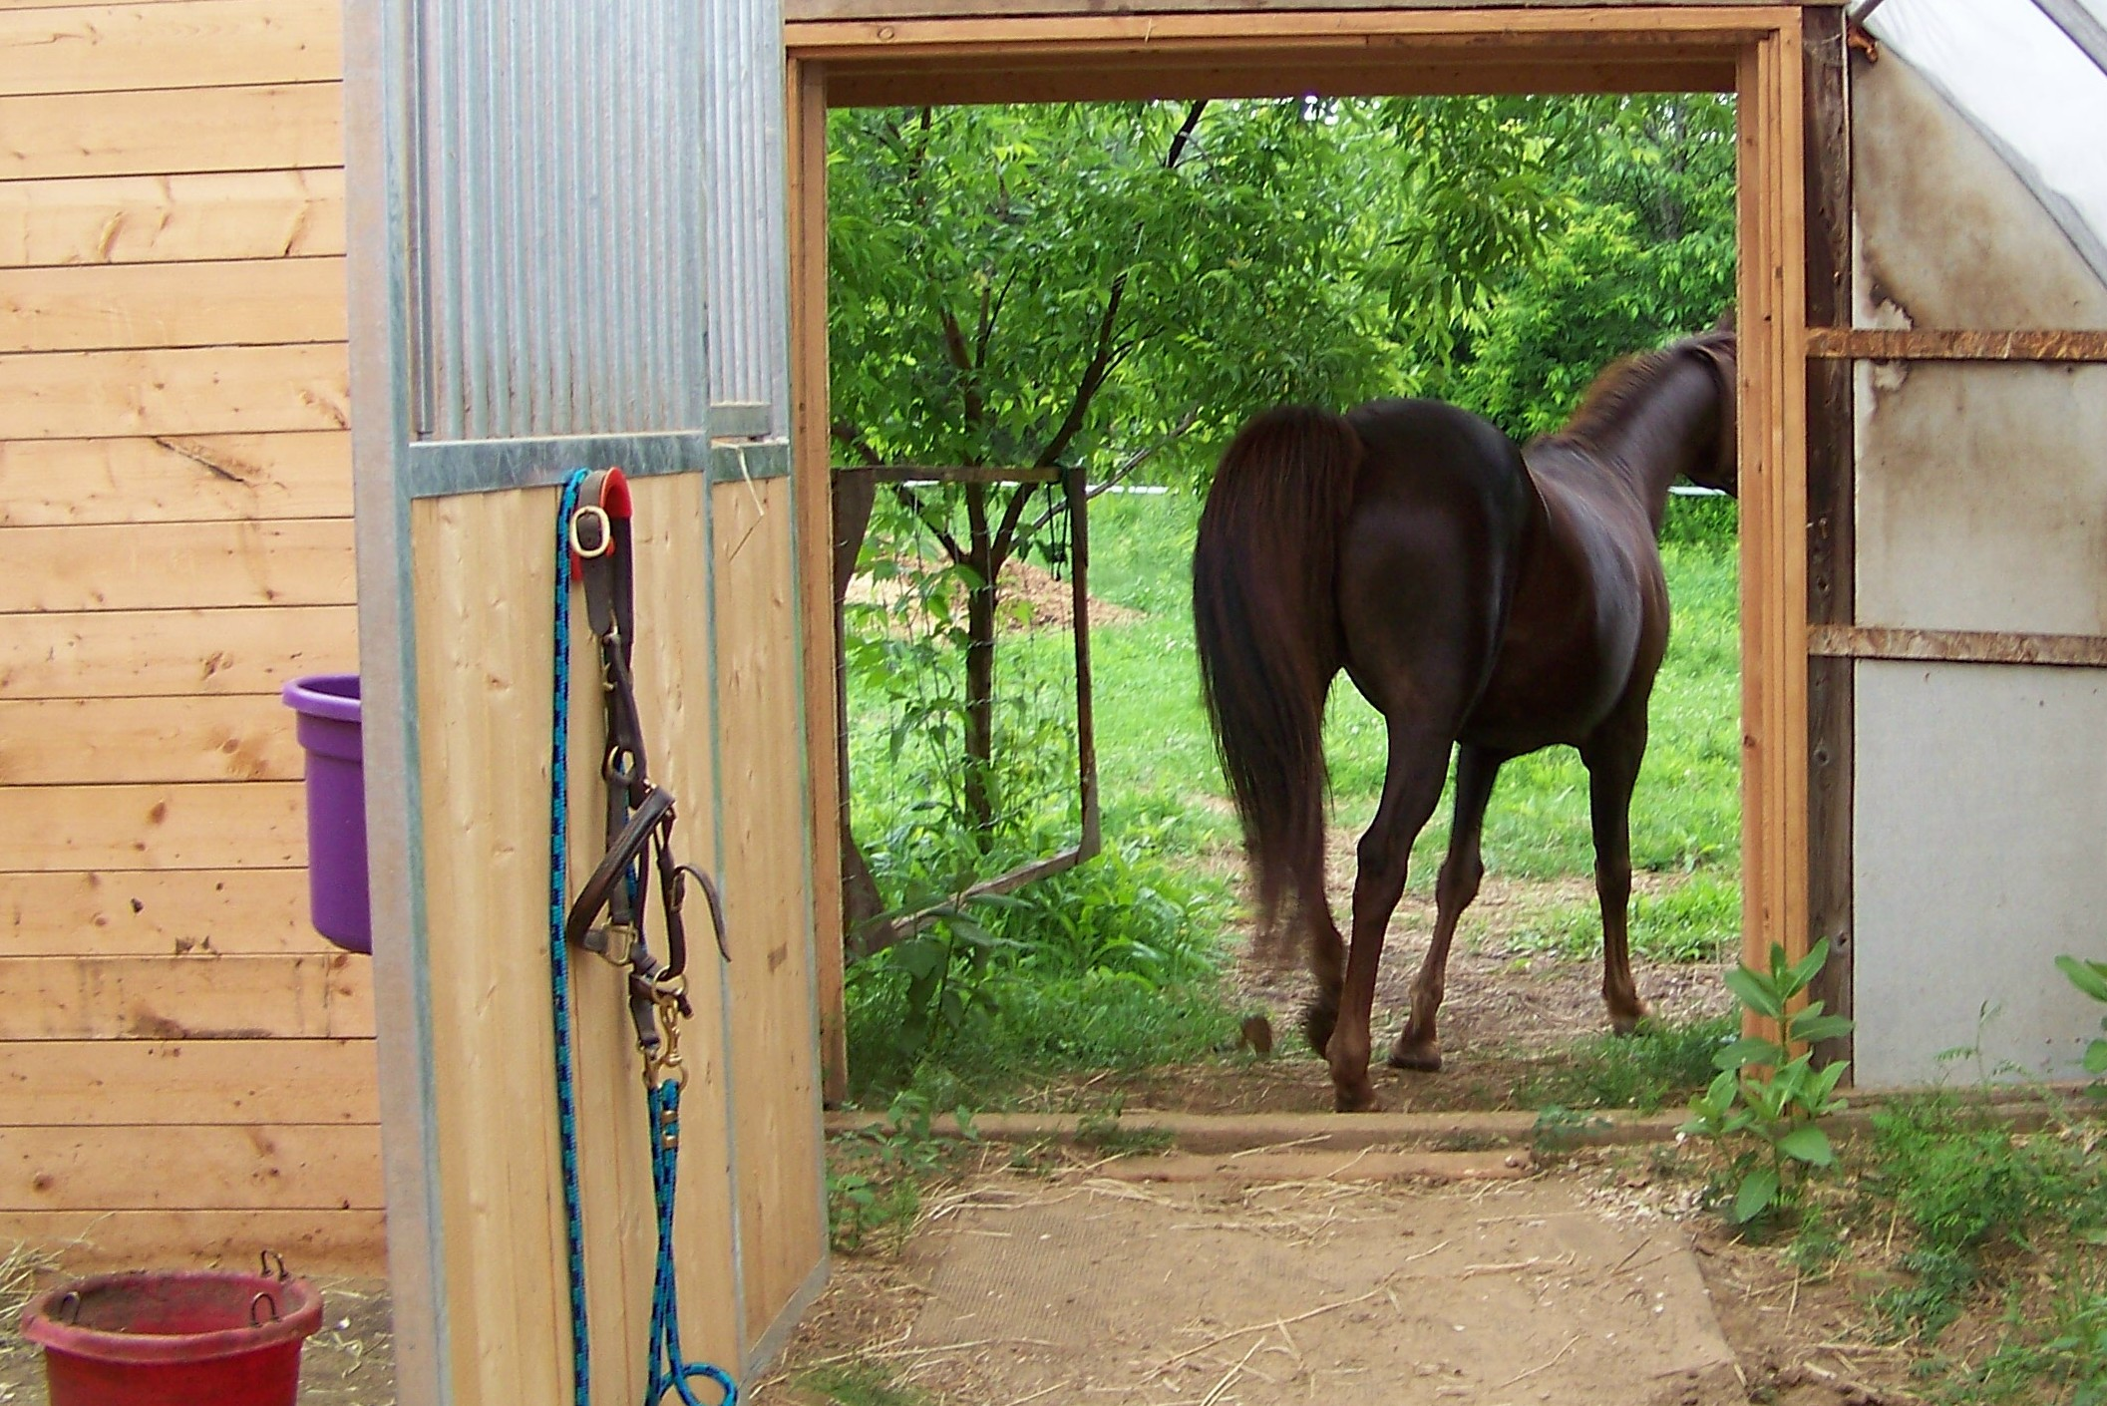
Red Cell Alloimmunization: More Complex Situations
How do we support multiple alloantibody-makers?
After the horse is out of the barn (i.e., after the antibodies have been made) …
  We generally are left dealing with the consequences
  Our case study was a classic example of this
  This is why we take reasonable preventive steps in support of patients known to be at special risk of alloimmunization …

Slide 46
Red Cell Alloimmunization: More Complex Situations
We face special challenges when dealing with:
  Multiple alloantibodies again non-”high-frequency” antigens (sometimes called “common alloantibodies”)
  AND/OR …
  One (or more) alloantibodies against high-frequency antigens (often referred to as “rare alloantibodies”)
Next we’ll focus on alloantibodies against high-frequency antigens

Slide 47
Red Cell Alloimmunization: More Complex Situations
Some (rare) individuals develop alloantibodies against high-frequency antigens
Definition
“High-frequency RBC antigens occur at frequencies
of over 99 percent.”
Transfusion 2003. 43: 1563-6.

Slide 48
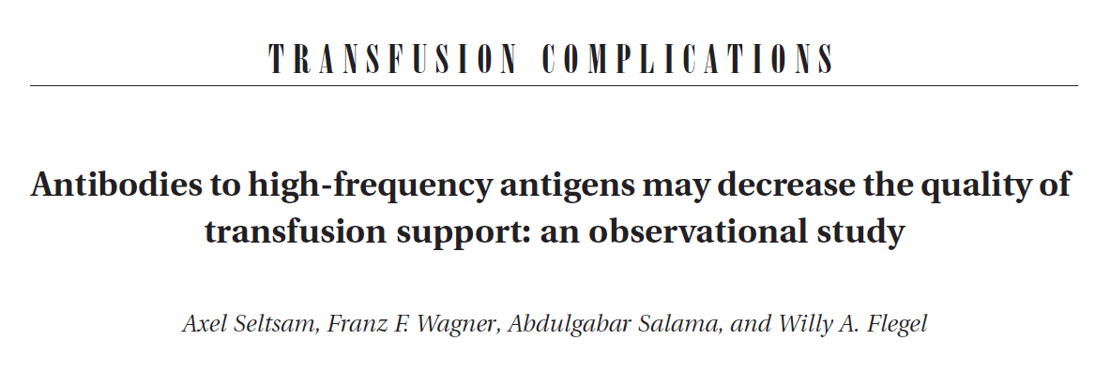
Red Cell Alloimmunization: More Complex Situations
BACKGROUND: “There is only little information on the transfusion support of patients with antibodies to high-frequency RBC antigens.”
STUDY DESIGN AND METHODS: “In cooperation with reference labora-tories and transfusion services in Austria, Germany, and Switzerland, the transfusion support provided to hospitalized patients identified as having such antibodies was reviewed during a 20-month period.”
Transfusion 2003. 43: 1563-6.

Slide 49
Red Cell Alloimmunization: More Complex Situations
RESULTS
Treated 52 patients with antibodies to high-frequency antigens
Twenty-two received 104 units of antigen-negative RBCs
In 23 cases, antigen-incompatible units were given
About 20 percent of all units were supplied internationally.
Four antibody specificities – anti-Kp^{b}, anti-Vel, anti-Lu^{b}, and anti-Ytª – were identified in two-thirds of the patients.
Transfusion 2003. 43: 1563-6.

Slide 50
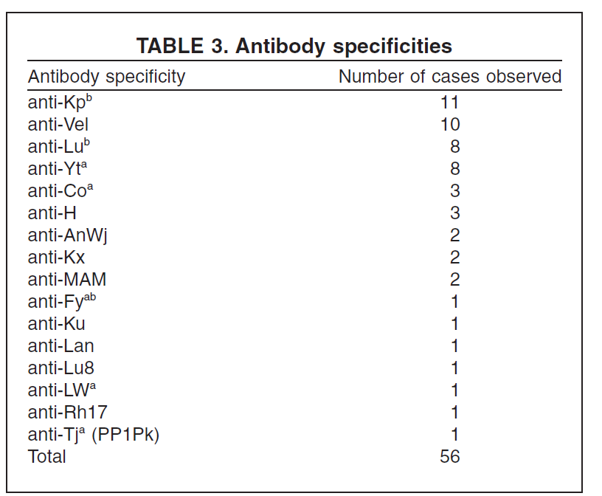
Red Cell Alloimmunization: More Complex Situations
Further RESULTS (demonstrating many other specificities against high-frequency antigens)
Transfusion 2003. 43: 1563-6.
Notes:
Four antibody specificities – anti-Kp^{b}, anti-Vel, anti-Lu^{b}, and anti-Ytª – were identified in two-thirds of the patients

Slide 51
Red Cell Alloimmunization: More Complex Situations
CONCLUSION
“Transfusion support was unsatisfactory in about one-third of the hospitalized patients with antibodies to high-frequency antigens.
Maintaining a rapidly accessible stock of just four types of rare blood units would ensure adequate transfusion support for most of these patients.”
Transfusion 2003. 43: 1563-6.
Notes:
Kpb , Vel, Lub , and Yta. Four antibody specificities – anti-Kp^{b}, anti-Vel, anti-Lu^{b}, and anti-Ytª – were identified in two-thirds of the patients

Slide 52
Debriefing/Take-Home Messages
Red Cell Alloimmunization: More Complex Situations
Rare RBC transfusion needs are seen in patients with:
  Multiple alloantibodies against “relatively-lower-frequency” antigens
  --AND/OR …
  One alloantibody against a high-frequency antigen
Many factors … almost always in association with transfusions and/or pregnancy … play a role in the development of such alloantibodies
One of the major factors is the transfusion of RBCs having very different antigenic profiles from the recipient

Slide 53
Outline
Case study: An extremely alloimmunized patient
Background: Overview of red cell alloimmunization
Solutions: What can we do to mitigate and respond to these challenging situations?
Fun quiz (non-graded ☺)
References
Q-&-A

Slide 54
Extreme Alloimmunization: How We Mitigate/Respond to These Situations
A General Overview: Univ. of Pittsburgh Med. Ctr.’s strategy includes six key components (that also apply to “routine” patient blood management):
Leverage computerized physician order entry systems to guide evidence-based transfusions
Reduce all forms of waste related to blood transfusion practice
Promote alternative blood transfusion methods & systems
Promote anemia management strategies
Limit iatrogenic blood loss
Provide blood management education, awareness and auditing for clinicians, as well as patient-centered shared decision-making tools
From “Using blood wisely” (on Choosing Wisely website)

Slide 55


Extreme Alloimmunization: How We Mitigate/Respond to These Situations
More general thoughts …
Patients NEVER should be denied transfusions if compatible blood is not available or does not exist
Communication between blood center and hospital (both transfusion service and clinicians) is crucial
MAKE A PLAN!
WORK THE PLAN!!

Slide 56
Extreme Alloimmunization: How We Mitigate/Respond to These Situations
Prevention-focused measures (in general)
As we do this, we must remember that our main goal is NOT focused on RBC transfusions (though that is important)
Rather, we are using all our resources to protect the patient from the deleterious impacts of anemia
Much of what we will discuss comes down to choosing wisely
Notes:
‘;,/

Slide 57

Extreme Alloimmunization: How We Mitigate/Respond to These Situations
Red cell alloantibodies: Prevention
Primary strategy is to transfuse only when needed
Complementary strategies include:
  Current – More extensive a priori matching for selected antigens in RBC units intended for “at-risk” patients (see also next slide)
  Future (???) – Immunomodulatory therapy for patients at greatest risk for life-threatening alloimmunization
Don’t transfuse more units of red blood cells or other components than absolutely necessary.
(AABB’s 1st admonition in its “Choosing Wisely” checklist)
Blood. 2019. 133: 1821–30..

Slide 58
Extreme Alloimmunization: How We Mitigate/Respond to These Situations
Prevention-focused measures involving selection of RBCs
  Applied most often to patients with:
    Sickle cell disease
    AND …
    Autoimmune hemolytic anemias
  Increasingly used for others at risk
  Most common is to match for:
    Rh (C, c, D, E, e), and
    K
  Some protocols expand the above to include other red cell antigens.

Slide 59
Extreme Alloimmunization: How We Mitigate/Respond to These Situations
Other prevention-focused measures
Optimizing hemoglobin values (especially pre-procedural)
  Identifying, diagnosing, and treating anemias early
  Often this is as “simple” as …
  Administering:
    Iron (intravenously for imminently pending procedures)
    (Sometimes) an erythropoiesis-stimulating agent
  Resolving previously-unrecognized bleeding (e.g., GI or Gyn)
Acquiring suitable rare RBC units via collections of :
  Preoperative autologous blood
  Family donor blood
  Blood from:
    Local (or other/partnering) blood centers
    American Rare Donor Program (ARDP)

Slide 60
Extreme Alloimmunization: How We Mitigate/Respond to These Situations
American Rare Donor Program (ARDP)
History: Formed in 1998
Purpose: “To provide rare blood units for patients in need”
Mechanism
  “Members … identify rare donors and submit donor information … into a database, REGGI.
  Information on patients in need of rare blood is also submitted and entered into REGGI.
  REGGI serves to match phenotypes of registered donors with patients having the respective antibodies.
  A search process for available units ensues, and blood is provided [when available] to the patient.”
Transfus Med Hemother 2014; 41: 342–5.

Slide 61
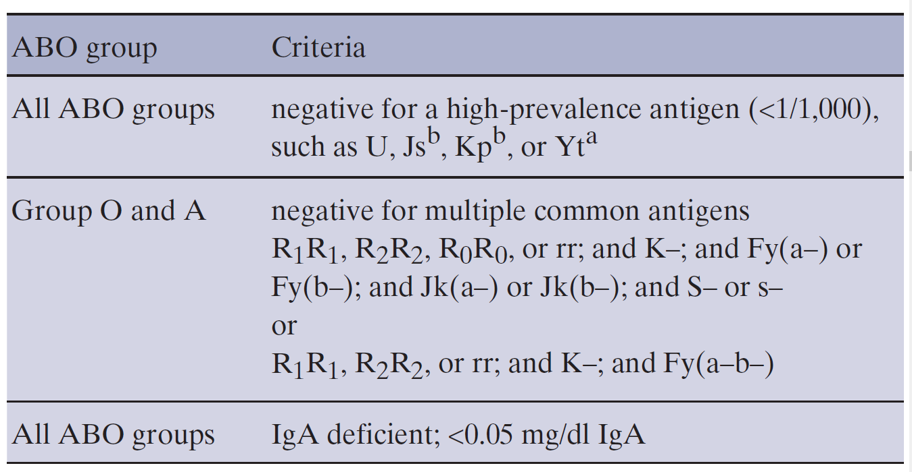
Extreme Alloimmunization: How We Mitigate/Respond to These Situations
American Rare Donor Program (ARDP)
ARDP’s definition of a rare donor …
Transfus Med Hemother 2014; 41: 342–5.

Slide 62
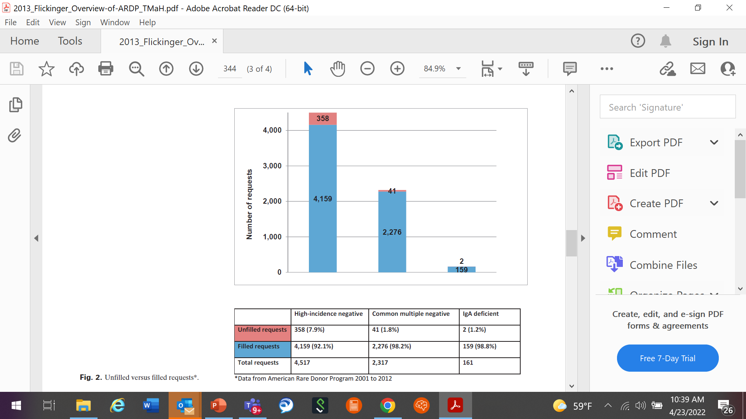
Extreme Alloimmunization: How We Mitigate/Respond to These Situations
American Rare Donor Program (ARDP)
ARDP’s “track record”
~2/3 of requests
~1/3 of requests
Transfus Med Hemother 2014; 41: 342–5.

Slide 63
Extreme Alloimmunization: How We Mitigate/Respond to These Situations
Other prevention-focused measures
Determining likely clinical relevance of alloantibodies using the monocyte monolayer assay
Reducing risk for procedural bleeding via selected medications
  Antifibrinolytic agents
  Hormonal agents
  Modified anticoagulation/antiplatelet regimens
Prepping for perioperative autologous collections, e.g.,
  Acute normovolemic hemodilution
  Intraoperative salvage
  Postoperative blood salvage
Notes:
ANH) involves a controlled removal of whole blood immediately prior to the operation. The patient’s intravascular volume is maintained with solutions that contain non-red cells. The operative procedure is conducted with a normal blood volume, but with a reduced red cell mass. At the conclusion of the operation, the stored autologous blood is restored to the patient.
intraoperative blood salvage (also called auto-transfusion) which recovers a patient's own blood by suctioning it directly from a surgical incision. It is then filtered, washed, and returned to the patient. The technique, developed as a method of avoiding allogeneic (donor) transfusion, is used when significant surgical blood loss is anticipated.
Postoperative cell salvage involves collecting blood that is lost from the wound post-operatively. into special autologous wound drains where it is filtered before being reinfused to the patient

Slide 64
Extreme Alloimmunization: How We Mitigate/Respond to These Situations
Monocyte monolayer assay (MMA)
The essentials …
What it is: A predictive, in vitro assay to get an estimate of how clinically significant a particular antibody is
What it is good for: Helpful in situations when patients will be transfused with an antigen(s) corresponding to their antibody
What it is not good for: Situations requiring urgent resolution or rapid TAT

Slide 65
Extreme Alloimmunization: How We Mitigate/Respond to These Situations
Monocyte monolayer assay (MMA)
Mechanism …
Figures from Dr. Ghislain Noumsi - SCABB presentation

Slide 66
Extreme Alloimmunization: How We Mitigate/Respond to These Situations
Monocyte monolayer assay (MMA)
Mechanism …
Figures from Dr. Ghislain Noumsi - SCABB presentation

Slide 67
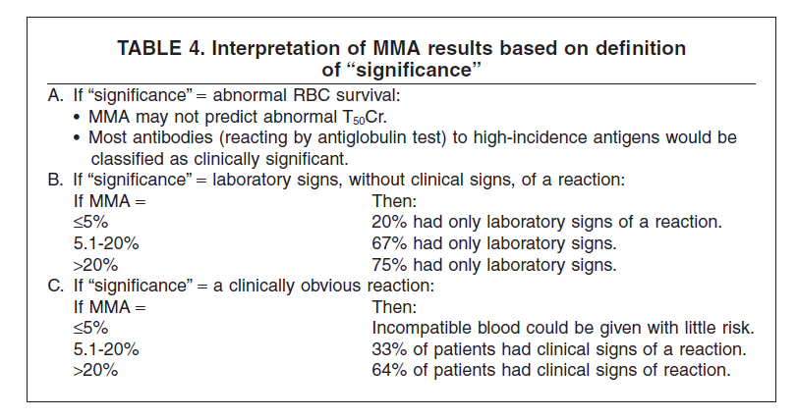
Extreme Alloimmunization: How We Mitigate/Respond to These Situations
Monocyte monolayer assay (MMA)
Interpretation
Figures from Dr. Ghislain Noumsi - SCABB presentation

Slide 68

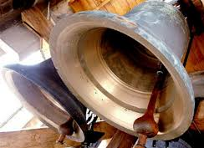
Extreme Alloimmunization: How We Mitigate/Respond to These Situations
Reactive/therapeutic measures, i.e., trying to …
  Get the horse back in the barn
  Squeeze the toothpaste back into the tube
  “Un-ring” the bell (well … you get the idea ☺)

Slide 69
Extreme Alloimmunization: How We Mitigate/Respond to These Situations
Reactive/therapeutic measures
  Many of those we’ve discussed under the heading of “preventative” measures
  Also …
    Providing maximally supportive care, e.g.,
    Bed rest
    Oxygen support
    Being ready to transfuse incompatible RBCs … even if not vetted as “probably safe” by the MMA
    Working in an interdisciplinary manner to meet the patient’s needs

Slide 70
Debriefing/Take-Home Messages
Extreme Alloimmunization: How We Mitigate/Respond to These Situations
Prevention of alloimmunization is critical
Where prevention is unsuccessful (or not applied), further preparation (plus, where needed, treatment) is essential
Remember that the “big-picture” focus is not transfusing the patient but (instead) protecting the patient from the deleterious impact of anemia
Lab’s main role is testing (w/ varying degrees of complex-ity) and then finding suitable antigen-negative RBC units
From a clinical perspective, general patient blood management practices go a long way in all of this

Slide 71
Outline
Case study: An extremely alloimmunized patient
Background: Overview of red cell alloimmunization
Solutions: What can we do to mitigate and respond to these challenging situations?
Fun quiz (non-graded ☺)
References
Q-&-A

Slide 72
Consolidating this discussion with a fun (really ☺) true/false quiz …

Slide 73
Brief Quiz – True or False
  Question 1: Most transfused patients do not develop red cell alloantibodies, let alone multiple alloantibodies and/or alloantibodies to high-frequency antigens.

Slide 74
Brief Quiz – True or False
  Question 1: Most transfused patients do not develop red cell alloantibodies, let alone multiple alloantibodies and/or alloantibodies to high-frequency antigens.
TRUE

Slide 75
Brief Quiz – True or False
  Question 1: Most transfused patients do not develop red cell alloantibodies, let alone multiple alloantibodies and/or alloantibodies to high-frequency antigens.
  Question 2: High-frequency red cell antigens are defined as having a prevalence of > 95%.
TRUE

Slide 76
Brief Quiz – True or False
  Question 1: Most transfused patients do not develop red cell alloantibodies, let alone multiple alloantibodies and/or alloantibodies to high-frequency antigens.
  Question 2: High-frequency red cell antigens are defined as having a prevalence of > 95%.
TRUE
FALSE

Slide 77
Brief Quiz – True or False
  Question 1: Most transfused patients do not develop red cell alloantibodies, let alone multiple alloantibodies and/or alloantibodies to high-frequency antigens.
  Question 2: High-frequency red cell antigens are defined as having a prevalence of > 95%.
  Question 3: Patients with alloantibodies do not develop autoantibodies or drug-associated antibodies.
TRUE
FALSE

Slide 78
Brief Quiz – True or False
  Question 1: Most transfused patients do not develop red cell alloantibodies, let alone multiple alloantibodies and/or alloantibodies to high-frequency antigens.
  Question 2: High-frequency red cell antigens are defined as having a prevalence of > 95%.
  Question 3: Patients with alloantibodies do not develop autoantibodies or drug-associated antibodies.
TRUE
FALSE
FALSE

Slide 79
Brief Quiz – True or False
  Question 1: Most transfused patients do not develop red cell alloantibodies, let alone multiple alloantibodies and/or alloantibodies to high-frequency antigens.
  Question 2: High-frequency red cell antigens are defined as having a prevalence of > 95%.
  Question 3: Patients with alloantibodies do not develop autoantibodies or drug-associated antibodies.
  Question 4: The most important thing to prevent and/or manage for patients with rare blood needs is the deleterious impact of the anemia (which may not involve transfusion support).
TRUE
FALSE
FALSE

Slide 80
Brief Quiz – True or False
  Question 1: Most transfused patients do not develop red cell alloantibodies, let alone multiple alloantibodies and/or alloantibodies to high-frequency antigens.
  Question 2: High-frequency red cell antigens are defined as having a prevalence of > 95%.
  Question 3: Patients with alloantibodies do not develop autoantibodies or drug-associated antibodies.
  Question 4: The most important thing to prevent and/or manage for patients with rare blood needs is the deleterious impact of the anemia (which may not involve transfusion support).
TRUE
FALSE
FALSE
TRUE

Slide 81
Brief Quiz – True or False
  Question 1: Most transfused patients do not develop red cell alloantibodies, let alone multiple alloantibodies and/or alloantibodies to high-frequency antigens.
  Question 2: High-frequency red cell antigens are defined as having a prevalence of > 95%.
  Question 3: Patients with alloantibodies do not develop autoantibodies or drug-associated antibodies.
  Question 4: The most important thing to prevent and/or manage for patients with rare blood needs is the deleterious impact of the anemia (which may not involve transfusion support).
  Question 5: The American Rare Donor Program (ARDP) usually cannot find rare RBC units for patients in need.
TRUE
FALSE
FALSE
TRUE

Slide 82
Brief Quiz – True or False
  Question 1: Most transfused patients do not develop red cell alloantibodies, let alone multiple alloantibodies and/or alloantibodies to high-frequency antigens.
  Question 2: High-frequency red cell antigens are defined as having a prevalence of > 95%.
  Question 3: Patients with alloantibodies do not develop autoantibodies or drug-associated antibodies.
  Question 4: The most important thing to prevent and/or manage for patients with rare blood needs is the deleterious impact of the anemia (which may not lead to transfusions).
  Question 5: The American Rare Donor Program (ARDP) usually cannot find rare RBC units for patients in need.
TRUE
FALSE
FALSE
TRUE
FALSE

Slide 83
Outline
Case study: An extremely alloimmunized patient
Background: Overview of red cell alloimmunization
Solutions: What can we do to mitigate and respond to these challenging situations?
Fun quiz (non-graded ☺)
References
Q-&-A

Slide 84
Selected References
AABB’s Five things physicians and patients should question. From Choosing Wisely website 2022. https://www.choosingwisely.org/societies/american-association-of-blood-banks/ (accessed 04/21/2022).
American Society of Anesthesiologists Task Force on Perioperative Blood Management. Practice Guidelines for Perioperative Blood Management. Anesthesiology 2015; 122: 241-75.
Arndt P, Garratty G. A retrospective analysis of the value of monocyte monolayer assay results for predicting the clinical significance of blood group alloantibodies. Transfusion 2004; 44: 1273-81.
Dube C, et al. Urgent transfusion in a new patient with rare blood type. Blood 2020; 136 (Suppl 1): 28.
Flickinger C. REGGI and the American Rare Donor Program. Transfus Med Hemother 2014; 41: 342–5.
Goodell PP, et al. Risk of Hemolytic Transfusion Reactions Following Emergency-Release RBC Transfusion. AJCP 2010; 134: 202-6.

Slide 85
Selected References
Kahn J, Delaney K. Transfusion Support of Minority Patients: Extended Antigen Donor Typing and Recruitment of Minority Blood Donors. Transfus Med Hemother 2018; 45:271–6.
Seltsam A, et al. Antibodies to high-frequency antigens may decrease the quality of transfusion support: an observational study. Transfusion 2003; 43: 1563-6.
Tormey C, Hendrickson JE. Transfusion-related red blood cell alloantibodies: induction and consequences. Blood 2019. 133: 1821–30.
Using blood wisely. From Choosing Wisely website 2018. https://www.choosingwisely.org/resources/updates-from-the-field/using-blood-wisely/ (accessed 04/21/2022).
Ward D. Transfusion in individuals with complex serologies on pretransfusion testing. Up to Date 2022. https://www.uptodate.com/contents/transfusion-in-individuals-with-complex-serologies-on-pretransfusion-testing (accessed 04/19/2022).

Slide 86
Outline
Case study: An extremely alloimmunized patient
Background: Overview of red cell alloimmunization
Solutions: What can we do to mitigate and respond to these challenging situations?
Fun quiz (non-graded ☺)
References
Q-&-A

Slide 87

Thank you
Q & A +
Other Discussion
rabdallah@vitalant.org
87

