Slide 1
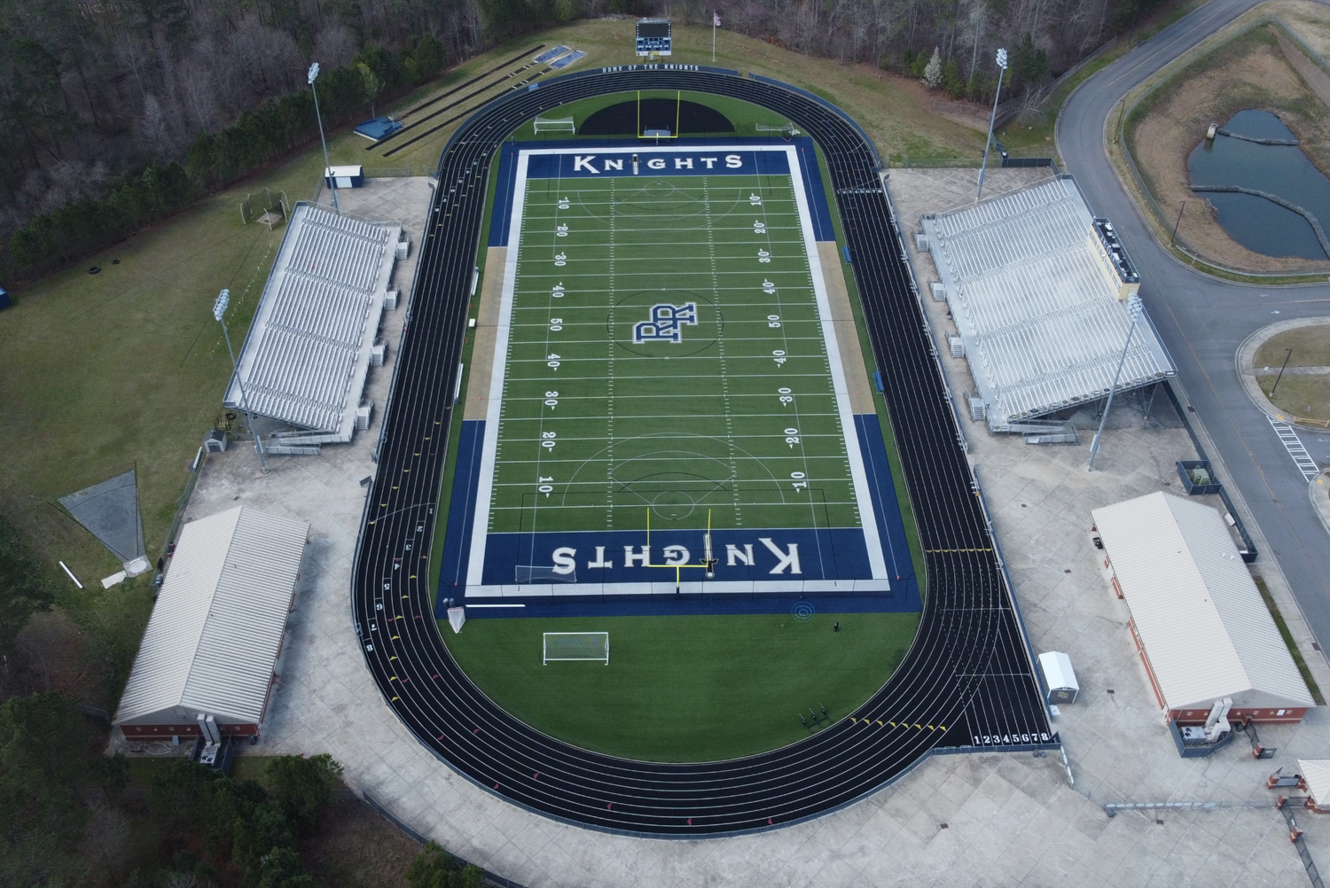
LJ & TJ Spectators
PV Spectators
HJ Spectators
HOSPITATLITY
Track Entry
Northside
Discus Spectators
Team Tents
Warm Up Area:
Athletes Only
Shot Put Spectators
Track Entry
Team Tents
Team Tents

Slide 2
= Athlete Line Up for Races
HOSPITATLITY
Track Entry
TIMER
Northside
Check In
Team Tents
Warm Up Area:
Athletes Only
Track Entry
Team Tents
Team Tents

