Slide 1
Keeping the Flock Fed and Connected
Gary Charles Patterson, M. Div., Th. M., D.D., PCC
cldnnetwork@gmail.com - (210) 710-0998

Slide 2
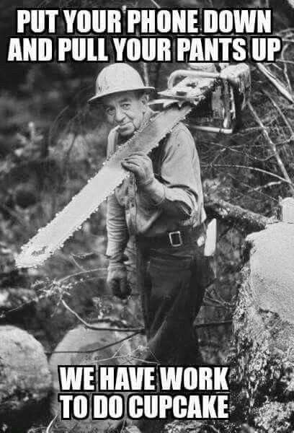
Keeping the Flock Fed and Connected
Running pulling our britches up
Shining a light through the fog
Further evidence of a VUCA world
We are being organically disrupted
Churches that are hurting could die
Things will not be the same Post-Corona
Forced into the future
Fred Flintstone meets George Jetson
But the gates of hades shall not prevail

Slide 3
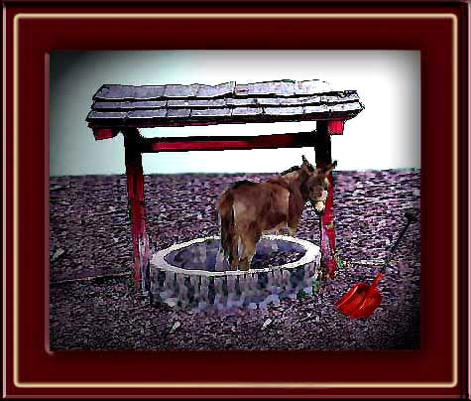
Keeping the Flock Fed and Connected
The Need of the Hour
We must do like the Williams Brothers song says…
“Shake it off and pack it under”
By
Finding a way to keep the flock together
To feed the flock
To encourage the flock
To communicate with the flock
To facilitate the ministry of the flock
To allow to flock to participate in Kingdom Building
To stimulate the fellowship of the flock

Slide 4
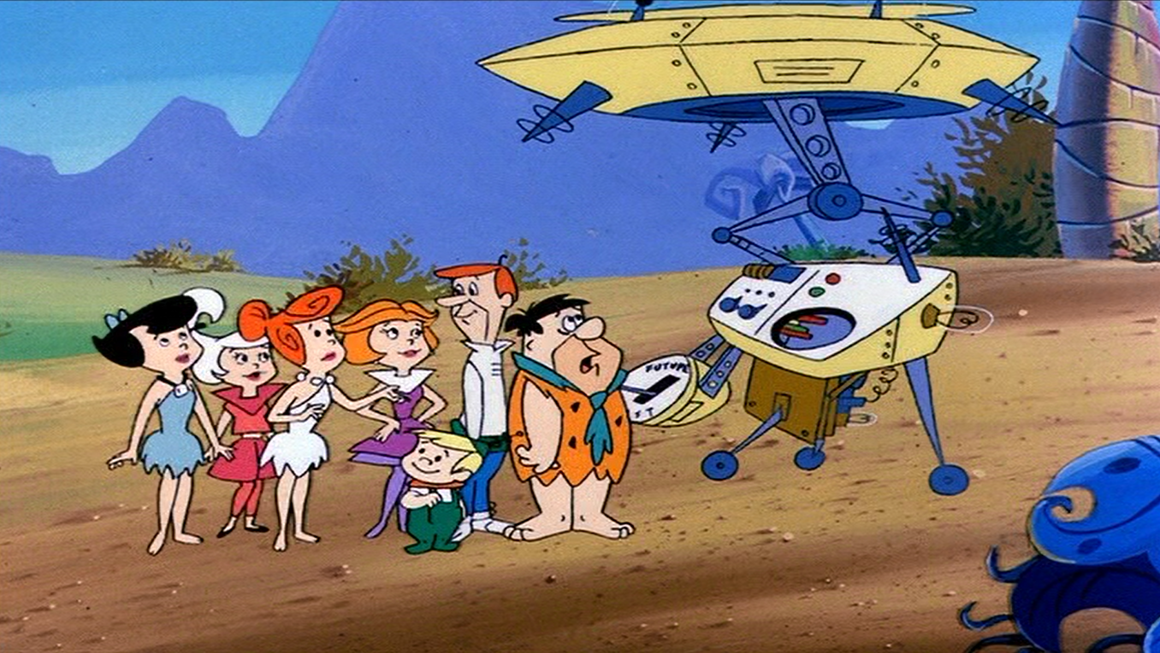
Keeping the Flock Fed and Connected
Ways to do that
Live Streaming (Facebook)
Recordings
Tele/smart phone ☎️ 📱
Pros and Cons
Live vs Recorded
Availability
Ability
Cost
“Welcome to the Future and you are here – Baptism by Corona…”

Slide 5
Keeping the Flock Fed and Connected
Technological Platforms
Facebook
Free Conference Pro
Adobe Connect
Go to Meeting
Skype
Zoom

Slide 6
Keeping the Flock Fed and Connected
Positive aspects of Zoom usage
Non-Facebook Community
Low Cost ($15.00 Monthly)
Consistently
Simplicity
Versatility (Audio/Video/Movies/Desktop/Automation/
Interactive (Chat/Polls/Breakout Rooms/Whiteboard/Calendar Interface)
Live
Connecting (Multiple Groups)
Internet availability widespread

Slide 7
Keeping the Flock Fed and Connected

Slide 8
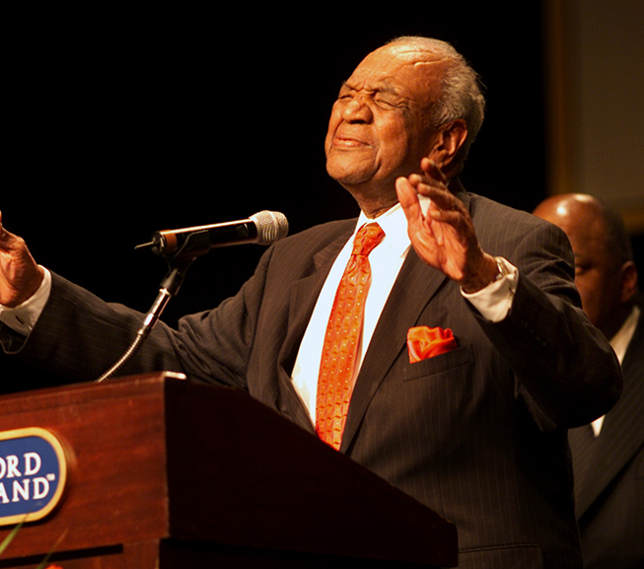
Keeping the Flock Fed and Connected
Practical Considerations
Church building upkeep and bills
Church staff salaries and volunteers
Psychological impact of displacement
Flock isolation
Potential multiple traumatic grief layers

Slide 9
Keeping the Flock Fed and Connected So… Where do we start?

Slide 10
Welcome to the Berean Bible Fellowship
Church
Sermon Today: “The Whole Armor of God”
Ephesians 6:10-20 Dr. Randolph Smith
The Berean Virtual Lifeguard – (210) 381-4600

Slide 11
The Berean Challenge Fellowship Hour Online Etiquette Mute your Audio**** Use the Chat Box to respond Call the Lifeguard w/problems Text Gwen w/Important Message Join the After-Service Fellowship
The Berean Virtual Lifeguard – (210) 381-4600

Slide 12
The Berean Challenge Fellowship Hour Order of Service Scripture Reading Announcements Worship and Praise Giving Community Prayer Special Music The Preached Word Invitation Song of Celebration Benediction
The Berean Virtual Lifeguard – (210) 381-4600

Slide 13
The Berean Challenge Fellowship Hour Scripture Reading
The Berean Virtual Lifeguard – (210) 381-4600

Slide 14
The Berean Challenge Fellowship Hour
The Issues We Are Facing
Community Spread
Social Distancing
Daily Fellowship/Prayer Check-In Hour 12:15
Long Run Approach
Zoom Orientation
We Are Working On
The Berean Challenge Fellowship Hour – Sundays 11:00
The Berean Challenge Disciple Hour – Sundays 9:30
The Berean Challenge Teaching Hour – Wednesdays 6:00
The Berean YEA Challenge Hour – Wednesdays 6:00
Online Giving
Givelify
Cash App
Square
Mailing Envelopes
Direct Deposit
Technology Setup Assistance
Let's Reach Out to all Bereans
Send Link to Family and Friends
www.Bereansa.com
Live Stream on Facebook
The Berean Virtual Lifeguard – (210) 381-4600

Slide 15
The Berean Challenge Fellowship Hour
Use the Chat Box
To record your praise!
The Berean Virtual Lifeguard – (210) 381-4600

Slide 16
The Berean Challenge Fellowship Hour Giving Time Givelify xxxxxx-xx Cash App xxxxxxx-xxx Square Envelopes Direct Deposit
The Berean Virtual Lifeguard – (210) 381-4600

Slide 17
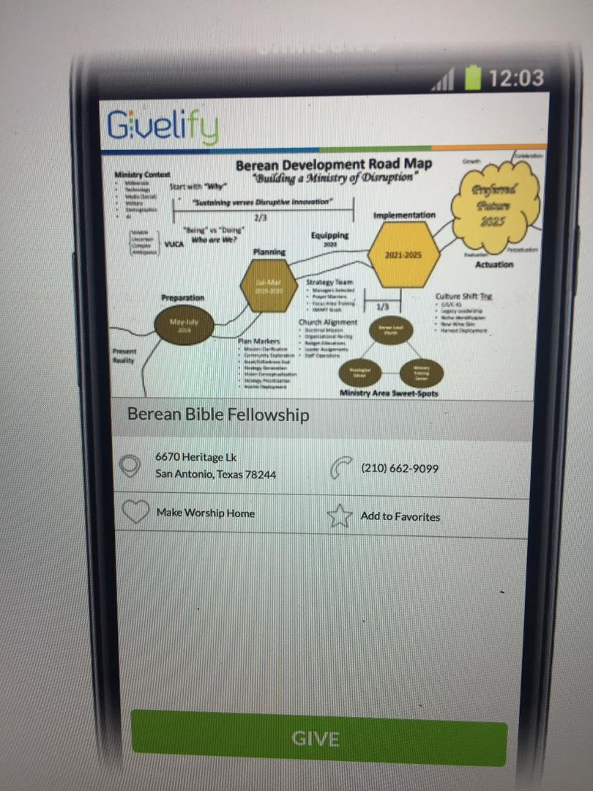
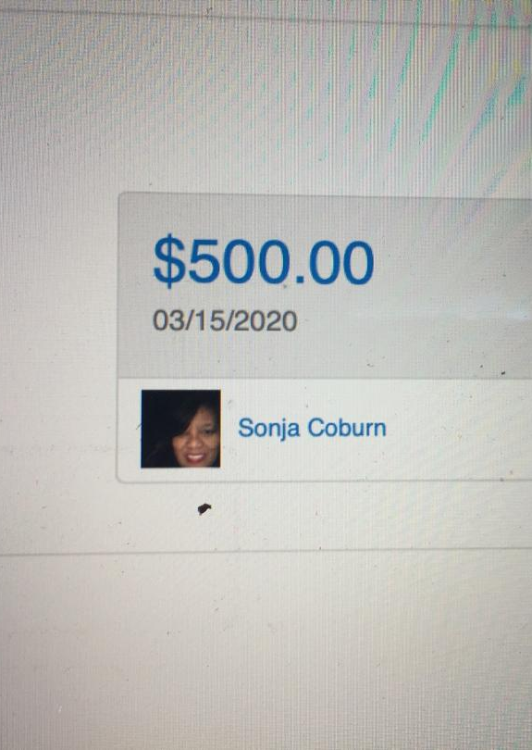
The Berean Challenge Fellowship Hour

Slide 18
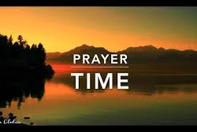
The Berean Challenge Fellowship Hour Community Prayer Time Use the Chat Box to Request Prayer
The Berean Virtual Lifeguard – (210) 381-4600

Slide 19
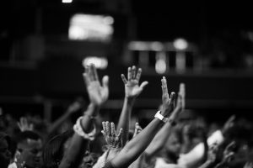
The Berean Challenge Fellowship Hour Preparation for the Word
The Berean Virtual Lifeguard – (210) 381-4600

Slide 20
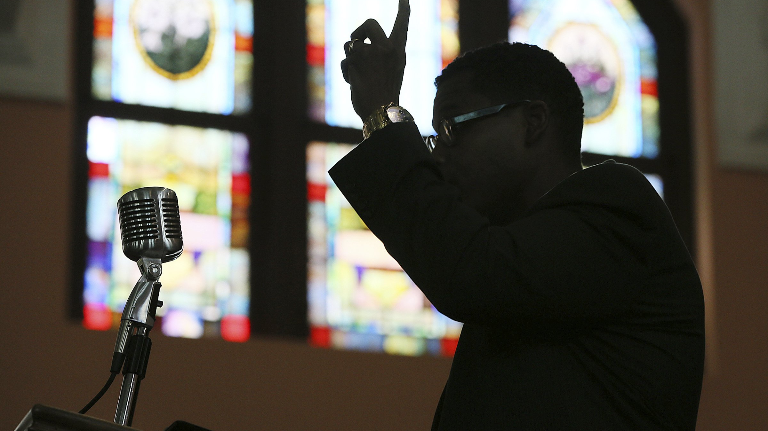
The Berean Challenge Fellowship Hour The Berean Challenge Message
The Berean Virtual Lifeguard – (210) 381-4600

Slide 21
Introduction Whole Armour of God
Ephesians 6:10-20
Reverend Dr. Randolph Smith

Slide 22
Key Scripture Text: ¹¹Put on the whole armour of God, that ye may be able to stand against the wiles of the devil.

Slide 23
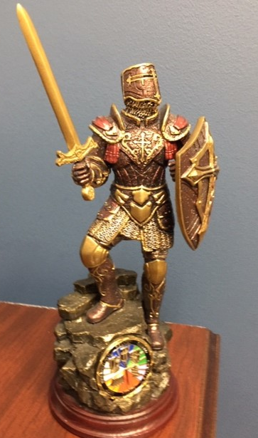
Whole Armour of God

Slide 24
Paul seeks to present the church as members of Jesus Body possessing the closest possible relationship with him. To encourage the church as a unified body of believers. At end of the Chapters Paul tells Christians to be prepared for the Christian Spiritual Battle against the evil one. He tells us to be prepared by putting on the Whole Armor of God. Remember we are soldiers in the Army of the Lord.

Slide 25
^{Overview:} I. Reason for the Armour? vs 10-12 II. Put on the Whole Armour of God VS 13-17 III. Prayer Activates the Armour VS 18-20 KJV version

Slide 26
I. Reason for the Armour? vs 10-12
¹⁰Finally, my brethren, be strong in the Lord, and in the power of his might. ¹¹Put on the whole armour of God, that ye may be able to stand against the wiles of the devil.
¹²For we wrestle not against flesh and blood, but against principalities, against powers, against the rulers of the darkness of this world, against spiritual wickedness in high places.

Slide 27
II. Put on the Whole Armour of God VS 13-17 ¹³Wherefore take unto you the whole armour of God that ye may be able to withstand in the evil day, and having done all, to stand. ¹⁴Stand therefore, having your loins girt about with truth, and having on the breastplate of righteousness; ¹⁵And your feet shod with the preparation of the gospel of peace; ¹⁶Above all, taking the shield of faith, wherewith ye shall be able to quench all the fiery darts of the wicked.

Slide 28
¹⁷And take the helmet of salvation, and the sword of the Spirit, which is the word of God:

Slide 29
Whole Armor of God

Slide 30
1) Loins –waist (belt), girt or held up. Relates to the Truth of God’s Word, Jesus Christ is the Way, the Truth and the life.
2) Breastplate of Righteousness - God’s Jesus Christ’s Holy Character and moral Conduct
3) Preparation of the gospel - Eagerness to carry the Gospel to or advance it to the world.. on Satan’s turf.
Are you ready or willing: How? Study 2 Tim 2:15.

Slide 31
4) Shield of Faith - Believe God’s Promises Heb 11:1 Now then faith is the substance of things hoped for and the evidence of things not seen.
5) Helmet of Salvation - Assurance of salvation through Jesus Christ.
6) The Sword of the Spirit – The word of God. The only offensive part of the Armor.
We now understand what the armor is and why it is to be used? We must have the power of the Holy Spirit who lives in us. We must now pray to activate the armor’s power. Paul gives discourse in verse 18.

Slide 32
Prayer Activates the Armour VS 18-20
¹⁸Praying always with all prayer and supplication in the Spirit, and watching thereunto with all perseverance and supplication for all saints;
¹⁹And for me, that utterance may be given unto me, that I may open my mouth boldly, to make known the mystery of the gospel, ²⁰For which I am an ambassador in bonds: that therein I may speak boldly, as I ought to speak. The King James Version, (Cambridge: Cambridge) 1769.

Slide 33
Whole Armour of God

Slide 34
We as disciples or learners should be able to be bold in sharing the Gospel of Jesus Christ. We have the power of the Holy Spirit and the Armor of God powered through prayer to God.

Slide 35
Whole Armor of God

Slide 36
Summary: We must be read to carry the Gospel and be well armed.
Re-motivation: We are prayed up and studied up.. Put on the Christian Armour. That is our Battle gear.
Closure: Are you ready to take the Battle to the Enemy if not he still will bring to you? You might as well be ready by putting on and using the Armor of God.

Slide 37
^{Summary:} I. Reason for the Armour? vs 10-12 II. Put on the Whole Armour of God VS 13-17 III. Prayer Activates the Armour VS 18-20

Slide 38
Conclusion Whole Armour of God
Ephesians 6:10-20
Reverend Dr. Randolph Smith

Slide 39
Whole Armor of God
Prayer of Invitation…

Slide 40
The Berean Challenge Fellowship Hour “What Really Happens When We Die?” Dr. G. C. Patterson
Go to www.bereansa.com
Starting Next Sunday 11:00
The Death Experience…
The Journey of the Resurrected Body…
The “Thy Kingdom Come” Reality…
The Eternal State in Glory/Heaven…
The Mercy & Grace of God Throughout…
The Series
The Berean Virtual Lifeguard – (210) 381-4600

Slide 41
The Berean Challenge Fellowship Hour Service Benediction
The Berean Virtual Lifeguard – (210) 381-4600

Slide 42
Keeping the Flock Fed and Connected
Emerging Ministries…
Barnabus Encouragement Session
Adult
Youth
Daily Prayer Time 12:15/6:30
Zoom Training Sessions
Staff Meeting Platform
Giving in Real Time
Technology Team
Pastoral Care Team (Daily Outreach)
Family Worship Clusters
TV Program Approach
And growing….

Slide 43
Keeping the Flock Fed and Connected

Slide 44
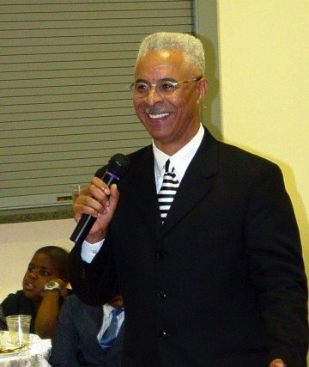
Your questions/suggestions etc.
Gary Charles Patterson, M. Div., Th. M., D.D., PCC
cldnnetwork@gmail.com - (210) 710-0998

