Slide 1
Paperless Submission of Military Enrollment Forms, Award Letters and Tracking Updates.
Willie Harris, School Certifying Official
Stefanie Jenkins, School Certifying Official
GAVCO 2021

Slide 2
Purpose
The purpose of this training is to share CSU’s new paperless Military Enrollment process to include the following:
An electronic solution for students to submit required documents for Military Enrollment.
An electronic solution for School Certifying Officials to keep track of student responses and schedules.
Notes:
In 2019 our Department presented to GAVCO the Paper Trail, No Paper.
Since then, we are completely paperless.
So our Presentation today will be talking about how we have enhanced.
What was painful in the past (TOO MUCH PAPER). Why did we create this?

Slide 3
Agenda
Military Enrollment Data Worksheet
Statement of Understanding
Certificate of Eligibility Upload
Cert Process
Report Functions
Tracking Updates
Part of Terms for Students
Overpayment (Chapter 33) Report
Notes:
FERPA if asked.

Slide 4
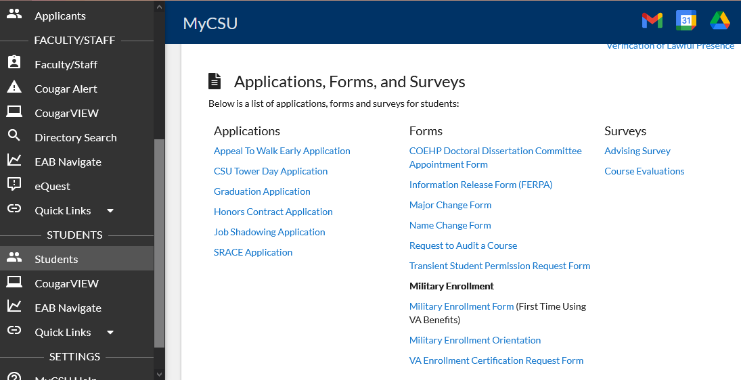
Military Enrollment Form
Notes:
What is the student First Step:
The first step is that the Student reaches out to Military Enrollment Dept advising them they are planning to enroll and use their Military Benefit.
Work study students will send a detailed email to the student directing them to the New Military Enrollment Form found in the student’s MYCSU portal to complete the Data Worksheet Online.
Any student using benefits for the first time must submit this form.

Slide 5
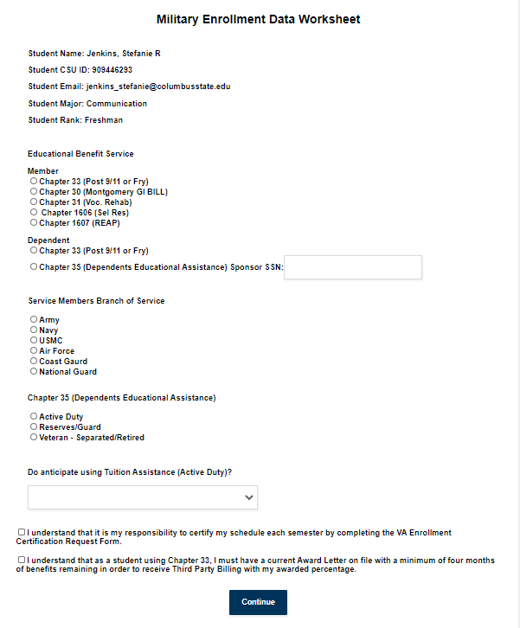
Military Enrollment Data Sheet
Notice the student’s information is generated from Banner.
Any student using benefits for the first time must submit this form to initiate the certification process.
Notes:
This is the actual form that they will complete online.
Notice the student’s information is generated from our Banner Sis.
This is critical to us because when our Student workers enter the info into the VA Once system we would like for the Major to match up what's in the Students Degree works.

Slide 6
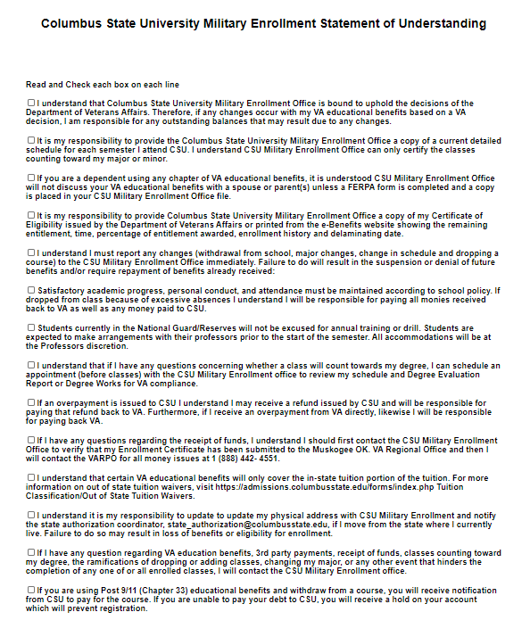
Statement of Understanding
The Statement of Understanding is specific to CSU. By signing the document, the student acknowledges they have read all statements and understand their responsibility in the accurate and timely certification of their military benefit.
Although this form is submitted electronically, a personal call is made to each student to reiterate all statements listed.
Recently added
Notes:
This form was created because the student would always call and say that they weren’t aware of the procedures.
This form puts the responsibility back on the student.
The last statement on this form we recently added.
We felt like with the new Changes with the Overpayment for Ch. 33 we want to make them aware of the new changes with withdrawals.

Slide 7
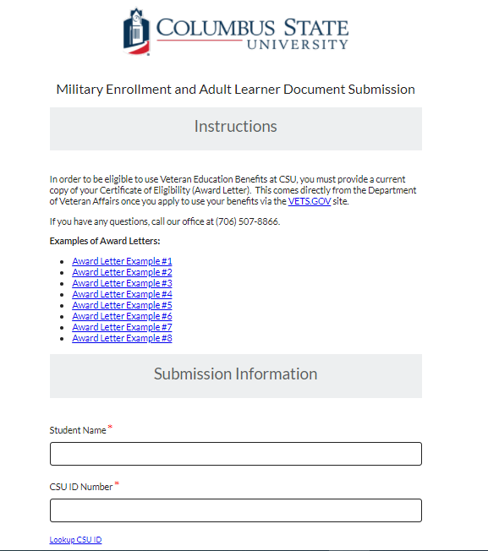
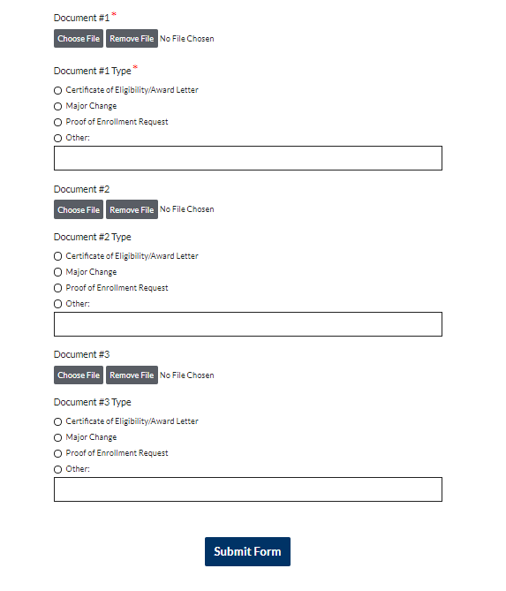
Military Enrollment and Adult Learner Document Submission
Notes:
Once the student has upload their documents into our system an email will be sent to our veterans affairs email account with the attached documents.
They may upload any documents that is needed for their files, like their COE, Major Change form, ChampVa form, etc.
Work Study students will then upload document to our imaging system.

Slide 8
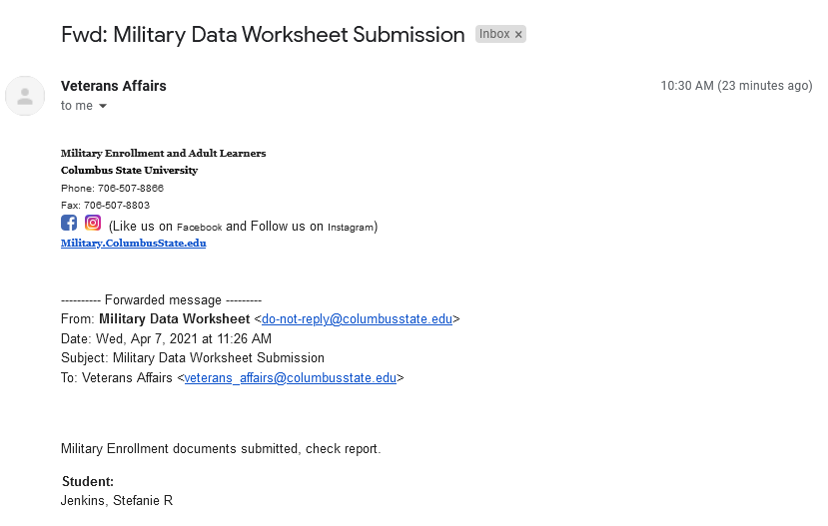
Student Data Worksheet
Email Generated
Notes:
This is the email we receive once the student has completed the Data Worksheet.

Slide 9
Student Data Worksheet Report
Notes:
After the student has submitted the data worksheet, where can we find their information they submitted?
We must go to the Student Data Worksheet Report

Slide 10
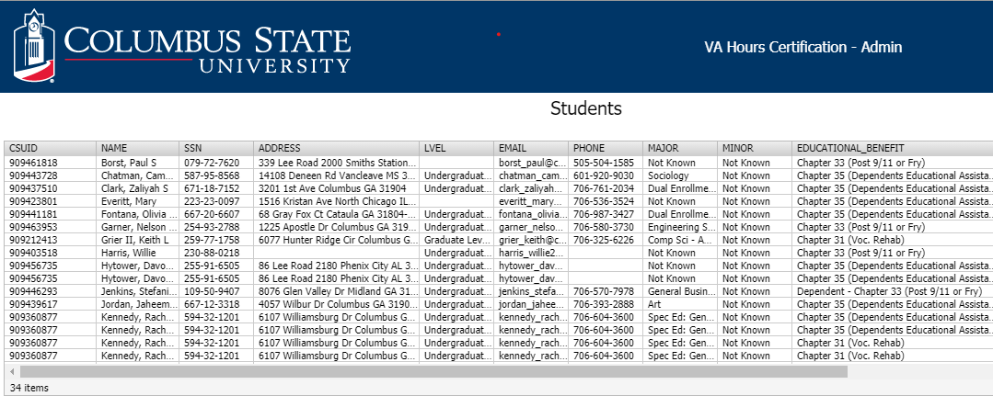
Student Data Worksheet
List of students that have submitted data worksheet
Notes:
This is the list of students who has submitted the Data Worksheet.
The Work-study will get all the information off this report to add them into the VAONCE System.
They will not add them into VAOnce system until we have all necessary documents on file.
After we have everything on file then they will ask the SCO’s to add the VA attributes.

Slide 11
Time to Certify Student

Slide 12
Student receives “VA01” Attribute in Banner when they have complete all necessary documents online.
VA01 Attribute is used to identity students utilizing VA Education Benefits.
Once student has exhausted benefits “VA02” Attribute is added to remove student from the certification list.
Cert Process
Notes:
Work Study students will contact us to add the VA 01 attribute that allows the student to submit their schedule to us.
Once the attribute has been added to their file, the Work Study students will proceed to add the students info in VA Once system.
They will send an email to the students explaining to them how to submit their schedule to our department.

Slide 13
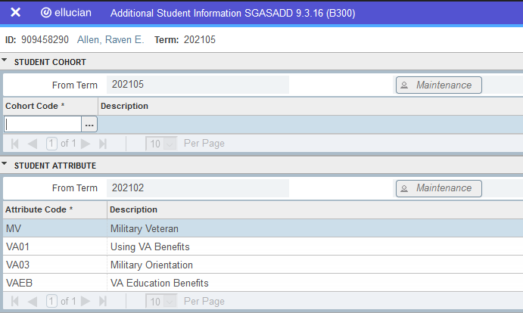
Banner-SGASADD
Notes:
SGASADD is the screen that we add all the attributes to the student files
MV is the Military Benefit.
VA 01 using VA Benefits and able to submit schedule.
VA 03 Military Orientation May complete the Online Orientation for free.
VA02 they are no longer eligible for the benefit.
VA 04 – Using Tuition Assistance. VAEB is using their VA Benefits.
After the attributes has been added to the student file.
The Work-study will send the student an email with the instructions on how to submit their electronic schedule.

Slide 14
SCO runs the report daily.
Student receives email notification to submit schedule.
SCO receives updated schedule.
SCO updates certified student's hours and codes student accordingly.
Cert Process

Slide 15
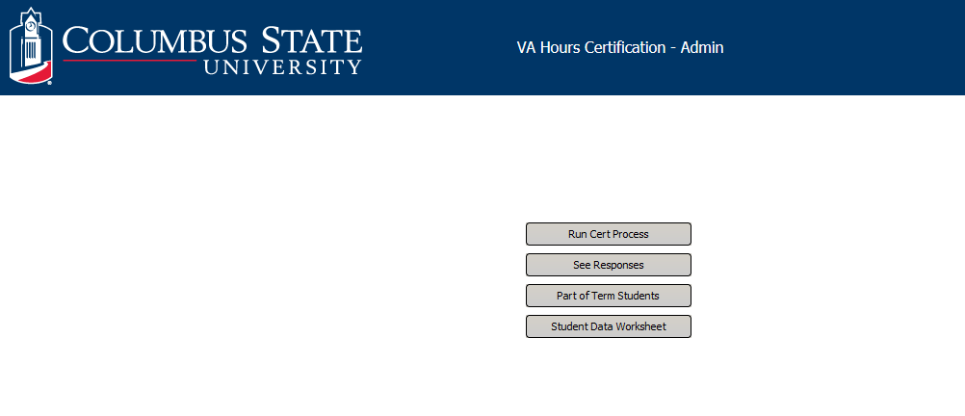
Argos VA Admin Datablock
Notes:
Run Cert Process Report we run Daily.
This sends an email reminder to the students to submit their schedules.

Slide 16
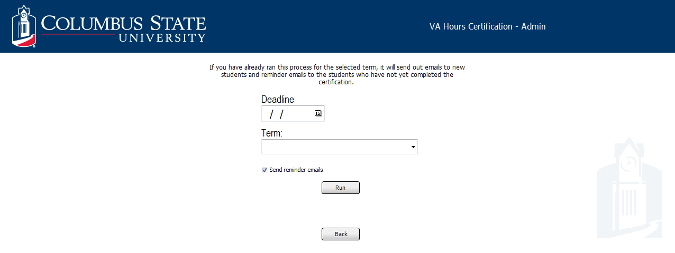
Run Cert Report
Notes:
This Report is ran first thing in the morning. Again this is a reminder to the student to submit their schedules.

Slide 17
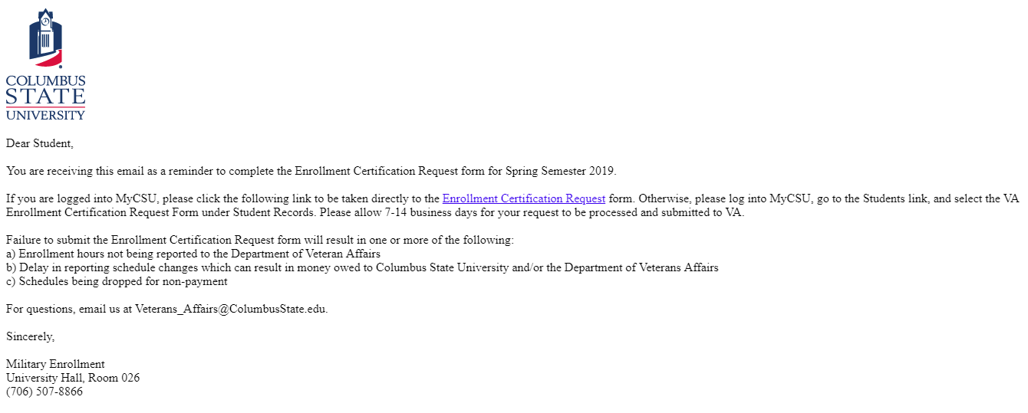
Email Notification
Notes:
This is the Email Notification they receive after the Cert Report has been ran.
It has the instructions in the email on how to submit their schedule to us.

Slide 18
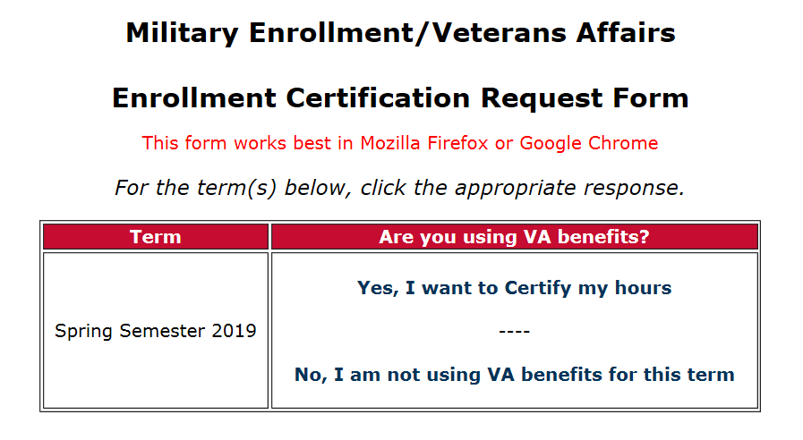
Enrollment Request Form
Notes:
Enrollment Certification Request form.
This is the form they must complete to submit their schedule to us electronically.
They may elect to use their benefit or not.
The next 3 screens will show the actual form they must complete.

Slide 19
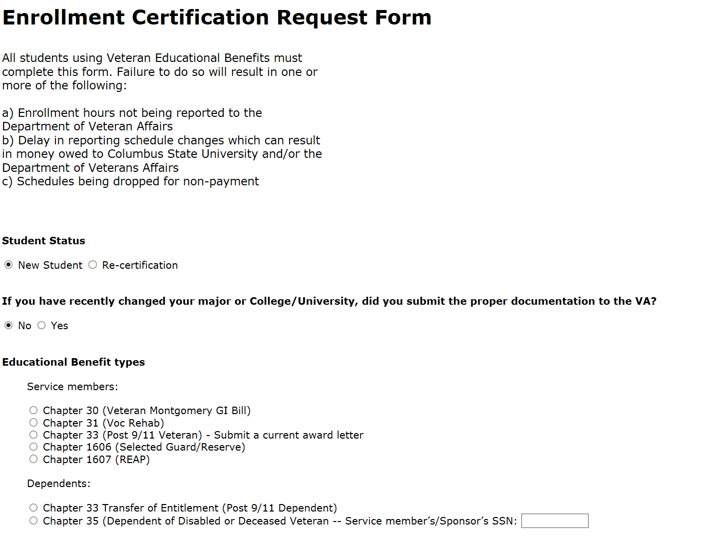
Enrollment Request Form
Notes:
All students using benefits must complete this form. It ask if they are new or re-certification.
If they have change Major, and finally their benefit they are using.
We really can’t go on the benefits that they mark in these boxes, because sometimes they aren’t sure.
So we look at their COE in our imaging system before we put their benefit in VA Once.

Slide 20
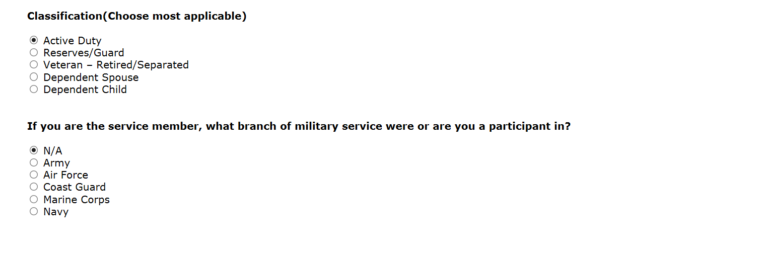
Enrollment Request Form
Notes:
Here they mark their Classification and if they are a service member.

Slide 21
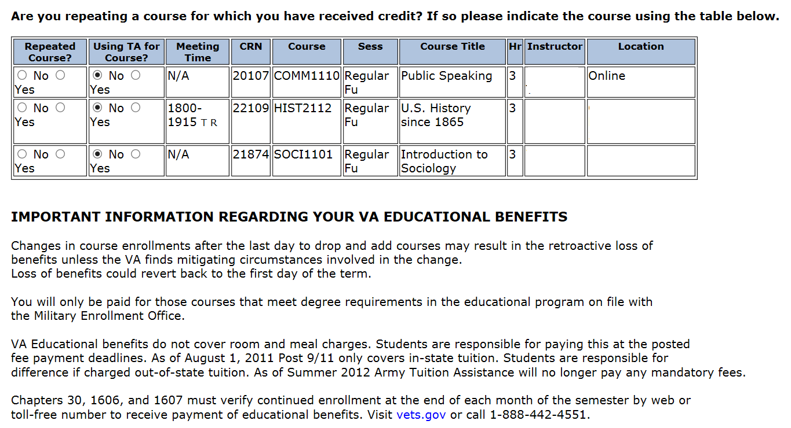
Enrollment Request Form
Notes:
This screen explains to them about the add/drop period as well as courses that are not in their degree works.

Slide 22
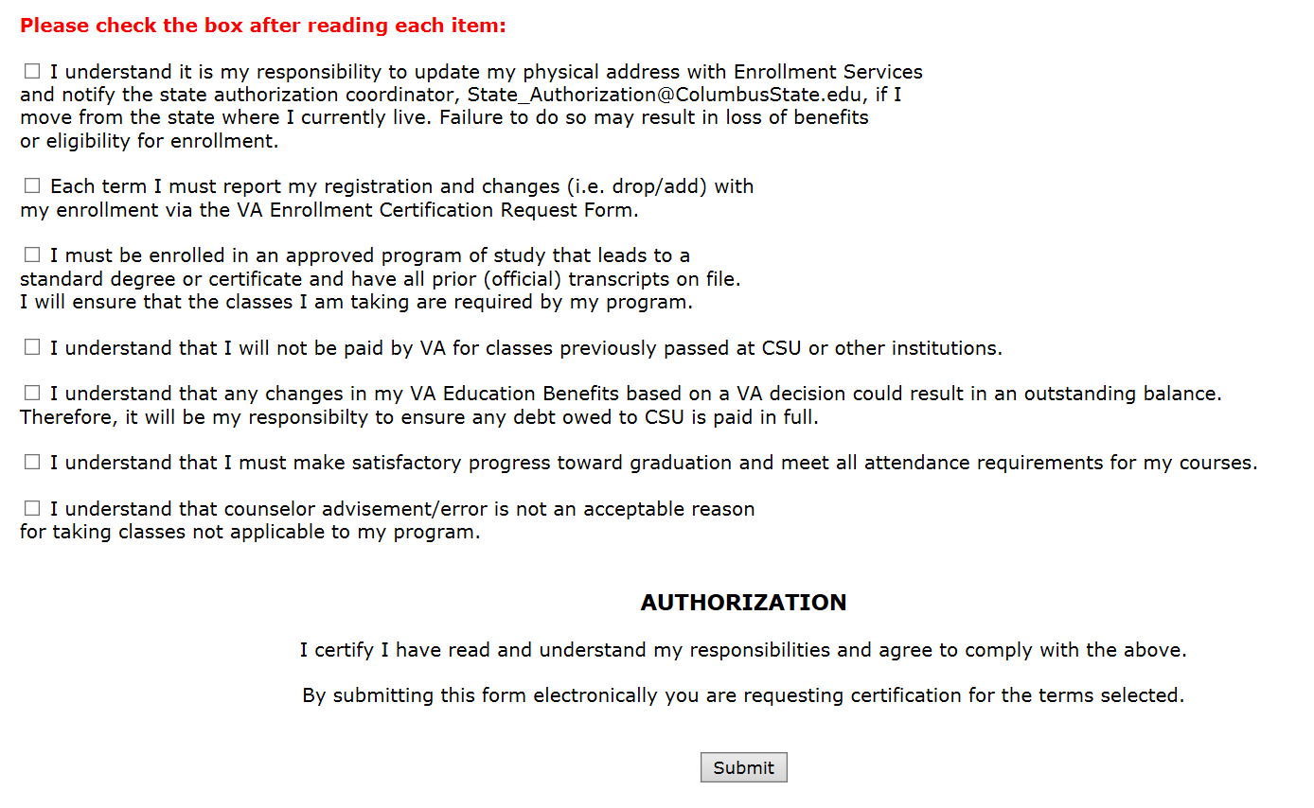
Enrollment Request Form
Notes:
This page makes them aware of their responsibilities and they will comply to all.
We all know how they will come back and say no one told me..
We can use this statement and say that you did sign each box that you did understand. A reading Man is a Ready Man.

Slide 23
ARGOS Reporting
Notes:
Once the student has submitted the Enrollment Request form we will click on See Response tab to see their information.

Slide 24
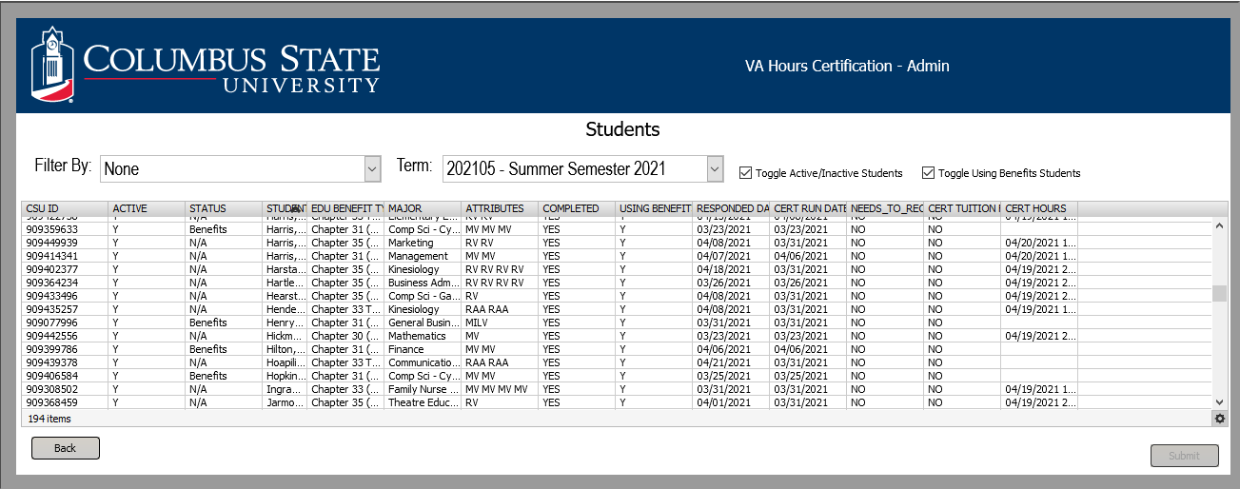
ARGOS Reporting
Notes:
We can now see a list of our students that have submitted their schedules for the term.
On this Report we see their benefit, major, attribute and date the SCO certified the hours.
If there is not a date listed in the Cert Hours column then we have not certify the student.
We must click on the student name, and click submit then it will take us to the next screen.

Slide 25
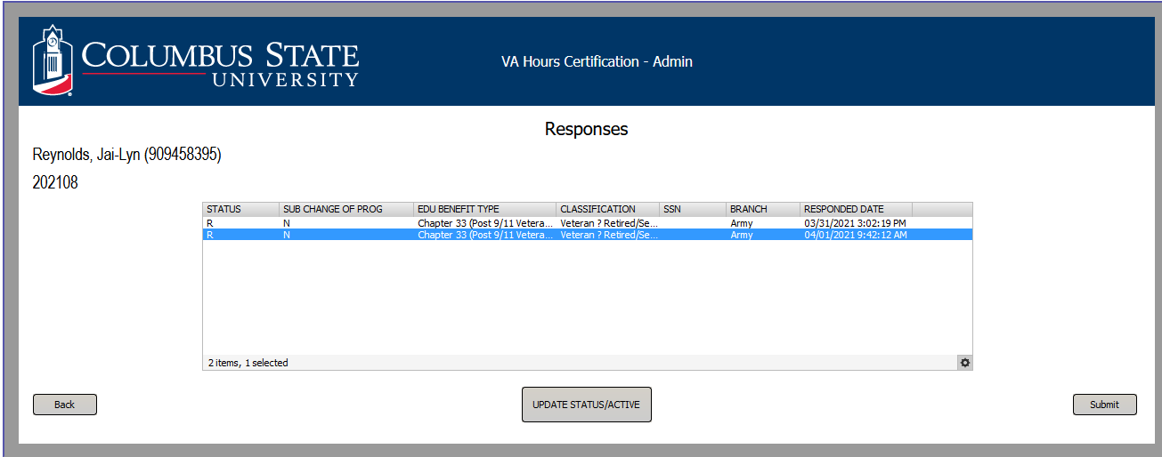
View Certification Responses
Notes:
This screen allows you to see most recent schedule they have submitted.
Click on the most recent schedule and press submit, the next slide will show you the schedule in detail.
Every time they change their schedule they must re-submit their schedule to us.

Slide 26
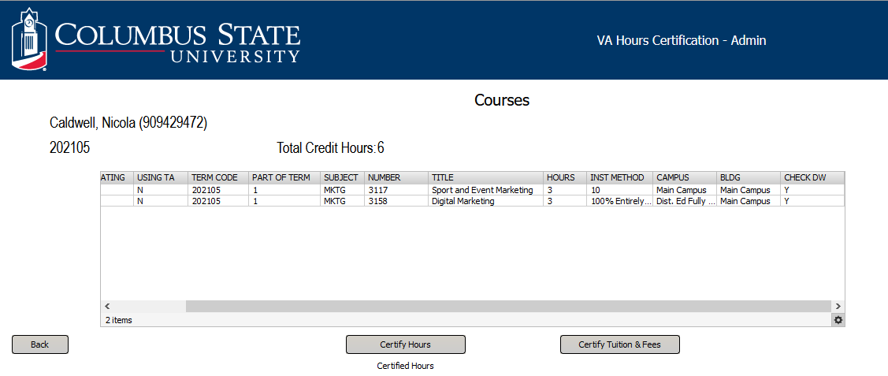
View Student Courses
Notes:
We now see the classes they are taking.
We can see if they are using TA benefits, the Term Code, Part of term, Subject and total credit hours for the term.
We can see if the classes are in the student degree works.
****The next screen we begin to Certify hours.

Slide 27
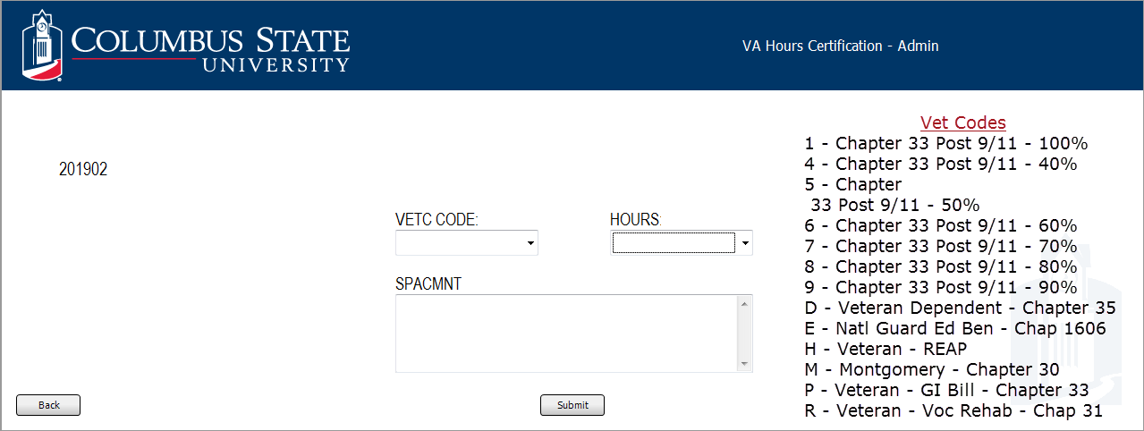
Certify Student Hours
Notes:
We submit their hours on this screen.
The Vet Codes that are listed on the side of the screen are the different VA benefits students are eligible to receive.
We will check the student COE in our imaging system to see which benefit they are eligible to receive.
We will then process the student accordingly to the benefit they are eligible to receive.
After we have certify hours, we will leave a message in the SPACMNT box to say if we certified their hours or if they didn’t have enough months left to add the 3rd party to the invoice.
After we submit the hours, then the Bursar office will see the student has been certified, and they will process their file accordingly to the VET Code that we submitted on the student.

Slide 28
Banner-SGASTDN
Notes:
This is the screen the Bursar Office will see that the student hours has been certified.
They will add the 3rd party accordingly to the VET Code that we placed on the student file.

Slide 29
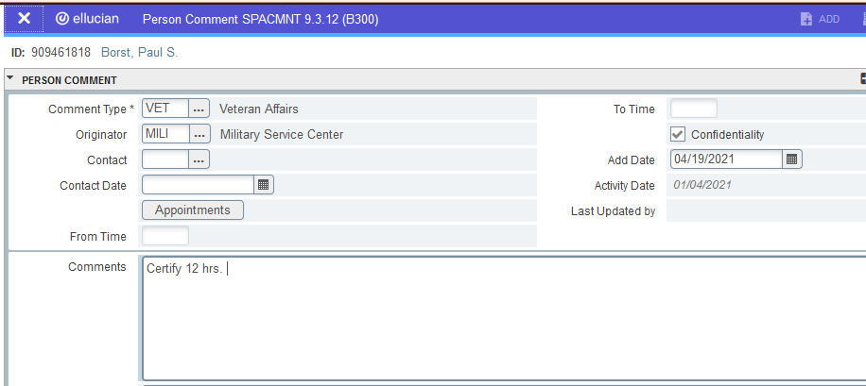
Banner-SPACMNT
Notes:
We’ll leave a message in SPACMNT let everyone know how we processed the student file in case they call in to check their status.

Slide 30
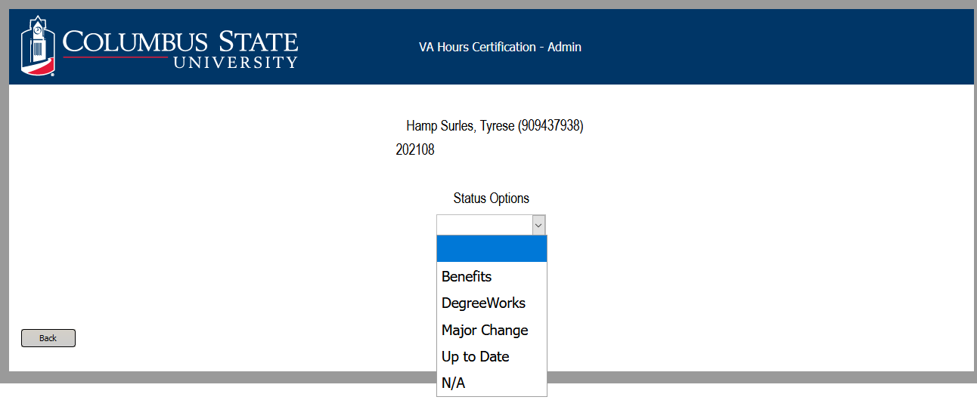
Update Student Status
Notes:
The Update Status tab allows you to update the student file after you have certify the student hours.
Sometime we are not able to certify their hours because we may be waiting on their benefits, classes aren’t in degree works or their major change has not been processed yet.
Once we coded them we will go back in the system periodically to check for updates on the student.

Slide 31
Recent Tracking Enhancements

Slide 32
Part of Terms
Notes:
This Report was just created a few weeks ago.
We noticed that when it was time certify the tuition and fees for our non-standard term students, we would have to go back through all our students under VA Enrollment Certification Report to try to locate our students that needed their tuition and fees submitted for the non-terms classes.

Slide 33
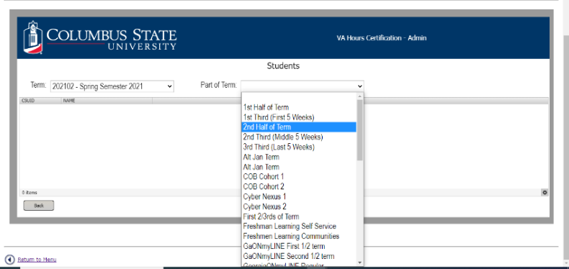
Part of Terms
Notes:
This is the list of Part of Terms for Spring 2021 term that is generated from SOATERMS in Banner Sis.

Slide 34
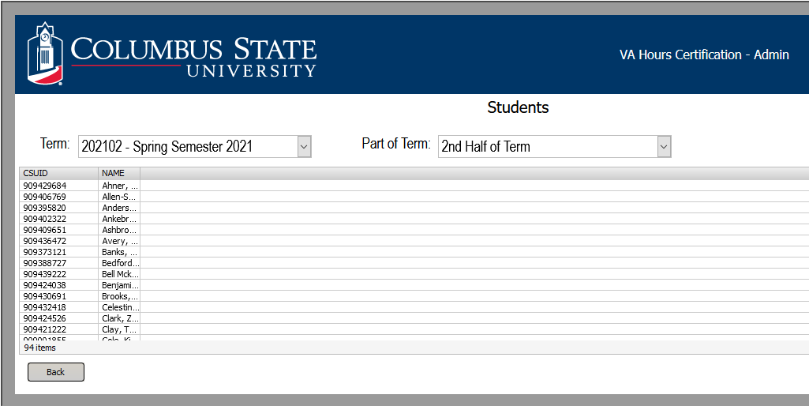
Part of Terms
Notes:
This shows the students ID# and names for the 2nd Half of term.
We can click on our student and submit the tuition and fees for the term.

Slide 35
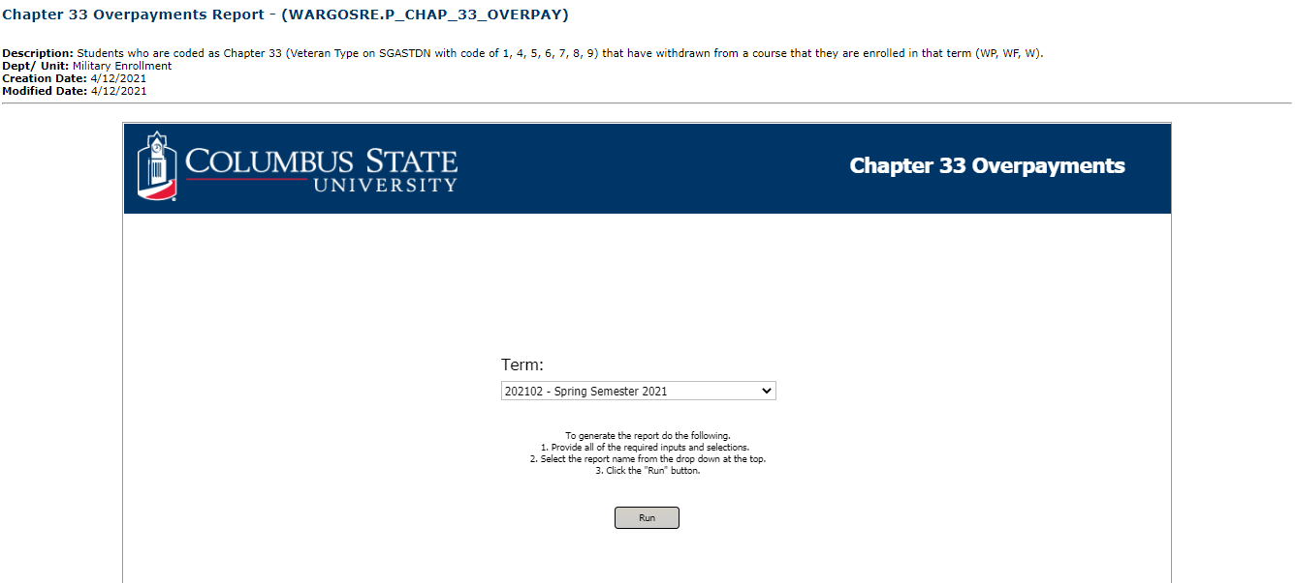
Overpayment (Chapter 33) Report
Notes:
This report was created a few weeks ago, especially after we received the new notifications about Ch 33 Overpayments on Withdraws. Again we talked to our IT guy and he has generated this report for us.
This Report will show all of our CH 33 students who have receive a W for any of their courses they have withdrawn from. We select the term we wish to view and run the report.

Slide 36
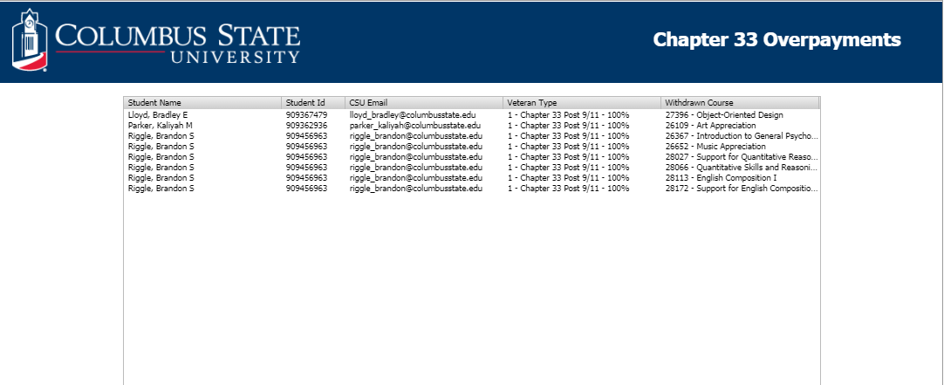
Overpayment (Chapter 33) Report
Notes:
This screen shows their names, and the courses that they withdrew from. Our Bursar Office will also have access to this report.

Slide 37
Benefits
User friendly for students.
Saves time for students (no delivery or trip to campus).
Reduces paper schedules.
Eliminates SCO from certifying students that do not want to use VA Education Benefits.
Places the responsibility on the student to notify office of schedule changes.
SCO receives email for complete withdrawals.

Slide 38
Benefits …
The Student Data Worksheet provides student’s major from Banner to ensure the correct information is entered in VA Once.
Part of Terms benefits SCO. System sorts and creates report behind the scenes. Compared to tracking individual student schedules for mini terms.
Total Hours allows us to confirm schedule and VA Hours are matching/same. Due to multiple schedule changes.
SCO receives emails when student has submitted new COE to our office.
Overpayment (Chapter 33) Report allows us to confirm we have made certification adjustments for all chapter 33 students that have withdrawn from any course. Bursar will also use this report for tracking purposes.

Slide 39
Thanks to Keith Grier II, Programmer II -UTIS

Slide 40
Questions
Notes:
If you have any questions about the backside of the process you may send me an email and I will be happy to forward the email on to Keith.

Slide 41
Contact Information
Willie Harris
Military Service Representative-Military Enrollment
706-507-8813
harris_willie2@columbusstate.edu
Stefanie Jenkins
Military Service Representative-Military Enrollment
706-507-8865
jenkins_stefanie@columbusstate.edu

