Slide 1
Trinity Evangelical Lutheran Church November 6, 2022
WELCOME!
Notes:
Image: Five Loaves by Caroline Coolidge Brown. Copyright © Caroline Coolidge Brown. All rights reserved. Used by permission of the artist.

Slide 2
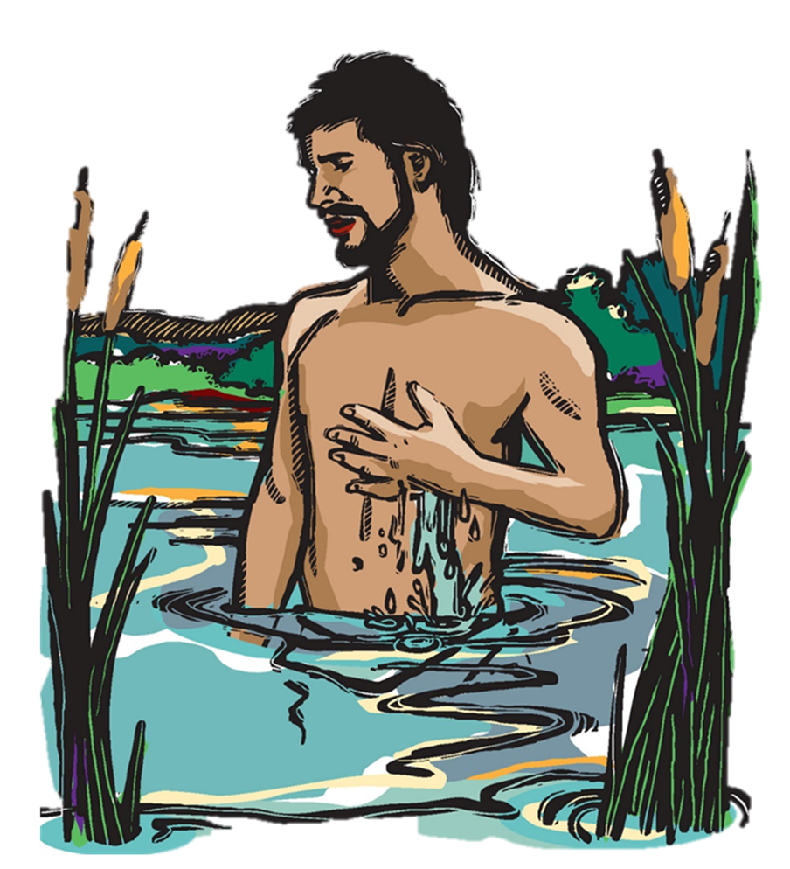
The Healing of Naaman
Notes:
Image: Five Loaves by Caroline Coolidge Brown. Copyright © Caroline Coolidge Brown. All rights reserved. Used by permission of the artist.

Slide 3
Prelude by Roxanne Groff
Office of the Acolyte and Ringing of the Bell
Welcome in the name of The Triune God
Notes:
Image: Five Loaves by Caroline Coolidge Brown. Copyright © Caroline Coolidge Brown. All rights reserved. Used by permission of the artist.

Slide 4
Confession and Forgiveness
All may make the sign of the cross, the sign marked at baptism, as the presiding minister begins.
P: We confess our sins before God and one another.
Pause for silence and reflection.
P: Gracious God,
Notes:
Image: Preparing yeast dough. Copyright © tomasworks/iStock/Thinkstock. Used by permission.

Slide 5
Confession and Forgiveness
C: We have sinned against you and our neighbors. We have taken what is not ours, and justified our actions. We have turned away from your wisdom. We have not done justice, loved kindness, nor walked humbly with you.
Notes:
Image: Preparing yeast dough. Copyright © tomasworks/iStock/Thinkstock. Used by permission.

Slide 6
Confession and Forgiveness
C: Forgive us for the harms we have caused through word and action, and restore us to the joy of following your will for us.
Notes:
Image: Preparing yeast dough. Copyright © tomasworks/iStock/Thinkstock. Used by permission.

Slide 7
Confession and Forgiveness
P: God knows our every weakness and yet loves us without ceasing. Rejoice and be glad, for the God of grace and mercy forgives you all your sins, for the sake of our savior Jesus Christ.
C: Amen.
Notes:
Image: Preparing yeast dough. Copyright © tomasworks/iStock/Thinkstock. Used by permission.

Slide 8
Gathering Song
“For all the Saints”
LBW 174
Verses 1, 2, & 4 only
Notes:
Image: Five Loaves by Caroline Coolidge Brown. Copyright © Caroline Coolidge Brown. All rights reserved. Used by permission of the artist.

Slide 9
For All The Saints LBW 174 (Vs 1, 2, 4)
1 For all the saints who from their labors rest,
all who by faith before the world confessed,
your name, O Jesus, be forever blest.
Alleluia! Alleluia!
Notes:
Image: Five Loaves by Caroline Coolidge Brown. Copyright © Caroline Coolidge Brown. All rights reserved. Used by permission of the artist.

Slide 10
For All The Saints LBW 174 (Vs 1, 2, 4)
2 You were their rock, their fortress, and their might;
you, Lord, their captain in the well-fought fight;
you, in the darkness drear, their one true light.
Alleluia! Alleluia!
Notes:
Image: Five Loaves by Caroline Coolidge Brown. Copyright © Caroline Coolidge Brown. All rights reserved. Used by permission of the artist.

Slide 11
For All The Saints LBW 174 (Vs 1, 2, 4)
4 Oh, blest communion, fellowship divine,
we feebly struggle, they in glory shine;
yet all are one within your great design.
Alleluia! Alleluia!
Notes:
Image: Five Loaves by Caroline Coolidge Brown. Copyright © Caroline Coolidge Brown. All rights reserved. Used by permission of the artist.

Slide 12
APOSTOLIC GREETING
P: The grace of our Lord Jesus Christ, the love of God, and the communion of the Holy Spirit be with you all.
C: And also with you.
Notes:
Image: Five Loaves by Caroline Coolidge Brown. Copyright © Caroline Coolidge Brown. All rights reserved. Used by permission of the artist.

Slide 13
KYRIE
P: In peace let us pray to the Lord.
C: Lord have mercy.
P: For the peace from above, and for our salvation, let us pray to the Lord.
C: Lord have mercy.
P: For the peace of the whole world, for the well being of the Church of God, and for the unity of all, let us pray to the Lord.
C: Lord have mercy.
Notes:
Image: Five Loaves by Caroline Coolidge Brown. Copyright © Caroline Coolidge Brown. All rights reserved. Used by permission of the artist.

Slide 14
KYRIE
P: For this Holy House, and for all who offer here their worship and praise, let us pray to the Lord.
C: Lord have mercy.
P: Help, save, and defend us, gracious Lord.
C: Amen.
Notes:
Image: Five Loaves by Caroline Coolidge Brown. Copyright © Caroline Coolidge Brown. All rights reserved. Used by permission of the artist.

Slide 15
PRAYER OF THE DAY
P: Let us pray… Loving God, Naaman’s pride almost prevented him from receiving the gift of your healing. Give us the humility to come to you for help in all things, that we might receive wholeness in you.
C: Amen.
Notes:
Image: Five Loaves by Caroline Coolidge Brown. Copyright © Caroline Coolidge Brown. All rights reserved. Used by permission of the artist.

Slide 16
Word Of GOD: 2nd Kings 5:1-19
Naaman, commander of the army of the king of Aram, was a great man and in high favor with his master, because by him the Lord had given victory to Aram. The man, though a mighty warrior, suffered from leprosy. ²Now the Arameans on one of their raids had taken a young girl captive from the land of Israel, and she served Naaman’s wife. ³She said to her mistress, “If only
Notes:
Image: Five Loaves by Caroline Coolidge Brown. Copyright © Caroline Coolidge Brown. All rights reserved. Used by permission of the artist.

Slide 17
Word Of GOD: 2nd Kings 5:1-19
my lord were with the prophet who is in Samaria! He would cure him of his leprosy.” ⁴So Naaman went in and told his lord just what the girl from the land of Israel had said. ⁵And the king of Aram said, “Go then, and I will send along a letter to the king of Israel.” He went, taking with him ten talents of silver, six thousand shekels of gold, and ten sets of garments. ⁶He brought
Notes:
Image: Five Loaves by Caroline Coolidge Brown. Copyright © Caroline Coolidge Brown. All rights reserved. Used by permission of the artist.

Slide 18
Word Of GOD: 2nd Kings 5:1-19
the letter to the king of Israel, which read, “When this letter reaches you, know that I have sent to you my servant Naaman, that you may cure him of his leprosy.” ⁷When the king of Israel read the letter, he tore his clothes and said, “Am I God, to give death or life, that this man sends word to me to cure a man of his leprosy? Just look and see how he is trying to pick a quarrel with me.” ⁸But
Notes:
Image: Five Loaves by Caroline Coolidge Brown. Copyright © Caroline Coolidge Brown. All rights reserved. Used by permission of the artist.

Slide 19
Word Of GOD: 2nd Kings 5:1-19
when Elisha the man of God heard that the king of Israel had torn his clothes, he sent a message to the king, “Why have you torn your clothes? Let him come to me, that he may learn that there is a prophet in Israel.”
⁹So Naaman came with his horses and chariots, and halted at the entrance of Elisha’s house. ¹⁰Elisha sent a messenger to him, saying, “Go, wash in
Notes:
Image: Five Loaves by Caroline Coolidge Brown. Copyright © Caroline Coolidge Brown. All rights reserved. Used by permission of the artist.

Slide 20
Word Of GOD: 2nd Kings 5:1-19
the Jordan seven times, and your flesh shall be restored and you shall be clean.” ¹¹But Naaman became angry and went away, saying, “I thought that for me he would surely come out, and stand and call on the name of the Lord his God, and would wave his hand over the spot, and cure the leprosy! ¹²Are not Abana and Pharpar, the rivers of Damascus, better than all the waters of
Notes:
Image: Five Loaves by Caroline Coolidge Brown. Copyright © Caroline Coolidge Brown. All rights reserved. Used by permission of the artist.

Slide 21
Word Of GOD: 2nd Kings 5:1-19
Israel? Could I not wash in them, and be clean?” He turned and went away in a rage. ¹³But his servants approached and said to him, “Father, if the prophet had commanded you to do something difficult, would you not have done it? How much more, when all he said to you was, ‘Wash, and be clean’?” ¹⁴So he went down and immersed himself seven times in the Jordan, according to
Notes:
Image: Five Loaves by Caroline Coolidge Brown. Copyright © Caroline Coolidge Brown. All rights reserved. Used by permission of the artist.

Slide 22
Word Of GOD: 2nd Kings 5:1-19
the word of the man of God; his flesh was restored like the flesh of a young boy, and he was clean.
¹⁵Then he returned to the man of God, he and all his company; he came and stood before him and said, “Now I know that there is no God in all the earth except in Israel; please accept a present from your servant.”
¹⁶But he said, “As the Lord lives, whom
Notes:
Image: Five Loaves by Caroline Coolidge Brown. Copyright © Caroline Coolidge Brown. All rights reserved. Used by permission of the artist.

Slide 23
Word Of GOD: 2nd Kings 5:1-19
I serve, I will accept nothing!” He urged him to accept, but he refused. ¹⁷Then Naaman said, “If not, please let two mule-loads of earth be given to your servant; for your servant will no longer offer burnt-offering or sacrifice to any god except the Lord.
Notes:
Image: Five Loaves by Caroline Coolidge Brown. Copyright © Caroline Coolidge Brown. All rights reserved. Used by permission of the artist.

Slide 24
Word Of GOD: 2nd Kings 5:1-19
¹⁸But may the Lord pardon your servant on one count: when my master goes into the house of Rimmon to worship there, leaning on my arm, and I bow down in the house of Rimmon, when I do bow down in the house of Rimmon, may the Lord pardon your servant on this one count.” ¹⁹He said to him, “Go in peace.”
Notes:
Image: Five Loaves by Caroline Coolidge Brown. Copyright © Caroline Coolidge Brown. All rights reserved. Used by permission of the artist.

Slide 25
2nd Kings 5:1-19
P: This is the Word of the Lord.
C: Praise to you O Christ! (Spoken)
Notes:
Image: Preparing yeast dough. Copyright © tomasworks/iStock/Thinkstock. Used by permission.

Slide 26
Sermon
Notes:
Image: Five Loaves by Caroline Coolidge Brown. Copyright © Caroline Coolidge Brown. All rights reserved. Used by permission of the artist.

Slide 27
NICENE CREED
C: We believe in one God, the Father, the Almighty, maker of heaven and earth, of all that is, seen and unseen.

Slide 28
NICENE CREED
C: We believe in one Lord, Jesus Christ, the only Son of God, eternally begotten of the Father, God from God, Light from Light, true God from true God, begotten, not made, of one Being with the Father.

Slide 29
NICENE CREED
C: Through him all things were made. For us and for our salvation he came down from heaven; by the power of the Holy Spirit he became incarnate from the virgin Mary, and was made man. For our sake he was crucified under Pontius Pilate;

Slide 30
NICENE CREED
C: he suffered death and was buried. On the third day he rose again in accordance with the Scriptures; he ascended into heaven and is seated at the right hand of the Father. He will come again in glory to judge the living and the dead, and his kingdom will have no end.

Slide 31
NICENE CREED
C: We believe in the Holy Spirit, the Lord, the giver of life, who proceeds from the Father and the Son. With the Father and the Son he is worshiped and glorified. He has spoken through the prophets. We believe in one holy catholic and apostolic Church.

Slide 32
NICENE CREED
C: We acknowledge one Baptism for the forgiveness of sins. We look for the resurrection of the dead, and the life of the world to come. Amen.

Slide 33
During the reading of our departed Saints, at the tolling of the Bell, please respond, “Here With US!”
PRAYERS OF INTERCESSION
Each petition will end with the words,
A: Merciful God.
The congregation will respond with:
C: You hear our prayer.

Slide 34
PRAYERS OF INTERCESSION
The prayer concludes…
P: We lift all for whom we pray into your loving arms, O God, in the name of Jesus, our savior.
C: Amen.

Slide 35
Offering Prayer
Notes:
Image: Five Loaves by Caroline Coolidge Brown. Copyright © Caroline Coolidge Brown. All rights reserved. Used by permission of the artist.

Slide 36
THE GREAT THANKSGIVING
Communion by pre-packaged Communion Cups. All the Baptized are welcome to celebrate this Holy Meal.

Slide 37
DIALOGUE
P: The Lord be with you.
C: And also with you.
P: Lift up your hearts.
C: We lift them to the Lord.
P: Let us give thanks to the Lord our God.
C: It is right to give him thanks and praise.

Slide 38
THE PREFACE
P: It is indeed right and salutary …
…we praise your name and join their unending hymn:

Slide 39
THE SANCTUS
C: Holy, holy, holy Lord, God of power and might: Heaven and earth are full of your glory. Hosanna. Hosanna. Hosanna in the highest. Blessed is he who comes in the name of the Lord. Hosanna in the highest.

Slide 40
EUCHARISTIC PRAYER
P: With all the saints……
…And all God’s people shouted…
C: Amen!

Slide 41
THE LORD’S PRAYER
P: United into one body, let us pray as Jesus taught…
C: Our Father, who art in heaven, hallowed be thy name, thy kingdom come, thy will be done, on earth as it is in heaven.

Slide 42
THE LORD’S PRAYER
C: Give us this day our daily bread; and forgive us our trespasses, as we forgive those who trespass against us; and lead us not into temptation, but deliver us from evil. For thine is the kingdom, and the power, and the glory, forever and ever. Amen.

Slide 43
INVITATION TO COMMUNION
P: Come be made clean through the body and blood of our lord Jesus Christ. God invites you to the feast of healing and wholeness.

Slide 44
POST COMMUNION BLESSING
P: The body and blood of our Lord Jesus Christ strengthen you and keep you in his grace.
C: Amen.

Slide 45
POST COMMUNION PRAYER
P: Let us pray… God of the abundant table, you have refreshed our hearts in this meal with bread for the journey. Give us your grace on the road that we might serve our neighbors with joy; for the sake of Jesus Christ, our Lord.
C: Amen

Slide 46
Announcements
Notes:
Image: Five Loaves by Caroline Coolidge Brown. Copyright © Caroline Coolidge Brown. All rights reserved. Used by permission of the artist.

Slide 47
SENDING BLESSING
P: The God of peace, who creates all things and calls them good, who makes us alive in Jesus, ☩ and who breathes on us the Spirit of hope, bless you now and forever..
C: Amen

Slide 48
Sending Song
“Rise Up, O Saints of God”
LBW 383
Verses 1-4 only
Notes:
Image: Five Loaves by Caroline Coolidge Brown. Copyright © Caroline Coolidge Brown. All rights reserved. Used by permission of the artist.

Slide 49
Rise Up O Saints of God LBW 383
1 Rise up, O saints of God!
From vain ambitions turn;
Christ rose triumphant that your hearts
with nobler zeal might burn.
2 Speak out, O saints of God!
Despair engulfs earth’s frame;
as heirs of God’s baptismal grace,
his word of hope proclaim.

Slide 50
Rise Up O Saints of God LBW 383
3 Rise up, O saints of God!
His kingdom’s task embrace;
redress sin’s cruel consequence;
give justice larger place.
4 Give heed, O saints of God!
Creation cries in pain;
stretch forth your hand of healing now,
with love the weak sustain.

Slide 51
DISMISSAL
P: Depart in Christ’s Love.
C: Seeking, welcoming, and serving all. Amen!
POSTLUDE
By
Roxanne Groff
Copyright © 2022 Augsburg Fortress. All rights reserved. Reprinted by permission under Augsburg Fortress Liturgies Annual License #SAS023830. New Revised Standard Version Bible, Copyright © 1989, Division of Christian Education of the National Council of the Churches of Christ in the United States of America. Used by permission. All rights reserved. Revised Common Lectionary, Copyright © 1992 Consultation on Common Texts, admin Augsburg Fortress. Used by permission.

