Slide 1
Mr. Willie McLaurin, Interim Southern Baptist Convention President

Slide 2
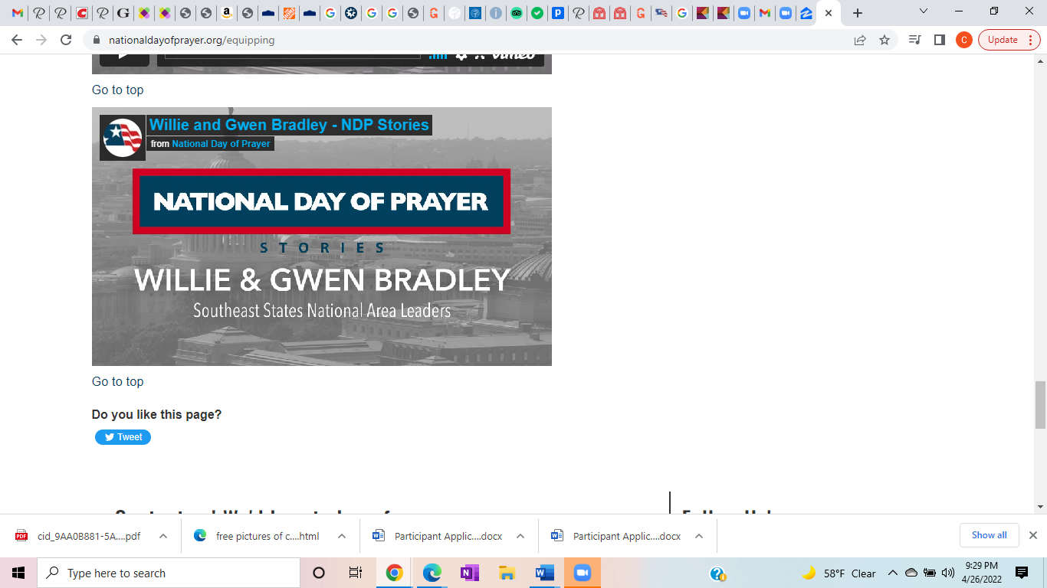

Slide 3
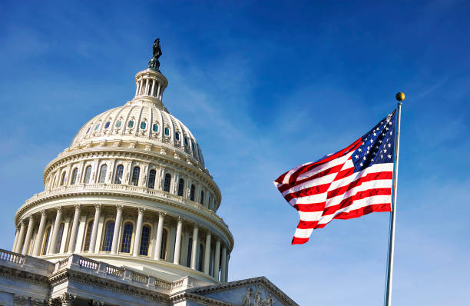
Pray for our leaders, as well as the judges in our courts. Ask God to grant them wisdom to act with integrity.
I Kings 3:28
I Timothy 2:1-2
Exodus 18:21
Proverbs 11:3
Romans 13:1-2
Federal Government
Consider praying for our President, Vice President, Cabinet Members, Congressional Leaders, Supreme Court Justices
State Government
Consider praying for your Governor, Executive Leaders, Legislative Leaders, Judicial Leaders
Local Government
Consider praying for your Mayor, City Counsel, Police Chief, Fire Chief, Judges, County Officials
Mrs. Antonia McLaurin, wife of Bro. Willie & Founder of Agape Love Prayer Network

Slide 4
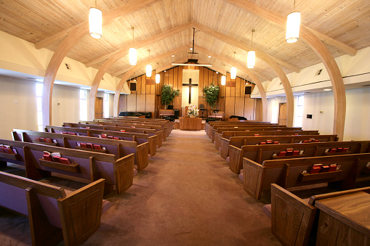
So then, just as you received Jesus Christ as Lord, continue to live in him, rooted and built up in him, strengthened in the faith as you were taught, and overflowing with thankfulness. See to it that no one takes you captive through hollow and deceptive philosophy, which depends on human tradition and the basic principles of this world rather than on Christ (Colossians 2:6-8)
The church would find a new zeal and commitment to the mission and purpose of Jesus Christ (Matt 22:37)
Unity with and among churches that reveal God’s love to the world (John 17:23)
Integrity–that God’s people look and act differently from the world (I Peter 2:11; 1 Corinthians 13:6)
Mr. Rusty Sumrall, Executive Director/Lead Coach Nashville Baptist Association

Slide 5
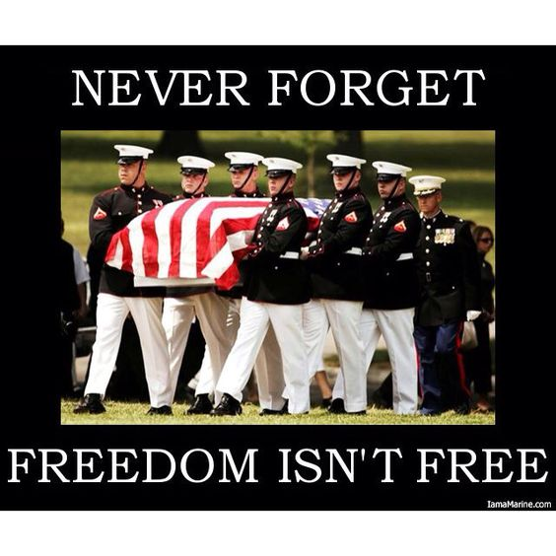
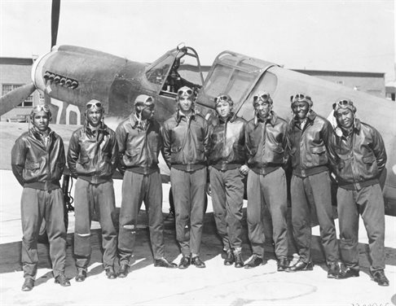
MILITARY
He appointed military officers over the people and assembled them...and encouraged them with these words: ‘Be strong and courageous. Do not be afraid or discouraged because of the king of Assyria and the vast army with him. With him only is the arm of flesh, but with us is the Lord our God to help us and to fight our battles...’” (2 Chronicles 32:6-8)
Perseverance to endure hardship (Isaiah 43:2; Deuteronomy 31:6)
Wise leaders who inspire respect from those under their command (Romans 13:1)
Protection and support for the families they have left behind (Romans 1:8-1)
Chaplain (Lieutenant Colonel) Debra Berry, ANG, Retired

Slide 6
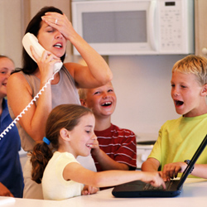
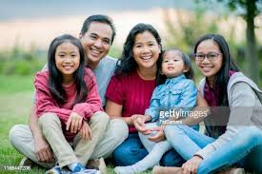
FAMILY
“If a house is divided against itself, that house cannot stand.” (Mark 3:25)
Unity and love in individual families that reach out in hospitality toward others (Romans 12:9-13)
Establish healthy relationships between parents and children (Malachi 4:5-6)
Healthy marriages, etc.
Pastor Gerald & Sis. Tonya O’Guinn, Love Fellowship Baptist Church

Slide 7
EDUCATION
“If you call out for insight and cry aloud for understanding, and if you look for it as for silver and search for it as for hidden treasure, then you will understand the fear of the LORD and find the knowledge of God. For the LORD gives wisdom, and from his mouth come knowledge and understanding.” (Proverbs 2:3-6)
A safe atmosphere conductive to learning
Excellence in educators (Exodus 18:20-21)
Equal opportunities for every student to achieve their full potential (Philippians 1:9)
Sis. Tina Williams, Hamilton Co. Baptist Assoc. WMU Director

Slide 8
MEDIA
“...Whatever is true, whatever is noble, whatever is right, whatever is pure, whatever is lovely, whatever is admirable–if anything is excellent or praiseworthy–think about such things.” (Philippians 4:8)
The decision makers within the media to realize they can make a profit by producing uplifting projects (Proverbs 8:10-11)
Christians in media to find favor and be filled with creative ideas that bring kingdom principles and life-giving messages to the public (Proverbs 2:1-15)
Sis. Sonya Harris, Sisters Who Care Co-Coordinator, HCBA

Slide 9
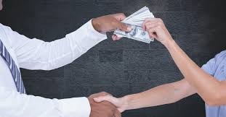
BUSINESS
“I have filled him with the Spirit of God, giving him great wisdom, ability, and expertise in all kinds of crafts. He is a master craftsman, expert in working...” (Exodus 31:3-4)
Impartation of ideas and resources to open principled businesses, especially in areas that need an economic boost (Psalm 132:15)
Christian workers to display Christ-like humility and service to their co-workers (Philippians 2:3)
Sis. Barbara Morris, Sisters Who Care – Atlanta, GA

Slide 10
SWC Transformation Place Sisters Who Care Christian Women’s Job Corp ALL MINISTRIES OF WMU
Pray for the launch of the new CWJC Site – SISTERS WHO CARE (SWC) TRANSFORMATION PLACE (Disciple making, guidance, discernment, resources, leaders, participants, spiritual growth)
Pray for Moving Forward (existing site) and all other CWJC sites in Tennessee and beyond
Pray for Sisters Who Care’s efforts to launch CWJC site & Radiant Wives Club
Mrs. Rebekah Sumrall, Leadership & Spiritual Formation Coach with Rebekah Sumrall Coaching
Sis. Odelle Cadwell, WMU State Director & CWJC, Detroit Michigan
Sis. Debra Berry, Sisters Who Care Trailblazer

Slide 11
SONGS/MUSIC In Christ alone my hope is found He is my light, my strength, my song This cornerstone, this solid ground Firm through the fiercest drought and storm What heights of love, what depths of peace When fears are stilled, when strivings cease My comforter, my all in all Here in the love of Christ I stand In Christ alone who took on flesh Fullness of God in helpless babe This gift of love and righteousness Scorned by the ones He came to save Till on that cross as Jesus died The wrath of God was satisfied For every sin on Him was laid Here in the death of Christ I live There in the ground His body lay Light of the world by darkness slain Then bursting forth in glorious day Up from the grave He rose again And as He stands in victory Sin's curse has lost its grip on me For I am His and He is mine Bought with the precious blood of Christ No guilt in life, no fear in death This is the power of Christ in me From life's first cry to final breath Jesus commands my destiny No power of hell, no scheme of man Can ever pluck me from His hand Till He returns or calls me home Here in the power of Christ I'll stand

Slide 12
2022 NATIONAL PRAYER FOR AMERICA
Lord, we exalt You.
We are filled with awe and wonder as our praise joins the heavenly hosts saying,
“Holy, Holy, Holy is the Lord of hosts,
The whole earth is full of His glory.”
You have established Your throne in heaven and the foundations of the earth.
You alone are the Creator; the earth is Yours and all it contains is for Your glory.
You created and established all of us as Your image bearers.
May our lips and lives continually praise You, reflecting and magnifying You in all our words and ways.
You are the author of our days, You have established Your plans and purpose for us.
We respond to your glory and authority in obedience to Your Word and will.
You have established prayer that we, Your children,
Can communicate with our Heavenly Father directing, strengthening, and discipling us in Your everlasting love.
We join heaven’s activities as we lift up our prayers
And pour out our praise, repentance, thanks, intercession and supplication.

Slide 13
Lord, You have established America through the hearts of our founding fathers and
the documents they penned declaring our dependence on Your sovereignty and supremacy.
We overflow with gratitude having been firmly rooted and built up in our faith in You.
Let our reputation be of our faith in Christ alone,
our love for all people, and fruitful lives bearing the attitude, affections, and actions of Your Spirit,
Who dwells and works within us and through us.
We pray for America: the Church, Family, Education,
Military, Workplace, Government, Arts, Entertainment and Media.
United in Your love, we exalt the Lord who has established us.
In Jesus Name we always pray, Amen!

