Slide 1
Substance Use Disorders Impact on Children and Adolescents
November 3, 2017
Jaime M. Bamford,
MD

Slide 2
Objectives
Understand current scope of substance use disorders (SUD) in VA
Understand impact on child and adolescent development
Develop framework for viewing SUDs in parents and children

Slide 4
Question…..

Slide 5
Case Study
5 yo male referred for defiance, hyperactivity and impulsivity at school
Recently started kindergarten
Behind academically
Disruptive in class, not keeping his hands to himself, talks back to teacher
Currently living with maternal grandparents due to parental substance abuse
During appt, told GM to “shut the h…. up”

Slide 6
Scope of the Problem
Approximately 20.2 million adults aged 18 or older had a past year SUD
16.3 million with an alcohol use disorder
6.2 million with an illicit drug use disorder
Opioid abuse is rising quickly
Only 7.6% received substance abuse treatment

Slide 7
Scope of Opiate Problem (Virginia)
Opioids have been the driving force behind the large increases in fatal overdoses since 2013
Fatal fentanyl overdoses (Rx, illicit, and analogs) increased by 176.4% from 2015 to 2016
Rural areas have the highest mortality rates due to Rx opioids
Urban areas have the highest mortality rates due to illicit opioids
The number of fatal cocaine overdoses began increasing in 2015. In 2016, 54% of fatal cocaine overdoses also had fentanyl causing death

Slide 9
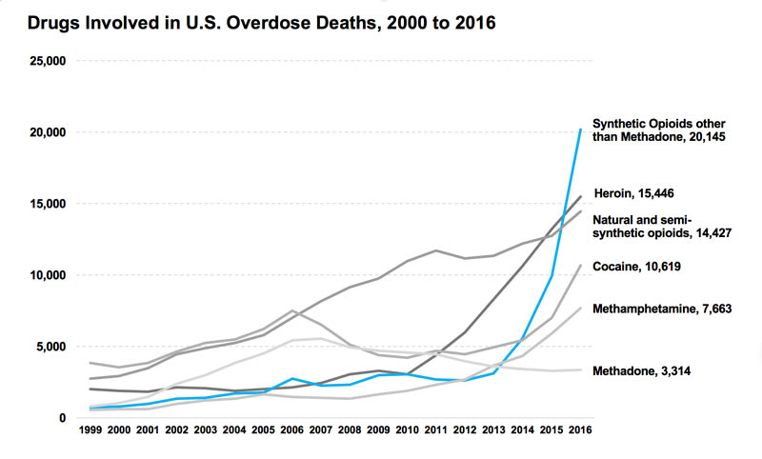

Slide 10
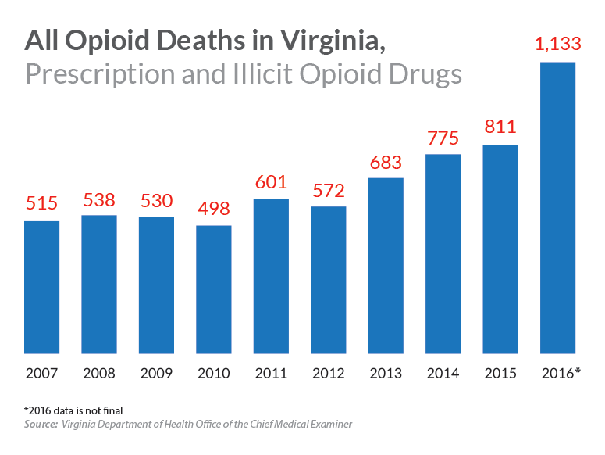

Slide 11
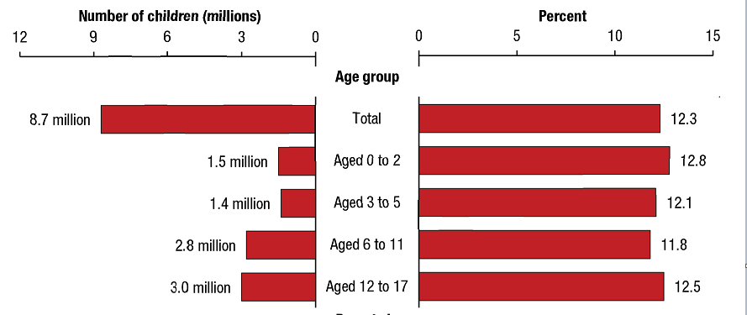
Effect on Children
1 in 8 children (8.7 million) aged 17 or younger lived in households with at least one parent who had a past year SUD
Alcohol use is more common
Illicit drug use (especially heroin & prescription drug abuse) is on the rise

Slide 12
Effect on Children
Children of parents with SUD
Lower socioeconomic status
More academic and social difficulties
Inadequate medical and dental care
Higher risk of physical abuse, sexual abuse and neglect
Higher rates of mental and behavioral disorders
More likely to develop SUD
Accumulation of Risk

Slide 13
Academic and Cognitive Functioning
Lower grade point averages
Increased grade retention
High absenteeism rate
Greater risk of suspension and expulsion
Less likely to pursue secondary education
Deficits worse if there was prenatal exposure

Slide 14
Prenatal Exposure
Children with Fetal Alcohol Syndrome have difficulties acquiring and learning new information
Children exposed to cannabis have small-for-age head circumference, lower verbal reasoning skills, increased levels of aggression and poor attention span (heavy use defined as more than 1 joint per day)
Prenatal opioid exposure can lead to increased activity levels, poor coordination, impulsivity in childhood

Slide 15
Rise of Neonatal Abstinence Syndrome
Every 25 minutes a baby is born suffering from opioid withdrawal
Mean length of stay is 16.9 days (compared to 2.1 days)
Hospital costs were $66,700 on average compared to $3,500

Slide 16
Attachment
Infants exposed prenatally or with parents who abuse substances after birth tend to develop insecure attachment styles
Insecure attachment defined as ambivalence, indifference and lack of distress to parental presence
Risk for insecure attachment is greatest at the youngest ages
Impact of insecure attachment on children may depend on presence of non-substance-abusing caregiver who can offset this risk*

Slide 17
Effect on Parenting Styles
Mothers who abuse substances are less responsive to their children
Display less warmth, encouragement and engagement with their children
In adolescence, maternal alcohol and substance abuse are associated with
Authoritarian, over-involved parenting styles
More harsh, commanding and punitive discipline
Less parental monitoring

Slide 18
Parenting Styles Cont.
Fathers with alcohol use disorder show
Higher negative affect
Less sensitivity
Low levels of positive engagement
Lower quality and number of verbalizations*
Poorer quality and less effective discipline
During adolescence, more parent-child conflict

Slide 19
30 Million Word Gap
By the age of 3, children born into low-income families heard roughly 30 million fewer words than their more affluent peers
Children who heard more words were better prepared when they entered school
These same kids, when followed into third grade, had bigger vocabularies, were stronger readers, and got higher test scores

Slide 20
Parenting Styles Cont.
Parents abusing ETOH, MJ, heroin and other anxiolytic drugs are more likely to display depressed or withdrawn behavior during interactions with their children
Cocaine and other stimulant abuse lead to more intrusive, impulsive and hostile parenting
Mother-child relationship factors (attachment security) may buffer children’s risk for negative outcomes associated with having an alcoholic father*

Slide 21
Environmental and Societal Impacts
Parents with SUDs often experience
Financial instability
Food and housing insecurity
Chaotic living environment
Inconsistent employment
Social stigma or isolation
Incarceration
Unsafe living environment due to chemicals, exposure to needles and drug paraphernalia

Slide 22
Child & Adolescent Maltreatment
2.7 times more likely to be physically or sexually abused
4.2 times more likely to be neglected
Higher rates of neglect in rural populations
Neonatal period is the period of highest risk of harm
27 % of children born to women with SUDs need involvement of CPS in preschool years
More likely to be placed and remain in foster care

Slide 24
Emotional, Behavioral and Social Adjustment
Increased rates of anxiety, depression, oppositional behavior, conduct problems and aggressive behavior
Lower rates of self-esteem and social competence
By young adulthood, mood disorders are double those of their peers
Additive effects if co-occurring parental psychopathology and substance abuse

Slide 25
Emotional, Behavioral and Social Adjustment
Type of paternal illness also impacts type of behavioral symptoms
Externalizing symptoms greatest among children in antisocial alcoholic families
Internalizing symptoms greatest among children in depressed alcoholic families
Children in rural populations have a greater risk of mental health problems
Greater risk if both parents are affected

Slide 26
Case Study
12 yo male here to establish care after recent hospitalization for suicide attempt
Overdosed on 27 tablets of Tylenol
Says he is hopeless, no one cares about him, he can’t do anything right, always in trouble, constantly irritable, difficulty sleeping
Has cut on himself in the past
3 previous hospitalizations for suicidal behavior within the last 4 months

Slide 27
Case Study Cont.
Diagnoses in last 6 month include bipolar disorder, ADHD, ODD, Conduct disorder, Major depressive disorder
Significant problems in school, defiant, poor grades, fights with peers
Tested positive for MJ in the hospital, states he has been using since he was 10 yo

Slide 28
Case Study Cont.
Lives with mom, dad and maternal grandparents who have joint custody
Mom admits to having a problem with alcohol and dad abused pills in the past but has been clean for several months
Significant family conflict and history of domestic violence between mom and dad
Dad is in and out of the house
Both parent with inconsistent employment

Slide 29
Future Substance Abuse
Heritability estimates range from 50-60% (strong genetic component)
Adopted children with alcohol dependent biological parents are at least twice as likely as other adopted children to develop alcoholism
The ability to tolerate a substance without becoming impaired may be strongly influenced by genetic makeup, and may contribute to a propensity to abuse that substance
Genetic influences are stronger in environments with lower parental monitoring and more substance-using friends

Slide 30
Future Substance Abuse Cont.
By adulthood, 53% of children of parents with SUDs have an alcohol or drug use disorder (compared to 25% of their peers)
Initiate substance use earlier and increase their rates of use more quickly
Greater risk if 2 parents with SUDs.
Greater risk if co-occuring SUDs and mental illness

Slide 31
Case Study
9 yo female presents for evaluation of depression and anxiety
Brought by dad and paternal GM
Has been withdrawn and irritable since mom passed away a few months ago
Refuses to sleep alone, very clingy
Mom died of opioid overdose 2 months ago
During evaluation, pt very quiet, doesn’t answer direct questions
Dx with depression and referred to therapy

Slide 32
Case Study
14 yo male presents to establish care after 14 months in residential treatment
Placed after multiple hospitalizations for suicidal ideation (7 over last 3 years)
Sent to facility with expertise in sexual predatory behavior in teens after pt was charged with sodomy, sexual assault and indecent exposure to female peers
Current diagnosis is Bipolar disorder and ADHD
Living with grandparents
Mom incarcerated for theft and Dad not involved due to his own substance abuse

Slide 33
Case Study
17 yo female referred from court services due to truancy and MJ abuse
As of Feb, has missed 37 days of school
In court tested positive for MJ so referred for substance abuse evaluation
Has chronic illness that leads to painful mouth ulcers
After 1 mo of individual therapy, discloses to therapist that she has been abusing Tramadol (weak opioid) that PCP is prescribing for pain

Slide 34
Case Study
19 yo male presents for help with substance abuse and irritability
Recently spent 3 days in jail for disorderly conduct and breaking and entering while high on meth and opiates
Long mental health treatment history
Released from group home placement 1 month before turning 18 yo
States he is “just pissed off at the world”

Slide 35
Case Study Cont.
Became tearful during interview “I never thought I would do this.”
Starting shooting up heroin 1 week ago
Lives with dad who also uses drugs
“I’m basically his supplier but I don’t have anywhere else to go”
Unemployed
Longest period of sobriety in last 3 mo was when he was living with his sponsor for 1 mo who ended up stealing $ from him

Slide 36
Case Study
19 yo male with history of PTSD and bipolar disorder presents for evaluation of drug use
Got arrested and spent 4 days in jail for assaulting a police officer
Was high on methamphetamine
During argument with GF, put a gun to his head and threatened to kill himself so she called 911
When police arrived, pt was agitated, paranoid and attempted to hit the officer
Has to go to court soon and requests documentation that he has attend treatment

Slide 37
Case Study Cont.
History reveals…
Biological parents abused multiple substances during pt’s early years (unknown prenatal exposure) and have multiple mental health dx
Pt was adopted from foster care at age 5 due to horrific physical and sexual abuse
Adopted parents separated at age 9 yo
Adopted father killed himself when pt was 13 yo
Pt was placed in residential treatment at age 14 due to out of control behavior

Slide 38
What can we do?
Treatment for parents and children works
Has to be affordable and accessible
Encourage local communities to establish treatment programs, family drug courts
Early intervention is the key….starting in pregnancy
Teaching parents how to engage with their children
Teens whose caregivers are “hands on”--engaged in their teens’ lives, supervising them, establishing rules and standards of behavior--are at one-fourth the risk of abusing substances
Excellent relationship with either parent are at 25 percent lower risk for substance abuse
Excellent relationships with both parents are at 40 percent lower risk.

Slide 39
What can we do?
In March 2015, Harvard’s Center on the Developing Child released a study saying, “Every child who winds up doing well has had at least one stable and committed relationship with a supportive adult.”

Slide 41
Citations
Family Matters: Substance Abuse and the Family. The National Center on Addiction and Substance Abuse at Columbia University. March 2005
Lipari, RN and Van Horn SL. Children Living with Parents who have a Substance Use Disorder. The CBHSQ Report. August 24, 2017. Center for Behavioral Health Statistics and Quality, Substance Abuse and Mental Health Services Administration.
Smith VC, Wilson CR. AAP Committee on Substance Use and Prevention. Families Affected by Parental Substance Use. Pediatrics. 2016; 138(2):e20161575
Solis, JM, Shardur J, Burns A and Hussong A. Understanding the Diverse Needs of Children whose Parents Abuse Substances. Curr Drug Abuse Rev. 2012 June; 5(2):135-147
Virginia Department of Health. Opioid Addiction Indicators. http://www.vdh.virginia.gov/data/opioid-overdose/
ChildNational Center on Substance abuse and Child Welfare. AFCARS Data 2000-2015. https://ncsacw.samsha.gov/resources/child-welfare-and-treatment-statistics.aspx

