Slide 1
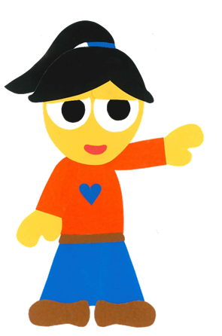
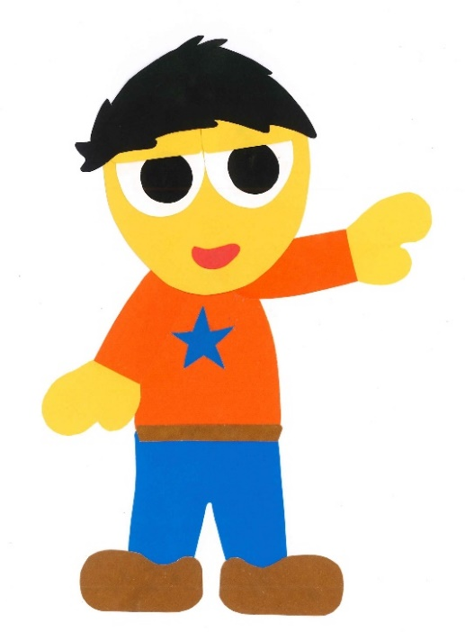
WE
CAN
READ
Donald Joyce

Slide 2
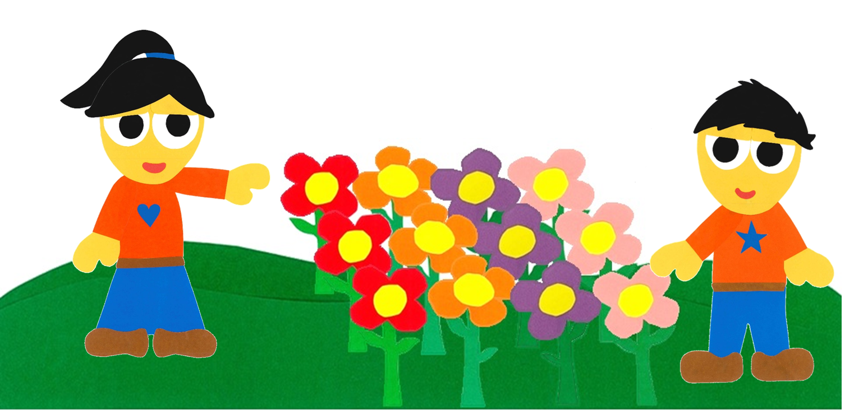
What Is In Your Garden?
By:
Donald Joyce
WE CAN READ

Slide 3
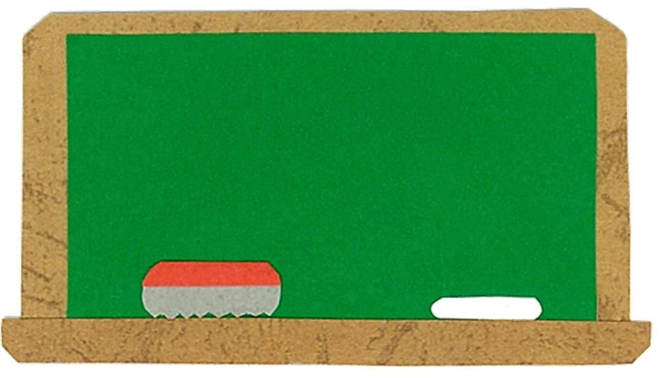
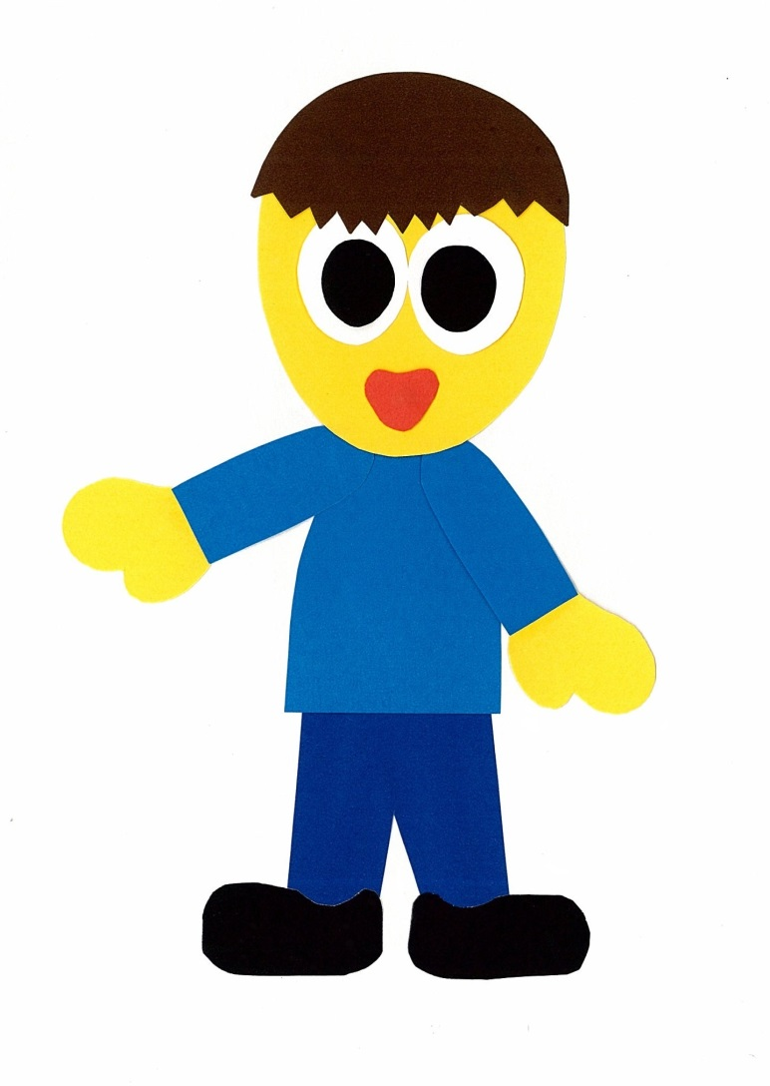
Let’s
Talk!

Slide 4
What can you see
in a garden?
I can see ___.

Slide 5
Let’s
Learn!

Slide 6
worm
grasshopper
beetle
ladybug
ant
butterfly
bee

Slide 7
Let’s
Read!

Slide 8
What Is In Your Garden?
By:
Donald Joyce
WE CAN READ

Slide 9
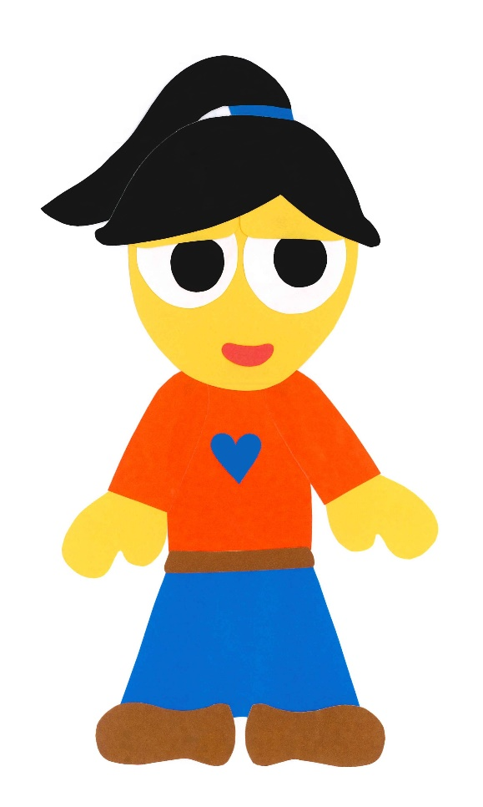
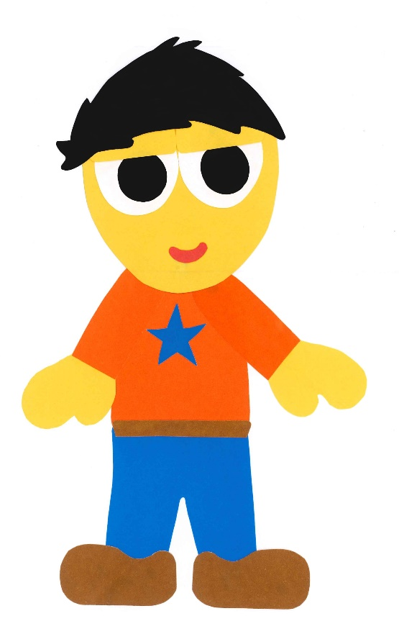
Your garden is beautiful!

Slide 10
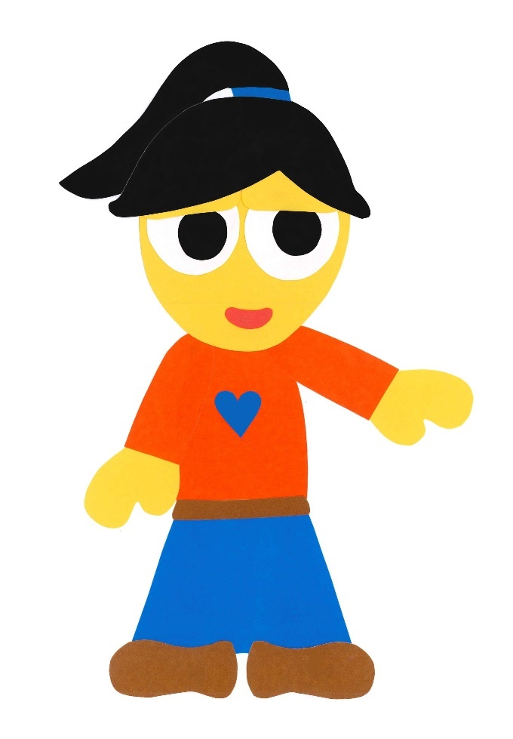
There are many flowers in your garden.

Slide 11
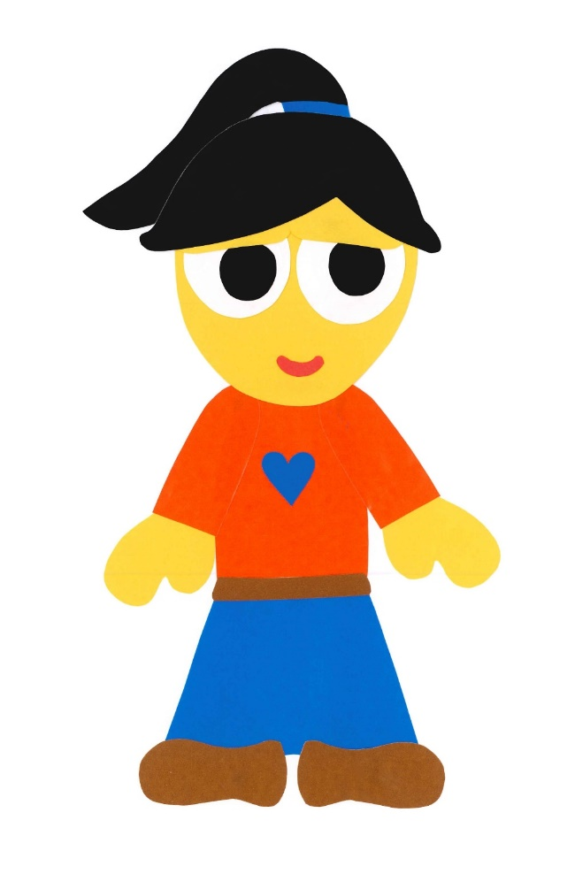
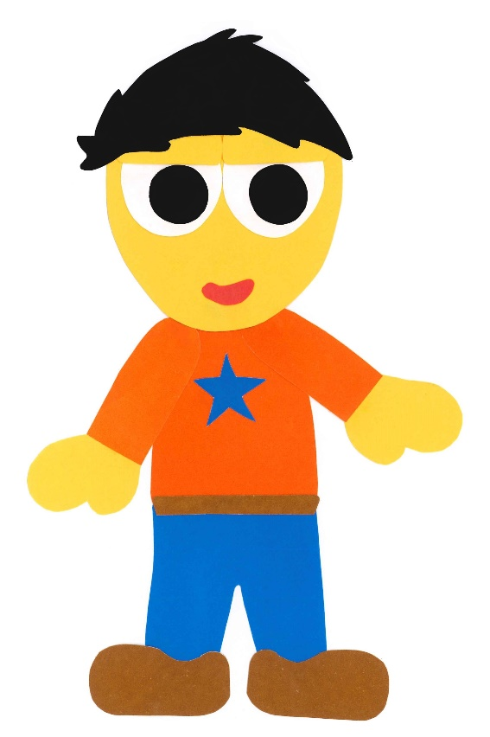
There are other things in my garden.

Slide 12
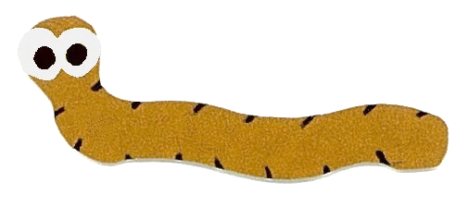
There is a worm
in my garden.

Slide 13
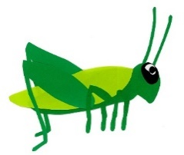
There are grasshoppers.

Slide 14
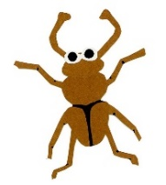
There are beetles.

Slide 15
There are ladybugs.

Slide 16
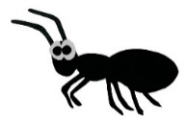
There are ants.

Slide 17
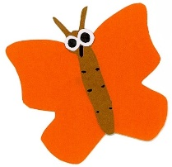
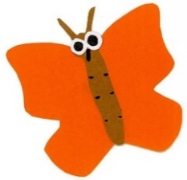
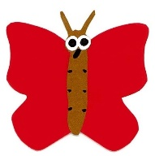
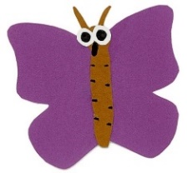
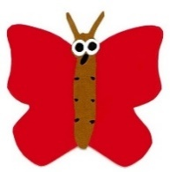
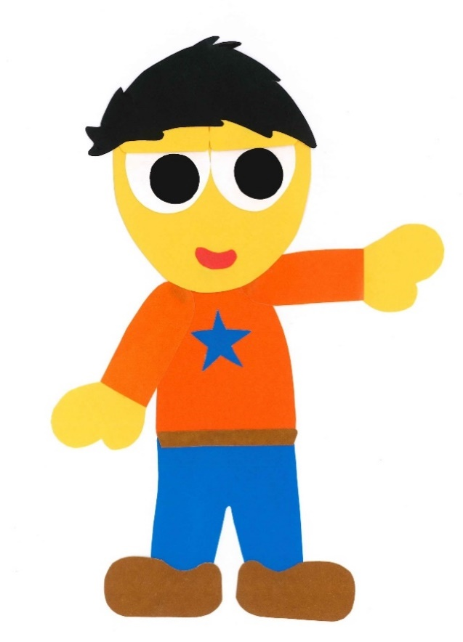
There are butterflies.

Slide 18
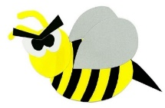
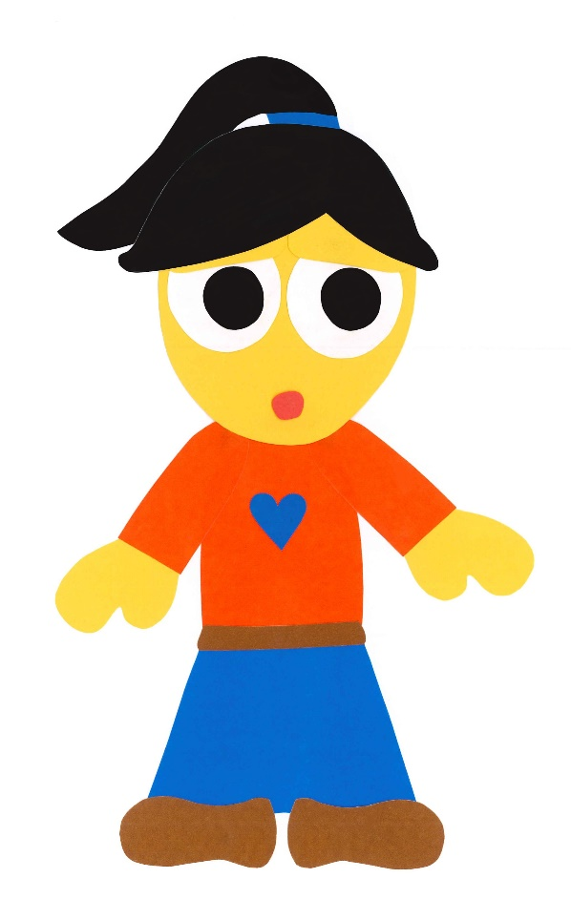
There are bees too!

Slide 19
My garden is beautiful.

Slide 20
What Is In Your Garden?
By:
Donald Joyce
WE CAN READ

Slide 21
Let’s
Review!

Slide 22
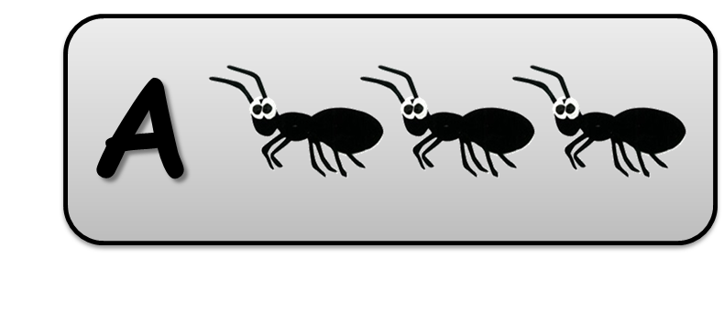
There are ants
in Sam’s garden.

Slide 23
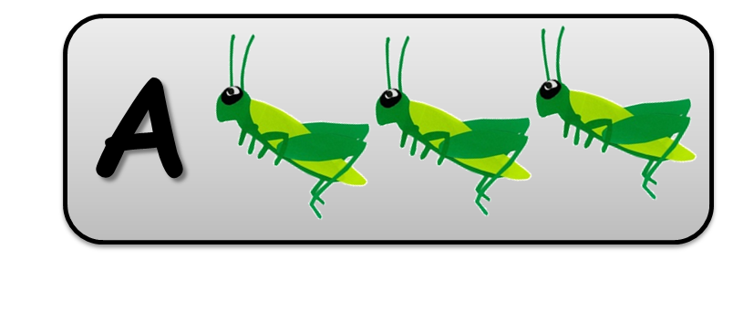
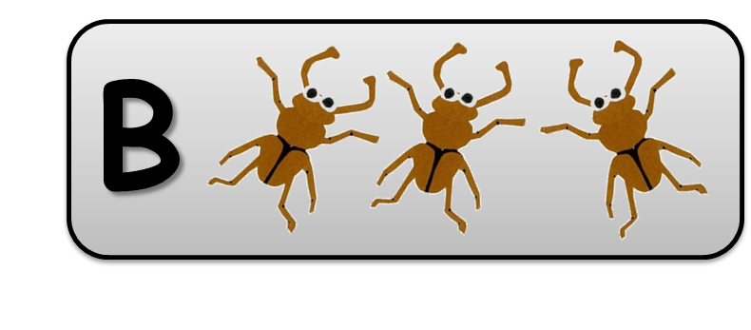
There are beetles
in Sam’s garden.

Slide 24
There is a worm
in Sam’s garden.

Slide 25
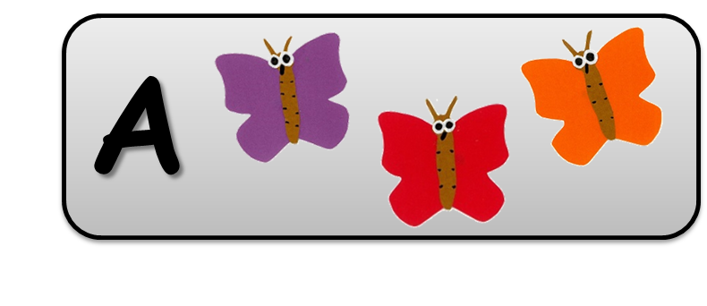
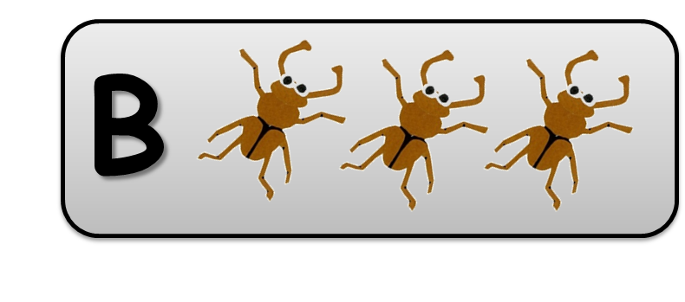
There are butterflies
in Sam’s garden.

Slide 26
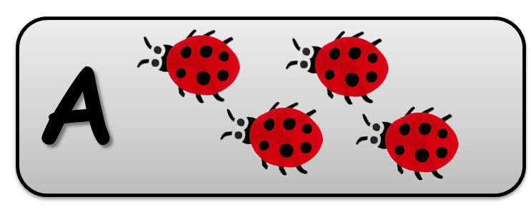
There are bees
in Sam’s garden.

Slide 27
Let’s
Connect!

Slide 28
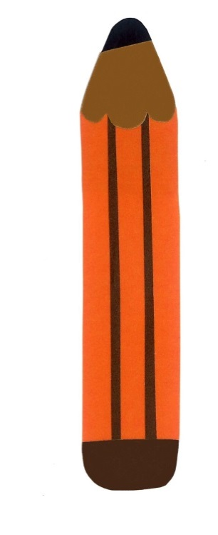
Get a pencil and paper!

Slide 29
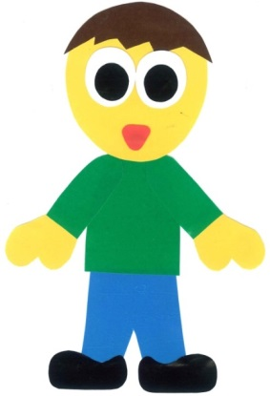
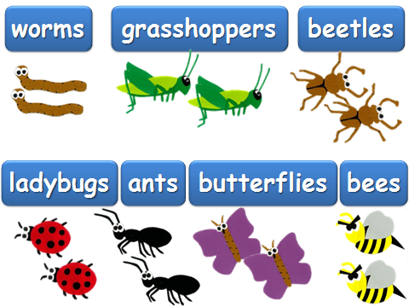
Draw a garden of your own.
There are __ in my garden.

Slide 30
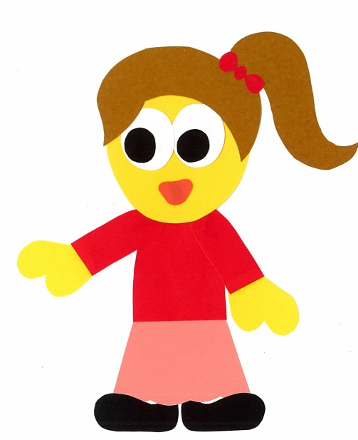
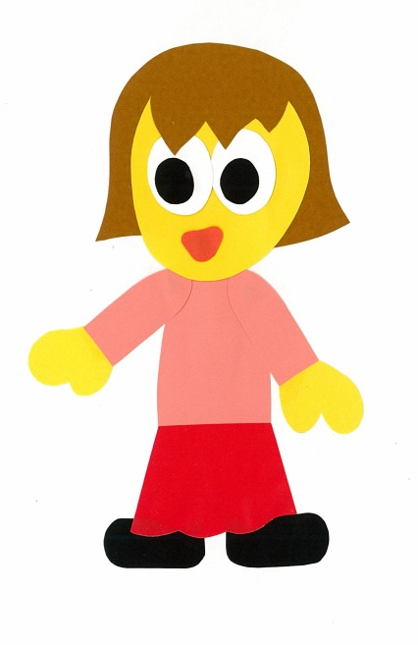
Find a friend. Play a guessing game.
Are there bees in your garden?
No, there aren’t.

Slide 31
Are there ___ in your garden?
Yes, there are.
No, there aren’t.

Slide 32
WE
CAN
READ
Donald Joyce
www.teacherdonald.com

