Slide 1
NOVEMBER 5 & 6, 2015 Craddock Terry Hotel & Conference Center 1312 Commerce Street, Lynchburg, VA 24504
VACPN
2015 Fall Conference
NURSING ETHICS AND
SCOPE OF PRACTICE

Slide 2
The Ethical Imperative of the Therapeutic Relationship
Presented by:
Dr. Irma H. Mahone, RN, PhD
Research Assistant Professor
UVA School of Nursing
ih3xn@virginia.edu

Slide 3
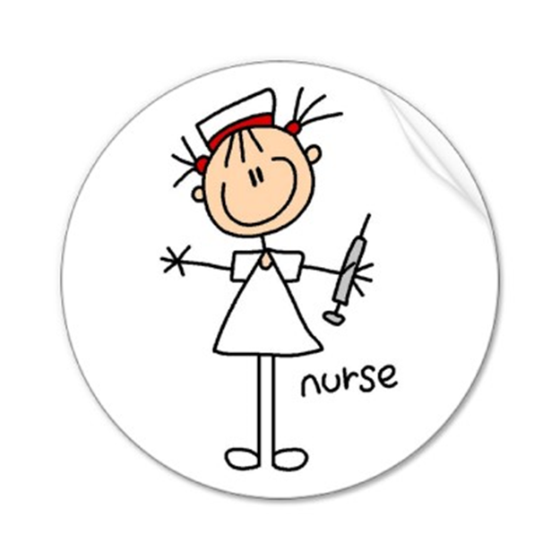
Introduction
Current nursing practice climate:
Three basic ethics theories
Nursing and the Affordable Care Act
ANA code of ethics
IOM’s Future of Nursing report
New legislation in California
Hildegard

Slide 4
Ethics: 3 Basic Theories
1) Virtue Theory:
Good is defined as that which is consistent with good character.
Divine command theory:
morality is dependent on God /we are to obey the commands of God /found in Judaism, Christianity, and Islam.
Guided by 3 theological Virtues (Faith, Hope, Charity) or 4 cardinal virtues of Plato (Wisdom, Courage, Temperance, Justice)
Humility is a virtue, a corrective to pride
Spiritual maturity = discerning good & evil
Human flourishing, is it what nurtures/ nourishes, leading to fully actualized human beings & human excellence?

Slide 5
Ethics: 3 Basic Theories
2) Deontological Theory
Duty, obligation, necessity, consistent with moral duty
Human Rights tradition = equality and autonomy
Consequences do not matter – only motivation/intent

Slide 6
Ethics: 3 Basic Theories
3) Utilitarian Theory
Acts are good based on their consequences.
Brings about greatest good for greatest number
To cause suffering to individuals may be justified to minimize or avoid communal suffering

Slide 7
Nursing & the Affordable Care Act
Affordable Care Act
Rebalances acute care model = values prevention & quality of life
Focuses on:
Managing chronic illnesses
Primary Care (care co-ordination, prevention, wellness)
Prevention of adverse events inpatient
Offers better:
Mental health services
School health services
Long-term care
Palliative care

Slide 8
Nursing & the Affordable Care Act
Continuous healing relationships needed in:
Care co-ordination
Patient-centered care (shared decision making)
Care partnerships
Population health
Ability to read context cues
Ethics of choices/ better choices/ effects of choices
Need care team to be:
Problem-solvers (vs prescribers)
Creative thinkers(vs seekers of the status quo)
Responsible practitioners/relational skills/sharing responsibility = quality outcomes

Slide 9
Nursing & the Affordable Care Act
“Relationship is the most important ingredient in any approach to collaboration.”*
Trust is the ingredient that builds & sustains therapeutic relationships
Relational ethics will play central role in future healthcare
*Seaburn, McDaniel, Kim & Bassen, 2005

Slide 10
Nursing & the Affordable Care Act
Ethics in a transforming practice environment requires:
Ethical sensitivity & mindfulness
Moral courage/ widening the “quality of life” circle
Sustained relationships built on:
Reciprocity
Trust
Social justice
Solid foundation of nursing’s relational core:
Care coordination
Patient/family/community-centered care
Collaborative care

Slide 11
ANA designated 2015 as the "Year of Ethics“
Released a revised code of ethics for the profession
New programs and products to help increase awareness and integration of The Code into everyday nursing practice

Slide 12
Online Ethics Book
http://nursingworld.org/MainMenuCategories/EthicsStandards/CodeofEthicsforNurses/Code-of-Ethics-For-Nurses.html

Slide 13
IOM Future of Nursing Report
Nurses should practice to the full extent of their education and training.
Nurses should achieve higher levels of education and training through an improved education system that promotes seamless academic progression.
Nurses should be full partners, with physicians and other health care professionals, in redesigning health care in the United States.
Effective workforce planning and policy making require better data collection and information infrastructure.
http://iom.edu/Reports/2010/The-Future-of-Nursing-Leading-Change-Advancing-Health/Report-Brief.aspx

Slide 14
IOM Future of Nursing Report
Central Drivers:
Primary Care
Prevention
Norms:
Interprofessional collaboration
Coordinated care
Transparency
Affordability
Questions in the face of economic drivers:
How will relationships be affected?
How will we communicate best in the new system?
Ethical knowledge based on:
Working with “knowledge partners”
Use of technology to build/sustain caring relationships

Slide 15
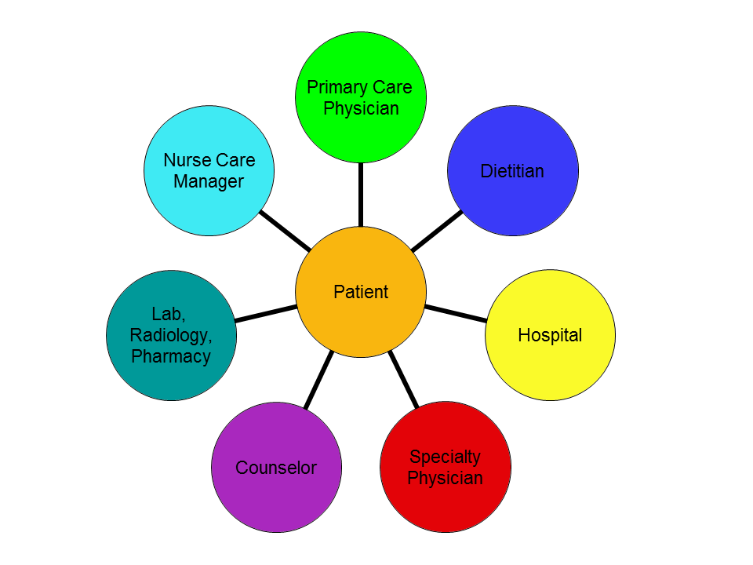
IOM Future of Nursing Report
Interactional ethical dialogue: (e.g. shared mind)
Balancing individual autonomy with relational autonomy
All stakeholders help “build” a decision
May result in completely new options (not considered before)
Considers simultaneously needs, interests & obligations of all partners
Fostering autonomy through mutually-respectful relationships:
Build a “common understanding”
More than provide information (patient education) and report data
Results in ”mature care”
Grounded in a relational process – i.e. reciprocal
Recognizes interests of both self & others
Promotes mutual responsibility

Slide 16
New Legislation in California
Debbie Ziegler holds a photo of her late daughter, Brittany Maynard,
after the California State Assembly approved a right-to-die measure on
Sept. 9. Maynard died on Nov. 1, 2014.
http://www.npr.org/sections/health-shots/2015/10/05/446107800/california-governor-signs-landmark-right-to-die-law

Slide 17
Statement of ANA Position:
“Prohibits nurses’ participation in assisted suicide and euthanasia because these acts are in direct violation of;
Code of Ethics for Nurses with Interpretive Statements;
the ethical traditions and goals of the profession
Nursing’s covenant with society.”
http://www.nursingworld.org/MainMenuCategories/EthicsStandards/
Ethics-Position-Statements/Euthanasia-Assisted-Suicide-and-Aid-in-Dying.pdf

Slide 18
Hildegard
the "mother of psychiatric nursing.“
original author of “therapeutic
use of self”
concept universally integrated
into nursing
her life and work produced the
greatest changes in nursing practice
since Florence Nightingale.
Hildegard Peplau
1909 - 1999
Peplau, H. E. (1952). Interpersonal relations in nursing. New York: G. P. Putnam & Sons.

Slide 19
Therapeutic Use of Self*
3 nurse attitudes:
“Go away. My world would be better without you.”
“You are an object, a task to be done. You mean nothing to me.”
“You are a person of worth. I care about you.”
* Lachman, V. 2009

Slide 20
Therapeutic Relationship
“A healing relationship is essential to ethical nursing practice.”
Requires a commitment to healing relationships
Requires a continuous dialogue among stakeholders
Is inextricably linked to nursing ethics
The therapeutic relationship is the ethical framework of nursing practice (broader conceptualization needed)
The therapeutic process is a self-awareness which assists the healing of patients

Slide 21
Quality of Life/Care
Nursing challenge:
Improving the patient’s quality of life
Nursing mandate:
Providing therapeutic quality of care
Shapes professional ethics
Is nurse’s response to social needs
Expects a certain nursing conduct
Requires certain skillset

Slide 22
Trust
Needed to provide “quality”
Essential for ethical standards
Necessary for providing care that is:
Humane
Competent
Accountable

Slide 23
Nursing Relational Framework
Includes:
Nurse/patient-only relationship
Others: care team, family, community
Considers :
biopsychosocial determinants
cultural and ethnic differences
consequences of treatment
more than ethical guidelines

Slide 24
Nursing Relational Framework
Intellectual process
Awareness of the interactive process
Self-awareness assists healing of patient
Nursing is a healing art = inherently therapeutic
Goal: help the sick & those in need of healthcare
Ethical core of nursing = nurse & patients working together

Slide 25
Nursing Relational Framework
Nursing Ethics = healing relationships
Contemporary array of treatment choices
Nursing judgments more complex today:
Safety
Effectiveness
Routine tasks
Cultural competence
Therapeutic relating
Concern for immediate situation PLUS real/potential problems:
e.g. racial/ethnic differences, physical disabilities, sexual orientation
Ethical guidelines not enough

Slide 26
Nursing Relational Framework
Trustworthy relating
Technology-oriented world:
relational networks = tweeting,
blogging, posting, face-time…
Nurses emphasize functionality and effectiveness
Reliance on general ethical principles applied to autonomous individuals
Includes context & motivation

Slide 27
Nursing Relational Framework
Relational capital = “working capital”
Value-added dimension
Guides & directs practice
Definition: “Cumulative trust, experience, and knowledge that forms the core of the relationship b/w businesses and their customers”*
Advantages:
Getting to know patients as individuals
Tracking progress
Early intervention
Tailoring interventions
Building relationships of trust
*Reich, 2009

Slide 28
Nursing Relational Framework
Ethical reflection guideline:
Person-in-relation to self, neighbor, world
Ethical action is a consequence of relating
Shaped by network of relationships
Traditional organizing principle = responsibility for one’s actions
Language of relationship more difficult = includes context & give/take of relationship over time

Slide 29
Nursing Relational Framework
Relational Ethic = worldview of a multi-person system
Derived from actual experience of continuous healing relationships
Many-sided: includes concepts, actions, behaviors, methods of inquiry, & practice
Embraces & bridges prevailing ethics theories
Helps persons:
make meaning of situations
move toward trust for the future

Slide 30
Nursing Relational Framework
Relational Ethic is holistic (full relational context):
Biological
Emotional
Behavioral
Spiritual
Social
Cultural
Environmental
Provides continuous & reciprocal feedback
Assumes individual action is shaped by full relational context of all concerned

Slide 31
Principles of Biomedical Ethics vs Core Nursing Components*
Autonomy: freedom or independence, self-determination
Nonmaleficence: do no harm
Beneficence: do that which benefits patient
Justice: social benefits and social burden are just
Benevolence: an act of kindness, a generous gift
Courage: to face personal issues and to take risks
Truthfulness: honest expression of beliefs/ disinclination toward deception.
Prudence: wise in practical affairs; discretion.
Justice: social benefits and social burden are just
*Doherty, 1991

Slide 32
Nursing Relational Framework
Holistic relating:
Emphasis on trust-building & prevention
Monitoring fairness
Deferring judgment/blame in “stuck” relationships
“I” positions (clarity/courage)
Dialogue about consequences
Acknowledging other’s contributions
Promote ethical dialogue
Recognize/limit destructive entitlements (ethically invalid)
Build on everyone’s assets
Relational analysis of problems (i.e. many-sided)
Linking individual/team ethical action

Slide 33
Nursing Relational Framework
Recognizes signals of ethical distress:
reactivity
blame
avoidance
Values ethical sensitivity through:
Mutually-respectful engagement
Shared consequences of action & behavior
Recognizing shifting roles & changing functions

Slide 34
Nursing Relational Framework
Includes openness to others:
Barriers to openness: disengagement , detachment
More than autonomous patients with rights
Ethical conflicts:
Opportunities for building trust
Require openness, directness, ethical sensitivity, multi-directed caring
Require skills of a therapeutic resource & guide
Require solutions in shared decision making
Make “meaning” within the larger context

Slide 35
Nursing Relational Framework
Values ethical sensitivity & mindfulness:
Ethical sensitivities built on:
Experiences of relationship
Courage
Risk taking

Slide 36
Nursing Relational Framework
Challenges to nursing sensitivity & mindfulness :
Stressful & challenging work conditions
Few opportunities to debrief
Lack of attention to prevention
Missed teaching/learning opportunities re respect/consideration
Personal characteristics of staff/patients
Lack of support for learning/applying relational skills
Lack of clarity re accountability and stagnant leadership
Appropriateness of treatment choices
Patient autonomy
Interpersonal relationships
Patient suffering
Colliding expectations
Institutional obstacles
Poor communication
Boundary issues

Slide 37
Nurse/Patient Relationship as Sacred Covenant
“As nurses we are privileged to be allowed into the most intimate points of people’s lives when they are at their most vulnerable. We view the nurse-patient relationship as sacred because of the intimacy and spirituality of that connection.”
- Dr. Ann Hershberger

Slide 38
Nurse/Patient Relationship as Sacred Covenant
Bonds of loyalty & responsibility
Mutual obligation (unspoken)
No conditions for faithfulness
No return for good services
Approaches:
Advocacy
Agape love
Empowerment
Grace
Justice
Partnership
Presence
Reconciliation
Service

Slide 39
Nurse/Patient Relationship as Sacred Covenant
Blends art, science, & spirit of unselfish devotion
Nursing is “ a sacred ministry of health care or health promotion”
A sacred covenant
Desire for wholeness for the patient
Holy calling/vocation within a faith context
Sacredness about the space created in nurse-patient relationship

Slide 40
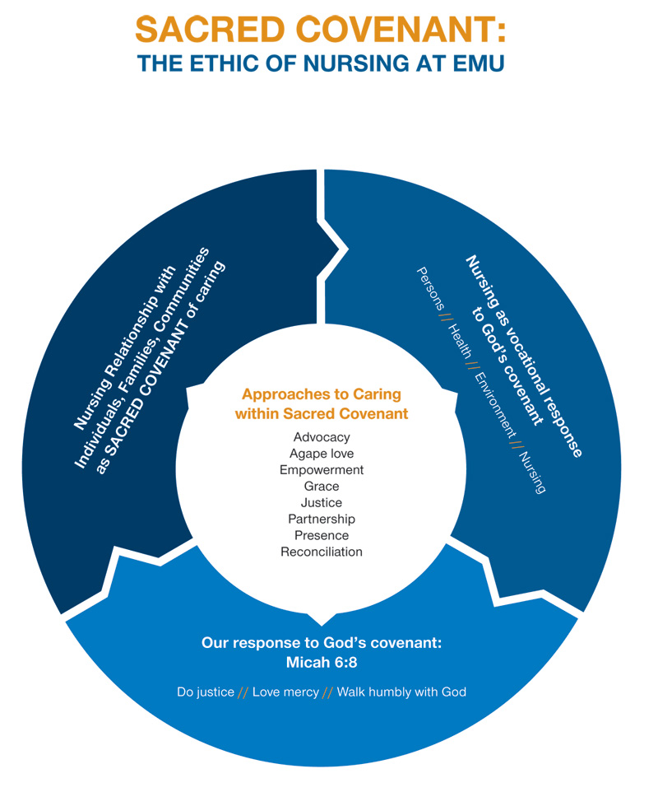

Slide 41
Nursing Relational Framework & Spirituality
As holistic care providers, we do not back away from assessing and addressing spiritual needs of our patients
Self-disclosure & therapeutic use of self:
talking about our own faith experiences, relationships, values
to connect with the patient/build rapport with the patient
used with discretion, remembering that the focus is always the patient

Slide 42
Nursing Relational Framework & Spirituality
Are we morally obligated to offer this domain of ourselves in our therapeutic relationships?
Does this apply – no matter what our religious affiliations are?
Will our holistic nursing care be enhanced if we embrace/offer this domain?
Is there an ethical imperative to
not only embrace therapeutic
relationships, but also every/any
aspect of our patient’s life?

Slide 43
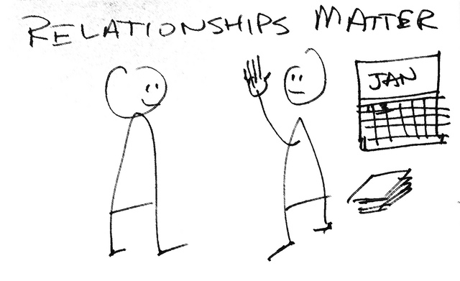
The End

Slide 44
Doherty, W. (1991). Virtue ethics: The person of the therapist. Ethics. Not just black & white. Newsletter of the American Family Academy, 46, 19-21. Hershberger, A. (2010). Sacred Covenant: The Nature of the Nurse-Patient Relationship in an Anabaptist Context. Unpublished manuscript. Lachman, V. (2009). Practical Use of the Nursing Code of Ethics: Part I. MEDSURGE Nursing, 16(1), 55-57. O'Brien, M. (2014). Spirituality in Nursing: Standing on Holy Ground (5th ed.). Burlington: Jones & Bartlett Learning. Peplau, H. E. (1952). Interpersonal Relations in Nursing. New York: G. P. Putnam & Sons. Reich, R. (2009). Relational Capital. Retrieved from www.WashingtonSpeakers.com Seaburn DB, McDaniel SH, Kim S, & Bassen D. (2004). The role of the family in resolving bioethical dilemmas: clinical insights from a family systems perspective. Journal of Clinical Ethics, 15(2), 123-134. Ulrich, C. M. (2012). In Hall C. (Ed.), Nursing Ethics in Everyday Practice: A Step-by-Step Guide. US: Sigma Theta Tau International.
Reference List

