Slide 1
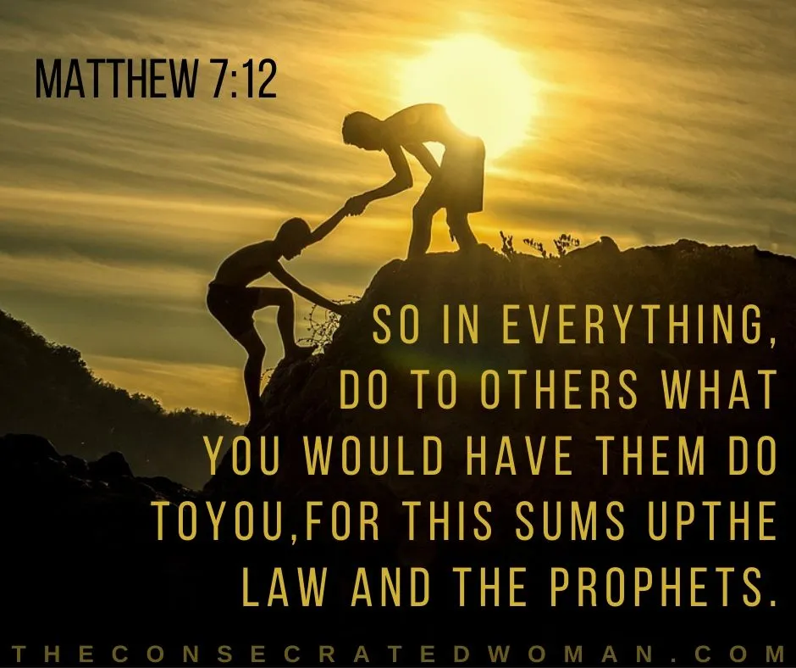
Trinity Evangelical Lutheran Church
February 4, 2023
WELCOME!
1. Gather
2. Word
3. Meal
4. Sending
Notes:
Image: Five Loaves by Caroline Coolidge Brown. Copyright © Caroline Coolidge Brown. All rights reserved. Used by permission of the artist.

Slide 2

= Please stand if able
= Please be seated
1. Gather
Prelude – Roxanne Groff
Office of the Acolyte
Ringing of the Bell
Welcome
Notes:
Image: Five Loaves by Caroline Coolidge Brown. Copyright © Caroline Coolidge Brown. All rights reserved. Used by permission of the artist.

Slide 3
1. Gather
CONFESSION
AND
FORGIVENESS
All may make the sign of the cross, the sign marked at baptism…
L: We confess our sins before God and one another.
Pause for silence and reflection.
L: Merciful God…
Notes:
Image: Five Loaves by Caroline Coolidge Brown. Copyright © Caroline Coolidge Brown. All rights reserved. Used by permission of the artist.

Slide 4
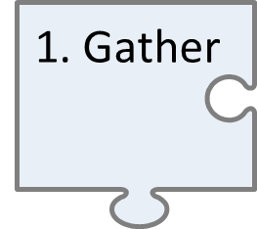
CONFESSION AND FORGIVENESS
C: Christ came into the world and showed us how to live, but we have failed to live by what he taught. We have not loved you with all our heart, soul, mind and strength, we have not done to others as we would have done to ourselves. Shine a light on our hearts, that we might turn from the shadows of our sin and walk in your ways.
Notes:
Image: Five Loaves by Caroline Coolidge Brown. Copyright © Caroline Coolidge Brown. All rights reserved. Used by permission of the artist.

Slide 5
CONFESSION AND FORGIVENESS
L: Jesus came not to condemn the world, but that the world might be saved through him. By his abundant love, all your sins are forgiven, that you might walk in the light of Christ.
C: Amen.
Notes:
Image: Five Loaves by Caroline Coolidge Brown. Copyright © Caroline Coolidge Brown. All rights reserved. Used by permission of the artist.

Slide 6
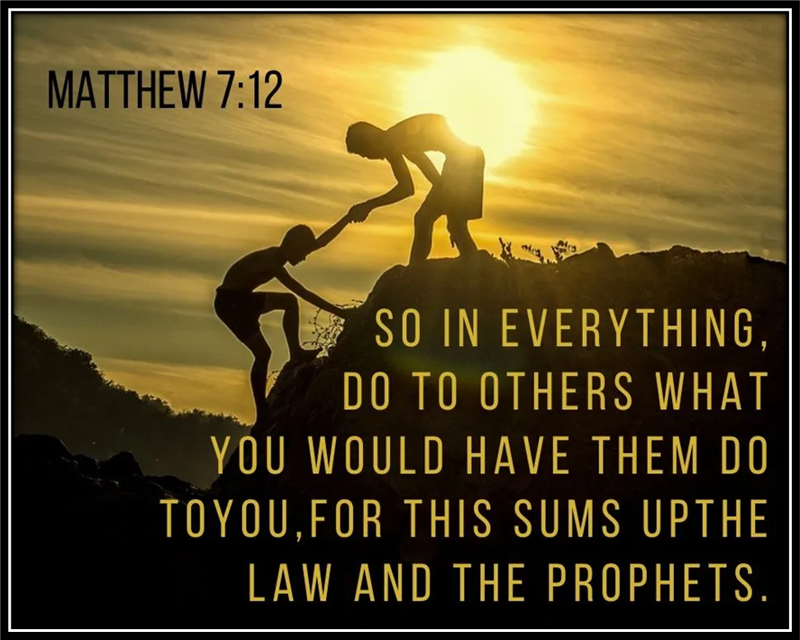
GATHERING SONG
1. Gather
Jesus, The Very Thought Of You
LBW 316
Notes:
Image: Five Loaves by Caroline Coolidge Brown. Copyright © Caroline Coolidge Brown. All rights reserved. Used by permission of the artist.

Slide 7
1. Gather
Jesus, The Very Thought Of You
LBW 316
1 Jesus, the very thought of you
fills us with sweet delight;
but sweeter far your face to view
and rest within your light.
Notes:
Image: Preparing yeast dough. Copyright © tomasworks/iStock/Thinkstock. Used by permission.

Slide 8
1. Gather
Jesus, The Very Thought Of You
LBW 316
2 No voice can sing, no heart can frame,
nor can the mind recall
a sweeter sound than your blest name,
O Savior of us all!
1. Gather
Notes:
Image: Preparing yeast dough. Copyright © tomasworks/iStock/Thinkstock. Used by permission.

Slide 9
1. Gather
Jesus, The Very Thought Of You
LBW 316
3 O Hope of ev'ry contrite soul,
O joy of all the meek,
how kind you are to those who fall!
How good to those who seek!
1. Gather
Notes:
Image: Preparing yeast dough. Copyright © tomasworks/iStock/Thinkstock. Used by permission.

Slide 10
1. Gather
Jesus, The Very Thought Of You
LBW 316
4 O Jesus, be our joy today;
help us to prize your love;
grant us at last to hear you say:
"Come, share my home above."
1. Gather
Notes:
Image: Preparing yeast dough. Copyright © tomasworks/iStock/Thinkstock. Used by permission.

Slide 11
1. Gather
APOSTOLIC GREETING
P: The grace of our Lord Jesus Christ, the love of God, and the communion of the Holy Spirit be with you all.
C: And also with you.
Notes:
Image: Five Loaves by Caroline Coolidge Brown. Copyright © Caroline Coolidge Brown. All rights reserved. Used by permission of the artist.

Slide 12
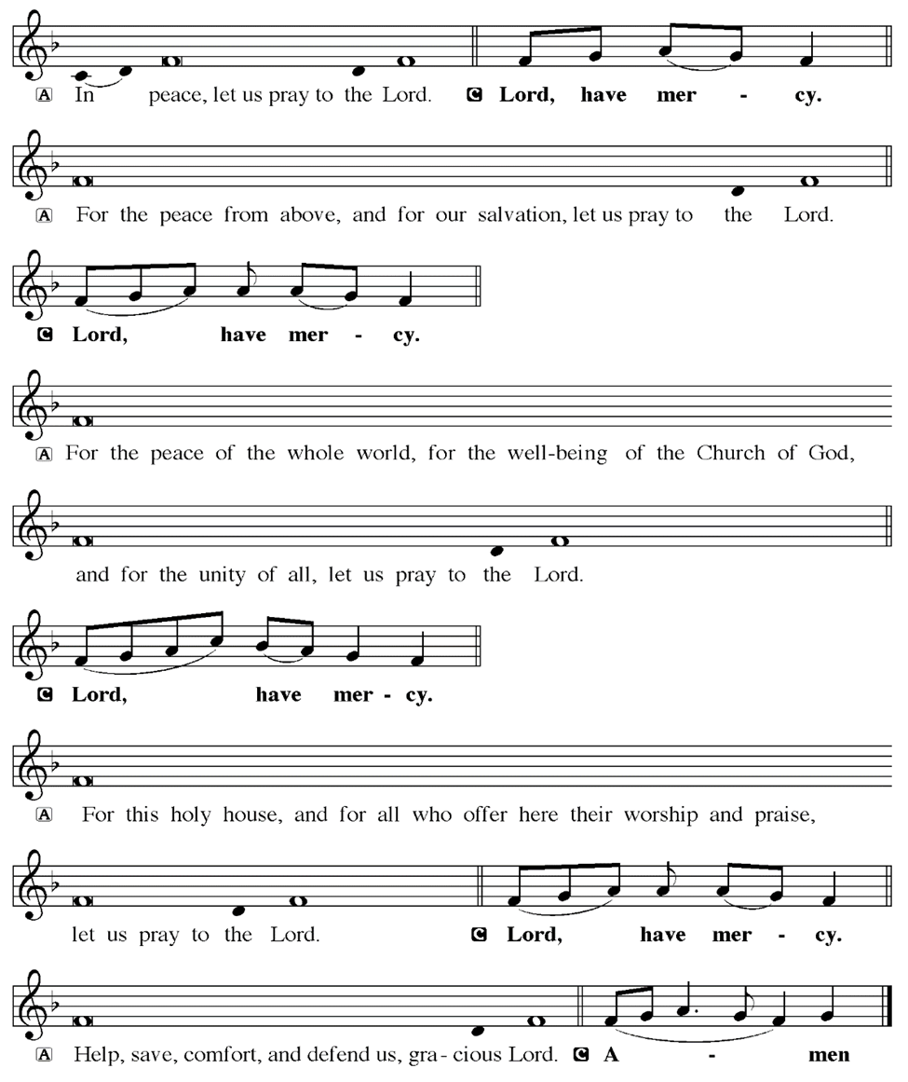
1. Gather
KYRIE
Notes:
Image: Five Loaves by Caroline Coolidge Brown. Copyright © Caroline Coolidge Brown. All rights reserved. Used by permission of the artist.

Slide 13
1. Gather
KYRIE
Notes:
Image: Five Loaves by Caroline Coolidge Brown. Copyright © Caroline Coolidge Brown. All rights reserved. Used by permission of the artist.

Slide 14
1. Gather
KYRIE
Notes:
Image: Five Loaves by Caroline Coolidge Brown. Copyright © Caroline Coolidge Brown. All rights reserved. Used by permission of the artist.

Slide 15
1. Gather
HYMN OF PRAISE
Glory be to God in heaven;
peace, goodwill to all the earth.
Mighty God of all creation,
Father of surpassing worth:
we exalt you, we adore you,
we lift high our thanks and praise.
Saints and angels bow before you; here on earth our songs we raise.
Notes:
Image: Five Loaves by Caroline Coolidge Brown. Copyright © Caroline Coolidge Brown. All rights reserved. Used by permission of the artist.

Slide 16
1. Gather
HYMN OF PRAISE
Glory be to Christ forever,
Lamb of God and Lord of love.
Son of God and gracious Savior, you have come from heav’n above;
on the cross you died to save us; now you reign at God’s right hand.
Hear our prayer; restore, forgive us; in your promise firm we stand.
Notes:
Image: Five Loaves by Caroline Coolidge Brown. Copyright © Caroline Coolidge Brown. All rights reserved. Used by permission of the artist.

Slide 17
1. Gather
HYMN OF PRAISE
Holy One we now acclaim you;
Lord alone, to you we call;
Holy One in faith we name you,
God most high, yet near to all:
Jesus Christ, with God the Spirit,
in the Father’s splendor bright.
For the peace that we inherit,
glory be to God on high!
Notes:
Image: Five Loaves by Caroline Coolidge Brown. Copyright © Caroline Coolidge Brown. All rights reserved. Used by permission of the artist.

Slide 18
1. Gather
PRAYER OF THE DAY
P: The Lord be with you.
C: And also with you.
P: Let us pray… Righteous God, judgment belongs to you alone. Make us aware of our own limitations that we may act with compassion toward those who differ from us. We ask this in Jesus name.
C: Amen.
Notes:
Image: Five Loaves by Caroline Coolidge Brown. Copyright © Caroline Coolidge Brown. All rights reserved. Used by permission of the artist.

Slide 19
Word
Gather
Sending
Meal
Notes:
Image: Preparing yeast dough. Copyright © tomasworks/iStock/Thinkstock. Used by permission.

Slide 20

Word
Notes:
Image: Preparing yeast dough. Copyright © tomasworks/iStock/Thinkstock. Used by permission.

Slide 21

Word
Notes:
Image: Preparing yeast dough. Copyright © tomasworks/iStock/Thinkstock. Used by permission.

Slide 22
Scripture Reading
Word
R: The Holy Gospel according to Saint Matthew, the 7th chapter.
C: Glory to you O’ Lord! (Spoken)
Notes:
Image: Five Loaves by Caroline Coolidge Brown. Copyright © Caroline Coolidge Brown. All rights reserved. Used by permission of the artist.

Slide 23
Word
Matthew 7:1-14, 24-29
“Do not judge, so that you may not be judged. ²For with the judgment you make you will be judged, and the measure you give will be the measure you get. ³Why do you see the speck in your neighbor’s eye, but do not notice the log in your own eye? ⁴Or how can you say to your neighbor, ‘Let me take the speck out of your eye,’ while the log is in your own eye? ⁵You hypocrite,
Notes:
Image: Five Loaves by Caroline Coolidge Brown. Copyright © Caroline Coolidge Brown. All rights reserved. Used by permission of the artist.

Slide 24
Word
Matthew 7:1-14, 24-29
first take the log out of your own eye, and then you will see clearly to take the speck out of your neighbor’s eye. ⁶“Do not give what is holy to dogs; and do not throw your pearls before swine, or they will trample them under foot and turn and maul you.
⁷“Ask, and it will be given you; search, and you will find; knock, and the door will be opened for you. ⁸For everyone
Notes:
Image: Five Loaves by Caroline Coolidge Brown. Copyright © Caroline Coolidge Brown. All rights reserved. Used by permission of the artist.

Slide 25
Word
Matthew 7:1-14, 24-29
who asks receives, and everyone who searches finds, and for everyone who knocks, the door will be opened. ⁹Is there anyone among you who, if your child asks for bread, will give a stone? ¹⁰Or if the child asks for a fish, will give a snake? ¹¹If you then, who are evil, know how to give good gifts to your children, how much more will your Father in heaven give good things
Notes:
Image: Five Loaves by Caroline Coolidge Brown. Copyright © Caroline Coolidge Brown. All rights reserved. Used by permission of the artist.

Slide 26
Word
Matthew 7:1-14, 24-29
to those who ask him!
¹²“In everything do to others as you would have them do to you; for this is the law and the prophets. ¹³“Enter through the narrow gate; for the gate is wide and the road is easy that leads to destruction, and there are many who take it. ¹⁴For the gate is narrow and the road is hard that leads to life, and there are few who find it.
Notes:
Image: Five Loaves by Caroline Coolidge Brown. Copyright © Caroline Coolidge Brown. All rights reserved. Used by permission of the artist.

Slide 27
Word
Matthew 7:1-14, 24-29
²⁴“Everyone then who hears these words of mine and acts on them will be like a wise man who built his house on rock. ²⁵The rain fell, the floods came, and the winds blew and beat on that house, but it did not fall, because it had been founded on rock. ²⁶And everyone who hears these words of mine and does not act on them will be like a foolish man who built his house
Notes:
Image: Five Loaves by Caroline Coolidge Brown. Copyright © Caroline Coolidge Brown. All rights reserved. Used by permission of the artist.

Slide 28
Word
Matthew 7:1-14, 24-29
on sand. ²⁷The rain fell, and the floods came, and the winds blew and beat against that house, and it fell—and great was its fall!” ²⁸Now when Jesus had finished saying these things, the crowds were astounded at his teaching, ²⁹for he taught them as one having authority, and not as their scribes.
Notes:
Image: Five Loaves by Caroline Coolidge Brown. Copyright © Caroline Coolidge Brown. All rights reserved. Used by permission of the artist.

Slide 29
Word
Matthew 7:1-14, 24-29
R: This is the Word of the Lord.
C: Praise to You, O Christ (Spoken)
Notes:
Image: Five Loaves by Caroline Coolidge Brown. Copyright © Caroline Coolidge Brown. All rights reserved. Used by permission of the artist.

Slide 30
Sermon
Word
Notes:
Image: Five Loaves by Caroline Coolidge Brown. Copyright © Caroline Coolidge Brown. All rights reserved. Used by permission of the artist.

Slide 31
Word
APOSTLE’S CREED
C: I believe in God, the Father almighty, creator of heaven and earth.

Slide 32
APOSTLE’S CREED
Word
C: I believe in Jesus Christ, his only Son, our Lord. He was conceived by the power of the Holy Spirit and born of the virgin Mary. He suffered under Pontius Pilate, was crucified, died, and was buried.

Slide 33
APOSTLE’S CREED
Word
C: He descended into hell. On the third day he rose again. He ascended into heaven, and is seated at the right hand of the Father. He will come again to judge the living and the dead.

Slide 34
APOSTLE’S CREED
Word
C: I believe in the Holy Spirit, the holy catholic Church, the communion of saints, the forgiveness of sins, the resurrection of the body, and the life everlasting. Amen.

Slide 35
NICENE CREED
Word
C: We believe in one God, the Father, the Almighty, maker of heaven and earth, of all that is, seen and unseen.

Slide 36
NICENE CREED
Word
C: We believe in one Lord, Jesus Christ, the only Son of God, eternally begotten of the Father, God from God, Light from Light, true God from true God, begotten, not made, of one Being with the Father.

Slide 37
NICENE CREED
Word
C: Through him all things were made. For us and for our salvation he came down from heaven; by the power of the Holy Spirit he became incarnate from the virgin Mary, and was made man. For our sake he was crucified under Pontius Pilate;

Slide 38
NICENE CREED
Word
C: he suffered death and was buried. On the third day he rose again in accordance with the Scriptures; he ascended into heaven and is seated at the right hand of the Father. He will come again in glory to judge the living and the dead, and his kingdom will have no end.

Slide 39
NICENE CREED
Word
C: We believe in the Holy Spirit, the Lord, the giver of life, who proceeds from the Father and the Son. With the Father and the Son he is worshiped and glorified. He has spoken through the prophets. We believe in one holy catholic and apostolic Church.

Slide 40
NICENE CREED
Word
C: We acknowledge one Baptism for the forgiveness of sins. We look for the resurrection of the dead, and the life of the world to come. Amen.

Slide 41
PRAYERS OF INTERCESSION
Word
Each petition will end with the words,
A: Merciful God,
The congregation will respond with:
C: You hear our prayer.

Slide 42
PRAYERS OF INTERCESSION
Word
The prayer concludes…
P: Receive our prayers and hold all for whom we pray in your loving arms, in the name of your son, Jesus Christ.
C: Amen.

Slide 43
OFFERING
OFFERTORY PRAYER
Gather
Word
Sending
Meal
Notes:
Image: Five Loaves by Caroline Coolidge Brown. Copyright © Caroline Coolidge Brown. All rights reserved. Used by permission of the artist.

Slide 44
DIALOGUE
Meal

Slide 45
DIALOGUE
Meal

Slide 46
THE PREFACE
P: It is indeed right and salutary…
… we praise your name and join their unending hymn.
Meal

Slide 47
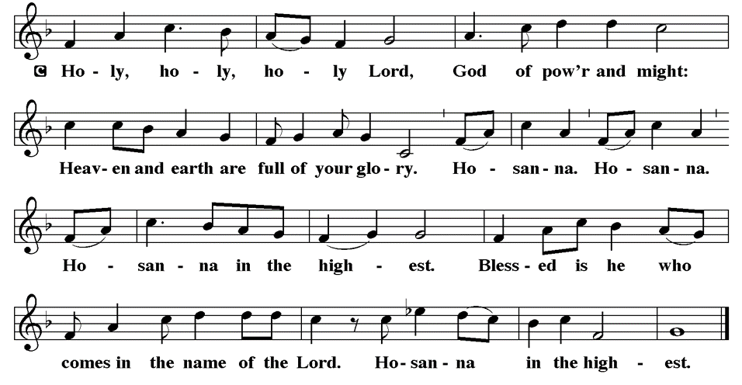
THE SANCTUS
Meal

Slide 48
THE SANCTUS
Meal

Slide 49
EUCHARISTIC PRAYER
P: Blessed are you O Holy God…
…both now and forever.
C: Amen.
THE LORD’S PRAYER
P: United into one through this heavenly food, we pray as Jesus taught…
Meal

Slide 50
THE LORD’S PRAYER
C: Our Father, who art in heaven, hallowed be thy name, thy kingdom come, thy will be done, on earth as it is in heaven.
Meal

Slide 51
THE LORD’S PRAYER
C: Give us this day our daily bread; and forgive us our trespasses, as we forgive those who trespass against us; and lead us not into temptation, but deliver us from evil.
Meal

Slide 52
THE LORD’S PRAYER
C: For thine is the kingdom, and the power, and the glory, forever and ever. Amen.
Meal

Slide 53
INVITATION TO COMMUNION
P: God, our holy parent, gives us only good gifts, that we might grow in spirit. Here at this table we receive the best gift of all, Jesus’ body and blood poured out in love for all creation. Come share in this holy gift.
Meal

Slide 54
COMMUNION DISTRIBUTION
Communion is at the Rail. The bread may be broken for distribution. As the ministers give the bread and wine, they say these words to each communicant:
The body of Christ, given for you.
The blood of Christ, shed for you.
The communicant may say: Amen.
Meal

Slide 55
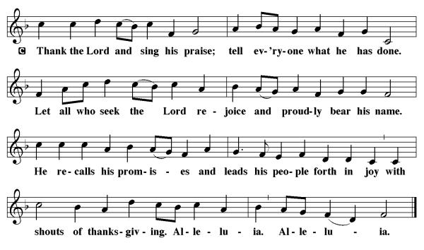
POST COMMUNION CANTACLE
Meal

Slide 56
POST COMMUNION CANTACLE
Meal

Slide 57
POST COMMUNION BLESSING
P: May Christ, the Sun of righteousness, shine upon you and scatter the darkness from before your path. Almighty God, ☩ Father, Son, and Holy Spirit, bless you now and forever.
C: Amen.
Meal

Slide 58
POST COMMUNION PRAYER
P: Let us pray… God our redeemer, you have fed us at this table with gifts of grace, truth, and life. As you have gathered us in joy, send us forth as messengers of your peace. Make us shine with the good news of your glory, born to us in Jesus Christ, our Savior and Lord.
C: Amen
Meal

Slide 59
ANNOUNCEMENYS
Gather
Word
Meal
Sending
Notes:
Image: Five Loaves by Caroline Coolidge Brown. Copyright © Caroline Coolidge Brown. All rights reserved. Used by permission of the artist.

Slide 60
SENDING BLESSING
P: The Lord bless you and keep you. The Lord make His face shine on you and be gracious to you. The Lord look upon you with favor and give you peace…
C: Amen.
☩
Sending

Slide 61

SENDING SONG
“Children of the Heavenly Father”
LBW 474
Sending
Notes:
Image: Five Loaves by Caroline Coolidge Brown. Copyright © Caroline Coolidge Brown. All rights reserved. Used by permission of the artist.

Slide 62
Children of the Heavenly Father LBW 474
1 Children of the heav'nly Father
safely in his bosom gather;
nestling bird nor star in heaven
such a refuge e'er was given.
2 God his own doth tend and nourish,
in his holy courts they flourish.
From all evil things he spares them,
in his mighty arms he bears them.
Sending
Notes:
Image: Preparing yeast dough. Copyright © tomasworks/iStock/Thinkstock. Used by permission.

Slide 63
Children of the Heavenly Father LBW 474
3 Neither life nor death shall ever
from the Lord his children sever;
unto them his grace he showeth,
and their sorrows all he knoweth.
4 Though he giveth or he taketh,
God his children ne'er forsaketh;
his the loving purpose solely
to preserve them pure and holy.
Sending
Notes:
Image: Preparing yeast dough. Copyright © tomasworks/iStock/Thinkstock. Used by permission.

Slide 64
DISMISSAL
P: … depart in Christ’s Love.
C: Seeking, welcoming, and serving all. Amen!
POSTLUDE
By
Roxanne Groff
From sundaysandseasons.com. Copyright © 2023 Augsburg Fortress. All rights reserved. Reprinted by permission under Augsburg Fortress Liturgies Annual License #SAS023830. New Revised Standard Version Bible, Copyright © 1989, Division of Christian Education of the National Council of the Churches of Christ in the United States of America. Used by permission. All rights reserved. Revised Common Lectionary, Copyright © 1992 Consultation on Common Texts, admin Augsburg Fortress. Used by permission.
Sending

