Slide 1
Trinity Evangelical Lutheran Church June 5, 2022
WELCOME!
Notes:
Image: Five Loaves by Caroline Coolidge Brown. Copyright © Caroline Coolidge Brown. All rights reserved. Used by permission of the artist.

Slide 2
Prelude By Roxanne Groff
= Please stand if able
= Please be seated
Office of the Acolyte and Ringing of the Bell
Welcome
Notes:
Image: Five Loaves by Caroline Coolidge Brown. Copyright © Caroline Coolidge Brown. All rights reserved. Used by permission of the artist.

Slide 3
CONFESSION AND FORGIVENESS
All may make the sign of the cross, the sign marked at baptism…
L: We confess our sins before God and one another.
Pause for silence and reflection.
L: God of all…
Notes:
Image: Five Loaves by Caroline Coolidge Brown. Copyright © Caroline Coolidge Brown. All rights reserved. Used by permission of the artist.

Slide 4
CONFESSION AND FORGIVENESS
C: Too often we focus on our differences and fail to lift up the ways that we are united. We judge others for what they cannot do, even while we cannot do it either. We separate ourselves and gather in cliques to the exclusion of many.
Notes:
Image: Five Loaves by Caroline Coolidge Brown. Copyright © Caroline Coolidge Brown. All rights reserved. Used by permission of the artist.

Slide 5
CONFESSION AND FORGIVENESS
C: Forgive us for all the ways we have failed to serve your faithful children. Teach us to do better, for the sake of your son, Jesus Christ. Amen.
Notes:
Image: Five Loaves by Caroline Coolidge Brown. Copyright © Caroline Coolidge Brown. All rights reserved. Used by permission of the artist.

Slide 6
CONFESSION AND FORGIVENESS
L: Our merciful God knows our weakness but doesn’t hold on to it. Receive this day the entire forgiveness of all your sins, and leave this place with a willingness and ability to love all of God’s creation. In Jesus’ name we pray.
C: Amen.
Notes:
Image: Five Loaves by Caroline Coolidge Brown. Copyright © Caroline Coolidge Brown. All rights reserved. Used by permission of the artist.

Slide 7
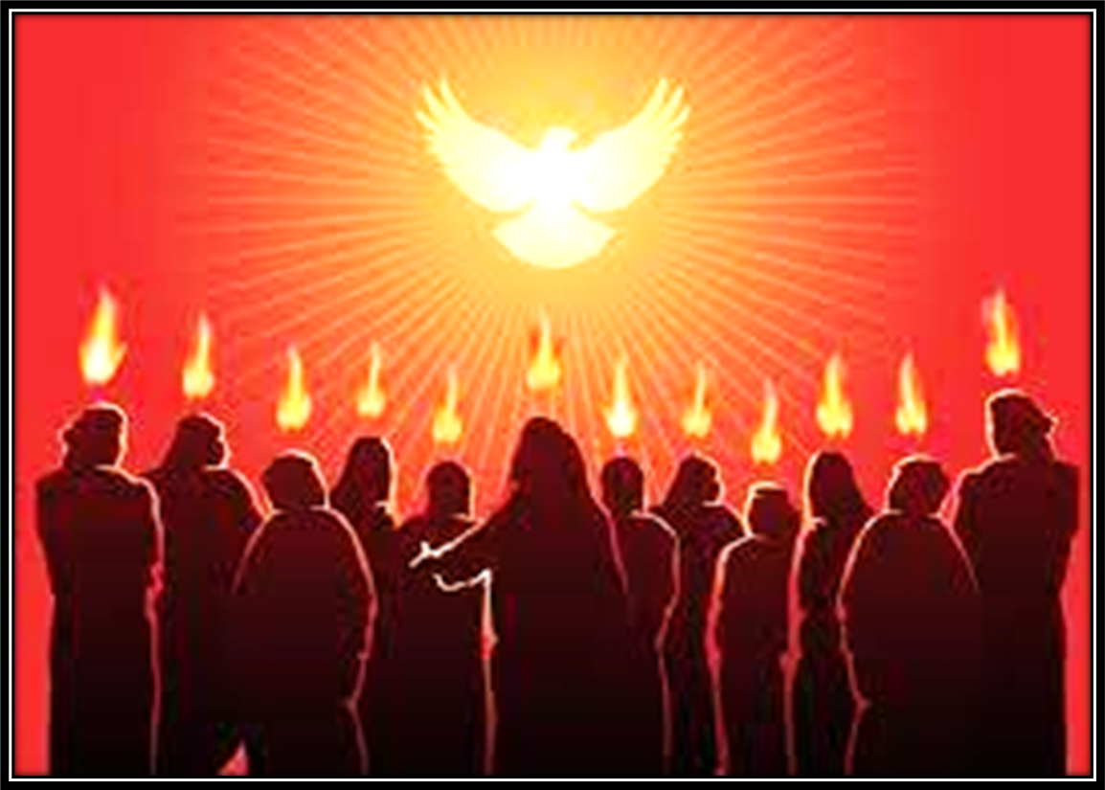
Hymn of Praise
Alleluia! Sing to Jesus
LBW 158
Notes:
Image: Five Loaves by Caroline Coolidge Brown. Copyright © Caroline Coolidge Brown. All rights reserved. Used by permission of the artist.

Slide 8
Alleluia! Sing to Jesus LBW 158
1 Alleluia! Sing to Jesus;
his the scepter, his the throne;
Alleluia! his the triumph,
his the victory alone.
Hark! The songs of peaceful Zion
thunder like a mighty flood:
"Jesus out of ev'ry nation
has redeemed us by his blood."
Notes:
Image: Preparing yeast dough. Copyright © tomasworks/iStock/Thinkstock. Used by permission.

Slide 9
Alleluia! Sing to Jesus LBW 158
2 Alleluia! Not as orphans
are we left in sorrow now;
Alleluia! he is near us;
faith believes, nor questions how.
Though the cloud from sight received him
when the forty days were o'er,
shall our hearts forget his promise:
"I am with you evermore"?
Notes:
Image: Preparing yeast dough. Copyright © tomasworks/iStock/Thinkstock. Used by permission.

Slide 10
Alleluia! Sing to Jesus LBW 158
3 Alleluia! Bread of heaven,
here on earth our food, our stay;
Alleluia! here the sinful
flee to you from day to day.
Intercessor, friend of sinners,
earth's redeemer, hear our plea
where the songs of all the sinless
sweep across the crystal sea.
Notes:
Image: Preparing yeast dough. Copyright © tomasworks/iStock/Thinkstock. Used by permission.

Slide 11
Alleluia! Sing to Jesus LBW 158
4 Alleluia! King eternal,
Lord omnipotent we own;
Alleluia! born of Mary,
earth your footstool, heav'n your throne.
As within the veil you entered,
robed in flesh, our great high priest,
here on earth both priest and victim
in the eucharistic feast.
Notes:
Image: Preparing yeast dough. Copyright © tomasworks/iStock/Thinkstock. Used by permission.

Slide 12
Alleluia! Sing to Jesus LBW 158
5 Alleluia! Sing to Jesus;
his the scepter, his the throne;
Alleluia! his the triumph,
his the victory alone.
Hark! The songs of peaceful Zion
thunder like a mighty flood:
"Jesus out of ev'ry nation
has redeemed us by his blood."
Notes:
Image: Preparing yeast dough. Copyright © tomasworks/iStock/Thinkstock. Used by permission.

Slide 13
APOSTOLIC GREETING
P: The grace of our Lord Jesus Christ, the love of God, and the communion of the Holy Spirit be with you all.
C: And also with you.
Notes:
Image: Five Loaves by Caroline Coolidge Brown. Copyright © Caroline Coolidge Brown. All rights reserved. Used by permission of the artist.

Slide 14
KYRIE
A: In peace let us pray to the Lord.
C: Lord have mercy.
A: For the peace from above, and for our salvation, let us pray to the Lord.
C: Lord have mercy.
A: For the peace of the whole world, for the well being of the Church of God, and for the unity of all, let us pray to the Lord.
C: Lord have mercy.
Notes:
Image: Five Loaves by Caroline Coolidge Brown. Copyright © Caroline Coolidge Brown. All rights reserved. Used by permission of the artist.

Slide 15
KYRIE
A: For this Holy House, and for all who offer here their worship and praise, let us pray to the Lord.
C: Lord have mercy.
A: Help, save, and defend us, gracious Lord.
C: Amen.
Notes:
Image: Five Loaves by Caroline Coolidge Brown. Copyright © Caroline Coolidge Brown. All rights reserved. Used by permission of the artist.

Slide 16
PRAYER OF THE DAY
P: Let us pray… God of all wisdom, Paul knew how to sit with people in their own reality before bringing them along the journey of the story of Christ. Teach us to honor people’s journeys with grace and respect.
C: Amen.
Notes:
Image: Five Loaves by Caroline Coolidge Brown. Copyright © Caroline Coolidge Brown. All rights reserved. Used by permission of the artist.

Slide 17
Notes:
Image: Preparing yeast dough. Copyright © tomasworks/iStock/Thinkstock. Used by permission.

Slide 18
Scripture Reading
R: The Scripture reading is from the Book of Acts, chapter 2 and Philippians, chapter 4.
C: Glory to you O’ Lord! (Spoken)
Notes:
Image: Five Loaves by Caroline Coolidge Brown. Copyright © Caroline Coolidge Brown. All rights reserved. Used by permission of the artist.

Slide 19
Acts 2:1-21 and Philippians 4:4-7
When the day of Pentecost had come, they were all together in one place. ²And suddenly from heaven there came a sound like the rush of a violent wind, and it filled the entire house where they were sitting. ³Divided tongues, as of fire, appeared among them, and a tongue rested on each of them. ⁴All of them were filled with the Holy Spirit and began to speak in
Notes:
Image: Five Loaves by Caroline Coolidge Brown. Copyright © Caroline Coolidge Brown. All rights reserved. Used by permission of the artist.

Slide 20
Acts 2:1-21 and Philippians 4:4-7
other languages, as the Spirit gave them ability.
⁵Now there were devout Jews from every nation under heaven living in Jerusalem. ⁶And at this sound the crowd gathered and was bewildered, because each one heard them speaking in the native language of each. ⁷Amazed and astonished, they asked, “Are not all these who are
Notes:
Image: Five Loaves by Caroline Coolidge Brown. Copyright © Caroline Coolidge Brown. All rights reserved. Used by permission of the artist.

Slide 21
Acts 2:1-21 and Philippians 4:4-7
speaking Galileans? ⁸And how is it that we hear, each of us, in our own native language? ⁹Parthians, Medes, Elamites, and residents of Mesopotamia, Judea and Cappadocia, Pontus and Asia, ¹⁰Phrygia and Pamphylia, Egypt and the parts of Libya belonging to Cyrene, and visitors from Rome, both Jews and proselytes, ¹¹Cretans and Arabs—in
Notes:
Image: Five Loaves by Caroline Coolidge Brown. Copyright © Caroline Coolidge Brown. All rights reserved. Used by permission of the artist.

Slide 22
Acts 2:1-21 and Philippians 4:4-7
our own languages we hear them speaking about God’s deeds of power.” ¹²All were amazed and perplexed, saying to one another, “What does this mean?” ¹³But others sneered and said, “They are filled with new wine.”
¹⁴But Peter, standing with the eleven, raised his voice and addressed them, “Men of Judea and all who live in
Notes:
Image: Five Loaves by Caroline Coolidge Brown. Copyright © Caroline Coolidge Brown. All rights reserved. Used by permission of the artist.

Slide 23
Acts 2:1-21 and Philippians 4:4-7
Jerusalem, let this be known to you, and listen to what I say. ¹⁵Indeed, these are not drunk, as you suppose, for it is only nine o’clock in the morning. ¹⁶No, this is what was spoken through the prophet Joel: ¹⁷‘In the last days it will be, God declares, that I will pour out my Spirit upon all flesh, and your sons and your daughters shall prophesy, and your
Notes:
Image: Five Loaves by Caroline Coolidge Brown. Copyright © Caroline Coolidge Brown. All rights reserved. Used by permission of the artist.

Slide 24
Acts 2:1-21 and Philippians 4:4-7
young men shall see visions, and your old men shall dream dreams. ¹⁸Even upon my slaves, both men and women, in those days I will pour out my Spirit; and they shall prophesy. ¹⁹And I will show portents in the heaven above and signs on the earth below, blood, and fire, and smoky mist. ²⁰The sun shall be turned to darkness and the moon to blood, before the coming of
Notes:
Image: Five Loaves by Caroline Coolidge Brown. Copyright © Caroline Coolidge Brown. All rights reserved. Used by permission of the artist.

Slide 25
Acts 2:1-21 and Philippians 4:4-7
the Lord’s great and glorious day. ²¹Then everyone who calls on the name of the Lord shall be saved.”
Philippians, chapter 4
⁴Rejoice in the Lord always; again I will say, Rejoice. ⁵Let your gentleness be known to everyone. The Lord is near. ⁶Do not worry about anything, but in everything by prayer and
Notes:
Image: Five Loaves by Caroline Coolidge Brown. Copyright © Caroline Coolidge Brown. All rights reserved. Used by permission of the artist.

Slide 26
Acts 2:1-21 and Philippians 4:4-7
supplication with thanksgiving let your requests be made known to God. ⁷And the peace of God, which surpasses all understanding, will guard your hearts and your minds in Christ Jesus.
Notes:
Image: Five Loaves by Caroline Coolidge Brown. Copyright © Caroline Coolidge Brown. All rights reserved. Used by permission of the artist.

Slide 27
Acts 2:1-21 and Philippians 4:4-7
P: This is the Word of the Lord.
C: Praise to You, O Christ (Spoken)
Notes:
Image: Five Loaves by Caroline Coolidge Brown. Copyright © Caroline Coolidge Brown. All rights reserved. Used by permission of the artist.

Slide 28
Sermon
Notes:
Image: Five Loaves by Caroline Coolidge Brown. Copyright © Caroline Coolidge Brown. All rights reserved. Used by permission of the artist.

Slide 29
NICENE CREED
C: We believe in one God, the Father, the Almighty, maker of heaven and earth, of all that is, seen and unseen.

Slide 30
NICENE CREED
C: We believe in one Lord, Jesus Christ, the only Son of God, eternally begotten of the Father, God from God, Light from Light, true God from true God, begotten, not made, of one Being with the Father.

Slide 31
NICENE CREED
C: Through him all things were made. For us and for our salvation he came down from heaven; by the power of the Holy Spirit he became incarnate from the virgin Mary, and was made man. For our sake he was crucified under Pontius Pilate;

Slide 32
NICENE CREED
C: he suffered death and was buried. On the third day he rose again in accordance with the Scriptures; he ascended into heaven and is seated at the right hand of the Father. He will come again in glory to judge the living and the dead, and his kingdom will have no end.

Slide 33
NICENE CREED
C: We believe in the Holy Spirit, the Lord, the giver of life, who proceeds from the Father and the Son. With the Father and the Son he is worshiped and glorified. He has spoken through the prophets. We believe in one holy catholic and apostolic Church.

Slide 34
NICENE CREED
C: We acknowledge one Baptism for the forgiveness of sins. We look for the resurrection of the dead, and the life of the world to come. Amen.

Slide 35
PRAYERS OF INTERCESSION
Each petition will end with the words,
A: Transforming Spirit,
The congregation will respond with:
C: hear our prayer.

Slide 36
PRAYERS OF INTERCESSION
The prayer concludes…
P: Into your hands we now commend all these things for which we pray, as we know with confidence that we can trust in you, Lord God, lover of our souls.
C: Amen.

Slide 37
OFFERING PRAYER
Notes:
Image: Five Loaves by Caroline Coolidge Brown. Copyright © Caroline Coolidge Brown. All rights reserved. Used by permission of the artist.

Slide 38
THE GREAT THANKSGIVING
Communion by pre-packaged Communion Cups. All the Baptized are welcome to celebrate this Holy Meal.

Slide 39
DIALOGUE
P: The Lord be with you.
C: And also with you.
P: Lift up your hearts.
C: We lift them to the Lord.
P: Let us give thanks to the Lord our God.
C: It is right to give him thanks and praise.

Slide 40
Preface
P: It is indeed right…
…join their unending hymn

Slide 41
Sanctus
C: Holy, holy, holy Lord, God of power and might: Heaven and earth are full of your glory. Hosanna. Hosanna. Hosanna in the highest. Blessed is he who comes in the name of the Lord. Hosanna in the highest.

Slide 42
Eucharistic Prayer
P: Holy God, Breath of life…
…in your holy Church, both now and forever.
C: Amen

Slide 43
THE LORD’S PRAYER
C: Our Father, who art in heaven, hallowed be thy name, thy kingdom come, thy will be done, on earth as it is in heaven. Give us this day our daily bread; and forgive us our trespasses, as we forgive those who trespass against us; and lead us not into temptation, but deliver us from evil.

Slide 44
THE LORD’S PRAYER
C: For thine is the kingdom, and the power, and the glory, forever and ever. Amen.

Slide 45
INVITATION TO COMMUNION
P: With the church that gathers in every corner of the world, we share this holy meal together. Though our tables are many, our host is the same—Jesus Christ, our Lord. As you call your children for dinner, gather us now to be fed, nourished, and blessed, so that we may be inspired to continue your work. Come, this global table is prepared for you.

Slide 46
POST COMMUNION BLESSING
P: May this Body and Blood of our Lord and Savior, Jesus Christ, strengthen, keep, and unite us, now and forever.
C: Amen.

Slide 47
POST COMMUNION PRAYER
P: Let us pray… We give you thanks, gracious God, for we have feasted on the abundance of your house. Send us to bring good news and to proclaim your favor to all, strengthened with the richness of your grace in your Son, Jesus Christ.
C: Amen

Slide 48
ANNOUNCEMENTS
Notes:
Image: Five Loaves by Caroline Coolidge Brown. Copyright © Caroline Coolidge Brown. All rights reserved. Used by permission of the artist.

Slide 49
SENDING BLESSING
P: God, the Author of life, Christ, the living Cornerstone, and the life-giving Spirit of adoption, bless you now and forever.
C: Amen.

Slide 50
SENDING SONG
“I’ve Got the Joy, Joy, Joy” TFF 257
Notes:
Image: Five Loaves by Caroline Coolidge Brown. Copyright © Caroline Coolidge Brown. All rights reserved. Used by permission of the artist.

Slide 51
“I’ve Got the Joy, Joy, Joy” TFF 257
1 I’ve got the joy, joy, joy, joy,
down in my heart, down in my heart, down in my heart;
I’ve got the joy, joy, joy, joy,
down in my heart, down in my heart to stay.
Notes:
Image: Five Loaves by Caroline Coolidge Brown. Copyright © Caroline Coolidge Brown. All rights reserved. Used by permission of the artist.

Slide 52
“I’ve Got the Joy, Joy, Joy” TFF 257
2 I’ve got the peace that passes understanding,
down in my heart, down in my heart, down in my heart;
I’ve got the peace that passes understanding,
down in my heart, down in my heart to stay.
Notes:
Image: Five Loaves by Caroline Coolidge Brown. Copyright © Caroline Coolidge Brown. All rights reserved. Used by permission of the artist.

Slide 53
“I’ve Got the Joy, Joy, Joy” TFF 257
3 I’ve got the love of Jesus, love of Jesus,
down in my heart, down in my heart, down in my heart;
I’ve got the love of Jesus, love of Jesus,
down in my heart, down in my heart to stay.
Notes:
Image: Five Loaves by Caroline Coolidge Brown. Copyright © Caroline Coolidge Brown. All rights reserved. Used by permission of the artist.

Slide 54
DISMISSAL
P: … depart in Christ’s Love.
C: Seeking, welcoming, and serving all. Amen!
POSTLUDE
By
By Roxanne Groff
From sundaysandseasons.com. Copyright © 2022 Augsburg Fortress. All rights reserved. Reprinted by permission under Augsburg Fortress Liturgies Annual License #SAS023830. New Revised Standard Version Bible, Copyright © 1989, Division of Christian Education of the National Council of the Churches of Christ in the United States of America. Used by permission. All rights reserved. Revised Common Lectionary, Copyright © 1992 Consultation on Common Texts, admin Augsburg Fortress. Used by permission.

