Slide 1
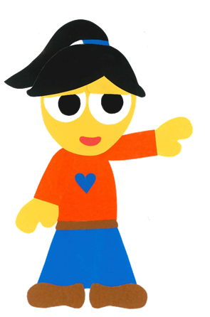
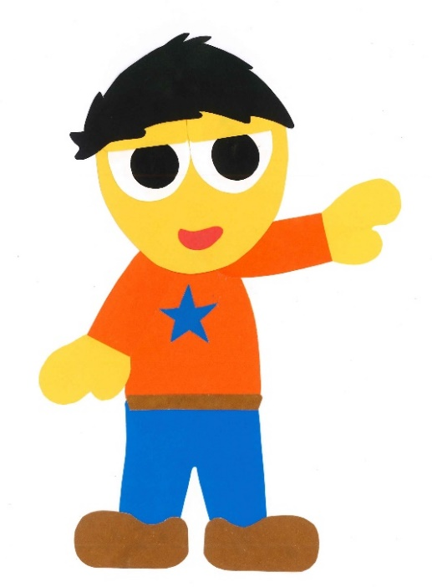
WE
CAN
READ
Teacher Donald

Slide 2
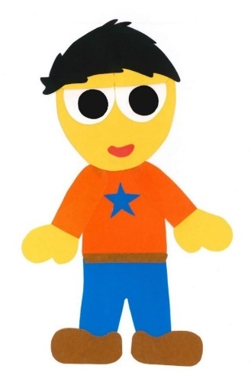
Let’s Go To
The Park!
WE CAN READ
By: Donald Joyce

Slide 3
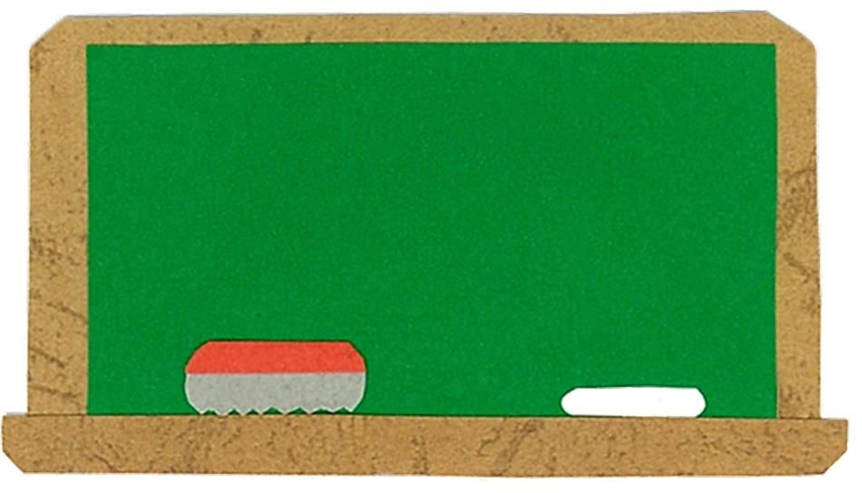
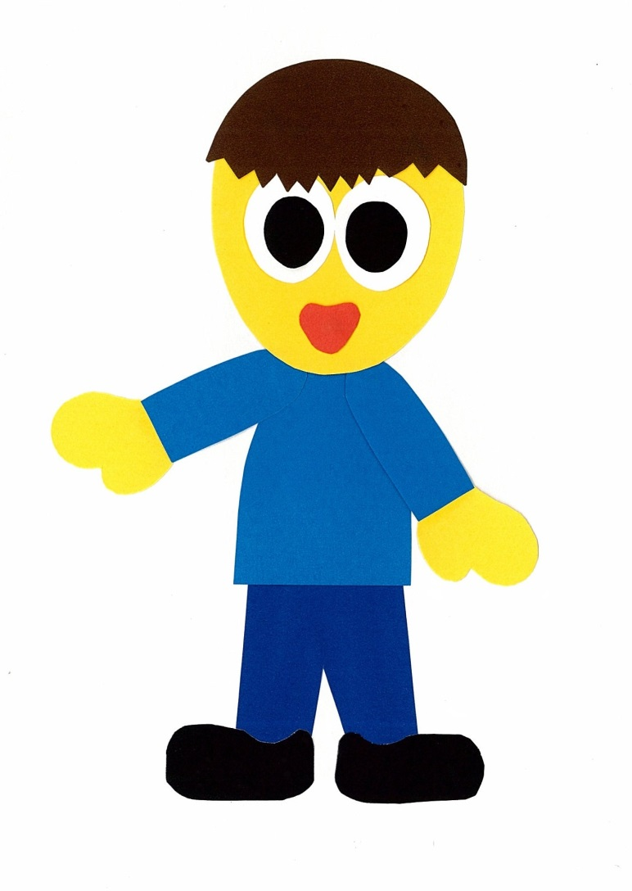
Let’s
Talk!

Slide 4
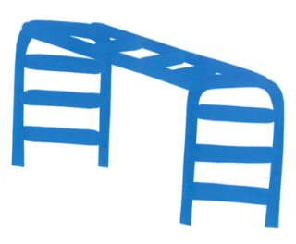
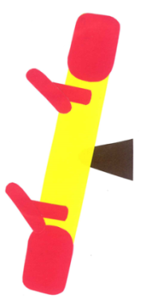
What can you see
at a park?
I can see ___.

Slide 5
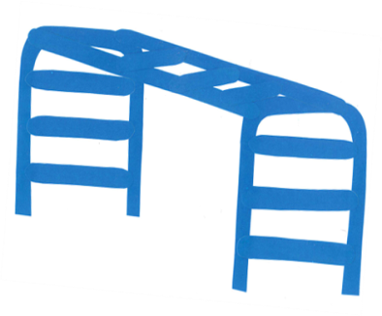
What do you
like to play on?
I like the ___.
Me too!

Slide 6
Let’s
Learn!

Slide 7
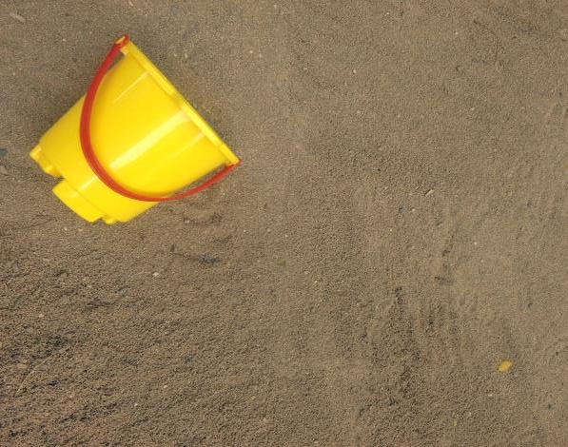
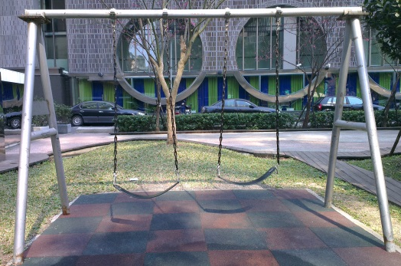
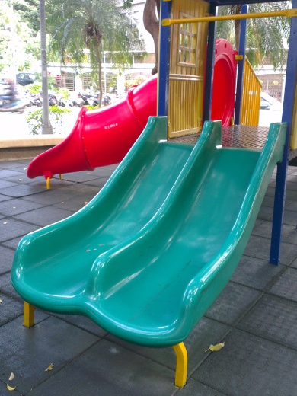
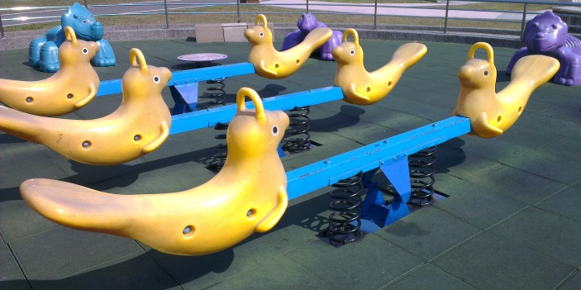
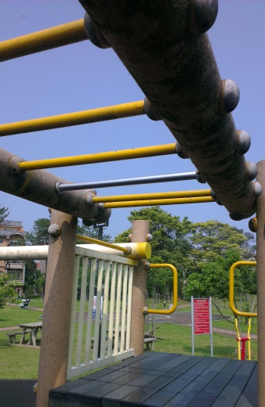
swings
roundabout
sandbox
slide
seesaw
monkey bars

Slide 8
Let’s
Read!

Slide 9
Let’s Go To
The Park!
WE CAN READ
By: Donald Joyce

Slide 10
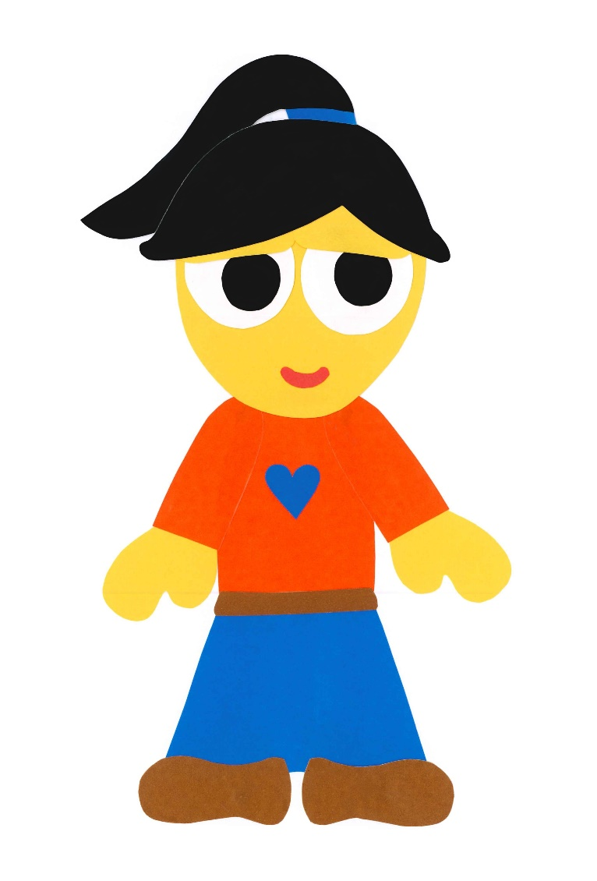
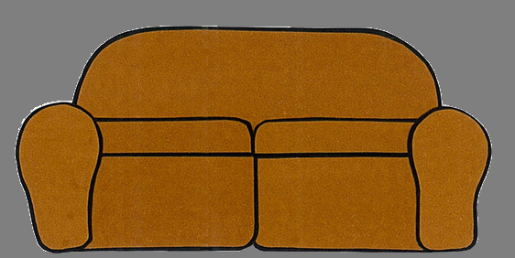
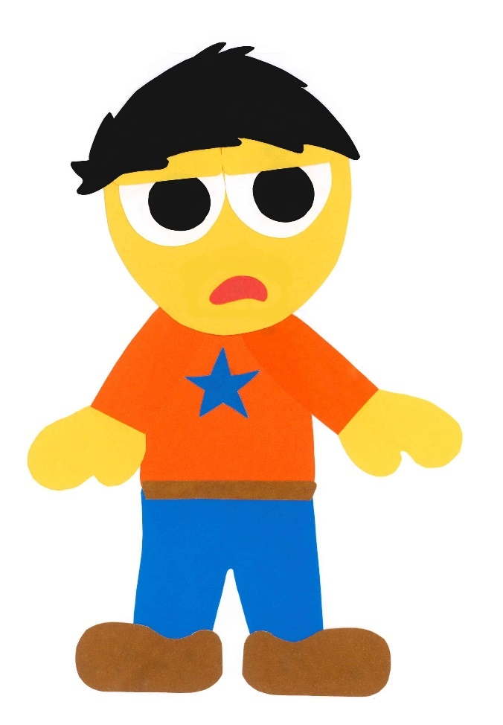
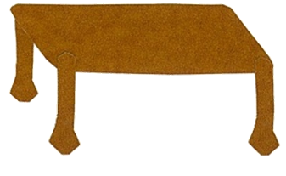
I am bored.

Slide 11
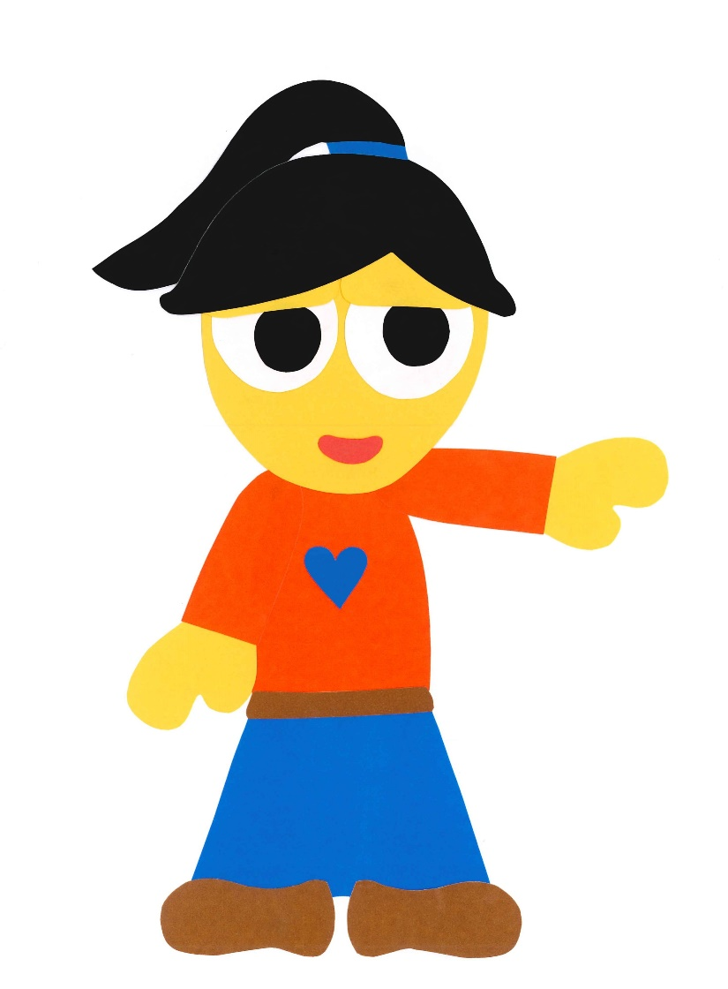
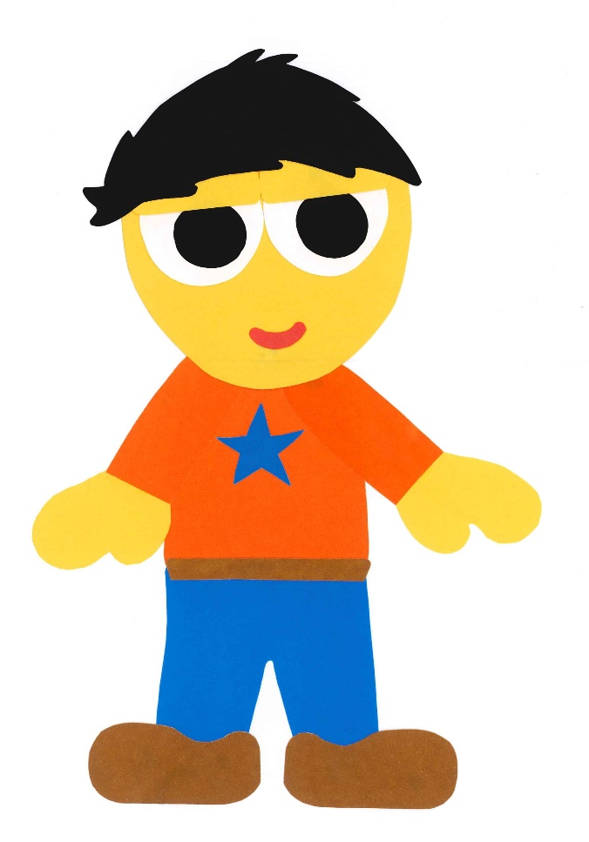
Let’s go to the park.

Slide 12
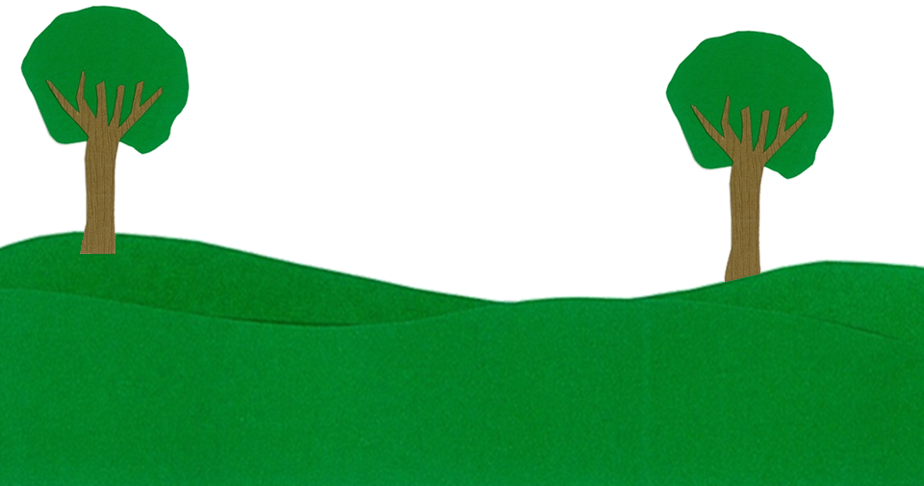
Let’s go down
the slide.

Slide 13
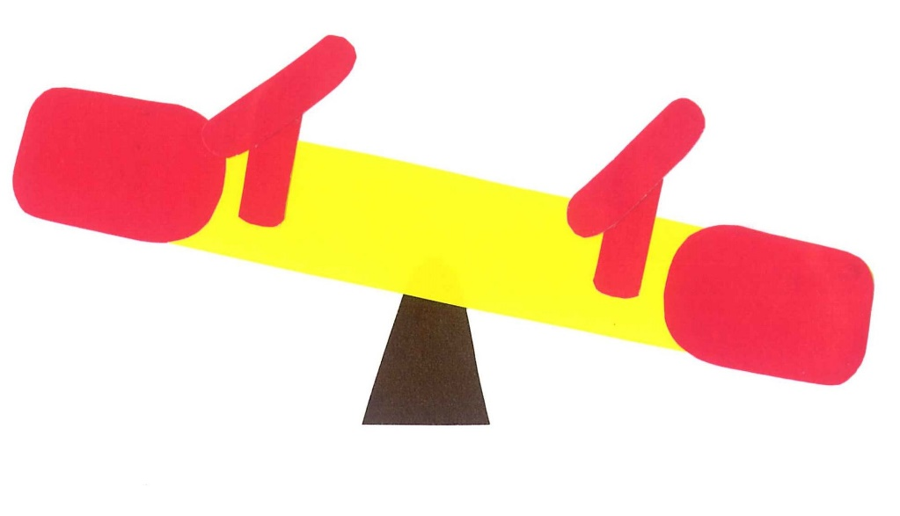
Let’s go up and down on the seesaw.

Slide 14
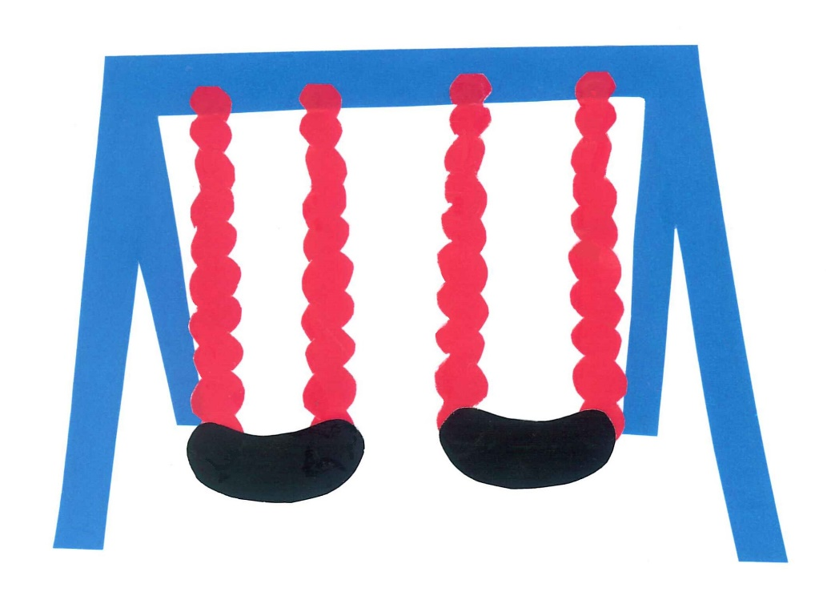
Let’s swing on
the swings.

Slide 15
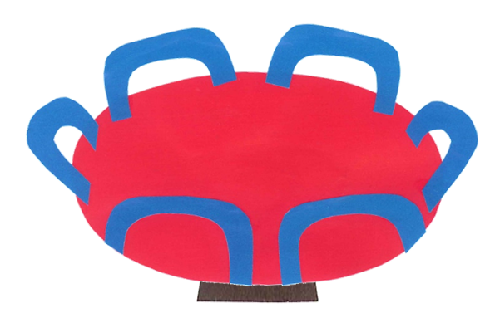
Let’s go on
the merry-go-round.

Slide 16
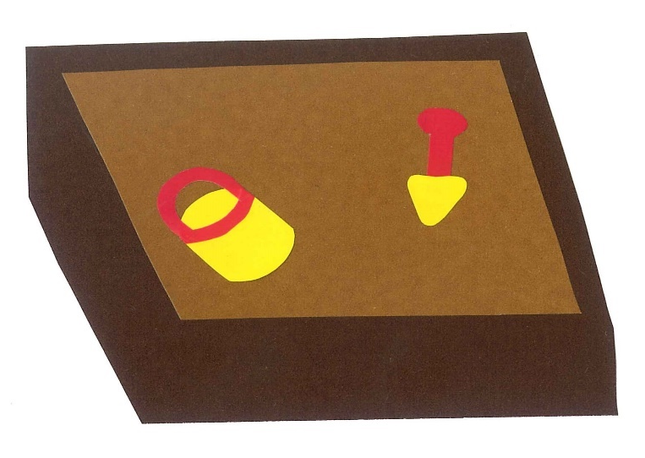
Let’s play in
the sandbox.

Slide 17
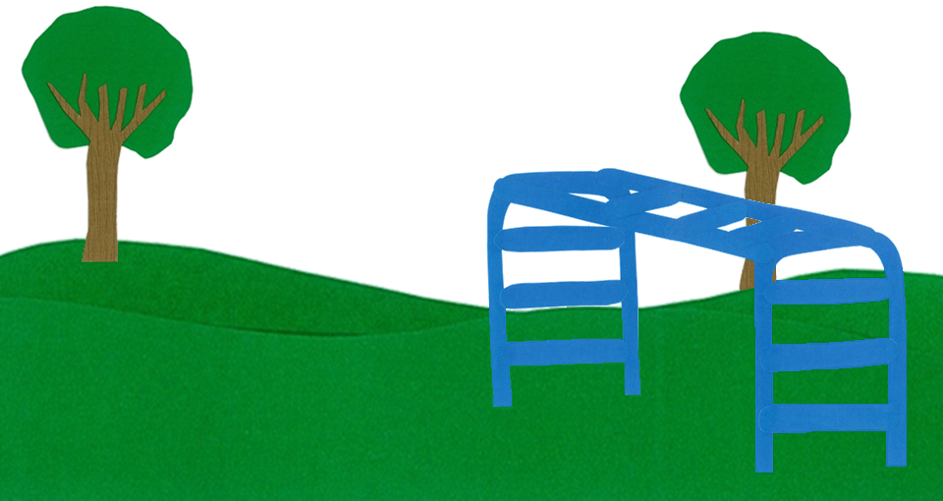
Let’s climb on
the monkey bars.

Slide 18
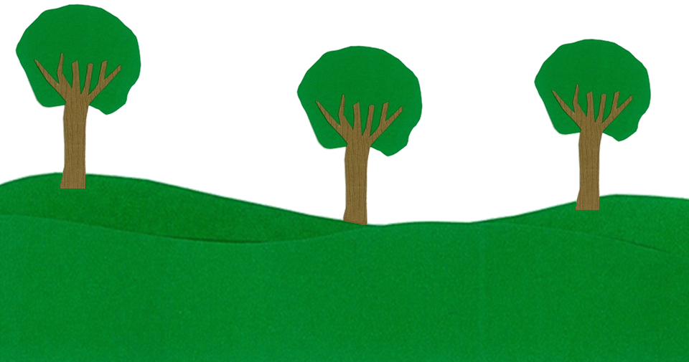
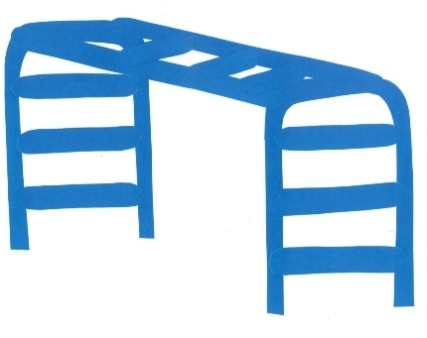
I am bored.

Slide 19
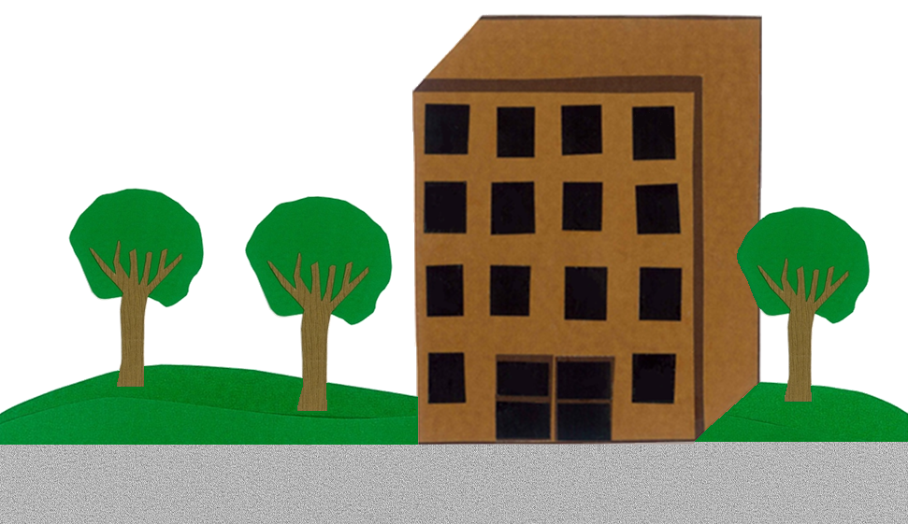
Let’s go home.

Slide 20
Let’s Go To
The Park!
WE CAN READ
By: Donald Joyce

Slide 21
Let’s
Review!

Slide 22
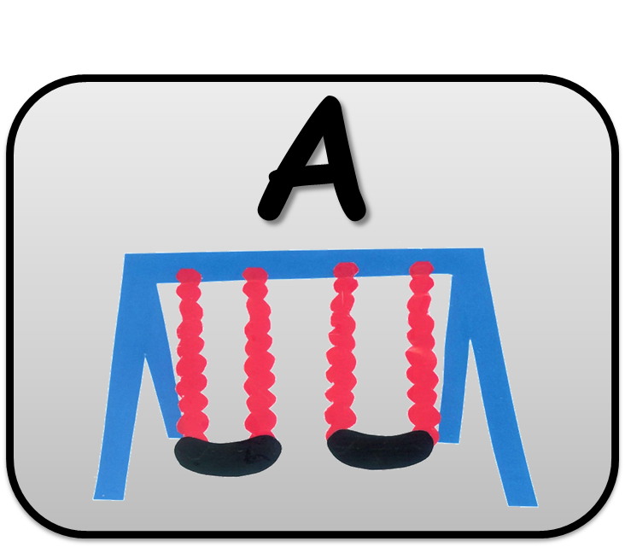
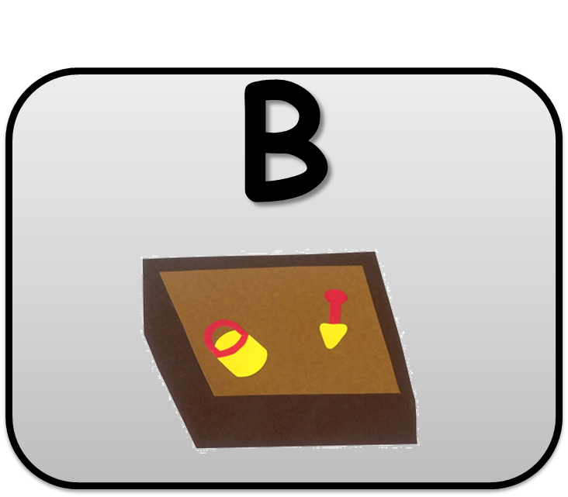
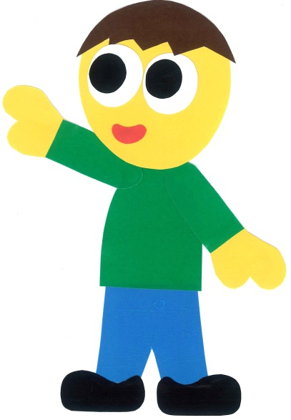
Let’s go in the sandbox.

Slide 23
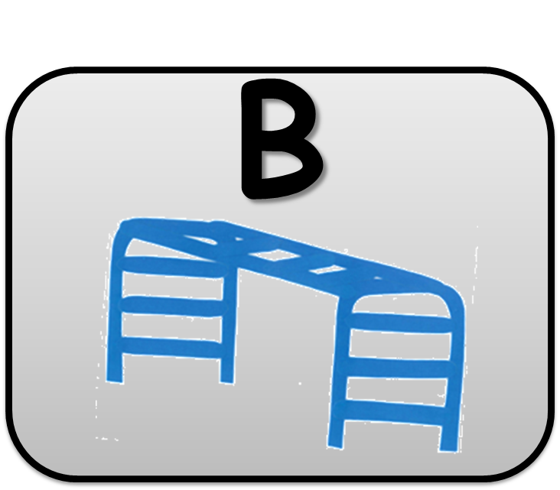
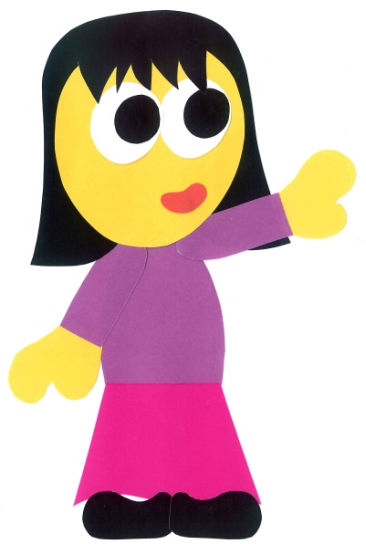
Let’s go on the monkey bars.

Slide 24
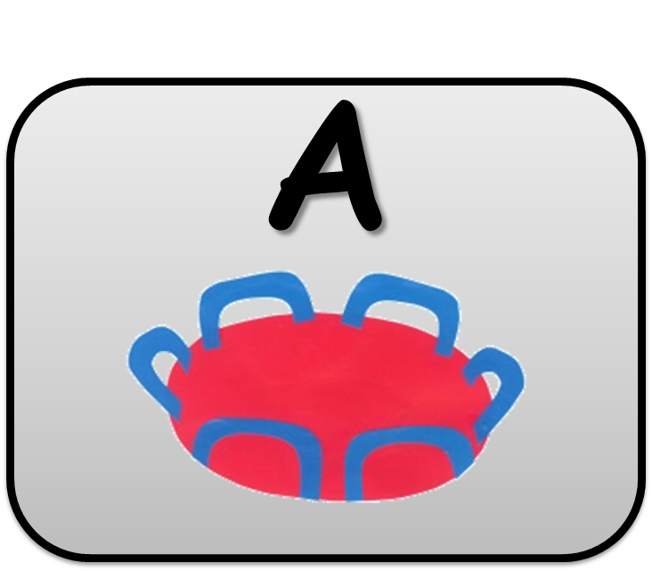
Let’s go
on the roundabout.

Slide 25
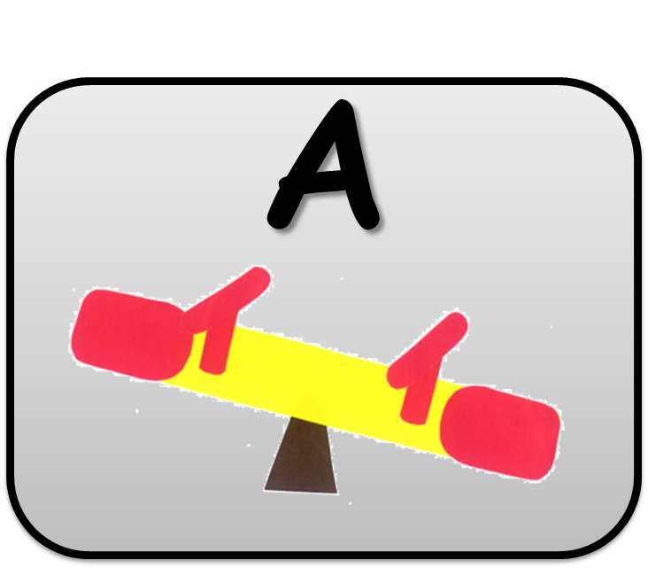
Let’s go up and down on the seesaw.

Slide 26
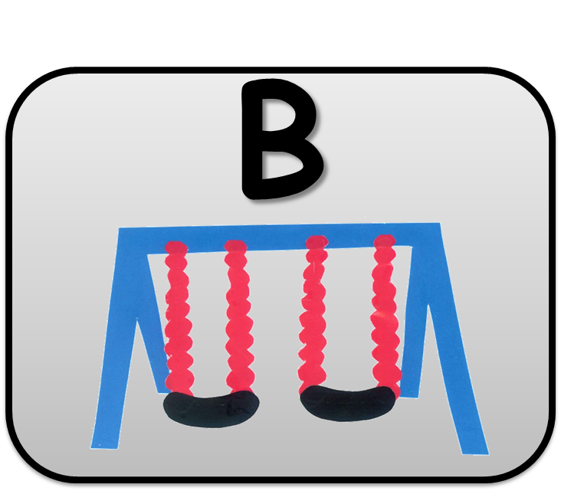
Let’s go on the swings.

Slide 27
Let’s go down the slide.

Slide 28
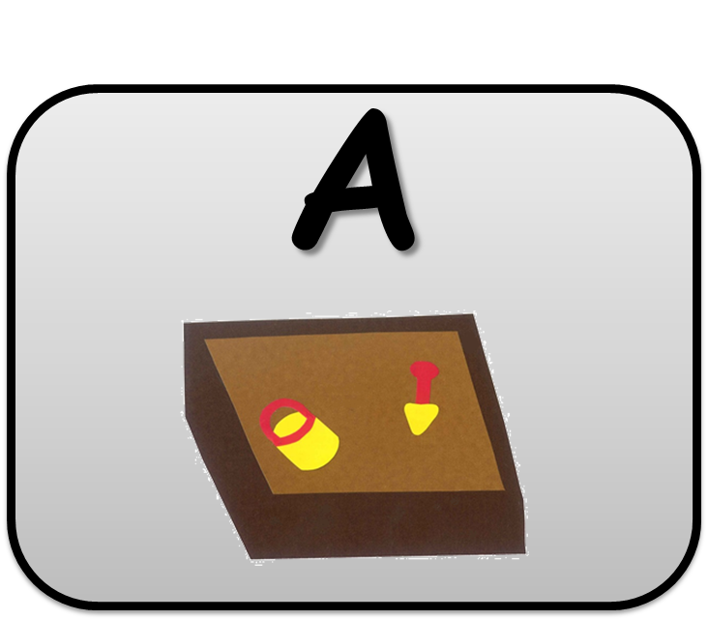
Let’s go home.

Slide 29
Let’s
Connect!

Slide 30
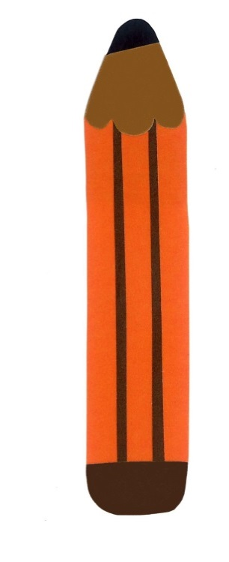
Get a pencil and paper!

Slide 31
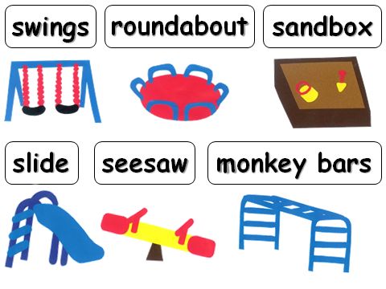
Draw your own park.

Slide 32
WE
CAN
READ
Donald Joyce
www.teacherdonald.com

