Slide 1
Trinity Evangelical Lutheran Church Announcements for March 20, 2022
This week’s scripture focus:
John 18:12-27
Notes:
Image: Preparing yeast dough. Copyright © tomasworks/iStock/Thinkstock. Used by permission.

Slide 2
Body, Mind, Spirit
BODY: Give yourself a facial
MIND: Allow yourself quiet time
SPIRIT: View the sunrise

Slide 3
Our Office Secretary Is Sharon Fourman
Church Office Schedule
Tuesday-Thursday
8:00 am – 12:00 pm
Church Office: 937 692-5670
Email: secretary@pitsburgtlc.org

Slide 4
The Trinity Trumpet
A Monthly Newsletter
Published by Trinity Lutheran Church,
Pitsburg, OH
We’re looking for stories and pictures of Trinity people in action!
Submit to Secretary, Sharon Fourman at secretary@pitsburgtlc.org
Articles and Info due on or about the 15th of each month

Slide 5
We’re Online!
www.pitsburgtlc.org
Sermons and announcements are posted weekly
Trinity Trumpet is Posted here too!
The ‘Official’ Trinity Calendar is available for you to see!
Pictures, Videos and more!
Also, like us on FaceBook at
facebook.com/pitsburgtrinitylutheran.church

Slide 6
We’re Online!
www.pitsburgtlc.org
We now have our own QR Code!
Scan this code with your Smartphone and you will connect to all our Online media (Facebook, YouTube, and our own Church Website)

Slide 7
Online Giving
www.pitsburgtlc.org
Click the “Give to Trinity” Button
Stay current in your giving even when you can’t make it to Worship!
Separate Giving Categories for:
General Treasury
Building Fund
Annual Christmas Auction
Donald K. Lucas Memorial Fund

Slide 8
Church
Council
Trinity Church Council
Next Meeting:
Wednesday, April 20, 2022
@ 7:00 pm

Slide 9
Trinity’s Team Meetings
Next Meeting
Wed, Sept 15th
@ 6:00 pm
On the Agenda – Preparing the proposed 2022 budget

Slide 10
Please Pass the Pew Pads
(We now track Communion on the Pads)

Slide 11
Worship Team
Next Meeting:
TBD

Slide 12
Mutual Ministry Team
Julie Kossler
Joe Netzley
Peggy Didier
Please see one of them with your comments and suggestions
Next Meeting - TBD

Slide 13
Christian Education
Sunday School Teachers and Helpers Needed!!!
New, easy to use curriculum
Can you give one Sunday per month for our Children?

Slide 14
Trinity’s Team Meetings
Christian Education Team
Next Meeting
Tuesday, September 14, 2021
@ 3:30 pm

Slide 15
Trinity Trumpet
Your Trinity Trumpet Newsletter for April is available!
Please take your copy before you leave today!

Slide 16
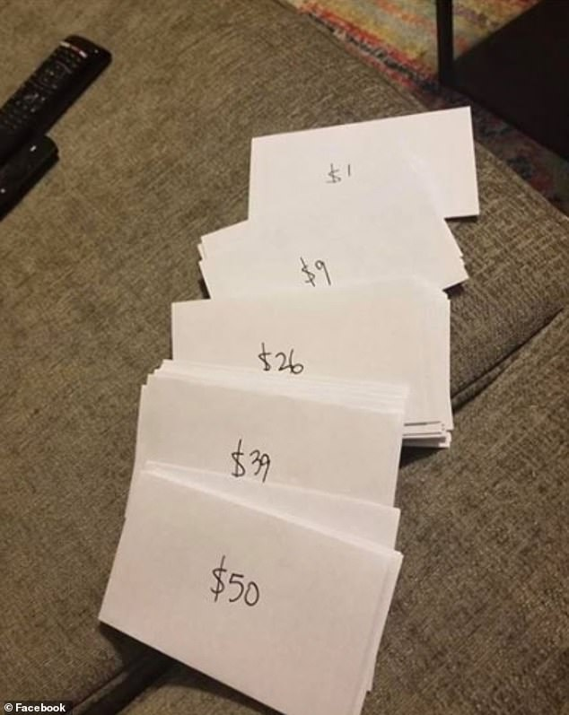
Pick A Number - Fund Raiser
Fund Raiser to help a Trinity Member meet Dental Expenses
Total dental cost $10,000
99 Numbered Envelopes
If all envelopes are taken and returned we will raise $5,050
Envelopes are hanging from the widows in the Narthex

Slide 17
Choice FISH Pantry
Please join us every Friday @ 3:30 pm
400 Markwith Dr, Greenville OH
Most Needed Items
Kidney Beans
Canned Peas
Hamburger Helper
Pork & Beans
Canned Mixed Veggies
Large Cans of Soups
Applesauce
Boxed Meals
(i.e. Rice a Roni)

Slide 18
Next Meeting:
Thursday, April 6, 2022
@ 6:30 pm

Slide 19
Prayers and Squares
Quilting Ministry
March 22, 2022 @ 10:00 am
April 14, 2022 @ 10:00 am

Slide 20
Ladies and Gents Luncheon
Thursday, April 21, 2022
Where:
For Reservations:
See Linda Baker or call her at (937) 547-0975

Slide 21
Confirmation Classes
All 7th and 8th Grade Students
Meets on 2nd and 4th Wednesdays
Time – 6:30 – 8:30 pm

Slide 22
Confirmation Program
Weekly Worship attendance is required (In person or via FaceBook)
Worship Notes may be emailed to pastor@pitsburgtlc.org or placed in Pr Mel’s mailbox outside the Church Office
Confirmands are encouraged to take turns as Acolyte

Slide 23
Please sign up for Acolyte Duty on the chart by the Church Office!
Confirmation Students are Highly Encouraged to perform Acolyte duty…
Please sign up today!

Slide 24
WELCA PROJECT JANUARY thru MARCH
Personal Care Kits
1 Adult Tooth Brush
2 Bath Size Bars of Soap
1 Wide Tooth Comb
1 Bath Towel
(Dark in color & no larger than 52X27)
1 Nail Clippers (w/ optional nail file)

Slide 25
Commemorate special days like Anniversaries, Birthdays, Baptisms and more…
Please sign up for Altar Flowers on the chart by the Church Office or see Shirley Rhoades

Slide 26
Holy Communion – Today!
Communion Elements are prepackaged by TruVine, a division of Concordia Church Supply Co.
Safe for all humans (Especially sinners)
Holy Communion Schedule will resume our Pre-Covid Schedule
First and Third Sundays each month
All White and Red Sundays of the Church Year

Slide 27
Lenten Mid-Week Reflections
The Things of God
Reflections based on items mentioned during the Passion of Christ
The Thorns
The Sponge
The Coins
The Sign on the Cross
The Cup
These Reflections will be pre-recorded and released on our Facebook page on Wednesday each week during Lent

Slide 28
Maundy Thursday – April 14th
Seder Meal @ 6 pm includes Holy Communion and stripping of the Altar
Good Friday – April 15th
Worship Service @ 7 pm “A Service of Tenebrae” (Shadows)
Easter Morning – April 17th
8 am – Early Service
9:15 am Easter Breakfast
10:00 am Easter Prize Hunt
10:30 am Late Service

