Slide 1
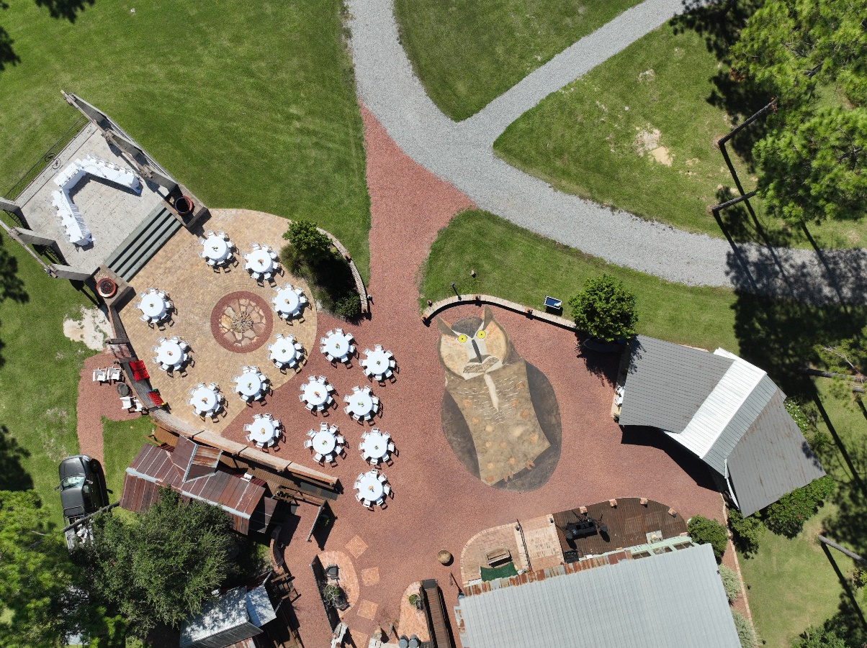
Courtyard Set Up

Slide 2
Stage
30’ wide x 24’ deep
Pavered Area of Courtyard
51’ wide x 25’ deep
(Note: 13’ foot water fountain in the middle- water feature is NOT working)
25’
Covered Patio
(back: 42’ wide; front 32’ wide x 20’ deep)
8’
Owl Dance Floor
20’ wide x 40’ tall
13’
Rocky Area
34’ wide x 10’ deep

Slide 3
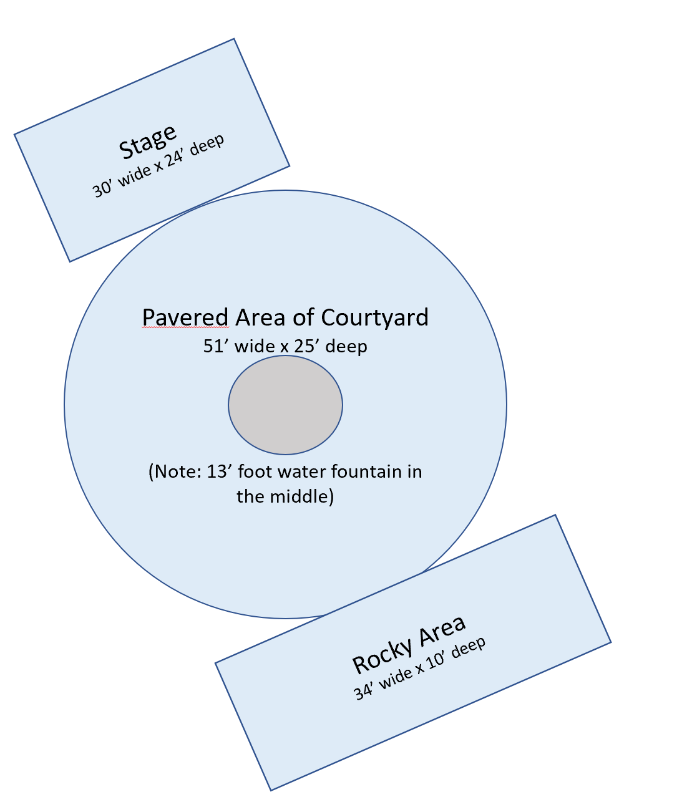
6’
8’
8’
8’
10 round tables is the max that can fit comfortably on the circle area
8’
8
8
60” Table
10’ Needed
Seats 8
8
8
8
Cocktail table 32”
8
8
8
8
8
8
8’ Table
13’ Needed
Seats 8
8
8
6’ Table
11’ Needed
Seats 6
8
60” Table
10’ Needed
Seats 8
8
12 round tables is the max that can fit comfortably on the attached rocky area
8
8

Slide 4
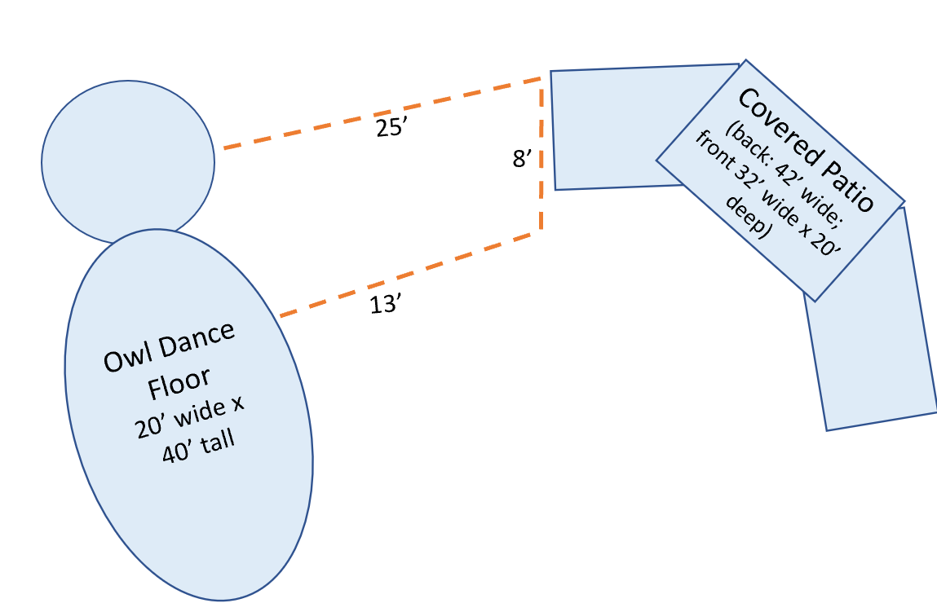
7 round tables is the max that can fit comfortably on the attached rocky area (I have put 10 under there before, but it is tight)
Bar
8
8
8
8
8
Owl Dance Floor
20’ wide x 40’ tall
8
8
8
8
8
8
8

Slide 5
Granite Bar
8’
8’
8
8’
8’
8
8’
Owl Dance Floor
20’ wide x 40’ tall
48” Seats 4
8
8’
8
8’
8’
8
Raised Stage
(many people put their DJ here)

Slide 6
8
8
8
6’
8
10 round tables is the max that can fit comfortably on the circle area
8
8
60” Table
10’ Needed
Seats 8
8
8
8
8
Cocktail table 32”
48” Seats 4
8
8
8
8
8’ Table
13’ Needed
Seats 8
8
8
8
6’ Table
11’ Needed
Seats 6
8
60” Table
10’ Needed
Seats 8
8
12 round tables is the max that can fit comfortably on the attached rocky area
8
8

Slide 7
6’
8’
8’
8’
8’
8
60” Table
10’ Needed
Seats 8
8
8’
8
8’
Cocktail table 32”
8
8’
8’
8
8
8
8’ Table
13’ Needed
Seats 8
8’
8
6’ Table
11’ Needed
Seats 6
8’
60” Table
10’ Needed
Seats 8
8
8’
8

