Slide 1
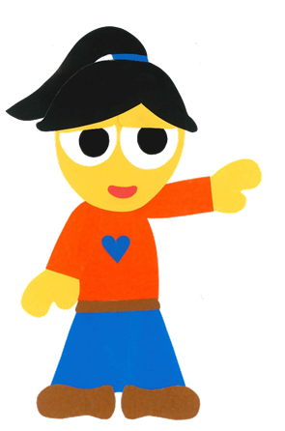
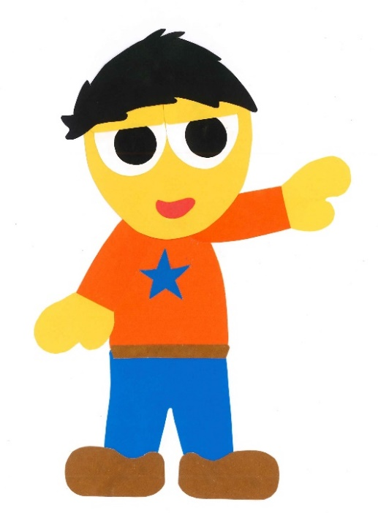
WE
CAN
READ
Donald Joyce

Slide 2
Colors, Colors, Colors
By:
Donald Joyce
WE CAN READ

Slide 3
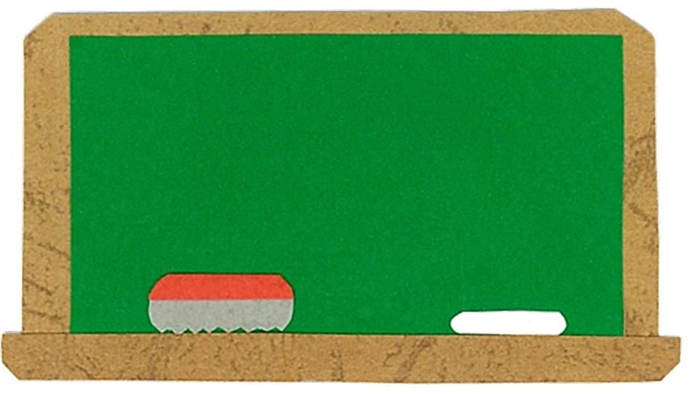
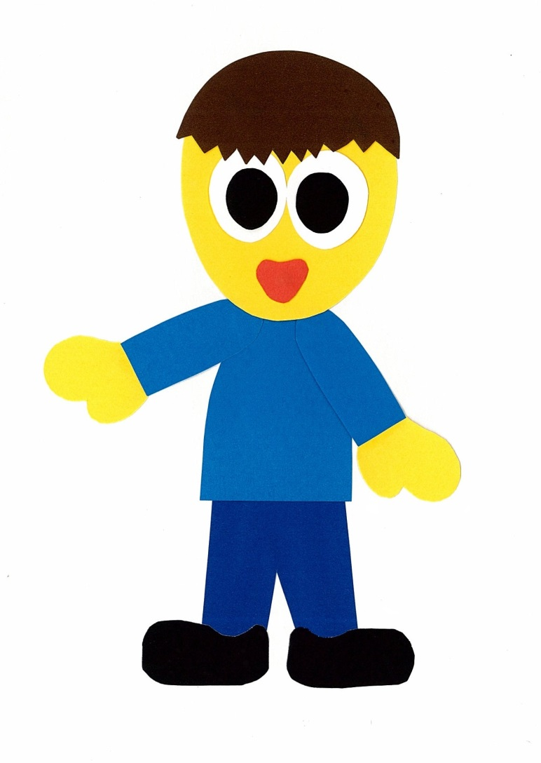
Let’s
Talk!

Slide 4
Look around.
What colors can you see?
I can see ___.

Slide 5
What is your
favorite color?
I like ___.
Me too!

Slide 6
Let’s
Learn!

Slide 7
red
purple
yellow
green
blue
pink
orange
brown
black

Slide 8
Let’s
Read!

Slide 9
Colors, Colors, Colors
By:
Donald Joyce
WE CAN READ

Slide 10
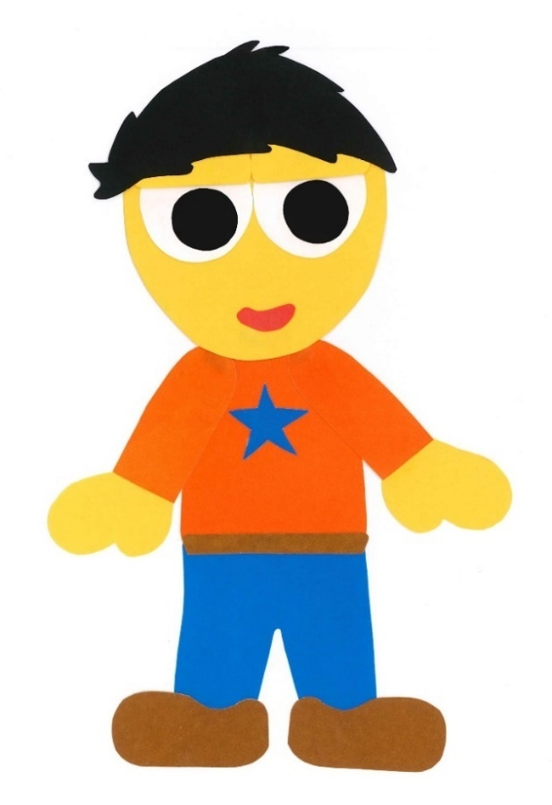
What is red?

Slide 11
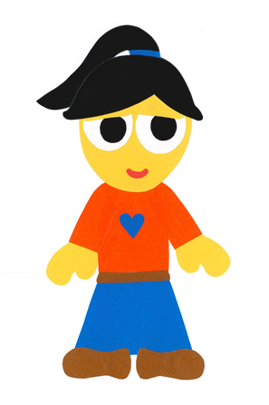
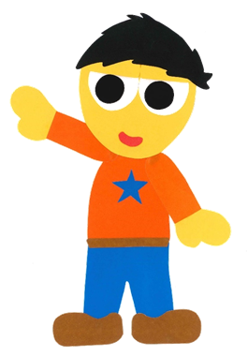
An apple is red.

Slide 12
What is purple?

Slide 13
A plum is purple.

Slide 14
What is yellow?

Slide 15
A sunflower is yellow.

Slide 16
What is green?

Slide 17
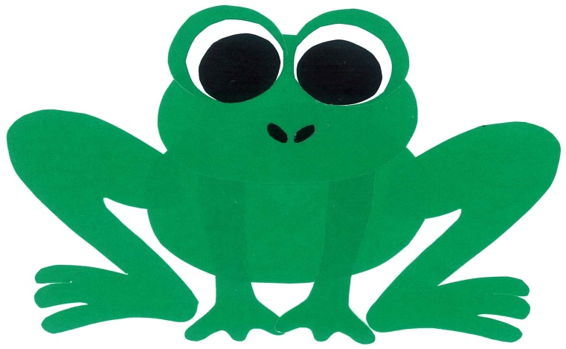
A frog is green.

Slide 18
What is blue?

Slide 19
The sky is blue.

Slide 20
What is pink?

Slide 21
A pig is pink.

Slide 22
What is orange?

Slide 23
A carrot is orange.

Slide 24
What is brown?

Slide 25
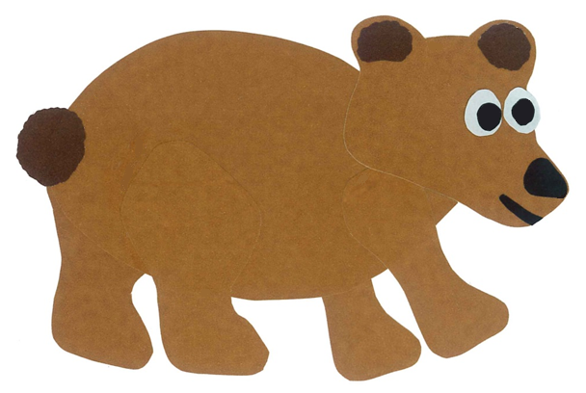
A bear is brown.

Slide 26
What is black?

Slide 27
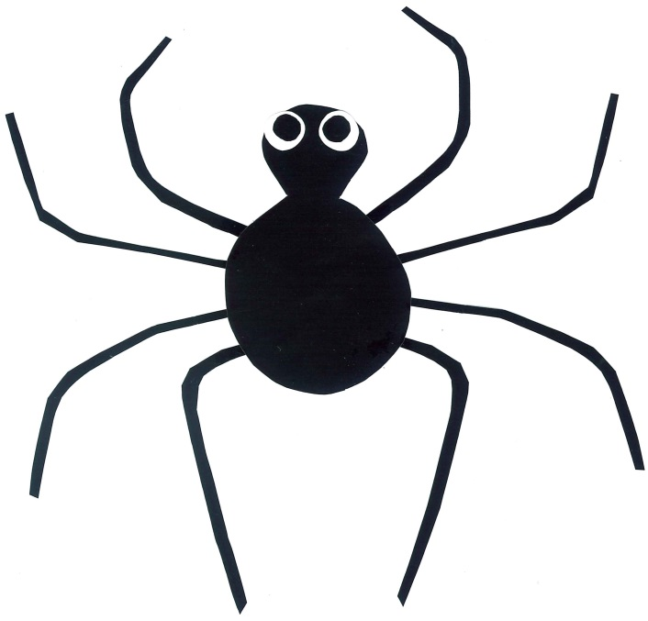
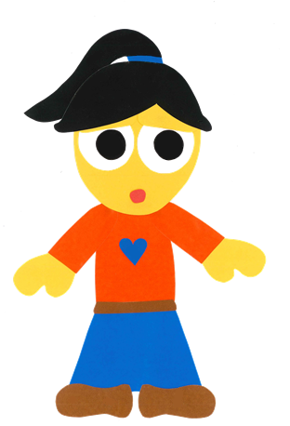
A spider is black.

Slide 28
Colors, Colors, Colors
By:
Donald Joyce
WE CAN READ

Slide 29
Let’s
Review!

Slide 30
A frog is ___.

Slide 31
A frog is green.

Slide 32
A pig is ___.

Slide 33
A pig is pink.

Slide 34
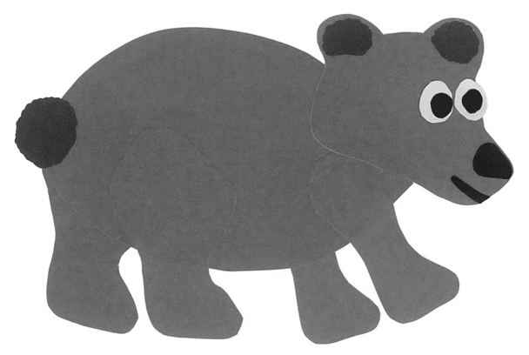
A bear is ___.

Slide 35
A bear is brown.

Slide 36
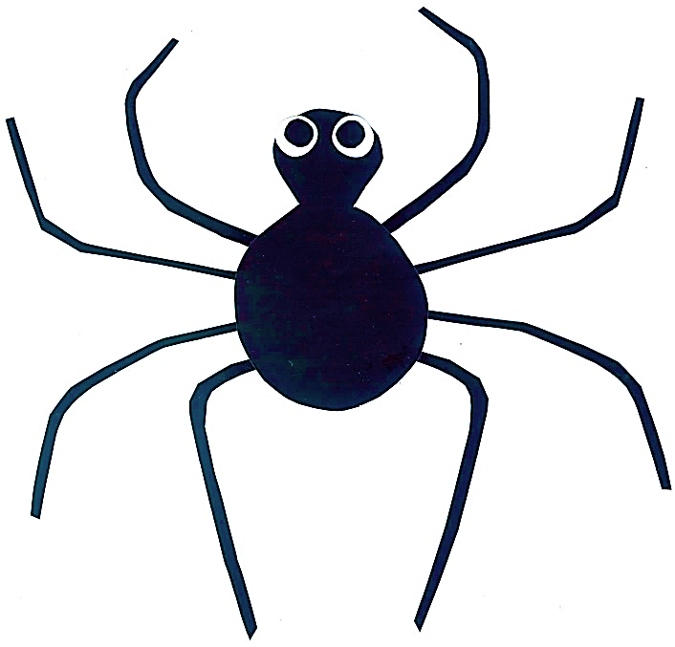
A spider is ___.

Slide 37
A spider is black.

Slide 38
Let’s
Connect!

Slide 39
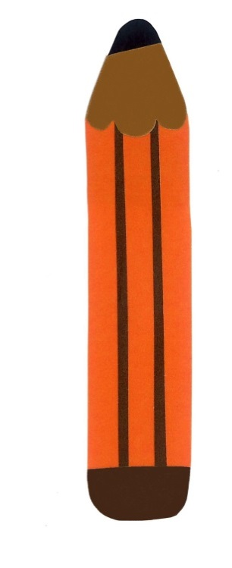
Get a pencil and paper!

Slide 40
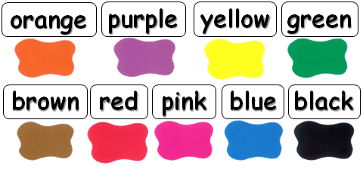
What is your favorite color?
My favorite color is ____.

Slide 41
WE
CAN
READ
www.teacherdonald.com

