Slide 1
Yourholidayinspain
Shopping, markets, restaurants

Slide 2
Restaurants

Slide 3
Restaurants
 | TAPAS | LIZARRAN | tapas, prijs per stokjes, | torrevieja en albaneras en Zenia (boven) | http://lizarran.es/
++ | Argentijn | Argentinian steak house | a volonté, diverse aan grill op spit | Calle Salvador Dali, Zenia boulevard Shopping, La Zenia | http://www.cherestaurant.es/
 | Spaans pizza | La Boca | Spaans & pizza | Av. Dr. Mariano Ruiz Canovas, 30; Torrevieja | http://labocarestaurante.com
+++ | Spaans | Meson El Prado |  | Calle Lope de Vega, San Miguel Salimos
+++ | Spaans | El Cruce | palmharten (alcochovas) | Via Camino, Almoradi | www.restaurante-elcruce.com
+++ | Belgisch | Sunset beach | mosselen, ribben, Belgen | Avenida de los Marineros 17, Playa des Cura, Torrevieja | www.sunsetbeach.es
+++ | Spaans | Rebate | met flamingo dansen | Carretera CV952 (km10,5), 03190 Pilar de la Horadada | www.restauranterebate.com
 | Pizza | Pizzeria Centro Playa | pizza | Playa de los Locos 36, Torreviega
 | Spaans | Tosca Nueva Bahia | tapas | Calle Diego Hernandez 32, Torreviega | http://www.tascanuevabahiatorrevieja.com/index.php
++ | Argentijns | CHE Argentinos | a volonté | La Zenia Boulevard
+ | Italiaans | CHE Italiano | a volonté | La Zenia Boulevard
+++ | Indisch | Spice City | ook take away | San Miguel, locale 65, La Finca Golf, 03169 Algorfa
+++ | Belgisch | El Gusta |  | Avda Federico Garcia Lorca, 17, Benijófar | http://www.elgusto.es
 | Magali en Valentin | Zenia Lounge | gekend van huis onder de zon | Centro comercial Costa Zenia, Nr S12 , La Zenia | contact@zenia-lounge.com
+++ | Spaans | El Chiringuito | tapas | parc aan callecommunida valenciana Algorfa | https://www.facebook.com/elchiringuito.algorfa
 |  | Arcena | vooraf reserveren | Puerto de Alicante, Muelle Levante, 6, Alicante | http://darsena.com/
 | Spaans | Villa beach | paella, … | Paseo Juan Aparicio, 16, Torrevieja, Alicante | http://velabeachrestaurante.com/torrevieja/
 | Spaans | El patio chico |  | Calle Pedro Lorca 3, 03181 Torrevieja | https://www.facebook.com/el.p.chico/
 |  | El Ermita |  | Av. Constitución, 13, 03169 Algorfa
 | Italiaans | Day and night |  | Avenida Naciones 9, 03170 Ciudad Quesada

Slide 4
Shopping

Slide 5
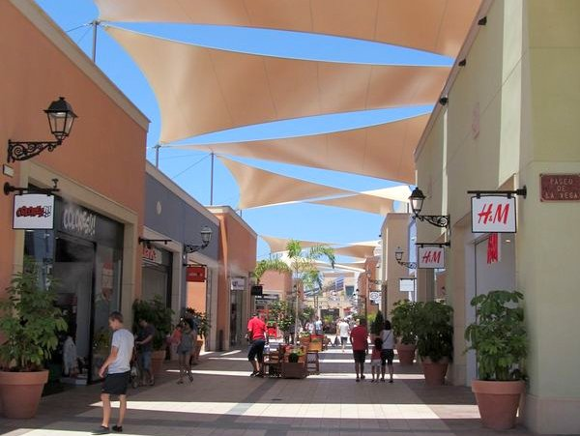
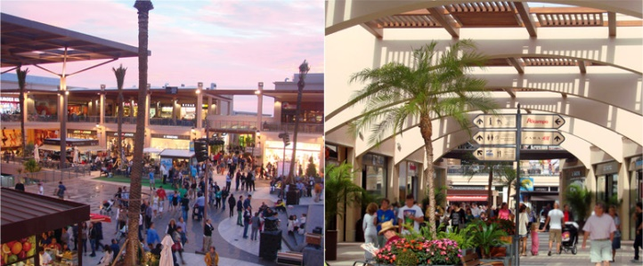
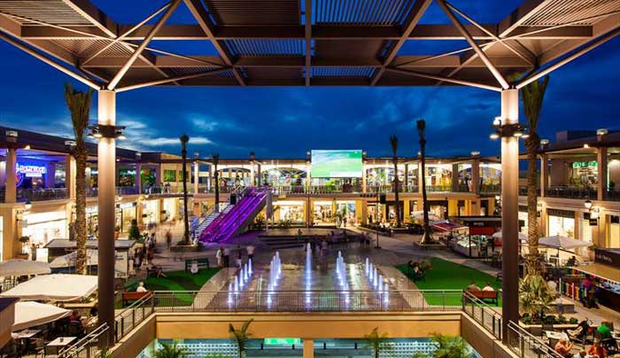
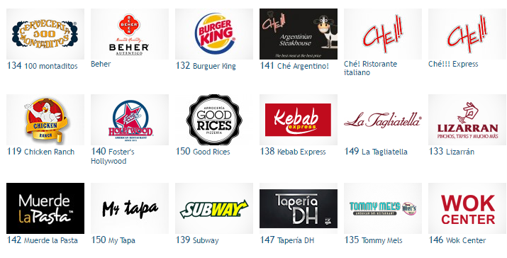
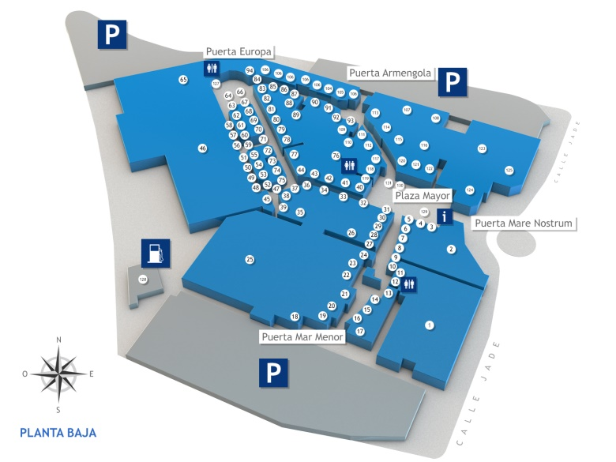
Yourholidayinspain
Zenia Shopping centra
360 days a year open from shops 10h – 22h (Alcampo 9 – 22h), restarants 12h – 1h30
Check the events calender (see below)
36 7 Camicie 122 Adidas 46 Alcampo 103 Amichi 20 Astoria by Patrimi 82 Baby center
63 Barber Shop 115 Benetton 33 Berska 31 Bijou Brigitte 10 Botticelli 78 C&A
18 Caja Rural 111 Calzedonia Centro de lavado 107 Charanga 37 Claire's 75 Colores
104 Cortefiel 1 Decathlon 107 Décimas 17 Decoquality 39 Deichmann 90 Desigual
23 Di Marco 9 Don Dino 99 DonnaN 105 Druni 109 Encuentro Moda 48 Equivalenza
00 Farmacia 53 Fashion Nails 127 Floristería The flower shop Forecast 67 Frágola Game
128 Gasolinera Alcampo 14 Geox 96 Gerry Weber 59 Gold Rush 98 Greenwich 54 Grupo Móvil
24 Guess 76 H&M 92 Infinity Love 38 Inside 60 Inspiral 30 Intimity Closet
118 Iokesé 4 Jack & Jones 112 Kiko R-39 Koala Bay La Boutique La Rapa
35 Lefties 25 Leroy Merlín Levi's Lion of porches Loterías y Apuestas del Estado 87 Macson
110 Mango 79 Marvimundo 72 Marypaz 117 Massimo Dutti 40 Mayka 88b Mayka Snickers
70 Mayoral 123 Media Markt 106 Misako 62 Mister Minit 7 Multiópticas R-550 Natura
15 Nichi Seijo 108 Norauto Oh Juliette Ole Internacional 52 Orange 121 Oysho
6 Paco Martínez 66 Palpelo 29 Pandora R-550 Party Fiesta 21 Pepe Jeans 42 Pewter
Piel de Toro 90 Polinesia 65 Primark 100 Primichi 26 Procomobel 32 Pull & Bear
44 Punto Roma Rituals 71 Roberto Martín Salsa 3 Salvador Artesano 114 Santos Ochoa
8 Saxo 94 Shana 47 Soloptical 34 Springfield 119 Stradivarius 19 Superperfumerías
5 Swarovski 56 The Phone House 81 Tiendanimal 88a Tiger 41 Time Road / Festina 77 Tino González R 103 Tintorería Lavandería 12 Tous 68 Tutto piccolo 49 TV Horadada 102 Twister of Dreams 28 Two Dos 74 UlanKa 27 Único 85 Vans 22 Via di Milano Williot 43 Women'secret
Yves Rocher 116 Zara 120 Zara Home 95 Zippy
http://www.zeniaboulevard.es/gbr/home
http://zeniaboulevard.es/gbr/events

Slide 6
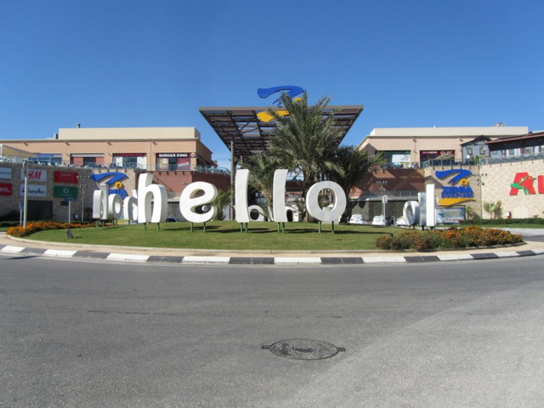
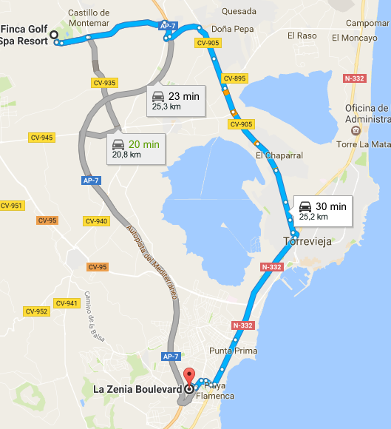
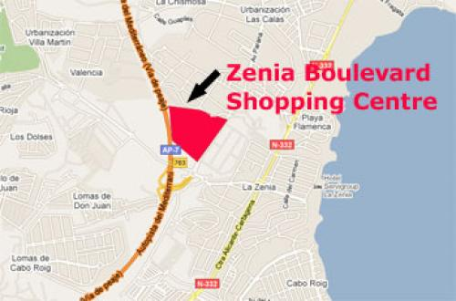
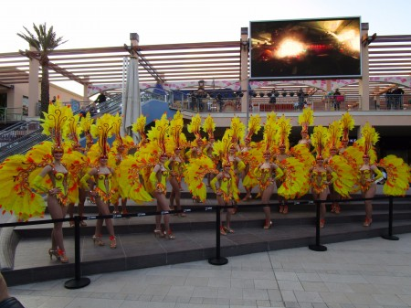
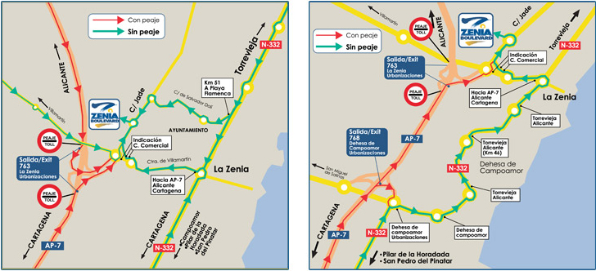
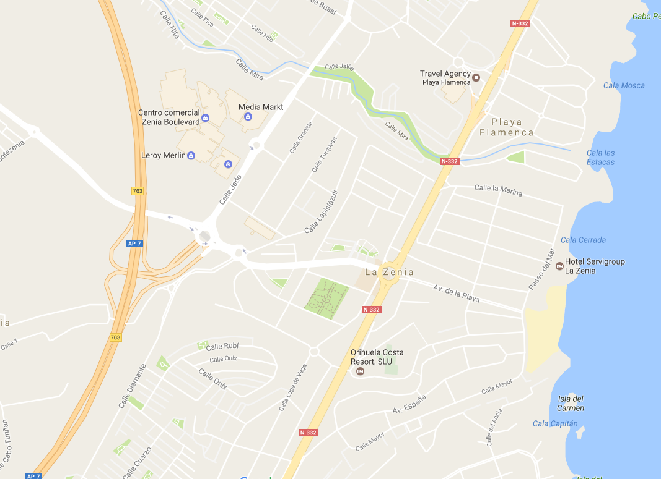
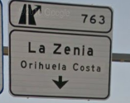
Yourholidayinspain
Zenia Shopping centra
Weg naar La Zenia
Snelste weg via autosnelweg (betalend) afrit
Via weg rechtdoor bij uitgang La Finca naar Quesada (snelweg over), grote weg naar Torrevieja. Kustweg richting Cartagena/San Javier. Aanwijzers richting La Zenia volgen
Je kan parkeren onder La Zenia of aan Leroy Merlin (alles gratis)
http://www.zeniaboulevard.es/gbr/home

Slide 7
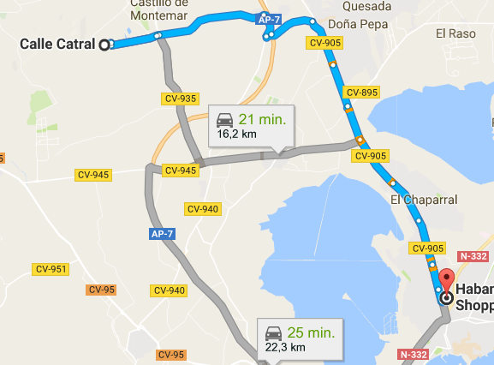
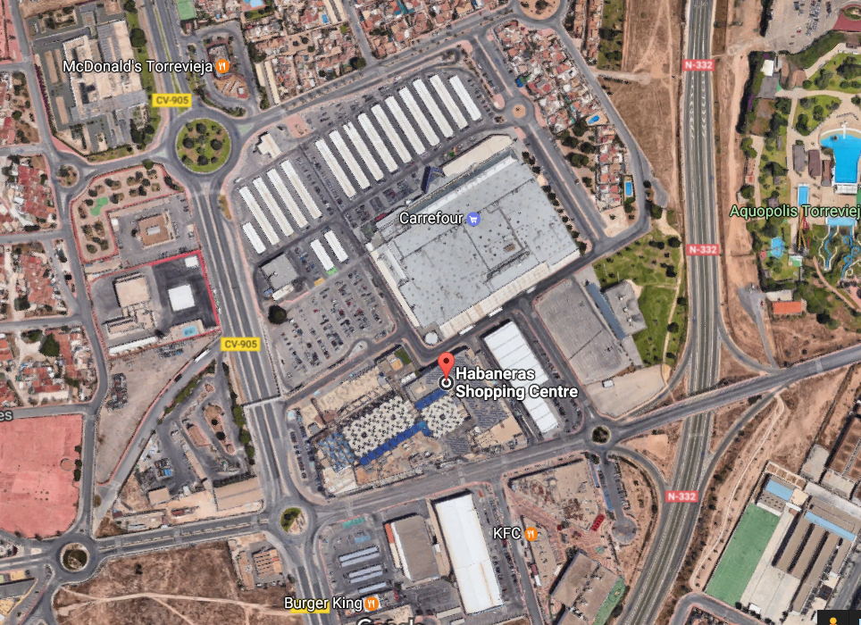
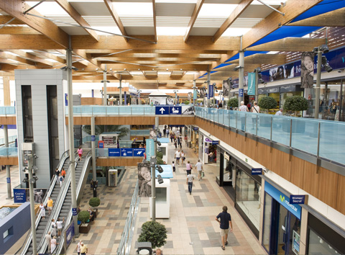
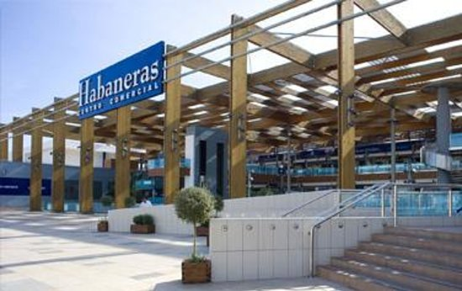
Yourholidayinspain
Habaneras Centro
Avda. Rosa Mazon Valero, 03184, Spanje
http://www.habaneras.es/en/
360 days a year open, 10h – 23h
AKI BELROS BERSHKA CALZEDONIA C&A CELIO CLAIRE'S DI AROMAS DON DINO DOUGLAS DRUNI DAKOTA
ENCUENTRO EL RINCÓN DEL CAFÉ EBANNI EFANBI FORUM SPORT FESTA GERRY WEBER GINOS GAME
GUESS H&M INTERSPORT INSIDE IOKESE JACK & JONES KIKO Milano LIZARRAN MASSIMO DUTTI
MOVISTAR MAYKA OYSHO ORO VIVO PUNT ROMA PULL & BEAR SAMSUNG SOLOPTICAL
STRADIVARIUS SPRINGFIELD SWAROVSKI SECRETOS DE INDIA
SIRVENT MIRALLES TIME ROAD TWO DOS URBAN WOMAN VAINI WOMEN'SECRET ZARA HOME
ZARA 100 MONTADITOS
CARREFOUR and a lot of restaurants around

Slide 8
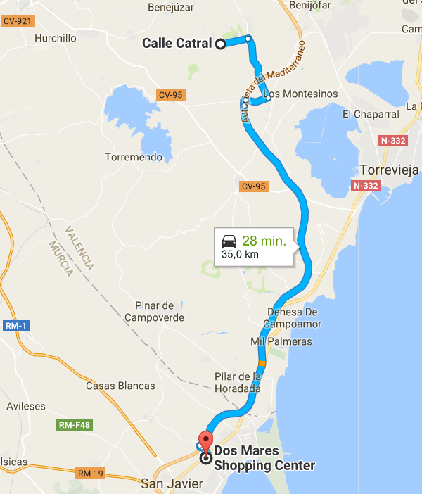
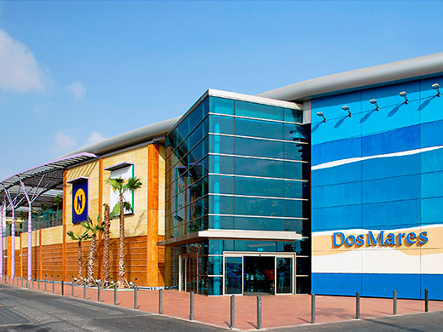
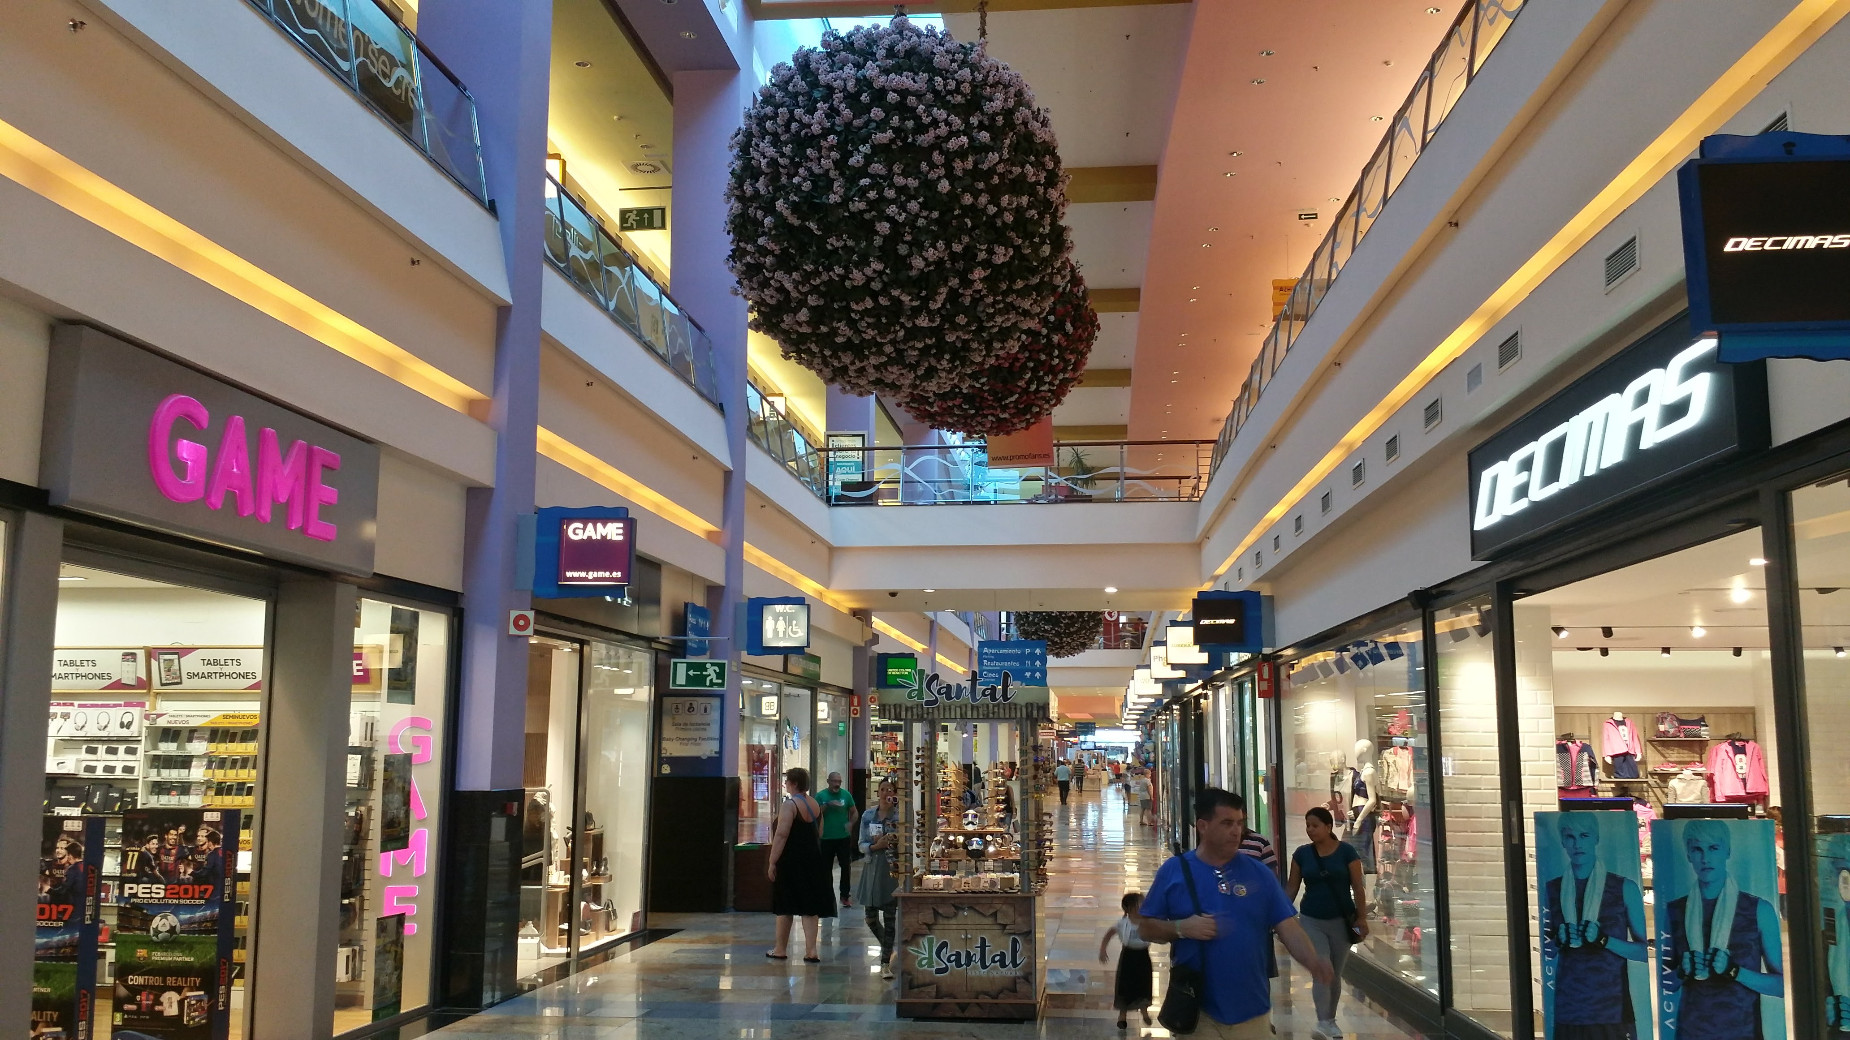
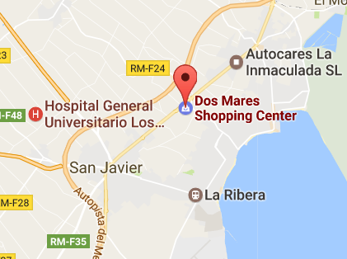
Yourholidayinspain
Centro Dos Mares Shopping centra Autovia de Alicante, salida 777de la AP-7.
http://www.centrodosmares.com/

Slide 9
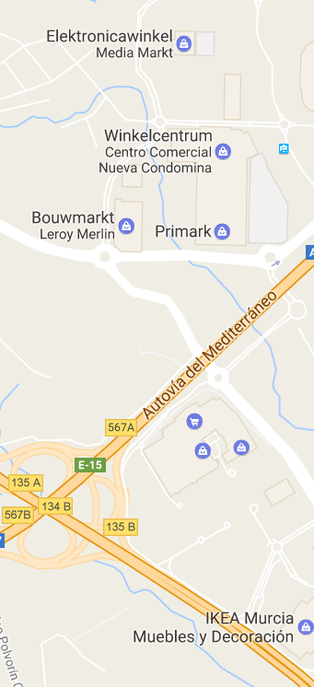
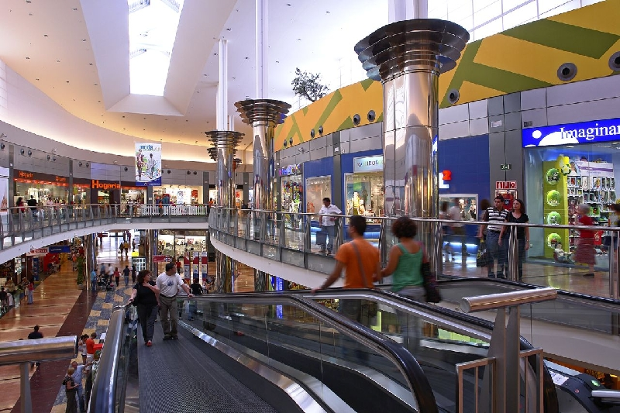
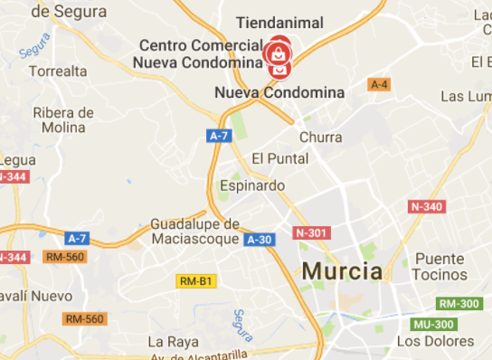
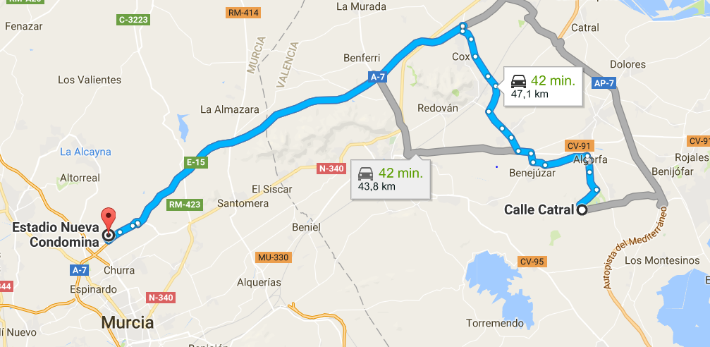
Yourholidayinspain
Murcia Shopping centra’s
1) Murcia Nueva Condomina N38°02.458 W1°08.943
From here: walk into the massive shopping mall or through the car park to the large individual shops. Remember the Thader mall and Ikea are 2 minutes drive away using the bridge over the motorway. The shops are open Monday to Saturday from 10:00 to 22:00 and on certain Public Holidays and some Sundays.
Top tip: take a look at the website for the most up to date opening times and a plan of the shops. official
2 Murcia Thader & 3 Ikea Shopping Mall N38°01.806 W1°08.895
From here: walk into the massive shopping mall or cross the car park for Ikea. Remember the Nueva Condomina mall is 2 minutes drive away using the bridge over the motorway.
1)
http://es.club-onlyou.com/nuevacondomina
2)
3)

Slide 10
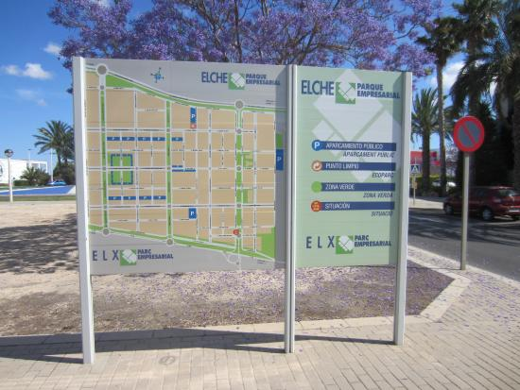
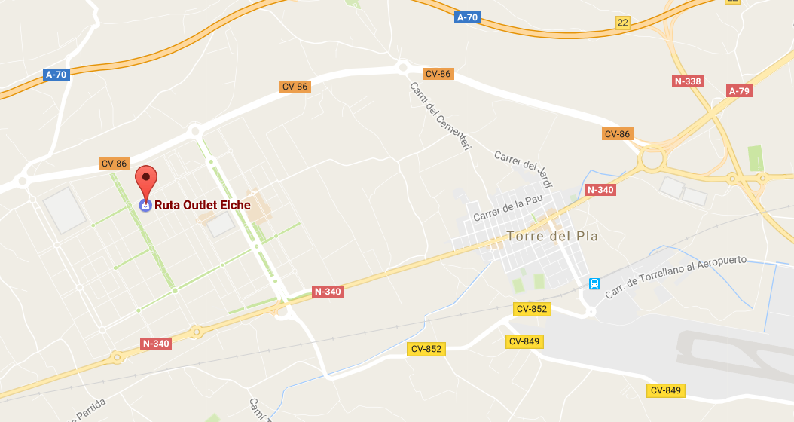
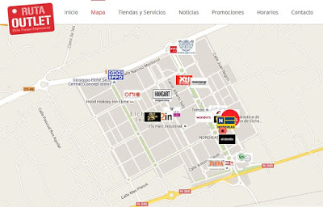
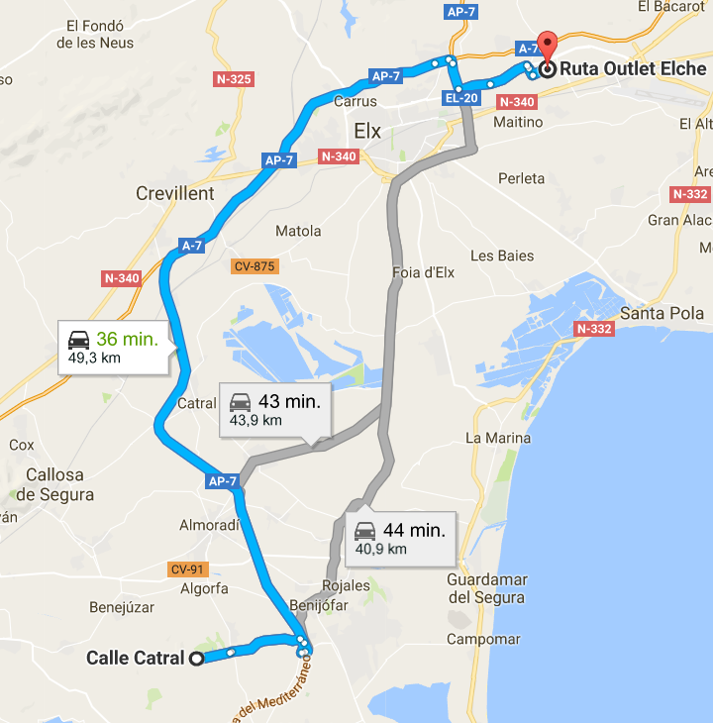
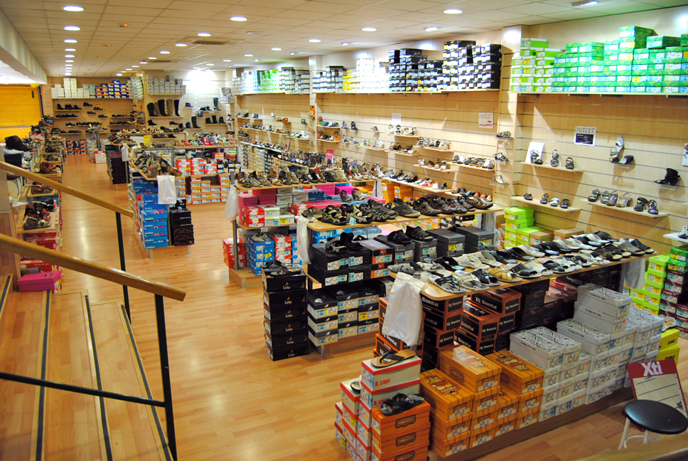
Yourholidayinspain
Ruta Outlet Elche Parque Empresarial
Calle Miguel Servet 25. | Elche Parque Empresarial, 03203 Elche, Spanje
Monday to Thursday 10 – 14h and 16h – 20h
Friday 10 – 20h
Saterday 10-14u30 and 17h-20h
Elche is the shoe production region,
http://www.rutaoutlet.es

Slide 11
Food shopping

Slide 12
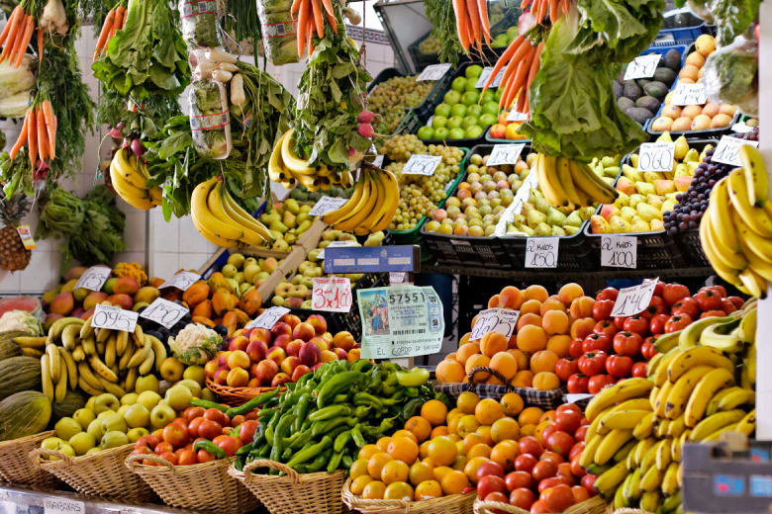
Yourholidayinspain
Street Markets
Morning market
 | TOWN | WHEN | Type | adres
 | Albir | Saturday
 | Alicante | Monday, Saturday |  | mercado central
 | Alicante | Thursday, Saturday |  | mercadillo teulada close to arena
 | Almoradi | Saturday | big, vegetables | around the church
 | Altea | Tuesday
 | Benidorm | Saturday, Sunday |  | rastro 'el cisne'
 | Benidorm | Wednesday, Sunday | Big, cloths | naast Hotel Barcelo Pueblo
 | Calpe | Saturday
 | Calpe | Tuesday
 | Catral | Saturday
 | Cox | Monday
 | Elche | Monday to Saturday |  | Mercado, placade la fruita
 | Guardamar del segura | Wednesday |  | big market 300 at the plaza de la iglesia
 | Guardamar del segura | Sunday | English market | Campo de Guadamar, Guadamar-Montesinos Road
 | La Mata | Wednesday |  | Canal del Acequion
 | Murcia | Sunday | local farmers and craftman | after the Museo Salzillo. Bº de Sankt Andres, Murcia
 | Murcia | Tuesday |  | Murcia (in Los Alcáceres en La Unión
 | Orihuela | Tuesday | streetmarket | N38°04.909 W0°56.646
 | Orihuela costa | Saturday
 | Rojales | Thursday
 | Rojales | Sunday | English market | mercado el zoco,
 | San Javier | Thursday
 | San miguel de salines | Saturday |  | rommelmarkt castillo e conesa
 | San miguel de salines | woensdag |  | in centrum of town
 | San Pedro del Pinatar | Monday
 | Torrevieja | Friday |  | avenida de paris
 | Santa Pola | Saturday, Monday |  | center
 | Santa Pola | Daily |  | mercado central

Slide 13
Supermarkets
Mercadona Almoradi Av. Comunidad Europea, 03160 Almoradí 9u-21u30 Sunday closed
Carrefour Torrevieja Ctra. Crevillente, Km 34.4, 03180 Torrevieja 9u-22u Sunday open
Lidl Quesada Avda. de los Regantes, 6 Rojales 9u – 22u Sunday closed
Alcampo Orihuela Costa Zenia Boulevard, Calle Jade, s/n, 9u – 22u Sunday open
Consum Quesada Av. Jerez de la Frontera, 03170 Rojales 9u30-21u30 Sunday up to 13u30
Mercadona Benijofar Carretera Torrevieja-Benijofar, (CV905a) 9u – 21u30 Sunday closed
Aldi
On La Finca: At the entrance on the right sight coming into the resort.
Johnsonssupermarket (www.johsonssupermarket.com) everyday open 9u – 20h, 0034966729647

Slide 14
Yourholidayinspain
Street Markets
Morning market
 | TOWN | WHEN | Type | adres
 | Albir | Saturday
 | Alicante | Monday, Saturday |  | mercado central
 | Alicante | Thursday, Saturday |  | mercadillo teulada close to arena
 | Almoradi | Saturday | big, vegetables | around the church
 | Altea | Tuesday
 | Benidorm | Saturday, Sunday |  | rastro 'el cisne'
 | Benidorm | Wednesday, Sunday | Big, cloths | naast Hotel Barcelo Pueblo
 | Calpe | Saturday
 | Calpe | Tuesday
 | Catral | Saturday
 | Cox | Monday
 | Elche | Monday to Saturday |  | Mercado, placade la fruita
 | Guardamar del segura | Wednesday |  | big market 300 at the plaza de la iglesia
 | Guardamar del segura | Sunday | English market | Campo de Guadamar, Guadamar-Montesinos Road
 | La Mata | Wednesday |  | Canal del Acequion
 | Murcia | Sunday | local farmers and craftman | after the Museo Salzillo. Bº de Sankt Andres, Murcia
 | Murcia | Tuesday |  | Murcia (in Los Alcáceres en La Unión
 | Orihuela | Tuesday | streetmarket | N38°04.909 W0°56.646
 | Orihuela costa | Saturday
 | Rojales | Thursday
 | Rojales | Sunday | English market | mercado el zoco,
 | San Javier | Thursday
 | San miguel de salines | Saturday |  | rommelmarkt castillo e conesa
 | San miguel de salines | woensdag |  | in centrum of town
 | San Pedro del Pinatar | Monday
 | Torrevieja | Friday |  | avenida de paris
 | Santa Pola | Saturday, Monday |  | center
 | Santa Pola | Daily |  | mercado central

Slide 15
Yourholidayinspain
Food shops
Butcher
Bakery
Wine

Slide 16
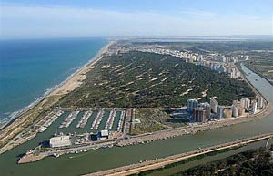
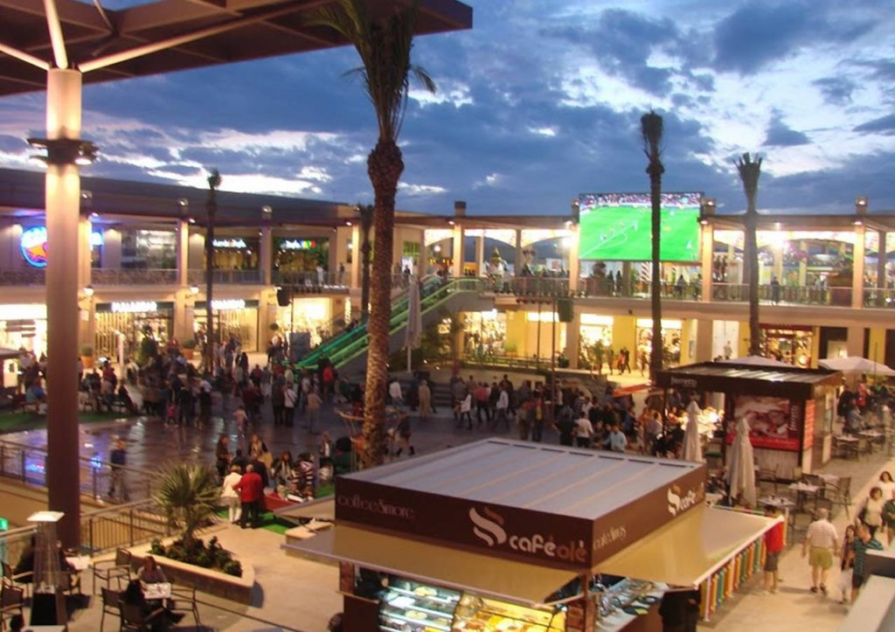
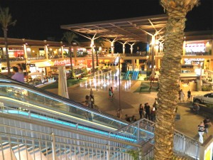
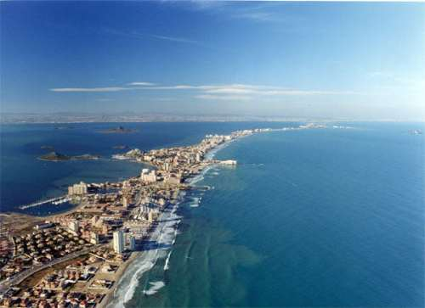
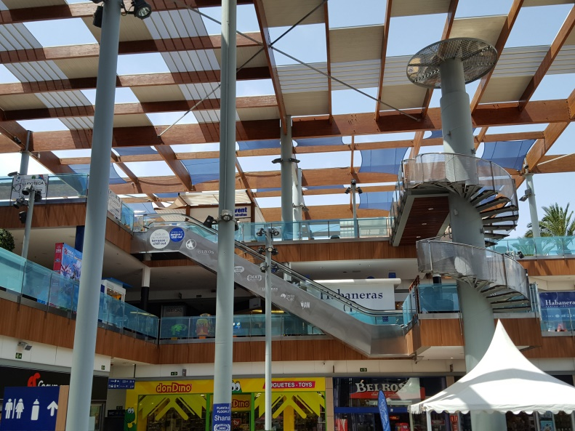
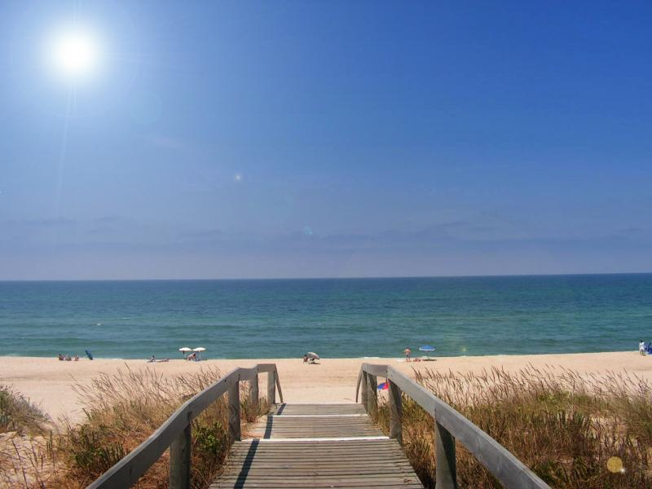
Beaches & shopping
Guardamar del segura beach
Torreviega beach
Villamartin beach
Zenia shopping
La Manga del Mar Menor

Slide 17
Yourholidayinspain mailaddres: info@yourholidayinspain.com website: www.yourholidayinspain.com Tel: +32494725130 or +32473937990 Veerle & Andy

