Slide 1
POPE
CROSS
COUNTRY

Slide 2
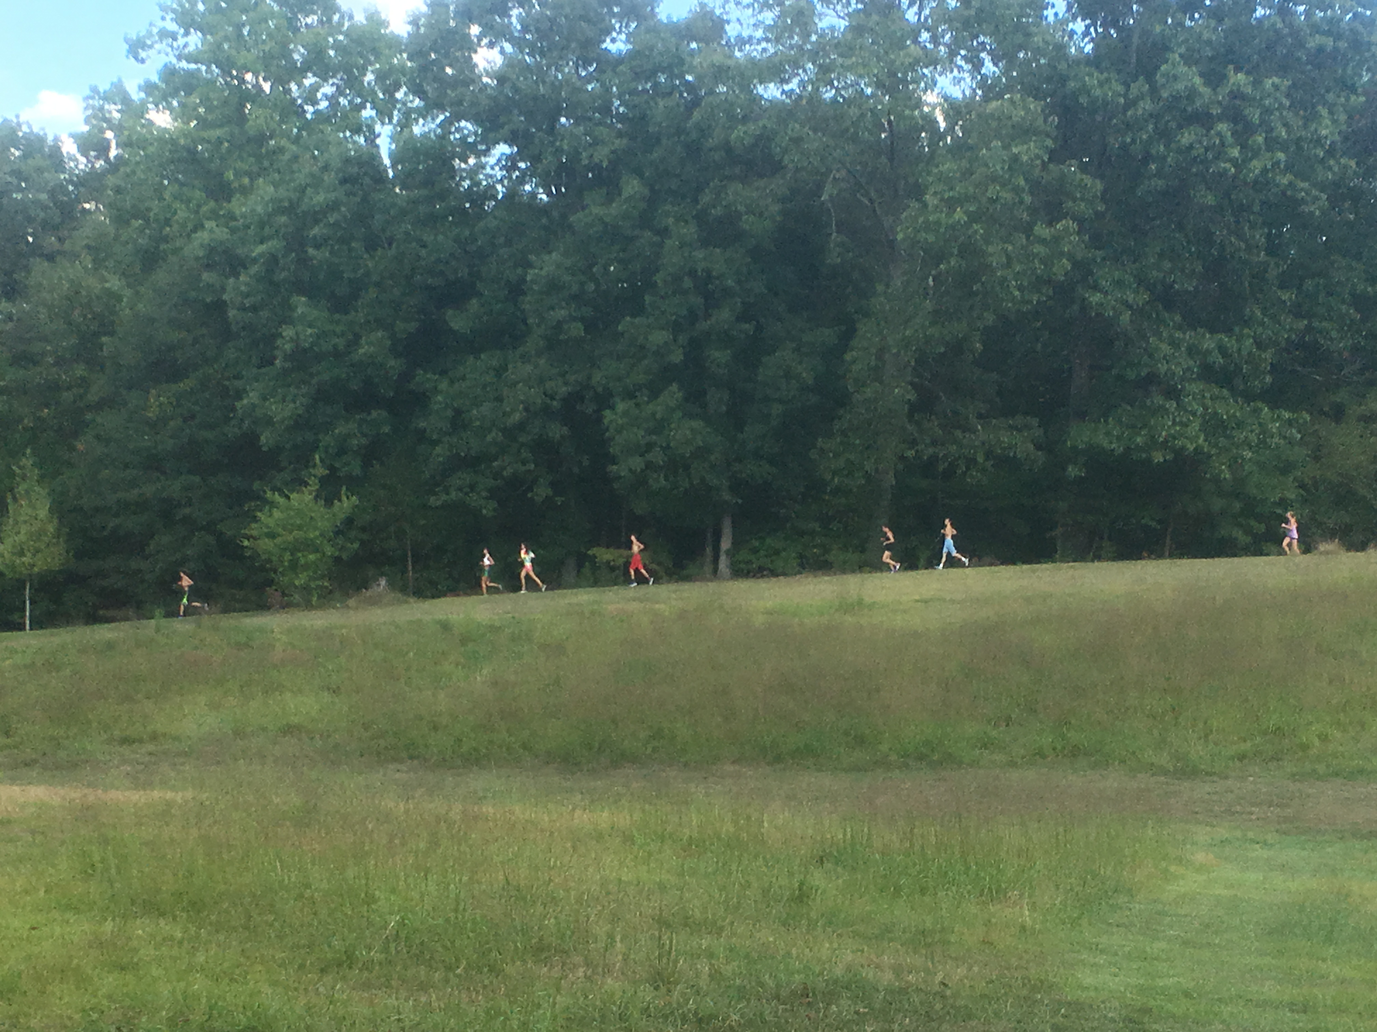
GO GREYHOUNDS GO

Slide 4
THIS IS FUN but you must prepare!!!

Slide 5
WE worked out over the summer, WE went to camp and trained hard all season!!!

Slide 6
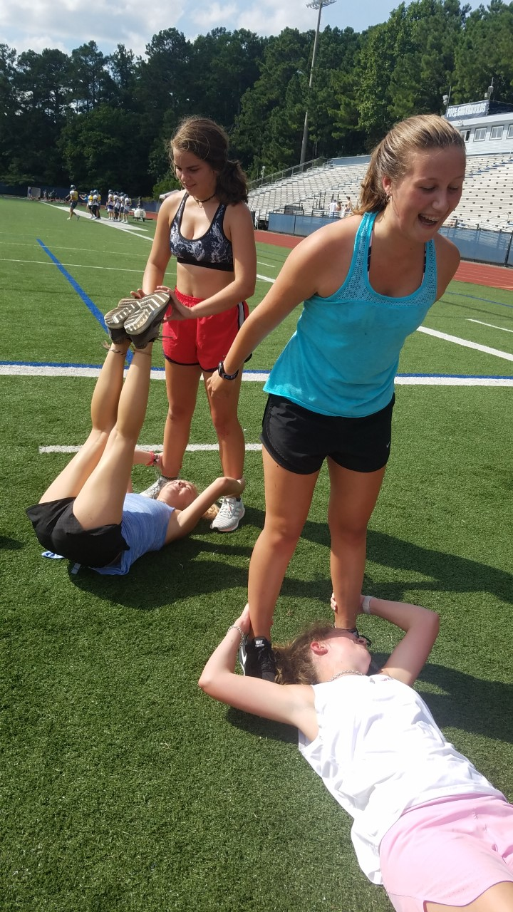
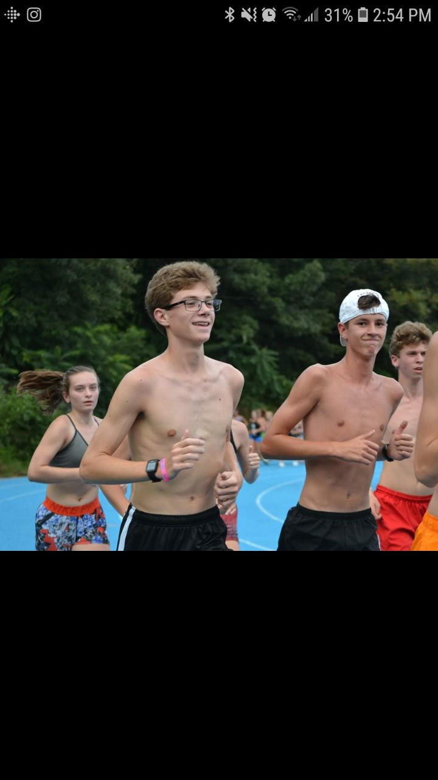
STATIONS
CAMP

Slide 7
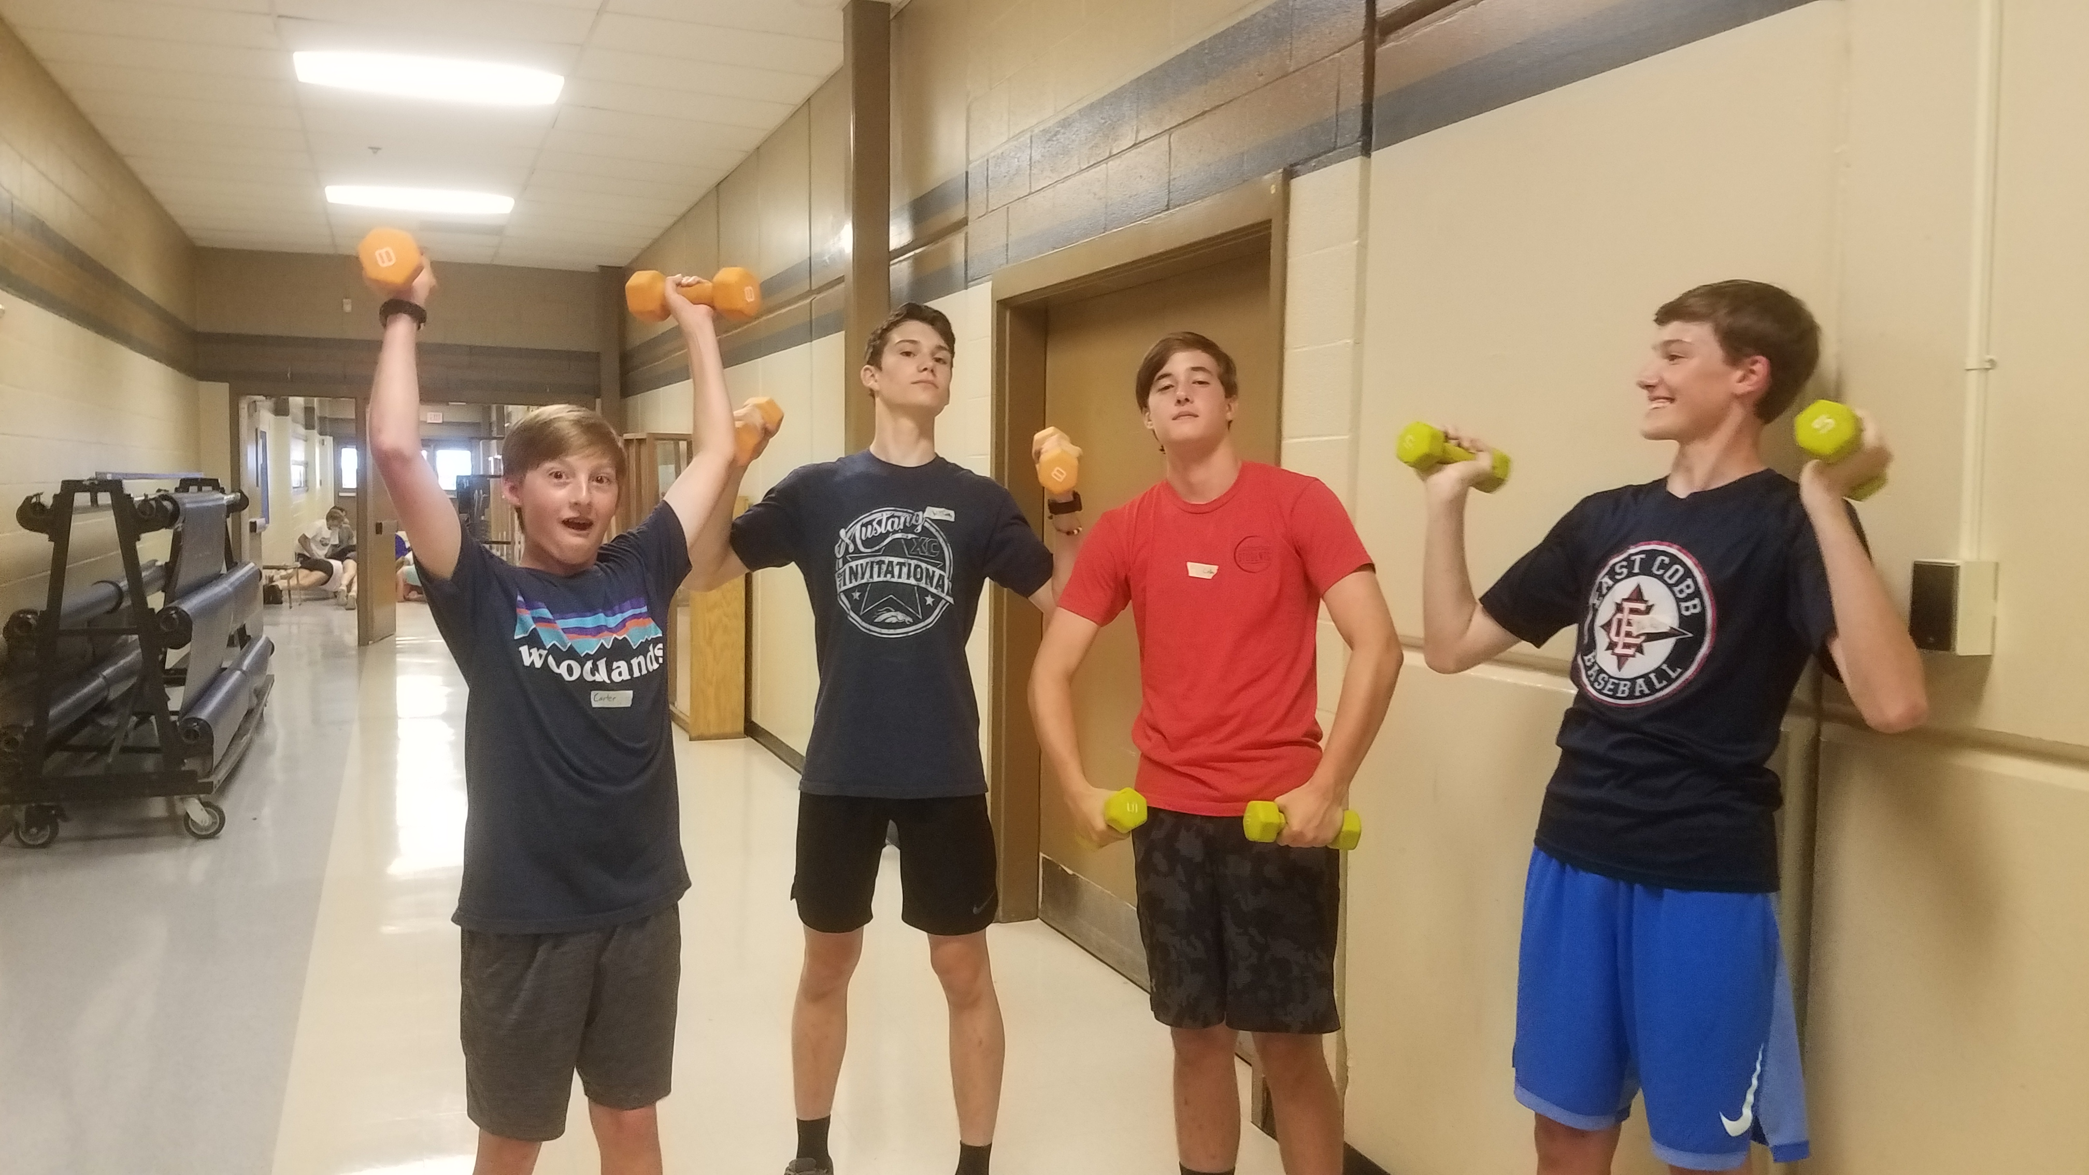

Slide 8
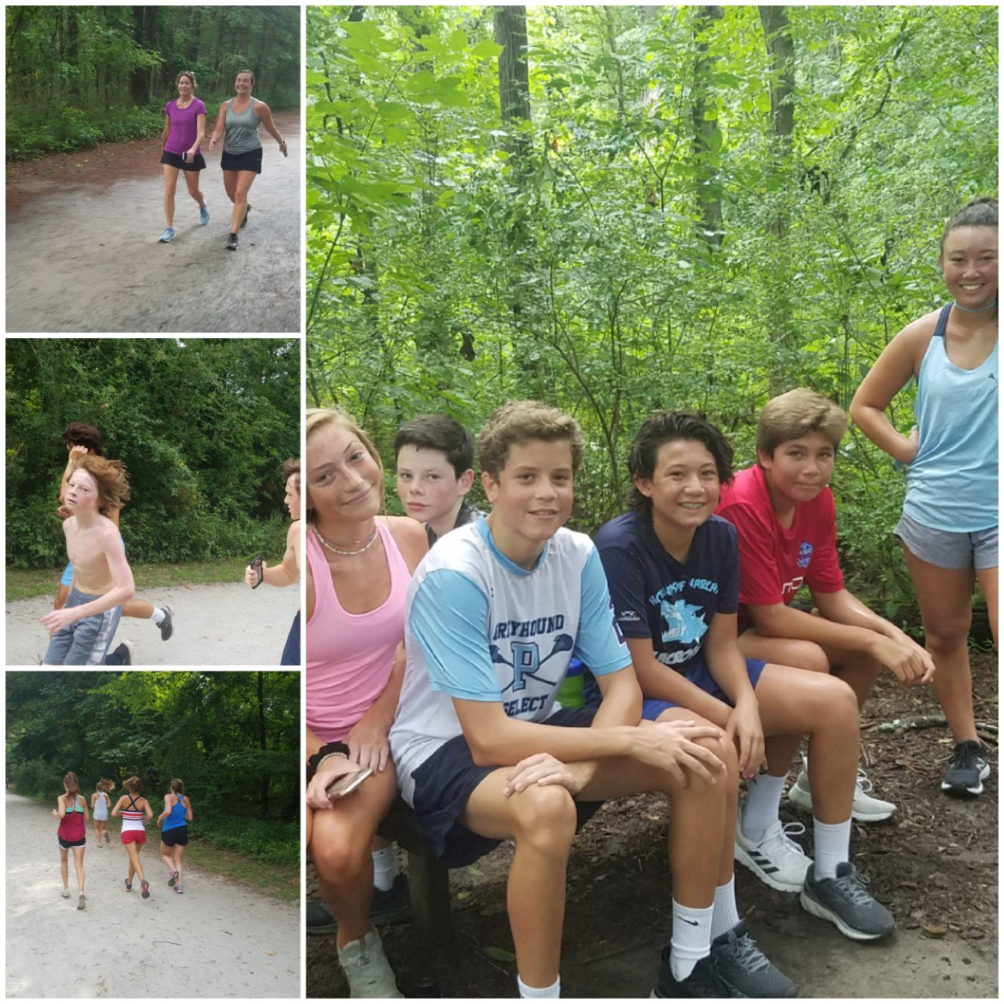
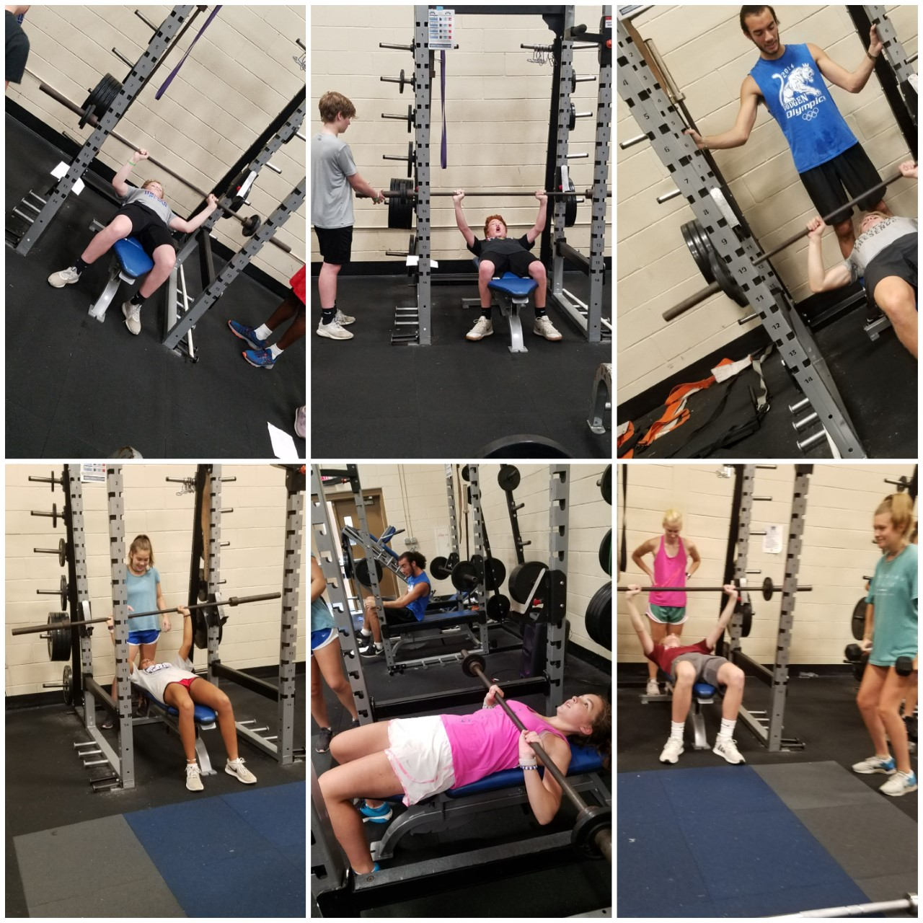
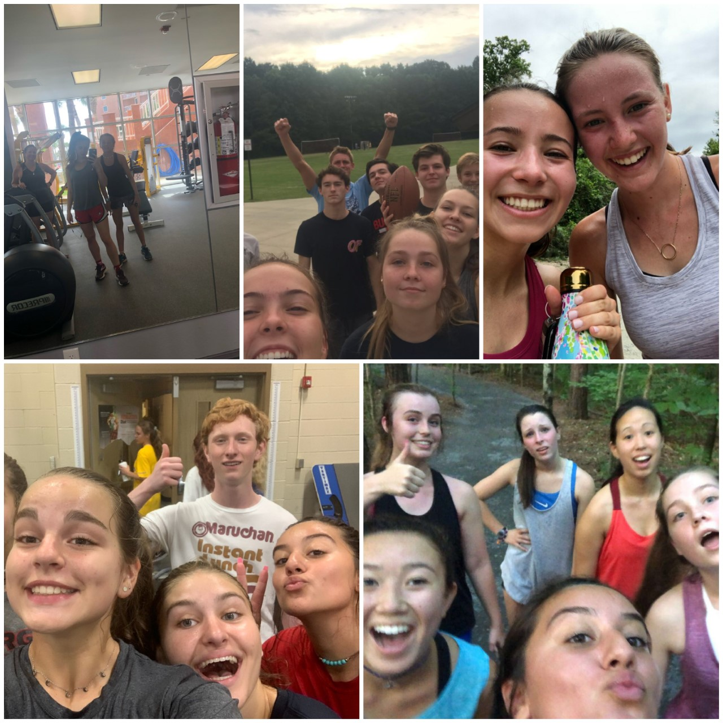
Summer training matters!!!

Slide 9
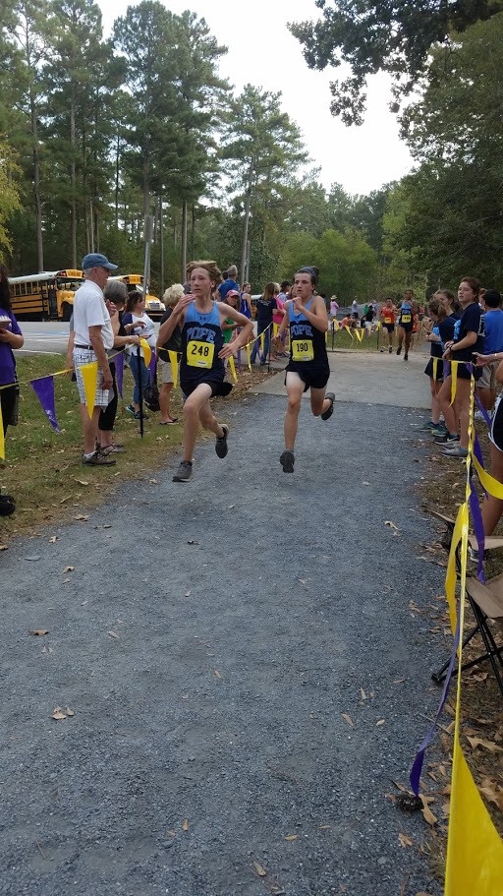
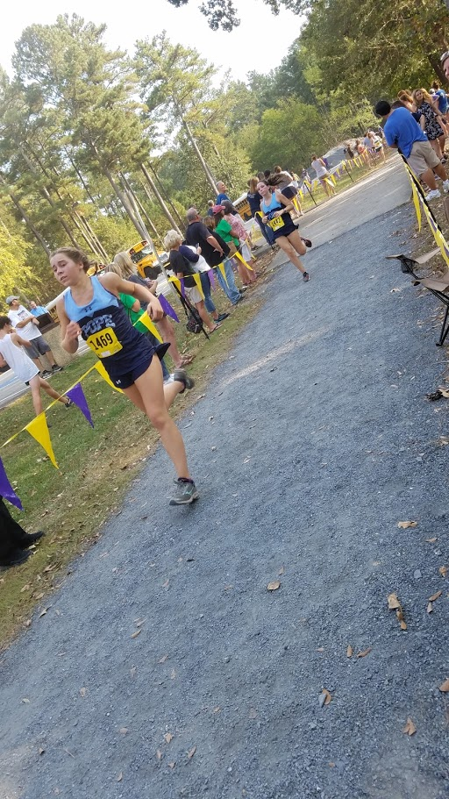
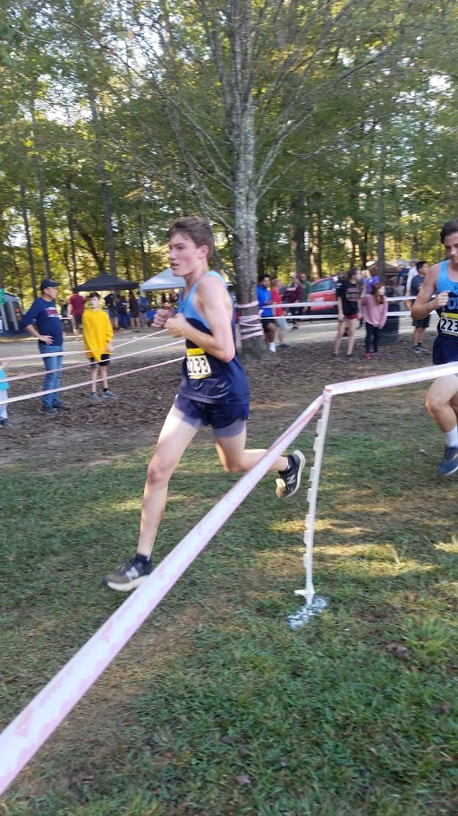
New RUNNERS

Slide 10
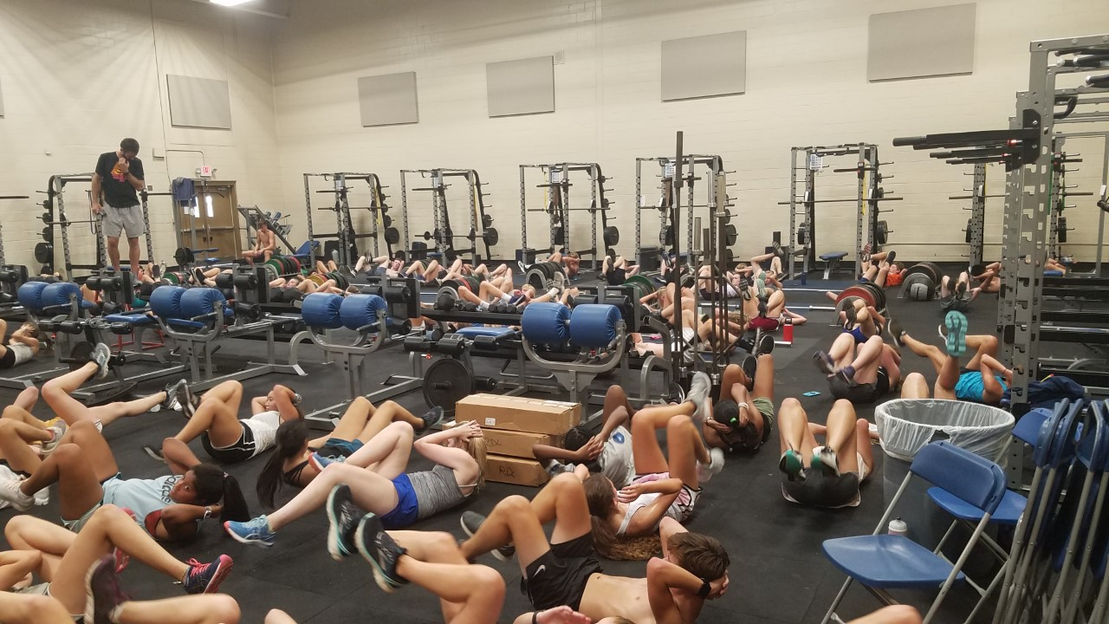
HAVE STRENGTH IN NUMBERS

Slide 11
What can I do to insure that my REGION
race is GREAT???
HYDRATE, FOOD AND SLEEP

Slide 12
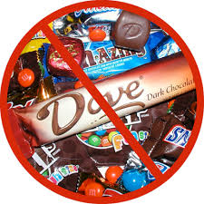
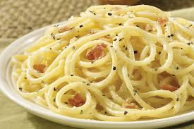
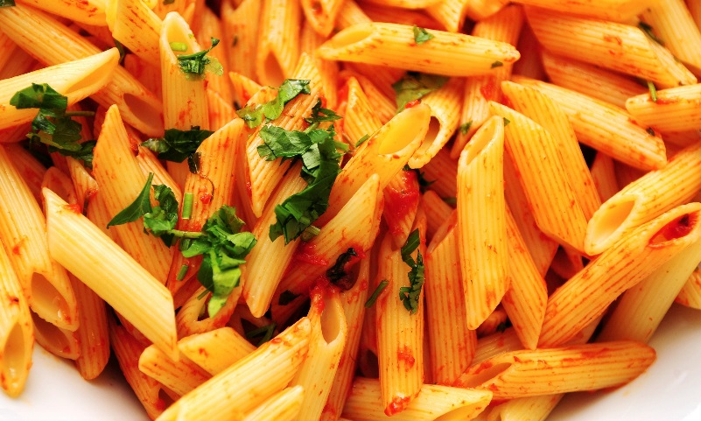
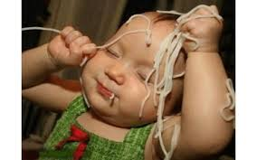
Carbo load TONIGHT
Limit sugar intake as it has an
inflammatory effect
ICE BATH

Slide 13
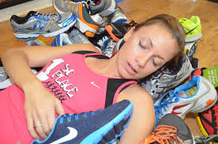
GET SOME QUALITY SLEEP!!!

Slide 14
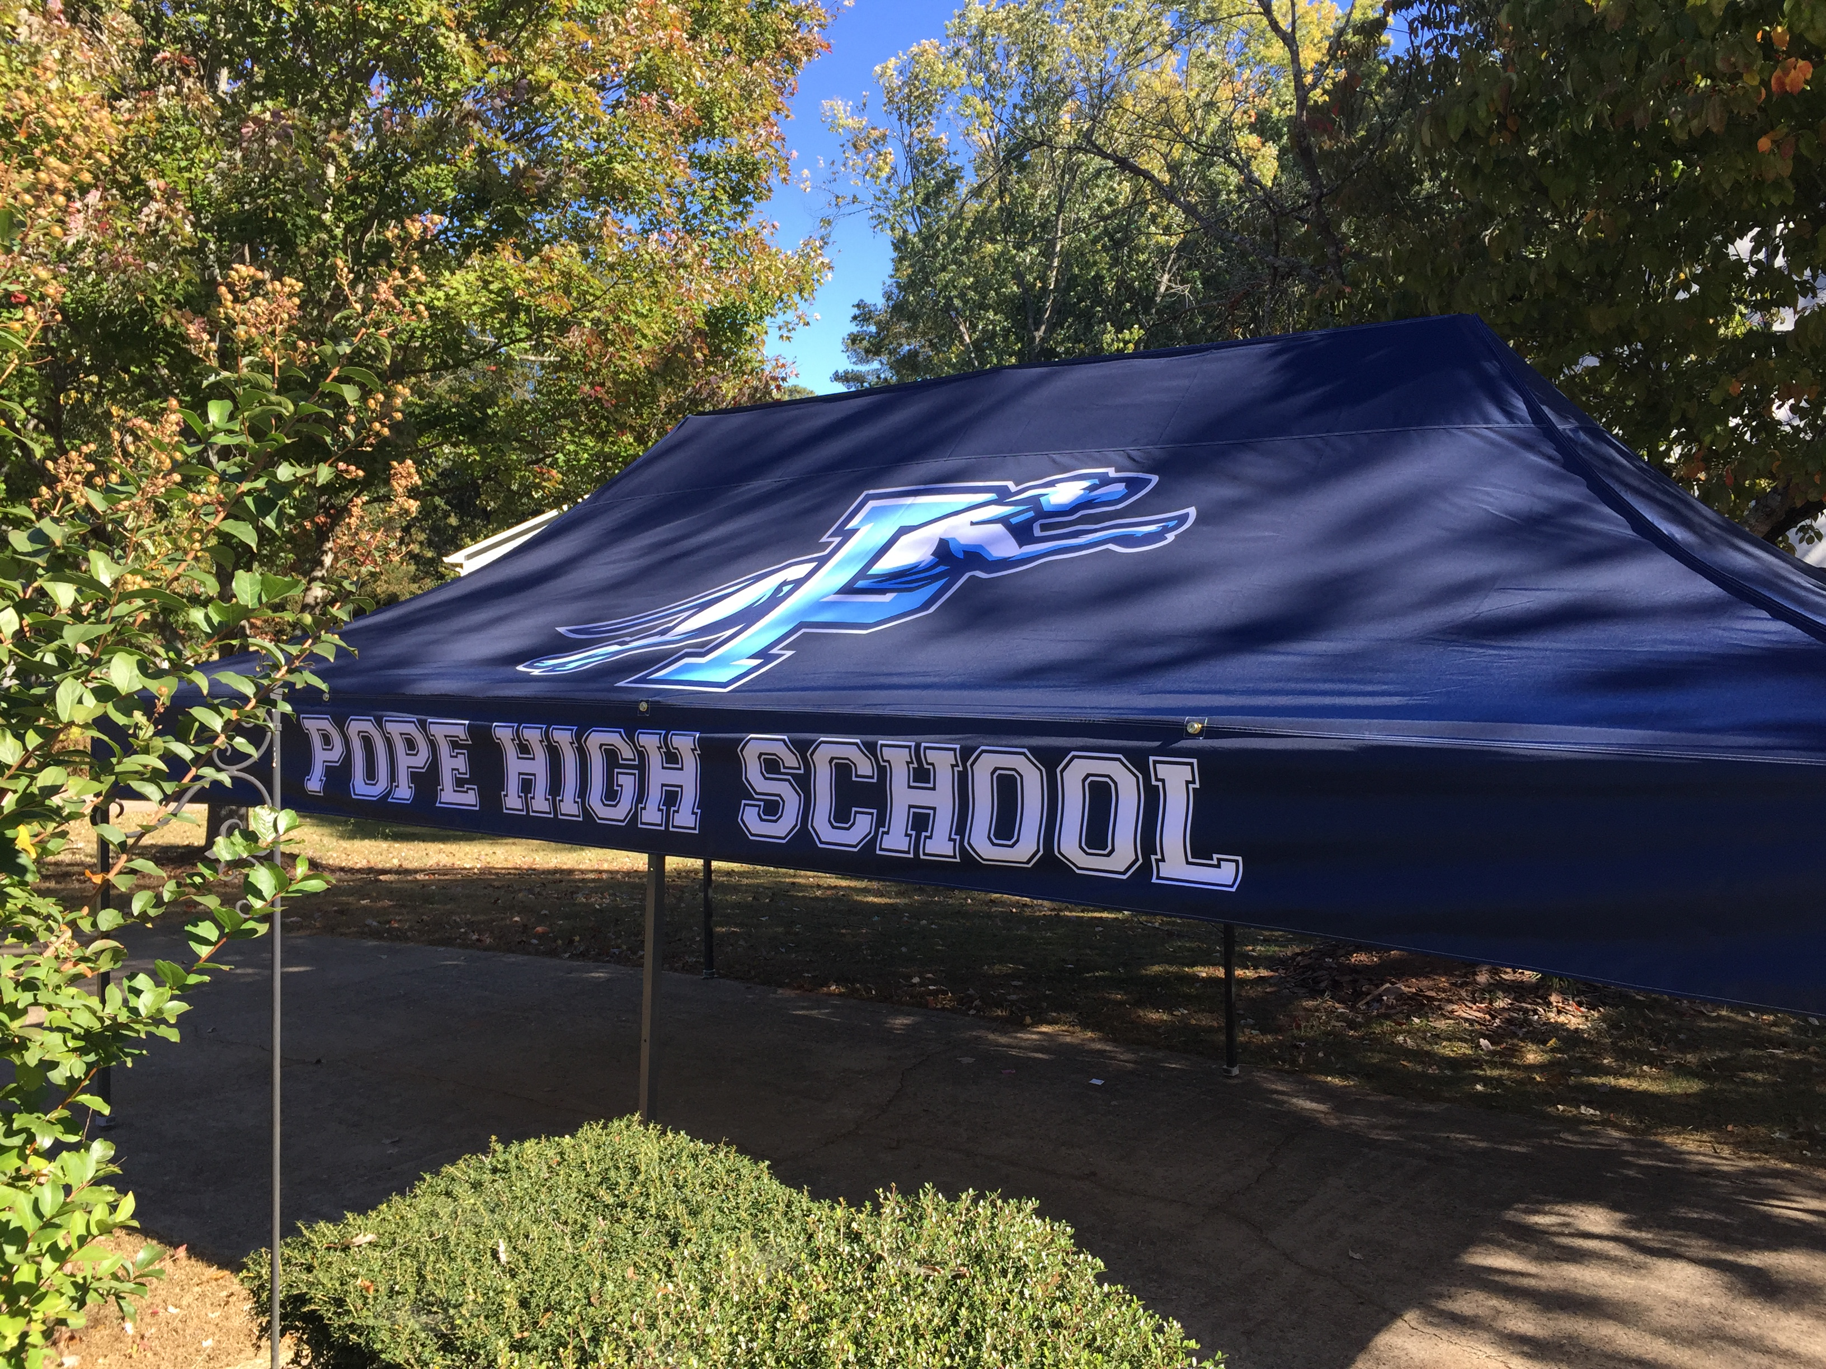

Slide 15
Let’s goooooo!!!
REGION!!!!!!!!

Slide 16
Get ‘em fired up PATRICK!!!
…BUT KEEP OUR EYE ON THE PRIZE!!

Slide 17
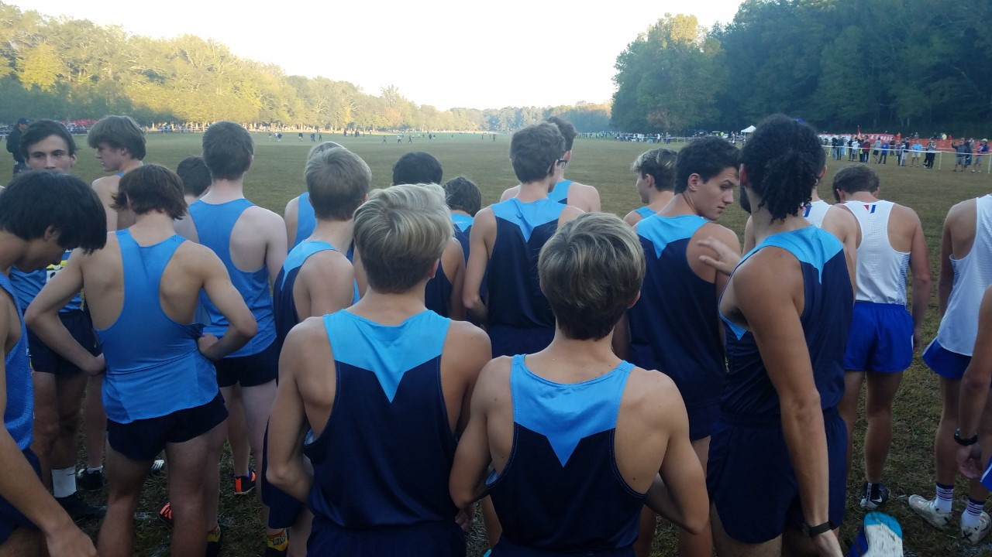
FOCUS

Slide 18
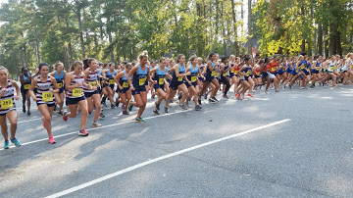
Get a great start!!!!

Slide 19
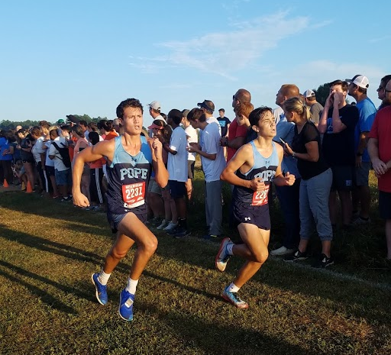
HAVE STRENGTH IN NUMBERS

Slide 20
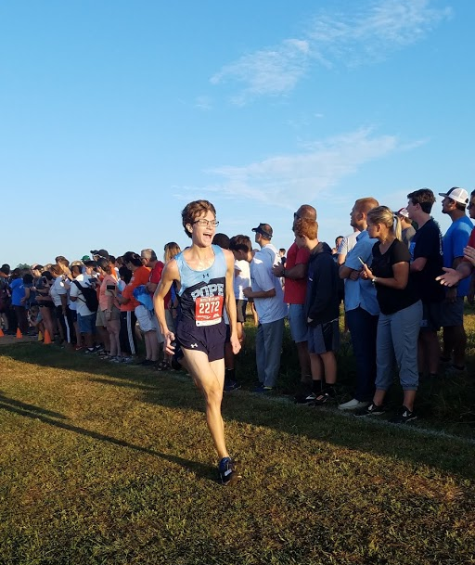
FINISH THE RACE!!!!

Slide 21
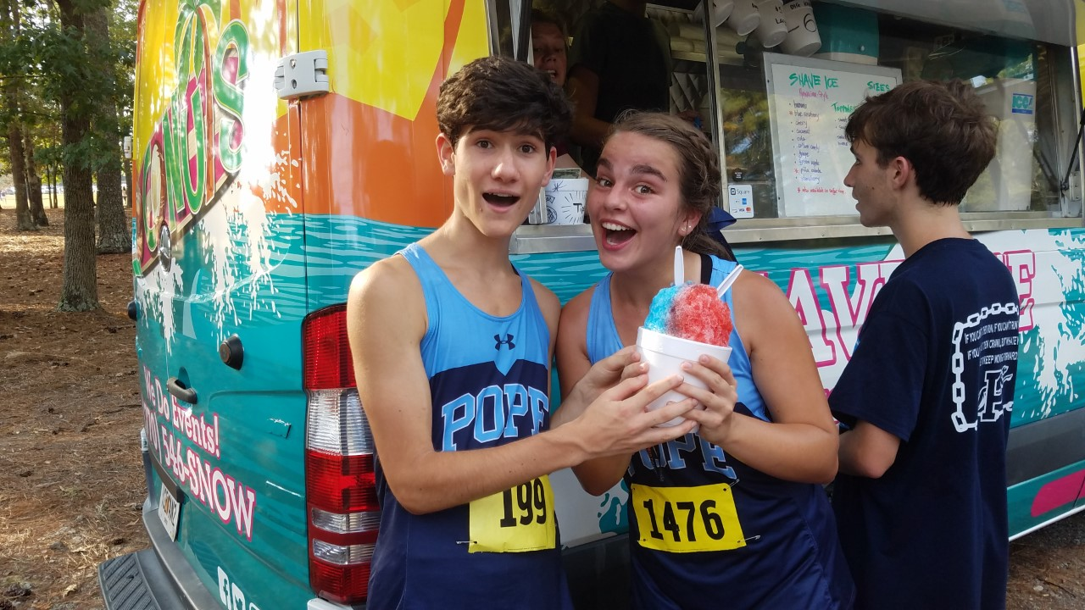
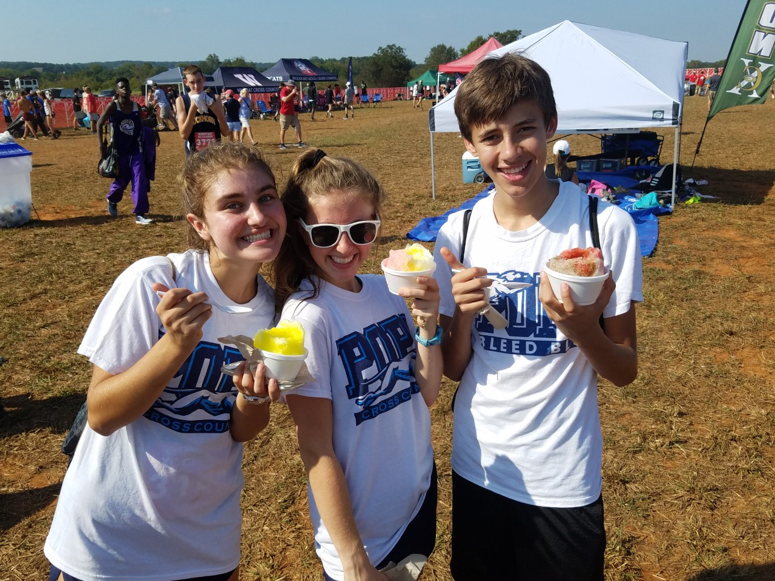
TEAM

Slide 22
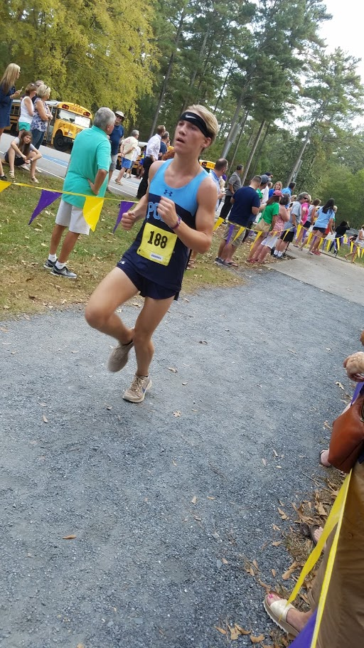
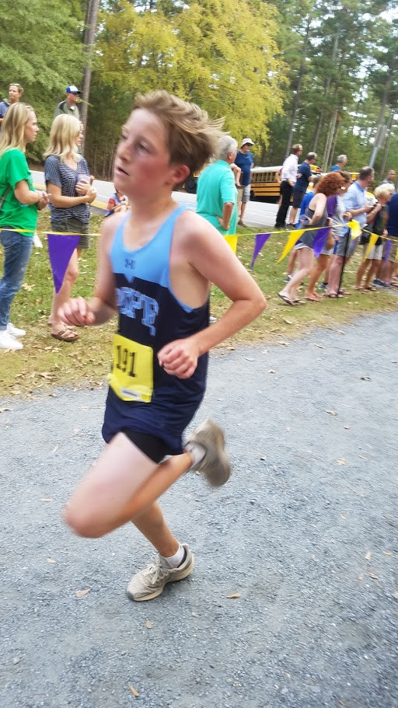
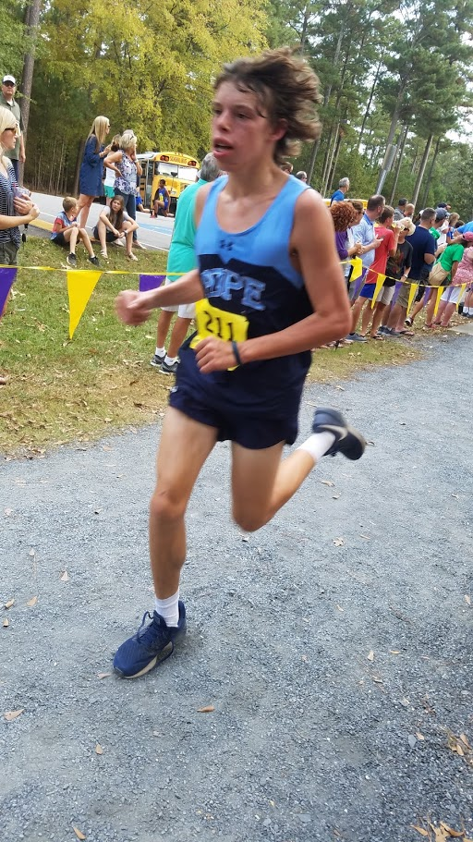

Slide 23
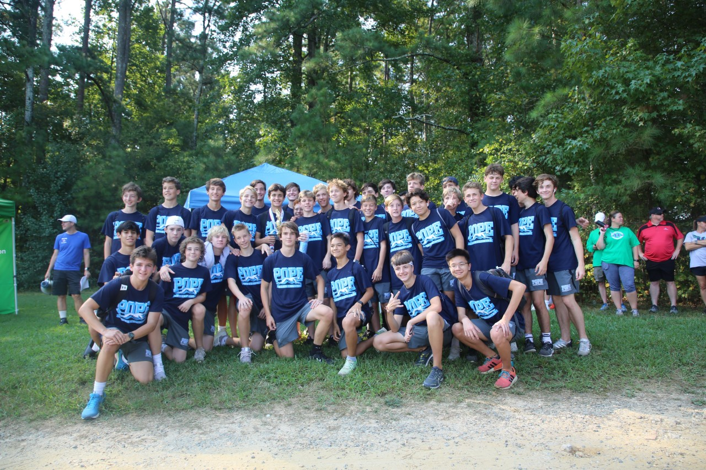
2019 JV COUNTY RUNNERUPS
Are YOU the next guy/gal to STEP UP?!!

Slide 24
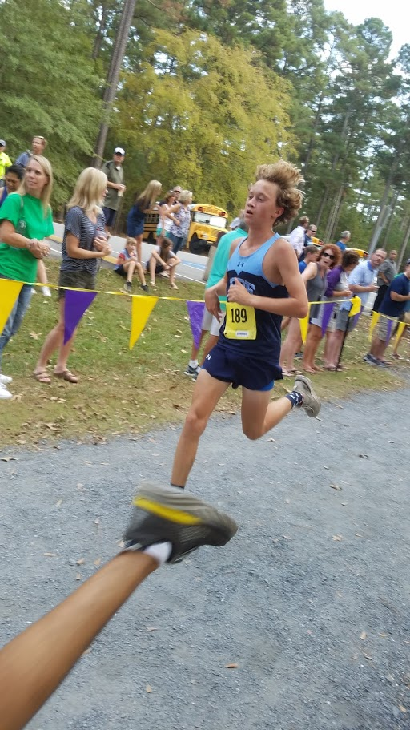
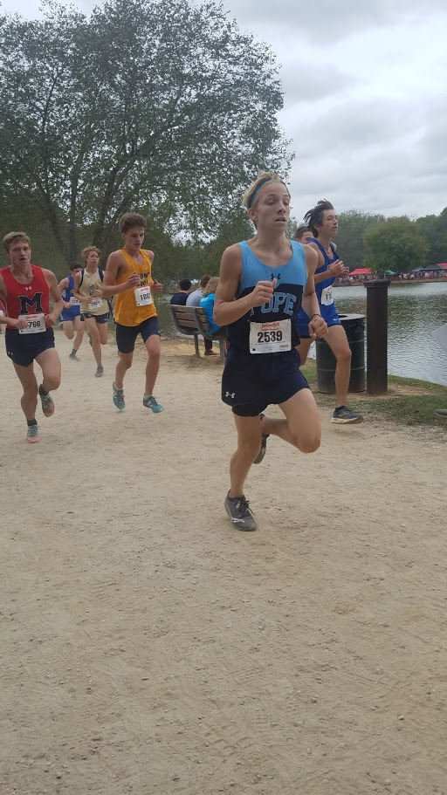
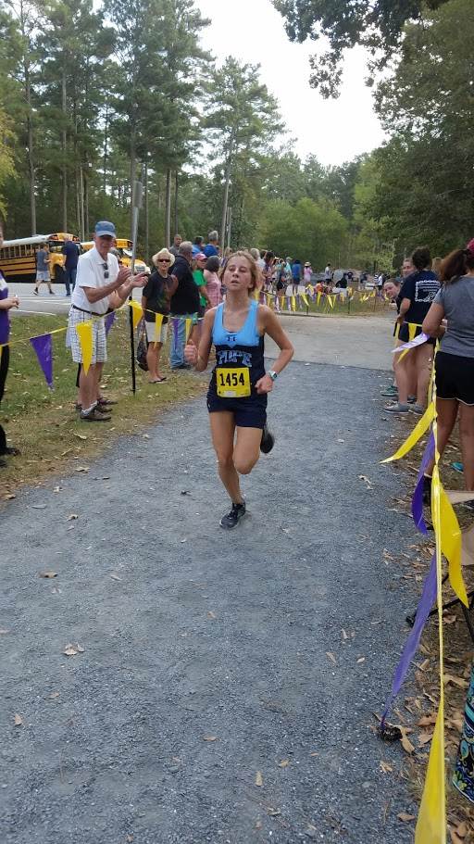
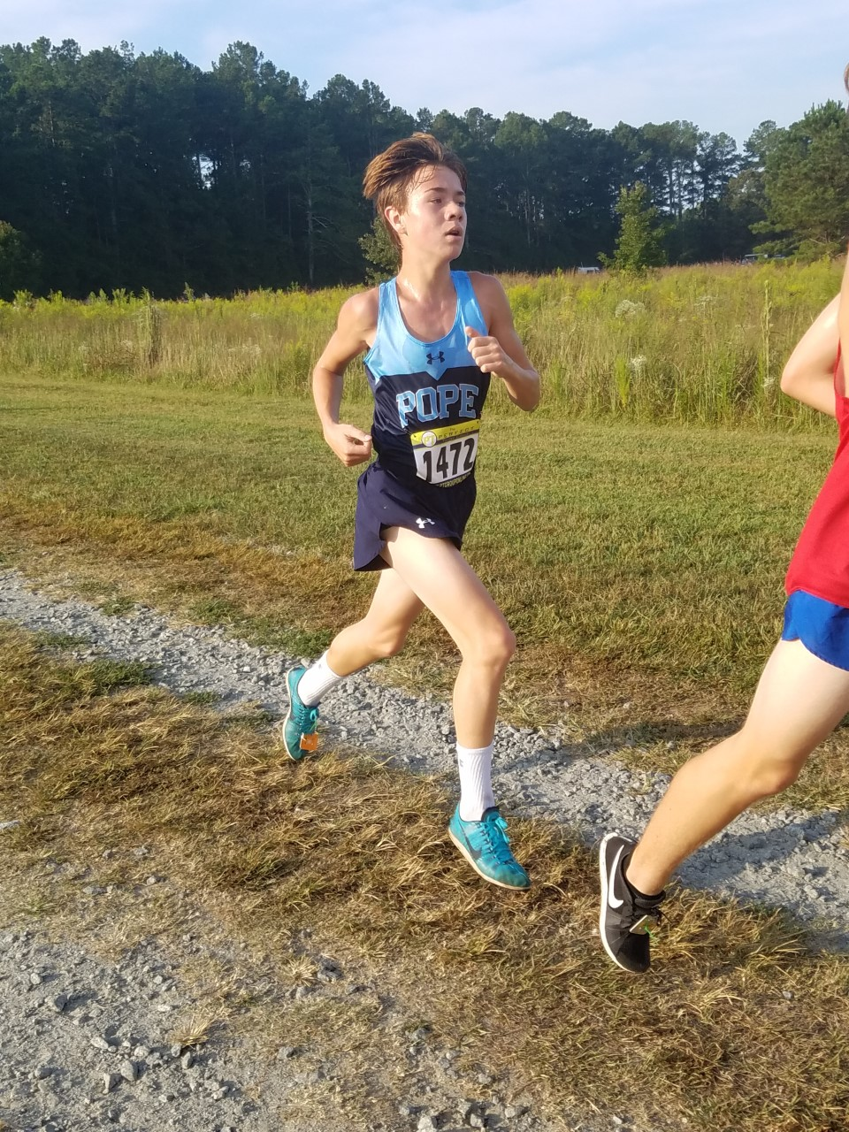
Are YOU the next guy/gal to STEP UP?!!

Slide 25
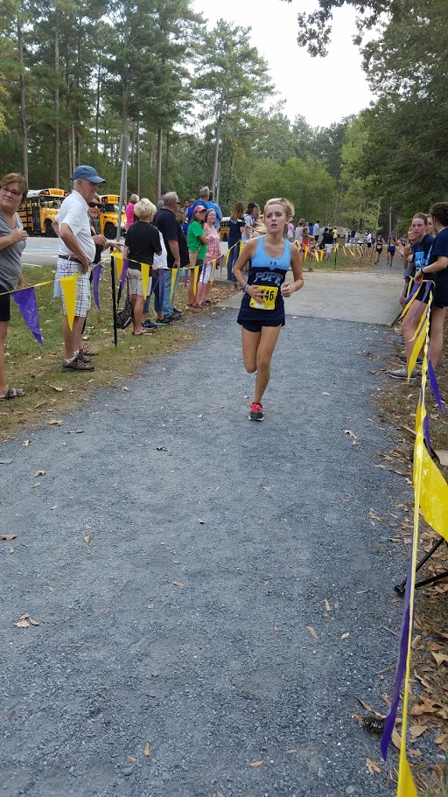
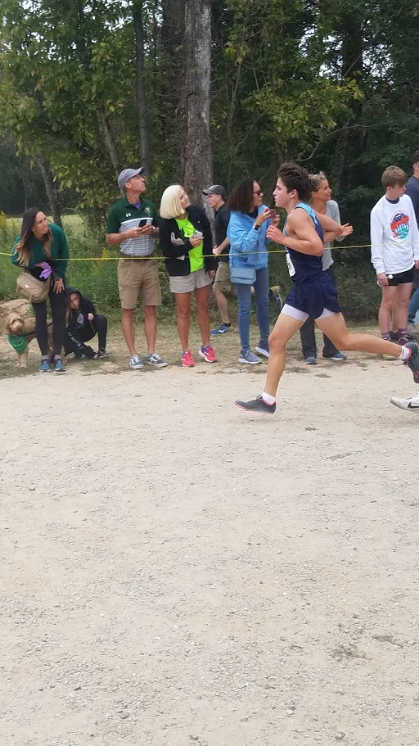
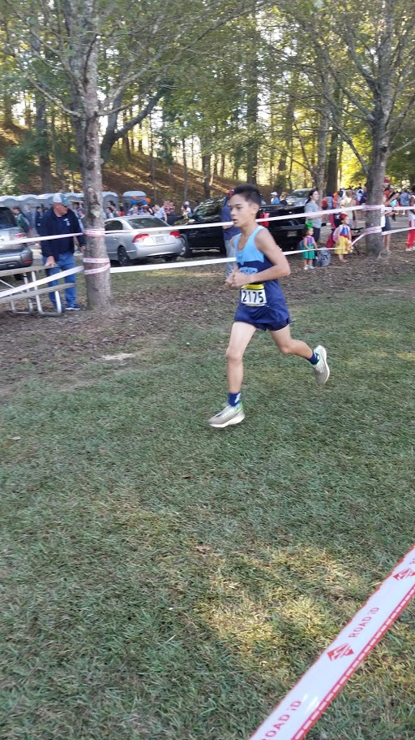
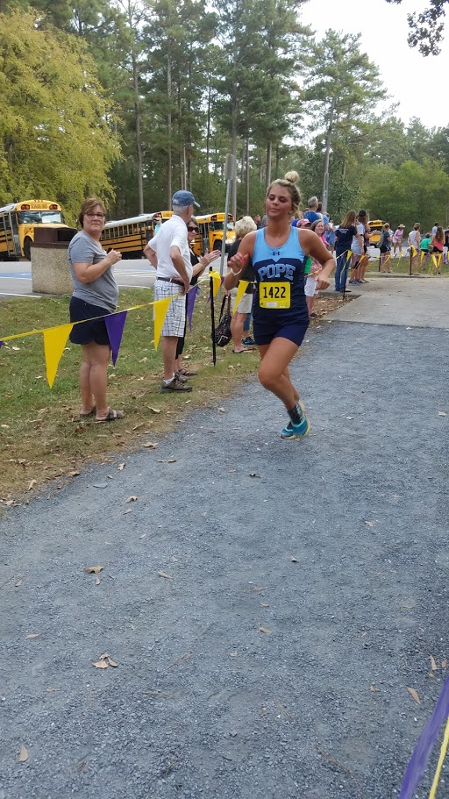
LEADERS FOR TOMORROW

Slide 26
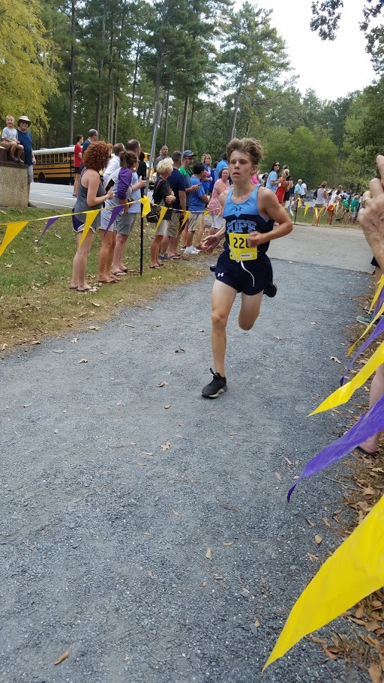
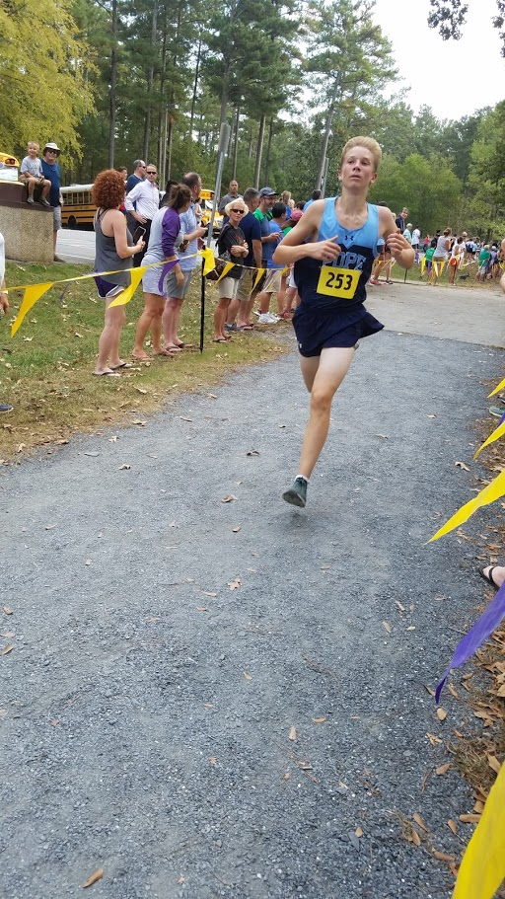
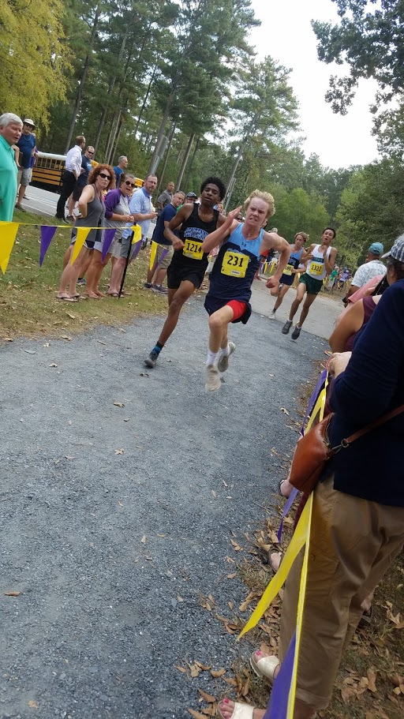

Slide 27
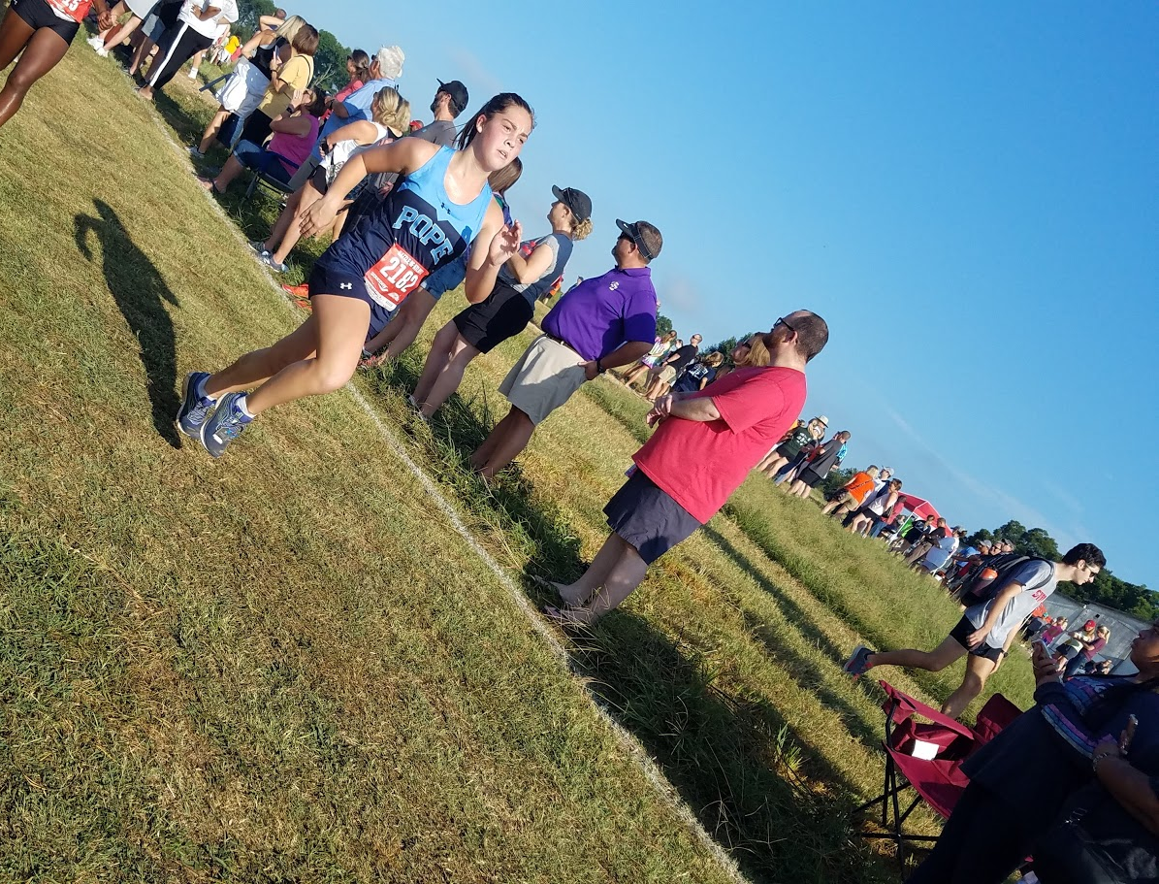

Slide 28
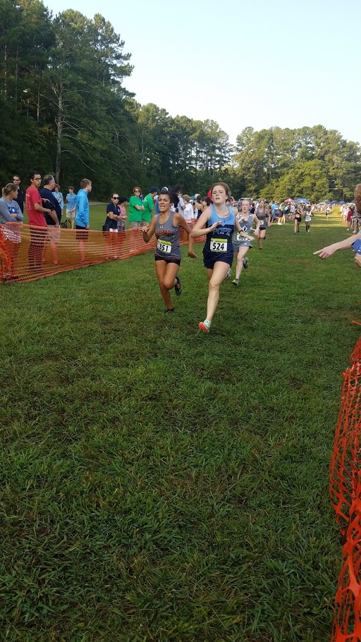
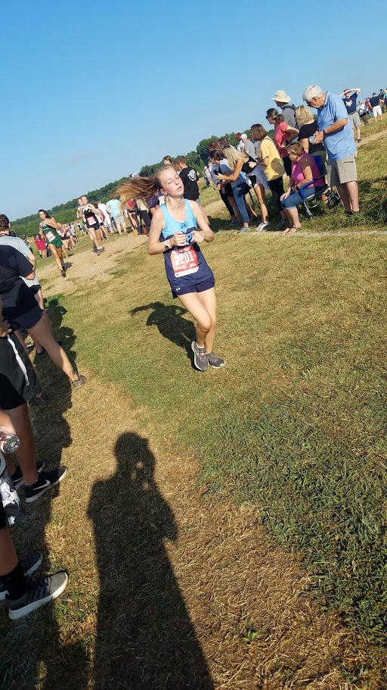

Slide 29
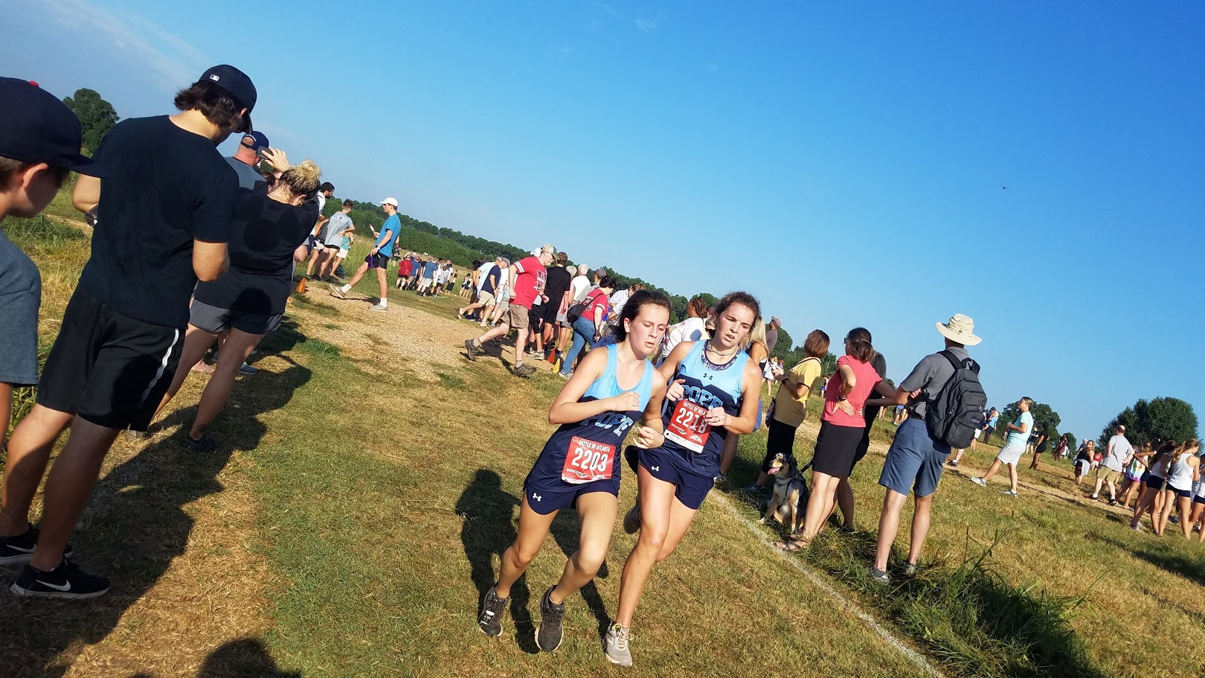

Slide 30
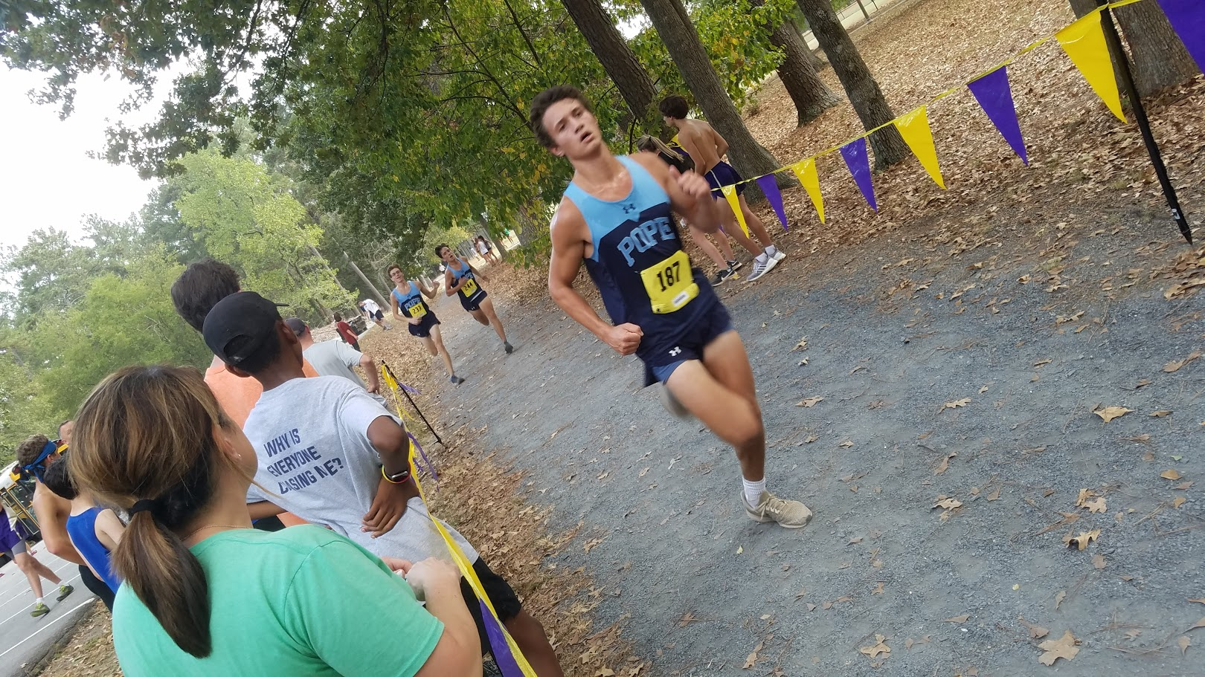
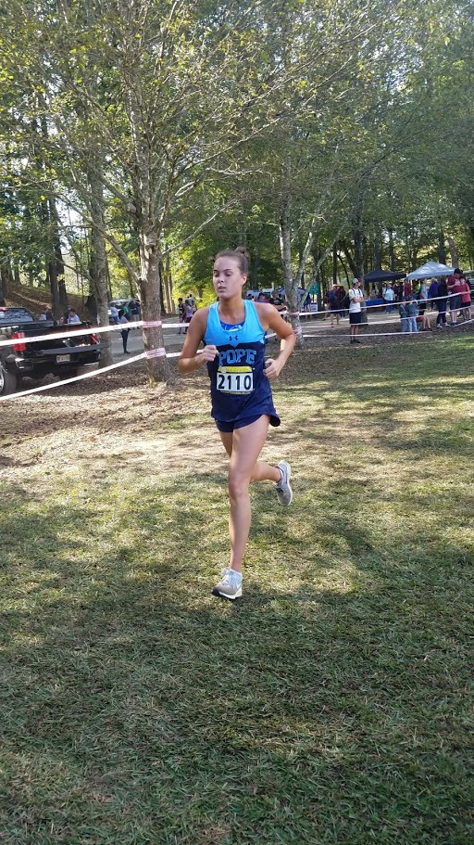
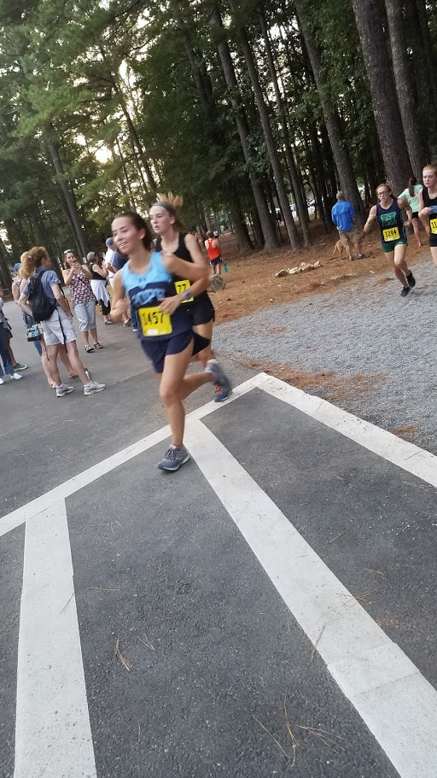
SENIORS

Slide 31
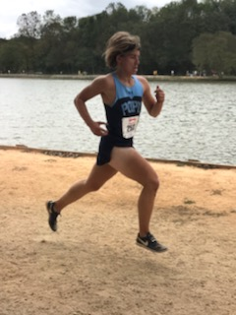
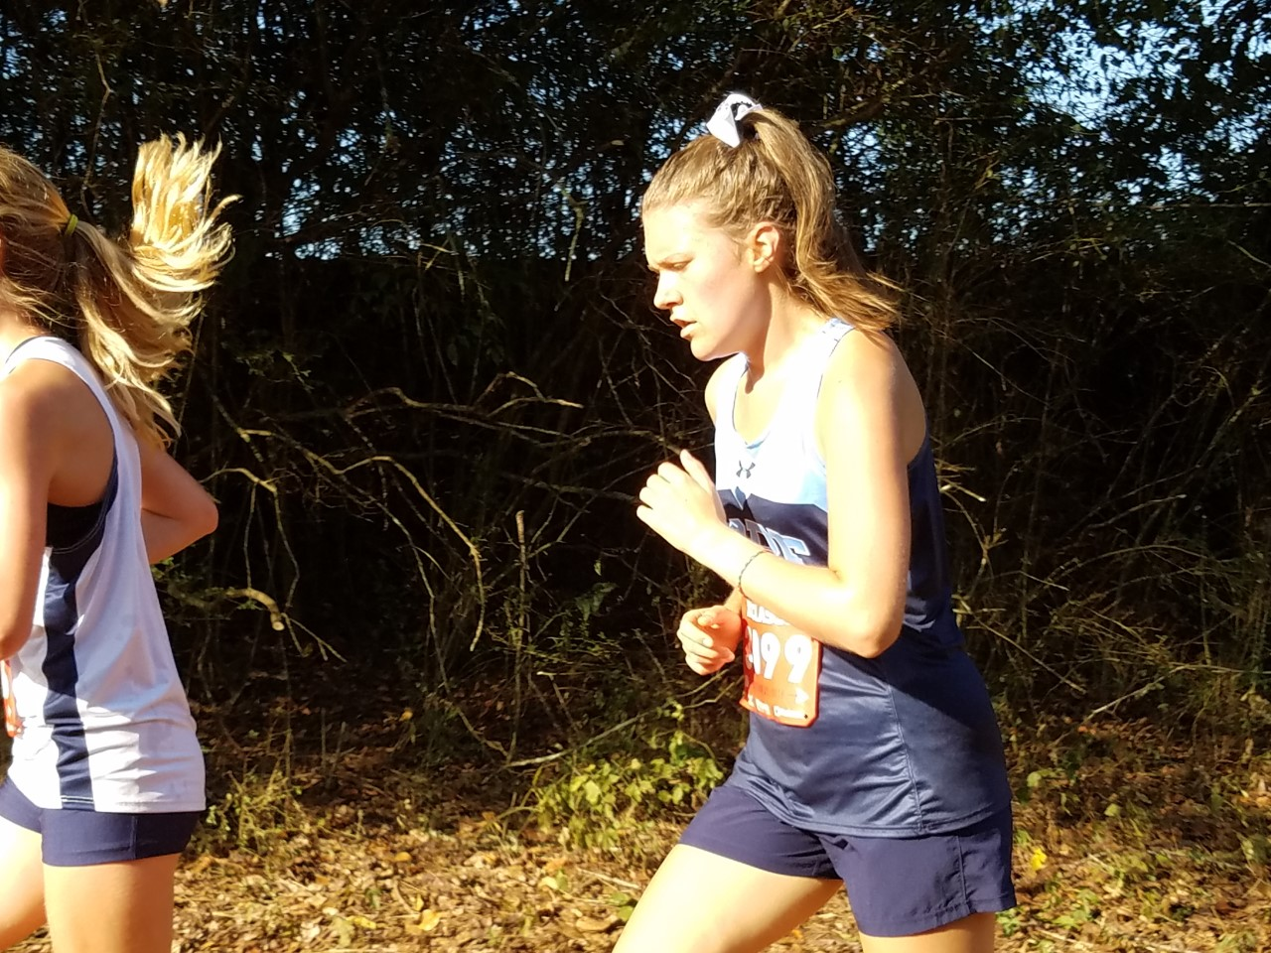
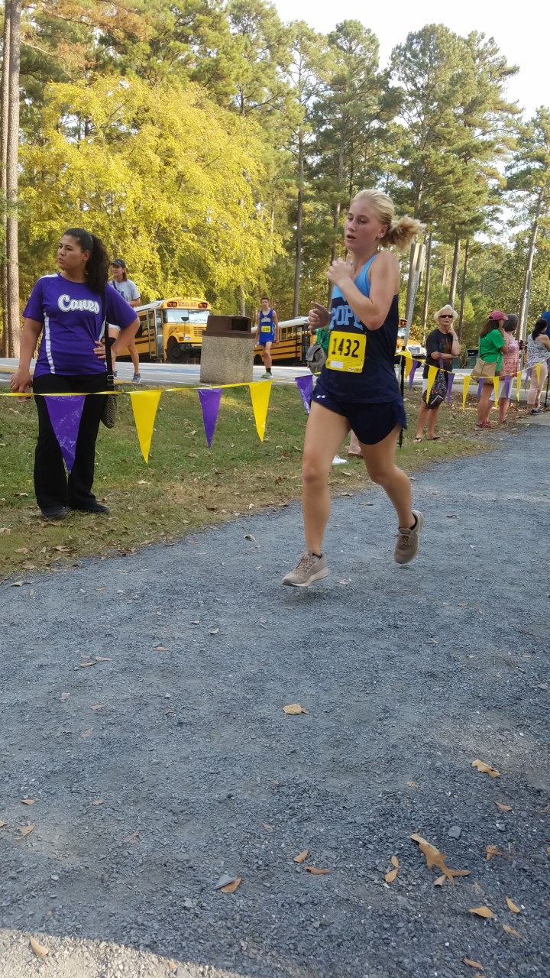
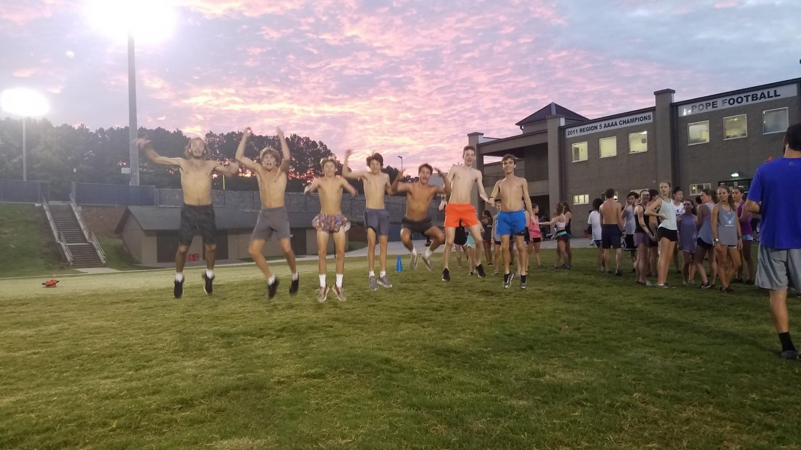
SENIORS

Slide 32
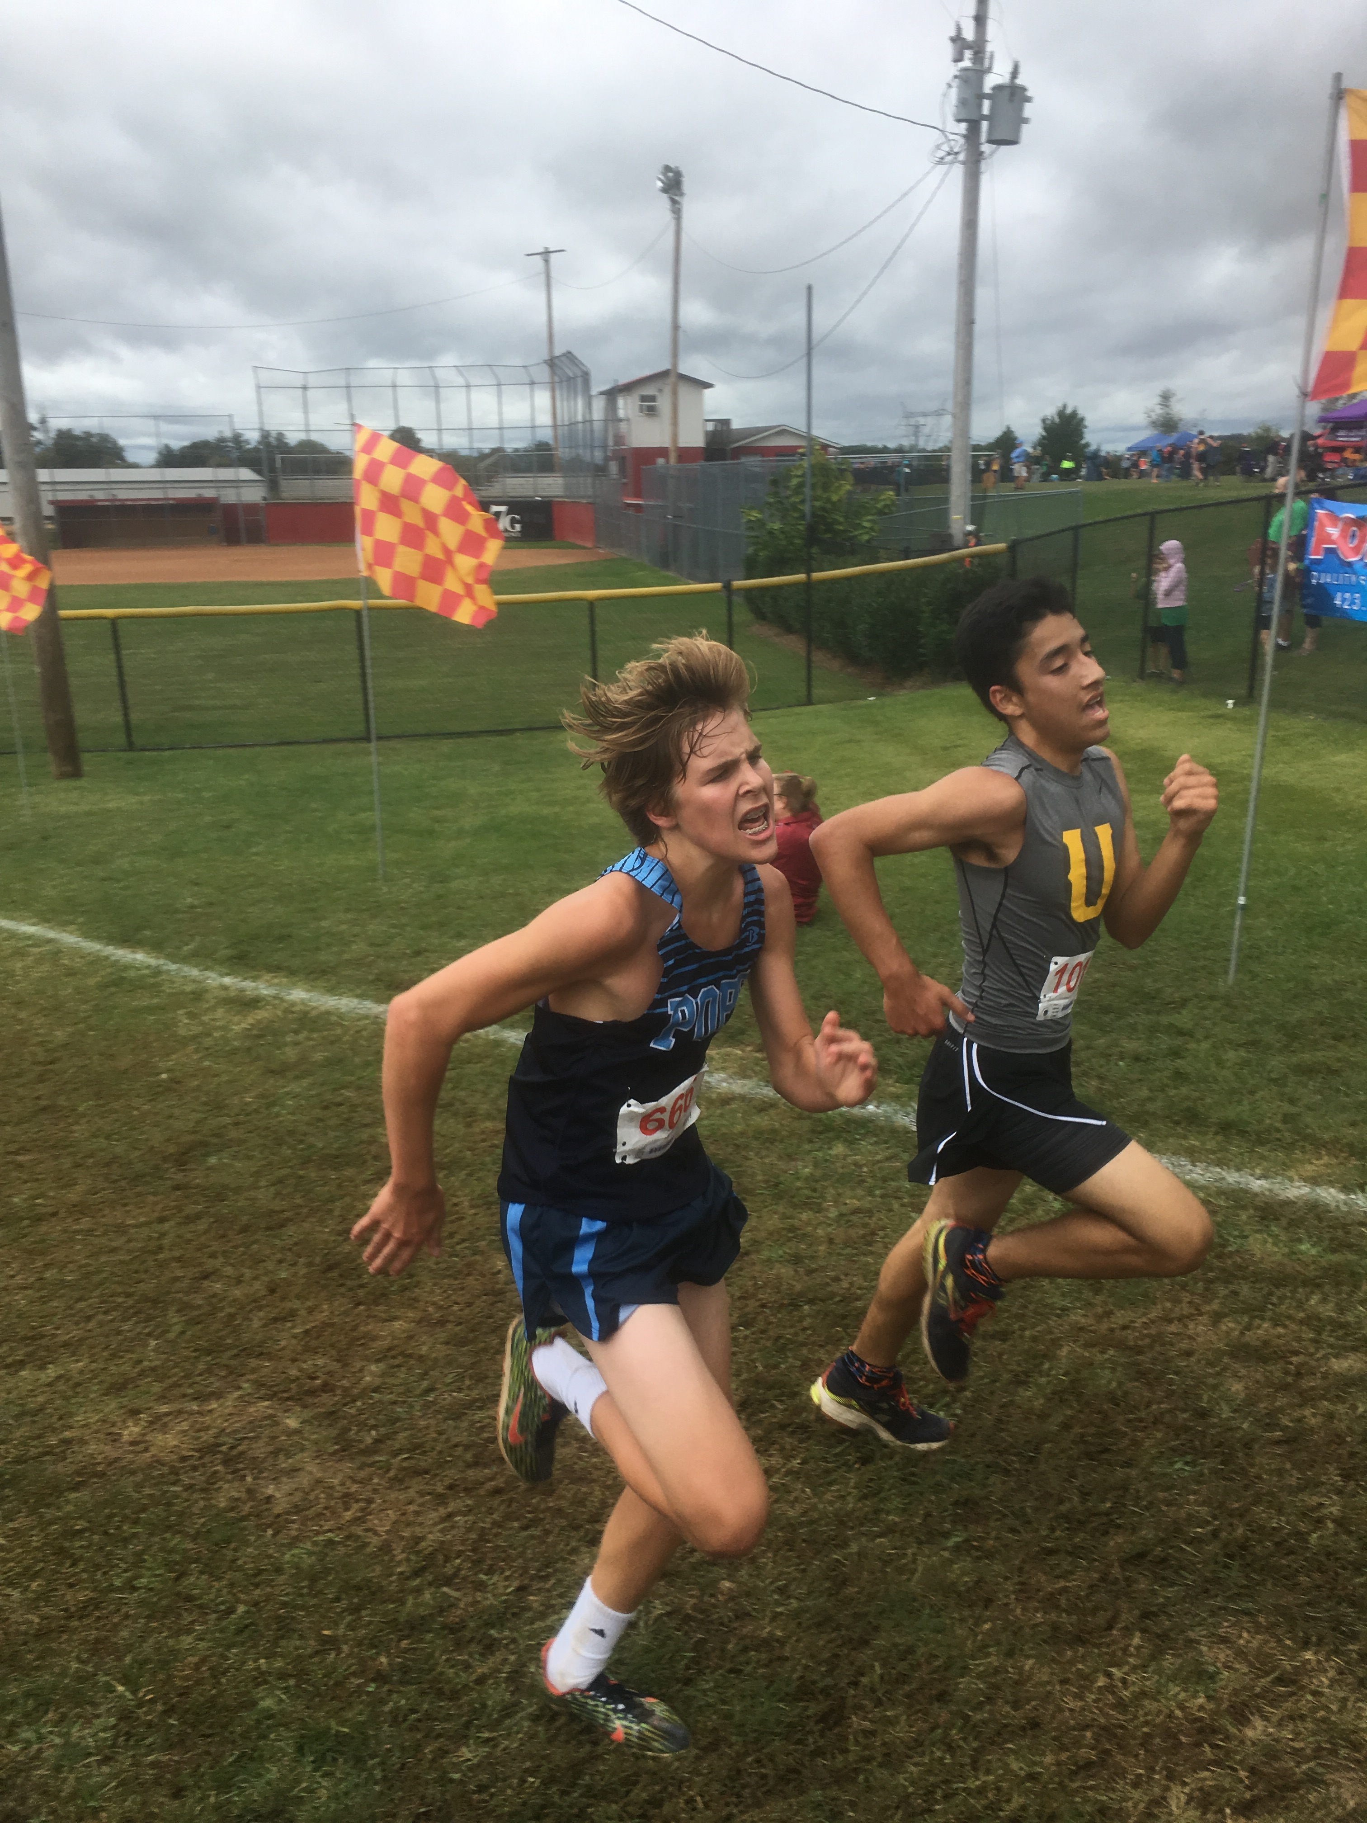
SENIORS

Slide 33
WILL BROWN
ETHAN STOLTZ

Slide 34
HOW ABOUT TEAM POPE!!!!
Pickens Preview
Cass CArtersville
BATTLE OF ATLANTA

Slide 35
Wendy’s Invitational

Slide 36
I run for my TEAMMATES

Slide 37
SENIORS WERE THE 2016 JV County CHAMPIONS!!!
Ethan
Josh
Patrick
Jacob
Cole
Noah
Will
KC

Slide 38
Rely on your teammates!!!

Slide 39
It took the whole TEAM to make this happen!!!
2018 REGION CHAMPS
STATE 4TH PLACE

Slide 40
3x REGION CHAMPS
VARSITY BOYS

Slide 41
2018 STATE CHAMPIONS

Slide 42
SENIORS!!!!!!!!

Slide 43
There have been many quality pope cross country athletes through the years that are all linked together by this great program!!!!
You are now part of that chain!!!

Slide 44
The Link
I carry a link in my pocket
A simple reminder to me
Of the fact that I am a team member
No matter where I may be
This little link is not magic
Nor is it a good luck charm
It isn’t meant to protect me
From every physical harm
It’s simply an understanding
Between my teammates and me

Slide 45
When I put my hand in my pocket
To bring out a coin or key
The link is there to remind me
Of what a team member should be
It links me to the team
It links me to the school
It is a constant reminder
That there is no place for a fool
So I carry this link in my pocket
To remind me many a time
That a teammate without conviction
Isn’t worth a simple dime

