Slide 1
The Story of Suriname(r) 3.0
SURINAME 3.0

Slide 2
Doelstelling en opbouw presentatie
Suriname(r) 3.0
Reflectie
Law of attraction
Ivan Kuster

Slide 3
Verandering van tijdperken
We beleven een verandering van tijdperken (Jan Rotman)
1.0 Lanbouw
2.0 Industrie
3.0 Informatie / kennis
4.0 Wijsheid
https://www.youtube.com/watch?v=kvzsd25ciAg

Slide 4
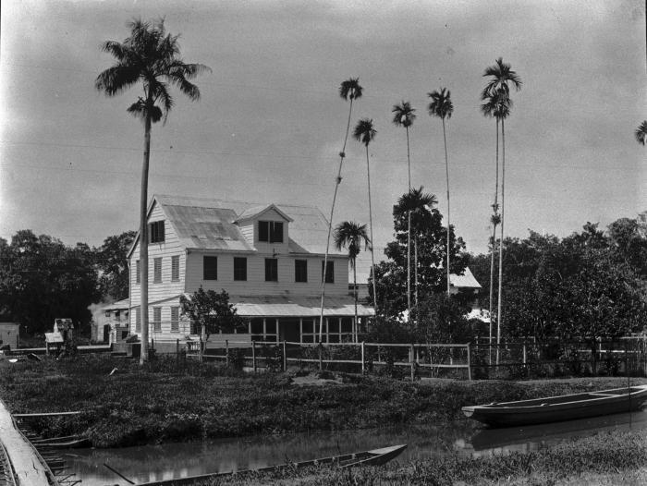
1.0
was a scheme for structuring society around relationships derived from the holding of land in exchange for service or labor
1863
Notes:
Is the feudal era: was a whole of legal and military customs in medieval Europe that blossomed between the 9th and 15th centuries, which, broadly defined, was a scheme for structuring society around relationships derived from the holding of land in exchange for service or labor.

Slide 5
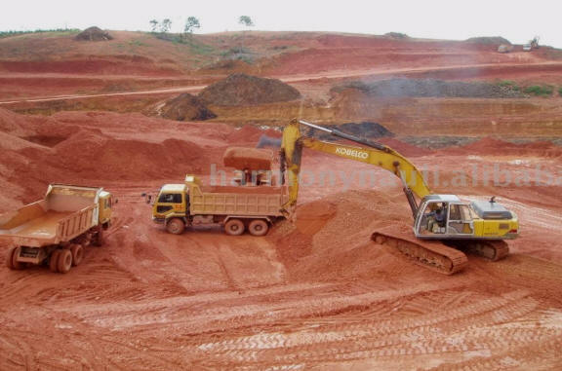
2.0
the conversion of manually made good to machine made goods
1930?
Notes:
2.0 Is the industrial era: the era after the industrial revolution, the conversion of manually made good to machine made goods. The capitalist class and the working class are created.

Slide 6
Connectivity is a human right
Internet is de basis

Slide 7
3.0
Is the information or internet era (1990)
The creative class is the driving force of society.
Knowledge Society
When the internet cable landed?
Network society
Notes:
Is the information or internet era: the world dominated by the internet. The creative class is the driving force of society.

Slide 8
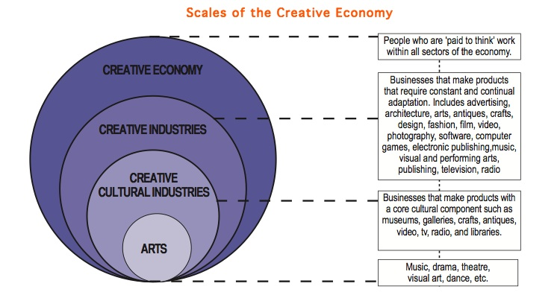
The Creative++ Experience Economy

Slide 9
Suriname denkt na
Vision 2030 uit 2013
Megatrends Suriname van augustus 2014 (Adjiedj Bakas)
Notes:
Individuele empowerment. Dit groeit door armoede-reductie, groei van de middenklasse, onderwijs, technologie en vooruitgang in de gezondheidszorg.
Diffusie van macht. Hegemonie verdwijnt: macht verschuift naar nieuwe netwerken en coalities in een multipolaire wereld.
Demografische verschuivingen. De economische groei zal afnemen in landen met een vergrijzende bevolking, 60% van de wereldbevolking zal wonen in urbane gebieden, migratie zal toenemen.
Voedsel-, water- en energieketen. Door bevolkingsgroei zal de vraag naar deze producten toenemen.

Slide 10
Suriname internet
5.2% van de inwoners toegang tot internet.
En 22.7% van de huishoudens heeft een internetaansluiting.
In het Caraïbisch gebied heeft 32.4% van de inwoners een internetaansluiting.

Slide 11
Curaçao
"Meer dan de helft (53,2%) van de woningen heeft in 2011 een internetaansluiting aan de woning;
dat is een forse toename vergeleken met de 20,9 procent in 2001. "

Slide 12
Curaçao Broadband Connectivity: nr. 10

Slide 13
Curaçao Cost of Internet: nr 2

Slide 14
Curaçao Download speed

Slide 15
Seacables
Suriname
ABC

Slide 16
Minder dan 95%
Dat is niet genoeg. Internet is een grondrecht.
Stel dat 47% geen water had.
En ik heb geen woorden over voor het feit dat er zoveel gedoe is geweest over het zogenaamde gratis onderwijs, maar niemand heeft gerept over het project "one laptop per child".
Waarschijnlijk begrijpt de huidige generatie van babyboomers en Gen X, het internet niet..

Slide 17
Technologie, Internet, World is flat
Virtueel Suriname
Content
Governance, horizontal
Kiesstelsel
Drones

Slide 18
Caribbean SIDS 3.0

Slide 19
Small Island Development State
Caricom
Sustainabilty
People, Planet, Profit
Ecologie

Slide 20
2.0 is broken and cannot be fixed

Slide 21
What to do?
Develop the talent
Good Governance
Climate Change
Sustainable Development
ICT

Slide 22
Education
Children learn by themself
OLPC
Nicholas Negroponte (2006)
Blended learning
Incubator
Webinar
Notes:
Nicholas Negroponte (born December 1, 1943) is a Greek American architect best known as the founder and Chairman Emeritus ofMassachusetts Institute of Technology's Media Lab, and also known as the founder of the One Laptop per Child Association (OLPC).

Slide 23
Leiderschap
De rol van de elite
Mindset 3.0
Relaties creative class
Be the change you want to see

Slide 24
Curaçao

Slide 25
Suriname Strategy

Slide 26
Resource curse / mineral curse
The resource curse, also known as the paradox of plenty, refers to a paradox.
Notes:
The resource curse, also known as the paradox of plenty, refers to the paradox that countries and regions with an abundance of natural resources, specifically point-source non-renewable resources like minerals and fuels, tend to have less economic growth and worse development outcomes than countries with fewer natural resources.

Slide 27
Vision / Master plan 3.0
The vision is to be the best SIDS in your niche

Slide 28
Policy CSIDS 3.0
Consider the Suriname as corporation.
Make a strategic plan.
Fight corruption.
Have a mean and lean civil service.
Experience economy.
Notes:
Consider the island not as a state but as a corporation.
Make a strategic plan and execute it.
Fight corruption because corruption is a root cause of underdevelopment. It makes everything more expensive because it disturbs the market.
Have a small competent civil service, mean and lean.
The strategy regarding tourism should be based on the theory of experience economy.

Slide 29
Master Plan CSDIS3.0
ICT | Financial sector | Experience Tourism | Transnational education |  | Airport City, with logistics, tourism, ICT, financial sector, education and research. | Knowledge zone | Creative zone | Green Town | Logistical hub | Medical Tourism
Government and governance
Law and order
Harbors and airport
Roads
Utilities
ICT
Education
Healthcare
Social welfare

Slide 30
Conclusion
CSIDS 3.0 must develop a vision and long-term master plan based on the following trends:
ICT is the leading technology;
Attracting a creative class is essential;
Local agriculture will be vital;
It is about sustainability.
100% Internet acces

Slide 31
The message
Cooperate
Create knowledge networks
Reverse diaspora
Create funds Create and business incubators

Slide 32
The message is
To cooperate and not compete.
Include not exclude.
To not reinvent the wheel but learn from each other.
It is about a new mindset 3.0.
All this is enabled by ICT.
Create a practical master plan and implement like crazy.
Apply Corporate Governance / Transparency

Slide 33
Change management
Om gaan met weerstand
Need for change
Vision
Leadership
People involvement
Measurement

Slide 34
Workshop Suriname(r) 3.0
SURINAMER 3.0

Slide 35
The S-curve

Slide 36
Do you remember?
Library
The book store. Now we have the ebook
The record shop. Now we download music
The photo shop
The video store
Radio is digital
TV is digital
The mail man
The Faxmachine

Slide 37
What happened?
Populism
Nationalism/ inward looking
Anti Know How
Anti Intellectualism
Good Governance
Corruption
TOC

Slide 38
Wat is 3.0?
1.0
2.0
3.0

Slide 39
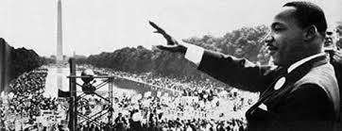
Dream 3.0
“If you can dream it, you can do it.”
Walt Disney
Notes:
5 September 2013 King’s dream book
MLK 50 years ago

Slide 40
Everything that can will be digitalized
3D Printer
everything that can will be digitalized (1995)
http://fablab.vicepresident.gov.sr/?page_id=5
Notes:
1960s till explotion in 1990s

Slide 41
Banken beginnen mobiel betalen in Leiden, rest volgt
2 september 2013
zaterdag 10 augustus 2013, 20:06
De helft van de filialen van de Rabobank moeten dicht. Het filiaal van de Rabobank in Axel, Zeeuws-Vlaanderen, sluit dit jaar nog zijn deuren.
We are in line not online
eBanking but still in line
Notes:
NIEUWS - 29 augustus 2013
Duizend particulieren klanten van ABN AMRO, ING en Rabobank kunnen vanaf volgende week hun portemonnee thuislaten als ze de stad ingaan. Hun telefoon fungeert dan als portefeuille, te gebruiken bij 150 winkels.

Slide 42
Smart Watch / Google Glasses
4 september 2013
Notes:
De langverwachte 'smartwatch' van Samsung, de Galaxy Gear, wordt wel degelijk op 4 september voorgesteld, net voor de IFA-beurs in Berlijn. Na geruchten die daarover al enkele weken de ronde deden, bevestigde een van Samsungs managers het nieuws gisteren.

Slide 43
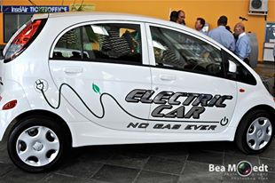
No driver
2011 Nevada
Notes:
The U.S. state of Nevada passed a law on June 29, 2011 permitting the operation of autonomous cars in Nevada. Google had been lobbying for robotic car laws.^{[4][5][6]} The Nevada law went into effect on March 1, 2012, and the Nevada Department of Motor Vehicles issued the first license for an autonomous car in May 2012. The license was issued to a Toyota Prius modified with Google's experimental driverless technology.^{[7]} As of April 2012, Florida became the second state to allow the testing of autonomous cars on public roads.^{[8]} California became the third state to legalize the use of self-driven cars for testing purposes as of September 2012 when Governor Jerry Brown signed the bill into law at Google HQ in Mountain View.^{[9]}

Slide 44
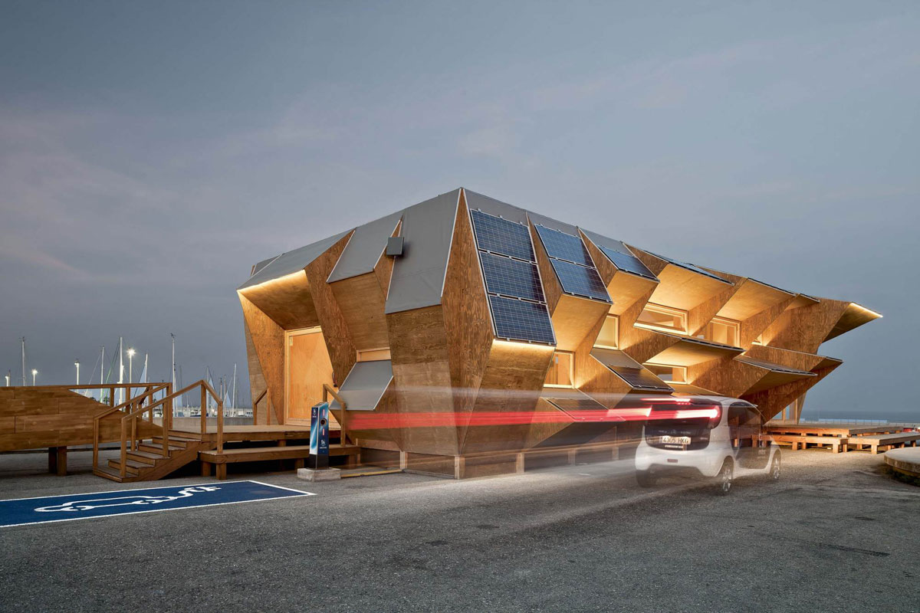
Solar House 2.0 Barcelona “printed” and build in 2 weeks
http://www.youtube.com/watch?v=3R1CBFBxuew

Slide 45
Smarthomes
Family 3.0

Slide 46
Government
eGovernment
Less government
We solve our own problems
Service via internet
Government legging behind

Slide 47
Agriculture
Permaculture
Home 3.0 will grow some of their own food

Slide 48
Police 3.0
No helicopter but drone
Camera
GPS
Control rooms

Slide 49
Tomorrow's cities: Do you want to live in a smart city?
19 August 2013 Last updated at 00:00T
By Jane WakefieldTechnology reporterCLICKABLE
Johannesburg
Singapore
Songdo
Masdar
Barcelona
Amsterdam
Dublin
Rio de Janeiro
Boston
London
Notes:
How do you fancy living in a city with which you can interact? A city that acts more like a living organism, a city that can respond to your needs.
Around the world such cities are already being built, from Masdar in Abu Dhabi to Songdo in South Korea. Now the chaotic city near you may be in line for a makeover.
In the future everything in a city, from the electricity grid, to the sewer pipes to roads, buildings and cars will be connected to the network. Buildings will turn off the lights for you, self-driving cars will find you that sought-after parking space, even the rubbish bins will be smart.
But how do we get to this smarter future. Who will be monitoring and controlling the sensors that will increasingly be on every building, lamp-post and pipe in the city?
And is it a future we even want?
Technology firms such as IBM, Siemens, Microsoft, Intel and Cisco are busy selling their software to solve a range of city problems, from water leaks to air pollution to traffic congestion.
In Singapore, Stockholm and California, IBM is gathering traffic data and running it via algorithms to predict where a traffic jam will occur an hour before it has happened.

Slide 50
Transport communication / nieuwe werken
Transport
Bus
Trein
Taxi
Internet
No more in line
Apps with information
Apps to arrange a ride

Slide 51
Tourism 3.0
Experience economy
Space Port
Students with their smartphones
CNSJ

Slide 52
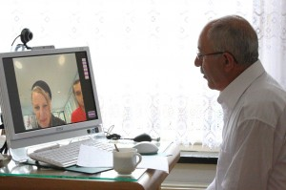
Healthcare
IHealth/ E-Health
You manage your health
Preventive healthcare
Integration of systems
Medical tourism

Slide 53
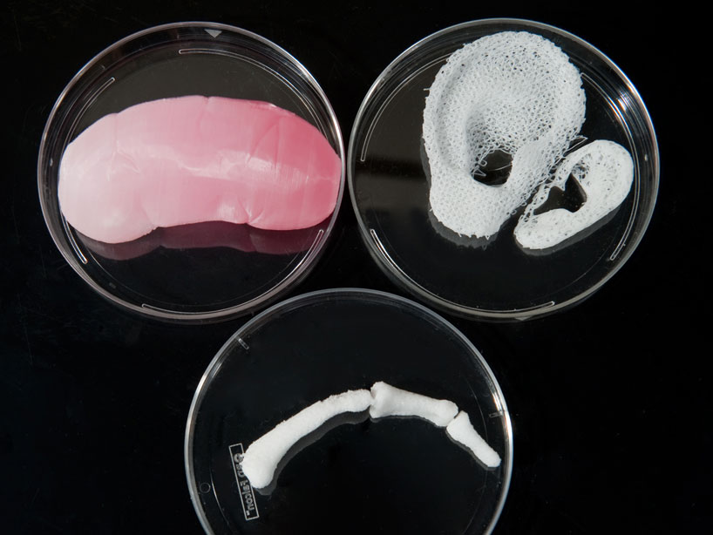
Medical Possibilities
Printing a Kneecap
http://youtu.be/KAQsB_NTuFw
Saving Lifes
http://youtu.be/j1okQrqBa70
http://www.wired.co.uk/news/archive/2013-04/24/3d-printed-liver

Slide 54
Values
Values 3.0
Oude waarde
Sharing
Virtual
Immaterial
Faith
Confidence
Functional
Transparent
Open source
Internet
Moreel verval
Oude waarde
Greed
TOC
Notes:
Sharing
The way forward is based on “sharing”, the transmission of unnecessary stuff, of stuff one no longer uses.
CSR 3.0 If more than social entrepreneurship. A second principle is the social responsibility (CSR). It involves solving a social problem, or something to contribute and to earn.
Capitalism 3.0
Virtual
It does not matter where you are and when. Virtually one is always at the right time in the right place
Immaterial
It's no longer about what you have, but who you are and what you stand for
Faith
Confident belief in the truth, value, or trustworthiness or a person, idea, or thing. Belief That does not rest on logical proof or material evidence.
Confidence
It is confidence that ultimately provides stability in relationships (privacy)

Slide 55
The Mesh
"The Mesh is reshaping how we go to market, who we partner with and how we invite participation and engage new customers. . . . If you embrace the Mesh you'll discover how your business can inspire customers in a world where access trumps ownership." LISA GANSKY

Slide 56
Generation gap
Baby boomers: are those born between (roughly) 1945 and 1955.
Generation X: this group comprises roughly the people who were born between 1961 and 1981.
Generation Y: born between 1982 and 2001.
Generation Z: born between 1990 and the beginning of the current millennium, is coming of age and enter the job market in the 2020’s.
Notes:
Baby boomers: are those born between (roughly) 1945 and 1955.
Generation X: this group comprises roughly the people who were born between 1961 and 1981.
Generation Y: born between 1982 and 2001.
Generation Z: born between 1990 and the beginning of the current millennium, is coming of age and enter the job market in the 2020’s. A generation that is online all the time. For whom social media is not a discovery, but a necessity. What are the consequences of this development on a social level?

Slide 57
Darkside
Big Brother
Cyber crime
Bullying
Weakileaks

Slide 58
Deming Cycle
Singapore
Weekly meeting
Daily breefing

Slide 59
The Creative Class
They are the drivers of the new creative economy
Seedorf
Raymann
TTT

Slide 60
Knowledge Zone or Creative Zone
K-Zone is a regional know-ledge center and a Centre of Excellence
Notes:
] in the field of sustainable development of small developingstates (SIDS) [2] with a focus on the Millennium Development Goals(MDGs) [3]. The K-Zone will use the obvious advantages of Curaçao.Geographically central connects Curaçao Dutch, English, Spanish and French Caribbean. Moreover, the intersection of the CuraçaoCaribbean, Latin American, North American and Europeanacademic tradition. The K-Zone gives concrete shape to the North-South and South-South alliance in the spirit of UNESCO. For the vision to materialize, the K-Zone cooperate with allknowledge-intensive sectors and institutions, particularly the JanNoorduynweg to Brionplein on one side and the airport on the other side, and in this way a K-zone (Knowledge Zone) create.

Slide 61
Media 3.0

Slide 62
Democracy 3.0
Electronic voting
Internet voting
Demostration using social media
Snowden?
People will worry less about government

Slide 63
Social Policy 3.0
Everybody works!
Apprenticeship
Notes:
Everybody works!
Apprenticeship is a system of training a new generation of practitioners of a structured competency a basic set of skills. Apprenticeships ranged from craft occupations or trades to those seeking a professional license to practice in a regulated profession.

Slide 64
Business Models 3.0
BM describes the rationale of how an organization creates, delivers, and captures value
Connectivity/ Social media
New business models
Crowdsoursing
eBook
Crowddesign
Cloud
Notes:
(economic, social, cultural, or other forms of value)
Crowdsoursing
the practice of obtaining needed services, ideas, or content by soliciting contributions from a large group of people, and especially from an online community, rather than from traditional employees or suppliers. Crowdsourcing is different from an ordinary outsourcing since it is a task or problem that is outsourced to an undefined public rather than to a specific, named group.

Slide 65
Mindset 3.0
3.0 is ICT driven but not only about technology. It is also about a mindset.

Slide 66
Who will get it?
Will the 2.0 generation get it?
Start where you are, do not wait…
We do not know if the government will get it

Slide 67
www.miguelgoede.com

Slide 68
Thank you!
We do not need leaders, but ideas

