Slide 1
What you need to know about an IEP
A Parent’s Guide
Elizabethtown College Class of 2016
Early Childhood/Special Education Majors
Kari Kurjiaka
Megan McNaul
Michaela Lehane
Elizabeth Tracy

Slide 2
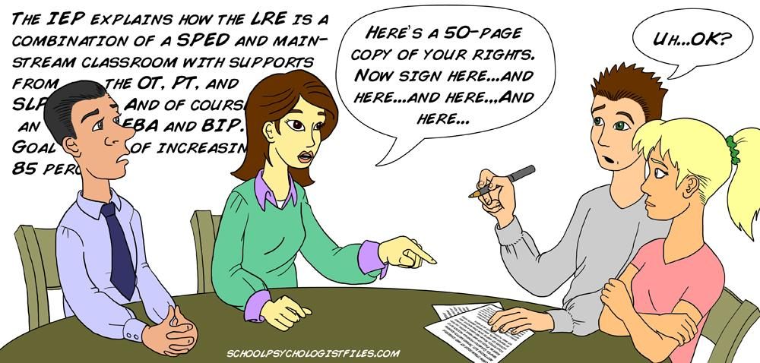

Slide 3
FAPE
Free Appropriate Public Education
All students with a disability have the right to a Free Appropriate Public Education (FAPE), but it does not have to be the BEST education.

Slide 4
Parents RIGHTS to ensure your child is receiving FAPE
Right to participate as a member of your child’s education plan (Individualized Education Plan or IEP)
To get written notice when the school decides if your child is eligible for special education, and before your school district changes your child’s program or refuses to change your child’s program.
Right to understand every document you sign
Right to disagree with what your district wants to do (or refuses to do) for you child’s education plan
To know and understand your rights in the language you understand the best.
To see copies of all of your child’s education records.

Slide 5
What is an IEP?
Individualized Education Program
Who writes the IEP?
What is in the IEP?
What are a parents’ rights at an IEP meeting?

Slide 6
Who writes the IEP?
Parents
Special educator
General educator
School officer (LEA), typically an administrator
Interpreter of evaluation
Gifted teacher (if applies)
The child (as appropriate)
Can invite others too (advocate, family members, etc.)
Related Service Providers (OT, PT, SLP, Nurse)

Slide 7
What is in the IEP?
Special Considerations- needs in the area of communication(AT), behaviors that affect learning (BIP)
Current ED. Level- This section should include information on how the child’s disability affects her involvement and progress in the general education curriculum.This present level of performance serves as a springboard for developing goals
Transitions- postsecondary goals (must be filled out by 14 or older)
Participation in Assessment-decides whether the child can participate in state-wide or district wide test and with accommodations

Slide 8
What is in an IEP?
Measurable academic and functional goals-The IEP must list annual functional and academic goals for the child. These goals must be measurable, and must be designed to meet the child’s needs to make progress in regular education curriculum
Specific Special Education to be provided- this is the modifications, services, and supports the student needs
Educational Placement- where the student will receive services

Slide 9
IEP Meeting
Parent can agree in writing to excuse one (or more) members of the IEP Team if their expertise is not needed or if they cannot attend .
The school must notify parents of the meeting date early enough so that they can attend, and schedule the meeting at a time and place that is convenient for all parties. This notification must include the time, date, location, and purpose of the meeting.
The school may give parents a draft of IEP before meeting, but cannot ignore parental input.
The child must be invited to the meeting if postsecondary goals and transition needs will be discussed at the meeting (age 16)

Slide 10
Factors in Deciding Placement
Placement decision MUST be based on the needs of the child, not on the convenience of the school district.
Example: It is illegal for a district to say that a child will be placed in an autistic support classroom because all children with autism in the district are placed there.
Children with disabilities must be educated with their non-disabled peers as much as appropriate (inclusion).
If a child is pulled out of the classroom for more than 80% of the day, the school district must justify in the IEP why pulling out the child is appropriate.
The LRE does not have to be the general education setting for 80% of the day, but if the school decides it is not, they must explain why.

Slide 11
What is a child’s LRE?
It is the regular education classroom if the child can make progress toward his or her IEP goals in this setting with supplementary aids and services.
When deciding the LRE, the school district MAY NOT refuse to place the child in the general education classroom for the following reasons:
The child cannot do the same work as his peers but can make progress on the IEP goals
It would be more costly and inconvenient for the school
Based on the child’s label: “All kids with autism are placed in the autism support class”
Class size in the general education classroom is too high
Curriculum would need to be modified
The child would make more progress in the special education setting
** School chosen for the child should be as close to home as possible

Slide 12
Types of Support Programs
Itinerant | Supplemental | Full-Time
child receives supports and services by special education professionals for 20% or less of the school day | child receives supports and services by special education professionals between 20% and 80% of the school day | child receives supports and services by special education professionals for 80% or more of the school day

Slide 13
School Discipline for Children With Disabilities
An Overview
School Code of Conduct
Extra Protections Under Special Education Law
Qualifications to Receive Full Protections
What constitutes a change in placement?
Manifestation Determination
Special Circumstances

Slide 14
Code of Conduct
A school cannot punish a child with a disability more harshly than it would punish a child without a disability under the same circumstances
A school can only legally punish a child for breaking a rule that is listed in the school code of conduct
Parents should request a copy or download one from the school website
Sometimes a rule that a child breaks may allow the school to suspend the child or transfer them to another school. In this case, special protections may apply.

Slide 15
Special Education Law
The full protections of this law apply if:
The penalty that the school is seeking qualifies as a “change in placement”
The behavior was a manifestation of the child’s disability
There are no “special circumstances”

Slide 16
Is the proposed discipline a change in placement?
For children with mental retardation attending public school the following are considered a change in placement:
A suspension (even for one day)
Expulsion
Transfer to an alternative school

Slide 17
Is the proposed discipline a change in placement?
NOT a change in placement
Is a change in placement
School disciplines child using rules that apply to students without disabilities
School must hold a manifestation determination meeting for the child

Slide 18
2. Was the behavior a manifestation of the child’s disability?
To decide if the child’s behavior was caused by the child’s disability, the school must hold a manifestation determination meeting within 10 school days of the proposed punishment.
The school may not transfer your child to a new school setting before the meeting unless the child’s behavior involves:
Drugs
Guns
Serious injury to another person
** We will talk more about these special circumstances later on in the
presentation

Slide 19
2. Was the behavior a manifestation of the child’s disability?
At the meeting…
Review all information from the child’s file
Ask the following questions
Was the child’s misbehavior caused by, or directly and substantially related to, the child’s disability?
Was the child’s misbehavior a direct result of the school’s failure to follow the child’s IEP?
Bring the Manifestation Determination Worksheet
http://pattan.net-website.s3.amazonaws.com/images/2013/04/08/Manif_DetermWksht_0213.pdf

Slide 20
2. Was the behavior a manifestation of the child’s disability?
NOT a “manifestation”
WAS a “manifestation”
School disciplines child using rules that apply to students without disabilities. However, child must still receive needed special education services.
School must send a NOREP/PWN.
IEP Team must conduct an FBA and the school may not suspend, expel, or transfer the child to an alternative school.

Slide 21
3. What happens if the child’s misbehavior involves special circumstances?
Special circumstances involve drugs, a weapon, or serious injury to someone.
If the behavior involves these circumstances, the school can immediately transfer the child for up to 45 days
Manifestation determination does not apply
It does not matter if the child has an MR label
You can request that the school allows the child to stay where he/she is currently placed and consider other discipline options (new behavior plan, counseling, etc)

Slide 22
3. What happens if the child’s misbehavior involves special circumstances?
Parental consent not necessary to move the child to an alternative placement if:
School district has concluded that the behavior was not a manifestation of the child’s disability AND the schools published rules allow the child to be transferred based on that misbehavior
The behavior involved drugs, weapons, or serious injury to another person

Slide 23
School Bus
If a child acts out on the school bus, parents should check to see if the bus is a related service outline in the IEP
If it is, the child cannot be banned from riding the bus for more than 10 days in a row (change in placement)
If the proposed punishment counts as a change in placement, a manifestation determination meeting must be held within 10 days
Remember, schools cannot ban children with an MR label from the bus for even one day unless their behavior involves the special circumstances

Slide 24
Using Restraints
Restraints are the use of physical force to stop a child from freely moving
Use restraints to to control a child’s aggression if they can harm themselves or other
Restraint may be used only as a last resort
The law limits the use of restraints by school
If it occurs must hold an IEP meeting 10 days after
Schools also have to report it to the PDE

Slide 25
Resolving Disputes
As a parent, you may not always agree with the school’s decisions about your child when it comes to evaluation, placement, or their IEP. Do not worry! There are a variety of options available to help resolve these issues.

Slide 26
Types of Disagreements
There are three main types of disagreements that you may have with the school, each with its own steps to follow in order to solve them.
Compliance
the school is not following some or all of the IEP, legal rules, or required timelines
Disagreement over appropriateness of the child’s program
you and the school cannot agree what should be in the IEP
Discrimination
the school district is refusing to make a reasonable adjustment so that your child can participate in part of the school program or an extracurricular program
*Before taking further action, talk to your child’s teacher or call an IEP meeting to try and gain more information about the issue and to try and resolve it

Slide 27
What is Mediation
Mediation is a free and voluntary way to resolve disputes
Both parties must agree or it will not take place
A mediator is assigned by the state Office for Dispute Resolution (ODR)
They do not work for the school and are trained to help people reach agreements
This session will usually be scheduled within 7 to 10 days of the request
These sessions are confidential and cannot be used by the school or parents in any future hearings or court cases
Usually the mediator will meet with both sides separately, then together
Neither side can bring a lawyer but the school must send someone who can make decisions for the school
If an agreement is reached, it must be written down and signed by both parties

Slide 28
Due Process
A parent can request a special education hearing to resolve disputes about almost any issue they are having with the school district. The most common topics are appropriateness of a program or placement. The school can also request a hearing.
To Request a hearing:
You can check the “Due Process Hearing” box on a NOREP
**You must also send a letter (called a complaint) to the school and to the ODR
Can also fill out a due process complaint notice at the ODR’s website
**Make sure to carefully choose what to put in the complaint, what is written there is the only thing that the Hearing Officer can make decisions oj

Slide 29
Thank you for listening!

