Slide 1
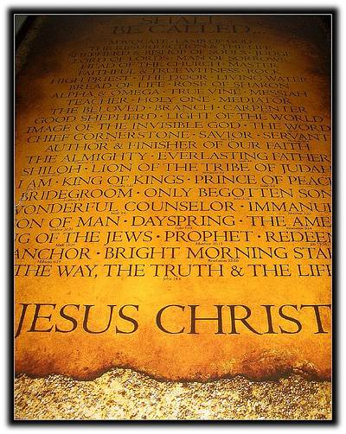
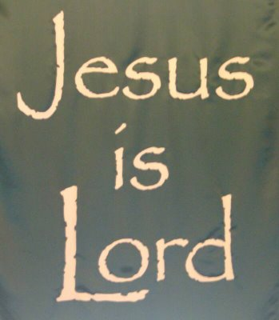
DINE
ON
THE WORD

Slide 2
A WORLD DIET VS A WORD DIET
The World Conveys That Life Is Linked To A Diet Of Dining On The Delicacies The World Has To Offer.
The Word Of God Confirms That True Life Is Linked To A Diet Of Dining On The Delights The Word Provides.

Slide 3
PROPER DINING DIET IMPORTANT
The Diet Of Dining That A Person Selects Does More Than Determine If They Will Gain Relief From Earthly Hunger, It Determines If They Will Gain The Reward Of An Eternal Home.

Slide 4
GOD GAVE INSTRUCTIONS TO DINE ON THE WORD
“This Book Of The Law Shall Not Depart From Your Mouth, But You Shall Meditate In It Day And Night, That You May Observe To Do According To All That Is Written In It. For Then You Will Make Your Way Prosperous, And Then You Will Have Good Success.”
(Joshua 1:8)

Slide 5
DINING ON THE WORD IS NECESSARY FOR LIVING
“And Jesus Answered Him, Saying, It Is Written, That Man Shall Not Live By Bread Alone, But By Every Word Of God.”
(Luke 4:4)

Slide 6
THE WORD IS SOUL SAVING FOOD
“Therefore Lay Aside All Filthiness And Overflow Of Wickedness, And Receive With Meekness The Implanted Word, Which Is Able To Save Your Souls.”
(James 1:21)

Slide 7
DIETARY RECOMMENDATIONS
We Encourage You To Dine On More Than Good Soul Food, Be Sure You Dine On God’s Food For The Soul.
Be Sure To Sustain Your Spiritual Health And Well-being By Taking Time To Dine On God’s Wonderfully Prepared Food For The Soul.
“Let The Word Of Christ Dwell In You Richly In All Wisdom, Teaching And Admonishing One Another In Psalms And Hymns And Spiritual Songs, Singing With Grace In Your Hearts To The Lord.” (Colossians 3:16)

Slide 8
BON APPETITE!!!!!

Slide 9
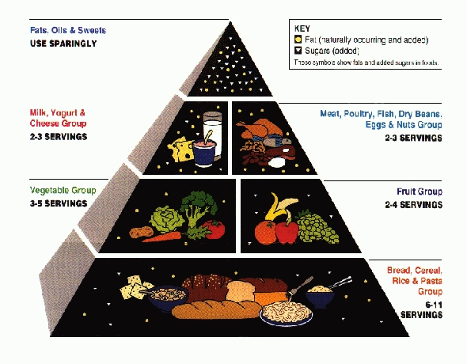
OH TASTE AND SEE THAT THE LORD IS GOOD!!!!!

Slide 10
Compliments
of
Truth Nothing But Truth (TNT)
Evangelistic Outreach
www.tntevangelisticoutreach.com

Slide 11
Provided By Inspiration of the Holy Spirit
Written and Prepared by Rev. Lenny M. Young
Copyright 2010
All Rights Reserved.
Bible Verses From The Modern King James Version
Song Entitled “Oh Taste and See” by Min. Don Pope

