Slide 1
Harrisburg Diocese Council of Catholic Women
Celebrating years of service and a new vision!

Slide 2
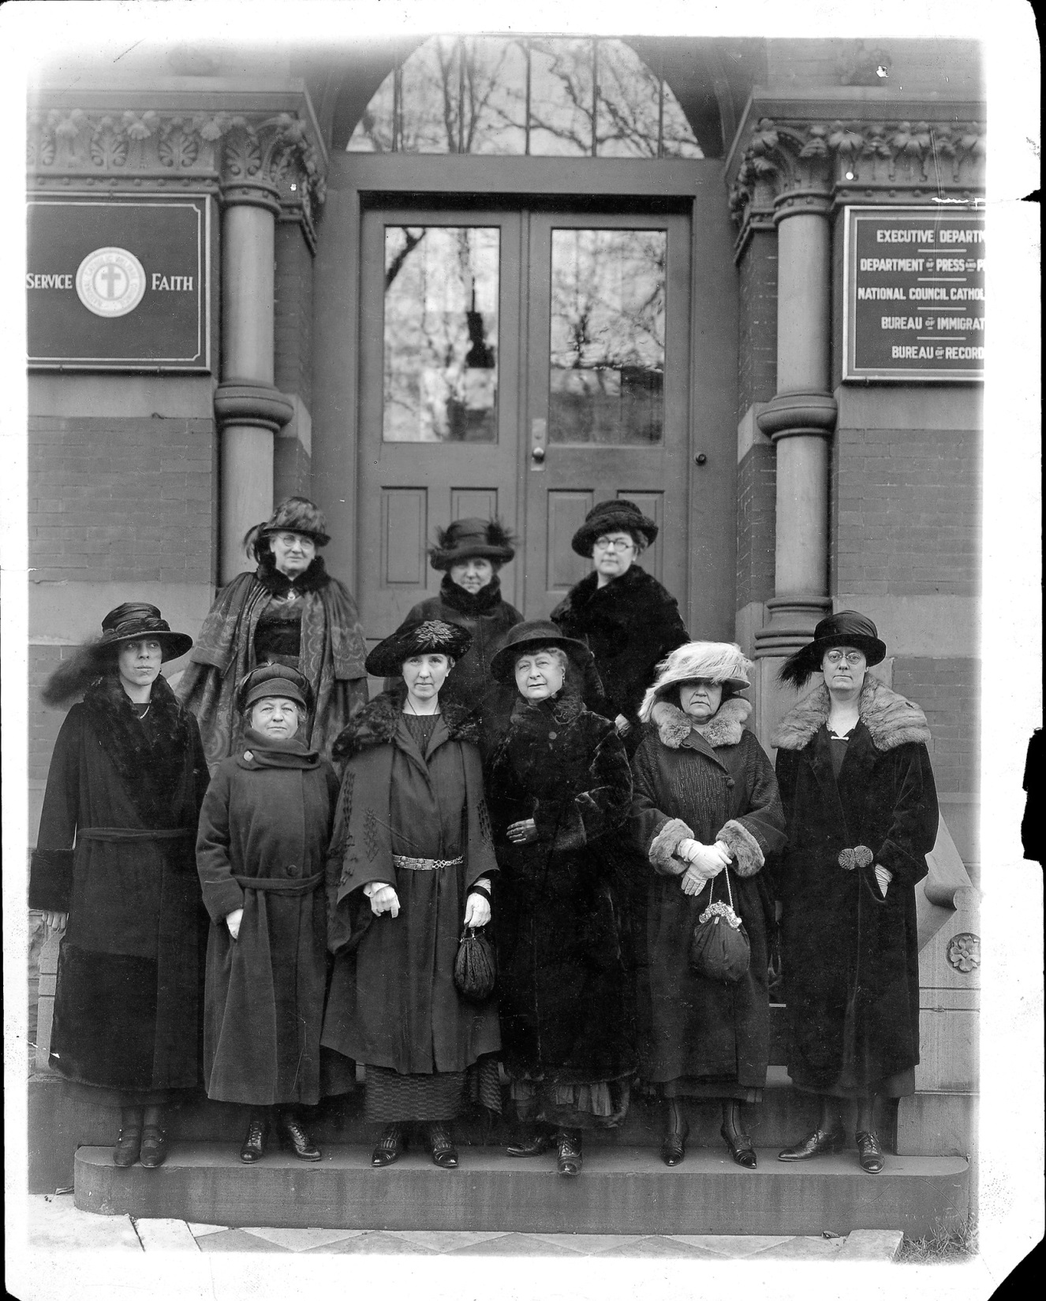
NCCW Founding Mothers

Slide 3
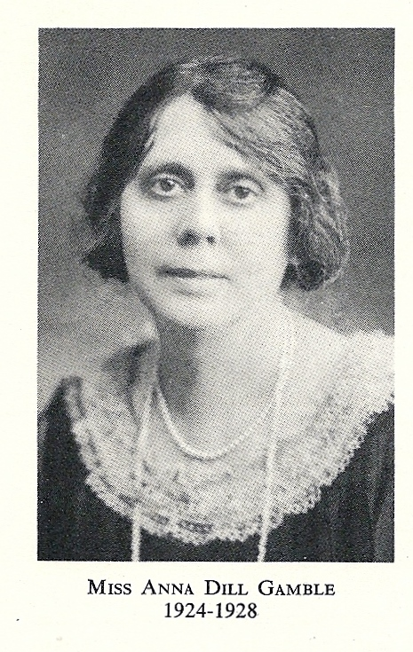
Our First President

Slide 4
A Solemn High Mass, in the presence of the Bishop in St. Patrick’s Cathedral in Harrisburg, opened the first semi-annual conference on October 27, 1924. The sessions were held in the Knights of Columbus Hall.
The Cause for Mother Seton, Beautification of Pope Pius X, crusade for vocations in Harrisburg Diocese. From October 1948 –June 1949 a total of 210, 468 Hail Mary’s recorded.
In 1937 Deanery Presidents were appointed and began the work of organizing the parishes CCW.
In 1930 membership dues were established at $1 per member.
First Conference
Membership
Parish CCW
Prayer
1925
1934
1938
1924
1930
1937
1948
First Convention
Retreat Movement
Hershey Convention
In the fall of 1925 it was voted to have only one conference a year and to be held in May. Thus began the beginning of our annual convention.
The Retreat movement was started in 1934 and retreats were held at Sylvan Heights in Harrisburg; Lancaster; and York. These continued until the war years, when they had to be curtailed.
1938 the Convention was held in Hershey with 650 women attending and 350 attended the banquet at the Hotel Hershey.

Slide 5
Pro Life
Miss Anna Dill Gamble wrote a pamphlet, “Are People Necessary?” It was written to combat the work of Planned Parenthood. 2,500 copies were distributed throughout the diocese, many going to parish CCW’, church pamphlet racks, ministers, doctors, business and professional people, health and welfare workers and educators, to bring to all the Catholic viewpoint on this subject

Slide 6
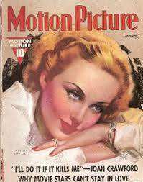
Immoral & Vile Literature
In 1934 the women began a vigorous fight on immoral and vile literature. Each section of the Diocese, under the guidance of the spiritual moderators, began a systemic task to rid the news stands of this type of literature. The work continued over a period of years and in 1938 a resolution was sent to the National Convention in Biloxi, Mississippi, stating that the Harrisburg Diocesan Council was taking in this campaign. The work progressed so well that at the Diocesan Convention in 1939 it was reported that many magazines “cleaned up” their publications to such a degree that they were removed from the list of salacious literature and many were withdrawn entirely from the news stands.

Slide 7
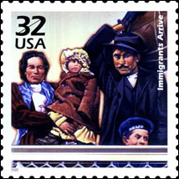
Immigration
In order to help women who had come to this country seeking refuge, classes in Citizenship and Languages were opened. In 1939, 100 immigrant women attended classes in English, Civics and Americanization. Many women of the council attended Naturalization court as witnesses to these women. Interest has never waned on immigration problems. G.I. brides and their problems is now the work of the committee.

Slide 8
Rural Vacation Schools
February 28, 1928, $100 was voted to establish a project called “Rural Vacation Schools”. By 1930, eleven schools were established with 1, 424 children enrolled with 20 Sisters and lay teachers. In eight years, 24 centers had been established, 98,412 children had been instructed; 676 had received their First Holy Communion; 152 had been confirmed. The sisters visited homes of negligent Catholics in the area., thus bringing many souls back to God.

Slide 9
War Relief
In 1941 there were four army camps in the area of Harrisburg: at Middletown, Carlisle, New Cumberland and Indiantown Gap. The ladies provided articles and altar cloths for the chapels, Catholic magazines, sick call kits were sent; and at Christmas and Easter flowers and decorations were placed.
A Catholic Community Center for the troops was established in Harrisburg. Each Parish and deanery had a turn entertaining; they served meals, cookies, refreshments for dances and parties. Breakfast was served every Sunday. Blankets, bed linens, towels were provided.
The women also did Red Cross work, making surgical dressings, knitting, sewing, child care and clerical work. They cooperated with civil scrap drives; and sent monthly newsletters to the boys in their own Parishes.

Slide 10
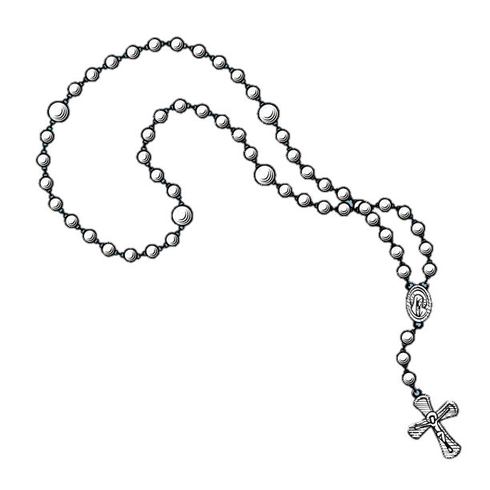
The 1950’s
A U.S.O. committee was presented, started in November and ended July 26, 1953, 10,000 boys slept free of charge on Saturday nights, 12,000 breakfasts were served, 75 dances held. Several hundred missals and rosaries were distributed. The U.S.O. at 223 North St., Harrisburg, was truly “A Home Away From Home.”

Slide 11
PROJECTS
Hundreds of cord rosaries were made for use in teaching potential converts how to use the rosary. 85,000 lbs. of used clothing were sent overseas, mostly to Korea.
The councils gave to the Hungarian Relief and to the “Feed a Family” project of the Foreign Relief Committee, which replaced the war relief committee.
“Put Christ Back into Christmas” became a permanent project of the spirituality committee.
The “Bishop’s Fund for Diocesan Needs” received the title “Special Diocesan Activities Fund”, known today as SDA.
1959 – The Madonna Plan was introduced through the Committee on Foreign Relief.
’50s

Slide 12
The standing committee structure was revised into a five-committee system:
◊ Personal Formation
◊ Family Education
◊ Community Action
◊ World Responsibility
◊ Organization & Development
Migrant Ministry
Under the direction of Father Mercurio Fragapane, Diocesan Vicar for Spanish-speaking people, women in the Northern, Shamokin and Mount Carmel deaneries became members of the four county Migrant Ministry.
1965
Miss Patricia Mannix established a Harrisburg Office of Women in Community Service (WICS, Inc.)
1967
At Annual conventions 130 complete layettes were contributed for shipment to hospitals and orphanages in Vietnam
1968
All deaneries and districts contributed generously to NCCW’s effort to aid the innocent victims of war and famine in Biafra

Slide 13
Roe vs Wade passed January 22, 1973
Our ladies wrote letters to legislators stating objections.
Pro-Life Supporters, along with Bishop Joseph Daley, gathered in Lancaster on a Sunday in January at the Court House, to show concern on the anniversary of the court’s decision, to say, “Abortion is Murder”.
https://www.txccri.org/single-post/2019/12/09/Rep-Phil-King-Spearheads-Pro-Life-Research

Slide 14
70’s Projects
Community service
Gave aid during the Agnes flood, held ecology programs, worked with migrants and held classes in language, sewing and cooking for the Spanish speaking.
Family Life
Volunteered to be phone girls for birthright, wrote letters to TV networks concerning X-rated films, and wrote letters to legislators pertaining to the Abortion Law.
International:
Raised funds for an orphanage in Vietnam, made monetary donations for Lepers, Child –in –Need and Bangladesh. Bi-monthly checks were sent to a priest in India.
Water for Life:
Our goal is one tank at the cost of $475, in support of the Kenya Water Tank Project.
https://www.txccri.org/single-post/2019/12/09/Rep-Phil-King-Spearheads-Pro-Life-Research

Slide 15
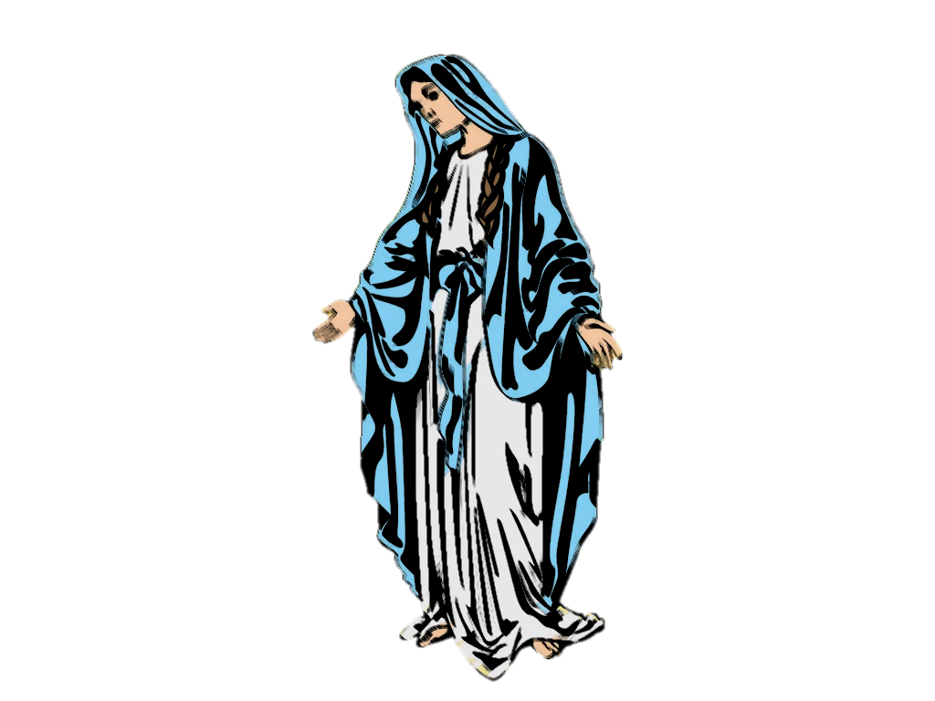
80s
1,014 letters were written to legislators about current issues.
1984- First annual Marian Day held.
Pro-Life
Petitions, which included 737 HDCCW members and containing more than 200,000 signatures, were delivered to Representative Christopher Smith, for entry into the Congressional Record.
Legislative
White Ribbon Anti-Pornography Program was promoted.
Father Gotwalt became our Spiritual Advisor.

Slide 16
1990
Prayers for Priests: A monthly prayer list with a different priest to pray for each day.
Junior CCW: Initially started in Orlando, Fla with membership coming from CCW members
HDC Catholic Women: Quarterly newsletter published through the Organization Services commission
Mary’s Garden: A NCCW proposal for a garden to be designed and planted at the National Shrine of the Immaculate Conception in Washington, DC
Marian Day was held in York at St. Patrick Church on October 10, 1992. Ladies brought unusual and antique artifacts honoring Our Lady for display. 300 attended.
The ladies participate in Pro-Life activities such as the “Human Life Chain” and the “March on Washington”.

Slide 17
2000s
Scholarship program was initiated, with the hope of announcing the first recipient in 2006
Over 1200 toothbrushes were collected in the Harrisburg Diocese and hand carried to the villages of Guatemala.
2010 we held our first annual HDCCW retreat at Mt. St. Mary’s University in Emmitsburg, MD. with close to 150 ladies in attendance.
With technology playing an ever more important role in our lives, we started our own Facebook page and website: hdccw.webs.com. It is hoped this will be an effective communication tool and reach out to younger potential members.

Slide 18
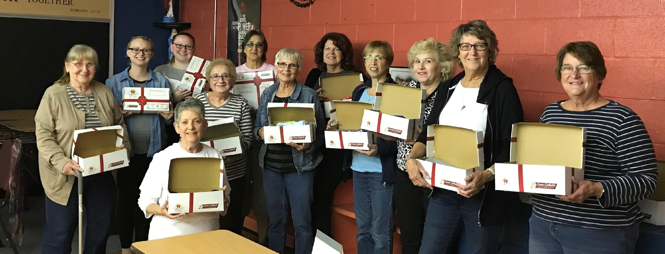
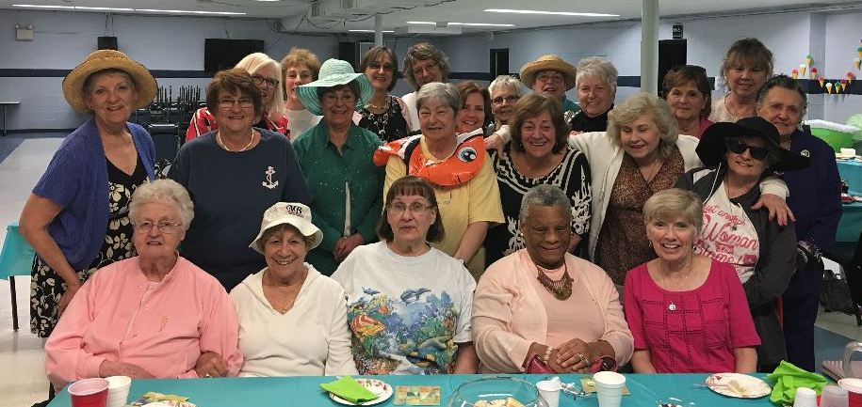
Seven Sorrows CCW
Dauphin District

Slide 19
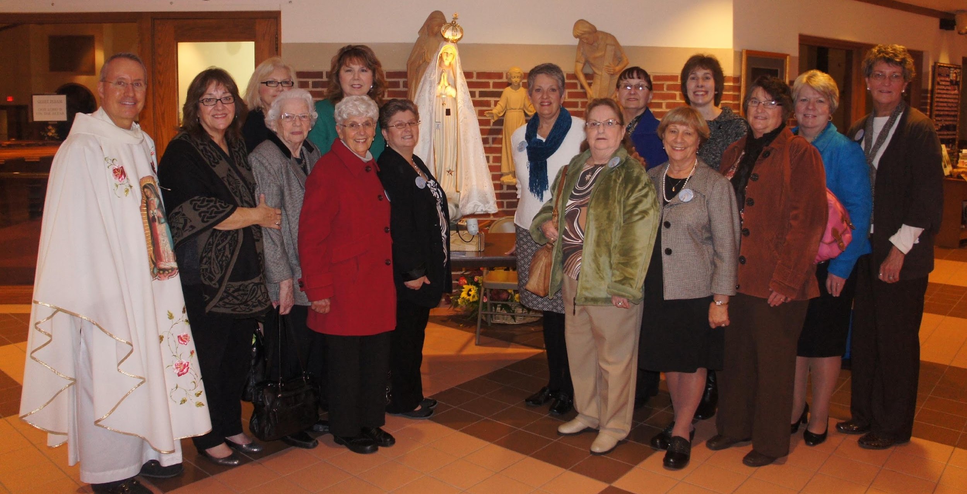
Seven Sorrows CCW
Dauphin District

Slide 20
Northern District CCW

Slide 21
Hanover CCW Movie Night
Conewago District

Slide 22
Lebanon District CCW
Marian Day

Slide 23
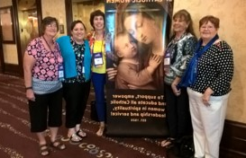
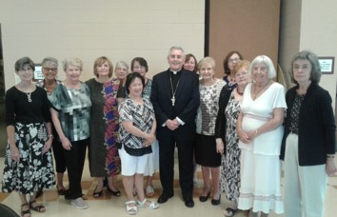
HDCCW Weekend Retreat
NCCW Convention
HDCCW Convention

Slide 24
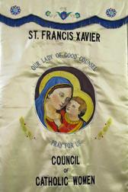
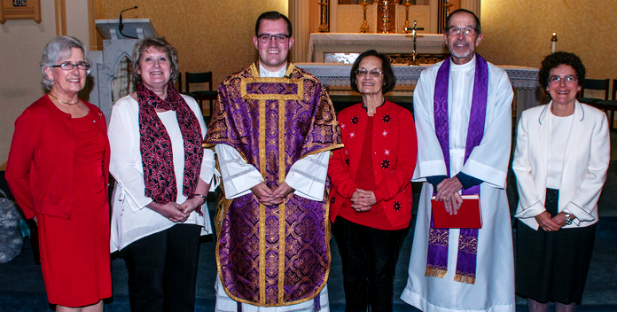
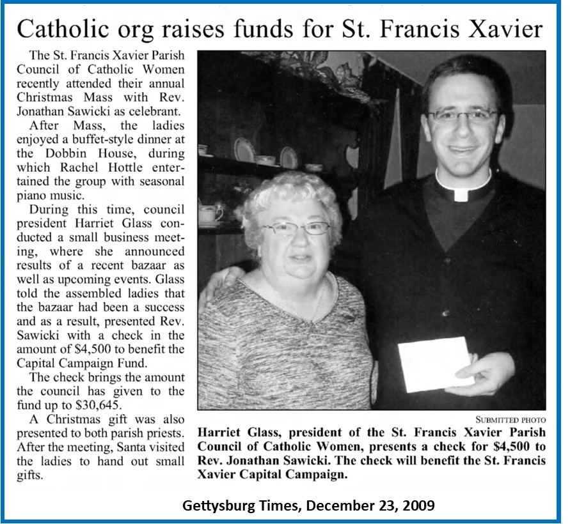
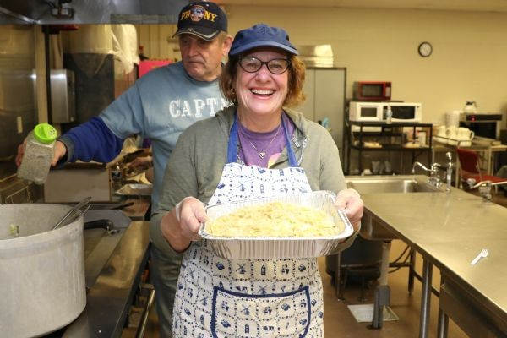
Saint Francis Xavier CCW
Conewago District

Slide 25
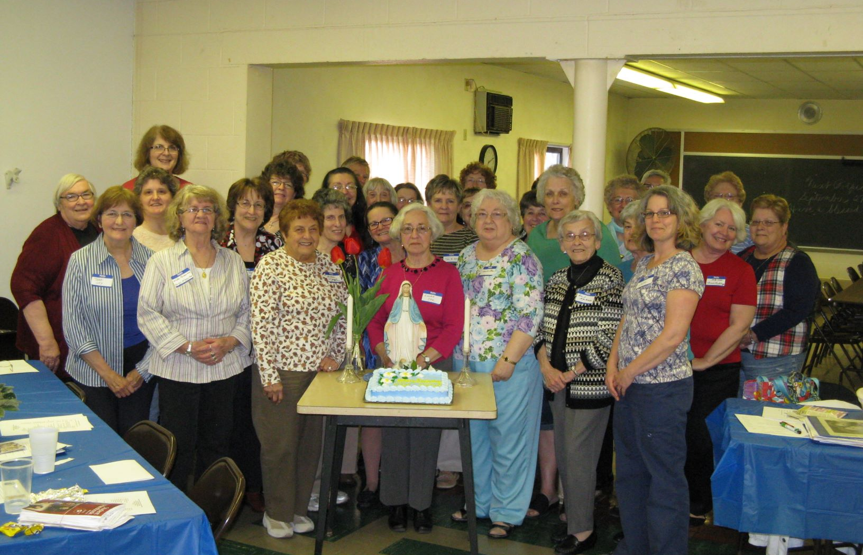
Conewago District CCW

Slide 26
Saint Catherine Laboure CCW
Dauphin District

Slide 27
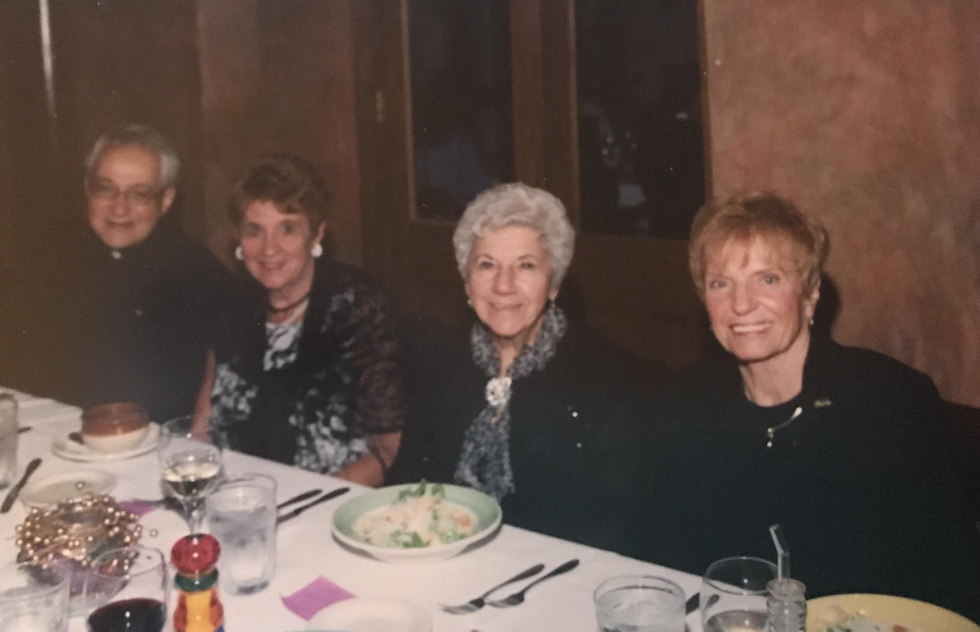
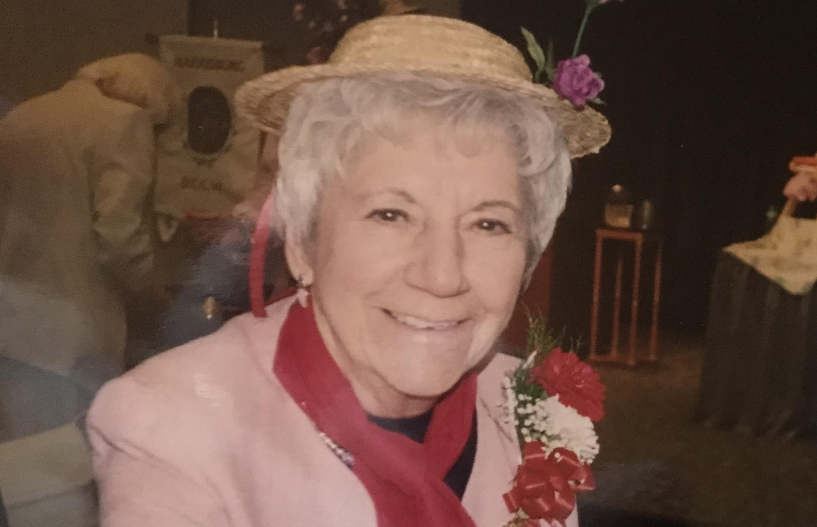
Prince of Peace CCW
Dauphin District

Slide 28
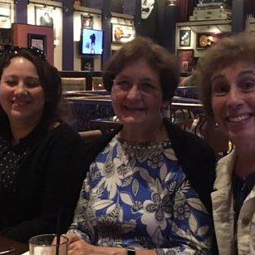
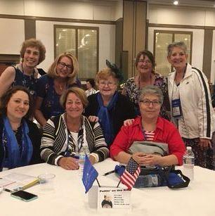
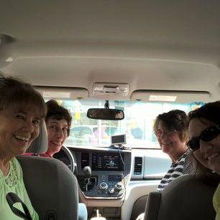
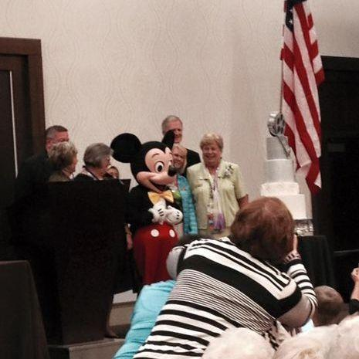
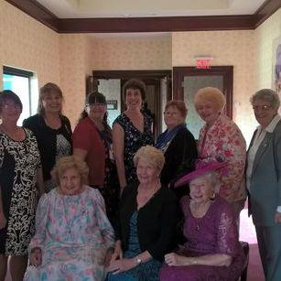
NCCW Conventions

Slide 29
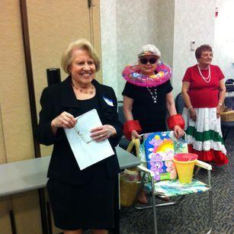
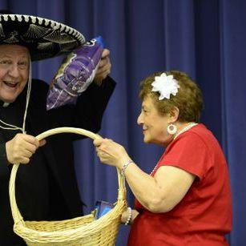
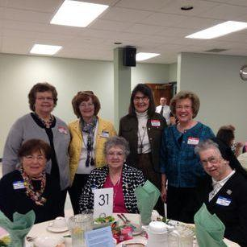
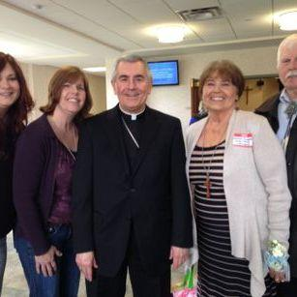
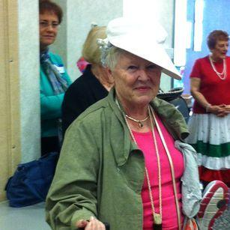
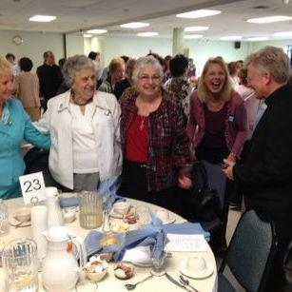
NCCW Conventions

Slide 30
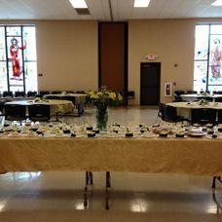
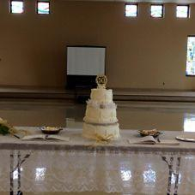
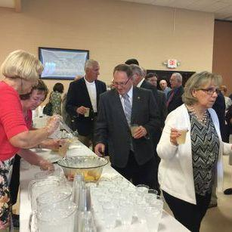
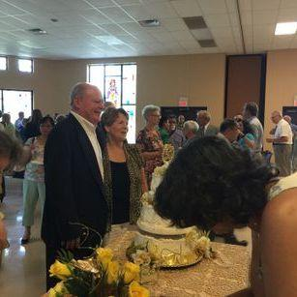
50th Anniversary Mass

Slide 31
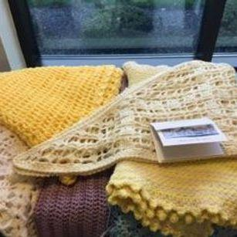
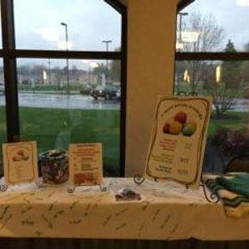
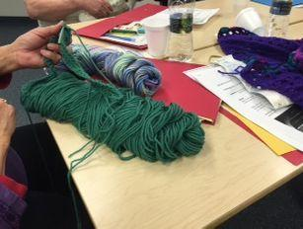
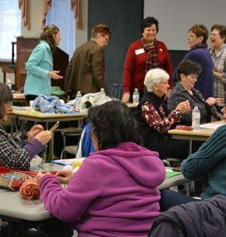
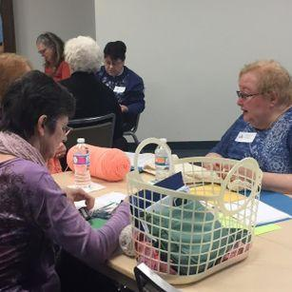
HDCCW Prayer Shawl Retreats

Slide 32
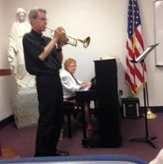
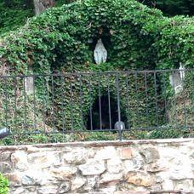
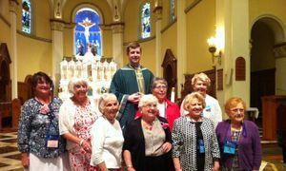
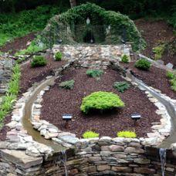
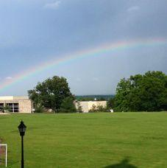
HDCCW Weekend Retreats

Slide 33
Past HDCCW Presidents
+Miss Anna Dill Gamble | 1924-28
*Miss Hannah Cassidy | 1928-30
*Mrs. George Vanier | 1930-34
*Mrs. Robert Angelo | 1934-42
*Mrs. Joseph Michels | 1942-43
*Mrs. Paul Sullivan | 1943-46
*Mrs. Robert Angelo | 1946-48
*Miss. Katherine McCarthy | 1948-50
*Mrs. Pauline Callaghan | 1950-52
*Mrs. Bernard Wert | 1952-54
*Miss Helen Murphy | 1954-56
*Mrs. Gertrude Wright | 1956-58
*Miss Helen Bunty | 1958-60
*Miss Anna Rehm | 1960-62
*Mrs. John Shields | 1962-64
*Miss Patricia Mannix | 1964-66
*Mrs. William Pinter | 1966-68
*Mrs. Marian Sneeringer | 1968-70
* Mrs. Foster Richards | 1970-72
Mrs. Betty Schell | 1972-74
*Mrs. Nancy Nazay | 1974-76
Miss Catherine Zealherg | 1976-78
*Mrs. Gertrude Oravitz | 1978-80
Mrs. Paula Schlager | 1980-82
*Mrs. Evelyn Schmidt | 1982-84
*Mrs. Blandene Whalen | 1984-86
Mrs. Susan Miller Merfa | 1986-88
Mrs. Anne Shepos | 1988-90
*Mrs. Sylvia Weaver | 1990-91
Mrs. Kathryn Memmi | 1991-94

Slide 34
Past HDCCW Presidents
*Mrs. Carmelia Urich | 1994-96
*Mrs. Louise Condon | 1996-98
Mrs. Peg Clissa | 1998-00
Mrs. Patricia Leone | 2000-02
*Mrs. Betty Kress | 2002-04
*Mrs. Dolores Stichter | 2004-06
Mrs. Joyce Scott | 2006-08
Mrs. Barbara McCarthy | 2008-10
Mrs. Bonnie Onomastico | 2010-12
Mrs. Anne Hasting | 2012-14
Mrs. Jeanne Warren | 2014-16
Mrs. Marge Schmader | 2016-18
Ms. Alycia Laureti | 2018-Present

Slide 35
Honoring God’s Past With Mercy
Living Our Present With God’s Love
Hopeful For Our Future With His Providence

Slide 36
Who has enough faith and courage to join us?
Harrisburg Diocesan Council of Catholic Women
hdccw.webs.com

