Slide 1
The Integrity of Clinical Documentation: A Sticky Matter of Proving Medical Necessity: OB/Gyn
Presented by:
Ambulatory Coding Review

Slide 2
Evaluation and Management

Slide 3
Billing your Office Level of Service
When assessing your level of service there are two ways you can bill. They are as follows:
Billing based on the three key components
Medically Appropriate History and Exam
Medical Decision Making
Billing based on time with noting the following:
Total Day Management

Slide 4
E/M Revisions for 2021: Compared to Other E/M Codes
Component(s) for Code Selection | Office or Other Outpatient Services (99201-99215) | Other E/M Services (Hospital Observation, Hospital Inpatient, Consultations, *Emergency Department, Nursing Facility, Domiciliary, Rest Home or Custodial Care, Home)
History and Examination | As medically appropriate. Not used in code selection | Use Key Components (History, Examination, MDM)
Medical Decision Making (MDM) | May use MDM or total time on the date of the encounter | Use Key Component (History, Examination, MDM)
Time | May use MDM or total time on the date of the encounter | May use face-to-face or time at the bedside and on the patient’s floor or unit when counseling and/or coordination of care dominates. *Time is not a descriptive component for E/M levels of emergency department services
MDM Elements | Number and complexity of problems addressed at the encounter Amount and/or complexity of data to be reviewed and analyzed Risk of complications and/or morbidity or mortality of patient management | Number of diagnoses or management options Amount and/or complexity of data to be reviewed Risk of complications and/or morbidity or mortality

Slide 5
Code | Level of MDM (Based on 2 out of 3 Elements of MDM) | 2021 Elements of Medical Decision Making
 |  | Number and Complexity of Problems Addressed | * Amount and/or Complexity of Data to be reviewed and Analyzed Each unique test, order, or document contributes to the combination of 2 or Combination of 3 in Category 1 below | Risk of Complications and/or Morbidity or Mortality of Patient Management
99211 | N/A | N/A | N/A | N/A
99202 99212 | Straight/ forward | Minimal 1 self-limited or minor problem | Minimal or none | Minimal risk of morbidity from additional diagnostic testing or treatment
99203 99213 | Low | Low 2 or more self-limited or minor problems; or 1 stable chronic illness; or 1 acute, uncomplicated illness or injury | Limited (Must meet the requirements of at least 1 of the 2 categories) Category 1: Tests and documents Any combination of 2 from the following: Review of prior external note(s) from each unique source*; review of the result(s) of each unique test*; ordering of each unique test* or Category 2: Assessment requiring an independent historian(s) (For the categories of independent interpretation of tests and discussion of management or test interpretation, see moderate or high) | Low risk of morbidity from additional diagnostic testing or treatment
99204 99214 | Moderate | Moderate 1 or more chronic illnesses with exacerbation, progression, or side effects of treatment; or 2 or more stable chronic illnesses; or 1 undiagnosed new problem with uncertain prognosis; or 1 acute illness with systemic symptoms; or 1 acute complicated injury | Moderate (Must meet the requirements of at least 1 out of 3 categories) Category 1: Tests, documents, or independent historian(s) Any combination of 3 from the following: Review of prior external note(s) from each unique source*; Review of the result(s) of each unique test*; Ordering of each unique test*; Assessment requiring an independent historian(s) or Category 2: Independent interpretation of tests Independent interpretation of a test performed by another physician/other qualified health care professional (not separately reported); or Category 3: Discussion of management or test interpretation Discussion of management or test interpretation with external physician/other qualified health care professional\appropriate source (not separately reported) | Moderate risk of morbidity from additional diagnostic testing or treatment Examples only: Prescription drug management Decision regarding minor surgery with identified patient or procedure risk factors Decision regarding elective major surgery without identified patient or procedure risk factors Diagnosis or treatment significantly limited by social determinants of health
99205 99215 | High | High 1 or more chronic illnesses with severe exacerbation, progression, or side effects of treatment; or 1 acute or chronic illness or injury that poses a threat to life or bodily function | Extensive (Must meet the requirements of at least 2 out of 3 categories) Category 1: Tests, documents, or independent historian(s) Any combination of 3 from the following: Review of prior external note(s) from each unique source*; Review of the result(s) of each unique test*; Ordering of each unique test*; Assessment requiring an independent historian(s) or Category 2: Independent interpretation of tests Independent interpretation of a test performed by another physician/other qualified health care professional (not separately reported); or Category 3: Discussion of management or test interpretation Discussion of management or test interpretation with external physician/other qualified health care professional/appropriate source (not separately reported) | High risk of morbidity from additional diagnostic testing or treatment Examples only: Drug therapy requiring intensive monitoring for toxicity Decision regarding elective major surgery with identified patient or procedure risk factors Decision regarding emergency major surgery Decision regarding hospitalization Decision not to resuscitate or to de-escalate care because of poor prognosis

Slide 6
Office or Other Outpatient Services
New Patient (CPT codes 99202-99205)
Is a patient who has not received any professional services from the physician/qualified health care professional or another physician of the exact specialty and subspecialty who belongs to the same group practice within the past three years
Established patient (CPT codes 99211-9915)
An established patient is defined as a patient who HAS received professional services face to face from the physician of the EXACT same specialty and subspecialty or practice within 3 years.

Slide 7
New vs. Established Patient Decision Tree

Slide 8
Inpatient Services
Inpatient Hospital Services
Initial Hospital (CPT codes 99221-99223)
Subsequent (CPT codes 99231-99233)
Any service that is provided in the inpatient setting, this would also include partial hospital admissions (behavioral health).

Slide 9
Inpatient Hospital Services Initial – H & P
Level of Service | History | Examination | Medical Decision Making
99221 30 minutes (1.92 wRVUs) | Detailed/Comprehensive HPI: Ext. (4) ROS: Ext (2-9) PFSH: Pert (1 of 3) | Detailed/Comprehensive 12 - 17 bullets from 2 (or more) body/organ systems OR from single system exam – ‘97 “extended” 2 system OR 5-7** systems – ‘95 | Straight Forward /Low (2 of 3) min. #dx & mgt. option(s) No to min. data to review min. risk
99222 50 minutes (2.61 wRVUs) | Comprehensive cc HPI: Ext. (4) ROS: Comp. (10+) PFSH: comp. (3 of 3) | Comprehensive 18+ bullets(2 each) from 9 (or more) body/organ systems OR ALL single system exam – ‘97 8 or more multi-system OR complete single system ‘95 systems – ‘95 | Moderate Complexity (2 of 3) mult. #dx & mgt. options mod. amt./complex. data to review mod. risk
99223 70 minutes (3.86 wRVUs) | Comprehensive cc HPI: Ext. (4) ROS: Comp. (10+) PFSH: comp. (3 of 3) | Comprehensive 18+ bullets(2 each) from 9 (or more) body/organ systems OR ALL single system exam – ‘97 8 or more multi-system OR complete single system –‘95 systems – ‘95 | High Complexity (2 of 3) ext. #dx & mgt. options ext. amt./complex. data to review high. risk

Slide 10
Inpatient Hospital Services - Subsequent
Level of Service | Interval History | Examination | Medical Decision Making
99231 15 minutes (.76 wRVUs) | Problem Focused cc HPI: Brief (1-3) | Problem Focused 1-5 bullets –‘97 “limited” 1 system – ‘95 | Straight Forward /Low (2 of 3) min. #dx & mgt. option(s) No to min. data to review min. risk
99232 25 minutes (1.39 wRVUs) | Expanded Problem Focused cc HPI: Brief (1-3) ROS: PP (1) | Expanded Problem Focused 6-11 bullets –‘97 “limited” 2 system – ‘95 | Moderate Complexity (2 of 3) mult. #dx & mgt. options mod. amt./complex. data to review mod. risk
99233 35 minutes (2.0 wRVUs) | Detailed cc HPI: Ext. (4) ROS: Ext (2-9) | Detailed 12 - 17 bullets from 2 (or more) body/organ systems OR single system exam – ‘97 “extended” 2 system OR 5-7** systems – ‘95 | High Complexity (2 of 3) ext. #dx & mgt. options ext. amt./complex. data to review high. risk

Slide 11
Coding Based on Time

Slide 12
Time Based Elements
 | YES | NO
Does documentation indicate total visit time? Outpatient: Face to face time Inpatient: Unit/floor time
Does documentation describe the content of counseling and/or coordination of care?
Does documentation indicate that > 50% of the total time was spent counseling or coordination care?
**If all answers are yes, select the E/M level based on time

Slide 13
Billing for preventive services
Medicare, Medicaid Commercial

Slide 14
Preventive Services
Most commercial and managed care plans now cover an annual preventive physical. The CPT codes 99381-99397 are based on the age of the patient.
The majority of patients want to take advantage of that benefit and will ask to schedule a “physical” with their provider. These CPT codes are not covered by Medicare.

Slide 15
What’s the difference between the two?
Medicare has “Wellness Visits” which are not the same and should not be used inter-changeably with the “annual preventive physical”.
The purpose of these visits is to establish or update medical and family history, taking height, weight, BMI or waist circumference and blood pressure.
The goal of the visit is health promotion and disease detection and the coordination of screening and preventive services that may already be covered and paid for under Medicare.

Slide 16
Example: Medicare Breast and Pelvic Exam G0101
See handout page 28 for frequency details
7 of 11 exam elements required
Inspection of breasts
Digital Rectal exam including, sphincter tone, presence of hemorrhoids and rectal masses
External genitalia (general appearance, hair distribution, or lesions)
Urethral meatus (size, location, lesions, or prolapse)
Urethra (masses, tenderness or scarring)

Slide 17
G0101 cont.
Bladder (fullness, masses or tenderness)
Vagina (appearance, estrogen effect, discharge, lesions, pelvic support, cystocele or rectocele)
Cervix (general appearance, lesions or discharge)
Uterus (size, contour, position, mobility, tenderness, consistency, descent or support)
Adnexa/Parametria (masses, tenderness, organomegaly or nodularity)
Anus and perineum
When PAP obtained add Q0091

Slide 18
Billing procedures the same day as a visit:
Modifier 25

Slide 19
Same Day Procedures with an E/M Modifier 25
A Physician may need to indicate (via documentation) that on the day of a procedure or service was performed, the patient’s condition required a significant, separately identifiable E/M service
E/M services may be prompted by the symptom or condition for which the procedure and/or service was provided (it should never be implied)
A Different diagnosis is not required for reporting of the separate E/M service however;
Documentation must support E/M level selected

Slide 20
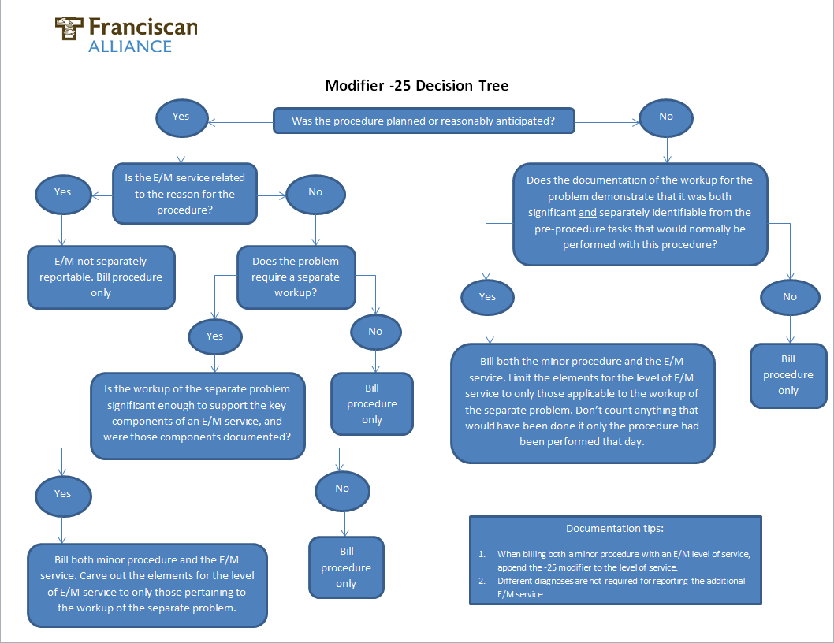

Slide 21
Modifier 25 example
An new Medicare patient presents to the office for their Gynecological Exam. Among pertinent gynecological exam elements, the physician palpates a mass within the uterus
The Physician decides to do further work up by means of an ultrasound and also decides to perform a biopsy to send to pathology for further review.

Slide 22
Modifier 25 example cont’d
In this instance, billing for the additional service(s) would be appropriate. The billing for this service would look like.
9920x-25,
G0101
Q0091 (if pap was collected)
58100 (biopsy)
Based on the previous example, let’s say you the provider, did a detailed history and examination and the MDM was Low. What LOS could this be billed?
Rationale: It is often believed that when a Medicare service is performed that billing for additional services is not billable. When in fact, if you have met the minimum requirements for the gyne/breast exam, you can bill for all the services as long as the documentation was supported throughout your note.

Slide 23
OB/Gyn package billing
What’s included, what’s not?

Slide 24
OB/GYN Package Billing
Type of Service | Initial Visit Codes* | Antepartum Codes | Postpartum Codes | Delivery Only Codes | Global Package Codes
Antepartum Care | E/M 99201 - 99215 *Up to 3 visits (1,2 OR 3 OV’s) | 59425 4 - 6 visits 59426 7 or more Billed Once commercially Billed Each Visit for IHCP with Trimester Modifiers | N/A | N/A | N/A
Postpartum Care | 59430 (physician may provide IP and OP care for IHCP) | N/A | 59430* | N/A | (Post Partum w Delivery) 59410,59614 59515,59622
Delivery Only | N/A | N/A | N/A | 59409,59612 59514,59620 | N/A
Global Package Care | E/M 99201 – 99215* *For (Confirmation of Pregnancy) | N/A | N/A | N/A | (AntePartum, Delivery, Postpartum) 59400,59510 59610,59618

Slide 25
What’s Included in Antepartum Care?
The initial and subsequent history and PE
Weight BP’s FHT, Routine UA
Monthly visits up to 28 weeks (5-6 visits)
Billable with 59425
Biweekly visits to 36 weeks (4 visits)
Weekly visits until delivery (3-4 visits)
Billable with 59426
AND any services that a physician provides in uncomplicated cases are usually included in the global package.
IHCP Patients are billed per visit with U1, U2 or U3 modifiers to generate charge in EPIC

Slide 26
Separate Billable Antepartum Services
Examples of services that can be reported separately in addition to global OB services.
Amniocentesis and cordocentesis (59000-59012)
Chorionic Villus Sampling (59015)
Fetal Biophysical Profile (76818-76819)
Fetal scalp blood sampling (59030)
Fetal Stress and NST (59020-59025
Fetal Invasive procedures (59070-59076)
External Cephalic version (59412)
Maternal and/or fetal US (76801-76828)
Certain Other services

Slide 27
Included Delivery Services
Admission to the hospital
Admission H & P
Any E/M service on the calendar date and/or calendar date prior to delivery
Management of uncomplicated labor including IV induction of labor or medications
Vaginal Delivery (with or without episiotomy, with or without forceps or vacuum) OR cesarean.
Delivery of the placenta
Routine follow up Inpatient Care (Except IHCP patients)

Slide 28
Included Delivery Services Cont’d
According to ACOG, they also believe included with the delivery are the following services:
Insertion of cervical dilator on the same day of delivery
Simple removal of cerclage (for complicated removal under anesthesia, see code 59871)

Slide 29
Postpartum Services
Included Postpartum Care
Routine Obstetric Care following delivery
Excluded Postpartum Care
Inpatient OR Outpatient E/M services or procedures performed to treat complications, illness or disease unrelated to postpartum care.** (Puerperal endometriosis )
Examples are:
Infection perineal wound (obstetric) O86.0
Puerperal sepsis or pyemia O85
NOTE: **IHCP patients receive two Postpartum visits IP/OP (within 60 days of delivery billed with 59430)

Slide 30
Related Antepartum Care Services
Problem in current Pregnancy
If a problem develops in the current pregnancy, additional visit may be reported separately ONLY if the patient is seen for more than 13 visits.
In most instances, this will not be clear until AFTER the delivery, AND the total number of antepartum visits exceed 13.**
ACOG “suggests” to bill the additional visits for non IHCP patients AFTER they have delivered.
NOTE: **For IHCP, an NOP should be filed for justification.

Slide 31
Unrelated Antepartum Care Services
Services provided to a patient outside the “normal” antepartum care services are billable, however; there must be documentation to support these services.
These services should be documented outside the flow sheet with the appropriate level of service and the driving dx or immediate condition.
For example, (Acute sinusitis) J01.00 and the code for incidental to pregnancy Z33.1

Slide 32
Unrelated Antepartum Care Services
In order for the services to be coded as incidental, it must be clearly unrelated OR the physician MUST state that it is NOT affecting the management of the pregnancy.
IF it is not stated, you would code this as a pregnancy complication specific to the condition or illness the physician is managing
Any additional work up associated should also be reported.

Slide 33
Covering Physicians

Slide 34
Covering Physician Situations
Because of the long global periods and the unpredictability*, the physician providing the antepartum may not always do the delivery.
Arrangements** have or should be developed to facilitate the reporting of the global package in such situations.
If obstetricians from different groups OR tax ID’s routinely cover for each other, payers generally accept the primary obstetrician will bill for the global package and the covering physician will not bill separately.
**Check with your local FPN Operations for verbal/written agreements.

Slide 35
Assistant to Surgery

Slide 36
Assistant to Surgery
An assistant at surgery is a physician who actively assists the physician in charge of a case in performing a surgical procedure. He or she does not have primary responsibility for the surgical procedure and does not perform a distinct part of the surgery.
The assistant surgeon is not required to provide an operative note. However, he/she may want to confirm that the primary surgeon has documented the information below in order to be reimbursed for his or her assistant surgeon services.

Slide 37
Assistant to Surgery cont’d
If having an assistant at surgery is medically necessary for a particular procedure, the general requirements for documenting their services are based on the Centers for Medicare and Medicaid Services (CMS) guidelines.
The primary surgeon documentation requirements include:
The primary surgeon’s operative report documentation must substantiate the medical necessity for an assistant surgeon for this specific procedure.

Slide 38
Assistant to Surgery Cont’d
The primary surgeon’s operative report should document the time the assistant surgeon was present during the procedure.
The primary surgeon’s operative report should document the specific activities the assistant surgeon performed.
The assistant surgeon's name should be listed in the primary surgeon’s operative report

Slide 39
Icd 10 coding ob/gyn

Slide 40
ICD-10-CM Chapter 15 Pregnancy Childbirth and Puerperium Preview
There will be 9 categories.
7th digit will specify the trimester of pregnancy.
Guidelines for coding will be the same.
Complications that occur only during childbirth or the puerperium will contain this information in the code descriptor.

Slide 41
ICD-10-CM Chapter 15 Pregnancy Childbirth and Puerperium Preview
O00-O08 Pregnancy with abortive outcome
O09-O09 Supervision of high-risk pregnancy
pregnancy, childbirth and the puerperium
O10-O16 Edema, proteinuria and hypertensive disorders in predominantly related to pregnancy
O20-O29 Other maternal disorders

Slide 42
ICD-10-CM Chapter 15 Pregnancy Childbirth and Puerperium Preview
O30-O48 Maternal care related to the fetus and amniotic cavity, and possible delivery problems
O60-O77 Complications of labor and delivery
O80, O82 Encounter for delivery
O85-O92 Complications predominantly related to the puerperium
O94-O9A Other obstetric conditions, not elsewhere classified

Slide 43
The MEAT of ICD 10 CM
ICD 10 includes Official Guidelines for Coding and Reporting. Adherence to these guidelines is required under HIPAA.
Documentation must show that the condition Monitored, Evaluated, Assessed or Treated (MEAT)
A diagnosis code may only be reported IF it is explicitly spelled out in the Medical Record
No coding from problem lists super bills or medical history
Treatment is evident of a diagnosis – AND your treating, it therefore exists.

Slide 44
The MEAT of the Encounter’s Documentation

Slide 45
Diagnosis Selection Summarized
Your diagnosis selection should be based upon what is supported throughout the note
Simply listing the diagnosis without indicated the nature of which you are managing via the status does not support medical necessity.
The diagnosis must meet MEAT, if it does not meet MEAT, the diagnosis should not be used as part of your assessment and plan

Slide 46
Prolonged Services Without Direct Patient Contact : 99358-99359
A major change has taken place regarding prolonged non-face to face services.**
CMS has determined separate payment for non-face to face services that does NOT require the presence of the patient, however; there are specifics of which this services is now payable.
They are as follows:
**CMS is monitoring these services with much scrutiny. Appropriate documentation is imperative when billing

Slide 47
Prolonged Services Without Direct Patient Contact : 99358-99359
Must be tied to a previous E/M service.
The service may be reported on a different date than the primary service to which it is related.
Total face to face time MUST be documented when billing
CMS has not provided any additional information regarding the billing of these services. We are strongly suggesting that should you decide to bill for these services, a separate note/entry should be documented within the patient’s chart.
NOTE: IF time is NOT documented, these services are NOT billable

Slide 48
References
https://www.cms.gov/Regulations-and-Guidance/Guidance/Transmittals/downloads/r178cp.pdf.
http://www.wpsmedicare.com/j8macpartb/
http://provider.indianamedicaid.com/media/155559/obstetrical%20and%20gynecological%20services.pdf

