Slide 1
Division of Conservation Update
March 2022

Slide 2
DOC Update
Budget
Draft
$2.5 million in cost share
$900,000 in direct aid

Slide 3
FY22 Cost Share
387 projects
$4.3 million awarded
Funds are based on the score of the individual application
The fewer funds that are available, the higher the score must be to receive funding

Slide 4
FY22 Cost Share
Cost share is awarded based on the individual application
Prevention of soil erosion
Protection of water quality
Priority given to animal manure (per the statute)
Cost share is very competitive
$12m in applications
$4m in award

Slide 5
Cost Share
High priority
Animal mortality facility, CNMP, Fence to remove animals from a stream, Grade stabilization structure, HUA (feeding pads), Riparian forest buffer, Waste storage facility, Water facility
Medium priority
Critical area planting, Field border, Terrace
Low priority
Fence to divide a field, HUA (gate openings), Water facility (ramp in pond), Water well

Slide 6
FY 22 Cost Share
Notes:
We got 1000 applications. 1/3 of them are at the top of this mountain. Once you get to the group at the top of this mountain, one point can be the difference in $500,000.

Slide 7
FY 22 map

Slide 8
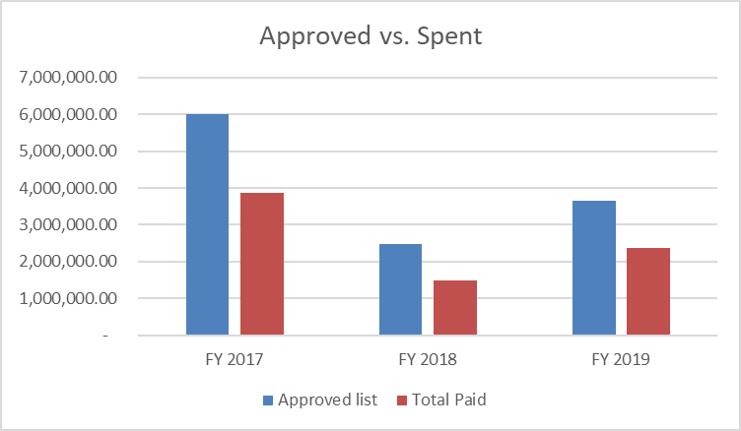
How can you give out more than was appropriated?
FY17 cost share
23% canceled
25% overestimated
$6,006,932 approved and $3,870,289 paid
FY18 cost share
33% canceled
10% overestimated
$2,469,726 approved and $1,495,779 paid
FY19 cost share
29% canceled
10% overestimated
$3,663,850 approved and $2,369,131 paid
Notes:
Updated through 10/31/20

Slide 9
Cost Share
Modifications
If you need to make a change to a cost share project, complete a Modification form and include the information about the change
Change in units of a practice (e.g., 200 foot more of fence)
Name changes
Deletion of practices
Modifications that change practices will be re-scored to verify that they would have been eligible for funding if they applied for those practices initially
Overrun
Complete when the units of a practice haven't changed but have cost more than the estimate.
Remember - the statute says 75% of the actual cost verified by receipt, voucher or bill

Slide 10
Cost Share Dates
FY20
Must have been completed by 2/1/22.
FY21
First extension due 3/1/22
Second extension due 9/1/22
Must be complete by 3/1/23
FY22
First extension due 2/1/23
Second extension due 8/1/23
Must be complete by 2/1/24

Slide 11
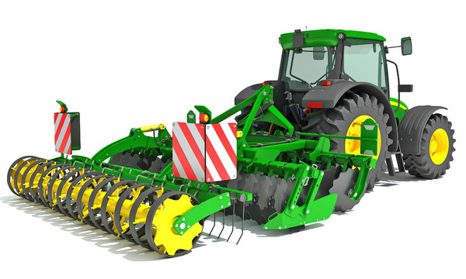
Equipment Loans
Still $600k available for loans to districts
Ask early – we must check if equipment is available on price contract. Not everything can be purchased from your local dealer.
Any legislative changes won't take effect until July 1st.

Slide 12
Trainings
Hundreds participated in our virtual trainings last year
If you have a topic of interest, please let your field rep know or email Conservation@ky.gov

Slide 13
AWQA Tool
Live in June 2021
Over 1000 people have completed a new online Ag Water Quality Plan
Info available at eec.ky.gov/Natural-Resources/Conservation/Pages/Agriculture-Water-Quality-Act.aspx

Slide 14
Questions
Paulette.Akers@ky.gov
502-782-6300
Conservation@ky.gov

Slide 15
Disaster Preparedness
March 2022

Slide 16
Disaster Preparedness
What disasters should you be prepared for?
How should you prepare your office?
What is your role in your community?
What you should not do.

Slide 17
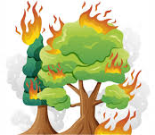
Disaster Preparedness
What disasters should you be prepared for?
Ice storms/winter storms
Flood
Tornado
Fire
Extreme heat/cold
Earthquake
Landslide
Cyberattack
Others?
Is your location vulnerable or helpful?

Slide 18
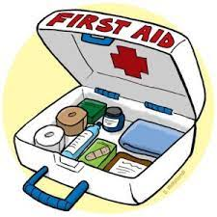
Disaster Preparedness
How should you prepare your office?
Chain of command and communication
File backups
First aid kit and trained individuals
Gas and water cut off
Smoke alarms, carbon monoxide detector
Fire extinguisher and spill cleanup kit
Location of hazardous chemicals

Slide 19
Disaster Preparedness
What is your role in your community?
Work with local emergency manager
Heating/cooling station
Equipment
Storage space
Emergency operations center
Office space for another organization

Slide 20
Disaster Preparedness
What you should not do -
Donate tax-payer funds to another county without checking with an attorney or auditor
Work in a vacuum

Slide 21
Disaster Preparedness
Small Business Association
https://www.sba.gov/business-guide/manage-your-business/prepare-emergencies
FEMA
https://www.ready.gov/
Kentucky Association of Mitigation Managers
http://www.kymitigation.org/

