Slide 1
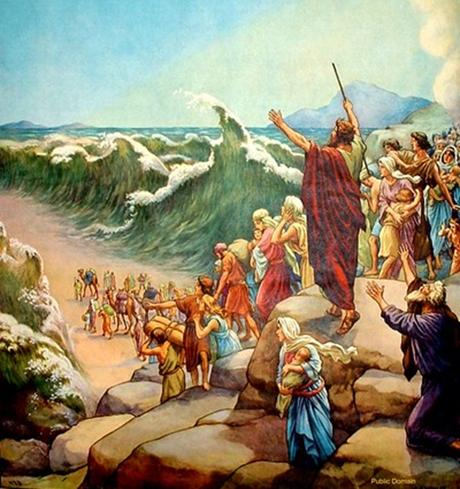
Trinity Evangelical Lutheran Church October 2, 2022
WELCOME!
Exodus 14:5-7, 10-14, 21-29
Notes:
Image: Five Loaves by Caroline Coolidge Brown. Copyright © Caroline Coolidge Brown. All rights reserved. Used by permission of the artist.

Slide 2
= Please stand if able
= Please be seated
Prelude – Darrell Fryman
Office of the Acolyte
Ringing of the Bell
Welcome
Pastor Doug Jacobs
Notes:
Image: Five Loaves by Caroline Coolidge Brown. Copyright © Caroline Coolidge Brown. All rights reserved. Used by permission of the artist.

Slide 3
CONFESSION AND FORGIVENESS
All may make the sign of the cross, the sign marked at baptism…
L: We confess our sins before God and one another.
Pause for silence and reflection.
L: God of promise…
Notes:
Image: Five Loaves by Caroline Coolidge Brown. Copyright © Caroline Coolidge Brown. All rights reserved. Used by permission of the artist.

Slide 4
CONFESSION AND FORGIVENESS
C: You have given us all we are and all we have, and still we have not trusted you fully. We have tried to be god in our own lives, hurting ourselves and those around us in our attempts to control. Wash us clean in the waters of your salvation, and bring us back into right relationship with you.
Notes:
Image: Five Loaves by Caroline Coolidge Brown. Copyright © Caroline Coolidge Brown. All rights reserved. Used by permission of the artist.

Slide 5
CONFESSION AND FORGIVENESS
L: God welcomes you home with open arms, and forgives you all your sin, for the sake of Jesus Christ. By the power of the Holy Spirit, live in the promise of God’s love, freely given.
C: Amen.
Notes:
Image: Five Loaves by Caroline Coolidge Brown. Copyright © Caroline Coolidge Brown. All rights reserved. Used by permission of the artist.

Slide 6
Hymn of Praise
“Come, Ye Faithful, Raise the Strain”
LBW 132
Notes:
Image: Five Loaves by Caroline Coolidge Brown. Copyright © Caroline Coolidge Brown. All rights reserved. Used by permission of the artist.

Slide 7
Come You Faithful, Raise The Strain—LBW 132
1 Come, you faithful, raise the strain
of triumphant gladness!
God has brought his Israel
into joy from sadness,
loosed from Pharaoh’s bitter yoke
Jacob’s sons and daughters,
led them with unmoistened foot
through the Red Sea waters.
Notes:
Image: Preparing yeast dough. Copyright © tomasworks/iStock/Thinkstock. Used by permission.

Slide 8
Come You Faithful, Raise The Strain—LBW 132
2 ’Tis the spring of souls today:
Christ has burst his prison,
and from three days’ sleep in death
as a sun has risen;
all the winter of our sins,
long and dark, is flying
from his light, to whom is giv’n
laud and praise undying.
Notes:
Image: Preparing yeast dough. Copyright © tomasworks/iStock/Thinkstock. Used by permission.

Slide 9
Come You Faithful, Raise The Strain—LBW 132
3 Now the queen of seasons, bright
with the day of splendor,
with the royal feast of feasts
comes its joy to render;
comes to gladden faithful hearts
which with true affection
welcome in unwearied strain
Jesus’ resurrection!
Notes:
Image: Preparing yeast dough. Copyright © tomasworks/iStock/Thinkstock. Used by permission.

Slide 10
Come You Faithful, Raise The Strain—LBW 132
4 For today among the twelve
Christ appeared, bestowing
his deep peace, which evermore
passes human knowing.
Neither could the gates of death,
nor the tomb’s dark portal,
nor the watchers, nor the seal,
hold him as a mortal.
Notes:
Image: Preparing yeast dough. Copyright © tomasworks/iStock/Thinkstock. Used by permission.

Slide 11
Come You Faithful, Raise The Strain—LBW 132
5 Alleluia! Now we cry
to our King immortal,
who, triumphant, burst the bars
of the tomb’s dark portal.
Come, you faithful, raise the strain
of triumphant gladness!
God has brought his Israel
into joy from sadness!
Notes:
Image: Preparing yeast dough. Copyright © tomasworks/iStock/Thinkstock. Used by permission.

Slide 12
APOSTOLIC GREETING
P: The grace of our Lord Jesus Christ, the love of God, and the communion of the Holy Spirit be with you all.
C: And also with you.
Notes:
Image: Five Loaves by Caroline Coolidge Brown. Copyright © Caroline Coolidge Brown. All rights reserved. Used by permission of the artist.

Slide 13
KYRIE
A: In peace let us pray to the Lord.
C: Lord have mercy.
A: For the peace from above, and for our salvation, let us pray to the Lord.
C: Lord have mercy.
A: For the peace of the whole world, for the well being of the Church of God, and for the unity of all, let us pray to the Lord.
C: Lord have mercy.
Notes:
Image: Five Loaves by Caroline Coolidge Brown. Copyright © Caroline Coolidge Brown. All rights reserved. Used by permission of the artist.

Slide 14
KYRIE
A: For this Holy House, and for all who offer here their worship and praise, let us pray to the Lord.
C: Lord have mercy.
A: Help, save, and defend us, gracious Lord.
C: Amen.
Notes:
Image: Five Loaves by Caroline Coolidge Brown. Copyright © Caroline Coolidge Brown. All rights reserved. Used by permission of the artist.

Slide 15
PRAYER OF THE DAY
P: Let us pray… Saving God, with awesome power, you led your people through the sea and rescued them from those who would harm them. Continue to lead us through our challenges, that we might sing your praises on the other side.
C: Amen.
Notes:
Image: Five Loaves by Caroline Coolidge Brown. Copyright © Caroline Coolidge Brown. All rights reserved. Used by permission of the artist.

Slide 16
Notes:
Image: Preparing yeast dough. Copyright © tomasworks/iStock/Thinkstock. Used by permission.

Slide 17
Scripture Reading
R: The Scripture reading is from the Book of Exodus, Chapter 14.
C: Glory to you O’ Lord! (Spoken)
Notes:
Image: Five Loaves by Caroline Coolidge Brown. Copyright © Caroline Coolidge Brown. All rights reserved. Used by permission of the artist.

Slide 18
Exodus 14:5-7; 10-14; 21-29
⁵When the king of Egypt was told that the people had fled, the minds of Pharaoh and his officials were changed toward the people, and they said, “What have we done, letting Israel leave our service?” ⁶So he had his chariot made ready, and took his army with him; ⁷he took six hundred picked chariots and all the other chariots of Egypt with officers over all of them.
Notes:
Image: Five Loaves by Caroline Coolidge Brown. Copyright © Caroline Coolidge Brown. All rights reserved. Used by permission of the artist.

Slide 19
Exodus 14:5-7; 10-14; 21-29
¹⁰As Pharaoh drew near, the Israelites looked back, and there were the Egyptians advancing on them. In great fear the Israelites cried out to the Lord. ¹¹They said to Moses, “Was it because there were no graves in Egypt that you have taken us away to die in the wilderness? What have you done to us, bringing us out of Egypt? ¹²Is this not the very thing we told you in Egypt, ‘Let
Notes:
Image: Five Loaves by Caroline Coolidge Brown. Copyright © Caroline Coolidge Brown. All rights reserved. Used by permission of the artist.

Slide 20
Exodus 14:5-7; 10-14; 21-29
us alone and let us serve the Egyptians’? For it would have been better for us to serve the Egyptians than to die in the wilderness.” ¹³But Moses said to the people, “Do not be afraid, stand firm, and see the deliverance that the Lord will accomplish for you today; for the Egyptians whom you see today you shall never see again. ¹⁴The Lord will
Notes:
Image: Five Loaves by Caroline Coolidge Brown. Copyright © Caroline Coolidge Brown. All rights reserved. Used by permission of the artist.

Slide 21
Exodus 14:5-7; 10-14; 21-29
fight for you, and you have only to keep still.”
²¹Then Moses stretched out his hand over the sea. The Lord drove the sea back by a strong east wind all night, and turned the sea into dry land; and the waters were divided. ²²The Israelites went into the sea on dry ground, the waters forming a wall for them on their right and on their left.
Notes:
Image: Five Loaves by Caroline Coolidge Brown. Copyright © Caroline Coolidge Brown. All rights reserved. Used by permission of the artist.

Slide 22
Exodus 14:5-7; 10-14; 21-29
²³The Egyptians pursued, and went into the sea after them, all of Pharaoh’s horses, chariots, and chariot drivers. ²⁴At the morning watch the Lord in the pillar of fire and cloud looked down upon the Egyptian army, and threw the Egyptian army into panic. ²⁵He clogged their chariot wheels so that they turned with difficulty. The Egyptians said, “Let us flee from the Israelites, for the Lord
Notes:
Image: Five Loaves by Caroline Coolidge Brown. Copyright © Caroline Coolidge Brown. All rights reserved. Used by permission of the artist.

Slide 23
Exodus 14:5-7; 10-14; 21-29
is fighting for them against Egypt.” ²⁶Then the Lord said to Moses, “Stretch out your hand over the sea, so that the water may come back upon the Egyptians, upon their chariots and chariot drivers.” ²⁷So Moses stretched out his hand over the sea, and at dawn the sea returned to its normal depth. As the Egyptians fled before it, the Lord tossed the Egyptians into the sea.
Notes:
Image: Five Loaves by Caroline Coolidge Brown. Copyright © Caroline Coolidge Brown. All rights reserved. Used by permission of the artist.

Slide 24
Exodus 14:5-7; 10-14; 21-29
²⁸The waters returned and covered the chariots and the chariot drivers, the entire army of Pharaoh that had followed them into the sea; not one of them remained. ²⁹But the Israelites walked on dry ground through the sea, the waters forming a wall for them on their right and on their left.
Notes:
Image: Five Loaves by Caroline Coolidge Brown. Copyright © Caroline Coolidge Brown. All rights reserved. Used by permission of the artist.

Slide 25
Exodus 14:5-7; 10-14; 21-29
P: This is the Word of the Lord.
C: Praise to You, O Christ (Spoken)
Notes:
Image: Five Loaves by Caroline Coolidge Brown. Copyright © Caroline Coolidge Brown. All rights reserved. Used by permission of the artist.

Slide 26
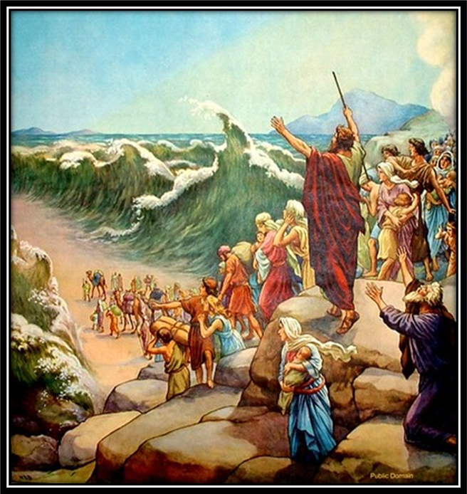
Sermon
Notes:
Image: Five Loaves by Caroline Coolidge Brown. Copyright © Caroline Coolidge Brown. All rights reserved. Used by permission of the artist.

Slide 27
APOSTLE’S CREED
C: I believe in God, the Father almighty, creator of heaven and earth.

Slide 28
APOSTLE’S CREED
C: I believe in Jesus Christ, his only Son, our Lord. He was conceived by the power of the Holy Spirit and born of the virgin Mary. He suffered under Pontius Pilate, was crucified, died, and was buried.

Slide 29
APOSTLE’S CREED
C: He descended into hell. On the third day he rose again. He ascended into heaven, and is seated at the right hand of the Father. He will come again to judge the living and the dead.

Slide 30
APOSTLE’S CREED
C: I believe in the Holy Spirit, the holy catholic Church, the communion of saints, the forgiveness of sins, the resurrection of the body, and the life everlasting. Amen.

Slide 31
NICENE CREED
C: We believe in one God, the Father, the Almighty, maker of heaven and earth, of all that is, seen and unseen.

Slide 32
NICENE CREED
C: We believe in one Lord, Jesus Christ, the only Son of God, eternally begotten of the Father, God from God, Light from Light, true God from true God, begotten, not made, of one Being with the Father.

Slide 33
NICENE CREED
C: Through him all things were made. For us and for our salvation he came down from heaven; by the power of the Holy Spirit he became incarnate from the virgin Mary, and was made man. For our sake he was crucified under Pontius Pilate;

Slide 34
NICENE CREED
C: he suffered death and was buried. On the third day he rose again in accordance with the Scriptures; he ascended into heaven and is seated at the right hand of the Father. He will come again in glory to judge the living and the dead, and his kingdom will have no end.

Slide 35
NICENE CREED
C: We believe in the Holy Spirit, the Lord, the giver of life, who proceeds from the Father and the Son. With the Father and the Son he is worshiped and glorified. He has spoken through the prophets. We believe in one holy catholic and apostolic Church.

Slide 36
NICENE CREED
C: We acknowledge one Baptism for the forgiveness of sins. We look for the resurrection of the dead, and the life of the world to come. Amen.

Slide 37
PRAYERS OF INTERCESSION
Each petition will end with the words,
A: God of promise,
The congregation will respond with:
C: You hear our prayer.

Slide 38
PRAYERS OF INTERCESSION
The prayer concludes…
P: Trusting in your grace and mercy, we lift these prayers to you, in the name of Jesus Christ.
C: Amen.

Slide 39
Offering Prayer
Notes:
Image: Five Loaves by Caroline Coolidge Brown. Copyright © Caroline Coolidge Brown. All rights reserved. Used by permission of the artist.

Slide 40
THE GREAT THANKSGIVING
Communion by pre-packaged Communion Cups. All the Baptized are welcome to celebrate this Holy Meal.

Slide 41
DIALOGUE
P: The Lord be with you.
C: And also with you.
P: Lift up your hearts.
C: We lift them to the Lord.
P: Let us give thanks to the Lord our God.
C: It is right to give him thanks and praise.

Slide 42
Preface
P: It is indeed right…
…join their unending hymn

Slide 43
Sanctus
C: Holy, holy, holy Lord, God of power and might: Heaven and earth are full of your glory. Hosanna. Hosanna. Hosanna in the highest. Blessed is he who comes in the name of the Lord. Hosanna in the highest.

Slide 44
Eucharistic Prayer
P: Holy God, our Maker, Redeemer, and Healer…
…in your holy Church, both now and forever.
C: Amen

Slide 45
THE LORD’S PRAYER
C: Our Father, who art in heaven, hallowed be thy name, thy kingdom come, thy will be done, on earth as it is in heaven. Give us this day our daily bread; and forgive us our trespasses, as we forgive those who trespass against us; and lead us not into temptation, but deliver us from evil.

Slide 46
THE LORD’S PRAYER
C: For thine is the kingdom, and the power, and the glory, forever and ever. Amen.

Slide 47
INVITATION TO COMMUNION
P: God’s love has brought us into the life God has promised. Now we join with all God’s children at this table, in remembrance of him who is God’s promise fulfilled. Come and be fed.

Slide 48
POST COMMUNION BLESSING
P: May this Body and Blood of our Lord and Savior, Jesus Christ, strengthen, keep, and unite us, now and forever.
C: Amen.

Slide 49
POST COMMUNION PRAYER
P: Let us pray… God of the abundant table, you have refreshed our hearts in this meal with bread for the journey. Give us your grace on the road that we might serve our neighbors with joy; for the sake of Jesus Christ, our Lord.
C: Amen

Slide 50
Announcements
Notes:
Image: Five Loaves by Caroline Coolidge Brown. Copyright © Caroline Coolidge Brown. All rights reserved. Used by permission of the artist.

Slide 51
SENDING BLESSING
P: God, who gives life to all things and frees us from despair, bless you with truth and peace. And may the holy Trinity, ☩ one God, guide you always in faith, hope, and love.
C: Amen.

Slide 52
Sending Song
“On Our Way Rejoicing” ELW 537
Notes:
Image: Five Loaves by Caroline Coolidge Brown. Copyright © Caroline Coolidge Brown. All rights reserved. Used by permission of the artist.

Slide 53
“On Our Way Rejoicing” ELW 537
1 On our way rejoicing
gladly let us go.
Christ our Lord has conquered;
vanquished is the foe.
Christ without, our safety;
Christ within, our joy;
who, if we be faithful,
can our hope destroy?
Notes:
Image: Five Loaves by Caroline Coolidge Brown. Copyright © Caroline Coolidge Brown. All rights reserved. Used by permission of the artist.

Slide 54
“On Our Way Rejoicing” ELW 537
Refrain
On our way rejoicing;
as we forward move,
hearken to our praises,
O blest God of love!
Notes:
Image: Five Loaves by Caroline Coolidge Brown. Copyright © Caroline Coolidge Brown. All rights reserved. Used by permission of the artist.

Slide 55
“On Our Way Rejoicing” ELW 537
2 Unto God the Father
joyful songs we sing;
unto God the Savior
thankful hearts we bring;
unto God the Spirit
bow we and adore,
on our way rejoicing
now and evermore.
Notes:
Image: Five Loaves by Caroline Coolidge Brown. Copyright © Caroline Coolidge Brown. All rights reserved. Used by permission of the artist.

Slide 56
“On Our Way Rejoicing” ELW 537
Refrain
On our way rejoicing;
as we forward move,
hearken to our praises,
O blest God of love!
Notes:
Image: Five Loaves by Caroline Coolidge Brown. Copyright © Caroline Coolidge Brown. All rights reserved. Used by permission of the artist.

Slide 57
DISMISSAL
P: … depart in Christ’s Love.
C: Seeking, welcoming, and serving all. Amen!
POSTLUDE
By
Darrell Fryman
From sundaysandseasons.com. Copyright © 2022 Augsburg Fortress. All rights reserved. Reprinted by permission under Augsburg Fortress Liturgies Annual License #SAS023830. New Revised Standard Version Bible, Copyright © 1989, Division of Christian Education of the National Council of the Churches of Christ in the United States of America. Used by permission. All rights reserved. Revised Common Lectionary, Copyright © 1992 Consultation on Common Texts, admin Augsburg Fortress. Used by permission.

