Slide 1
MWMA Interim Meeting
Weights and Measures Week March 1 – 7, 2023

Slide 2
Weights and Measures Week
March 1 – 7, 2023

Slide 11
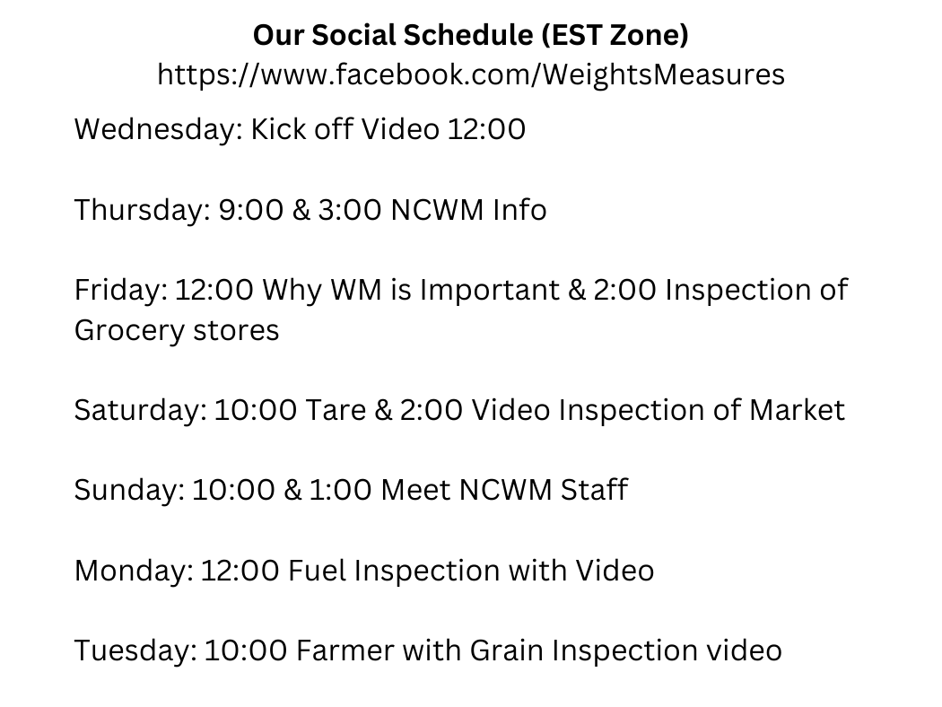

Slide 12
SCALES
Small and Retail Computing Scales

Slide 13
Checking Commercial Scales

Slide 14
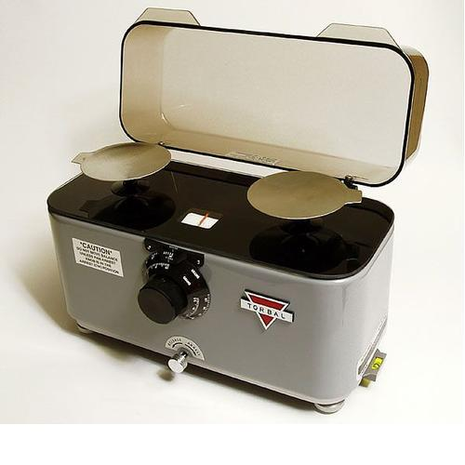
Small and Retail Computing -Pharmacy, Jewelers, Cannabis -Retail Stores (supermarkets, deli’s, convenience stores, etc)

Slide 15
INSPECTION
Types -Routine -Request -Follow-Up
Visual/Inspecting -Scale legal for trade? -Suitable for use? -Capacity, Divisions
Physical/Testing -Seal intact -Increasing Load -Shift -Decreasing Load
Findings

Slide 16
Inspecting vs Testing
Inspecting
Testing
examinations made to determine compliance with design, maintenance, and user requirements
EPO
HB 44 General Code
HB 44 Scale Code
Field Manual for guidance
those operations carried out to determine the accuracy of value or performance of the equipment under examination by comparison with the actual physical standards of the official.
EPO
HB 44 Scale Code, Tolerances
Field Manual for guidance

Slide 17
Accurate & Correct
Accurate
Correct
A piece of equipment is accurate when its performance or value (that is, its indications, its deliveries, its recorded representations, or its capacity or actual value, etc., as determined by tests made with suitable standards) conforms to the standard within the applicable tolerances and other performance requirements.
A piece of equipment is correct when, in addition to being accurate, it meets all applicable specification requirements.

Slide 18
Pre-Inspection
Where are you going? What device(s) will you be dealing with? -In-Use? New? History on device? (last years report)
Proper Equipment: ID, Weights, seals, stickers, etc
Handbook 44, EPO, and MGL (website has all!)
Paperwork: certificate of conformance, report, invoice
Field Manual from NCWM -Field Training Manual

Slide 19
Retail Scale 30 x 0.01Lbs
Handbook 44 -General Code -Section 2.20: Scales
EPO 1: Retail Computing Scales
Certificate of Conformance
30lbs weight kit
Seals, Approval Stickers

Slide 20
Begin Inspecting
Introductions/Explanations
Scale Legal for Use? CC#?
Zero Load Balance -Is the scale able to show 0.00
General Considerations -Is the scale suitable for use? -Safe to use/test
Markings -Accuracy Class: Marked or Unmarked -Identification (Nomenclature plate) -Capacity and Division/Verification
Tolerance Determination -Table 6 or Table 1.1

Slide 21
Marked or Unmarked
Is the scale marked Class III?
Does scale have more than 5000 division?
No
yes
Yes
No
Use Table 6 or TN.3.2.
Use Table T.1.1.

Slide 23
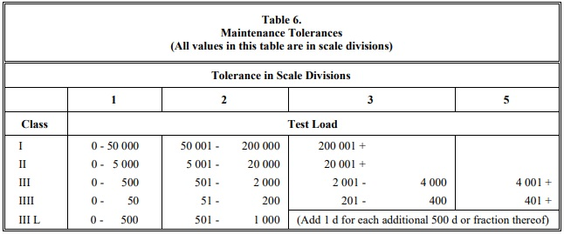

Slide 24
Tolerance Calculation
What is a Division? (d) -Smallest Increment in which the scale can measure -Example: 0.01 Lbs -d vs e (verification)
How many Divisions are there? (n)
What Tolerance are you using? -Maintenace -Acceptance
Breakpoints -500, 2000, 4000

Slide 25
Division (d) vs Verification (e)
Division: Smallest displayed unit of the scale.
Verification: Represents the legal for trade division
In most cases d and e are equal
Usually differ in class I and II scales
e must be equal to or 10x greater than d ie: d = 0.001, e = 0.01
When the values differ, we will use the e value

Slide 26
Division Calculation
30 lbs x 0.01 lbs
Division size is 0.01 lbs -How many 0.01 are in 30 lbs?
30 / 0.01 = 3000 divisions
Break points -A change in tolerance based on number of divisions -Set by table 6 -Break point size multiplied by division size = tolerance up to that weight in pounds -500 x 0.01 = 5 -2000 x 0.01 = 20 -3000 x 0.01 = 30

Slide 27
Tolerance Types
Acceptance
Maintenance
Equipment to be put into commercial service
Equipment placed into commercial service within the last 30 days
Equipment under-going type evaluation
Equipment that has been rejected for performance and is being retested within 30 days following corrective service
Equipment being tested within 30 days after reconditioning or overhaul
Equipment in actual use except when acceptance tolerances apply

Slide 28
PHYSICAL INSPECTION

Slide 29
Inspection Demo

Slide 30
Inspection Findings
Does the scale pass? -Yes = sealed (or not sealed) -No = why? (out of tolerance, markings, etc) -Adjusted/Re-Calibrate(not required by WM official) -Condemn Scale until corrected
Physical or Audit Trail Seal
Approval Sticker
Explanation of findings

