Slide 1
Faith, Spiritual Practices
The Family Solution Finder Learning Seminars

Slide 2
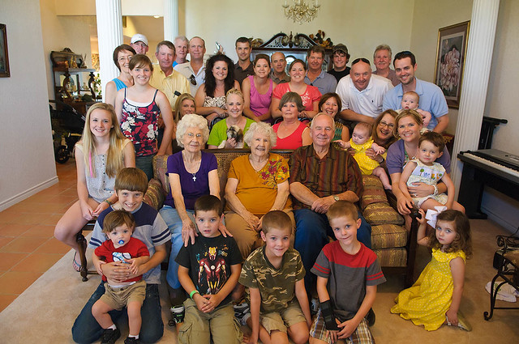
Faith, Spiritual Practices
The Family Solution Finder Learning Seminars
SP~ARK’s Program
M.O.R.E. Program networking Referrals
Notes:
The family Solution Finder has 32 1.5hr seminars coving all the issues a family will likely face in their journey. The family can view these in the monthly meeting or at home. Each issues require a family plan of action

Slide 4
Faith, Hope & Love
Why Suffering is part of this journey
Building a Ministry for Family Members
Practical Exercise
Supportive Family environment

Slide 6
Decisions, Questions and more decisions,
You don’t’ have to start a ministry in order to grow in your faith:
Read the scriptures of your religion.
Seek to counsel of others in the leadership of your community faith group.
Ask the tough questions, and expect in someway you will receive answers, through some to of way, not necessarily on your timeline and not necessarily in the way you might want to be answered.
If you are on this journey and you are the type of person who practices faith then begin to make these connections now, while your head is clear, with the understanding more will be needed of the same later.
Get the resources guidebook: “It’s Time to Get Networked Workbook”. Know the material before you introduce it to your faith organization. Because you are brining it to them, they will expect you know what is in it as “to-Do” steps getting started.

Slide 7
A 33-video series on how to build a ministry

Slide 8
Conclusion
Purchase the “Invest in the Family Ministry” Ministry Set up Guide and Volunteer User Manual
Purchase the “The Substance Use Disorder Journey, It’s time to get networked workbook.
Purchase both the Family Solution Finder Study Guide and Family Solution Finder Workbook. 32 seminars for learning the family journey.
Go to our website: www.familiesimpactedbyopioids.com and see the tabs for Invest in the Family Ministry and 32 free download learning seminars.

Slide 9
CONTACT US:
Roy Poillon Executive Director/Founder
Office: 440.385.7605 Mobile: 814.722.8946
Familiesimpactedbyopioids@gmail.com
www.Familiesimpactedbyopioids.com
LinkedIn Roy Poillon
Facebook: Familiesimpactedbyopioids public group
Instagram: Families Impacted by Opioids
ALWAYS SEEK THE ADVICE OF A PROFESSIONAL THERAPIEST BEFORE ACTING ON ANY PART OF THE INFORAMTION PROVIDED IN THESE PROGRAMS.

