Slide 1
CARDIOVASCULAR INFECTIONS
Assistant prof. Dragan Ledina, MD

Slide 2
INFECTIVE ENDOCARDITIS
Acute endocarditis is life-threatening and often requires surgical intervention
Subacute endocarditis is an indolent disease that can continue for months
Epidemiology:
Infective endocarditis remains a serious but relatively uncommon problem
The incidence varies from 0,6 per 100 000 to 11 per 100 000 members of the population
Reasonable estimate is probably 2 per 100 000 members of the population
In recent series, more than half of of the patients with endocarditis were over the age of 50

Slide 3
Pathogenesis and predisposing risk factors
Host factors:
results from valve damage that is followed by platelet and fibrin deposition
NBTE /nonbacterial thrombotic endocarditis/ results from:
rheumatic heart disease;
congenital heart disease (bicuspid valve, ventricular septal defect);
mitral valve prolapse;
degenerative valve disease (calcific aortic valve disease); or
prosthetic valve.

Slide 4
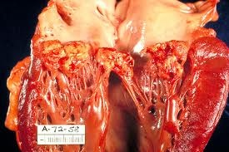
Venturi effect results in vegetation formation on the low-pressure side of high-flow valvular lesions
Disease of the mitral or aortic valve is most common; disease of tricuspid valve is rarer (usually seen in intravenous drug abusers).

Slide 5
Bacterial factors:
Sticky bacteria adhere more readily to inert surfaces and to the endocardium (streptococci)
Streptococci that produce higher levels of dextran demonstrate increased ability to cause dental caries and to cause bacterial endocarditis
Streptococcus viridans; named for its ability to cause green hemolysis on blood agar plates, often have a high dextran content and are a leading cause of dental caries and bacterial endocarditis
Streptococcus bovis also has high dextran content; associated with colonic carcinoma
Candida albicans adheres well to NBTE; C krusei adheres poorly and seldom causes infective endocarditis
S. sanguis – bind to platelet receptor, S aureus – binding to fibrinogen and fibronectin

Slide 6
Causes of bacteremia potentially leading to endocarditis
Procedure or manipulation | Positive blood culture
DENTAL
Dental extraction | 18-85%
Periodontal surgery | 32-88%
Gum chewing | 15-51%
Tooth brushing | 0-26%
Oral irrigation device | 27-50%
UPPER AIRWAY
Bronchoscopy (rigid scope) | 15%
Intubation or nasotracheal suction | 16%

Slide 7
Causes of bacteremia potentially leading to endocarditis
GASTROINTESTINAL
Upper gastrointestinal endoscopy | 8-12%
Sigmoidoscopy or colonoscopy | 0-9,5%
Barium enema | 11%
Liver biopsy (percutaneous) | 3-13%
UROLOGIC
Urethral dilatation | 18-33%
Urethral Catheter | 8%
Cystoscopy | 0-17%
Transurethral prostatectomy | 12-46%

Slide 8
Causes of bacteremia that can lead to infective endocarditis:
Dental manipulations (extraction,periodontal surgery), oral irrigators (’’Waterpick’’)
Tonsillectomy
Urology procedures (urethral dilatation, cystoscopy, prostatectomy)
Pulmonary procedures (rigid bronchoscopy, intubation)
Gastrointestinal (GI) procedures (upper GI endoscopy, sigmoidoscopy, colonscopy)

Slide 9
Microorganisms that cause infective endocarditis
Organism | Native valve % | IV drug abuse % | Prosthetic valve
 |  |  | Early % | Late%
Strepococcus sp | 60-80 | 15 | <10 | 35
S. viridans | 30-40 | 5 | <5 | 25
S.bovis | 10 | <5 | <5 | <5
other | <5 | <5 | <5 | <5
Staphylococcus | 20-35 | 50 | 50 | 30
Coagulasa poz | 10-27 | 50 | 20 | 10
Coagulasa neg | 1-3 | <5 | 30 | 20
Enterococcus s | 5-18 | 8 | <5 | <5

Slide 10
Microorganisms that cause infective endocarditis
Organism | Native valve % | IV drug abuse % | Prosthetic valve
 |  |  | Early % | Late%
Gram-neg. bacilli | <5 | 15 | 20 | 20
Miscellanous b | <5 | 5 | 5 | 5
HACEK group | <5 | <1 | <1 | <5
Coinobacterium and propiob. | <1 | <5 | <5 | <5
Anaerobes | <1 | <1 | <1 | <1
Fungi | <5 | 5 | 5 | 5
Coxiella burneti | <1 | <1 | <1 | <1
Polymicrobial | <1 | <5 | <5 | <5
Culture neg. | 3-5 | 3-5 | <5 | <5

Slide 11
About the causes of infective endocarditis:
Native valve endocarditis:
most common cause is streptococci: S. viridans is number one, then S. faecalis (Enterococcus) and S. bovis (associated with colonic cancer);
Staphylococcus aureus is the second most common cause;
HACEK group is an uncommon cause, but considered in culture-negative cases (hold blood cultures for more than 7 days).

Slide 12
Intravenous drug abusers:
Most common cause is S. aureus;
Gram-negative aerobic bacilli are the second most common cause; Pseudomonas aeruginosa;
Fungi;
Multiple organisms.

Slide 13
Prosthetic valve:
“Early” is the result of nosocomial pathogens: S. aureus, coagulasa-negative staphylococci, gram negative bacilli, fungi
“Late” (more than 2 months post-op) is the result of mouth and skin flora: S. viridans, coagulasa-negative staphylococci, S. aureus, gram-negative bacilli, fungi

Slide 14
History in infective endocarditis:
Non-specific symptoms usually begin 2 weeks after initial bacteremia
On average, diagnosis takes 5 weeks from the onset of symptoms
Low grade fever is most common; may be accompanied by night sweats
Fatigue, malaise, general weakness, anorexia and weight loss are common; mimics cancer
Myalgias and arthralgias may suggest a connective tissue disease

Slide 15
Physical findings in infective endocarditis
A cardiac murmur is heard in nearly all patients.
a) Absence of murmur is rare, but it may occur with rupture
of chordae tendinae.
b) Classic changing murmur is rare, but it may occur with rupture of chordae tendinae.
c) New aortic regurgitation is the result of infective endocarditis until proven otherwise.

Slide 16
Embolic phenomena are found in up to 50 % of cases
Are most common conjunctiva; cluster can be found anywhere.
Splinter hemorrhages, linear streaks, are found under nails.
Osler nodes, painful, raised lesions in the pads of the fingers or toes, are evanescent.
Janeway lesions, red macules, are more persistent and most common in acute endocarditis attributable to Staphyloccocus aureus.
Roth spots are retinal hemorrhages with a clear center.

Slide 18
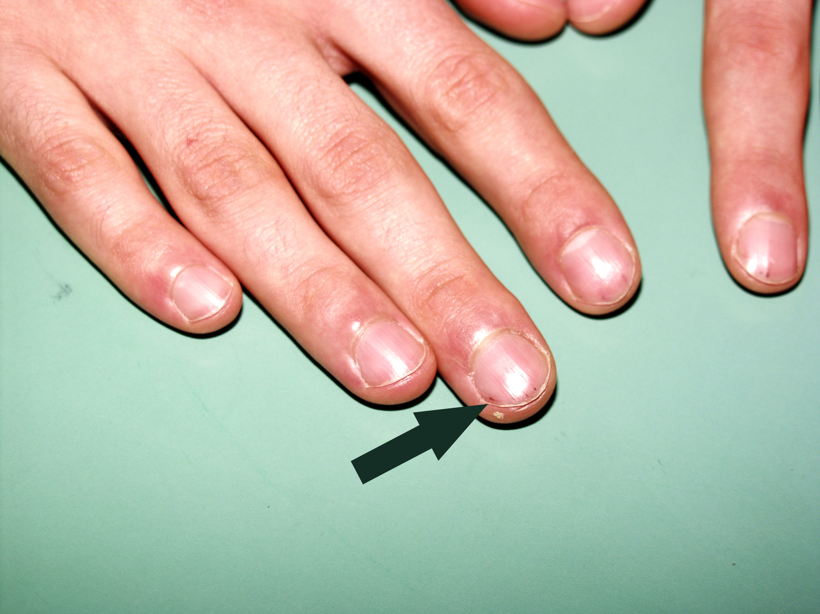

Slide 19
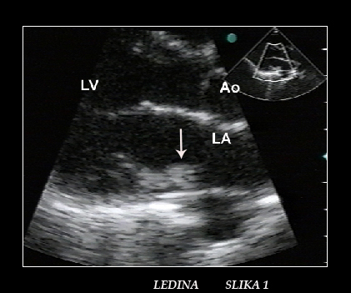

Slide 20
Splenomegaly can be found; left upper quadrant tenderness can occur with embolic infraction
Check all pulses as a baseline because of the risk of obstructive emboli
Perform a thorough neurologic exam; a sudden embolic stroke can develop

Slide 21
Laboratory findings in infective endocarditis:
Anemia of chronic disease is found in most patients
The peripheral white blood cell count is normal, unless myocardial abscesses or acute disease is present
Manifestation of chronic antigenemia mimic a connective tissue disorders
Elevated sedimentation rate and C-reactive protein
Positive rheumatoid factor
Elevated imunoglobulins, cryoglobulins and immune complexes
Decreased complement
Hematuria and proteinuria

Slide 22
Laboratory findings in infective endocarditis-continued:
A chest radiograph may be abnormal
Circular, cannonball-like lesions in embolic right-sided endocarditis
Pulmonary edema pattern secondary to left-sided congestive heart-failure
Monitor the electrocardiogram closely; conduction defects can progress to complete heart block

Slide 23
Diagnosis:
Blood culture is a critical test for making a diagnosis of infective endocarditis (IE)
IE is associated with a constant low-level bacteremia
Blood culture spaced at least 15 minutes apart; three over 24 hours for subacute bacterial endocarditis
Large volumes of blood (at least 10 ml) need to be added to blood culture flasks
Blood culture is usually negative for at least 7 days after an antibiotic is given

Slide 24
Diagnosis continued:
Documentation of endocardial involvement (transesophageal echocardiography – TEE – is more sensitive than transthoracic echocardiography); TEE is always preferred in prosthetic valve endocarditis
Duke criteria are helpful in making the clinical diagnosis of infective endocarditis in the absence of pathologic tissue

Slide 25
Major Duke criteria:
Two separate blood cultures, both positive for typical endocarditis-associated organisms, including Staphylococcus aureus OR persistent positive blood cultures – two more than 12 hours apart, or three, or a majority from among more than four, during 1 hour
Evidence of endocardial involvement by positive echocardiogram (for patients with possible infective endocarditis, TEE is recommended) or new regurgitant murmur
Positive Q fever serology (antiphase I IgG >1:800), or single blood culture positive for Coxiella burnetii

Slide 26
Minor criteria:
Predisposing heart condition
Fever of 38⁰C or more
Vascular phenomena
Immunologic phenomena
Single positive blood culture with typical organisms
Previous minor criterion of suspicious lesion on TEE now eliminated

Slide 27
Definite infective endocarditis:
2 major criteria, or
1 major criterion and 3 minor criteria, or
5 minor criteria

Slide 28
Possible infective endocarditis:
1 major and 1 minor criterion, or
3 minor criteria

Slide 29
Complications associated with infective endocarditis
Cardiac complications occur in up to half of the patients:
Congestive heart failure;
Myocardial abscess (aortic disease associated with conduction defects);
Myocardial infarction (rare complication of aortic disease);
Two thirds of systemic emboli go to the cerebral cortex.

Slide 30
Neurologic complications can arise from emboli:
Embolic stroke (most commonly with Staphylococcus aureus, fungi, and HACEK group organisms)
Mycotic aneurysms (most common with S. aureus infection)
Encephalopathy, meningitis and brain abscess
Renal complications are possible:
Membranoproliferative glomerulonephritis resulting from deposition of immune complex
Interstitial nephritis
Embolic damage

Slide 31
Drug | Dose | Relative efficacy | Duration 4-6 weeks
Acute empiric
Vancomycin, plus | 30mg/kg IV q 24h, divided q 12 h |  | Vancomycin more slowly cidal
Ampicillin, plus | 12 g IV q 24h, divided q 4h
Gentamicin | 1mg/kg IV q 8h
Culture negative
Ampicillin, plus | 12g IV q 24h, divided q 4h
Gentamicin | 1mg/kg IV q 8h
Prosthetic-empiric
Vancomycin, plus | 1g IV q 12h |  | Duration6-8 weeks
Gentamicin, plus | 1mg/kg IV q 8h |  | Duration 2 weeks
Rifampin | 600mg po q 24h |  | Duration 6-8 weeks

Slide 32
Streptococcus viridans
Drug | Dose | Relative efficacy | Comments (duration 4-6 weeks unless otherwise noted)
Penicillin G or | 24x10⁶ U IV q 24 h or divided q 4h | First line | Short course if uncomplicated
Ampicillin plus gentamicin | 12gr IV q 24h,divided q 4h 1mg/kg IV q 8h |  | 2 weeks
Ceftriaxone, plus gentamicin | 2gr IV q 24h | Alternative | Short course if uncomplicated, duration 2 weeks for both
Vancomycin | 30mg/kg IV q 12h | Alternative | For penicillin-allergic patients, 4 weeks

Slide 33
Enterococcus
Drug | Dose | Relative efficacy | Comments (duration 4-6 weeks unless otherwise noted)
Ampicillin | 12g IV q 24h, divided q 4h | First line | Relapse is common in the absence of gentamicin; use sensitivity to determine best regimen
Penicillin G, plus | 24x106 U IV q 24h or divided q 4h |  | Duration 2-6 weeks
Gentamicin | 1mg/kg IV q 8h

Slide 34
Meticillin sensitive Staphylococcus aureus (MSSA)
Drug | Dose | Relative efficacy | Comments (duration 4-6 weeks unless otherwise noted)
Nafcillin | 12g q 24h or divided q 4h | First line | Addition of gentamicin may shorten bacteremia, but has no effect on final outcome; duration 6 weeks
Oxacillin, with or without gentamicin | 3mg/kg IV q24h | 3-5 days | Either one
Cefazolin, with or without gentamicin | 2g IV q 8h duration 6 weeks 3mg/kg IV q 24h | Second line Duration 3-5 days | For non-anaphylactic reaction to penicillin

Slide 35
Drug | Dose | Relative efficacy |  | Comments (duration 4-6 weeks unless otherwise noted)
Methicillin-sensitive Staphylococcus aureus (tricuspid valve only)
Nafcilin, | 12g IV or divided q 4h |  | First line | Short course effective if no metastatic lesions and MSSA; duration 2 weeks
Oxcillin, plus gentamicin | 1mg/kg IV q 8h |  |  | Duration 6 weeks
Ciprofloxacin, plus | 750 mg per os q 12h |  | Second line | May be effective in MSSA; duration 4 weeks
Rifampin | 300 mg per os q 12h |  |  | Duration 4 weeks
Methicillin-resistant staphylococcus aureus (MRSA)
Vancomycin | 30mg/kg IV q 24h divided q 12h |  | First line | Slow response; duration 6 weeks
Daptomycin | 6mg/kg IV q 24h |  | First line | Comparable outcome to vancomycin. Staphylococcus aureus (tricuspid)

Slide 36
Antibiotic treatment in infective endocarditis:
The goal is to achieve serum cidal levels of 1:8 to 1:32, these levels of cidal activity being associated with cure
Dual therapy? Shortening bacteremia, but no rate of cure
Cidal antibiotics must be used, and therapy must be prolonged
Therapy for 4-6 weeks (except for uncomplicated streptococcus viridans infection, in which penicillin or ceftriaxone combined with low-dose gentamicin for 2 weeks is effective)
Therapy must be guided by minimum inhibitory concentration and synergy testing
Synergistic therapy not shown to be of benefit in Staphylococcus aureus infection

Slide 37
Antibiotic treatment in infective endocarditis:
Whenever possible, β-lactam antibiotics are preferred over vancomycin
Antibiotics alone rarely sterilize prosthetic valves; some success occurs with coagulase-negative staphylococci having used vancomycin, gentamicin, and rifampin
In tricuspid endocarditis:
a) nafcillin or oxacillin plus gentamicin for 2 weeks is effective, except in HIV-infected patients
b) oral ciprofloxacin plus rifampin for 4 weeks may also be effective

Slide 38
Surgery for infective endocarditis:
The threshold for surgery should be low; it increases the likelihood of cure
The cardiologist and cardiac surgeon should be consulted early
Indication for surgery includes:
moderate-to-severe congestive heart failure; early surgery lowers intraoperative and postoperative mortality
more than 1 systemic embolus
uncontrolled infection
resistant bacteria or a fungal pathogen
perivalvular leak or myocardial abscess

Slide 39
Surgery for infective endocarditis:
Neurologic deficits are not an absolute contraindication to surgery
Neither positive blood cultures at the time of surgery nor positive valve cultures have been associated with increased risk of relapse

Slide 40
Prognosis:
Cure rates depend on the organism involved and the valve infected
Staphylococcus and patients with regurgitation have about 50% mortality
Fungi and gram-negative are associated with poor outcome
CHF and neurological deficit; poor prognosis

Slide 41
Prophylaxis in infective endocarditis:
The efficacy of prophylaxis has not been proved; however, it is considered the standard of care
Give to high-risk (prosthetic valve, previous endocarditis, cyanotic heart disease, surgical shunt). No longer required for moderate-risk patients (rheumatic and other acquired valvular dysfunction, hypertrophic cardiomyopathy, mitral valve prolapse with regurgitation).
Give in time to achieve peak antibiotic levels at the time of the invasive procedure

Slide 42
Doses and schedules of prophylactic antibiotics
Patients | Agent |  | Schedule
Dental, oral, and upper respiratory procedures – all patients, oral administration
Non-penicillin-allergic | amoxicillin | 2gpo 1 hour pre-procedure
Penicillin-allergic | Clindamycin or Cephalexin or Cefadroxil Azitromycin or Clarytro… | 600 mg po 1 hour pre-procedure 2 gr po 1 hour pre-procedure 500 mg 1 hour pre-procedure

Slide 43
Dental,oral, and upper respiratory procedures-all patients, parenteral administration
Non-penicillin allergic | Ampicillin | 2 g i.m. or IV 30 min pre-procedure
Penicillin-allergic | Clinadamycin or | 600 mg IV 30 min pre-procedure
 | Cefazolin | 1 g i.m. or IV 30 min pre-procedure Cephalosporin should not be given to a patient with a history of an immediate hypersensitivity reaction to penicillin

Slide 44
INTRAVASCULAR CATHETER-RELATED INFECTIONS
Can be life-threatening; often prolong hospital stay, and can be complicated by metastatic lesions and bacterial endocarditis
Bacteria infect catheters in three ways:
skin flora migrate along the catheter track;
bacteria are injected into the port;
hematogenous spread occurs.
Catheter location and type affect the risk of infection
Regular exchange of central venous catheters over guidewires does not reduce the incidence of infection; the technique is not recommended, because it can precipitate bacteremia

Slide 45
Intravascular catheter-related infections
Gram-positive cocci predominate:
Coagulase-negative straphylococci are the most common, adhere to catheters using a glycocalyx
S. aureus
Enterococci
Corynebacteria

Slide 46
Gram-negative organisms account for one third of infections:
Enterobacter species, Escherichia coli, Acinetobacter species, Pseudomonas species, and Serratia species
Klebsiella species, Citrobacter, or nonaeruginosa strains of pseudomonas are associated with contaminated infusate
Candida albicans also forms an adherent glycocalyx; associated with high glucose solutions

Slide 47
Clinical manifestations and diagnosis of intravascular catheter-related infections:
Symptoms are non-specific; these historical facts are suggestive
Rigor or chills associated with infusion
Resolution of symptoms on removal of the intravenous catheter
Blood culture positive for Staphylococcus epidermidis, Corynebacteria, or Candida albicans
Purulence around the catheter site provides strong evidence, but this sign is absent in many cases

Slide 48
Clinical manifestations and diagnosis of intravascular catheter-related infections:
Cytospin Gram or acridine orange staining of catheter sample provide rapid diagnosis
Roll and sonication methods can be used for quantitating bacteria on the catheter tip; surveillance cultures are not recommended
Blood samples for culture should be drawn simultaneously from the catheter and the peripheral veins
Bacterial growth from the catheter sample that is 5 to 10 times that from the peripheral sample is quantitative for catheter infection
Positive bacterial growth from catheter more than 2 hours earlier than positive growth in a peripheral sample indicates catheter infection

Slide 49
The catheter should be removed if
The patient is severely ill:
fever and positive blood cultures persist for more than 48 hours;
a virulent organism is the infecting agent;
bacteremia is polymicrobial;
tunnel infection, neutropenia, endocarditis, metastatic infection, or septic thrombophlebitis is present.
Empiric therapy is vancomycin and an antipseudomonal third- or fourth-generation cephalosporin

Slide 50
Duration of therapy has not been studied
Average duration is 3 weeks
For coagulase-negative staphylococci continue tratment for 7 to 10 days if the line has been removed, and 2 weeks if line has been kept in place
For complicated infections, continue treatment for 4 to 6 weeks
Antibiotic lock therapy improves cure rate for tunneled catheter (vancomycin, gentamicin)
Infection with S. aureus has a high risk for endocarditis; transesophageal echocardiography is helpful in determining the duration of therapy

Slide 51
For candida albicans infection, always remove the line, and treat for 2 weeks to prevent endophtalmitis:
a) Fluconazole for uncomplicated catheter-related infection;
b) Amphotericin B for severely ill, neutropenic, or resistant fungus-infected patients.

Slide 52
MYOCARDITIS
Fulminant myocarditis can be fatal or lead to chronic CHF
Most cases are self-limiting and are followed by full recovery
Primarily caused by adenoviruses and enteroviruses (Coxsackievirus B and echovirus)
In asymptomatic HIV, incidence of myocarditis is 1,6% annually
Risk factors for symptomatic disease include forced exercise, pregnancy, steroids or non-steroidal anti-inflammatory agents, consumption of ethanol, and nutritional deficiencies

Slide 53
Myocarditis continued:
Many patients are asymptomatic. Some develop:
flu-like illness, sometimes with chest pain,
arrhythmias, and
congestive heart failure (CHF).
A physical exam reveals S3 gallop (indicating left-sided CHF), mitral regurgitation resulting from ring dilatation
In a few cases, cardiac enzymes are elevated
Echocardiography is very helpful; magnetic resonance imaging allows for assessment of the extent of inflammation
Endomyocardial biopsy combined with analysis by PCR is experimental

Slide 54
Treatment includes β-interferon, bed rest, drugs for congestive heart failure and arrhythmias, anticoagulation
Full recovery is usual; however, fulminant cases may require heart transplant

Slide 55
PERICARDITIS
Viral pericarditis usually has a self-limiting benign course;
However, among patients with purulent pericarditis there is a high mortality rate and require emergent care
Pericarditis has three forms:
A) viral, with enteroviruses most common (Coxackievirus and echovirus);
b) purulent, which is usually hematogenous (multiple organisms, including Staphylococcus aureus);
c) tuberculous, which is usually seeded during primary disease, but can spread from a pulmonary focus.

Slide 56
Main symptom is substernal chest pain, which is relieved
by sitting forward; pain is less common in purulent pericarditis and has a gradual onset in tuberculous disease
Physical exam shows:
a) Three-component friction rub early; rub later disappears with increased pericardial fluid
b) Pulsus paradoxicus (exceeding 10 mmHg is abnormal)
c) Jugular venous distension with depressed Y descent

Slide 57
Diagnosis and treatment of pericarditis:
Echocardiography should be performed immediately:
Allows for assessement of pericardial thickness, pericardial fluid, and tamponade
Can be used to guide emergency pericardiocentesis
Electrocardiogram shows diffuse ST and T changes, depressed PR interval, decreased QRS voltage, electrical alternants
Pericardiocentesis only for those with tamponade or suspected of having purulent pericarditis. Pericardial biopsy improves the diagnosis yield

Slide 58
Viral or idiopathic pericarditis is self-limiting
a) Use non-steroidal agents only if no myocarditis
b) Colchicine can be used
Purulent pericarditis requires emergency surgical drainage and systemic antibiotics; mortality rate is 30%
Tuberculous pericarditis is treated with:
a four-drug antituberculous regimen, and
prednisone to prevent constriction (20% to 50% incidence during treatment);
calcific form requires pericardiectomy

Slide 59
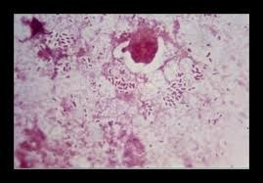
ENDOCARDITIS CAUSED BY HAEMOPHILUS PARAINFLUENZAE: FASTIDIOUS AGENT SERIOUS ILLNESS

Slide 60
INTRODUCTION:
Haemophilus parainfluenzae endocarditis is a rare acute or subacute disease and is usually associated with rheumatic or congenital heart disease.
It is characterized with frequent appearance of peripheral blood vessel embolisation and formation of affluent vegetation on heart valves
Mortality caused by haemophilus endocarditis was up to 50% three decades ago.
It is reduced to approximately 10% by the present time

Slide 61
AIM:
The aim of this case report is to emphasize that haemophilus parainfluenzae can cause infective endocarditis in a young immunocompetent person without predisposition for infective endocarditis (IE).

Slide 62
CASE REPORT:
23 –year- old sportsman was admitted to Department of Infectious Diseases, due to fever accompanied by chills and shivers. The fever lasted for six days and reached 39,5⁰C.
At the admission the patient was febrile with herpes on his lower lip.
Laboratory: ESR 10 mm/1.h, WBC 9,75,
PLT 94, LDH 498 U/L, CPK 249 U/L.
On the sixth day he developed petechiae on his palms and soles and splinter haemorrhages.
Ultrasound showed vegetation on dorsal mitral valve 1,9x0,95 cm in diameter.

Slide 65
The patient was treated with amoxicillin-clavulonic acid plus gentamicin for six weeks.
By the end of the treatment the heart ultrasound showed disappearance of endocardial vegetation.
Echocardiographic and clinical monitoring performed on 3 rd, 6 th and 12 th month after therapy showed no pathological aberrations.

Slide 66
DISCUSSION:
Haemophilus parainfluenzae is a rare causative agent of endocarditis and it usually affects patients with predisposing heart disease, especially after stomatological or other surgical procedures within oral cavity.
Acute course of disease, peripheral embolisations and positive hemoculture after incubation period over 72 hours indicated HACEK group of microorganisms as a possible agent.

Slide 67
Large endocardial vegetations and common embolisations of large arteries characterize H. parainfluenzae endocarditis.
Surgery and heart valve replacement is often indicated.
In our patient, endocardial vegetation showed substantial size reduction and thereafter disappearance by the end of antimicrobial treatment.
This case report shows that Haemophilus parainfluenzae can cause infective endocarditis in a young immunocompetent person without heart or other predisposing diseases for IE.

