Slide 1
Faith That Brings Down Walls
Joshua 6:1-20 Hebrews 11:30

Slide 2
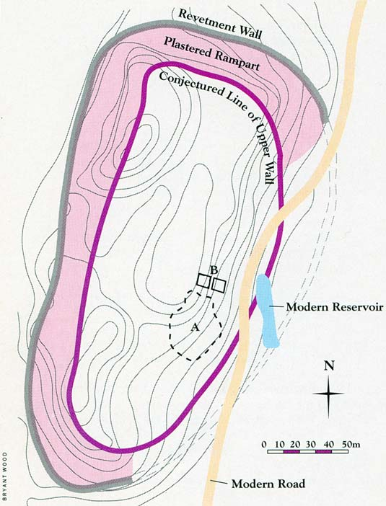

Slide 3
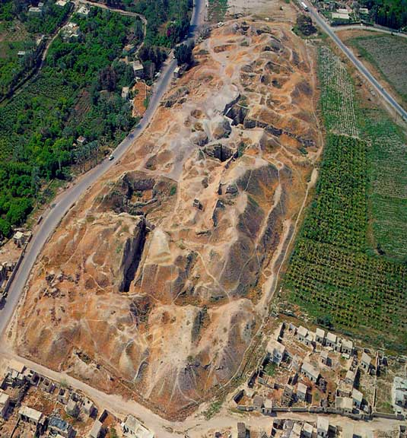

Slide 4
Joshua 6:1-20 (KJV)
1 Now Jericho was straitly shut up because of the children of Israel: none went out, and none came in.
2 And the Lord said unto Joshua, See, I have given into thine hand Jericho, and the king thereof, and the mighty men of valour.

Slide 5
3 And ye shall compass the city, all ye men of war, and go round about the city once. Thus shalt thou do six days.
4 And seven priests shall bear before the ark seven trumpets of rams' horns: and the seventh day ye shall compass the city seven times, and the priests shall blow with the trumpets.

Slide 6
5 And it shall come to pass, that when they make a long blast with the ram's horn, and when ye hear the sound of the trumpet, all the people shall shout with a great shout; and the wall of the city shall fall down flat, and the people shall ascend up every man straight before him.

Slide 7
6 And Joshua the son of Nun called the priests, and said unto them, Take up the ark of the covenant, and let seven priests bear seven trumpets of rams' horns before the ark of the Lord.

Slide 8
7 And he said unto the people, Pass on, and compass the city, and let him that is armed pass on before the ark of the Lord.

Slide 9
8 And it came to pass, when Joshua had spoken unto the people, that the seven priests bearing the seven trumpets of rams' horns passed on before the Lord, and blew with the trumpets: and the ark of the covenant of the Lord followed them.

Slide 10
9 And the armed men went before the priests that blew with the trumpets, and the rereward came after the ark, the priests going on, and blowing with the trumpets.

Slide 11
10 And Joshua had commanded the people, saying, Ye shall not shout, nor make any noise with your voice, neither shall any word proceed out of your mouth, until the day I bid you shout; then shall ye shout.

Slide 12
11 So the ark of the Lord compassed the city, going about it once: and they came into the camp, and lodged in the camp.
12 And Joshua rose early in the morning, and the priests took up the ark of the Lord.

Slide 13
13 And seven priests bearing seven trumpets of rams' horns before the ark of the Lord went on continually, and blew with the trumpets: and the armed men went before them; but the rereward came after the ark of the Lord, the priests going on, and blowing with the trumpets.

Slide 14
14 And the second day they compassed the city once, and returned into the camp: so they did six days.

Slide 15
15 And it came to pass on the seventh day, that they rose early about the dawning of the day, and compassed the city after the same manner seven times: only on that day they compassed the city seven times.

Slide 16
16 And it came to pass at the seventh time, when the priests blew with the trumpets, Joshua said unto the people, Shout; for the Lord hath given you the city.

Slide 17
17 And the city shall be accursed, even it, and all that are therein, to the Lord: only Rahab the harlot shall live, she and all that are with her in the house, because she hid the messengers that we sent.

Slide 18
18 And ye, in any wise keep yourselves from the accursed thing, lest ye make yourselves accursed, when ye take of the accursed thing, and make the camp of Israel a curse, and trouble it.

Slide 19
19 But all the silver, and gold, and vessels of brass and iron, are consecrated unto the Lord: they shall come into the treasury of the Lord.

Slide 20
20 So the people shouted when the priests blew with the trumpets: and it came to pass, when the people heard the sound of the trumpet, and the people shouted with a great shout, that the wall fell down flat, so that the people went up into the city, every man straight before him, and they took the city.

Slide 21
Hebrews 11:30 (KJV)
30 By faith the walls of Jericho fell down, after they were compassed about seven days.

Slide 22
Faith That Brings Down Walls
The Obedience of Faith vs. 14
The Discipline of Faith vs. 10. 14
The Patience of Faith vs. 14
The Shout of Faith vs. 20
The Glory of Faith vs. 19

