Slide 1
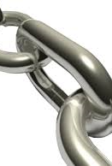
LINKS to the future!!
When your legs tire run with your heart

Slide 2
2022
POPE Cross Country
Kickoff Meeting
WELCOME!

Slide 3
2022 Pope XC Booster Club
Christy Wright President
Tera-Lee Dodsworth
Cheryl Afshani
Jill Drake
Mandy Scales

Slide 4
----Board Objectives----
Pope TFXC Booster Club
Support
Support Development of Strong Winning Program
Continue
Continue Strong Booster Club Communication
Increase
Increase Family Participation
Repair / Maintain
Repair / Maintain of Pope Trail

Slide 5
Pope TFXC Booster Club
Volunteer Opportunities
Team Photographers
Trail Cleanup Day?
Senior Week
Team Banquet
Meet Set Up / Breakdown

Slide 6
Registration Fees Toward…
Coaches Stipends & Supplements
Athletic Trainer Supplement
Weight Room Fees
Team Events
Meet Supplies & Snacks
Meet Transportation
Trail Maintenance
Substitute Fees
Senior Gifts
Team Shirt/shorts
Team Awards

Slide 7
Where Do I Need to Do?
Pay Dues
- Cash, CC’s, Checks payable to Pope TFXC
2.Volunteer
3. Pay/Order/Pick Up Uniforms
TEAM SPIRIT PACK TEAM short
TEAM Tshirt

Slide 8
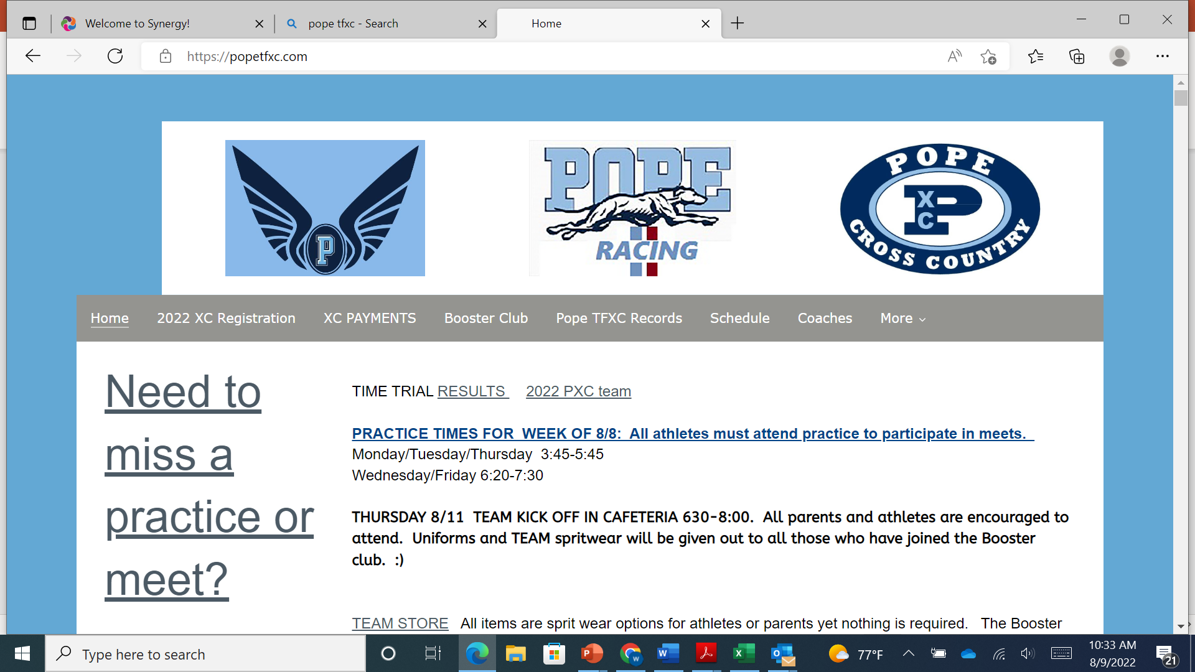
Website has everything you need to know
www.popetfxc.com

Slide 9
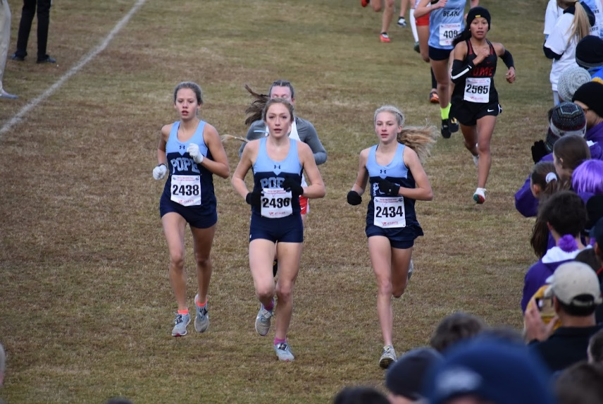
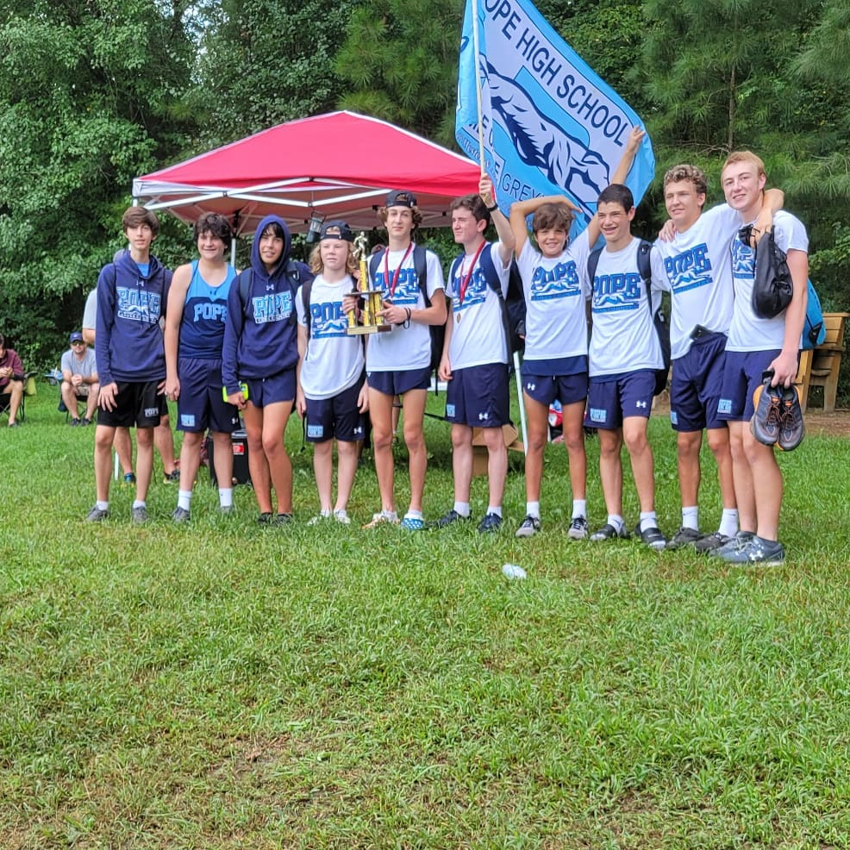
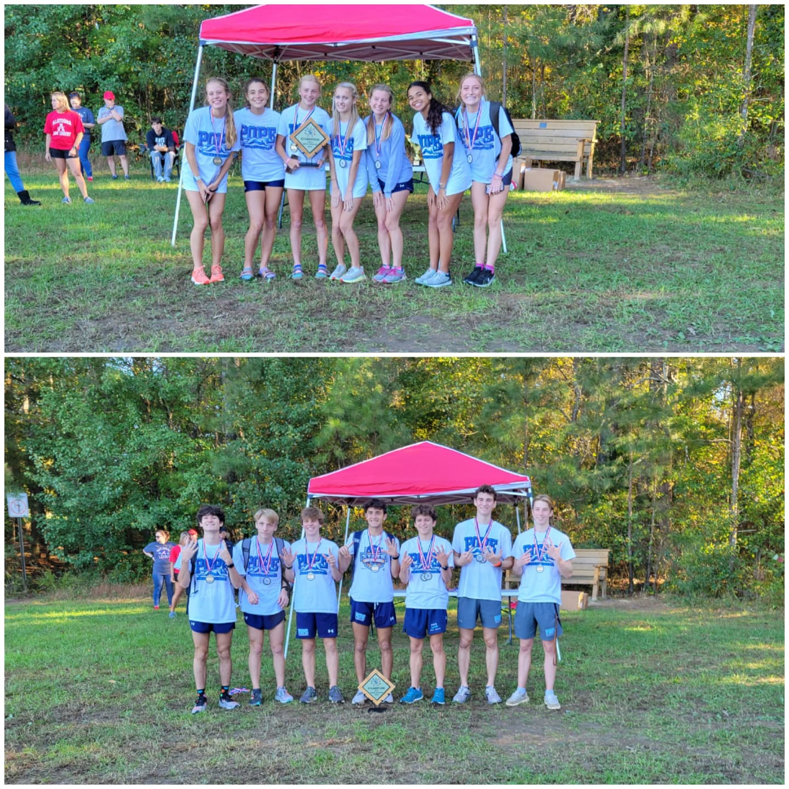
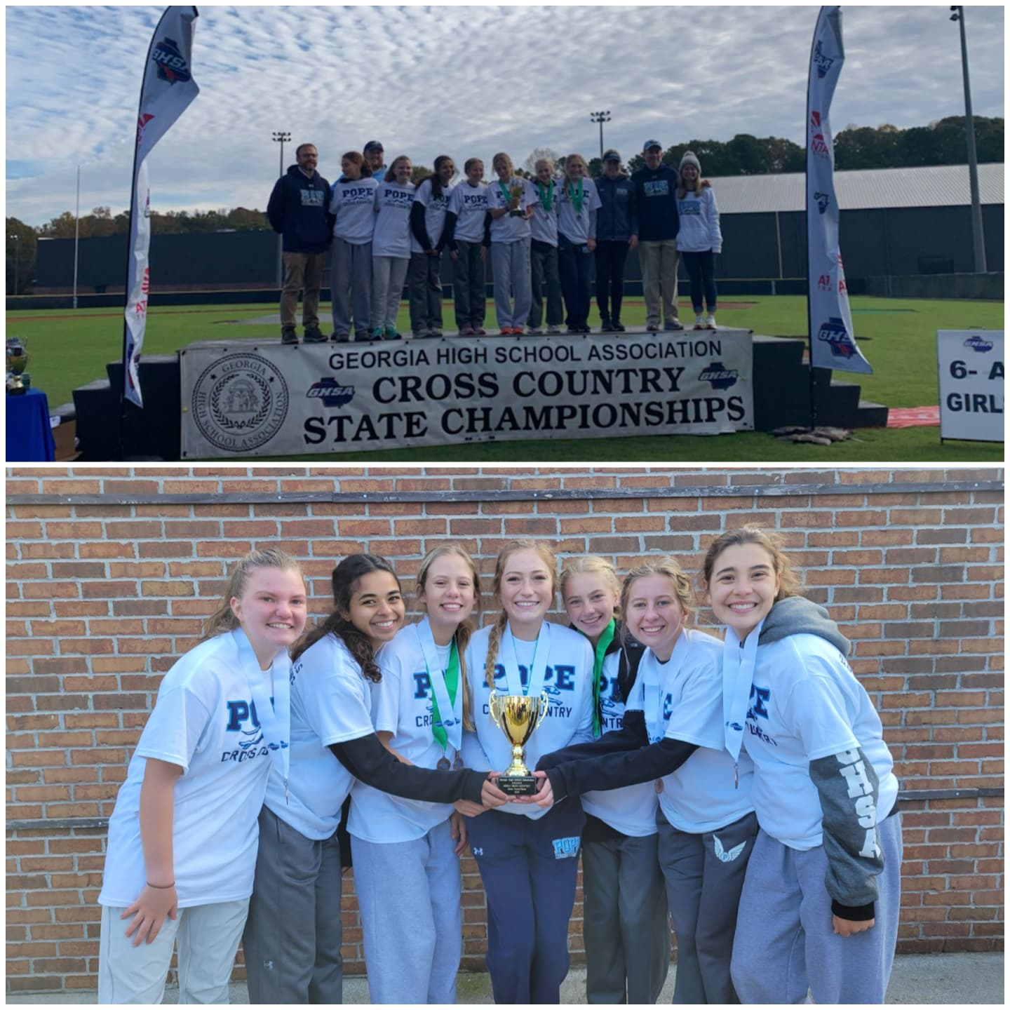
WE enjoyed previous years success but are challenged to do even more this year!!!!

Slide 10
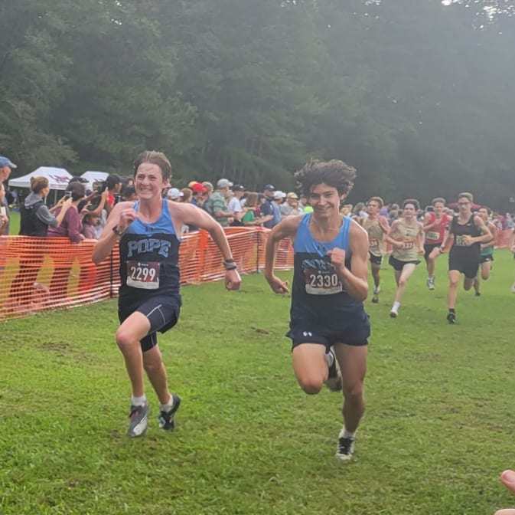
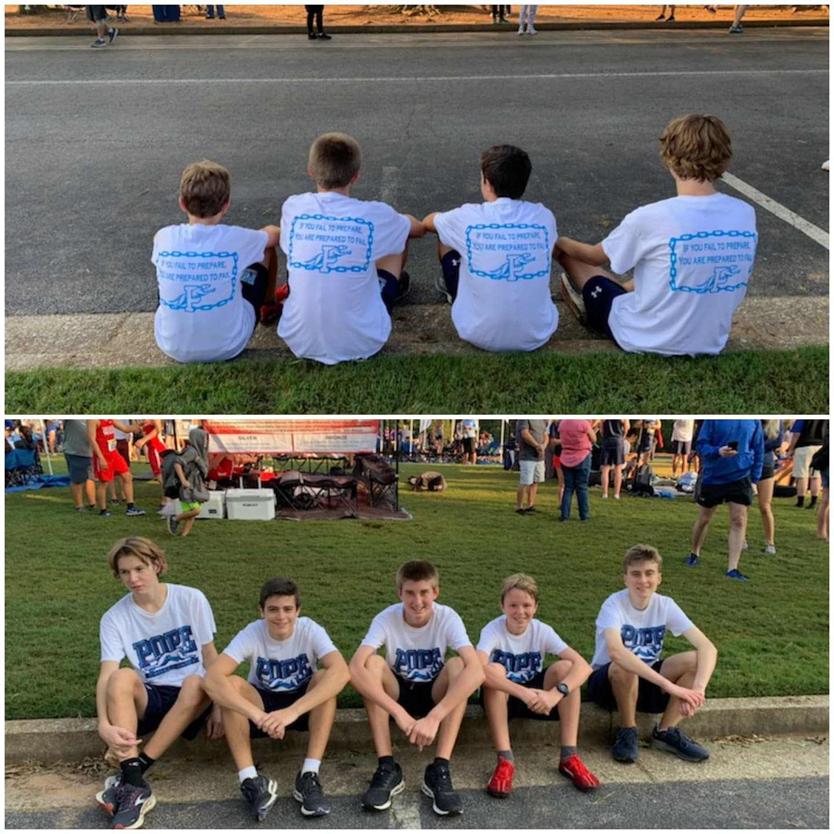
GREAT KIDS ☺

Slide 11
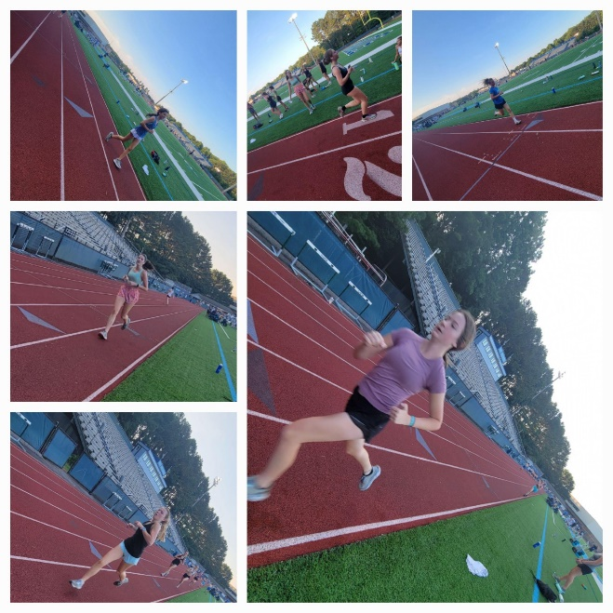
Strength training makes us faster
Time trial for training group placement.
SENIORS
Summer training on the trails and in the weightroom!!!!

Slide 12
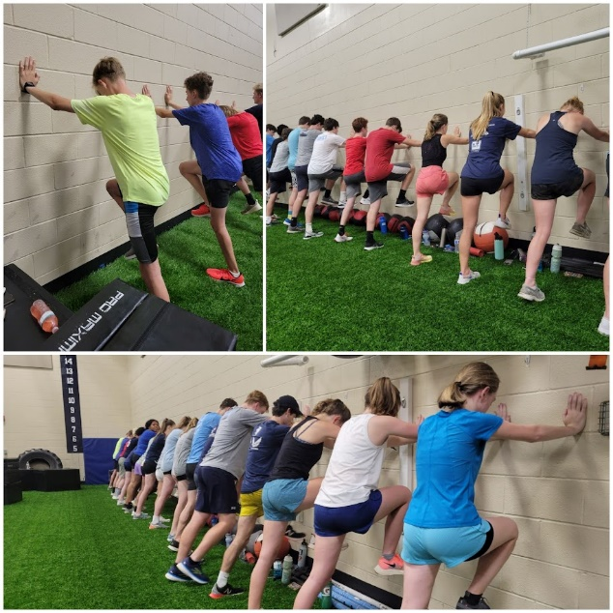
BILATERAL STRENGTH and upper body

Slide 13
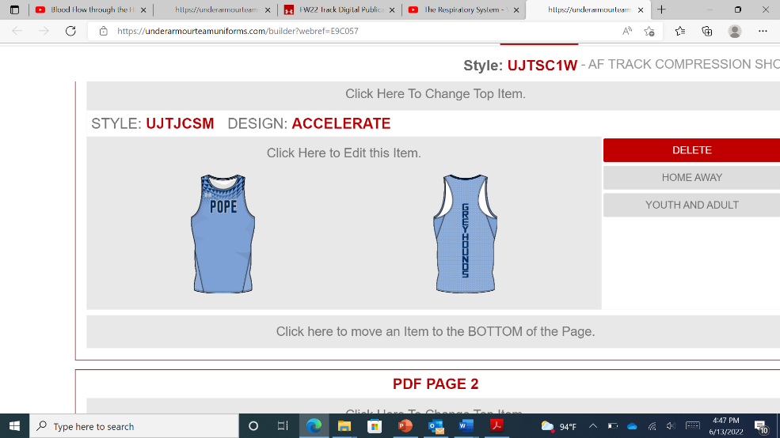
Uniforms
Required for all athletes: GHSA standard All athletes must have Pope Singlet & Shorts
Booster Club carries minimal inventory (cost)
XC uniforms are for sale through the Booster club for ALL athletes

Slide 14
Save on Shoes and Apparel
$$$
POPE XC - Discount at BIG PEACH-Marietta
POPE Athletes get 10% off training shoes/15% off spikes, and apparel, 10% off everything else in store.
HOURS: M-F 10a-8p, Sat 9a-6p, Sun 12p-5p
POPE Family members get 10% off any purchase
Shoes should normally be replaced every 300-500 miles ☺
www.bigpeachrunningco.com
* 1062 Johnson Ferry Road Marietta, GA 30068

Slide 15
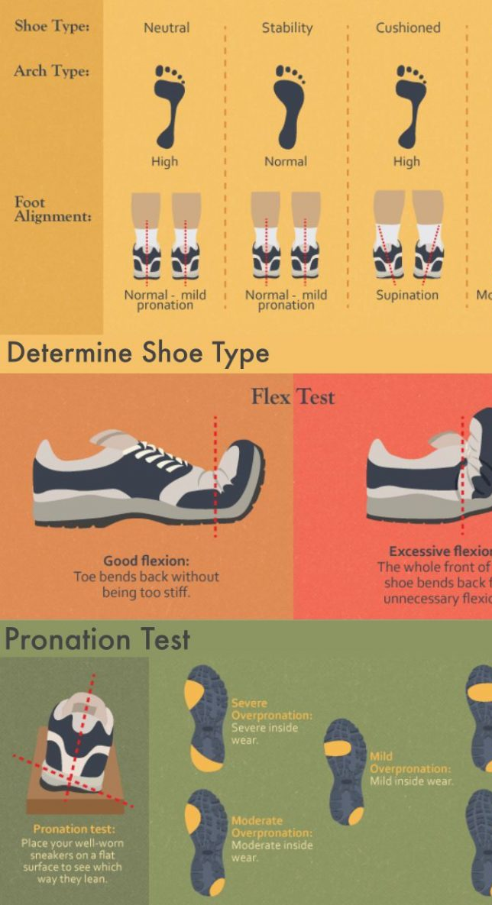
What shoe should I buy?
Big Peach allows athletes to try on/run in any shoes they would like. Camera on the treadmill allows for athletes to view motion issues in a shoe.

Slide 16
2021 Coaching staff
Head Coach
Cathi Monk
Assistant Coaches
Steve Krause
Will Harrison
Joey Giunta
Anne Chrzanowski

Slide 17
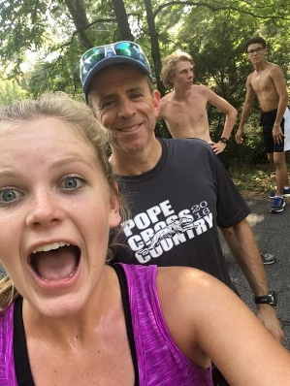
Coach Steve Krause
3 time State Champion in 300 AND 400.
PR of 48.3 in 400
Certified personal Trainer

Slide 18
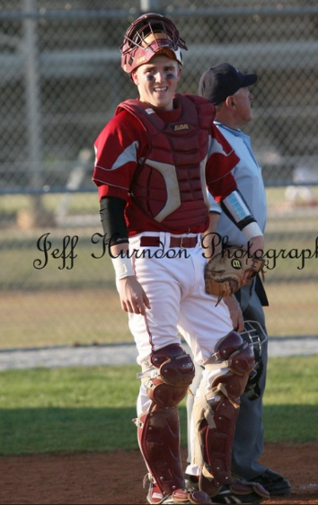
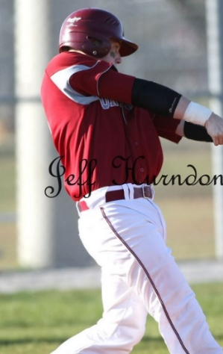
Coach will harrison
Special Education (transition academy) teacher at Pope High School
Baseball coach

Slide 19
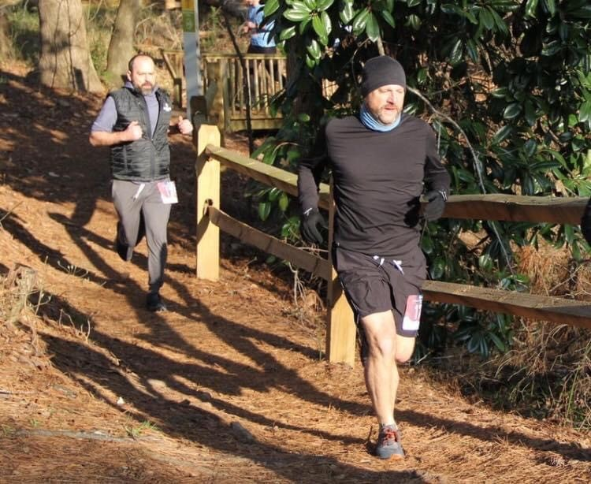
Coach joey giunta (jun –ta)
High school
Science technology teacher at Tritt elementary school.

Slide 20
Coach Anne ChrNOWski
Formerly of Starrs Mill
Ironman Triathlete

Slide 21
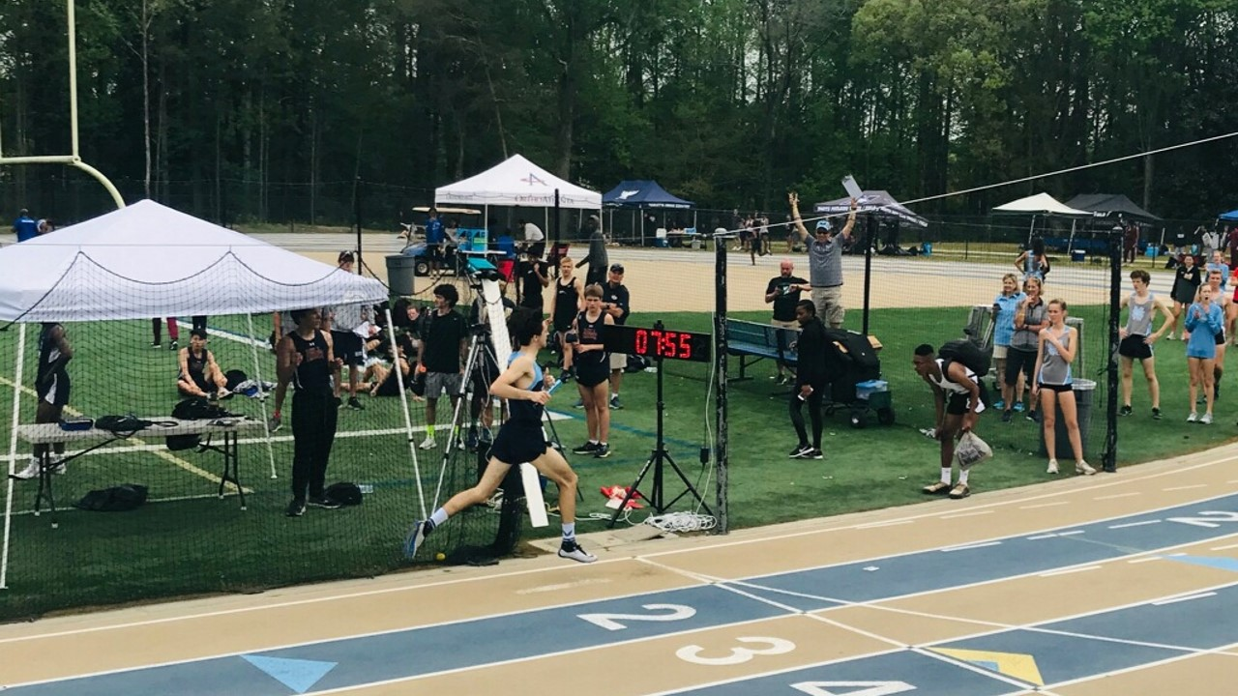
4x800 school record
Coach Krause
Coach Anne

Slide 22
Cathi monk
Walton HS alumni
Auburn University athlete
28 years of Coaching Experience
Coached multiple region and State individual/team Champions.
Numerous time County/Region Coach of the year.
TEAM GEORGIA Coordinator
Elected as Vice President of the GATFXCCA (Coaches Assn).
Post 40 PR’s
19:21 5K
41:40 10K
1:35 ½ marathon
3:22 marathon

Slide 23
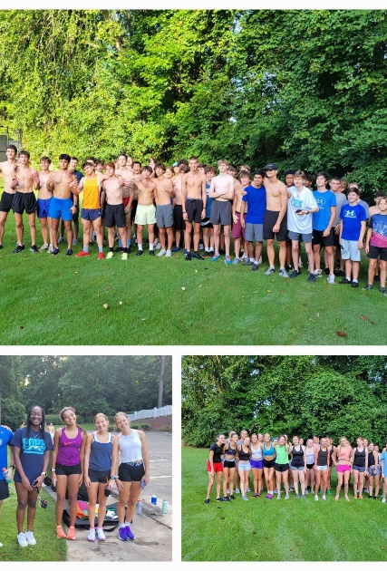
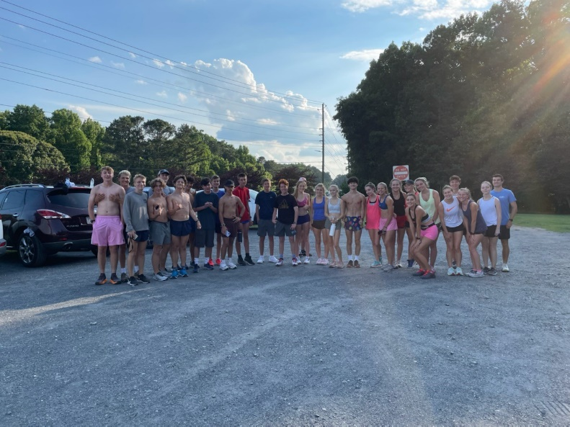
Summer training
Motivated athletes make our job as coaches SOOOOO much easier!! ☺

Slide 24
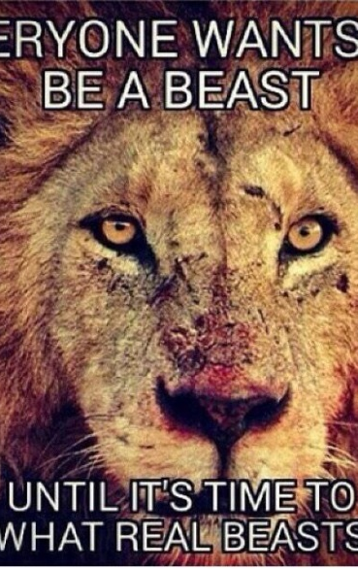
BUILD THE BASE!!!
Long runs!!!! Vary the terrain and pace!!
Weights
WE encourage STRONG athletes!!
Consistency in training is KEY!!

Slide 25
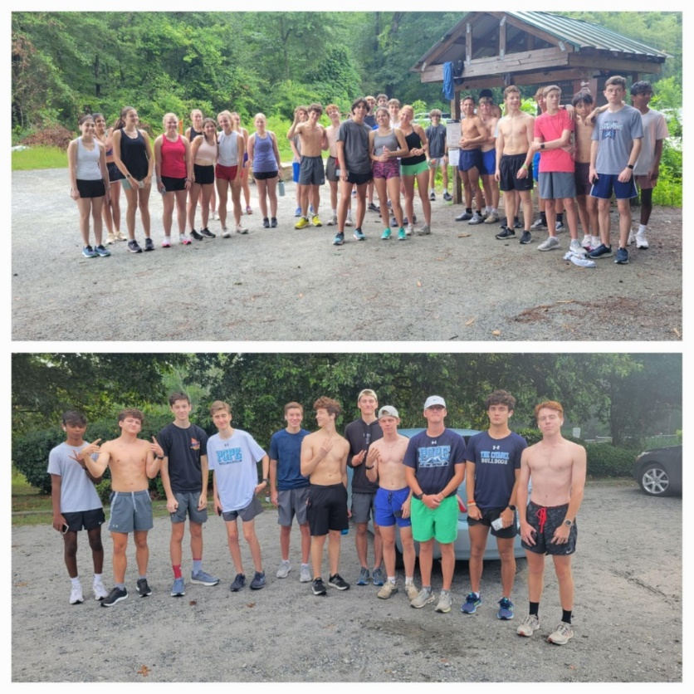
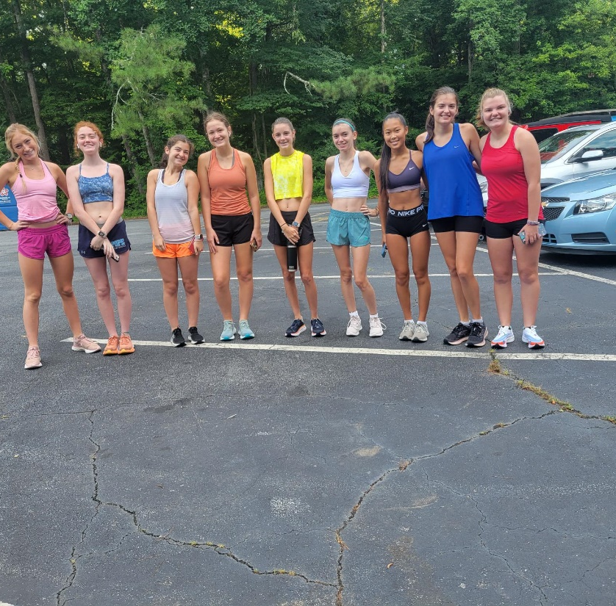
Practice Schedule
Monday Tuesday Thursday 3:45-5:45pm
Wednesday Friday 6:20-7:30am Check out with a COACH!!
Alert Coaches prior to practice if you are going to miss via the website. Go to the front page of the website….click on ABSENCE NOTIFICATION
No Practice = No RACE
DUE TO THE HEAT WE WILL OFFER PRACTICE AT 6:20 AND 345 ON MONDAY 8/15 AND 8/22.

Slide 26
Attendance policy
Please submit your absence notification BEFORE you miss practice.
If you have an UNEXCUSED absence, it is at the Coaches discretion to allow the athlete to compete. It is a privilege to compete and something you earn!!!!
If you miss practice to see doctor please get a “return to play” note from the Doctor.

Slide 27
Training of multisport athletes
BE TRUE TO THE GREYHOUND!!
All our Coaches share the same training philosophy and have numerous years of experience.
During XC season we expect that all athletes are PRIMARILY XC athletes for our major meets (County/Region/State) . IF you are a 2 sport athlete please bring/email a schedule in to the coaches ASAP.

Slide 28
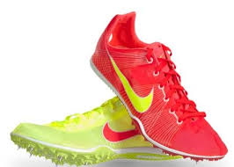
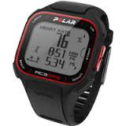
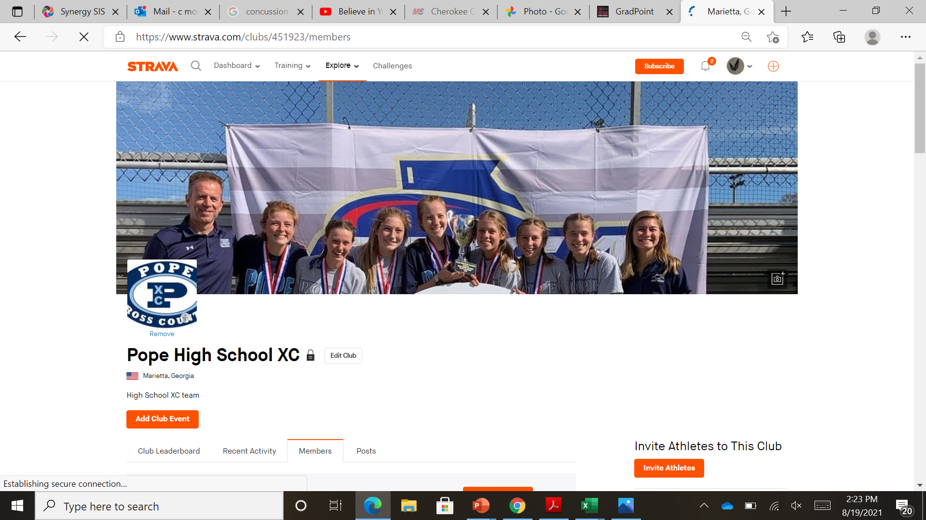
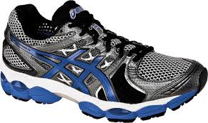
What do I need for xc?
SHOES!!!!!!!!! New within the last 3 months!!!
Most athletes need a basic cushioning running shoe –
Spikes for meets (optional but highly recommended)
Timing EVERYDAY!!!!
Sports watch –Walmart/Target
Map my Run or Strava
Team uniform – required
TEAM shorts/Tshirt

Slide 29
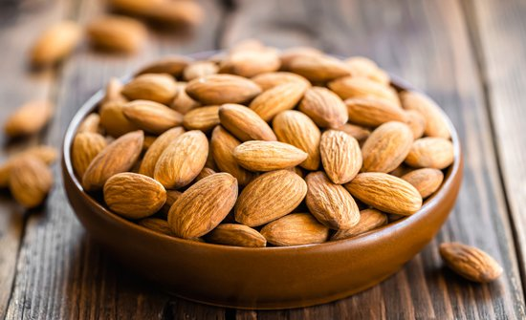
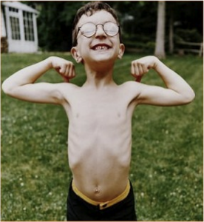
Take care of your body!!!!
Take your vitamins….specifically iron and D!!!!
Hydrate! 4-5 waters bottles a day.
Feed your children!!!!!
SLEEP!!
2-3 snacks a day and 3 FULL meals!!

Slide 30
2022 schedule
Date | Meet | location | Time | Athletes
Sat. 8/13 | Hoya 2 mile Invitational | Allatoona Creek Park | 8-12 | ALL
Sat. 8/20 | Kosh Classic | Westminster HS | 8-12 | ALL
Sat. 8/27 | Bob Blasto Invitational | Whitesburg, GA | 8-12 | ALL
9/4 | OFF (Labor Day)
Sat. 9/10 | Carrollton Orthopedic XC | Carrollton, GA | 6-12 | Top 14
Sat. 9/17 | Cobb County Championships | Allatoona Creek Park | 8-12 | ALL
Fri. 9/23 | Wingfoot Classic | Sam Smith Park, Cartersville, GA | 7-12 | ALL
Tues. 10/4 | Cass Cartersville Invitational | Dellinger Park Cartersville, GA | 2-7 | ALL
Saturday 10/8 | Atlanta Classic | Douglas County | 8-10 | ALL
Sat. 10/15 | Pickens and a Grinnin’ | Jasper, GA | 7-1 | ALL
Wed. 10/26 | Region meet | TBA | 9-1 | ALL
Saturday 11/5 | State | Carrolton Elementary School, Carrollton GA | 930 and 10:15 | TOP 10

Slide 31
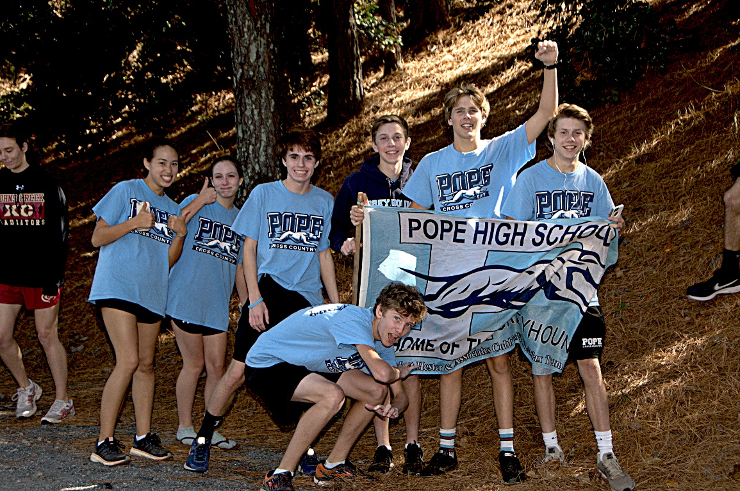
Now for the fun stuff : meets
In some meets/divisions we have entry limits!!!
If you need to miss a meet Go to the website….
Click on ABSENCE NOTIFICATION
BAHAAAAAA!!!!!!!

Slide 32
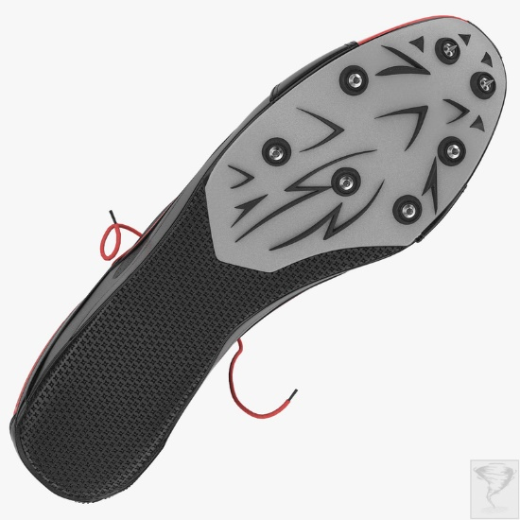
Now for the fun stuff : meets
WE have ¼" and 3/8” replacement spikes for the athletes to update throughout the season.
Athletes will need for meets: 1. Uniform 2. training shoes 3. Team Tshirt/shorts 4. Sweats when cold 5. spikes
6. WATER/Gatorade 7. TEAM SPIRIT!!!

Slide 33
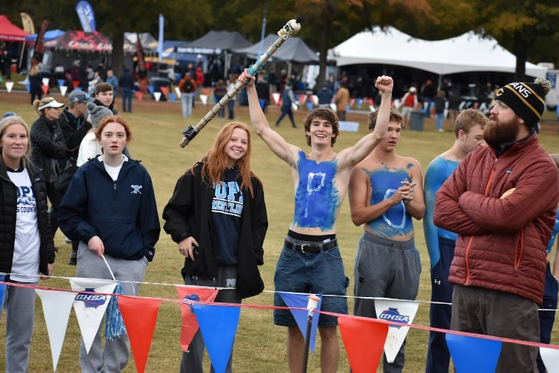
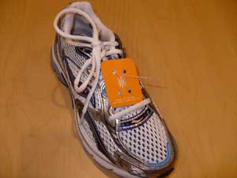
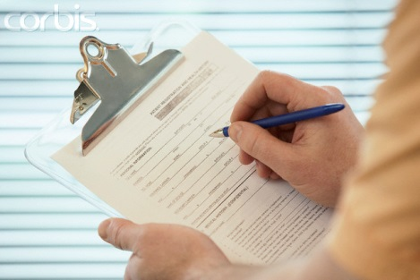
NOW THE FUN STUFF… MEETS!
Buses will leave EARLY in the morning so PLEASE be on time.
ATTACH your chip!!!!
Warm-up and Cool-down are important! All
athletes will need to cool down BEFORE parents sign them out at a meet!!!☺
If you are taking your kids home please sign them out at the meet. NO ATHLETES will be allowed to drive another athlete home!! THIS IS ONLY FOR THOSE WHO RIDE THE BUS DOWN BUT RIDE HOME WITH THEIR PARENTS.
After the race athletes will need to turn in their timing chip at the team tent. Failure to do so will cause a $25 fee

Slide 34
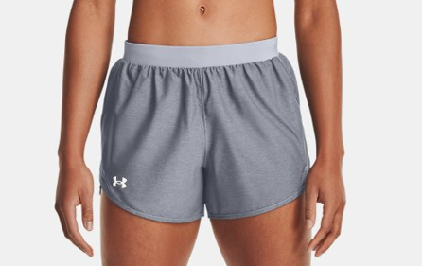
1st meet reminders
Pack your uniform and shoes the night before.
All athletes should wear their TEAM Tshirt and shorts over their uniform. Athletes should ONLY wear their uniform when racing.
Varsity will occasionally ride to meets with their parents. ALL others should ride the team bus.
Those athletes who ride with their parents to the meet should plan on being at the team tent 1 hour prior to their scheduled race time. Forty Five minutes before each race athletes should pick up their number and chip.
A warmup and cooldown is a KEY part of the meet process.
All other information will be updated on a daily basis to www.popetfxc.com

Slide 35
UPDATES
Most questions can usually be answered on the PHS XC website.
Follow us on Twitter: @PopeXC Instagram pope-xc coach.monk
Pope Athletics: @PopeAthletics

Slide 36
How do I earn a VARSITY LETTER?
VARSITY LETTER CRITERIA
AUTOMATIC TIME QUALIFIERS: 5K COURSES ONLY
GRADE MALE FEMALE
9 20:15 24:00
10 19:45 23:15
11 19:15 22:45
12 18:45 22:00
CHAMPIONSHIP MEETS:
Any athlete who places in the top 20 overall in the County or Region Championships.
Any athlete who places in the top 30 overall in the State Championships
SENIORS:
Any senior who has completed 2 Cross Country seasons in good standing with the team.
COACHES DISCRETION:
The coaching staff reserves the right to award a varsity letter to any athlete in a situation where they have not met any of the above criteria.
GUIDELINES:
The athlete must show progress throughout the season and compete maintain 80% attendance.
The athlete must finish the season in good standing with the team based on attendance and conduct.

Slide 37
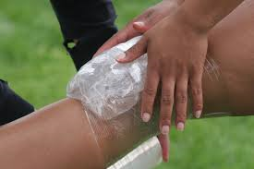
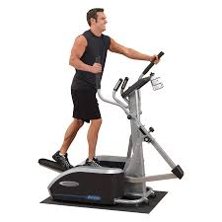
What if I am injured?
CHOA
Dani Hall, MS ATC
dani.hall@sourceatlanta.com
All athletes who have an injury should still come to practice. Prior to coming up to the track they should go to the trainer.

Slide 38
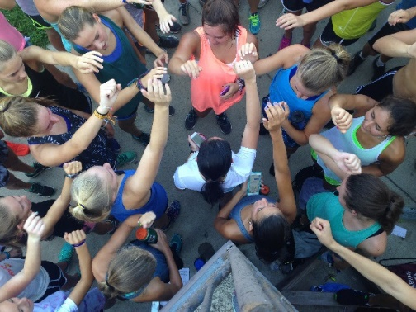
Cross Country 101
Races typically 5K or 3.1 miles
Varsity, Junior Varsity and Open Races
Boys & girls and varsity & junior varsity run separate races (typically same day & place)
Varsity events maximum of seven (or 10) athletes per team
Some JV events allow more runners
Lowest team score wins
Athletes must wear proper running shoes and watch
Athletes may choose to wear racing spikes or flats
No earrings (male and female)/jewelry

Slide 39
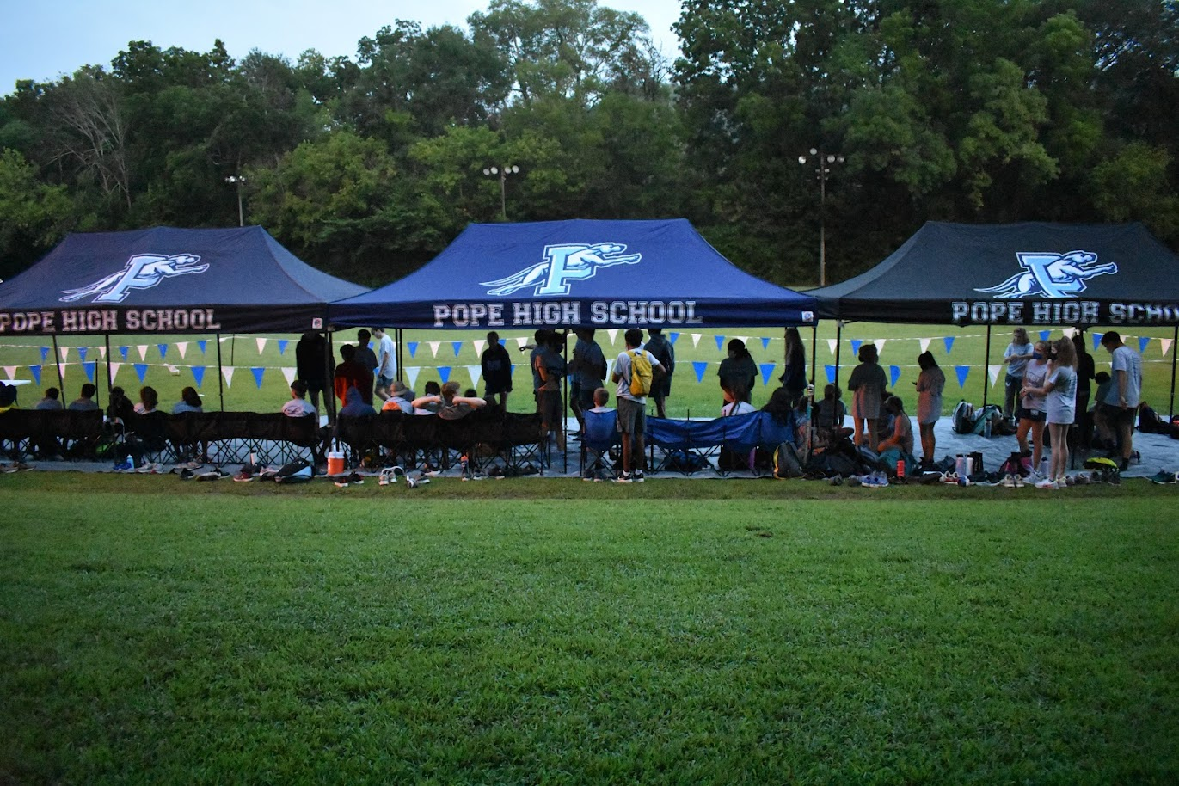
Cross Country 101
CHEER ON THOSE POPE ATHLETES!!!!!
Not the typical spectator sport
Select spot for best viewing
Spectators encouraged to cheer on all Pope athletes.
If you can’t put a name with an athlete’s face, fear not, “Go Pope!” or “Go Hounds!” works great!
Introduce yourself to other parents. It’s part of the sport!
Wear Pope spirit wear
Parents are needed to assist with set up and
Break down team tent area. d

Slide 40
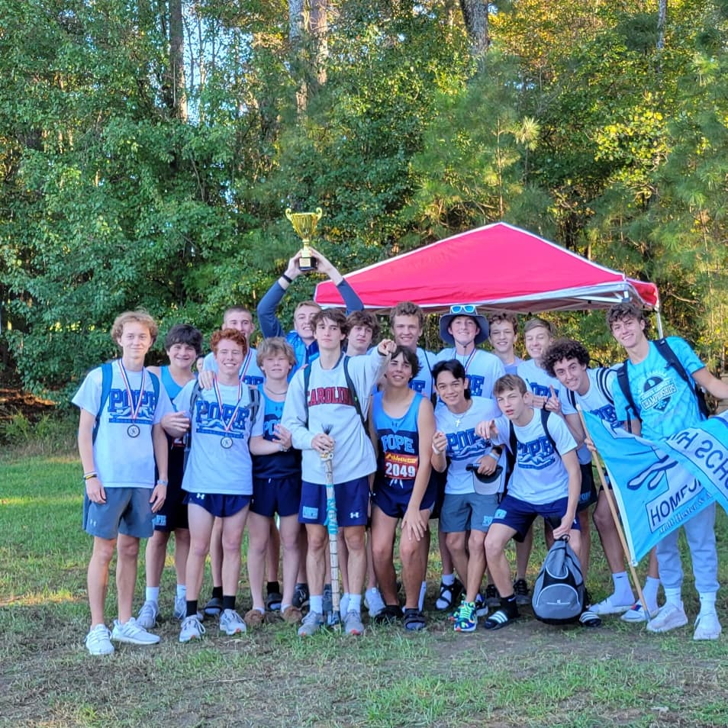
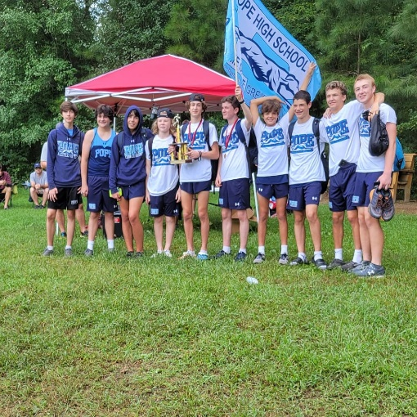
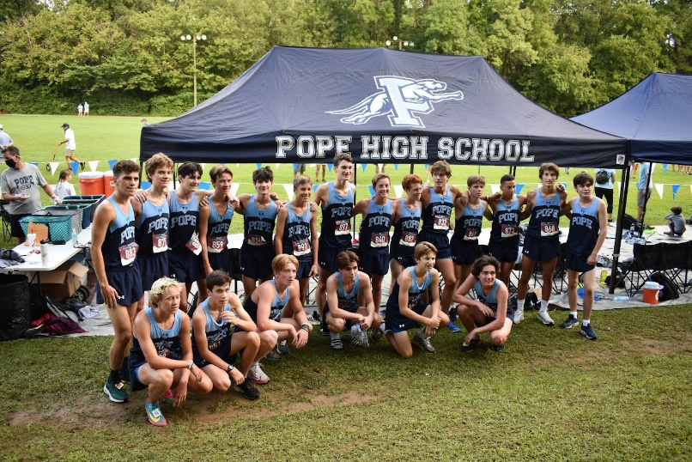
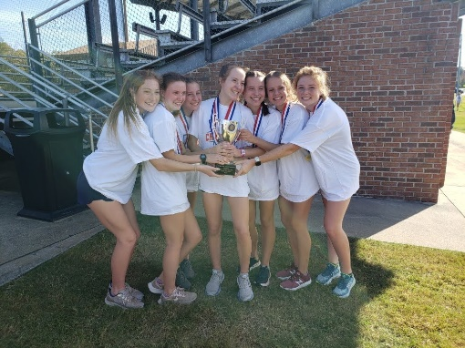
TEAM Champions Prove team depth!!!!
TEAM Champions Prove team depth!!!!
6 YEARS in a ROW Region TEAM CHAMPS!!!!
Girls REGION/STATE 3rd place....EVERY athlete counts #AlwaysRebuilding

Slide 41
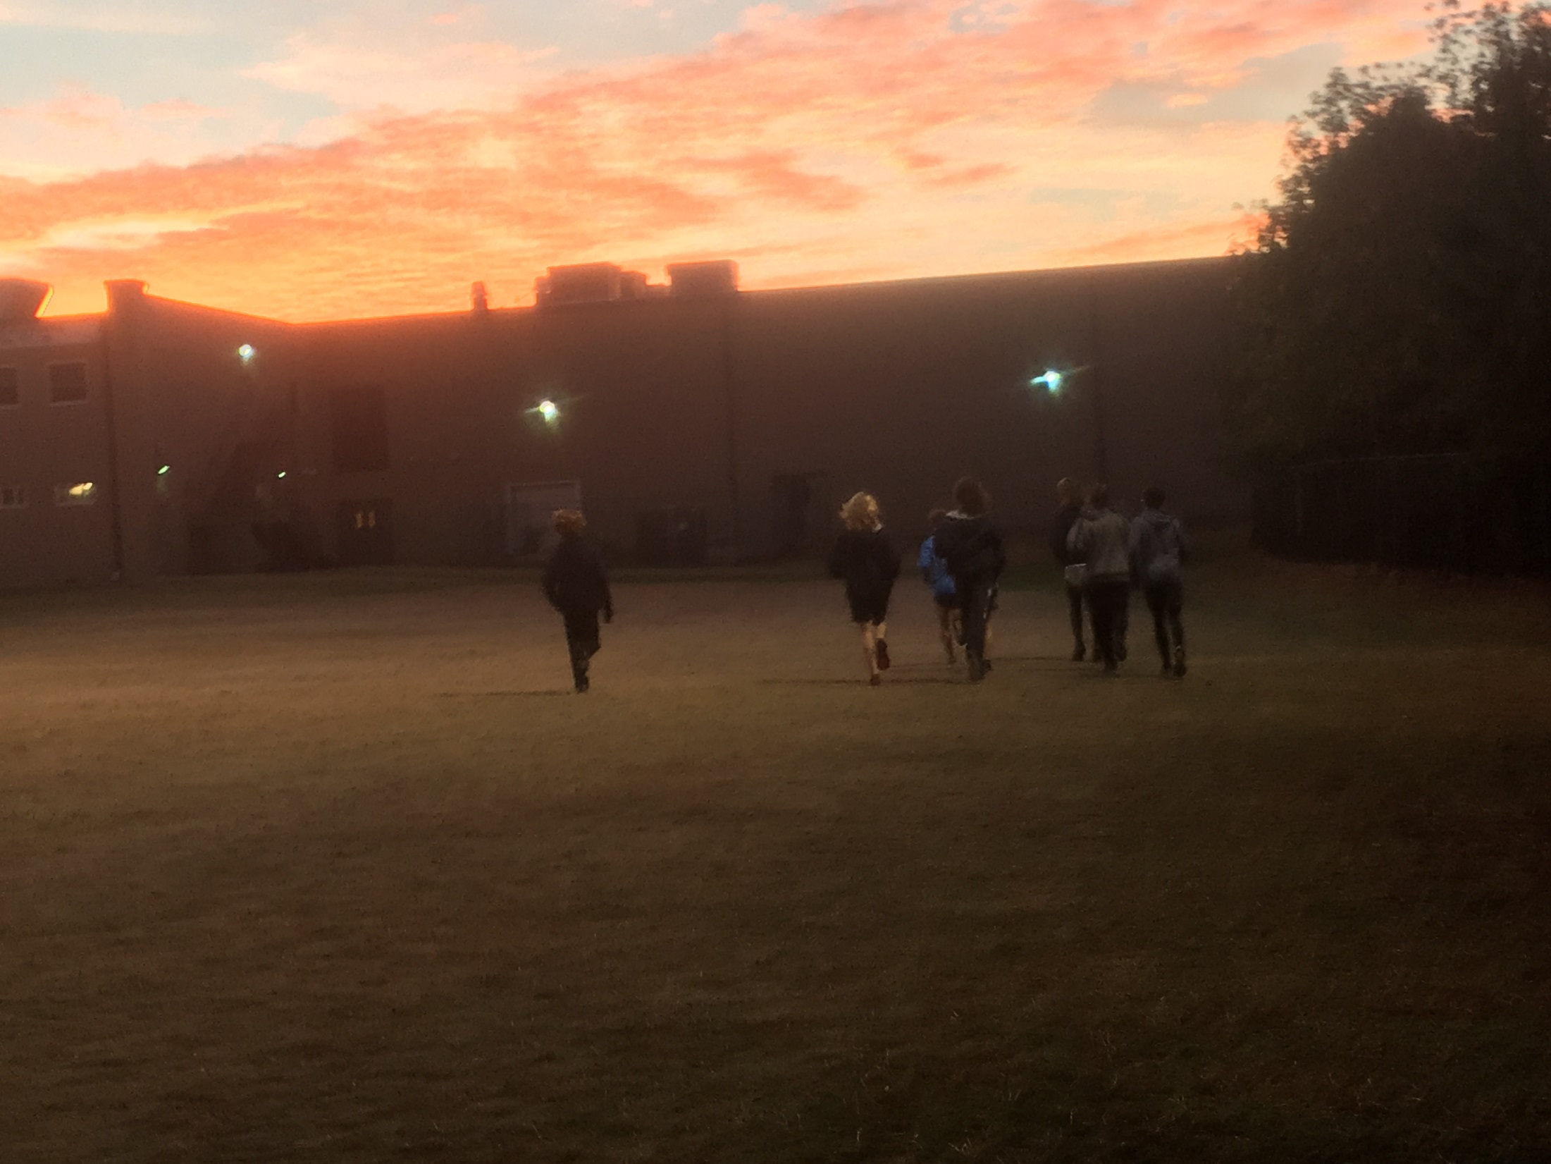
Will you be pleased with the result?????????
WE have made a concerted effort at practice all week to remind the athletes of procedures for practice and meets. Please email me should you have questions cathi.monk@cobbk12.org

Slide 42
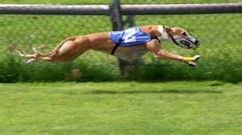
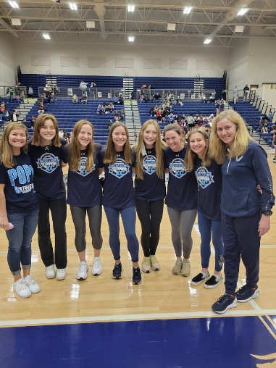
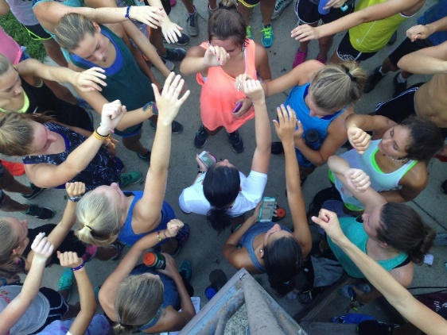
Be a part of something bigger than yourself!!

Slide 43
Questions?????
WE have made a concerted effort at practice all week to remind the athletes of procedures for practice and meets. Please email me should you have questions cathi.monk@cobbk12.org

