Slide 1
Key Priorities for Behavioral Health and Developmental Disabilities
Virginia Association of Community Psychiatric Nurses
Hughes Melton, MD, MBA
Commissioner
Virginia Department of Behavioral Health
and Developmental Services

Slide 2
System, Transformation, Excellence and Performance
STEP-VA
STEP-VA services will improve access, increase quality, build consistency and strengthen accountability across Virginia’s public behavioral health system.
STEP-VA Service | General Assembly Implementation Date Requirement
Same Day Access | July 1, 2019
Primary Care Screening | July 1, 2019
Behavioral Health Crisis Services | July 1, 2021
Outpatient Behavioral Health | July 1, 2021
Psychiatric Rehabilitation | July 1, 2021
Peer/Family Support Services | July 1, 2021
Veterans Behavioral Health | July 1, 2021
Care Coordination | July 1, 2021
Targeted Case Management (Adults and Children) | July 1, 2021
Notes:
$40m to support this in this biennial budget.
ACCELERATION!!!

Slide 3
Implementation of the First Steps
Beginning to Build Crisis Services
Primary Care Screening & Monitoring
Outpatient Services
The 2018 General Assembly provided $2M in FY 2020 for detoxification services to help divert individuals from state hospital admission under the influence of substances during emergency services evaluation.
The 2018 General Assembly provided $15M in FY 2020 for outpatient counseling services to allow the majority of people requesting services to be seen within 10 business days of the SDA appointment.
Same Day
Access
CSBs will begin providing or expand this service in early 2019.
By the end of
2018, all but 5
CSBs will have implemented
Same Day Access. The remaining 5 will implement in early 2019.
Notes:
STEP-VA features a uniform set of services with consistent availability across Virginia, high quality outcome measures, and improved oversight of services in all Virginia communities.
SDA is the first phase of STEP-VA. SDA allows a person who calls or appears at a CSB seeking services to receive a clinical assessment the same day instead of waiting for days or even weeks for a mental health appointment. If the assessment determines the person needs services, he or she will receive a first appointment for the appropriate service within 10 days depending on his or her clinical condition.
The 2017 GA provided funds for 18 CSBs to implement SDA and the 2018 provided funds for the remaining 22 CSBs to implement SDA. By the end of 2018, all but 5 CSBs will have implemented SDA and the remaining CSBS will implement in early 2019.
In addition, the 2018 General Assembly funded primary care screening beginning in FY2019. Primary Care Screening is the second phase of STEP-VA. This service is to ensure individuals at high risk of physical health issues related to behavioral health conditions receive needed health screening and monitoring as well as connection to appropriate healthcare providers. CSBs will begin providing or expand this service in early 2019.
In addition for FY2020, $15,000,000 was provided for outpatient counseling services. Expansion of outpatient counseling services will allow for the majority of individuals requesting services to be seen within 10 business days of the SDA appointment.
Also in FY 2020, $2,000,000 was provided for detoxification services. Additional detoxification services will help divert individuals from state hospital admission under the influence of substances during emergency services evaluation.

Slide 4
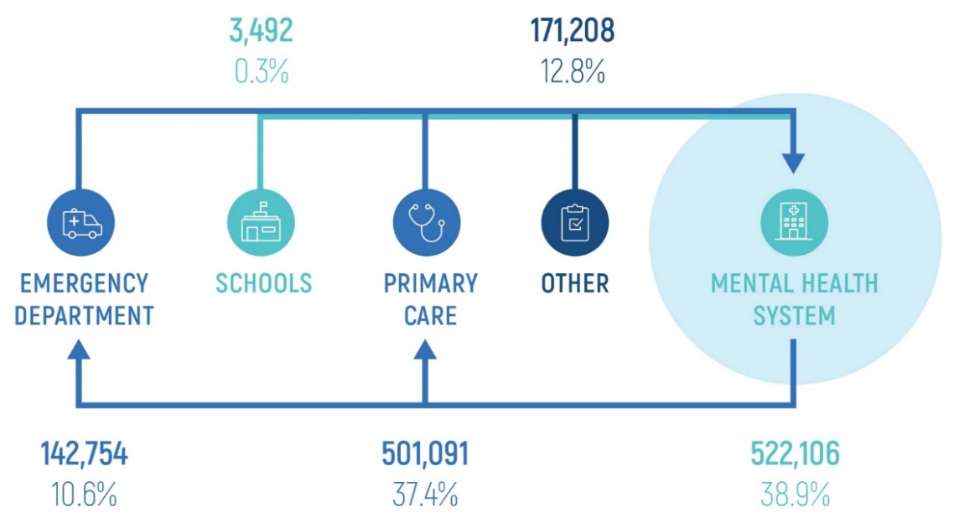
STEP-VA and Medicaid BH Redesign
A strong public behavioral health system provides a necessary foundation.
STEP VA meets the essential needs of of individuals through the public mental health system.
The remaining proportion of mental health needs will be met through the system redesign.
Both transformative efforts provide and enhance services through the continuum meeting the needs of all populations.
Medicaid BH Redesign
STEP VA
Notes:
When STEP-VA is fully implemented, the public mental health system will have achieved accessibility, consistency, quality and accountability as a necessary foundational support for behavioral health services.
Medicaid Behavioral Health Redesign will provide the network of support for STEP VA for long term sustainability to ensure access to essential services is met.

Slide 5



Behavioral Health in the Commonwealth of Virginia
Opportunity for Medicaid Redesign
Medicaid is the largest payer of behavioral health services in Virginia
$$$
40th in the county for overall mental health outcomes
47th in the country for children’s mental health outcomes
of Medicaid members had either a primary or secondary behavioral health diagnoses
28%
Notes:
Add notes here that summarize the state of Medicaid-funded behavioral health care in the commonwealth.
We pay for most of it
Our members have a high prevalence of BH dx and need for service
Compared to other states, we have high prevalence and problematic access
NOTE FROM ALYSSA: We would like to start with this slide to get straight to the point. What is the consolidated stat from MHA that references a 40th ranking? Kate was mentioning this at our meeting. We’d prefer that stat to the 23rd ranking…

Slide 6
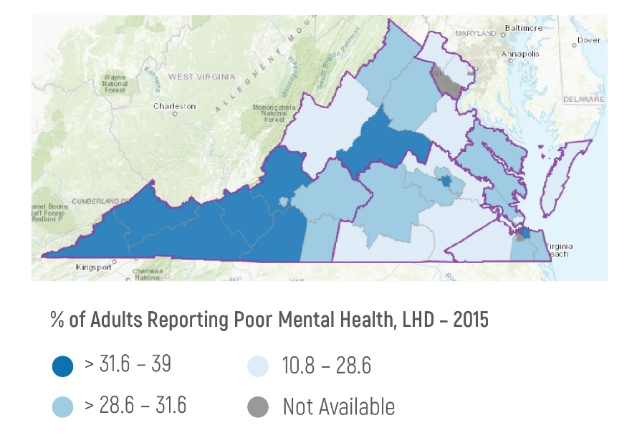
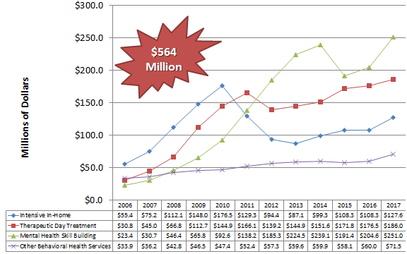

Farley Center’s work in Virginia: Key Findings
In FY17, 28% of Medicaid members had either primary or secondary behavioral health diagnoses
28%
Medicaid Expenditures on Community-Based Medicaid Mental Health Services
Among Medicaid community-based mental health services mental health skill building accounted for nearly
40% of the total expenditure, therapeutic day treatment for 29% and and intensive in-home for 20%.
Medicaid members with behavioral health diagnoses had 1.34+ million visits across multiple care settings
Notes:
FHPC received a grant from the Robert Wood Johnson Foundation to create an approach to advance state policy to integrate behavioral health. With this funding, FHPC worked with DMAS in 2017 to perform a behavioral health analysis for Virginia, assessing needs and opportunities.
Data from three agencies were included in the analysis:
Department of Medical Assistance Services (DMAS)
Claims Data from Fiscal Year 2017
Department of Behavioral Health and Developmental Services
Psychiatric Free Standing Hospitals
State-funded BH Facilities
CSB Locations and Service Areas
Department of Health
Population Health Outcomes, 2015
Mortality Rates
BH Outcomes including Self-Reported MH Status and many others
Aggregate Data – No Inference Intended on Individual Level
The report is available on the FHPC’s webpage
The findings focused on four main areas:
Outcomes, Needs, Access, and Cost
A few highlights of the finds are shown here:
(outcomes) Regional differences in mental health outcomes exist across the state, including in adults reporting poor mental health
(needs) In FY17, 28% of Medicaid members had either primary or secondary behavioral health diagnoses
(access) Medicaid members with behavioral health diagnoses had over 1.34 million visits across multiple care settings – 39% within the mental health system and 37 in primary care
(cost) Among Medicaid community-based mental health services mental health skill building accounted for nearly 40% of the total expenditure, therapeutic day treatment for 29% and and intensive in-home for 20%.
NOTE FROM ALYSSA: Can we turn the green circle into an infographic on this data? How was “poor mental health” operationalized for this measurement? Was it self-assessed? Where was that data obtained? I also would like in the big picture to understand more about that expenditure data. When we say that these 3 services had the biggest spend, do we know what is driving that cost (most encounters, length of stay, rates, # members receiving)?

Slide 7
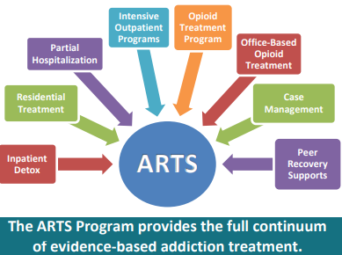
Addiction and Recovery Treatment Services (ARTS)
Transformed the Medicaid benefit and services using national American Society of Addiction Medicine criteria
Increased Medicaid reimbursement for evidence-based treatment
Notes:
Expansion will increase the impact of ARTS
Magellan will continue to cover community-based substance use disorder treatment services for fee-for-service members
All Community-Based SUD Services will be Covered by Managed Care Plans
In 2015 close to 70% of members were served in managed care. With the implementation of MLTSS, this will close to 90% served in managed care.
To fully integrate physical and behavioral health services for individuals with SUD and expand access to the full continuum of services, DMAS plans to “carve in” non-traditional SUD services into Managed Care for members who are already enrolled in plans. The only service currently covered by managed care is inpatient detoxification.
Non-traditional services that will be “carved in” include Residential Treatment, Opioid Treatment (medication and counseling component), Substance Abuse Day Treatment, Crisis Intervention, Intensive Outpatient Treatment, and Substance Abuse Case Management.
Magellan will continue to cover these services for those Medicaid members who are enrolled in FFS
Effective April 1, 2017 except for Peer Supports which will be effective July 1, 2017.
Providers will need to become enrolled and credentialed with the managed care plans beginning 4/1/17. Majority of members are covered by managed care and most when the Managed Long Term Services and Supports (MLTSS) is implemented.
Further notes from ARTS Presentation Slides:
VCU Evaluation: Outcomes From the First One Year of ARTS
Compared before ARTS (April 2016-March 2017) to same period after ARTS began (April 2017-Mar 2018)
Increase in total number of Substance Use Disorder Outpatient Providers
Total number of SUD OP went from 1,087 to 2,965 (up by 173%)
Broken down by provider type,
Physicians up from 261 to 1,571 (up by 502%)
NPs up from 25 to 188 (up by 652%)
Counselors and SW up from 300 to 457 (up 52%)
Others up from 501 to 749 (up by 50%)
VCU Evaluation: Outcomes From the First One Year of ARTS
Compared before ARTS (April 2016-March 2017) to same period after ARTS began (April 2017-Mar 2018)
Increase in total number of OPIOID USE Disorder Outpatient Providers
Total number of SUD OP went from 570 to 1,352 (up by 137%)
Broken down by provider type,
Physicians up from 128 to 1586 (up by 358%)
NPs up from 13 to 66 (up by 408%)
Counselors and SW up from 142 to 236 (up 66%)
Others up from 287 to 464 (up by 62%)
More members are receiving treatment for all Substance Use Disorders (SUD) and Opioid Use Disorder (OUD)
Members with SUD Receiving txt went from 15,703 to 24, 615 (up 57%)
Members with OUD receiving txt wen from 10,092 to 14,917 (up 48%)
Decrease in total number of prescriptions and members with prescriptions for opioid pain medications
Total number of prescriptions for opioid pain medications went from 549,442 down to 399,678 (down 27%)
Number of members who received prescriptions down from 137,847 to 115,096 (down 17%)
Fewer Emergency Department visits related to Substance Use Disorder (SUD) and Opioid Use Disorder (SUD)
ED visits related to SUD went from 24,962 down to 21,445 (down 14%)
ED visits related to OID went from 5,016 down to 3,756 (down 25%)
Fewer inpatient hospitalizations related to Substance Use Disorder (SUD) and Opioid Use Disorder (SUD)
Hospitalizations related to SUD went from 13,182 down to 12,650 (down 4%)
Hospitalizations related to OUD went from 3,520 down to 3,315 (down 6%)

Slide 8
“Begin with the end in mind…”
Envisioning our continuum activity
Promotion, Prevention, Screening
SBIRT
Early Intervention
Case Management
GAP Case Management
MH Case Management
Outpatient Services
Psychological Testing
Individual Outpatient Psychotherapy
Treatment Foster Care Case Management
Community Mental Health
Psychosocial Rehabilitation
Therapeutic Day Treatment
Mental Health Skill Building
Intensive Community Treatment
Intensive In Home
Crisis Stabilization
Day Treatment / Partial Hospitalization
Behavioral Therapy
Inpatient Services
Hospital E/M
Inpatient Hospitalization
Psychiatric Residential Treatment
Recovery
Mental Health Peer Supports
Family Support Partners
MH Screening in Primary Care
EPSDT Early Childhood Services
DBHDS Prevention Program
DD Case Management
Therapeutic Group Home
EPSDT Services: Residential, Group Home, 1:1
EPSDT Personal Care Services
DD Consumer Directed Services
REACH Services
PACT Services
STEP-VA
Psychiatric Services
Primary Care Services
Group Therapy
Family Therapy
Notes:
The continuum will be represented on post its on the back of the room for them to provide feedback
This is current services reimbursed (school based and early intervention exceptions)
NOTE: This does not include comprehensive DD Waiver Services

Slide 9
A closer look
Psychosocial Rehabilitation*
Therapeutic Day Treatment*
Mental Health Skill Building*
Intensive Community Treatment*
Intensive In Home*
Crisis Stabilization*
Day Treatment / Partial Hospitalization
Behavioral Therapy*
REACH Services
PACT Services
Community Mental Health
Notes:
So in particular, what is missing here?
* DMAS Covered Services

Slide 10
DBHDS/DMAS Vision of Redesign:
A comprehensive spectrum of behavioral health services
In collaboration with stakeholders’ clinical input, our goal is to develop recommendations for a comprehensive system redesign plan for Medicaid behavioral health services
Our vision for this system:
  Improved behavioral health outcomes for members
  A shift in our collective energies
  Manifestation of trauma-informed principles across member, provider, and system
  Reflective of the evidence for what works in community mental health
  Mindful of the evolving needs for members across the lifespan
Notes:
Bring the Commonwealth from 40th and 47th into the Top 10 in national rankings for behavioral health outcomes
Shift from working with a reactive, crisis-driven, high-cost system reliant on intensive services to one that is proactive/preventive, cost-efficient, and focused on providing services in the least restrictive environments
Integration of trauma-informed care principles across the continuum to empower individuals to build resiliency and overcome the impact of adverse experiences so that they can lead meaningful, productive lives in our communities
Build a robust children’s behavioral health system to address prevention and early intervention of mental health problems to allow each child the chance to reach their full developmental potential

Slide 11

Process and Contributions
Review best practices for Medicaid mental health services across the lifespan from research literature and state case studies
Analyze service gaps for the Virginia Medicaid population
Identify individual and population level metrics and quality outcomes
Assess DBHDS licensing and regulations to ensure quality and accountability
Enlist stakeholders’ input to shape recommendations for a continuum of care and next steps
Develop recommendations for a continuum of evidence-based, trauma-informed, and preventive-focused Medicaid community mental health services
Notes:
Ultimately, the charge is to: Partner with VA to Develop a continuum of evidence-based, trauma-informed, and preventive-focused Medicaid behavioral health services including early intervention services, school-based behavioral health services, and integrated primary care and behavioral health with recommended provider qualifications and reimbursement rates
Nationally: Review evidence-based and state policy research of best practices for Medicaid mental health services across the lifespan
VA-focused: Analyze service provision and gaps for the Medicaid population
Describe and propose individual and population level metrics and quality outcomes
Assess and align DBHDS licensing and regulations with DMAS reimbursement to improve quality and accountability (whether an individual is served with state general funds or Medicaid by a public or private provider)
Enlist stakeholder input throughout process to shape recommendations for a continuum of care and next steps

Slide 12
Anticipated Outcomes
Alignment:
  Recommendations to align Medicaid behavioral health services with DBHDS licenses to create a continuum of evidence-based, trauma-informed, prevention-focused and cost-effective service options for members across the lifespan
Accountability
  Recommendations on outcome measures that incentivize high quality services in least restrictive environments
Access
  Recommendations to expand access through a “no wrong door” approach for members across a full array of services delivered in settings where they naturally present for support.
  Recommendations to expand access to service types and therapeutic interventions that are best practices and well-matched to members’ level of impairment / support need.

Slide 13
Re-envisioning the Future of Crisis Services
Comprehensive
Array of Services
Lifespan
Support
Cross
Disability
  Prevention Services
  Mobile Crisis Stabilization
  Children’s Crisis Therapeutic Homes
  Provider Development
Children
Adolescents
Adults
Behavioral Health
Developmental Disability

Slide 14
U.S. DOJ Settlement Agreement
The Settlement Agreement requires individuals with developmental disabilities (DD) to be served in the most integrated settings appropriate to their needs.
Challenges have included expanding community capacity to support individuals through non-congregate services in integrated settings, improving the discharge process from training centers into the community, and developing a quality management system.
Strategies adopted from the beginning focused on:
  Redesigning the Medicaid DD waivers to provide the resources to support people in inclusive community settings.
  Creating a quality management system to ensure the quality of services.
Notes:
Virginia is about 65% of the way to reaching compliance.
As of October 9, there were 146 people in Virginia’s TCs: (75 in CVTC and 71 in SEVTC)

Slide 15
Areas of Focus to Achieve Full Compliance
Enhancing case management through additional guidance and tools for case managers;
Increasing child crisis capacity, including adding crisis prevention services and opening crisis therapeutic homes for children and youth;
Increasing provider capacity to serve people (including those with intense medical and BH support needs) in integrated, non-congregate settings;
Expanding opportunities for individuals to access competitive integrated employment and independent housing;
Enhancing data collection, reporting capabilities, and data to strengthen the system;
Improving risk management capabilities;
Developing and improving quality improvement mechanisms which improve outcomes for individuals living in the community; and
Improving consistency in the availability and quality of services.

Slide 16
How Have Living Situations Changed?
12%
-5%
15%
146%
97%
53%
Number of people
8%
10%
Living Situations
Arrows indicate change from Baseline
Notes:
Highest growth residential settings:
Supported Living
Living Independently
We are on a trajectory to increase less expensive, more integrated living situations.

Slide 17
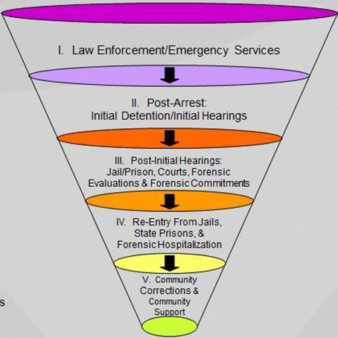
Sequential Intercept Model
Illustrates key points to “intercept” individuals to ensure:
  early identification
  prompt access to treatment
  opportunities for jail diversion
  timely movement through criminal justice system while receiving treatment services
  linkage to community resources
Notes:
Definition
This model builds on collaboration between the criminal justice and behavioral health systems; highlights where to intercept individuals as they move through the criminal justice system; identifies critical decision-makers who can authorize movement away from the justice system and into treatment; and delineates essential partnerships among mental health, substance abuse, law enforcement, pre-trial services, courts, judges, jails, community corrections, social services, and others.
Source: Substance Abuse and Mental Health Services Administration (SAMHSA)

Slide 18
Sequential Intercept Results in Virginia
  Develop/expand CIT training for dispatch, law enforcement officers or other first responders
  Improve communication between CSB and law enforcement
  Improve or increase access to or availability of behavioral health services and/or resources
  Establish secure drop off/CIT Assessment Sites
  Decrease law enforcement time and improve law enforcement ECO process
  Improve CSB crisis response
  Decrease wait time at CSB for crisis services
  Expand capacity at existing drop off/CIT Assessment Sites
  Reduce need for psych beds/number of TDOs
Gaps in Intercept One
Law Enforcement and
Emergency Services
Commonwealth efforts to Address the Gaps

Slide 19
Sequential Intercept Results in Virginia
  Improve communication between CSB, jails, courts and family members
  Develop screening process for identifying persons with behavioral health disorders
  Provide behavioral health training for magistrates and jail staff
  Provide behavioral health training to pretrial services
  Increase access to behavioral health services for pretrial agencies
  Jail Diversion Programs in approximately 15 localities across the state through Community Services Boards (CSB)
Gaps in Intercept Two
Initial Detention/
Initial Hearings
Commonwealth efforts to Address the Gaps

Slide 20
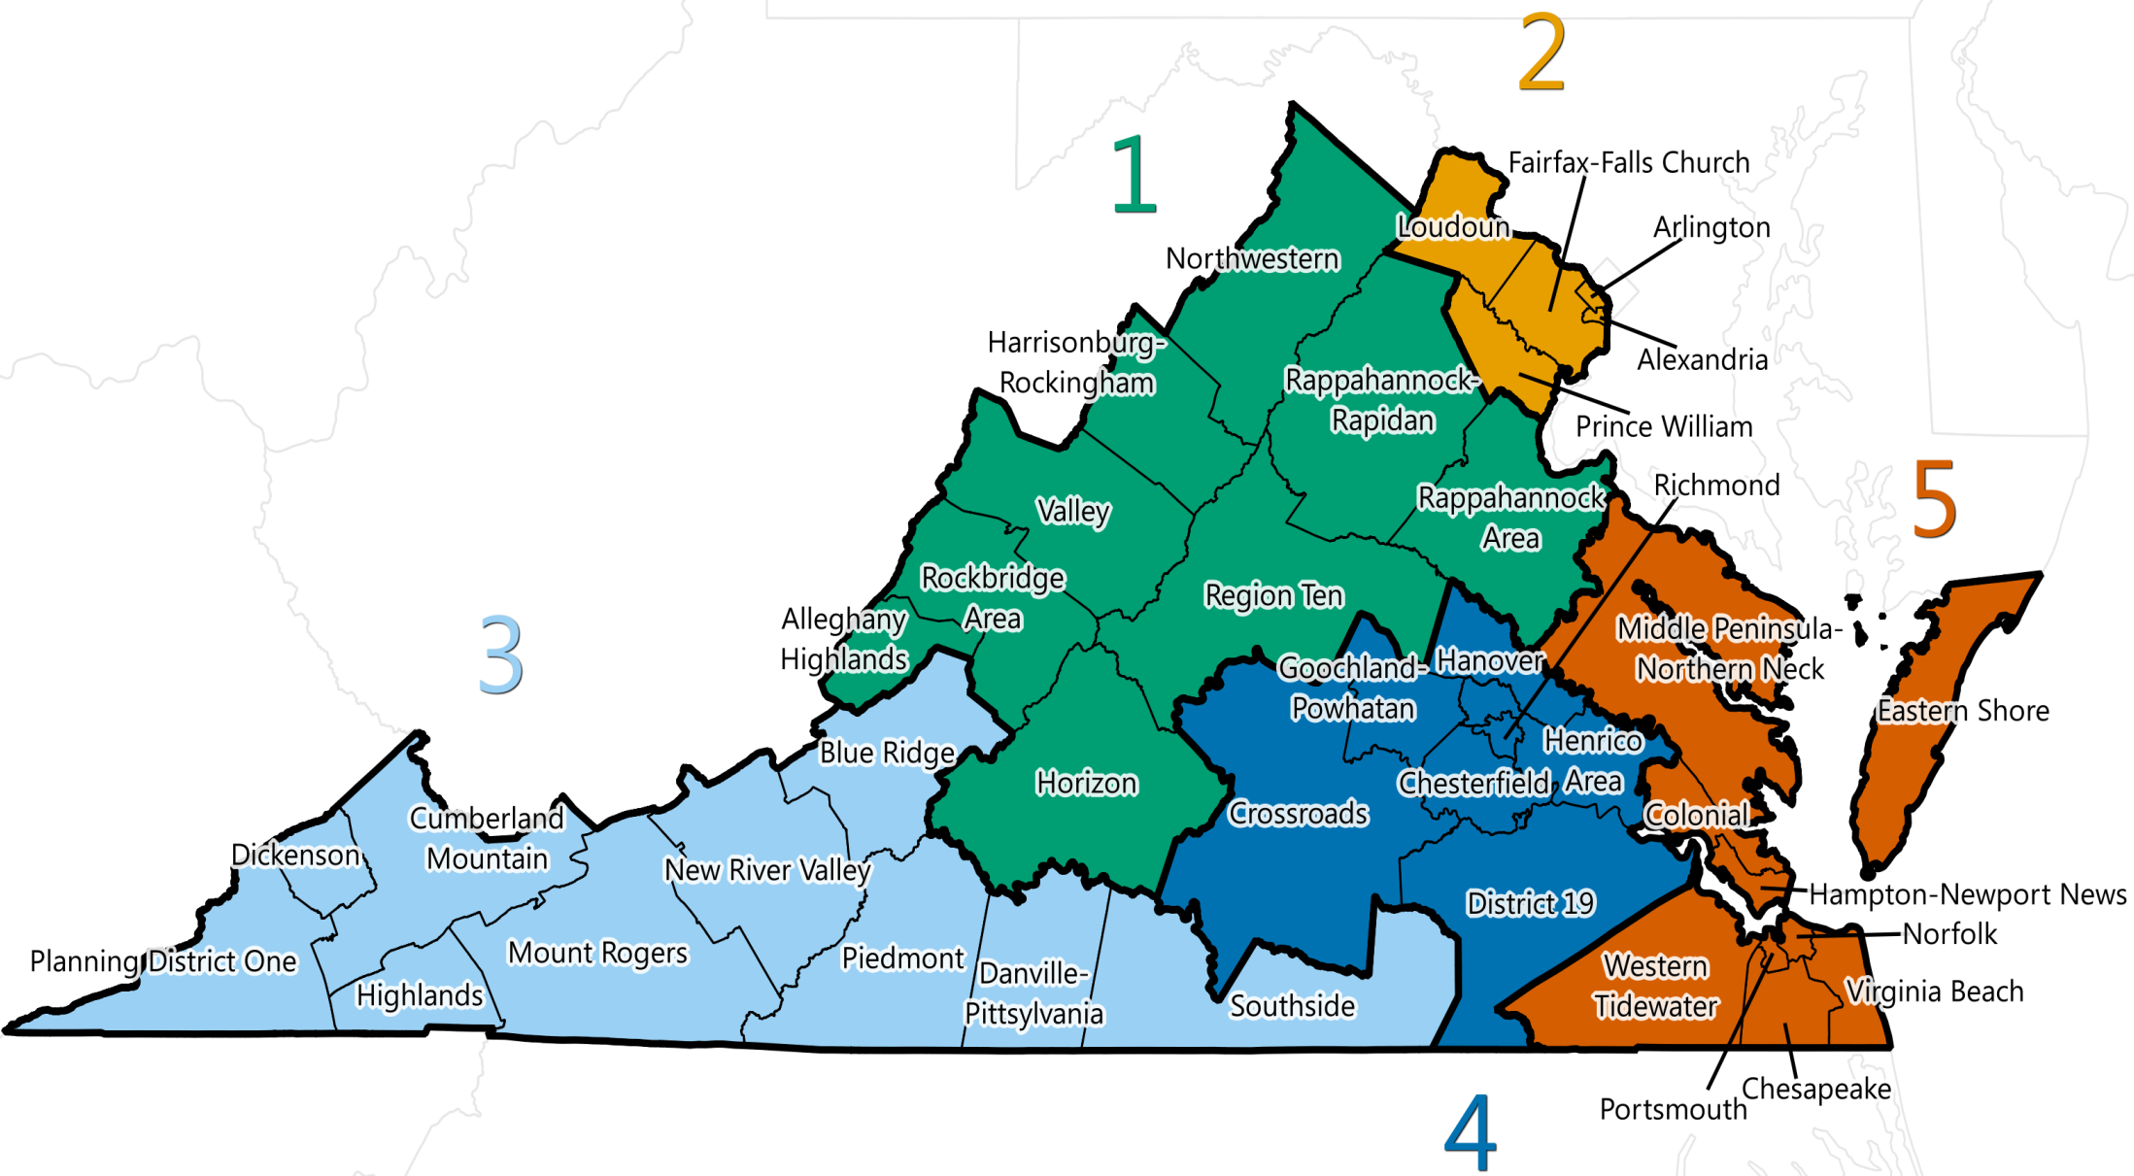
DBHDS Regions

Slide 21
Contact Information
S. Hughes Melton, MD MBA
Commissioner
Department of Behavioral Health and Developmental Services
Hughes.Melton@dbhds.Virginia.gov
(804) 786-3921
Website
www.dbhds.virginia.gov/
Twitter
twitter.com/VirginiaDBHDS
Facebook
www.facebook.com/DBHDS/
LinkedIn
www.linkedin.com/company/dbhds/

