Slide 1
Physics coursework Title 2017
Using conductors made of children’s play (modelling) dough, investigate quantitatively the effect on
resistance, calculated from measurements of voltage across and current through the conductors, of
changing the conductor length and obtain data to establish whether dough colour has an effect on
its resistance.

Slide 2
Part 1 (Introduction)
(i) Statement or problem to be investigated What
you are going to do in your own words
(ii) Background research undertaken You
will have to look up a few websites and books to
find information for your investigation. You may even have to ask your teacher or someone at
home for information. This is your background research you will need to give at least 2 pieces .Refer to questions sheet
Internet
(Give full link!)
Books
(Author and Publisher
Page and Details)

Slide 3
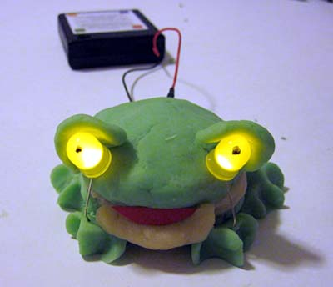
Background on project
It turns out that play dough conducts electricity
Play dough is made of flour, water, salt and borax( this stops the play dough developing mould),dye.

Slide 8
Part 2 (Preparation and Planning) (5 needed)
(i) Variables1. The Independent Variable (what I will change - 1 thing)*
Part 1:playdough length
Part2:playdough colour
2. The Dependent Variable (what I will measure - 1 thing)*
Resistance
3. The controlled Variable (what i will keep the same - as many as you can!)
Eg : Use Same multimeter each time
Same room temperature
Same uniform cross section of playdough
Same brand of play dough

Slide 9
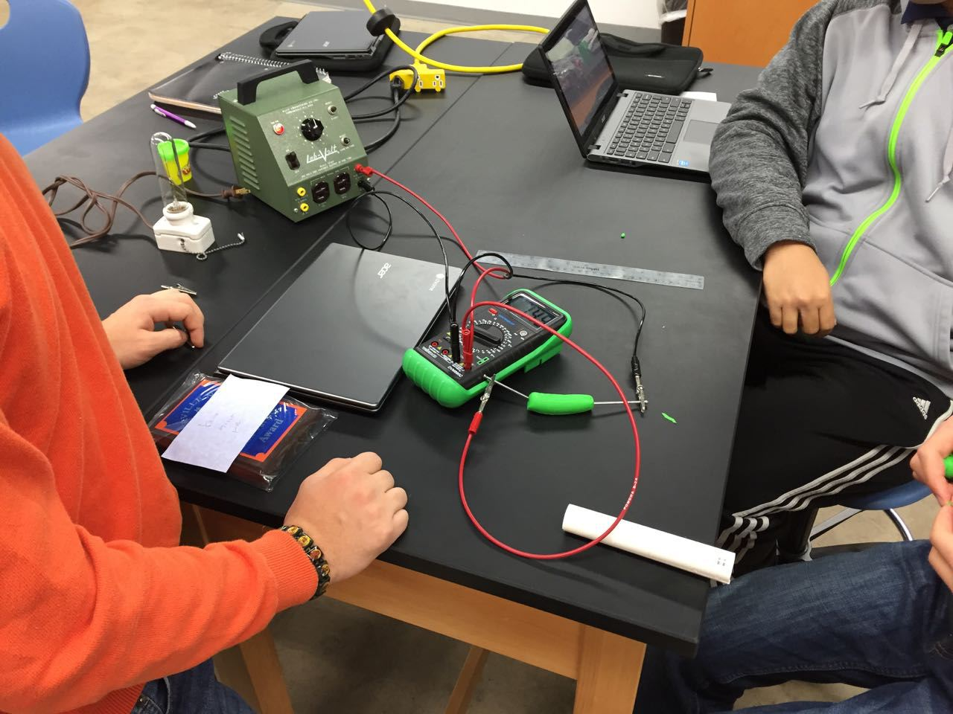
Equipment: Be sure to list every piece of equipment you use, leave nothing out!

Slide 10
Tasks:
This is the list of jobs that need to be done in order. (Like a to-do list)
Use bullet points 4 points needed
Eg :
Measure out the lengths of our play dough
Record and analyse results

Slide 11
Part 3 (Procedures, apparatus etc.)
(i) Safety (You need at least two safety precautions)
These must be specific to this project not general lab rules such as bags outside lab.
Eg set up circuit away from water
Disconnect the circuit after each measurement to prevent it from getting hot.

Slide 12
(ii + iii) Procedure with diagram
- The best advice I can give is to write it like a recipe if a person cannot copy the experiment using what you have written its no good and you need to do it again
You could divide experiment into 2 sections
Part 1: Changing play dough length
Part 2: Changing play dough colour
Number your steps. There must be 7 steps at least
Label all parts in your diagram

Slide 13
(iv) Data and observations
Decide what results you are going to take and when you are going to take them before the experiment. Make up a data table before you start your experiment so you can record your measurements as soon as you observe them. This will ensure that you are consistent in the way that you record your results and it will also make it easier to analyse
Measurements should be clearly laid out in a graph and/or table form.
Was there anything else you noticed when doing the experiment whatever it is no matter how small, include it.
Other observations to note include · Did you encounter any problems with the experimental method? · Did you notice any interesting patterns happening?

Slide 14
Sample Table : Results part 1 : Changing play dough length
Play Dough Length cm | Current T1 Amps | Voltage T1 Volts | Resistance T1 Ohms | Current T2 Amps | Voltage T2 Volts | Resistance T2 Ohms | Current T3 Amps | Voltage T3 Volts | Resistance T3 Ohms | Average Resistance Ohms

Slide 15
Sample graph Part 1 Changing Dough length

Slide 16
Or Resistance can be calculated by reading values from a voltage vs current graph

Slide 17
Sample table 2 Results: Changing Dough colour
Dough Colour | Current T1 Amps | Voltage T1 Volts | Resistance T1 Ohms | Current T2 Amps | Voltage T2 Volts | Resistance T3 Ohms | Current T3 Amps | Voltage T3 Volts | Resistance T3 Ohms | AverageResistance Ohms

Slide 18
Sample bar chart for graphing results in Part 2 Changing Dough colour
Play dough colour

Slide 19
Part 4 (Analysis) THIS IS A VERY IMPORTANT SECTION
(i) Calculations and Data Analysis –
Make sure you outline any calculations or formulae that you used.
Eg : formula for calculating resistance
How did you find average values?
Did you round off any numbers ?
Some useful sentence starters in this section are: · I can see from my results that ………………………….. · When I changed ………………….., ………………….. changed by………………….. · From the graph I can see that …………………………………………….

Slide 20
(ii) Conclusion and Evaluation of results. Answer some of the following questions in your written report.
Do your results answer the question you were asking at the start?
When you changed the play dough length/colour did it affect the resistance?
Were the results what you were expecting?
Is there a trend in your results or did anything unusual happen ?Can you explain it if so ?
If you drew a graph did you get a straight line or a curve – what does this show?

Slide 21
Resistance should be greater in small thick pieces of play doh than longer thinner pieces of play doh
The resistance of play doh increases with increased length once other factors that affect resistance are kept constant such as temperature, diameter of play doh etc.
Resistance seems to vary between different colours of play dough .This may be due to the chemicals that are added to the play doh to create the different dyes.
If your results did not show this trend can you explain why ?

Slide 22
Part 5 (comments) (i) Refinements, extensions and sources of error
Were you surprised by these results?
Was there anything that might have affected your results? Eg: multimeter readings fluctuating –loose connections in wires,cracks in play doh, play doh dried out.
Are there any changes you would make if you could do the experiment again? Is there any way of making it more accurate?
Does your investigation have any real life applications?
Could you develop your experiment further, how?

