Slide 1
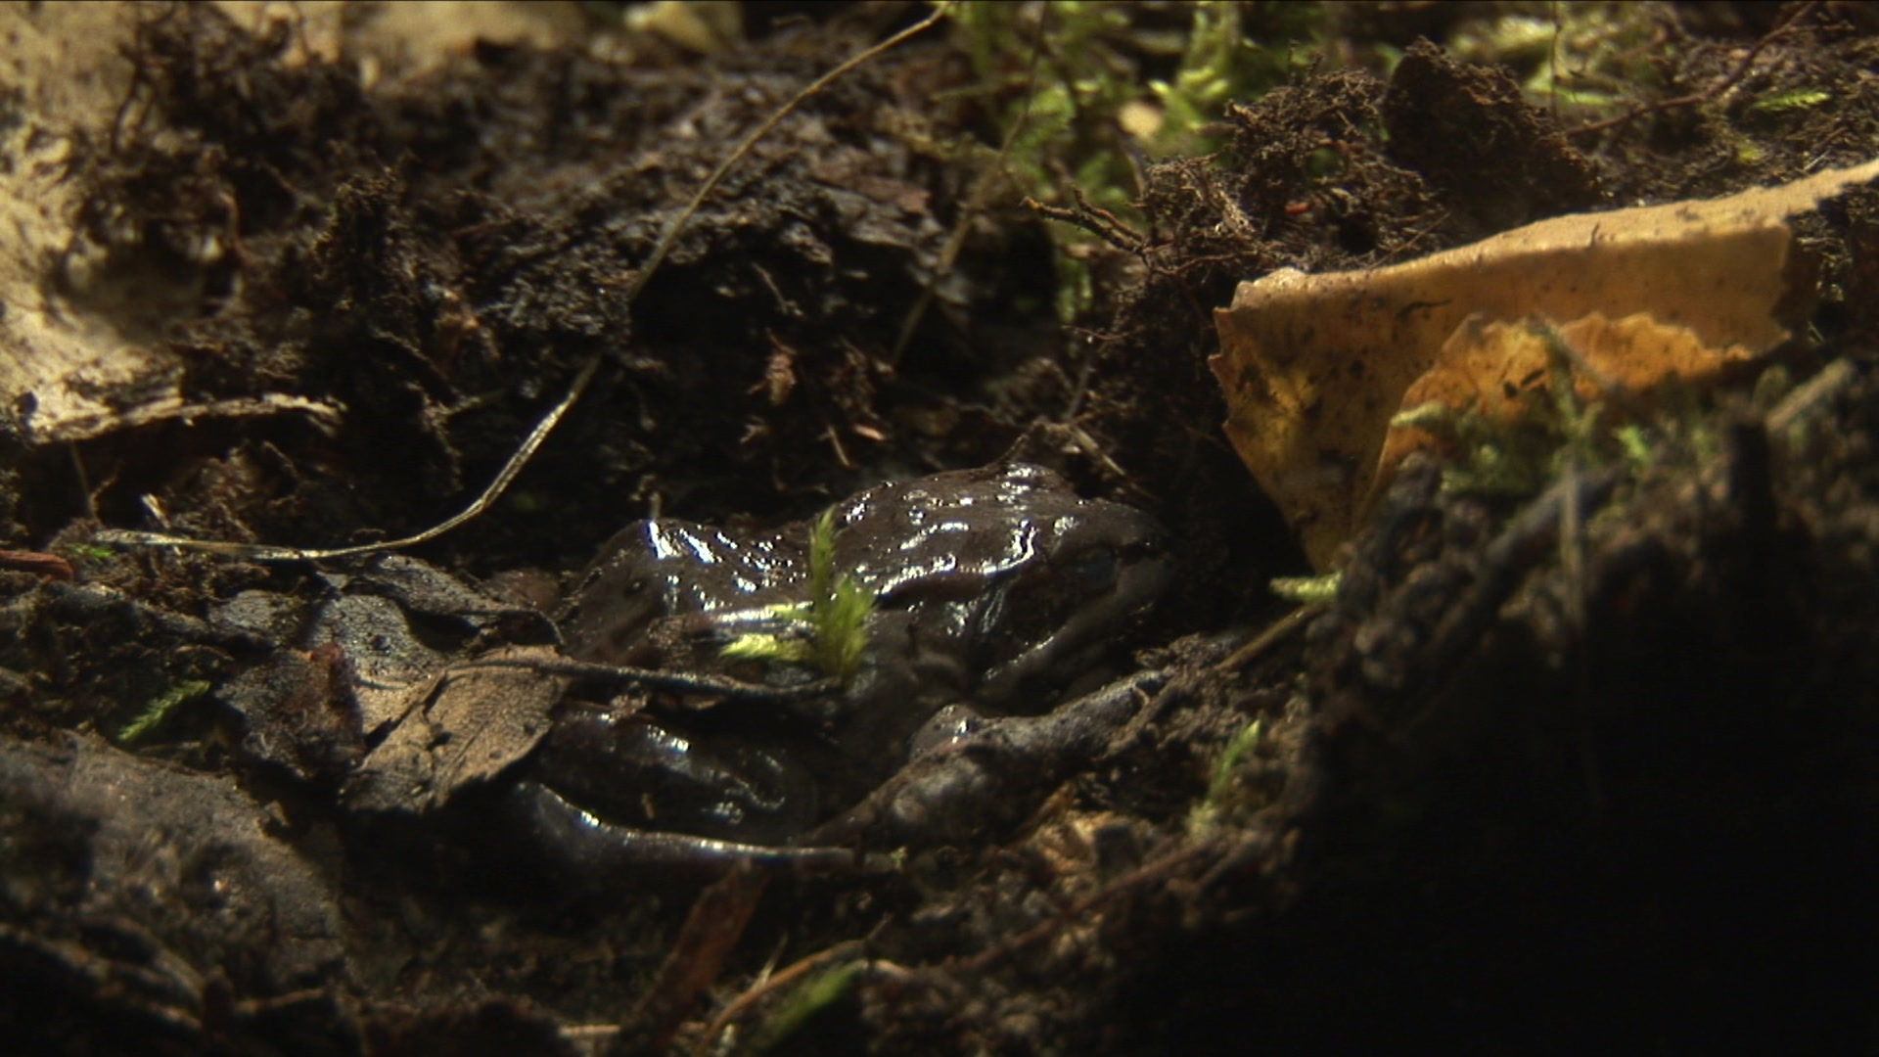
Wood frog adaptations to overwintering in Alaska: New limits to freezing tolerance
DJ Larson, L Middle, and BM Barnes
University of Alaska Fairbanks

Slide 2
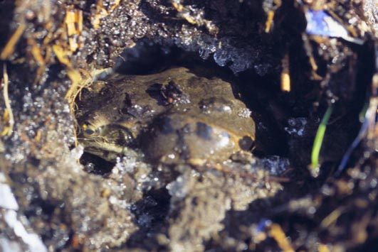
Wood frog uncovered in spring within natural hibernaculum

Slide 3
Ken Storey, Carleton Univ

Slide 4
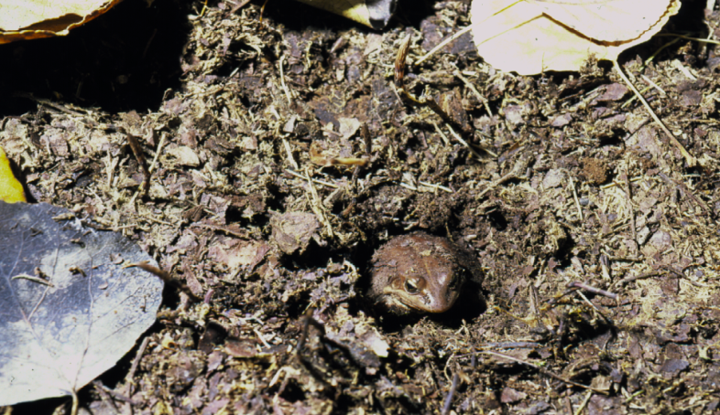
Previous Research
Lower lethal limit of up to 2 months
Lower lethal limits of -16ºC, previously -7ºC (Costanzo et al. 2013)
Few days frozen (Sinclair et al. 2013)

Slide 5
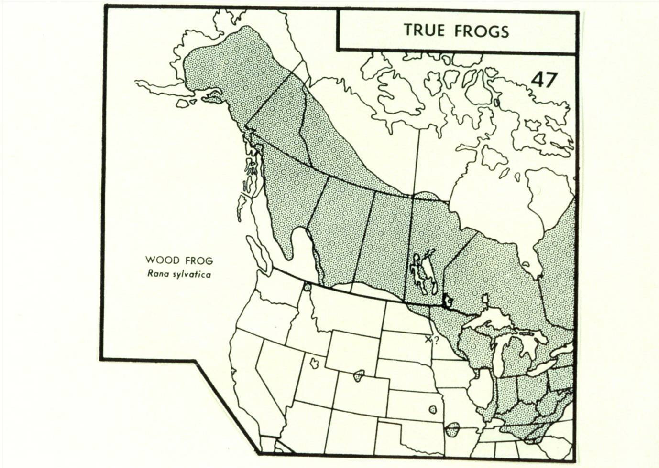
Wood Frog Range
Wood Frog
Lithobates sylvaticus
Martoff and Humphries 1959

Slide 7
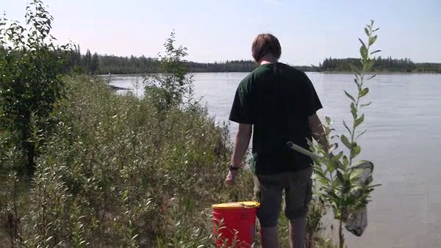
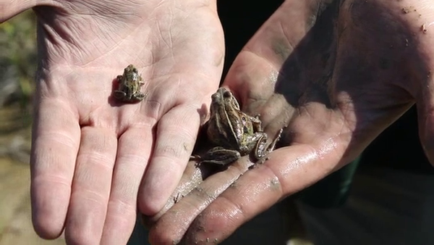
Wood frogs were collected, tagged with a transmitter, then tracked with transmitters to hibernacula

Slide 8
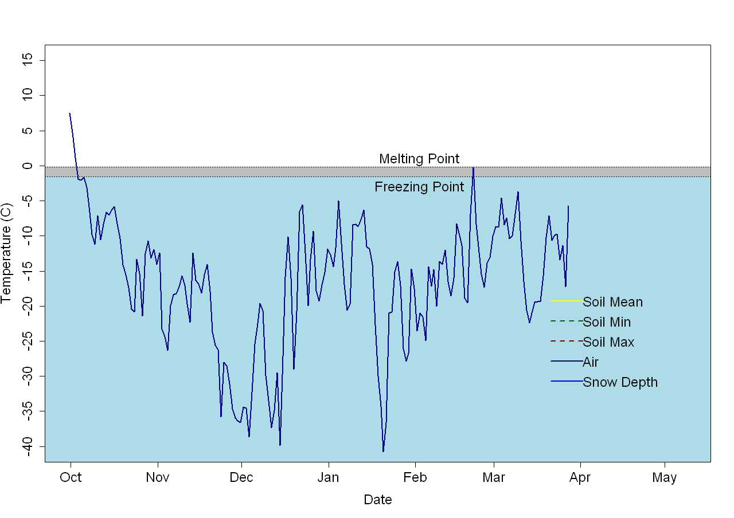
Winter Air Temperature
-40ºC
Daily snow depth, average daily air temperature, average daily soil temperature, minimum daily soil temperature, and maximum daily snow temperature at frog hibernacula (n=10) from October 2001 to May 2002 c

Slide 9
Average Hibernacula Temperature
Daily snow depth, average daily air temperature, average daily soil temperature, minimum daily soil temperature, and maximum daily snow temperature at frog hibernacula (n=10) from October 2001 to May 2002

Slide 10
Minimum Hibernacula Temperature
-18ºC
Daily snow depth, average daily air temperature, average daily soil temperature, minimum daily soil temperature, and maximum daily snow temperature at frog hibernacula (n=10) from October 2001 to May 2002

Slide 11
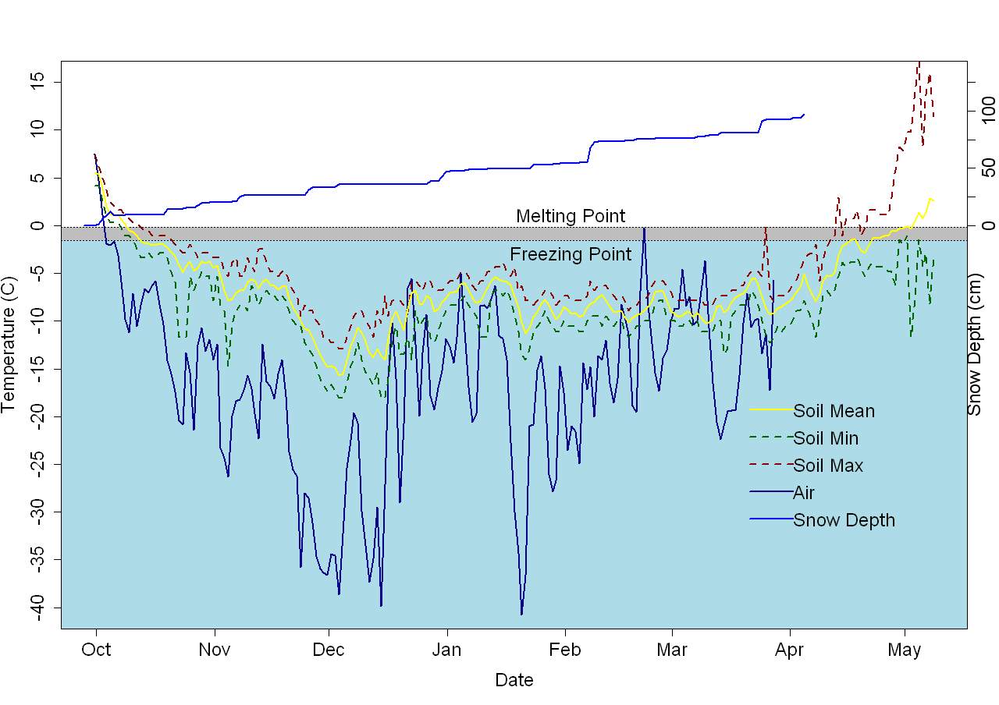
Snow Depth
Daily snow depth, average daily air temperature, average daily soil temperature, minimum daily soil temperature, and maximum daily snow temperature at frog hibernacula (n=10) from October 2001 to May 2002

Slide 12
201 days below freezing point
Daily snow depth, average daily air temperature, average daily soil temperature, minimum daily soil temperature, and maximum daily snow temperature at frog hibernacula (n=10) from October 2001 to May 2002

Slide 13
201 days below freezing point
100% Survival
N = 18
Daily snow depth, average daily air temperature, average daily soil temperature, minimum daily soil temperature, and maximum daily snow temperature at frog hibernacula (n=10) from October 2001 to May 2002

Slide 14
Summary of Hibernacula Conditions
193±11 (7 months) consecutive days frozen
Average hibernacula temperature of -6.3°C (Oct-May)
Minimum temperatures ranging from -8.9 to -18.1°C
100% survival

Slide 15
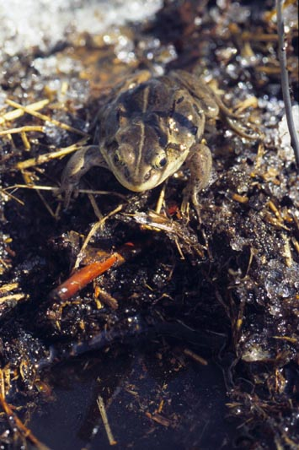
How are wood frogs surviving such low temperatures for so long?

Slide 16
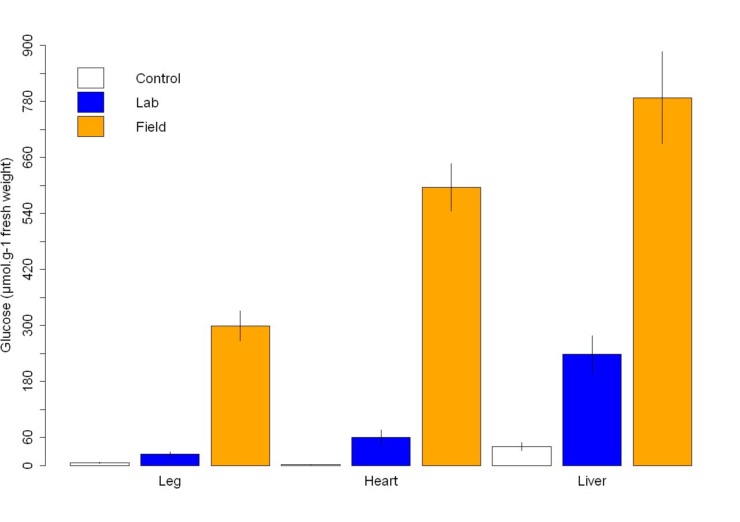
Glucose Concentrations in Lab and Field Frozen Frogs
Leg muscle, heart, and liver tissue glucose concentrations (mean ±SEM) in unfrozen control, laboratory frozen, and naturally frozen wood frogs, n=7,15,18, respectively (Larson et al., submitted).

Slide 17
Glucose Concentrations in Lab and Field Frozen Frogs
Leg muscle, heart, and liver tissue glucose concentrations (mean ±SEM) in unfrozen control, laboratory frozen, and naturally frozen wood frogs, n=7,15,18, respectively (Larson et al., submitted).

Slide 18
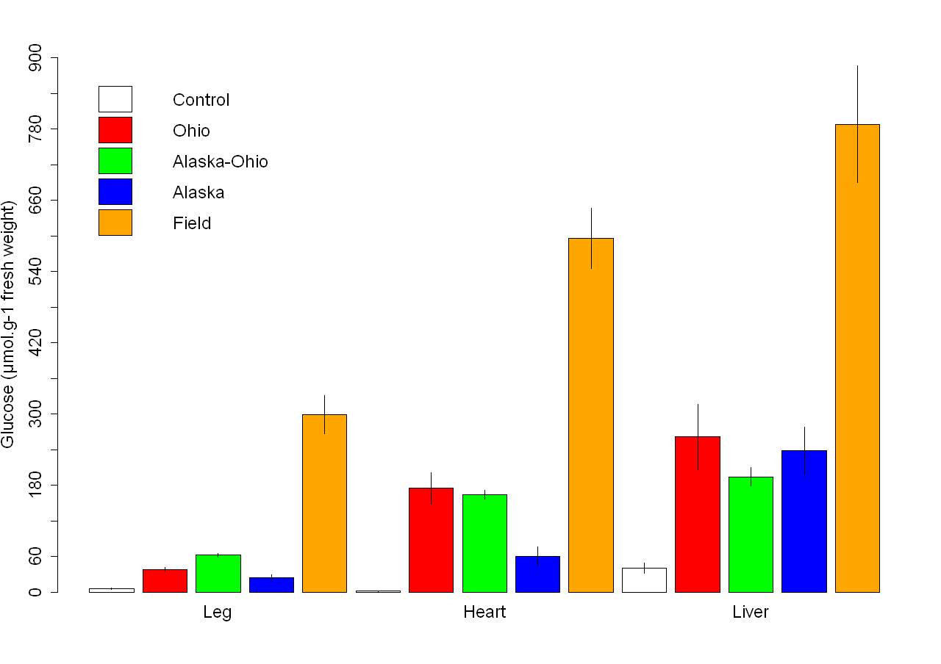
Results from Other Studies
Leg muscle, heart, and liver tissue glucose concentrations in unfrozen control, Ohio laboratory frozen(Costanzo et al. 2013), Ohio-Alaska laboratory frozen(Costanzo et al. 2013), laboratory frozen, and naturally frozen wood frogs, n=7,4,8,15,18, respectively.

Slide 19
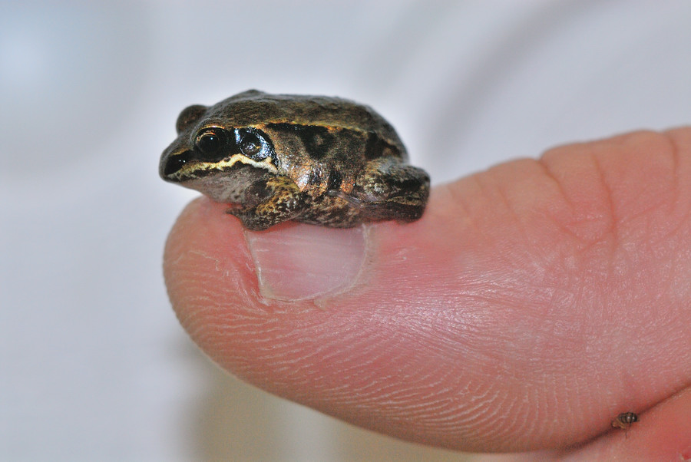
Why are glucose (cryoprotectant) concentrations so high in field frogs

Slide 20
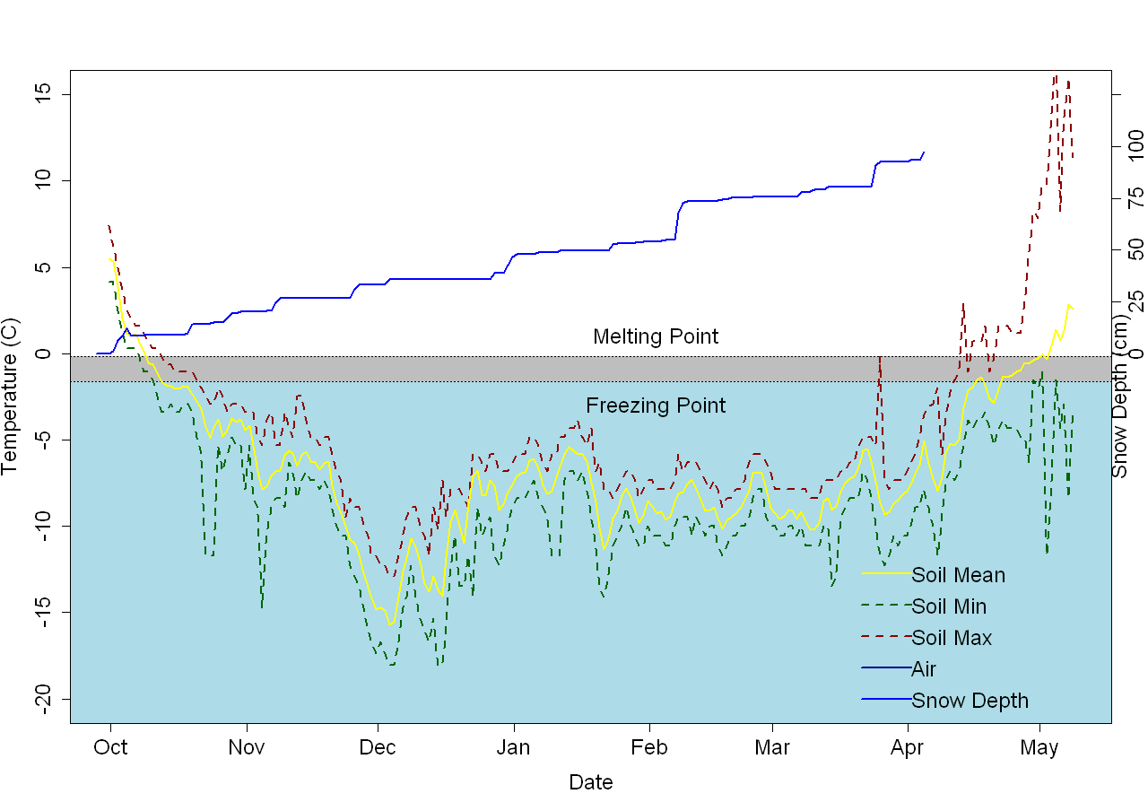
Hibernacula Conditions
Wood frog temperatures in a frog form recorded every 5 minutes from September 24 to October 27, 2012. Melting point is -0.16 (dashed line) (Sinclair et al., 2013) and freezing point(solid line)

Slide 21
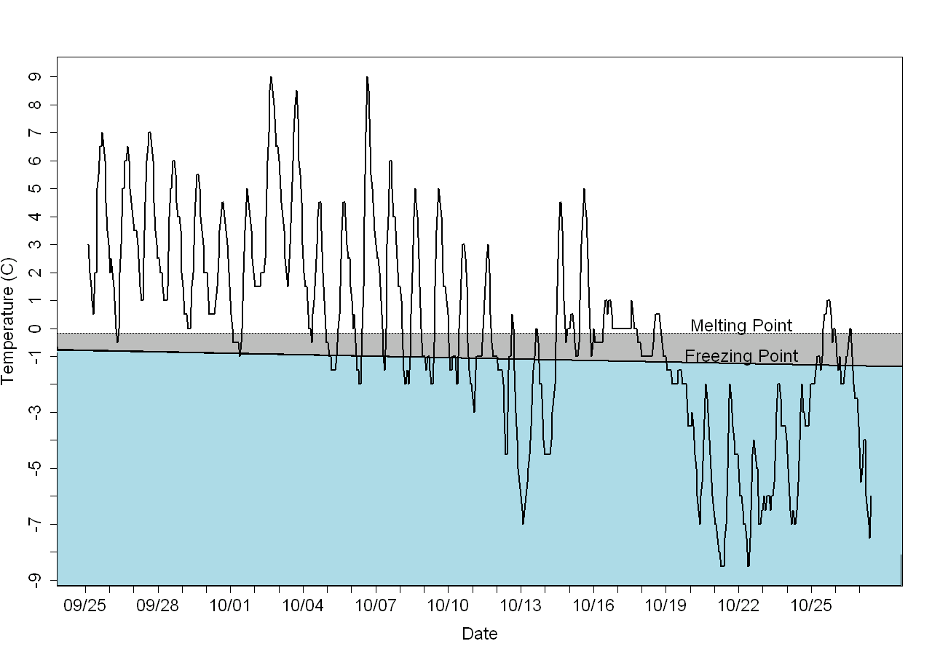
Early Winter Wood Frog Conditions
Wood frog temperatures in a frog form recorded every 30 seconds from September 24 to October 27, 2012. Melting point is -0.16 (dashed line) (Sinclair et al., 2013) and freezing point(solid line)

Slide 22
We hypothesize that naturally frozen wood frogs have higher concentrations of glucose than linear, laboratory wood frogs due to freeze-thaw cycling.

Slide 23
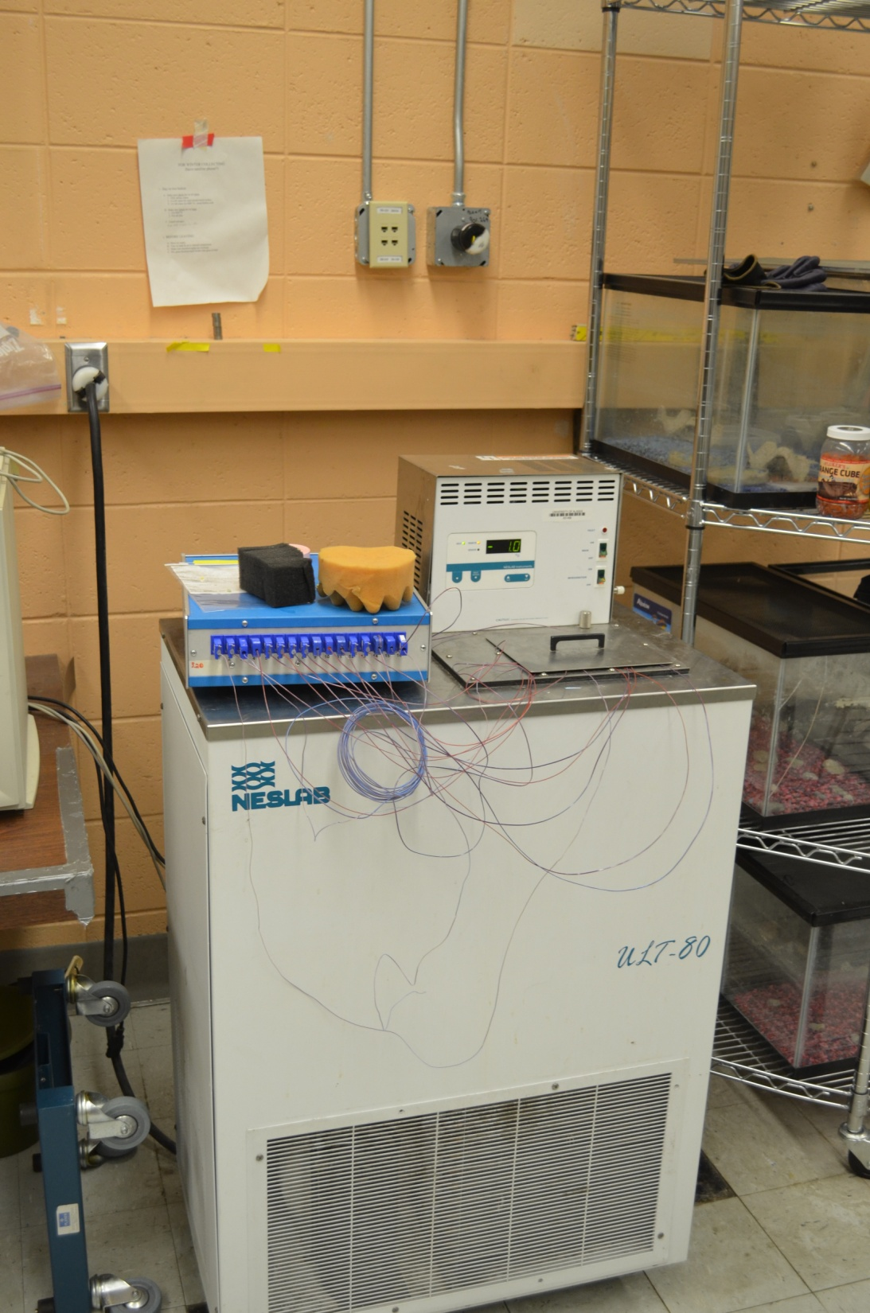
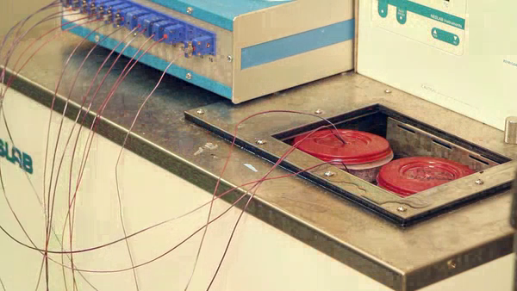
Experiment
Freeze-thaw
Linear freezing
Unfrozen

Slide 24
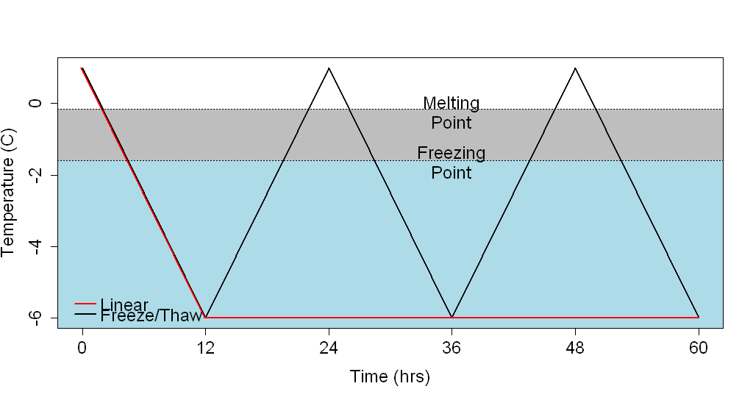
Experimental Freeze-Thaw and Linear Freezing Protocols
Freeze-thaw protocol. 5 animals were sampled at each sampling point

Slide 25
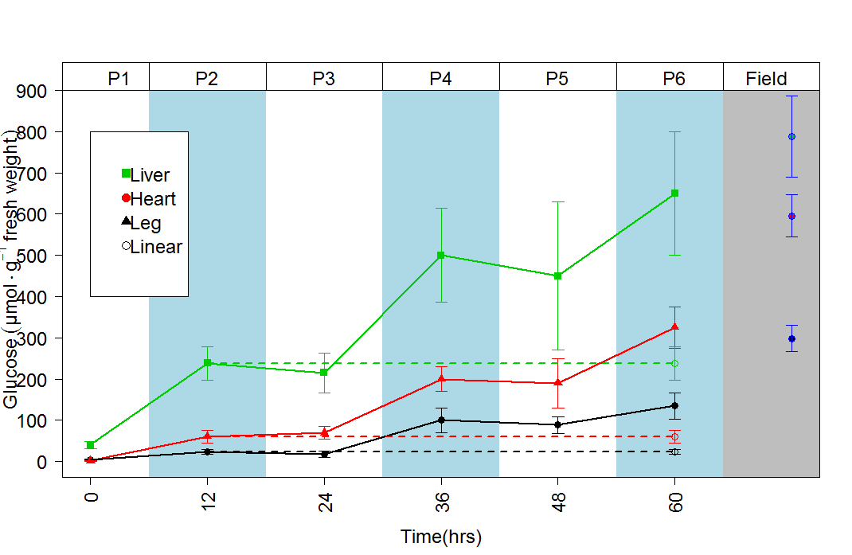
Glucose Concentrations of Freeze-Thaw Frogs Compared to Field Frogs
Leg muscle, heart, and liver tissue glucose concentrations sampled every 12 hours in alternating frozen or thawed condition (n=5 each) compared to values in naturally freezing wood frogs (n=19; right panel).

Slide 26
How Far North Do Wood Frogs Go?
Wood Frog
Lithobates sylvaticus
Martoff and Humphries 1959

Slide 27
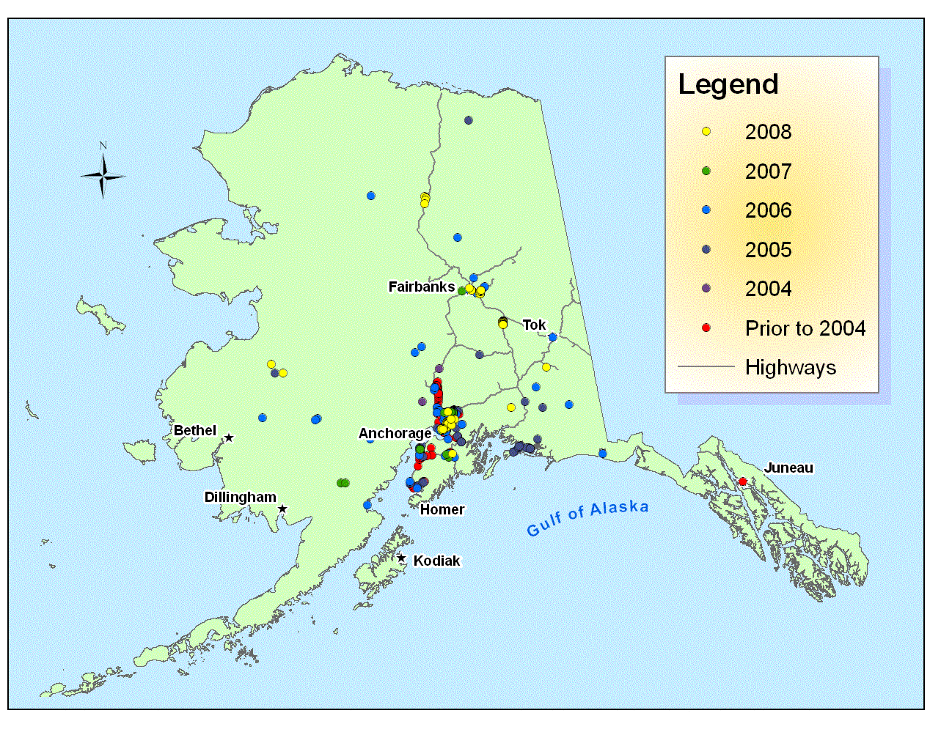
Alaska Wood Frog Monitoring Project RESULTS: 2002 – 2008
http://aknhp.uaa.alaska.edu/zoology/citizen-science/alaska-wood-frog-monitoring/results-2002-2008/

Slide 28
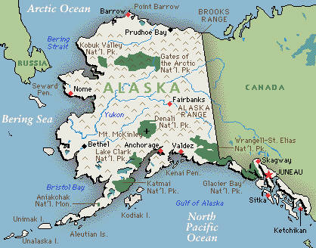

Slide 29
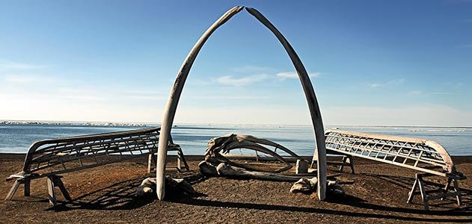
Barrow Temperatures
October 20-May 24
216 days
Lowest temp -23.6°C
Mean -12.13°C
Image courtesy of the Smithsonian

Slide 30
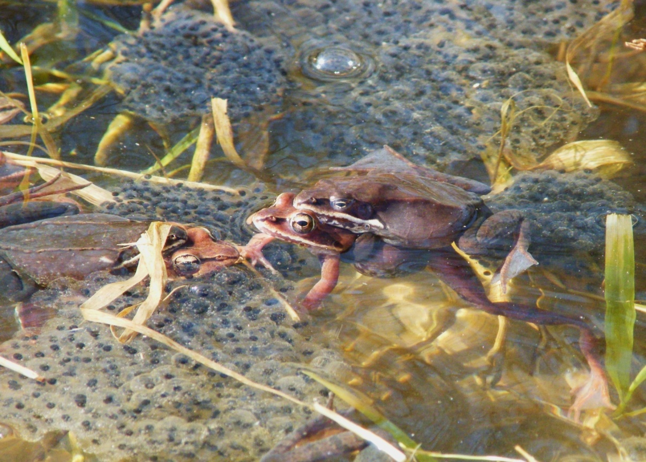
We Hypothesize Summer Pond Temperatures Limit Development
Herried and Kinney (1967) found eggs could not develop below 3.4°C
90% die off of eggs at 5.6°C
Eggs can survive brief periods of sub-zero temperatures

Slide 31
Summary
Alaskan wood frogs are surviving 7 months down to -18.1 °C. This is longer and lower than has ever been reported or predicted.
Alaska wood frogs frozen naturally are making more glucose (cryoprotectant) than wood frogs frozen linearly in a laboratory
When we replicate freeze-thaw patterns in the lab, glucose concentrations in wood frogs approach field values

Slide 32
Acknowledgements
Funding provided in part by the NSF GK-12 CASE program at University of Alaska Fairbanks, DGE-0948029; NSF IOS (BMB)
Roger Ruess, Bob Piorkowski, Scott Ayers, Jeannette Moore, Roger Topp, and Fran Kohl

Slide 33
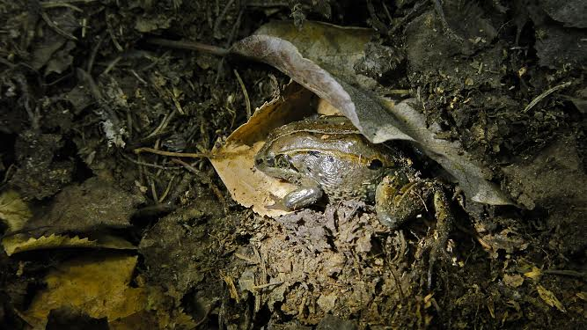
QUESTIONS?

